Slide 1
Model Calibration
Hydrologic Modeling with HEC-HMS
July 2026
Presented by: Alex Davis, P.E.
Notes:
I’ll be presenting on model calibration. At this point in the class, you guys have learned about different components to HMS, like the baseflow, transform and losses. This presentation brings all of what you learned together through the process of calibration.
Model is set up with our components and methods, now we want to calibrate or adjust the parameters to the model so results make sense

Slide 2
Outline
Calibration Theory
Calibration Strategies
Parameter Impacts
Calibration Metrics

Slide 3
Calibration Theory

Slide 4
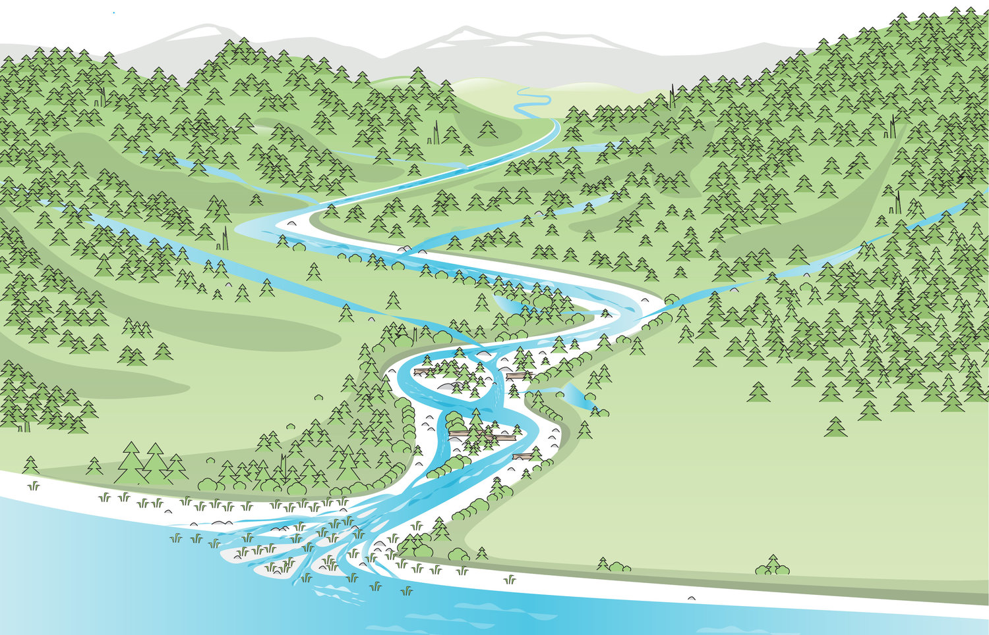
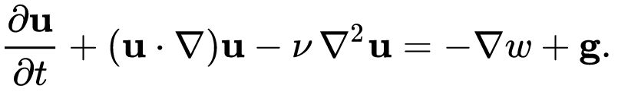
Hydrologic Modeling
Interested in the response given this input or property change
We can’t experiment on a real watershed
Our computer model stands in for reality
Goal: represent our watershed accurately using algorithms
Notes:
Why do we go about creating hydrologic models?
Often, hydrologic modelers are interested in performing experiments on a watershed so we can see how its behavior changes when some property of it is changed. We can’t experiment on a real watershed for many reasons. We can’t apply design rainfall; we can’t evaluate engineering project impacts without building them; we can’t have a side-by-side comparison of a control and an experiment. In order to experiment on a watershed, we need to use a model as a stand-in for the real thing.
Instead of soil and plants, we have equations that govern how much water goes where. These equations represent the physical world in a deterministic way.

Slide 5
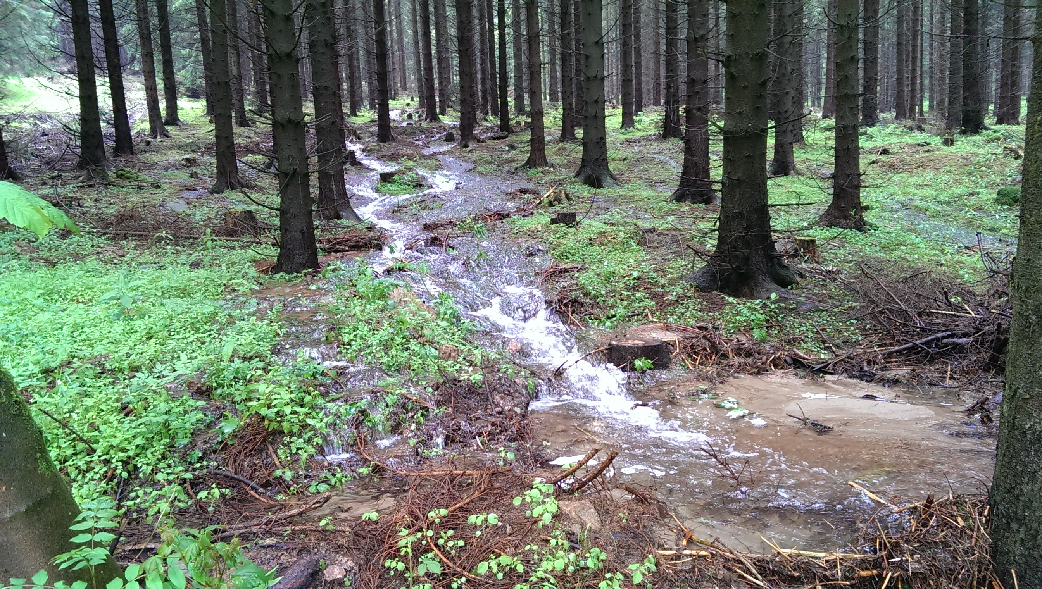
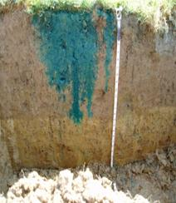
Hydrologic Modeling
Models contain approximations and simplifications
Simpler model → parameters represent more → more parameter uncertainty & error
Notes:
Within hydrologic model, we need to make approximations and simplifications. If we tried to model every single detail, computationally there isn’t a computer out there that could compute to completion. There are models that are more complex and try to model the physical nature of flow, such as hydraulic models or Computational Fluid Dynamic (CFD) models that use differential equations to numerically solve the movement of flow. But those are typically on a much smaller scale and they take a lot of computational power.
Hydrologic models, on the other hand, simplify the different processes where the equation could be solved by hand or excel given a few parameters. Using the two images below, we simplify runoff generation processes by using the unit hydrograph instead of the navier stokes equation and soil loss we use something like Green & Ampt or Deficit and Constant instead of the Richards equations. The pros are you can compute the model much quicker and get good results with calibration. The cons are the parameter values can be abstract to the point where it doesn’t have a physical meaning and there’s likely to be greater uncertainty and error that gets lumped into your parameter values.
It is necessary for a model of something as complex as the flow of water through the environment to contain approximations and simplifications of the real world. Even if we could represent the entire watershed at the atomic level, the measurement of the physical properties of the watershed necessary to model all the physics would contain uncertainty. Then, applying the physics at that scale would be computationally prohibitive.
Models should be as simple of a representation of the system being modeled as needed to answer the question or perform the experiment. When several related processes are rolled into one algorithm to represent them, the parameters of that algorithm become more and more abstract and uncertain. While the parameters become more uncertain, their level of abstraction also lends them well to being determined empirically.

Slide 6
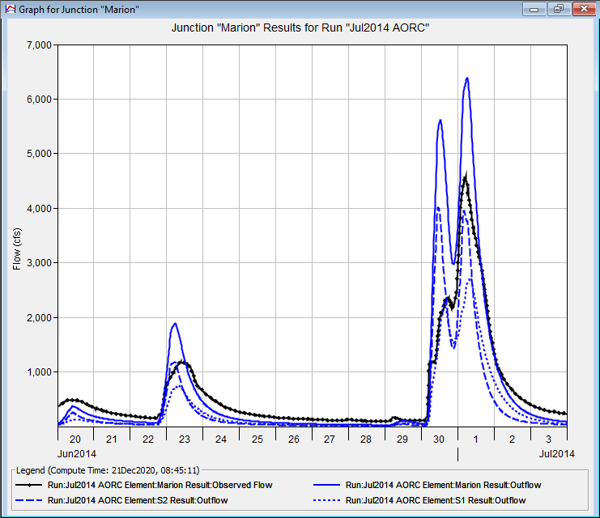
What is Calibration?
Adjustment of model parameters
Goal: match output with observed data
Manual or automatic
Notes:
Calibration is the adjustment of our model parameters to the equations that represent the various hydrologic processes. These processes were covered during the past few days such as the rainfall runoff transform, and soil loss. The goal of adjusting these parameters are to match the simulated data against observed dataset. The data is typically an historic dataset and can consist of multiple types of observations such as flow, evaporation, or snow accumulation and melt.
Our hydrologic model is a collection of parametric algorithms that simulate the hydrologic cycle. It is up to us as modelers to determine what the appropriate parameters for those algorithms are. We want to make our algorithmic representation of the watershed match the actual watershed across a wide range of conditions. Usually, we determine if our model matches reality by comparing model output for observed past events and seeing if key results match. We may consider whether the simulation of streamflow at locations where we have flow observations match reasonably well. We may also compare observations for other hydrologic processes such as snowmelt and accumulation, and evapotranspiration.
There are some so called “automated” tools for performing calibration, but the most reliable way to produce a calibrated model with reasonable parameters is to change the parameters yourself until the model results match observed data.

Slide 7


Why Calibrate?
Uncertainty abounds
All Models are simplifications
Initial estimates are only estimates
Boundary Conditions
Hydrologic Model
Observed Data
Notes:
We want a model that can best represent our watershed and we can confidently use the response from the watershed to make informed decisions. To make sure that we can simulate results that make sense, we need to fine tune our model parameters, which represents the various hydrologic processes in the system. All models are simplifications of the real world. That includes physically based models such as hydraulic models. You still need to calibrate your parameters to ensure your outputs make sense. As we mentioned, the equations are simplified and you probably will not get good results if you ran your simulations just based on initial estimates. Most your initial estimates are based on physical data, like for soils you might use the SSURGO dataset, but that dataset is just a broad estimate of the soil type. Calibrating your model will help to fine tune your parameter set so that it makes sense for your region of interest.
There is uncertainty inherent in all parts of the hydrologic modeling process. The data used to define the model has measurement error – everything from elevation data and land use data to meteorologic and hydrologic boundary conditions. Process simplifications can create parameters that represent several things all rolled into one number. Models are also abstractions of the real world. Even the most detailed so-called physical models are simplifications of the hydrologic cycle.
When we make an initial estimate of a parameter from physical data, it is just that – an estimate. Using the same technique across many watersheds will on average get you close to a good value, but each individual estimate may be off.
We assume that any mismatch between the hydrologic results and the observed data are due to mis-specification of hydrologic model parameters. There are more advanced techniques involved in jointly assessing uncertainty in boundary conditions, hydrologic model parameters, and the observed data – but that’s out of scope here.
What we want in the end is a model that represents our watershed well even when we change the boundary conditions out from underneath it.

Slide 8
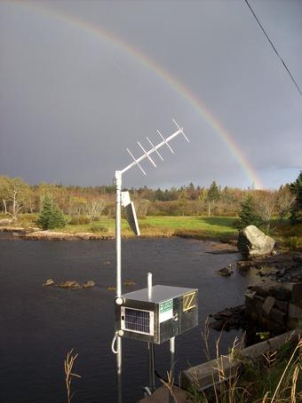
Observed Data
Observed data are necessary for calibration
  USGS stream gages
  Snow observations or models
  Evaporation data
Notes:
You need observed data for calibration. Calibration can be done for runoff, evaporation, and snowmelt.
Observed data are the key to knowing if our model represents reality or not. A known standard that we can compare the model to, will give us an assessment of its performance.
Usually, we are interested in calibrating flow, so we reach for instantaneous streamflow data when we can. Occasionally only coarse timestep data such as daily-average data are available, and we can aim for that instead.
Other times, the processes are more complicated. In snow-dominant watersheds we may want to calibrate the snow processes independently using observed (or modeled) snow data. For continuous calibration, it might be beneficial to calibrate the evapotranspiration process – although data to do so may be rare.

Slide 9
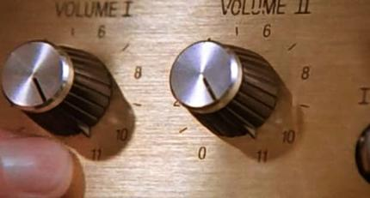
HMS Calibration
Basin model parameters
  Subbasins
  Reaches
  Reservoirs/diversions
  Snowmelt
Met model parameters
  ET
Notes:
So now getting into HMS, what are the model components that require calibration. You should be familiar now with the Basin model and Met model. In the basin model, we have parameters that exist in the subbasin, the reaches, reservoir operations, and snowmelt. In the Met model, you have the ET parameters that need calibrating.
When calibrating an HEC-HMS model, we are changing the parameter values for the processes inside the basin model and the meteorologic model.
In the basin model, the primary location we will make adjustments is in the subbasin elements. They handle the majority of the rainfall-runoff process. For more complicated watersheds where elements are connected with reaches, we may adjust reach parameters to get channel routing correct. In order to model historical events correctly, we may also need to make changes to reservoir or diversion operations.
Within the met model the most common changes are to snowmelt parameters in watersheds that need it. The temperature index method has several tunable parameters that can improve model performance not only in the explicit snowmelt and accumulation processes, but also in the resulting runoff. ET may be adjusted in a fine sense to match observations, or more coarsely to address mismatches in overall discharge volume.

Slide 10
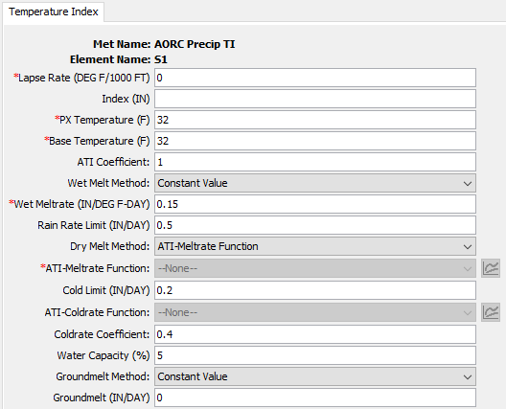
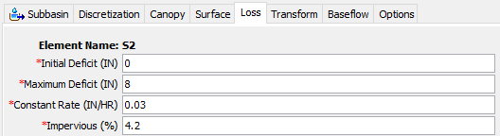
Model Parameters
Any numeric value or functional relationship that controls model response behavior
Notes:
We define model parameters as any numeric value or functional relationship that controls model response behavior. Here we have an example of the deficit and constant loss parameters for the loss method and the temperature index method which control snow accumulation and melt. Some parameters are generally fixed, such as the subbasin area. Others you want to change per calibration event, such as your constant loss. Other parameters can be functional relationships such as the meltrate function.

Slide 11
Calibration Process
Initial parameter estimates
Adjustment of parameters
Assessment of agreement
Validation
Iterate
Notes:
There is a four-step process to calibrating a hydrologic model.
First you must determine a set of initial parameters to get the model to run and assess the initial performance of the model. There are helpful tools for getting useful parameters based on data about the watershed.
Next you will begin to adjust the model parameters so that the agreement between the model and observed data begins to improve.
With each change in parameters, take the time to assess how the model performance changes. Then, go back to the parameter adjustment, and iterate. You will loop between step 2 and 3 many times, even if the initial parameter estimates aren’t bad.
Finally, once you have a candidate set of calibration parameters, you will run a validation simulation, which helps ensure your parameters are useful outside of the event you used for calibration.

Slide 12
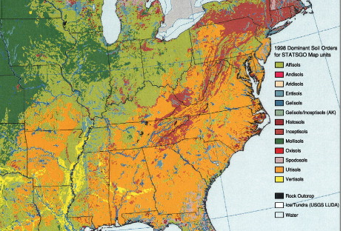
Initial Parameter Estimates
Gather informative data
  Soils
  Land use/imperviousness
  Basin characteristics
Estimate starting values from data
  Experience
  Regression
  Regional values
  Other heuristics
Notes:
HMS does not provide default values for model parameters. It is up to the user to provide reasonable starting values for model process parameters.
Experienced modelers can draw on knowledge of similar models to choose reasonable starting parameters. Models for similar watersheds may have similar parameters and parameter values from previous model calibrations may provide good starting points.
Data-driven approaches use physical information to estimate model parameter values. Typically, these estimates are driven by data such as soil surveys, land use/land cover and imperviousness data, basin physical characteristics, and so on.

Slide 13
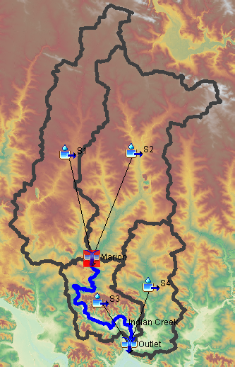
Adjustment of Parameters
Work upstream to downstream
Keep plausible ranges in mind
Consider physical evidence
Change one parameter at a time
S2
S1
S4
Marion
S3
Outlet
Notes:
Here are some simple rules for a successful calibration.
First, work upstream to downstream. Get a small area performing well, and then move downstream – and leave the smaller areas alone when adjusting parameters further downstream. In the image shown, you would calibrate S1 and S2 above the Marion junction first, and then calibrate S3, S4 and the Indian Creek reach next at the Outlet junction. When calibrating for the Outlet junction you should leave everything above the Marion junction alone once the performance at Marion is satisfactory.
When calibrating, keep in mind what ranges for a parameter are reasonable. If you are pushing against the boundary of reasonable values in your calibration, perhaps you need to be adjusting something else to bring that parameter back into range.
Consider why the model is behaving the way it is and consider the physical explanation for hydrologic behavior. Look at physical information to explain why the model behaves differently in different parts of the watershed. For example, parts of the watershed with poorly drained soils should probably have a lower infiltration rate than areas with well drained soils.
To really get a sense of the magnitude and direction of change on model performance you get by changing a parameter, change one parameter at a time and re-run the model. Then when you feel good about the model performance in one aspect (such as timing or volume) you can move on to another parameter to change that parameter. This isolates the effects of the parameters and gives you feedback on how sensitive the model performance is to it.

Slide 14
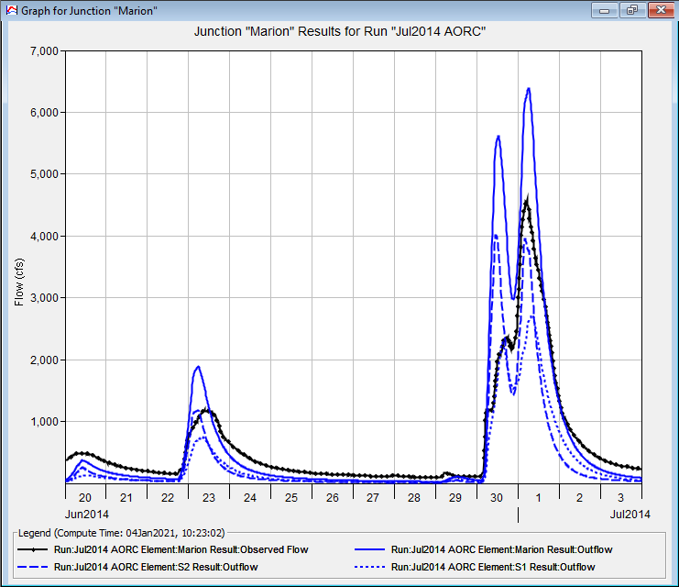
Assessment of Agreement
Visual agreement
Goodness-of-fit metrics
  Nash-Sutcliffe Model Efficiency
  Volume Error
  Root-Mean-Square Error
  Coefficient of determination (R²)
Notes:
In order to assess model agreement, you need to be able to compare the model output to observed data. In HEC-HMS, observed data is shown in black, with the simulated results in blue.
Visual agreement is the first step. It lets you qualitatively assess things like timing, volume, hydrograph shape, and so on. When you’re calibrating you can get a long ways just by using a visual comparison. Eventually you get to a point where it’s hard to know objectively whether one parameter set is better than another, and goodness-of-fit metrics can help. They can also give you an idea of how good your agreement is numerically.
Four common goodness-of-fit metrics are shown here.
There are guidelines for what values of these goodness-of-fit metrics describe good agreement between the model and observed data. These concepts will be discussed in another video.

Slide 15
Validation
Use calibrated parameters on another event
Do not adjust the parameters
Assess goodness of fit
Notes:
Validation is an extremely important and often overlooked step. It assures that you have not overfit your parameters to a single event, and that the model has predictive power outside of just the calibration period. A mistake often made is that a modeler will start to alter parameters during the validation process, but then the independent assessment of the model performance is ruined. The only parameters that MIGHT change in a situation like this are initial conditions (e.g., initial deficit, initial baseflow, etc.) Things like constant rate, unit hydrograph parameters, baseflow coefficients, and so on, should not change. The best way to represent the performance of a model for general use is to report its validation statistics.

Slide 16
Calibration Strategies

Slide 17
Objectives
Setting Initial Model Parameters
  Data Sources
  Estimation Methods
Setting Calibration Goals
  Calibration Metrics
Notes:
This lecture will cover how to set some of the more common initial model parameters—including data sources & estimation methods that you can use.
We’ll also cover how to set calibration goals and the calibration metrics that HMS provides.

Slide 18

Setting Initial
Model Parameters
Loss
Transform
Baseflow
Routing
Notes:
Setting initial model parameters—Where do those values come from?
We’ll discuss how you might estimate the initial loss, transform, baseflow & routing parameters for your model and will also touch briefly on ET & Snowmelt as well.

Slide 19
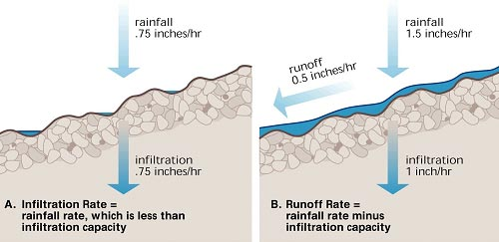
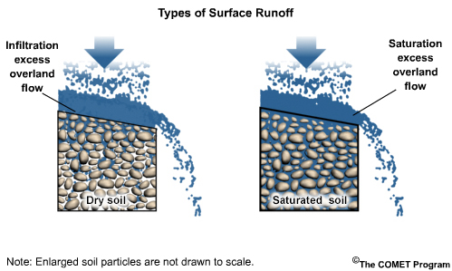
Initial Model Parameters - Loss
Loss Parameters
Regulate Infiltration
Various Methods Available
Depend On:
  Rainfall
  Soil Compaction
  Slope
  Cracks
  Roots
  Vegetation
  Soil Moisture
  Litter
  & More!
Source: (Top)- http://ftp.comet.ucar.edu/memory-stick/hydro/basic_int/runoff/navmenu.php_tab_1_page_2.1.0.htm, (Bottom)-https://cals.arizona.edu/extension/riparian/chapt3/p07.html
Notes:
Loss parameters regulate infiltration. How much of the rainfall get lost to infiltration There are various loss methods available. We have physical representation of loss such as Green and Ampt. The method we typically like to use is Deficit and Constant method which is a conceptual representation of the Richards Equation. Then there’s abstract methods like CN method. If you use physical and conceptual methods, the parameters typically have physical basis to it so you can derive initial estimates based on the soil type. When we model loss in HMS, I’ve typically seen users lump loss together with canopy storage and surface storage.
Loss parameters are very important within HMS—they regulate how much precipitation infiltrates into the soil and what becomes runoff.
There are several loss methods available within HMS. Loss parameters are physically-based and really depend on the soil properties and condition of your watershed.

Slide 20
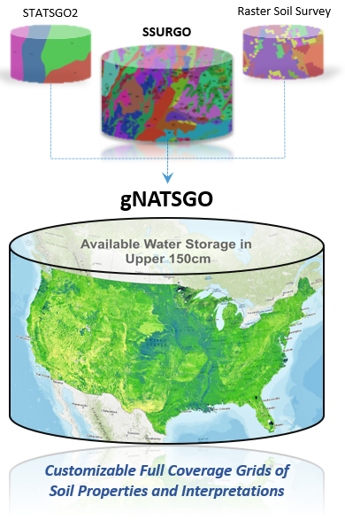
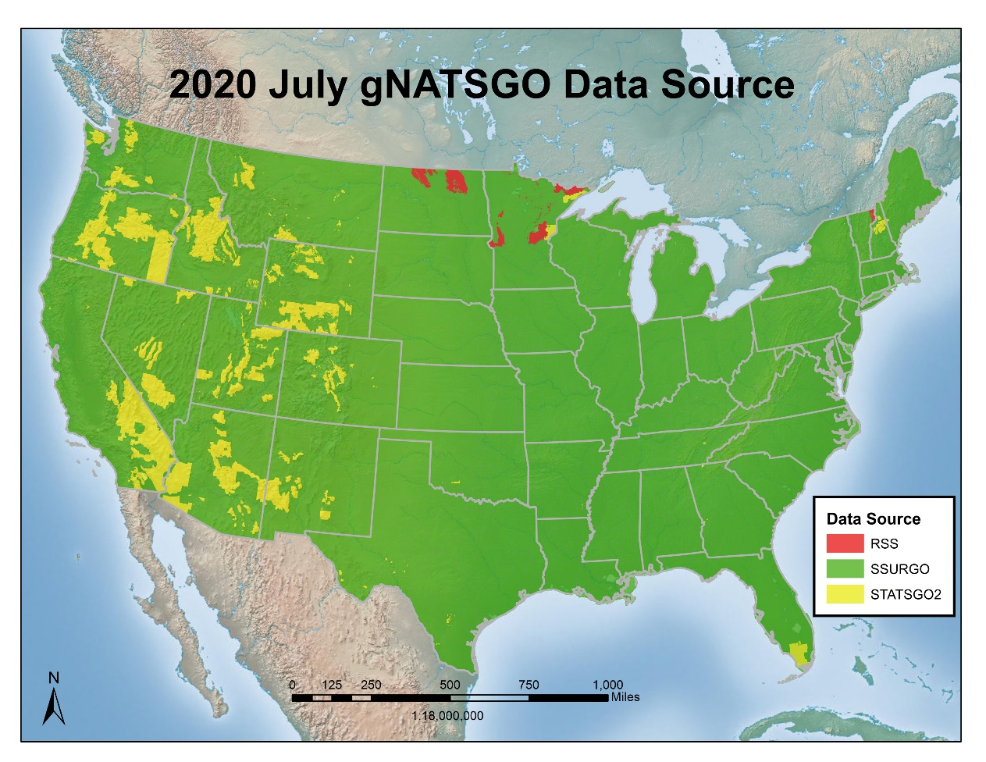
Initial Model Parameters - Loss
Loss Parameter Data Sources:
Gridded Soil Survey Geographic (gSSURGO) Database
Digital General Soil Map of the U.S. (STATSGO2)
*Gridded Nat'l Soil Survey Geo. Database (gNATSGO)*
National Land Cover Database (NLCD)
Local Resource Agencies/Studies
Source: https://www.nrcs.usda.gov/wps/portal/nrcs/detail/soils/survey/geo/?cid=nrcseprd1464625
Notes:
There are a number of nationwide, online products available that provide detailed soil information such as gSSURGO, STATSGO and gNATSGO that compiles the “best available” data to eliminate gaps.
The National Land Cover Database (NLCD) also provides valuable information on land use which can be used in estimating initial loss parameters.
Local resource agencies and nearby soil or watershed studies may also provide valuable information.

Slide 21
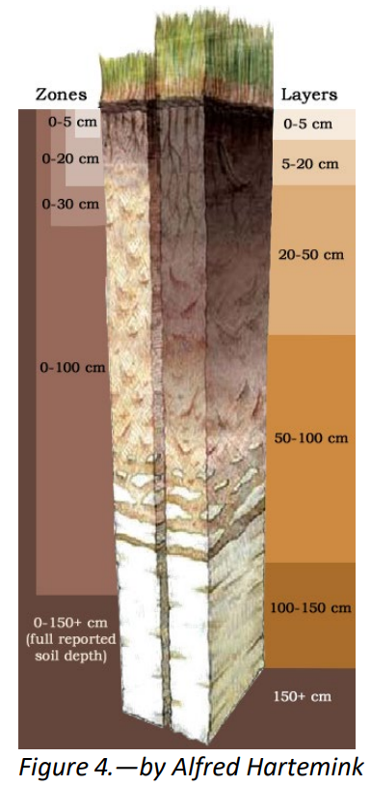
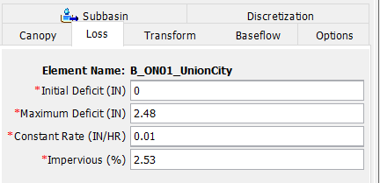
Initial Model Parameters - Loss
Initial Estimate Example:
Deficit and Constant Method
  Initial Loss: Dependent on Antecedent Conditions
    Fully Saturated? 0.0 in
    Very Dry? > 0.0 in
  Constant Loss
    Estimate using soil texture from gSSURGO and lit. values
  Maximum Deficit
    gSSURGO Available Water Storage
  Impervious (%): Dependent on Land Cover/Use
    NLCD Urban Imperviousness
    NLCD Impervious Estimate by Type of LC
      Assign each type a %-impervious value, ratio by area within subbasin
Source: https://www.nrcs.usda.gov/wps/PA_NRCSConsumption/download?cid=nrcs142p2_051847&ext=pdf
Notes:
As mentioned earlier, there are several loss methods available within HMS, but here’s an example of how you might estimate initial loss parameters for the Deficit & Constant method.
Initial loss is very dependent on antecedent conditions within the watershed. This value ranges from Zero—when soils are already fully saturated—to higher values if the simulation is starting during a dryer period.
Constant loss rates can be estimated using soils data (such as gNATSGO)—use the soil texture from gSSURGO and literature values.
The Maximum Deficit value can also be estimated using soils data by estimating the average available water storage within each subbasin.
The Percent Impervious values can be estimated using the NLCD Urban Imperviousness data or by deriving values from the regular NLCD data by estimating the impermeability of each land class and deriving an estimate from spatial statistics.
Which of these parameters can you be most certain of?

Slide 22
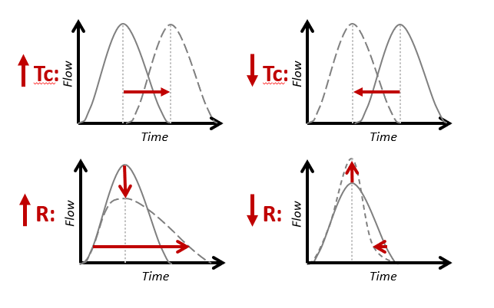
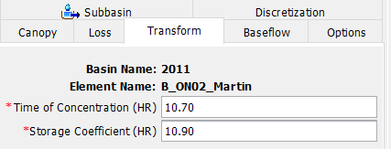


Initial Model Parameters - Transform
Transform Parameters Impact Hydrograph Timing & Attenuation within Subbasins
Compute Initial Estimate with Regression:
Time of Concentration (T_{c}):
T_{c} = Time of Concentration (hr)
L = Longest Flowpath (mi)
L_{ca} = Centroidal Longest Flowpath (mi)
S₁₀₋₈₅ = 10-85 Stream Slope (ft/mi)
Storage Coefficient (R):
R = Storage Coefficient (hr)
T_{c} = Time of Concentration (hr)
Try Constant=0.5 to start
Other Initialization Methods:
Previous Models
Other Regression Equations
$$Tc=2.2 {\left\lfloor \frac{\left(L×L_{ca}\right)}{\sqrt{S}}\right\rfloor }^{0.3}$$
$\frac{R}{\left(Tc+R\right)}$ = Constant
Notes:
Transform parameters are also critical within HMS—they impact the timing & attenuation of subbasin hydrographs.
You can compute initial estimates of the Time of Concentration (Tc) using subbasin physical properties.
The Storage Coefficient (R) is usually associated as a ratio with Tc and that ratio is usually set equal to a constant value. A good initial estimate would be setting the R/(Tc+R) ratio to 0.5 and solving for an initial R value.
Other methods to estimate these initial parameters include referencing previous models or referring to regression equations and studies from within your region as well. Some regions have even identified typical ranges of the R/(Tc+R) ratio—so local resources can be extremely helpful if you can find them!

Slide 23
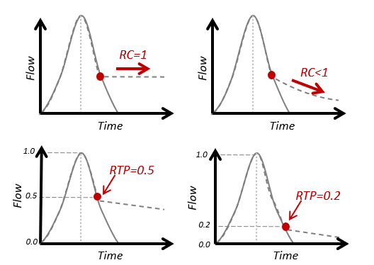
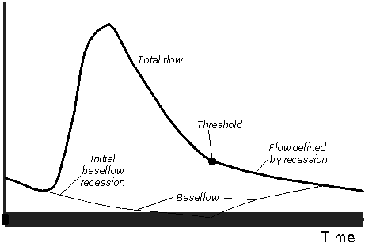
Initial Model Parameters - Baseflow
Baseflow Parameters Impact Hydrograph Attenuation & Recession within Subbasins
Common Baseflow Methods:
Recession:
  Recession Constant
    Baseflow recession slope
    Typically 0.7 to 1
    ↓ Value = ↑ Slope
    Start with 0.9, adjust in calibration
  Ratio to Peak
    Threshold at which BF recession begins
    Start with 0.2, adjust in calibration
Linear Reservoir:
  Conserves Volume (No Loss)
GW1 coefficient = 3 x T_{c}
GW2 coefficient = 10 x T_{c}
T_{c} = Time of Concentration
Flow
Notes:
HMS Baseflow parameters impact the hydrograph’s attenuation & recession within each subbasin.
HMS offers several baseflow methods, but we’ll focus on a couple of the most common.
The figures on this slide help illustrate the key components of the recession baseflow method—that has two primary parameters—the Recession Constant—which essentially defines the slope of the receding hydrograph. Recession constant values typically range from 0.7 to 1.0. A recession constant of 1 results in a completely horizontal tail. The further the value is from 1.0, the steeper the slope. Assuming an initial value of 0.9 & further adjusting in calibration is a good starting point for this parameter.
The Ratio to Peak parameter is essentially the threshold at which the Baseflow Recession begins—the pivot point of the hydrograph. Looking at the 2nd row of figures here—a Ratio to Peak of 0.5 places the pivot point at 50% of the peak flow value. A Ratio to Peak value of 0.2 lowers the pivot point to the 20% (of peak flow) value on the receding limb of the hydrograph.
Initial RTP values can be estimated by examining observed flow data or through adjustment during calibration.
The Linear Reservoir method is another popular HMS baseflow method and is particularly relevant when groundwater interaction is occurring within a watershed as it conserves volume throughout the simulation event. Rules of thumb for estimating the Groundwater Coefficients are shown here as 3 times the time of concentration for the 1st Coefficient and about 10 times Tc for the 2nd coefficient.

Slide 24
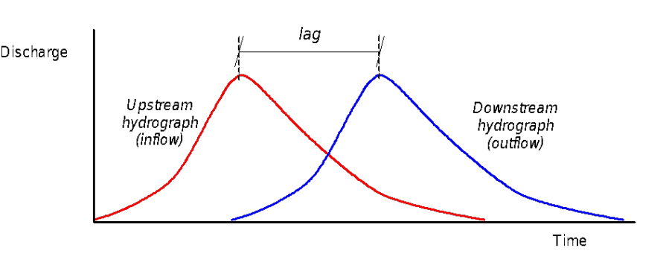
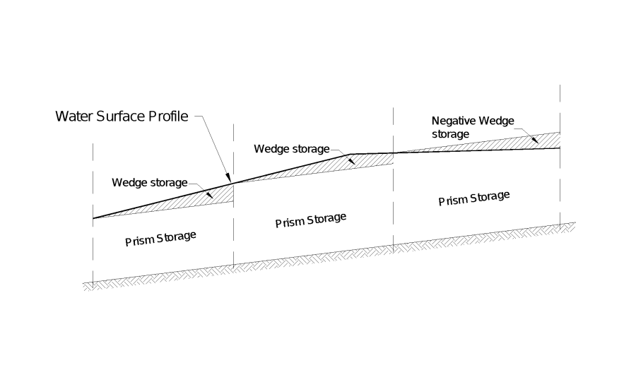

Initial Model Parameters - Routing
Routing Parameters Impact Hydrograph Timing & Attenuation within Reach Elements
Common Routing Methods:
Lag: Directly translates hydrograph as specified
Modified-Puls: storage-discharge relationship (e.g., derived from HEC-RAS) in specified reaches.
Muskingum:
  $Travel Time \left(K\right)= \frac{Length }{Velocity}$
  Muskingum X = Attenuation Factor (0 to 0.5, try starting with 0.25 & adjust in calibration)
  Number of Subreaches $≈ \frac{K}{∆t}$
  $∆$t = time step (hr)
Notes:
The HMS Routing parameters impact the hydrograph timing & attenuation within Reach Elements.
Several routing methods are available, but we’ll touch on a few of the common ones.
The Lag method directly staggers the hydrograph by the specified Lag Time and does not include any attenuation or storage.
The Modified-Puls method uses HEC-RAS to determine storage-discharge relationships within specified reaches.
The Muskingum method uses the length and slope of each reach to estimate its travel time. Attenuation can be adjusted by adjusting the Muskingum X value between 0 and 0.5—I suggest starting with 0.25 and adjusting further during calibration. The number of subreaches for this method is estimated by dividing the Travel Time by the simulation timestep.

Slide 25
Calibration Metrics

Slide 26
Setting
Calibration Goals
Goals Vary by Project Objective
Goal Examples:
  Quantitative Goodness-of-Fit
    Statistics
  Timing
  Volume
  Magnitude
Notes:
Now that you have your initial parameters, you can technically start your simulation and begin the calibration process. Before you do so, it is good practice to set goals for your calibration effort. These goals are going to be project dependent. An example of a goal can be I want my peak flow calibration to be within 5% of the observed values. Or, I want my statistical metrics to be within this threshold. Just because you set your goals, it doesn’t mean it can’t change. The project goals could change which can change your calibration goals. When you start calibrating, you might find you just don’t have enough data to produce a fully robust and calibrated model
Goals dependent on project needs, data availability, parameter type, modeling type.
According to the U.S. EPA (2002), the process used to accept, reject, or qualify model results should be established and documented before beginning model evaluation

Slide 27
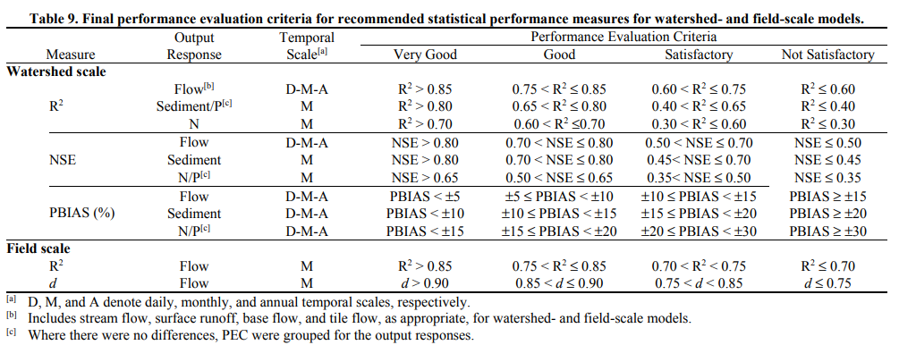
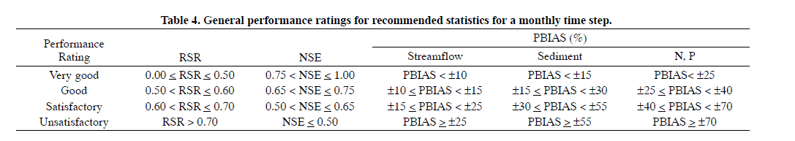
Statistics – Performance Ratings
Moriasi et al., 2015
Moriasi et al., 2007
Notes:
Here is an example of using statistical metrics for settings goals. We’ve listed here the metrics that are provided by HMS.
Statistics used for model evaluation:
Coefficient of Determination (R²) – linear relationship between measured data and simulated data. Range from 0 to 1. Zero indicates no relationship. Sensitive to extreme values
Nash-Sutcliffe Efficiency (NSE) – dimensionless statistic provide relative model evaluation assessment. Ranges from –inf to 1. Values less than 0 indicate the mean value is a better predictor than the simulated.
Root Mean Square Error standard deviation ratio (RSR) – quantify deviation in the units of data of interest. Standardizes RMSE by the standard deviation
Percent Bias (PBIAS) – tendency of simulated data to be larger or smaller than observed data. 0 being no bias. Positive values indicating model underestimation and negative values representing over estimating
Instead of simply using the “eyeball test” to visually look at whether or not model results match observed data, it is helpful to set quantitative goodness-of-fit goals using statistics such as R2, Nash-Sutcliffe & more.
Shown here is a handy table by Moriasi that proposes a range of statistical values that quantitatively categorize how well the calibration mirrors the observed event.
For example, to be satisfactory, the Nash-Sutcliffe efficiency for models with a daily or weekly timestep should be greater than 0.40 and if it’s above 0.65 it is considered a Very Good fit.

Slide 28
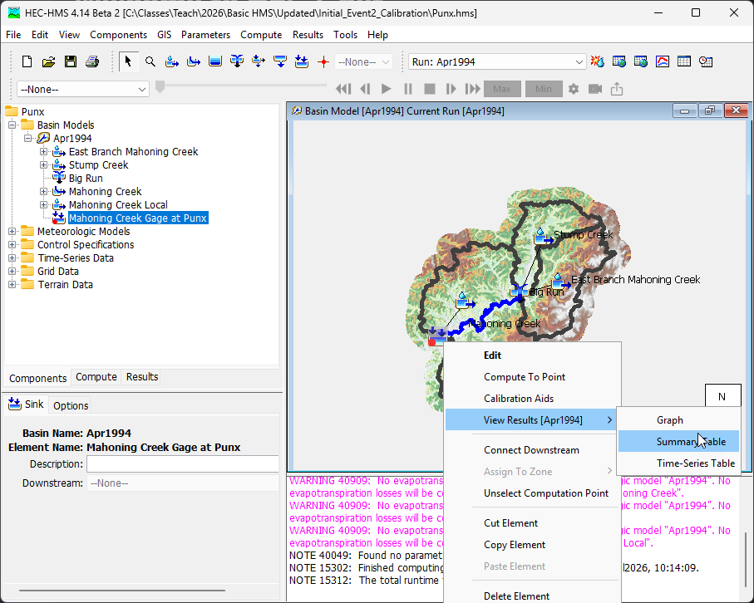
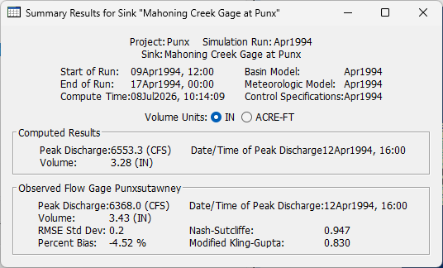
Calibration Goals
Right-Click!
Notes:
Thankfully, if you have observed flow data linked to a junction in HMS, the program will compute several goodness-of-fit statistics for you!
These statistics can be found in the junction’s Summary Table by right-clicking on the junction, selecting “View Results” and then “Summary Table.”

Slide 29

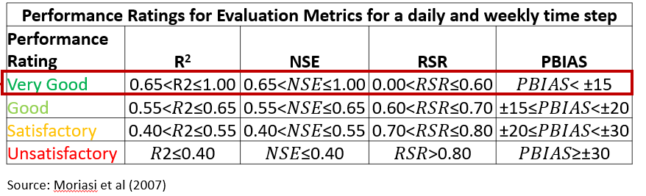
Calibration Goals
Notes:
For example, this location has a Nash-Sutcliffe efficiency of 0.888 which falls into the Very Good category—so this would be considered quantitatively well-fit to the observed data.

Slide 30
Calibration Goals
  Timing
    Ex: +/- 12 hours of Observed Peak
Notes:
Beyond simple statistics, it’s also very useful to set calibration goals for other event components based on the objectives and needs of your project.
For example, in some of our forecasting HMS models, we’ve set an initial goal of calibrating the timing of events to within 12 hours of the observed peak.
Again, timing goals may vary significantly based on what the objectives of your project are.
HMS makes it very easy to compare the modeled and observed peak timing by displaying both timestamps within the Summary table window as shown here.

Slide 31
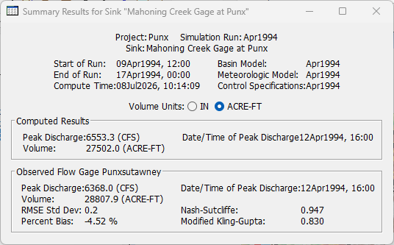
Calibration Goals
  Volume
    Ex: +/- 10% of Observed Event Volume
Notes:
Volume is another key component that you should consider setting calibration goals for---particularly if you’ll be using the HMS model for forecasting models or reservoir studies, the event volume is a critical component you’ll want to capture as closely as possible.
For some of my forecasting models, we set an initial goal of capturing total event volume within 10% of the observed event volume.
Again, HMS makes it very easy to obtain the modeled and observed volumes for the event from directly within the Summary Table.

Slide 32
Calibration Goals
  Peak Magnitude
    Ex: +/- 10% of Observed Peak
Notes:
Event Magnitude is another component you may consider setting calibration goals for—often peak magnitude corresponds to peak stage and inundation levels, so depending on the scope of your study, the magnitude goal may vary.
In the past, for forecasting models, we’ve set an initial calibration goal of coming within 10% of the observed peak magnitudes.
Again, looking at the Summary table again here, HMS makes it easy to do a quick peak magnitude comparison between modeled results and observed values if you have the gage data linked to the junction.

Slide 33
Reporting Model Performance (flow)
Event modeling
  Graphical comparison between simulated and observe time series
  Peak magnitude and timing
  Performance metrics and Performance rating

Slide 34
Takeaways
Setting Initial Model Parameters
  “Best Guess” Starting Values
  Parameters Will Evolve Throughout Calibration
Setting Calibration Goals
  Quantifying Fit (vs. “Eyeball Test”)
  Goals Depend on Scope of Project
Notes:
Let’s wrap up with the key takeaways from this lecture—
When setting initial parameters, it’s important to remember that these as simply your “best guess” numbers—the parameters will evolve further as you calibrate and hone in on the processes within your watershed.
When setting calibration goals—it’s helpful to set quantifiable goodness-of-fit goals vs. relying on the “eyeball test.” We provided some examples of goals, but the goals you set definitely depend on the scope and objectives of each unique project.

Slide 35
Parameter Impacts

Slide 36
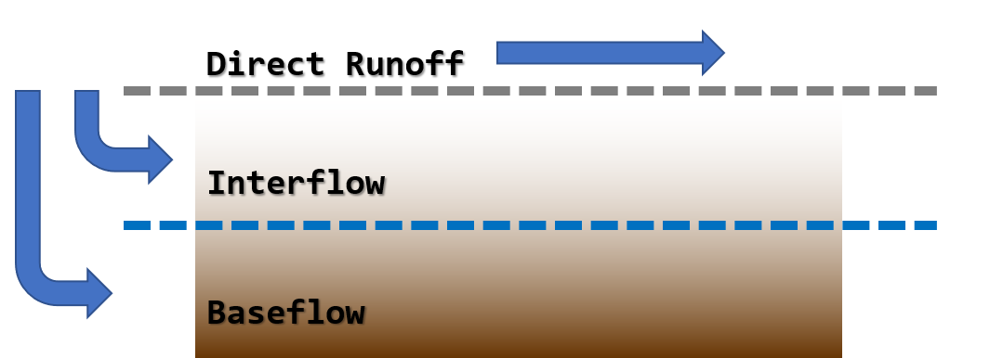
Parameter Impacts
Deficit + constant loss rate
Clark unit hydrograph
Linear reservoir baseflow
Notes:
We will investigate how changing the parameters for three of the model processes in a simple watershed model change the response of the output hydrograph.
The model we are testing is capturing three processes – direct runoff, interflow, and baseflow. The loss process partitions the incoming precipitation into direct runoff or sends it to interflow and baseflow. We can control that behavior by changing the loss parameters.
The shape of the direct runoff hydrograph at the outlet of the watershed is controlled by the unit hydrograph transform parameters.
For the water sent to baseflow, some of it responds slower than direct runoff, but faster than baseflow. This is interflow, which is water flowing in the unsaturated portion of the ground. Its response can be controlled with a layer of a linear reservoir.
The remainder of the water is sent to baseflow, which is the slowest responding portion of this model. It is also modeled with a layer of a linear reservoir.

Slide 37
Experimental Control
SCS type II storm
5 inches point depth
15-min time step
1 mi² subbasin
Initial deficit 1 in, constant rate 0.1 in hr⁻¹
T_{c} 1 hr, R 1 hr
Baseflow K₁ 30 hr, K₂ 100 hr
Notes:
This experiment gives us a well-behaved single peak hydrograph that is dominated by direct runoff. The values for these parameters are made up but are not unrealistic.
The experiment will vary parameters by taking half or double their baseline value, one a time.
We start with an SCS storm, which is a design storm time pattern that will give us a single-peaked hydrograph. The five inch point depth ensures that this event will generate direct runoff.
The area only affects the magnitude of the results, so we can give it an arbitrary area of one square mile.
The remainder of the parameters have been selected so that they are easy to alter.

Slide 38
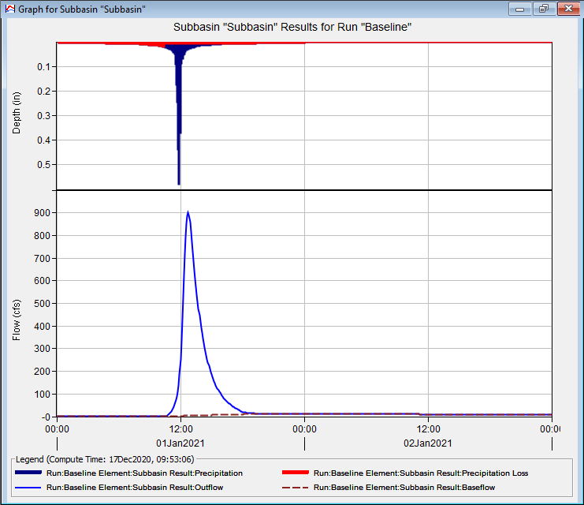
Baseline
Notes:
Here is the result of running the experimental control. The output hydrograph will be used as an observed data time series for the subbasin element we are simulating. This view of the subbasin result allows us to look at the behavior of the loss parameters on the input hyetograph on the top, as well as the output hydrograph, which shows both the total outflow hydrograph, as well as the baseflow contribution.

Slide 39
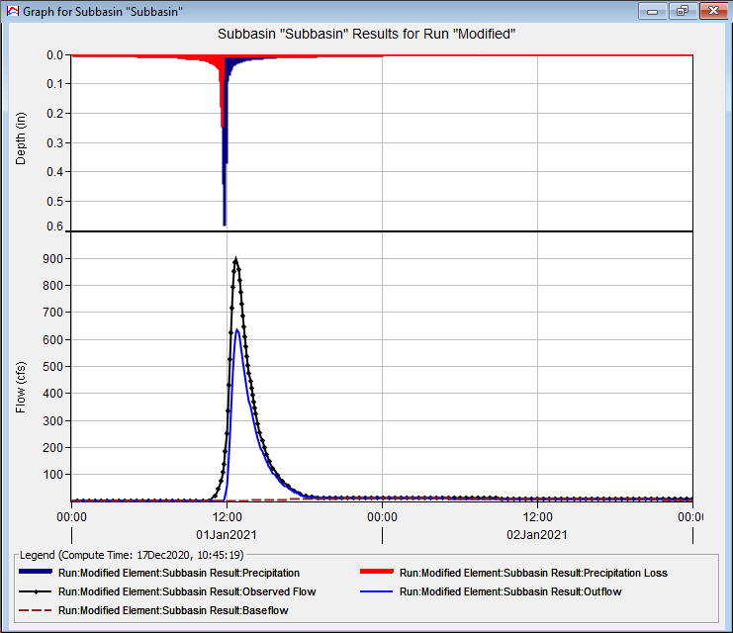
Initial Deficit Doubled
Notes:
The first result shows the change that occurs when the initial deficit is doubled. Note on top how much of the hyetograph is now lost in the red portion of the top graph. The impact of this can be seen below – the baseline is shown in black, with the new hydrograph in blue. Overall, volume and peak intensity have decreased. The volume comes off of the early part of the hydrograph.

Slide 40
When to Change Initial Deficit?
Volume is off-target
Adjust early part of hydrograph
Include/exclude antecedent events
Notes:
The initial deficit is also important when the input rainfall is not as simple as this experimental case. Often there will be small rainfall inputs prior to the main event of interest and controlling whether those produce runoff or not, and the magnitude of their runoff, will often be determined by the initial deficit value. Initial deficit is only going to be important for the initial events in a simulation, and will not have impacts on later hydrographs in a longer simulation.

Slide 41
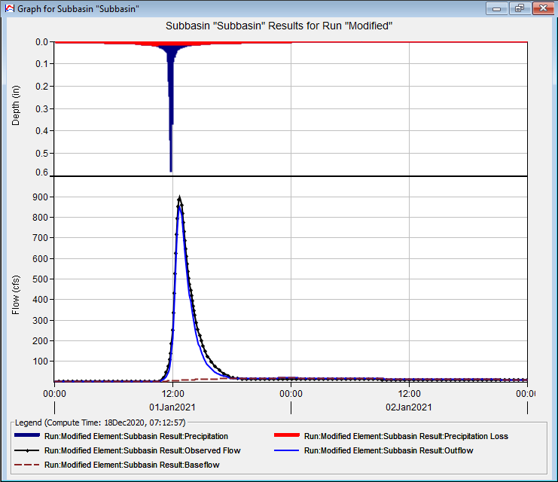
Constant Rate Doubled
Notes:
The constant rate is fundamental for calibration. It mainly controls the partition between direct runoff and baseflow. It has the effects of reducing the overall direct runoff volume, as well as the peak of the hydrograph. In this experiment the difference seems small because the output hydrograph is so dominated by direct runoff. When calibrating a case like this, the unit hydrograph parameters become very important.

Slide 42
When to Change Constant Rate?
Volume is off-target
Adjust peak runoff
Adjust contribution of direct runoff vs. baseflow
Notes:
Constant rate is going to be the most important factor in adjusting where the volume of water goes. If you are finding that your model response is generally much too fast, and you are missing the receding limb of the hydrograph as it returns to baseflow by a lot, then changing the constant rate to send more water to baseflow is probably the solution. The converse is true as well. To get much more rapid, “flashy” response, then decreasing the constant rate allows the unit hydrograph parameters to control that faster response.

Slide 43
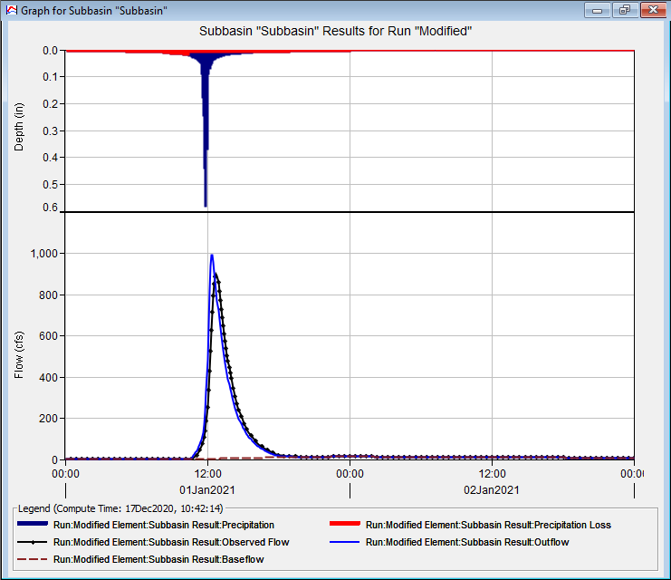
T_{c} halved
Notes:
On the other hand, shortening T_{c} shifts the hydrograph peak to the left and increases the peak magnitude. Watersheds that respond very rapidly to rainfall inputs tend to have small times of concentration and may have very “spiked” looking hydrographs such as the blue one in this figure.

Slide 44
When to Change T_{c}?
Direct runoff is most of the hydrograph
Adjust timing of peak
Adjust magnitude of peak
Notes:
Changes to time of concentration have the most impact when the hydrograph is dominated by direct runoff. Use T_{c} mainly to change the timing of the hydrograph peak. Small adjustments to the magnitude of the peak can be made with T_{c} as well.

Slide 45
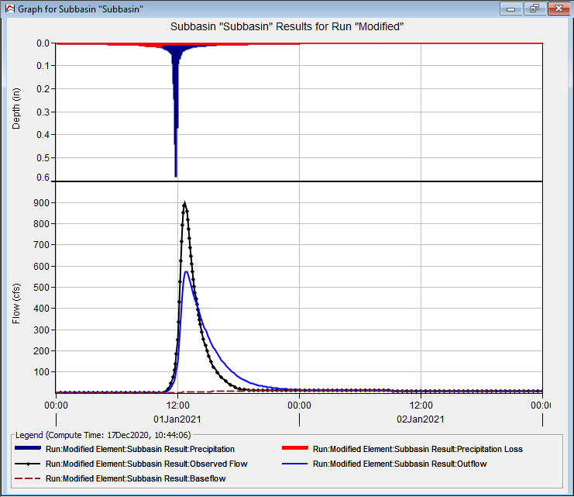
R doubled
Notes:
R has a tremendous amount of power in changing the shape of the response of direct runoff hydrographs. It does not change the timing of the response but does shape the attenuation. Note here with a doubling of R the peak magnitude drops, with the volume that occurred in the peak being pushed to the receding limb of the hydrograph.

Slide 46
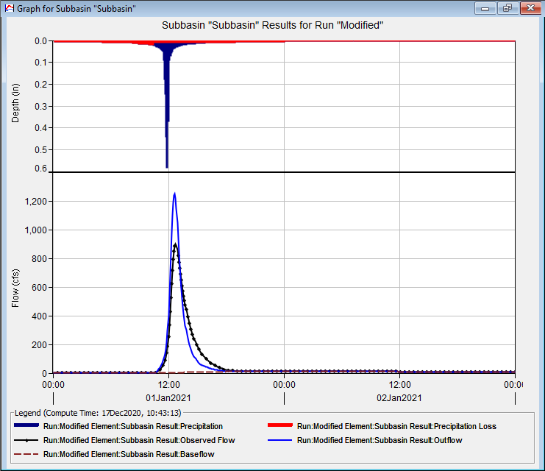
R halved
Notes:
On the other side of changes to R, a decrease causes an increase in the peak magnitude of the hydrograph by reducing attenuation. Much of the volume in the receding limb has been pushed into the peak. Shortening R allows you to model flashier watersheds.

Slide 47
When to Change R?
Direct runoff most of the hydrograph
Adjust overall peakedness of hydrograph
Adjust receding limb of direct runoff hydrograph
Notes:
R is a shape parameter, to contrast T_{c}, a timing parameter. Bear in mind that R and T_{c} are related. If your values for R and T_{c} head far in opposite directions from the initial estimates, then you might want to consider other kinds of adjustments. R is only going to have an impact if most of your hydrograph is generated by direct runoff, otherwise you will need to adjust baseflow instead.

Slide 48
Baseflow
Baseflow adjustments more important when direct runoff is small
Change the controls:
  Point depth reduced to 1 in
  Initial deficit reduced to 0 in
  Constant rate increased to 0.75 in hr⁻¹
  Longer simulation window
Notes:
To see the impacts of baseflow, we need to alter our experiment a little bit so that direct runoff doesn’t dominate the response. Here we will reduce the intensity of the storm event and allow most of the event to be infiltrated by increasing the loss parameter. To see the impacts of these changes, we will also need to run a longer simulation window.

Slide 49
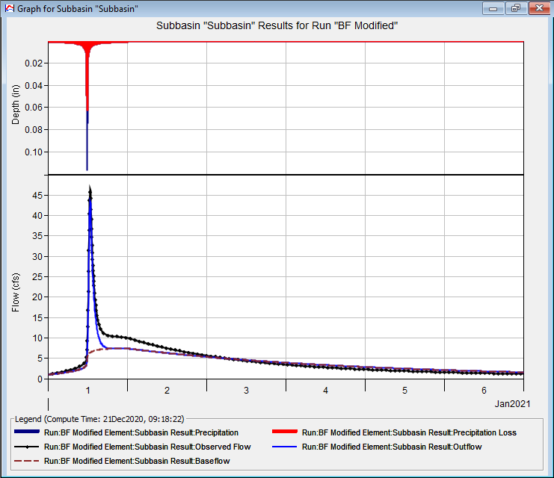
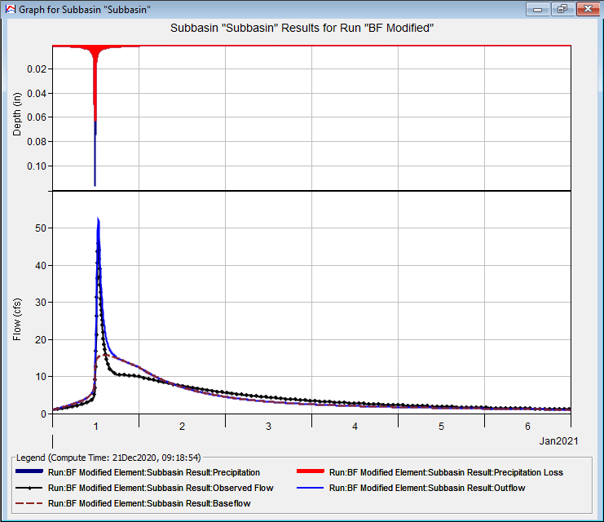
K₁ doubled
K₁ halved
Notes:
In our two-layer baseflow model, the first layer is being used to model the more rapid response of interflow. The response is still an order of magnitude slower than the direct runoff response, so it takes more time to see the impact of changing the coefficient.
Doubling the coefficient pushes a significant amount of the baseflow volume out into the long receding limb of the hydrograph. It also reduces the peak magnitude of the event hydrograph because of the slower response of the baseflow. Bear in mind that the losses occurring during the start of the rainfall event are going to baseflow, so the peak of the event can be affected when stacked on top of this changed baseflow response.
Halving the coefficient has the opposite effect – there is a much more rapid baseflow response, and because those initial losses are reaching the outlet faster, the hydrograph peak increases. Notice also that much of the baseflow volume occurs immediately after the peak of the direct runoff portion of the hydrograph, and the volume is lost from the long receding tail of the hydrograph.
For linear reservoir baseflow models with multiple layers, the lower layers generally are even slower and control the response shape on an even longer scale. They can be adjusted similarly, bearing in mind that the larger the coefficient relative to the length of the event, the less it will control the peak magnitude. It will however control how the event recedes.

Slide 50
When to Change Baseflow?
Need to match the recession speed
Watershed is interflow dominated
Notes:
Baseflow is mainly changed so that the receding limb of the hydrograph is matched. Usually this is taken as a sign that the overall baseflow response is captured adequately. However, in some watersheds, most of the response is controlled by interflow or baseflow. This occurs when overall rainfall intensities are low, although volumes may be large. This may also happen in conjunction with snowmelt. In these cases, the unit hydrograph parameters may exhibit little control and tuning the baseflow parameters will be more important.

Slide 51
Setting
Computation Points
Why?
Where?
How?
Notes:
Setting Computation Points within HMS—quality of life enhancement
Why might this be helpful to you?
Where should they be set?
How to set them…

Slide 52
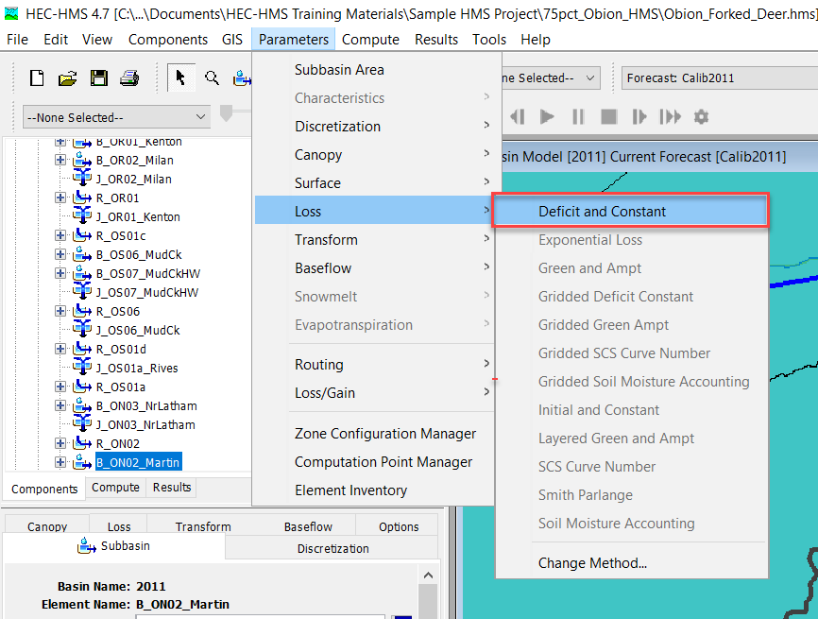
Setting Computation Points
Why Set Computation Points?
  Creates Element “Groups”
    Includes Subbasins between Computation Points
    Easy Parameter Table Filtering
  Enables “Compute to Point”
Notes:
Computations points lets you create Element Groups. Whats great about Element groups is filtering your subbasins to those upstream of the computation point. This is mainly helpful if you have a large watershed with a lot of subbasins and calibration points. You can set a computation point at gage location and what that will do is filter only the subbasins and reaches that contribute to that gage point.
How are computation points helpful to an HMS modeler? Computation points create element “groups” that include all subbasins & elements between computation points. The first handy computation point feature is that it enables fast & easy parameter table filtering—For example, heading to Paremeters > Loss > Deficit & Constant….

Slide 53
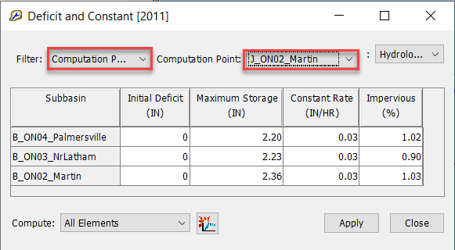
Setting Computation Points
Why Set Computation Points?
  Creates Element “Groups”
    Includes Subbasins between Computation Points
    Easy Parameter Table Filtering
  Enables “Compute to Point”
Notes:
The filtering occurs at the Global Parameter Editors table. The first selection is what you want to filter by: Computation Point or Zones. The Computation Point filters the Computation Point that you set up.
…brings up the Deficit & Constant parameter table—filtering by Computation Point and selecting the point of interest shows just those subbasins within that computation point group. This is helpful for viewing & comparing nearby parameter values—and can even be useful for calibration which we’ll touch on a bit later.

Slide 54
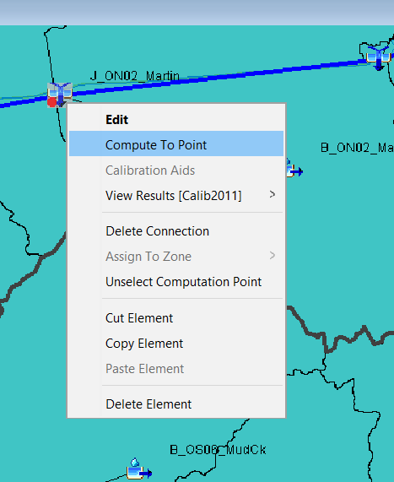
Setting Computation Points
Right-Click!
Why Set Computation Points?
  Creates Element “Groups”
    Includes Subbasins between Computation Points
    Easy Parameter Table Filtering
  Enables “Compute to Point”
    Only Re-Computes Elements Upstream of Computation Point (vs. Entire Model)
    Time Saver!
Notes:
Another useful feature of computation points is the ability to “Compute to Point.” By right-clicking on a computation point and “Computing to Point,” HMS will only recompute the elements upstream of that computation point (instead of re-computing the entire model) which can save a lot of time during calibration—particularly if you’re working in a large watershed!

Slide 55
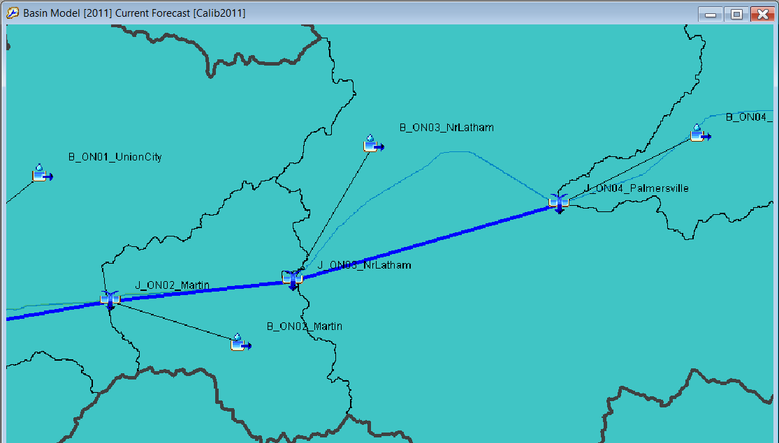
Setting Computation Points
Where to Set Computation Points?
  Junctions
    Gages
    Key Locations
! Gage Location !
Notes:
Where should computation points be set? They can be set at any junction, however, Gage Locations are a great place to use computation points since you’ll be adjusting and re-running the model frequently during calibration at these locations. Setting computation points are other key locations such as tributary junctions or areas where watershed features change rapidly may also be useful.

Slide 56
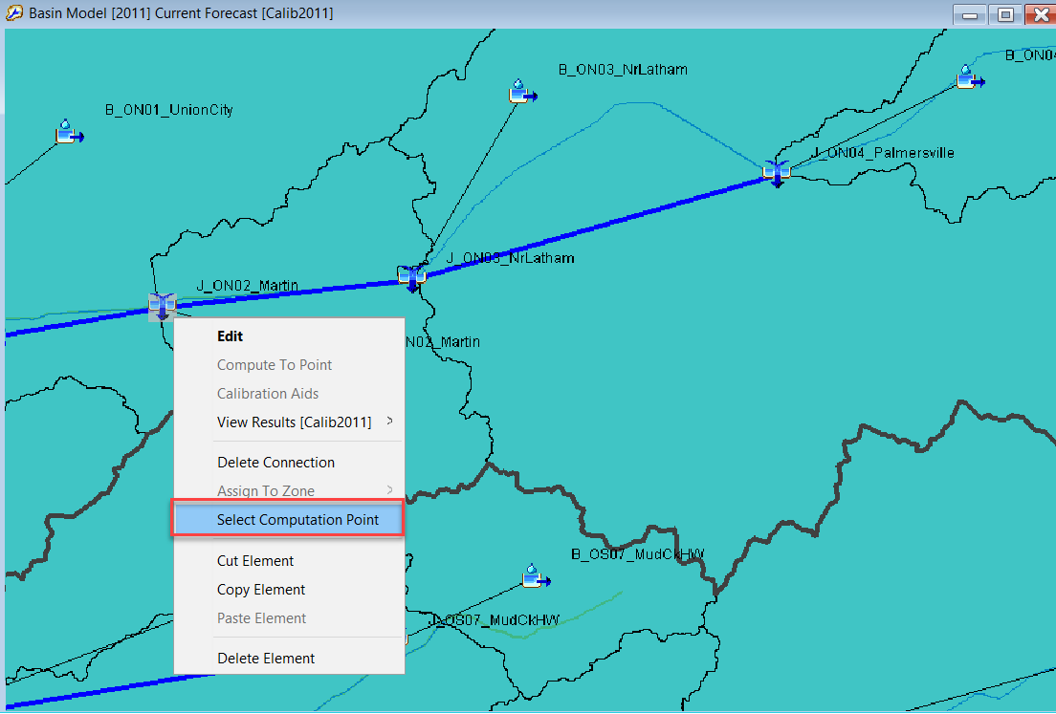
Setting Computation Points
How to Set Computation Points?
Right-Click!
Notes:
How do you set a computation point? It’s as simple as right-clicking on the intended junction element and “Selecting Computation Point!”

Slide 57
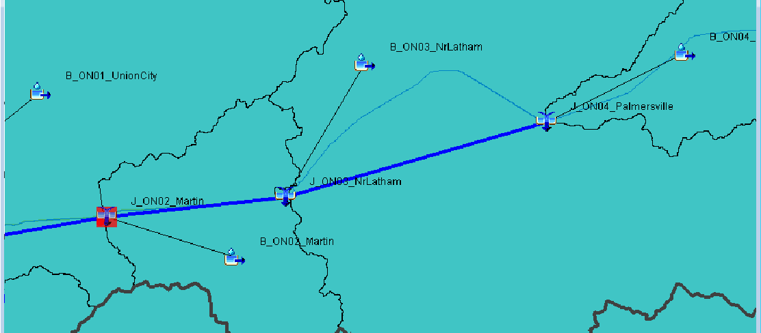
Setting Computation Points
How to Set Computation Points?
  Junction Icon Turns Red Once CP Set
Notes:
Once the computation point has been set, the junction icon will have a red background.

Slide 58
Summary Tables & Metrics
Where?
What?
How?
Notes:
Let’s talk about the Summary Tables & Metrics available within HMS—
Where are they located?
What useful information does it have?
How can I use the information?

Slide 59
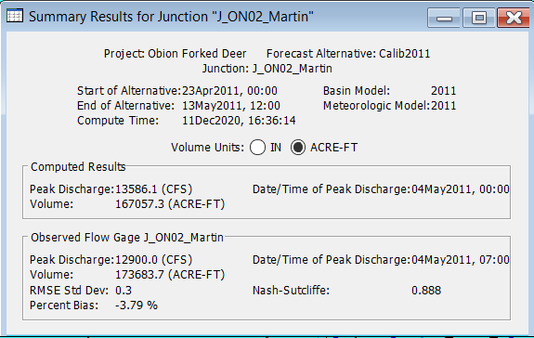
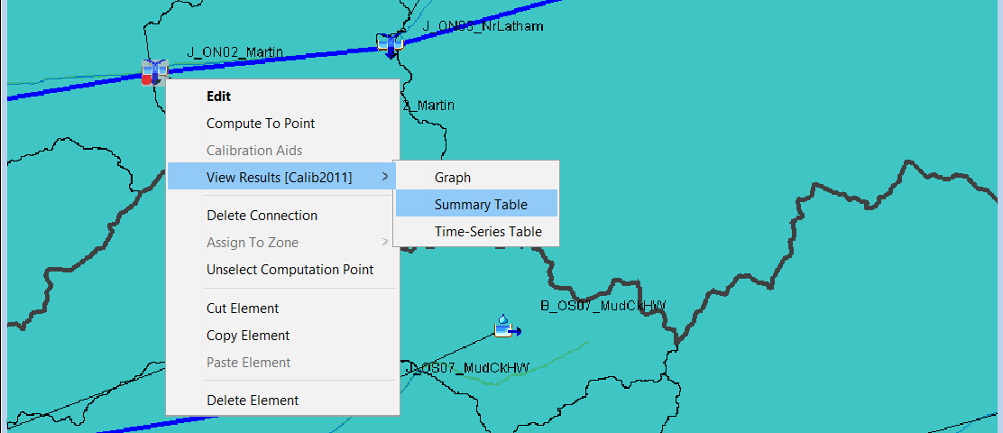
Summary Tables & Metrics
Where to Access Summary Tables?
  Right-Click Junction Elements
Right-Click!.
Notes:
Where are the HMS summary tables located? Summary tables can be found at every junction element within HMS by right-clicking on the junction element > View Results > Summary Table

Slide 60
Summary Tables & Metrics
What’s in the Summary Tables?
Simulation
Info
Notes:
What’s included in the summary tables?
Every summary table provides information about the simulation you’re running such as start/end date, which models the simulation is using…

Slide 61
Summary Tables & Metrics
What’s in the Summary Tables?
Volume
Unit
Selection
Computed Results
Observed Data
Notes:
Summary tables always summarize the computed timing and magnitude of the peak discharge as well overall modeled event volume—which can be displayed in inches or acre-feet (English Units, Metric is also available).
Another great summary table feature is if you have observed flow data linked to the junction, HMS will also summarize the same metrics from the observed data and…
Observed flow only shows up if you have observed information.

Slide 62
Summary Tables & Metrics
What’s in the Summary Tables?
Computed Results
Observed Data
Calibration Metrics
Notes:
…it will also compute several goodness-of-fit statistics for you!

Slide 63
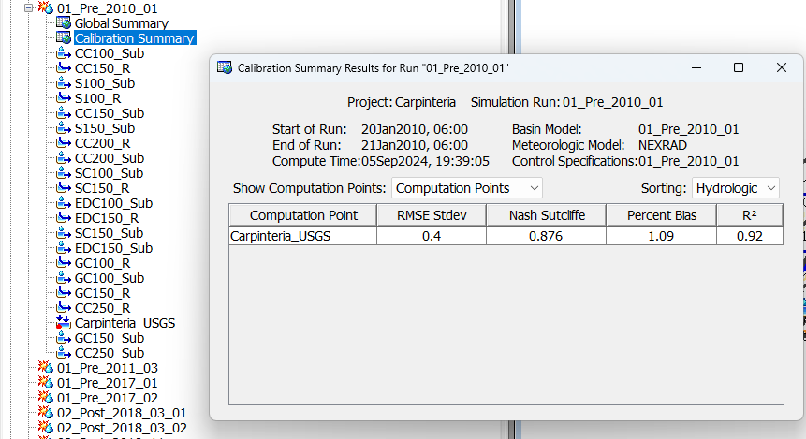
Calibration Summary Results

Slide 64
Zonal Calibration
Sliders
Group Tables
Notes:
Let’s touch on Zonal Calibration—I’ll mention two ways to calibrate HMS parameters by zone, including using the HMS Slider Bars feature as well as by groups within the Parameter Tables…

Slide 65
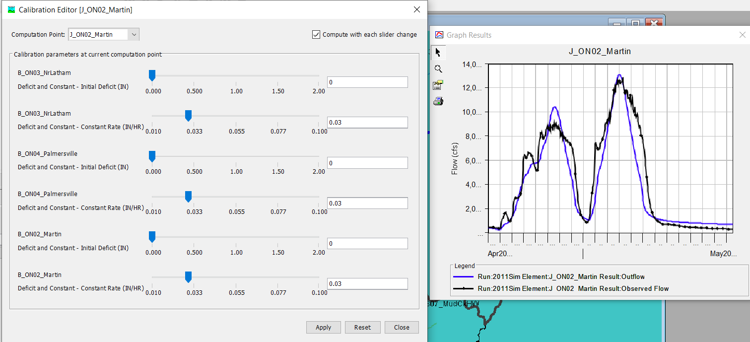
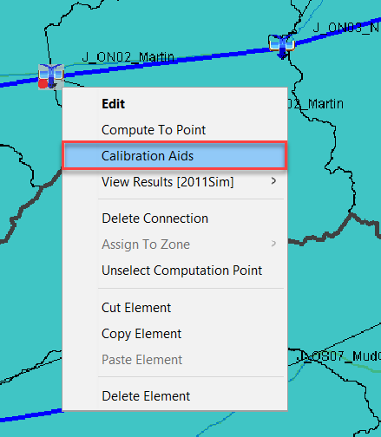
Zonal Calibration
Sliders
  Right-Click CP > Calibration Aids
Notes:
One great approach to Zonal Calibration is using the Slider Bar Calibration option. Elements, parameters and ranges must first be set up to enable slider bar use. To access the slider bar feature, right click on a Computation Point junction and select “Calibration Aids.”

Slide 66



Zonal Calibration
Notes:
You do need to configure your Slider by going to the Computation Point Manager. Select your Computation Point and the Parameters selection. This lets you choose which parameters you want on your slider bar. Then in Parameter Settings, this is where you set the range of plausible values.

Slide 67
Zonal Calibration
Sliders
  User-Set Parameters, Ranges, Plots
Notes:
The slider bar Calibration Editor dialog box will open. The sliders should be set up to reflect the calibrated range of each parameter with the option to include custom plots to track calibration progress.

Slide 68
Zonal Calibration
Sliders
  Auto-Recompute by Sliding
Notes:
Selecting “Compute with each slider change” will re-compute the model and update the associated plots each time the slider is adjusted. The re-computation is typically fairly quick for a nearly real-time cause/effect update as parameters are adjusted…

Slide 69
Zonal Calibration
Sliders
  User-Set Parameters, Ranges, Plots
  Auto-Recompute by Sliding
Pros
  Rapid Response to Adjustment
  Pre-Defined Parameter Ranges
Notes:
The prep work to set up the ranges for slider bar parameters can be time-consuming, but using them in real-time is efficient with rapid re-computation as parameters are adjusted. Having the pre-defined ranges is also useful for ensuring adjustments stay within reasonable ranges for each parameter.

Slide 70
Zonal Calibration
Parameter Tables
Notes:
Another approach to Zonal Calibration is adjusting multiple elements at once by viewing the parameters by Group in the parameter summary tables. For example, here we’re viewing the Loss parameters for the “Martin” computation point in this basin…

Slide 71


Zonal Calibration
Group Tables
  Scale/Factor Parameters by Computation Point or Zone
    Highlight & Right-Click > Fill
Notes:
Multiple subbasin parameters can be set or scaled at once by highlighting the parameter > Right-Clicking > Selecting Fill…

Slide 72


Zonal Calibration
Group Tables
  Scale/Factor Parameters by Computation Point or Zone
    Highlight & Right-Click > Fill
    Select Operation > OK
Pros
  View & Adjust Multiple Subbasins at Once
  Especially useful for large watersheds
Notes:
…which pops up the Table Fill Options dialog…from here, the initial parameters can be adjusted all at once.
Adjusting parameters within the parameter tables by group is particularly useful when working in a large watershed. The slider bar dialog for 10+ (or even 100+) subbasins can get a little overwhelming. Focusing on one Computation Point Groups at a time within the parameter tables and being able to scale/adjust multiple parameters all at once can be efficient when tackling larger watersheds.

Slide 73
Takeaways
Computation Points Enable:
  Element Grouping
  Compute-to-Point
  Slider Bar & Group Calibration
Summary Tables Provide:
  Model Results Overview
  Valuable Calibration Metrics
Zonal Calibration
  Slider Bars or by Table
  Efficient Calibration Tools
Notes:
Key takeaways from this Calibration Metrics & Tools lecture are:
Setting Computation Points enables:
Element grouping
Compute to Point feature
Slider Bar & Calibration by Group within Tables
The HMS Summary Tables Provide:
An overview of model results and observed data
Valuable calibration metrics
Zonal Calibration options include:
Slider bars or Scaling by Groups within the Parameter Tables
Both are efficient calibration tools

Slide 74



Parameter Regression
Calibrate models in a region
Predict calibrated parameters from physical data
$$t_{c}=0.39\sqrt{A}+{DD}^{2}$$
$$\frac{R}{t_{c}+R}=0.6$$
$$K_{1}=30t_{c}$$
Notes:
If youre lucky you might have a study that was done that performed some regression analysis on model parameters. At HEC, we did a regression analysis for estimating Tc and R for California. USGS has done these for other states.
Regression equations are sometimes developed from regional studies. Several models are calibrated, and their physical properties retained. Then, a regression model is fit to the data so that the physical properties explain the variability in the calibrated parameters. These equations can then be used to estimate parameters in other watersheds. An example of a predictor equation for time of concentration based on basin drainage area and drainage density is shown on the right. Time of concentration tends to be easier to predict using regional regression than some other parameters are.
Over time, modelers have developed other useful guidelines for estimating starting parameters. Some parameters are easier to estimate from physical data, such as constant loss rate, percent impervious, time of concentration, and so on. Then, simple rules can be applied to these estimated parameter values to estimate other parameter values. Two examples of this are shown in the lower right. After estimating time of concentration, the storage coefficient can be estimated using an empirical relationship such as this. Typical values for this ratio are in the range of 0.5-0.8. For linear reservoir groundwater parameters, the fast-response layer coefficient can be initially estimated by 30 times the time of concentration.

Slide 75


Initial Model Parameters – ET & Snow
Evapotranspiration (ET)
Accounts for water vaporization & plant absorption.
Data Sources:
  National Climatic Data Center (NCDC)
  Water Control Manuals/Local Reports
Snowmelt Parameters
Includes Temperature, Snow & Melt Parameters
Data Sources:
  Snow Data Assimilation System (SNODAS)
  Snow Telemetry (SNOTEL)
  Add’l Local & Nationwide Sources
ET & Snow can be calibrated independently of streamflow.
Notes:
Evapotranspiration accounts for both the vaporization of water from liquid to gas and the release of water from plants. ET is important if you are doing continuous simulation, which we’re not doing in the basic class. We have a number of methods available for ET. There’s the monthly average method, which simply you give the average ET value per month. There’s empirical methods like Hamon method which has just one coefficient. And more physically based ET method such as Penman Monteith.
Evapotranspiration (ET) and Snowmelt Parameters can also be applied within HMS.
ET accounts for water vaporization & plant absorption—initial ET values can be derived from Evaporation Data found on the NCDC website. ET estimates are also often included in USACE Water Control Manuals or reports on other local studies.
Snowmelt parameters include temperature, Snow and Melt components. Snowmelt data sources include SNODAS—which is national snow modeling output or SNOTEL which includes direct snow measurements and is widely available in the Western US.
Both the ET & Snowmelt components can be calibrated independently from the runoff/streamflow calibration within HMS.

Slide 76

Initial Deficit Halved
Notes:
Reducing the initial deficit mainly changes what happens in the early portion of the hydrograph. Notice that the hydrograph begins ascending earlier when the initial deficit is lower. This has the impact of increasing the volume of the hydrograph and slightly increasing the peak discharge.

Slide 77

Constant Rate Halved
Notes:
Decreasing the constant rate has the opposite effect – generally increasing the direct runoff volume, and increasing the peak of the hydrograph. Again, in this case, direct runoff is dominating so the effect is small.

Slide 78

T_{c} doubled
Notes:
The Clark unit hydrograph has two parameters, the time of concentration, abbreviated T_{c} and storage coefficient R. T_{c} can be thought of as how long it takes for water to reach the outlet of the watershed from the most hydrologically distant point. This means it is mainly a timing parameter. Here you can see that if you increase T_{c}, the peak of the hydrograph is delayed. It is also reduced in magnitude. Increasing T_{c} translates the hydrograph slightly, but also induces some attenuation.

