Slide 1
Introduction to HEC-HMS
Thomas Brauer, P.E.
Hydrologic Engineering Center
Notes:
Hi this is Tom Brauer from the Hydrologic Engineering Center. In this video I’m going to give a basic introduction to HEC-HMS. We’ll talk about some capabilities and limitations of the program.

Slide 2
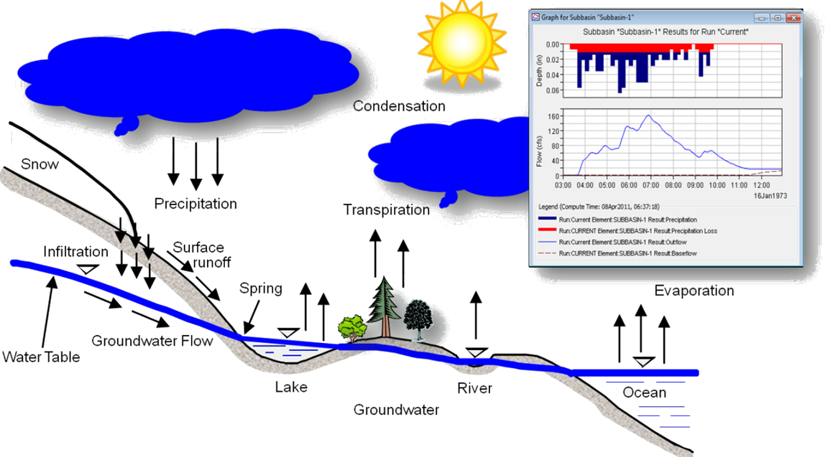
Hydrologic Modeling System
Notes:
The Hydrologic modeling system is designed to simulate surface-water hydrology. The program can, and has, been used to model temperate and tropical hydrology around the world.
If you’ve taken a hydrology class, this image should be familiar. What we see is a diagram of the hydrologic cycle. For each hydrologic process, HMS provides a range of mathematical model options to model the process.
To ease the modeling process HEC-HMS provides a rich graphical user interface including
a map of the watershed,
point-and-click functionality for entering and updating data
and graphical, and tabular, displays of simulation results.
One model limitation I will mention here is the groundwater representation in HEC-HMS. We do have simple baseflow methods, but we currently do not link directly to an aquifer model. Some losses and baseflow methods calculate a volume, that percolates through as deep aquifer recharge, which could be passed to an aquifer model. Some of our planned work is to include a simplified groundwater flow modeling option in HEC-HMS.

Slide 3
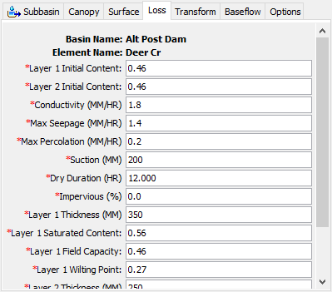
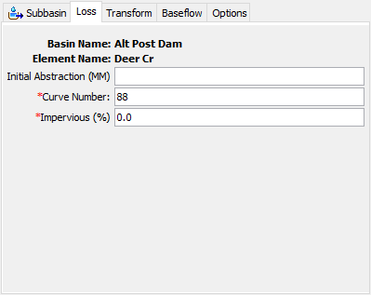
Empirical or conceptual
Notes:
For each hydrologic process, HEC-HMS provides a range of mathematical model options to model the process. In this example we show the same subbasin “Deer Cr” parameterized with two different loss models. The SCS Curve Number loss method on the left is very empirical. The Layered Green & Ampt loss method on the right is physically based.
You, the user, are able to make modeling choices based on:
How much data you have
What your study goals are
And how much time you have
One model limitation worth mentioning here is model coupling. Consider evapotranspiration and infiltration. In reality, you can’t have one without the other. Because you are able to select different modeling methods for each element in the program, it is difficult to couple processes. The way we minimize errors is to use small time steps. Some methods use an adaptive time step to perform computations at time steps less than the selected computation time interval.

Slide 4
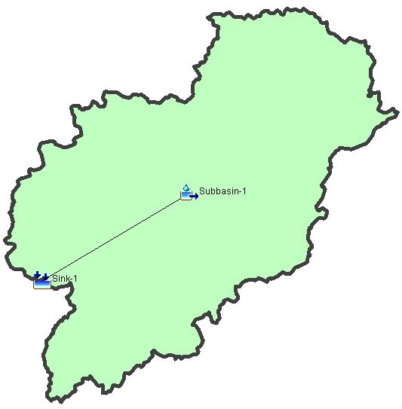
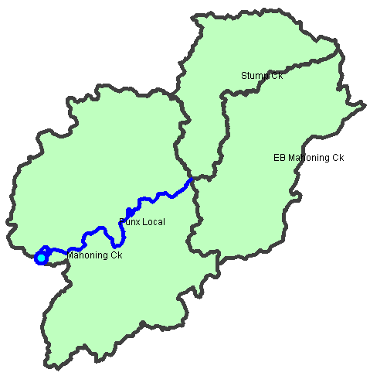
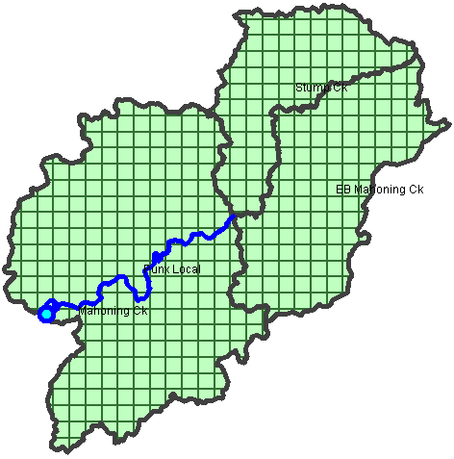
Subbasin-average or Gridded
Notes:
HEC-HMS can model both subbasin-average and gridded subbasins, and can model both at the same time.
The images on this slide represent some common modeling configurations in HEC-HMS. In the case on the left the entire modeling domain is represented with a single set of parameters for each hydrologic process. In the case in the middle the basin is divided into three subbasins. Each subbasin can be parameterized with unique values. In the case on the right, the basin is divided into gridded subbasins where each grid cell can have unique parameterizations.
It is common practice to define gridded precipitation and temperature boundary conditions and compute excess precipitation, and infiltration, on a per grid cell basis.

Slide 5
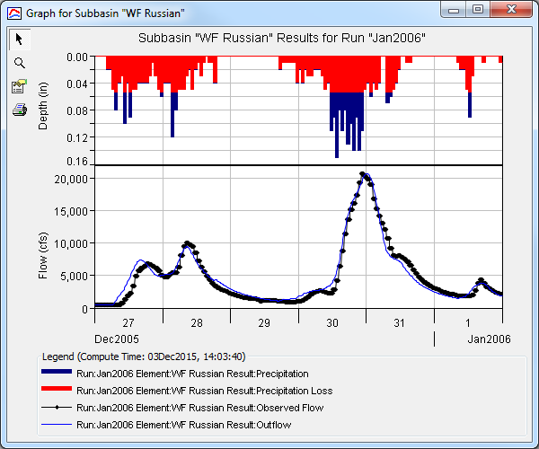
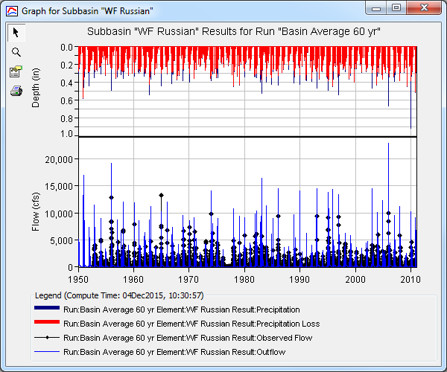
Event OR Continuous
Notes:
"Event" simulation is only concerned with hydrology during and immediately after a storm.
"Continuous" simulation includes events and the time between them, modeling up to several decades at a time.
In the case of HEC-HMS, the program can simulate both event and continuous hydrology.
There is no master switch in HEC-HMS that decides between event and continuous, it comes down to the modeling methods that are selected. Event models typically include just precipitation in the meteorologic model. Continuous simulations include potential evapotranspiration in the meteorologic model and a loss rate method that tracks soil moisture such as deficit & constant or soil moisture accounting.
A limitation that I will mention is constant vs variable parameters. In HEC-HMS, all but a few parameters are constant. A few things are allowed to change during the year, for instance, plant canopy can use an annual pattern. Some of our ongoing work is adding time-variable parameters to some of the infiltration methods. Once that work is complete we will probably look for other areas to apply time-variable parameters.

Slide 6
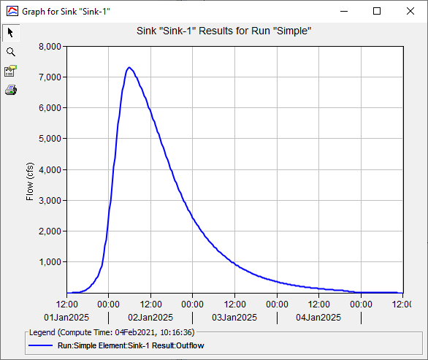
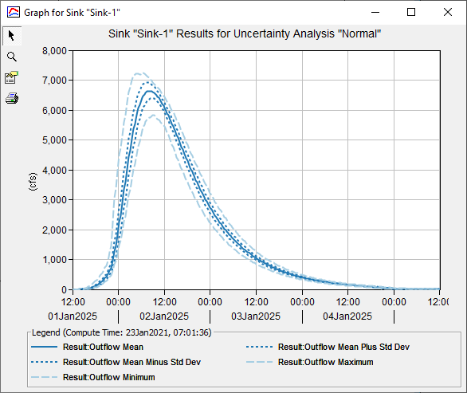
Deterministic or Stochastic
Notes:
We’ve talked about how, for each hydrologic process in HEC-HMS, there is a range of mathematical model options. The reality is that each of these modeling options is deterministic. In a deterministic model, we fix a set of parameters, and initial conditions, and the model runs.
There is a Monte Carlo simulation option in the program that allows us to take a deterministic model and create probabilistic output. One of our ongoing research areas is a probabilistic parameter estimation tool that allows us to estimate uncertainty in model parameters.

Slide 7
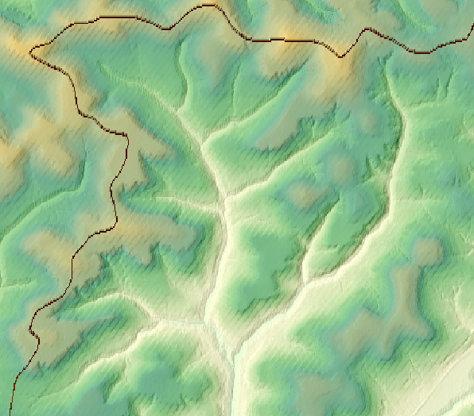
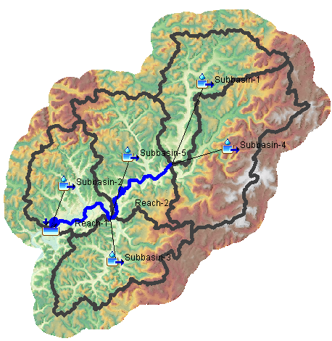
GIS Processing
Terrain modification
Sink fill and flow direction
Subbasin and reach delineation
Subbasin and reach splitting and merging
Subbasin and reach characteristics
Notes:
In addition to the program’s hydrologic modeling capability, HEC-HMS provides GIS processing capability to assist in the hydrologic modeling process.
GIS capability includes:
Terrain modification that allows you to build walls and burn streams into your terrain
Sink fill, and flow direction, terrain processing
Subbasin and reach delineation
Subbasin and reach splitting and merging
And subbasin and reach characteristics computation, such as longest flowpath and basin relief

Slide 8
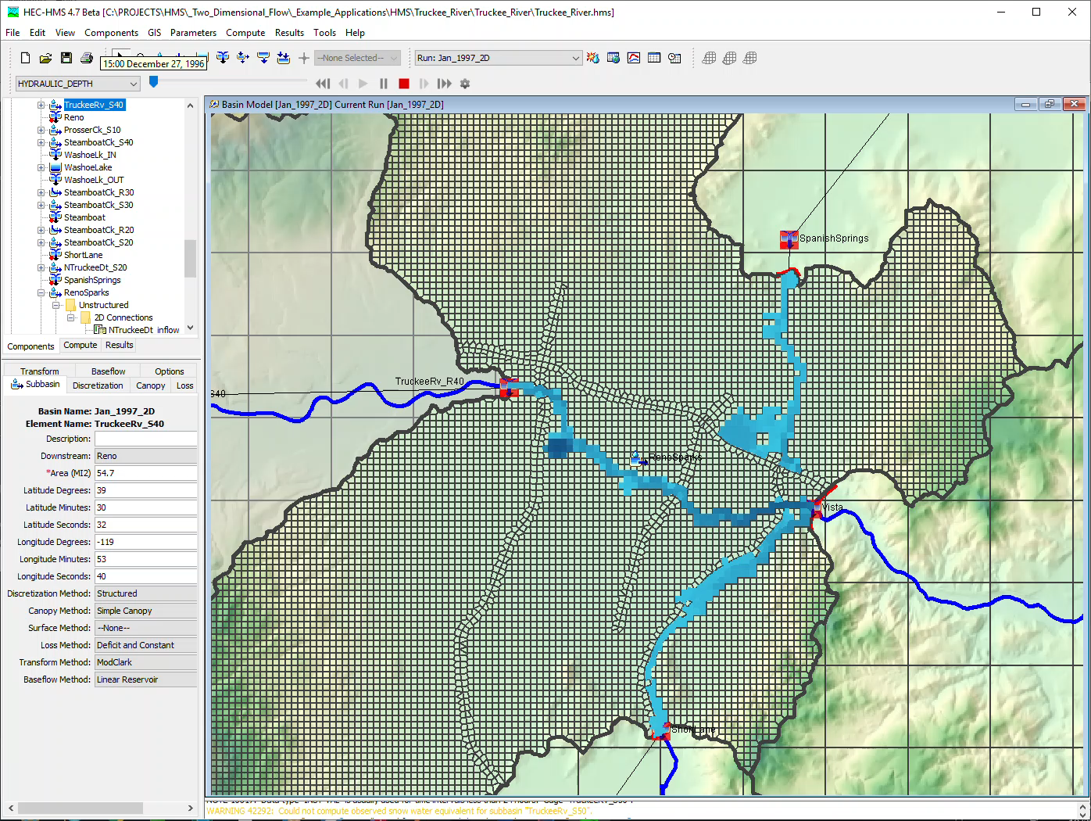
Hydraulic modeling
Notes:
Backwater and flow reversal and dendritic stream systems are problematic for many traditional hydrologic approaches.
The new 2D-Diffustion Wave transform method can be used in areas where flows might deviate from the main channel then return to the channel. A great example of this is in the Truckee River near Reno, 1997 event simulation shown here.
In cases where there is backwater in a reach, the Modified Puls routing method can helpful. In the Modified Puls routing method storage discharge relationships for the reach are informed by a hydraulic analysis.

Slide 9
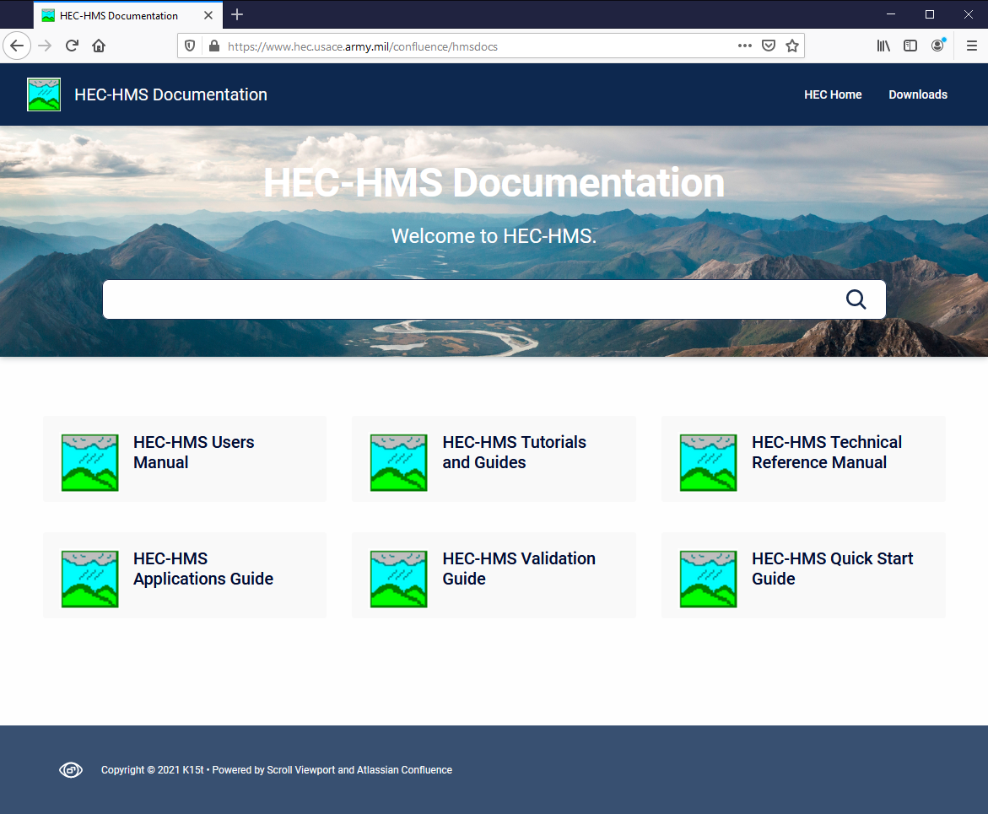
FOR MORE…
Notes:
This concludes the introductory presentation on HEC-HMS. For more resources on HEC-HMS check out the HEC-HMS documentation website.

