Slide 1


HEC-HMS
Shared Data Components:
Time-Series
Emily Moe, P.E.
St. Paul District
U.S. Army Corps of Engineers

Slide 2
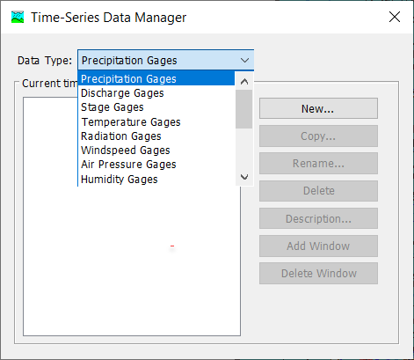
Time-Series Data
Observations of a Variable that are indexed by time.
Frequently used as hydrologic model boundary conditions.
Notes:
Time Series Data are observations of a hydrometeorological variable that are indexed by time.
Frequently, time-series data are used as boundary conditions for a hydrologic simulation.
Shown here is the Time-Series Data Manager, available by selecting Component > Time-Series Data Manager in the main window toolbar.
The Manager lists each type of Time-Series Data that are available in HMS. The Manager also allows the user to create a new Time-Series Component or create/rename/delete existing ones.

Slide 3
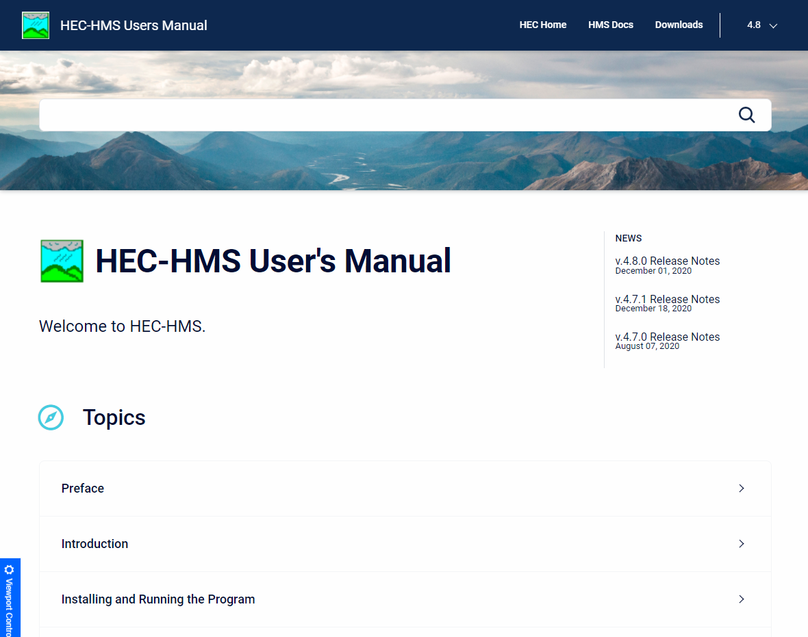
Time-Series Data
Common examples:
  Discharge
  Stage
  Precipitation
  Temperature
Full list available in the user’s manual: https://www.hec.usace.army.mil/confluence/hmsdocs/hmsum/latest/shared-component-data/time-series-data
Notes:
Common examples of time-series data include daily average streamflow, fifteen-minute precipitation gage observations, hourly surface temperature measurements and more.
A full list of time-series data that HMS can use is available in the user’s manual linked here: https://www.hec.usace.army.mil/confluence/hmsdocs/hmsum/latest/shared-component-data/time-series-data

Slide 4
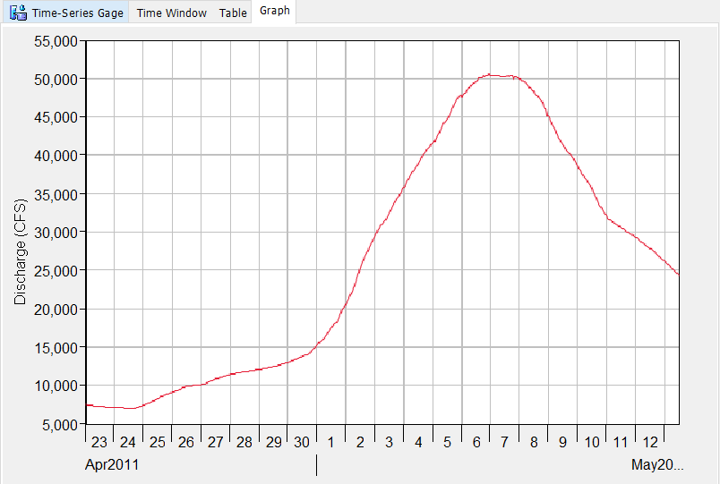
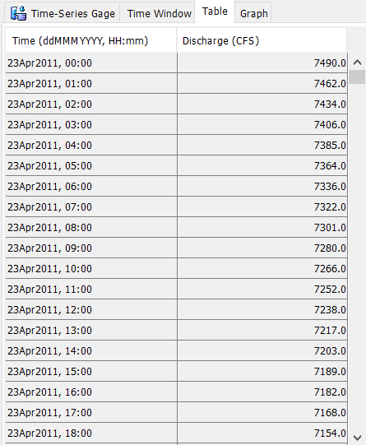
Discharge Gage
Notes:
Here is an example of Time-Series Data with a Discharge Gage.
The table on the left is one view that HMS offers of Time-Series Data. It includes the time and value of the parameter.
The graph on the right is the other HMS view of Time-Series components. It plots the timestamp (Date) on the x-axis and the value of the parameter on the y-axis.

Slide 5
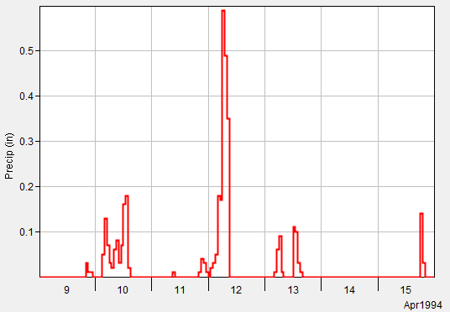
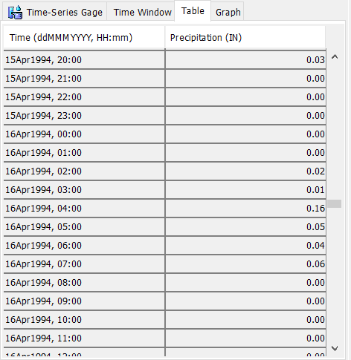
Precipitation Gage
Notes:
Here is another example of Time-Series Data with a Precipitation Gage
Again, the table on the left is one view that HMS offers of Time-Series Data. It includes the time and value of the parameter.
The graph on the right is the other HMS view of Time-Series components. It plots the timestamp (Date) on the x-axis and the value of the parameter on the y-axis.

Slide 6
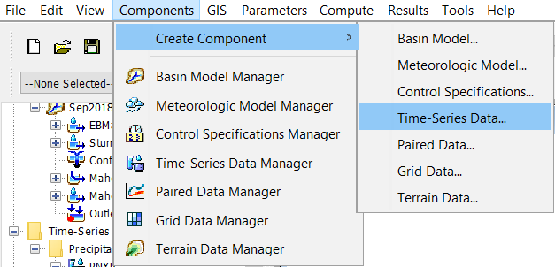
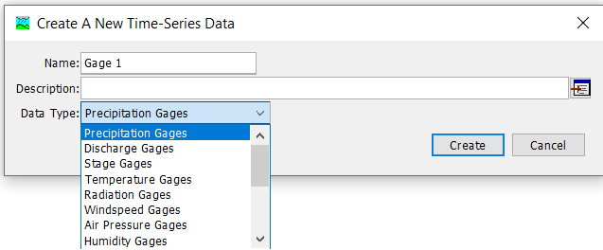
Notes:
There are two paths to creating new Time-Series Data Components.
The first is to use the Create Component > Time-Series Data… menu option. You will then be prompted with a window that asks for a name, a description and a data type. Select the data type first, then enter a name and description. As long as the name is unique for the data type, you can select Create and a new Time-Series Data Component will be created.

Slide 7
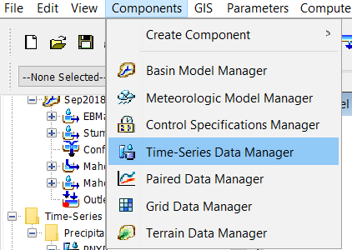
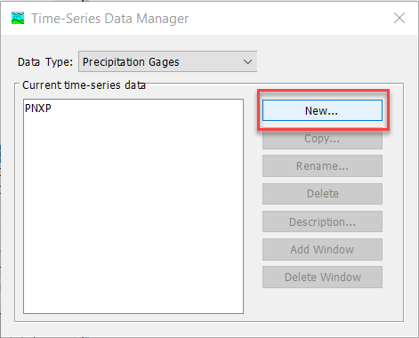
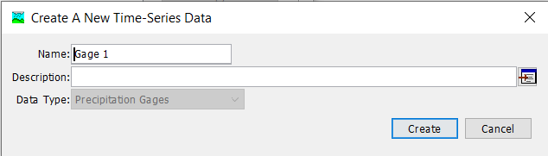
Notes:
The second path to creating a time series component is to use the Time-Series Manager menu option. A window will open that allows you to see all of the Time-Series Components that have been created for each type. Select the type of interest in the top menu, and the window will show all the Time-Series Components of that type that have been created, if any. To create a new one, select the New… button and then you will get a window like the lower left.

Slide 8
Time-Series Data Manager
View existing data by type
Create new
Copy
Rename
Delete
Notes:
Here is an overview of the options available within the Time-Series Data Manager.

Slide 9
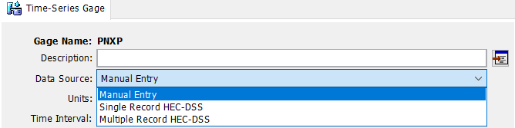
Time-Series Data Sources
Enter data manually
Link to an existing HEC-DSS file
Notes:
Once the time-series data gage is created, the time-series data must then be linked to the gage.
Time Series Data can be populated within HMS in one of two ways—manually (by copy/pasting data directly into the HMS time-series table) or by linking the time-series record from an existing DSS-file.

Slide 10
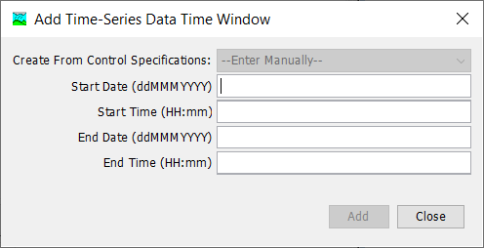
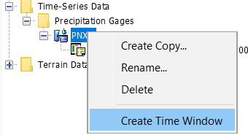
Time-Series Manual Entry
Create Time Window
Spreadsheet-like table
Copy-and-paste
Advanced functions
Notes:
To add a time-series data entry manually, you must first create a Time Window for the data.
Right-click on the gage > Create Time Window
Populate Add Time-Series Data Time Window Box

Slide 11
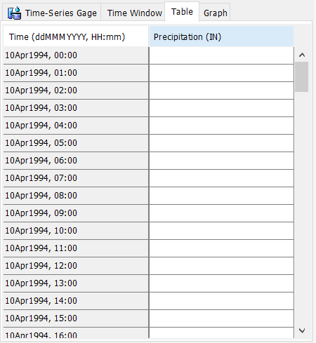

Time-Series Manual Entry
Create Time Window
Spreadsheet-like table
Copy-and-paste
Advanced functions
Notes:
Highlight the time window to enable the Manual Time Entry Table

Slide 12
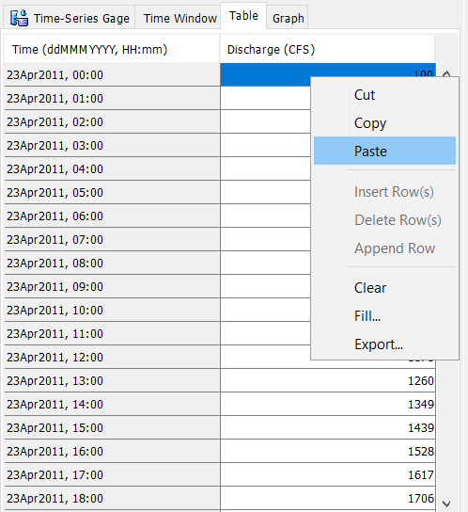
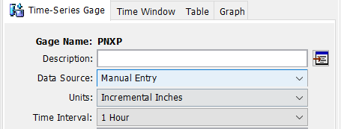
Time-Series Manual Entry
Create Time Window
Spreadsheet-like table
Copy-and-paste
Advanced functions
Notes:
The manual entry table behaves much like a spreadsheet. It is very easy to copy-and-paste from other applications like Excel to populate your time series data entry.
On the main tab, you must specify the units & time interval that you are entering for manual entry.

Slide 13
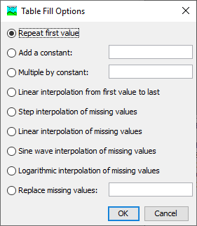
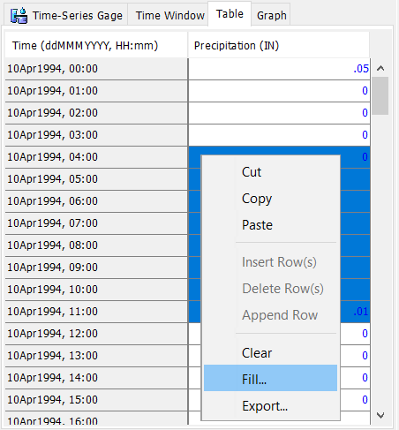
Time-Series Manual Entry
Create Time Window
Spreadsheet-like table
Copy-and-paste
Advanced functions
Notes:
The Fill… feature offers several advanced functions such as interpolating/filling in missing values.

Slide 14
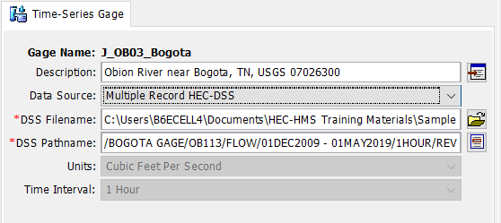
Time-Series from DSS-File
Link to existing time-series data in a DSS file
See User’s Manual for conventions:
https://www.hec.usace.army.mil/confluence/hmsdocs/hmsum/latest/shared-component-data/time-series-data
Notes:
Linking time series data directly to an HEC-DSS record is convenient when the time-series data already exists and you want to link it to the HMS model.
To do this, Simply point HMS to the correct DSS-File and Pathname to link the data to the time-series gage within HMS.

Slide 15
HEC-HMS
Shared Data Components:
Time-Series
Emily Moe, P.E.
St. Paul District
U.S. Army Corps of Engineers

