Slide 1
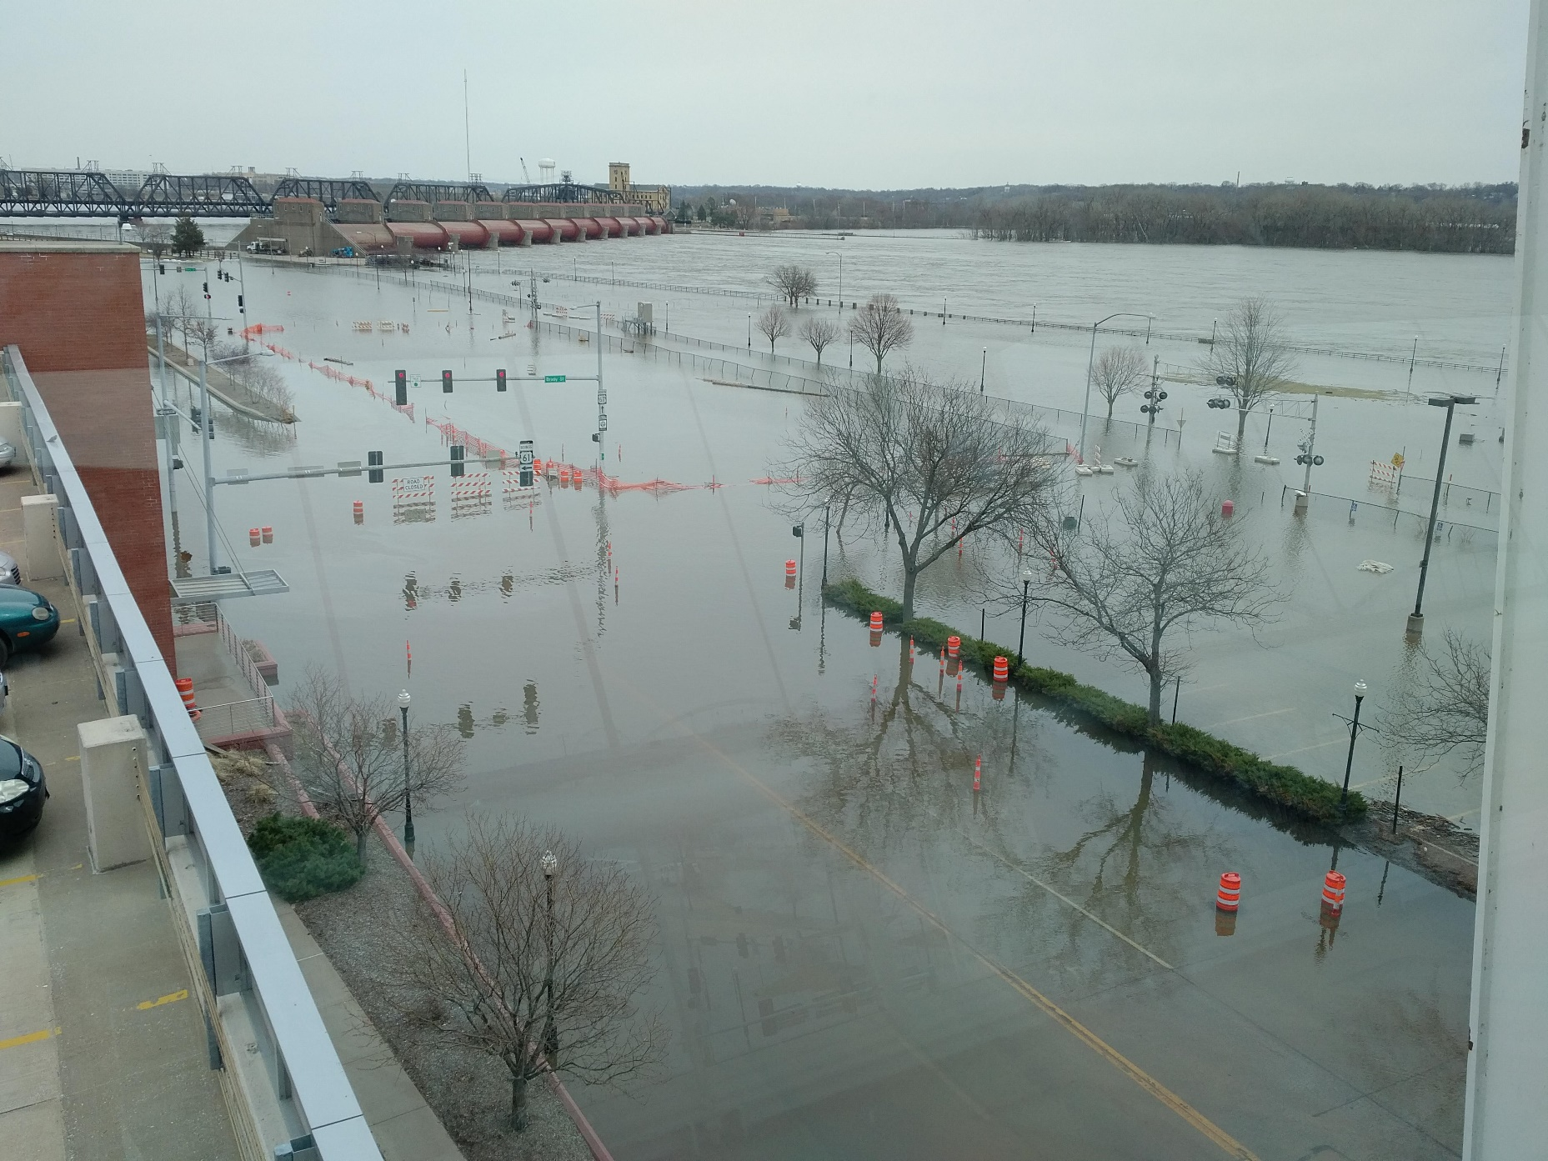

HEC-HMS Meteorologic Models:
Precipitation Methods
Gregory Karlovits, P.E., PH, CFM
Hydrologic Engineering Center
U.S. Army Corps of Engineers
Notes:
Hello HMS modelers, I’m Greg Karlovits, senior hydraulic engineer at the U.S. Army Corps of Engineers Hydrologic Engineering Center. In this video, we will go over a brief introduction to precipitation methods in the HEC-HMS meteorologic model.

Slide 2
What is my modeling goal?
I am trying to reproduce a precipitation event that occurred in the past.
  Historical storm method
I am trying to design something, perform a risk analysis, or otherwise model an idealized event.
  Hypothetical storm method
Notes:
There are two categories of precipitation methods in the HEC-HMS meteorologic model. HMS doesn’t label the methods with these categories, but it’s valuable to know which methods are related and what they are intended for.
Historical storm methods help you create precipitation boundary conditions for a storm or a period of time that has already occurred, so that you can simulate the hydrology for some time in the past. They may also be used creatively to model future forecasted conditions or other hypotheticals, but their primary purpose is representing past precipitation.
When you are designing something, performing a risk analysis, or doing any other kind of hydrologic analysis that makes many simplifying assumptions about the behavior of precipitation in space or time, hypothetical storm methods are the precipitation methods to use. These are also sometimes called design storms, or synthetic storms, but the idea is that they do not represent a specific storm event that has occurred. Instead, it is a generalization of storm behavior that allows the user to specify something interesting for design or analysis purposes.

Slide 3

Historical Storm Methods
Gage weights
Gridded precipitation
Inverse distance
Specified hyetograph
→ Key: driven by observed precipitation data
Notes:
Historical storm methods are means for providing precipitation boundary conditions to a basin model in a way that it reasonably represents an event that occurred in the past. Historical events are unique like fingerprints or snowflakes, varying in precipitation depth, temporal and spatial pattern, and so on. These methods intend to capture the things that make an event unique.
When you are calibrating a hydrologic model so that it represents a real watershed, use of a historical storm method is necessary. You need to represent the input precipitation as well as you can in order to isolate the uncertainty in the model to just the hydrologic parameters.
These are listed in the order HMS shows them. The first two we will cover in more detail in other videos.
Gage weights is a method for combining information from multiple precipitation gages and can vary the combination of gages for each subbasin in the model.
Gridded precipitation is just what the name says: a way to use gridded precipitation products as a boundary condition.
Inverse distance is also a method for combining information from multiple precipitation gages using inverse distance interpolation.
Finally, the specified hyetograph method is a simple way to represent precipitation for each subbasin in the model. Each subbasin gets its own precipitation gage. This can be a “real” gage, i.e. a weather station, or you can externally compute the subbasin-averaged precipitation using another method, and feed it in this way.
One other application that isn’t strictly a “historic” event would be using HMS for forecasting – however, the input data is probably from a model that reasonably represents the coming precipitation, and a good model will be close to the precipitation that actually occurs.

Slide 4

Hypothetical Storm Methods
Frequency storm
HMR52 storm
Hypothetical storm
Standard project storm
→ Key: intended to model highly idealized storms, usually for design
Notes:
Hypothetical storms are also called design storms, or synthetic storms. They control for a small number of design criteria, and then make a large number of simplifying assumptions about the remainder of a storm’s properties. These methods will not be covered in detail during this course, but more information can be found in the HMS user’s manual, and with the HMS tutorials and guides online.
Frequency storm is a very specific method for defining a storm pattern using precipitation-frequency information. It was designed to work with older precipitation-frequency information, such as HYDRO35, TP40, or TP49. Today, the recommendation is to use the hypothetical storm method instead.
The HMR52 storm is meant to perform probable maximum flood analyses for the central and eastern United States. It has a very specific application and is not intended for general use.
The hypothetical storm method is a flexible and generalized modeling method that subsumed the old SCS storm methods of HMS 4.2.1 and prior. It allows a user full control over the storm temporal pattern, point-to-area conversion, and can be used directly with precipitation-frequency grids from NOAA Atlas 14. I highly recommend this method for all idealized storm modeling needs. Tutorials on this method are available online with the HMS tutorials and guides.
The standard project storm is no longer used in practice; however, HEC-HMS maintains this capability in order to support older projects where it may still be necessary. This storm has an extremely specific application and should not be used for general modeling.

Slide 5

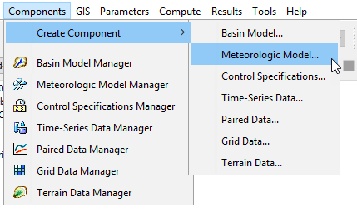
Create a Meteorologic Model
Notes:
Met models can be created through the Components menu. All simulation types require a basin model and a meteorologic model. Precipitation is one of the modeling methods inside of a meteorologic model. The meteorologic model is meant to manage all the atmospheric boundary conditions necessary for hydrologic modeling.

Slide 6
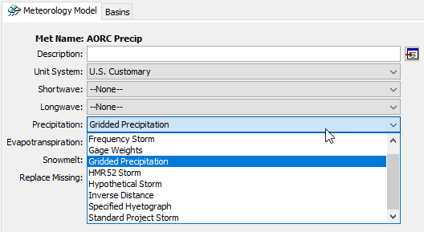
Setting a Precipitation Method
Set the method in your meteorologic model
Notes:
If there are subbasin elements in your basin model, you will be required to choose a precipitation method in order to run the model. It can be selected in the meteorologic model component editor.
Let’s take a look at the most important precipitation methods in HEC-HMS.

Slide 7
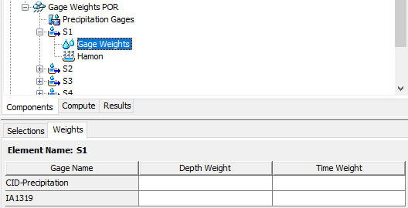
Gage Weights
Notes:
The controls for the gage weights method are at the subbasin level, since each subbasin has its own combination of gages that you can set. The selections tab lets you choose which of the precipitation gages to use for the selected subbasin. The weights tab lets you set the depth weight and time weight for each gage.
You would use this method when you have gage data scattered across your watershed, and you want control over how each one is used to estimate the volume and timing of precipitation for each subbasin.

Slide 8
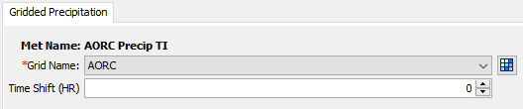
Gridded Precipitation
Notes:
The controls for gridded precipitation are very simple – choose a precipitation gridset. If there are time zone issues (for example your observed flow data and precipitation data are in different time zones) you can shift the precipitation grid times by whole hours.
The gridded precipitation method is very simple to set up, because most of the hard work is handled by the data itself. These grids are at a regular time interval, so that controls any temporal patterning. The grids themselves contain spatial patterns. The data are spatially-referenced, and the sub-basins know their locations if the model is georeferenced. This means that setting up the model is very simple.
If you have gridded precipitation data, you should use it. This is the method we recommend today.

Slide 9
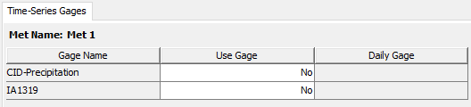
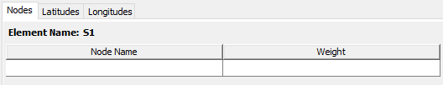
Inverse Distance
Notes:
Inverse distance requires information on which gages to use in the interpolation scheme, and what locations to interpolate to. Gage locations need to be specified in order to make the interpolation work.
This method can be useful when you want to take the work out of estimating how gages contribute to a basin average, and want the inverse distance routine to figure it out. It can run into challenges when dealing with averaging time patterns, so the gage weights method can be preferable.

Slide 10
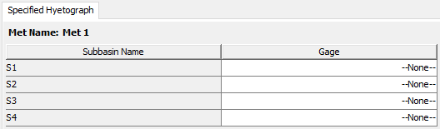
Specified Hyetograph
Notes:
The specified hyetograph method is very straightforward – for each subbasin, choose a precipitation gage.
This method is very flexible and you might use it for a number of reasons. The most common usage today is when precipitation timeseries for each subbasin are computed externally to HEC-HMS, and you want HMS to apply exactly that precipitation data. The biggest advantage is that this method is the most performant method in HMS, requiring no additional computation steps to apply precipitation to a subbasin.

Slide 11
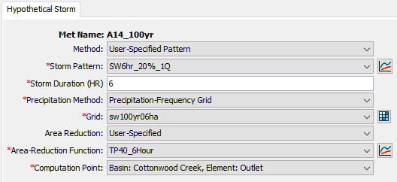
Hypothetical Storm
Notes:
The hypothetical storm method offers the user a lot of control, so there are many settings to be specified for it to run. This instance of the hypothetical storm requires the user to specify a dimensionless storm temporal pattern, a storm duration, a precipitation-frequency grid to pull depth information from, an area reduction method, an area reduction function, and a computation point to compute the storm area for.
Of the hypothetical or synthetic storm methods, this is the most flexible and applicable one. Unless you have specific project needs that require one of the other methods, it is recommended to use this method.

Slide 12
HEC-HMS Meteorologic Models:
Precipitation Methods
Gregory Karlovits, P.E., PH, CFM
Hydrologic Engineering Center
U.S. Army Corps of Engineers
Notes:
This has been an introduction to precipitation modeling methods in HEC-HMS. For more information, please see the HMS user’s manual, the HMS tutorials and guides online, or other videos in this series. Thanks, and have a great day!

