Slide 1
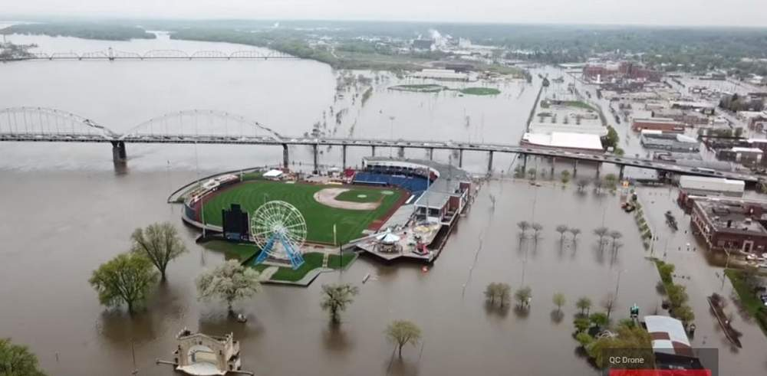

HEC-HMS Meteorologic Models:
Gage Weights Precipitation Method
Gregory Karlovits, P.E., PH, CFM
Hydrologic Engineering Center
U.S. Army Corps of Engineers
Notes:
Hello, HMS modelers. I’m Greg Karlovits, senior hydraulic engineer at the U.S. Army Corps of Engineers Hydrologic Engineering Center. In this video I will provide a brief introduction to the Gage Weights precipitation method in the HEC-HMS meteorological model.

Slide 2
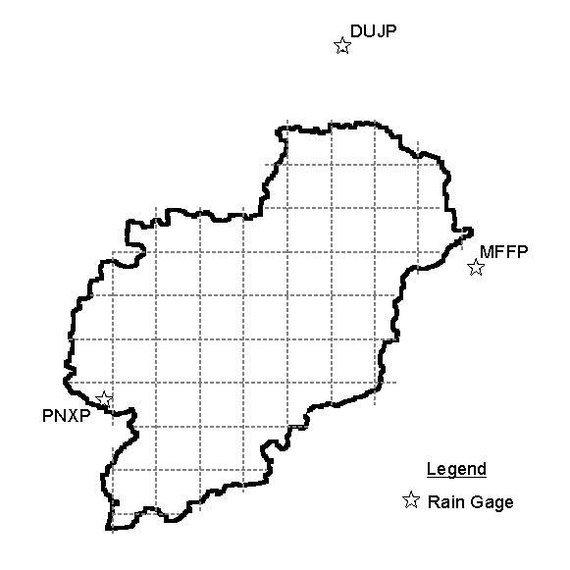
Gage Weights Precipitation Method
Pros
  Flexible
  Accounts for space and time variation
  Can be calibrated
Cons
  Still dependent on gage data
  Up to you to determine weights
Notes:
Gage weights is recommended for the general case of dealing with multiple imperfect precipitation gages used to estimate precipitation in a subbasin. Consider the figure on the right – there are three gages, which is fortunate. However, it’s hard to say if any of these will represent the rainfall for the watershed well. It’s likely that a combination of the three could work, because the three gages span the basin. Gage weights let you decide how these three gages will combine to estimate the precipitation over the subbasin of interest. You can specify how each of these gages combine into the basin average estimate.
For events where radar data aren’t available, this method offers the most control over using gages for watershed modeling. It gives you options to combine gage data in various ways, account for gauges with varying time resolution or no time information at all, and adjust for variations in climatology.
However, there is a significant hitch in all of this – gages have to be available for the event you are trying to model. In some areas, gages are sparse, and you must do your best to find the best available information. For small watersheds, there may not be any gages inside the boundary at all, and you may be making estimates using gages that are distant. Luckily, this method gives you several controls that let you adjust how these gages are combined to achieve the optimal result.

Slide 3
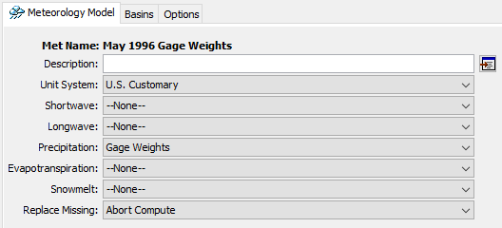
Setting Up A Gage Weights Model
Notes:
First, as always, create a new meteorologic model, by selecting one of the options in the Components menu. Then, in the met model component editor, select the Gage Weights method for precipitation.

Slide 4
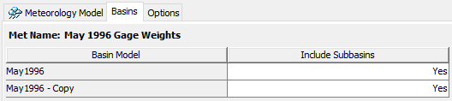
Include Subbasins
Notes:
This step is often forgotten, but what it does is tells the met model which subbasin elements are going to be controlled. Switch to the Basins tab of the met model editor. Here, you can decide which basin models are usable with the met model by selecting Yes for Include Subbasins. When the subbasins are included, they appear beneath the met model in the watershed explorer.
If you want to use multiple basin models with a met model, this can get cluttered sometimes, especially if your basin models have a lot of elements. For organization purposes, it can make more sense to make a copy of the met model and set up met models so they are 1:1 with basin models.

Slide 5
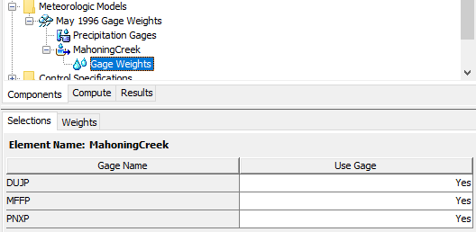
Use Gages
Notes:
This step tells the subbasin which gages will be used in the computation step. Expand the subbasin node of the watershed explorer, then select Gage Weights underneath it. On first click it will take you to the weights tab, where you will notice that there are no gages listed. Don’t panic, you need to switch over to the Selections tab and turn on any gages. If you don’t see any gages on this tab, that means you haven’t set up any precipitation gages yet. To do that you’ll need to create some time series components. Review that video if you need a refresher on how to do that.

Slide 6
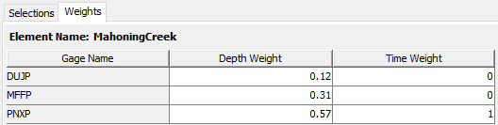
Weights
Notes:
After enabling some gages, you’ll be able to give them weights on a subbasin-by-subbasin basis. There are two types of weights: depth, and time.
Depth weights set what the total volume of rainfall will be for the simulation.
Time weights set how the time pattern will be computed for the simulation.
These values don’t have to add up to 1, but HEC-HMS will normalize the values during the simulation so that they do.

Slide 7
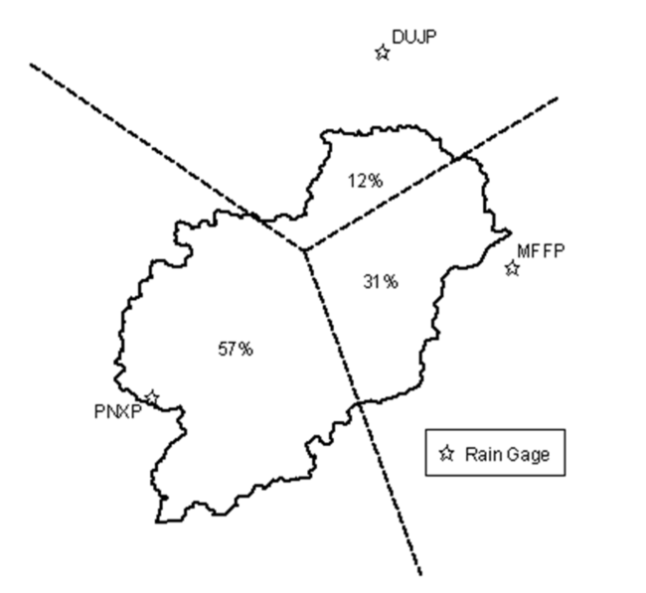
Estimating Depth Weights
Notes:
You are free to determine the depth weights in whatever method you find appropriate, but a good starting point is to use the Thiessen polygon method. This method tells you how much of the watershed is closest to each precipitation gage you are using. The percents can be used as weights directly. If you have a shapefile of your watershed and the gage locations, generating Thiessen polygons and intersecting them with the basin polygon is trivial in GIS.

Slide 8
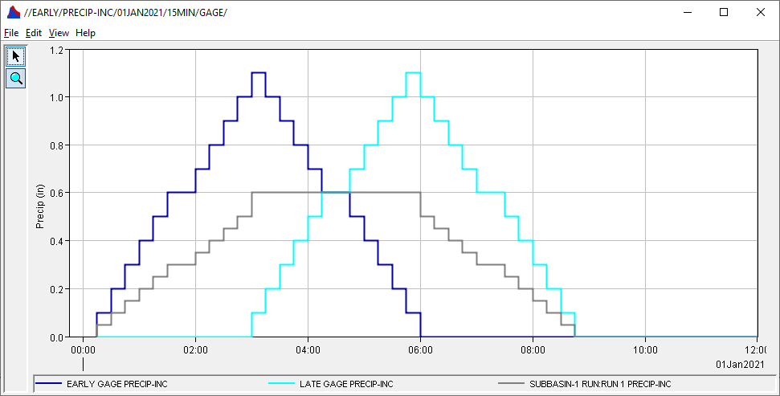

Estimating Time Weights
Best practice: use a weight of 1 for the “best” gage, considering:
  Granularity of data – finer is better
  Location of gage – near the center of subbasin is better
Use 0 for the rest
Notes:
For time weights, the best practice is to not average together gages to get a time pattern. If your precipitation stations have different time resolutions (for example one at daily level, and one at hourly), consider choosing the one with the finer time step to give you better estimates for the precipitation at shorter time steps. Also consider the location of the stations – if you have one near the center of the subbasin, it probably represents the rainfall inside the subbasin better than ones outside of it.
The effect of time-averaging is shown in the graph. Here, two completely made-up gages (in dark blue and light blue) were given an equal depth weight and time weight. When HMS computed the basin-averaged precipitation, the result is the grey Mayan Pyramid…
If you want to make sure you’re capturing the peak intensity of this storm, then time-averaging two non-coincident peaks will result in a hyetograph with a broad, flat peak, which may not be what you desire. If this helps describe the storm as it occurred in your watershed, feel free to break with best practices. However, if you’re finding that you’re underestimating peak storm intensity and you’re using time averaging, consider trying something else.

Slide 9
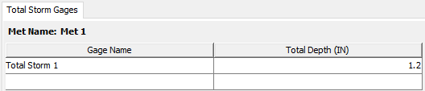
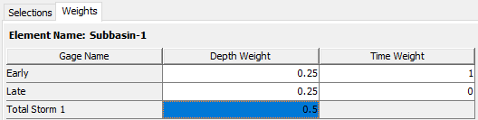
Total Storm Gages
Total precipitation known
Time distribution unknown
Notes:
In some situations, especially when modeling the most extreme of extreme floods, there are observations for total storm depth, but no time information was captured. Sometimes these are called “bucket surveys” and are literally an open container of some kind that was left outside (intentionally or not) during a storm event and filled up with water. You can add a total storm gage by filling in the row of the Total Storm Gages table under the Precipitation Gages node. It asks for a name, and a total depth. When you add this information, this gage will be selectable in the Selections tab, and then you can give it a depth weight, but not a time weight, because it has no timing information.

Slide 10
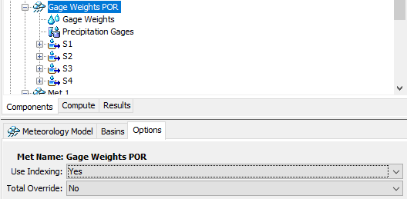

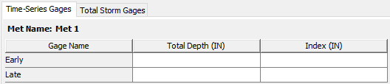
Optional Settings in Met Model Editor
Use Indexing
  Adjust for climatology
Total Override
  Override total depth for a gage
Notes:
If you click on the met model and switch over to the Options tab, you’ll see two options: “Use Indexing” and “Total Override”. These give you even more control over how HMS computes properties of the storm.
Enabling indexing adds an extra node underneath the met model, and also adds a new tab under the “precipitation gages” node that’s already there.
Indexing allows you to adjust gage depth averaging to account for variation in things like climatology. For example, in a mountainous area where the annual total precipitation changes quite rapidly with elevation, you may choose to use the annual total precipitation to adjust your estimate for how the depth should be applied to the subbasin. You would set the annual total precipitation for each gage in the Index column of the Time-Series Gages table, and then set the value for annual total precipitation in the Index column of the Gage Weights table. This lets you account for systematic differences in how precipitation might be recorded due to gage location. For small project areas this may not be necessary, but for larger project extents where the behavior of precipitation varies significantly, this allows you to adjust the estimated precipitation for the subbasins of interest.
Total override allows you to set the total depth for the gage instead of letting HMS compute it by taking the total of all timesteps in the gage entry.

Slide 11
HEC-HMS Meteorologic Models:
Gage Weights Precipitation Method
Gregory Karlovits, P.E., PH, CFM
Hydrologic Engineering Center
U.S. Army Corps of Engineers
Notes:
This has been an overview of the Gage Weights precipitation method in the HEC-HMS meteorologic model. For more information, please see the HMS user’s manual, the tutorials and guides online, or other videos in this series. Thanks and have a great day!

