Slide 1
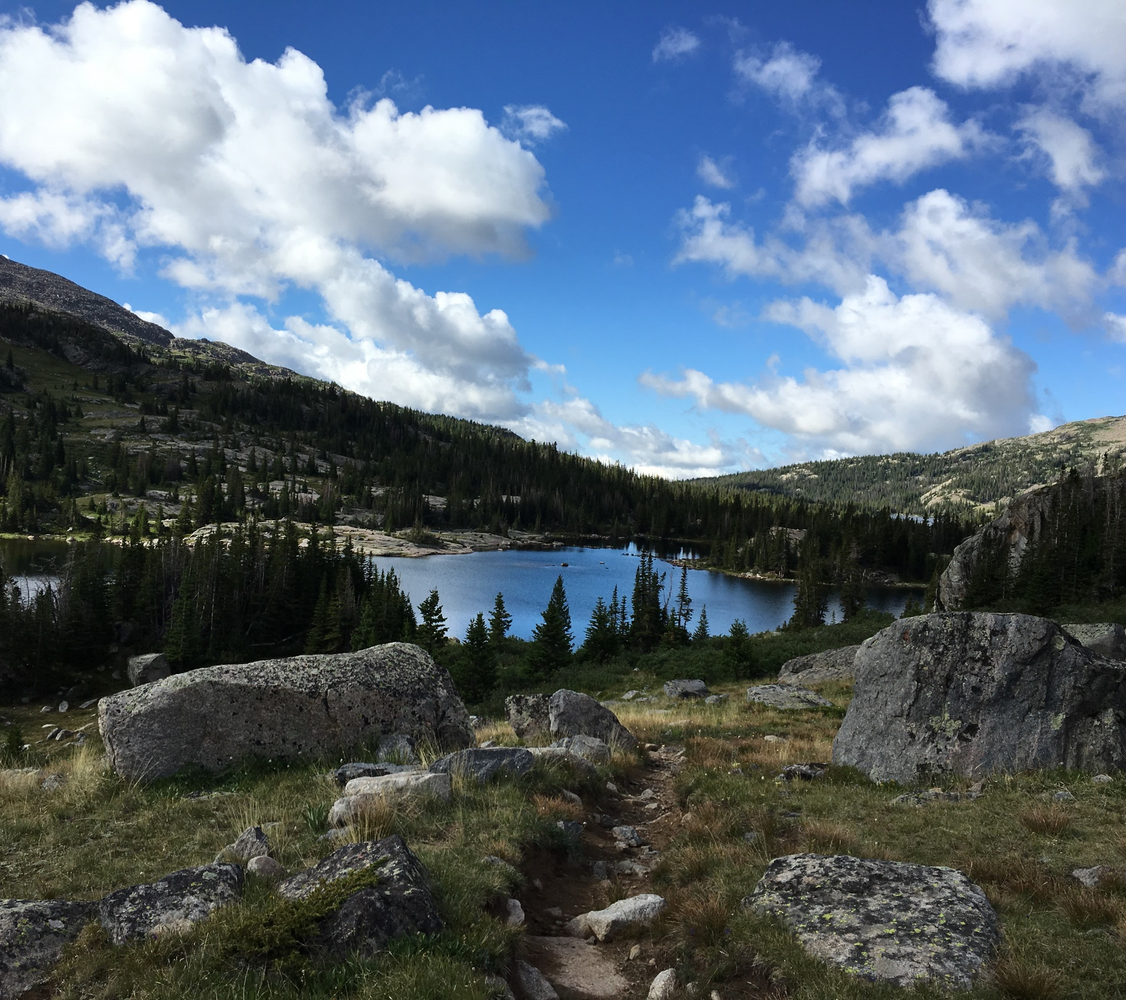

HEC-HMS Meteorologic Models:
Gridded Precipitation
Emily Moe, P.E.
St. Paul District
U.S. Army Corps of Engineers

Slide 2
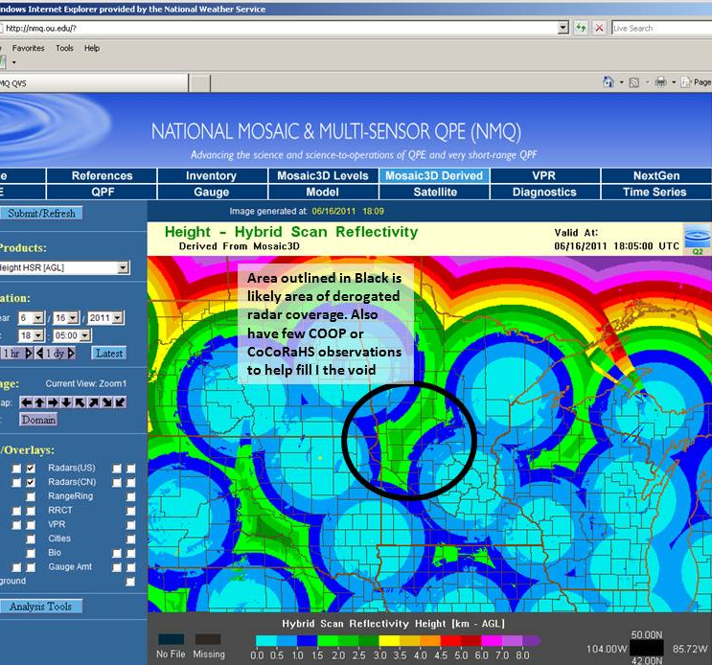
Gridded Precipitation
Pros
  Spatially distributes precipitation
    Ex: RADAR vs. precip gage
  Increasing number of sources available
    National & Local Availability
Cons
  May require conversion
  Quality of data varies
    Quality control recommended
      Gage comparison
      RADAR coverage
Notes:
The primary benefit of applying gridded precipitation to an HMS model is that the precipitation is then spatially distributed across the watershed as it’s been observed by RADAR or other products (versus a lump measurement being applied homogenously across the entire basin). Another positive note is that an increasing number of gridded precipitation sources are becoming available.
One slight drawback is that available gridded datasets may require conversion from their native format to an HEC-DSS record to be usable within HMS. However, conversion tools are available to make most conversions quick & easy!
It’s also important to note that the quality of the various available gridded datasets will vary. When selecting a gridded precipitation source, it’s recommended to perform spot-checks against established precipitation gage sites to determine how accurate that particular source is within your watershed. If applying RADAR data, a visual of RADAR coverage throughout the watershed may help with product quality control as well.

Slide 3
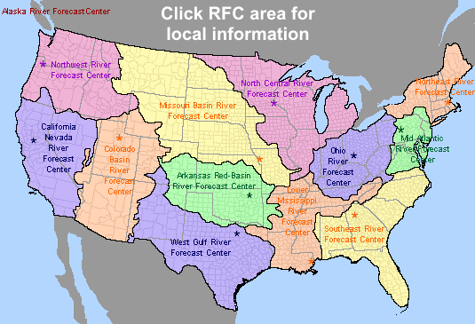
Gridded Precipitation Sources
National Products
  National Digital Guidance Database (NDGD) (2007-Present)
Regional Products
  NWS River Forecast Centers NEXRAD
CWMS
  USACE Water Management data
Add’l Other Products
Notes:
There are an increasing number of gridded precipitation products available. This includes both nationwide products as well as more locally developed sources such as from your local National Weather Service River Forecast Centers. Some of the most popular products include:
The National Digital Guidance Database (NDGD) has Real-Time Mesoscale Analysis (RTMA) hourly precipitation available for CONUS for download from 2007 to present.
NEXRAD RADAR data is a NWS product available regionally. There are currently 160 operational NEXRAD radar systems deployed throughout the United States and at selected overseas locations. Stage III and Multisensor Precipitation Estimator (MPE) products are hourly precipitation estimates that are computed by taking raw radar measurements and applying corrective algorithms. Rain gage data and satellite images are used to “correct” the raw data. Estimates from multiple radars are mosaicked together to create a precipitation grid (HRAP) for the entire river forecast center region. The period of record for NEXRAD data varies regionally.
There are several more gridded precipitation products available than those listed here and the quality of each product can greatly vary by region. As part of the USACE Corps Water Modeling System (CWMS) efforts, most USACE districts currently have real-time gridded precipitation products included within their Water Management server databases. It’s highly recommended to discuss the data available through CWMS with your local water management staff when searching for gridded precipitation products as there has likely already been some searching and testing of the available precipitation products within your region completed.
Also, as part of the USACE CWMS model development, many districts have gridded precipitation data available for their region on their water management servers.
Dipper.nws.noaa.gov/hdsb/data/nexrad/nexrad.html

Slide 4

Converting & Creating Precipitation Gridsets
Utilities available:
  HMS – certain file types can be imported directly within HMS
  VORTEX – converts several formats to HEC-DSS Records
    NetCDF, Grib, HDF, ASC & more
    Also allows for clipping, re-projecting, resampling, etc.
  gageInterp – creates a grid by interpolating point values
Notes:
Once you’ve decided to apply gridded precipitation to your model, how do you convert the raw precipitation data to an HEC-DSS file for use in HMS?
There are a few options available for converting formats or creating grids—
HMS can actually import select gridded file formats directly into HMS—(File > Import > Import Gridded Data…for more information, please see the Shared Data Components: Grid Data lecture).
VORTEX tool which can convert several native data formats to HEC-DSS, allows for additional spatial manipulation during the processing and is also user-friendly. More information on the VORTEX tool is included in a later lecture.
gageInterp tool which is a stand-alone program that creates grids by interpolation. The program takes point precipitation data (such as rain gage data) and creates a grid where the value for each cell is computed by weighting values from all gages within a specified distance. Weights can be computed using a simple average or distance.

Slide 5
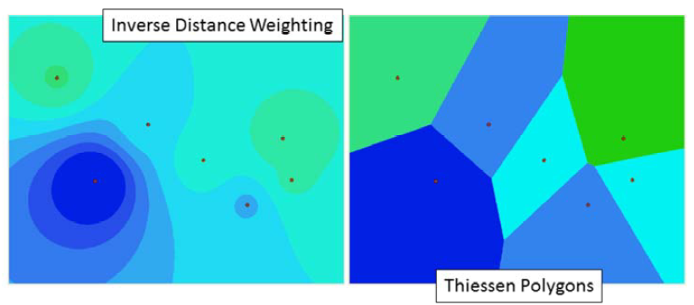
Creating Precipitation Gridsets from Point Data
gageInterp
  Converts observation points to grids
Notes:
When creating precipitation grids from observed gage data, the gageInterp program is useful.
gageInterp takes point values, like those from precipitation gages, and creates grids by interpolation. GageInterp estimates the value at each grid cell by calculating a weighted average of all gages located within a certain distance. The weights are computed by taking a simple average or using distance to gages. The figures on this slide show two examples of distance being used to compute a weight. The figure on the left was computed by giving more weight to the closest gage. Grid cell values become similar to gage values the closer they are to the gage (bulls-eye). The figure on the right was computed by assigning grid cell values using only the closest gage--using the Thiessen Polygon method (any point, or grid cell in this case, within a polygon is closer to that gage than any other).

Slide 6
Gridded Precipitation
DSS Pathnames for Grids in HEC-HMS
/A-part/B-part/C-part/D-part/E-part/F-part/
A – grid system (SHG, HRAP)
B – region or watershed name
C – the data variable (precip, temp, …)
D – starting time for grid (ex: 04JAN2021:1500)
E – ending time for grid (ex: 04JAN2021:1600)
F – additional identification (e.g. obs, radar, NWS, …)
Notes:
When converting or creating gridded datasets, it’s important to clearly name the resulting DSS-file pathnames so that it is clear where the data came from, the extent of the data and—most importantly—the data type and time.
The recommended naming convention for gridsets and parameter grids are shown on this slide. HEC-HMS requires specific C-part names. The program will not use the grid unless the C-part name is correct (the next slide shows correct C-part names for each grid type).
Gridsets, precipitation, temperature, solar radiation and crop coefficient will have both D and E-part pathnames. The parameter grids do not need E-part pathnames and only the parameter grids used by snowmelt require D-parts.

Slide 7
Gridded Precipitation
Grid Type | C-Part | Units | Data Type
Precipitation | PRECIPITATION | MM, IN | PER-CUM
Temperature | TEMPERATURE | DEG C DEG F | PER-AVER INST-VAL
Solar Radiation | SOLAR RADIATION | WATT/M2 LANGLEY/M IN | PER-AVER INST-VAL
Crop Coefficient | CROP COEFFICIENT | UNSPECIF | PER-AVER INST-VAL
Storage Capacity | STORAGE CAPACITY | MM, IN | INST-VAL
Percolation Rate | PERCOLATION | MM/HR IN/HR | INST-VAL
Storage Coefficient | STORAGE COEFFICIENT | HR | INST-VAL
Moisture Deficit | MOISTURE DEFICIT | MM, IN | INST-VAL
Impervious Area | IMPERVIOUS AREA | % | INST-VAL
SCS Curve Number | CURVE NUMBER | UNSPECIF | INST-VAL
Elevation | ELEVATION | M, FT | INST-VAL
Cold Content | COLD CONTENT | MM, IN | INST-VAL
Cold Content ATI | COLD CONTENT ATI | DEG C DEG F | INST-VAL
Meltrate ATI | MELTRATE ATI | DEGC-DAY DEGF-DAY | INST-VAL
Liquid Water | LIQUID WATER | MM, IN | INST-VAL
Snow Water Equivalent | SWE | MM, IN | INST-VAL
Grids must have:
  Correct C-part pathname
  Correct units
  Valid Data type
  Values for each grid cell
Notes:
HEC-HMS will not load a grid if the C-part pathname, Units or Data Type is incorrect. The table on this slide contains the correct C-part pathnames, Units and Data Type for each grid type in HEC-HMS.

Slide 8
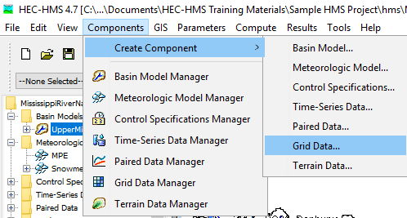
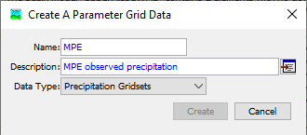
Adding Gridded Precipitation to HMS
Notes:
Once gridded precipitation has been converted to the HEC-DSS format and clearly labeled, it is ready to be added to the HMS model.
To create a precipitation gridset in HMS: Components > Create Component > Grid Data…
Within the Create a Parameter Grid Data dialog, ensure Precipitation Gridsets is selected as the Data Type and be sure to name and describe the precipitation data you are importing.
Select Create to add the grid to the Gridded Data Manager

Slide 9
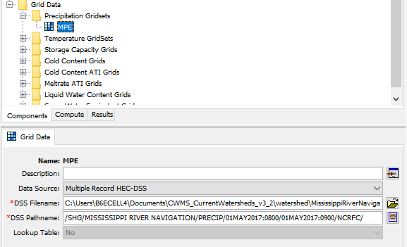
Gridded Data Manager
Notes:
Once the precipitation gridset is created and named, it is added to the Gridded Data Manager within the watershed explorer dialog.
Now, the gridded DSS record must be linked to the precipitation gridset by navigating to the dss file and selecting the appropriate pathname.

Slide 10
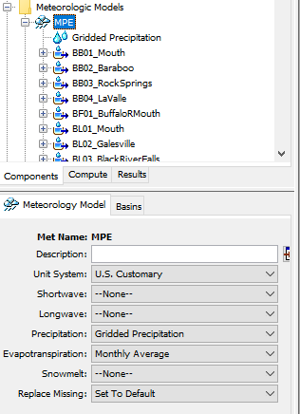
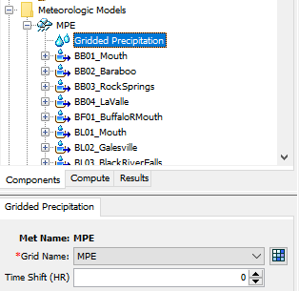
Linking Gridded Precipitation to Met Model
Notes:
Next, the meteorologic model must be configured to use gridded precipitation by highlighting the Meteorologic Model name and selecting Gridded Precipitation
The gridded precipitation data must then be linked to that Meteorologic Model by highlighting Gridded Precipitation and selecting the name of the precipitation grid in the dialog box below.

Slide 11
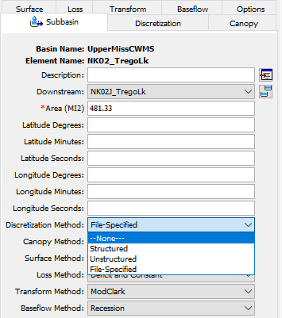
Defining Discretization
Required to run HMS with gridded components
Spatially relates gridded datasets to subbasins
Specified by Subbasin
Four Discretization Methods:
  Structured
  Unstructured
  File-Specified
  None
Notes:
Defining a discretization method is required to run HMS with spatially-discrete components such as precipitation gridsets. Defining the discretization allows the HMS model to spatially relate gridded components (precip, storage, etc.) to subbasin elements, enabling spatial variability within each subbasin vs. applying a singular value throughout the entire subbasin (ie, lumped-parameter).
Discretization is defined by subbasin and has four methods to choose from.

Slide 12
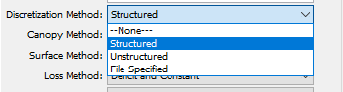
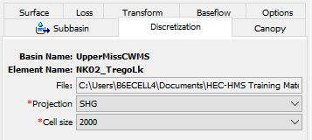
Defining Discretization
Four Discretization Methods:
  Structured*
    “Automatic” Method
    Defaults to standard SHG grid & 2-km cell size
  Unstructured
    Any coord. System
    Allows unstructured grid such as RAS plan files (ex: *.p##.hdf)
  File-Specified
    Points to HEC-HMS “Grid Cell Files” (*.mod)
  None
    “Lumped-Parameter”
    No variation within subbasin
Notes:
The “Structured” discretization method is a quick & easy approach to discretizing the model as it applies the Standard Hydrologic Grid (SHG) at a resolution. The structured method can also be used to apply a Universe Transverse Mercator (UTM) projection and various grid cell sizes ranging from 50 to 10,000 meters.
The Unstructured Method allows the application of any coordinate system (not just SHG or UTM) and can be easily defined with HEC-RAS plan files.
File-Specified allows the user to point directly to the HEC-HMS grid cell file (that was required in HMS version 4.2 & older).
Defining a “None” discretization assumes no variation of variables within the subbasin, resulting in a “lumped-parameter,” non-gridded approach.
Once the Discretization has been defined, the gridded precipitation can be added to a Simulation and the HMS model can be run.

Slide 13
HEC-HMS Meteorologic Models:
Gridded Precipitation
Emily Moe, P.E.
St. Paul District
U.S. Army Corps of Engineers

