Slide 1

HEC-HMS
Meteorologic Models:
Evapotranspiration
Gregory Karlovits, P.E., PH, CFM
Hydrologic Engineering Center
U.S. Army Corps of Engineers
Notes:
Hello HMS modelers. I’m Greg Karlovits, senior hydraulic engineer at the U.S. Army Corps of Engineers Hydrologic Engineering Center. In this video I will provide an overview of evapotranspiration modeling in HEC-HMS.

Slide 2
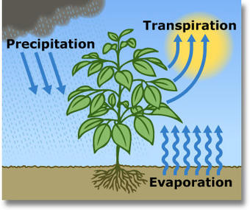
Role of Evapotranspiration
ET comprises two processes:
  Transpiration from plants
  Evaporation from surfaces
Key component of continuous hydrologic models
  Significant moisture is lost to the atmosphere
  Deficits created through ET
Notes:
A good continuous hydrologic model requires evapotranspiration modeling, especially for multi-year simulations. ET removes water from the soil and transmits it to the atmosphere, which can create a moisture deficit prior to flood events that reduces or eliminates direct runoff early during a precipitation event. HMS can simulate surface evaporation, plant canopy evaporation, and plant transpiration.

Slide 3
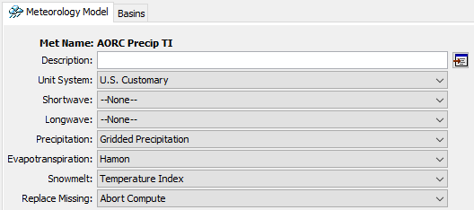
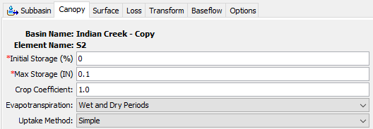
ET Modeling Requirements
Meteorologic model method
  Computes potential/reference ET
Canopy method in basin model
  Computes actual ET
  Creates moisture deficit
Notes:
In order to simulate the ET part of the water cycle in HMS, two components are needed.
The meteorologic model allows HMS to use atmospheric data to estimate the potential evapotranspiration. PET is dependent on the energy input and the ability to transport evaporated water vapor away from the surface, but is not limited by the supply of water.
Actual evapotranspiration is handled by the basin model. Within the subbasin component is the canopy method, which serves two purposes. The first is to model canopy interception. The second is to compute the actual amount of water that can be evaporated and transpired. The maximum amount is the potential evapotranspiration, but this amount is reduced depending on the type of vegetation (controlled by the crop coefficient) and is also reduced by the availability of water. At the maximum deficit, no more water can be transpired to the atmosphere.

Slide 4
Simple Canopy Settings
Evapotranspiration timing
  Wet and dry periods
  Only dry periods
Uptake method
  Simple
  Tension reduction
    SMA only!
Notes:
The simple canopy method is what you should use in the vast majority of cases. The storage terms control interception. The ET settings are below – you can choose your crop coefficient, during which periods actual ET is computed, and the uptake method. Unless you are using the SMA loss method, use the simple uptake method.

Slide 5
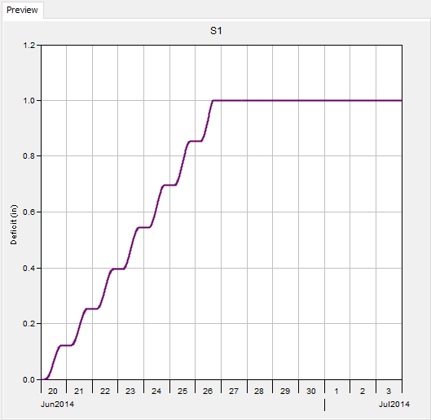
ET Impact
Max Deficit
Daily Actual ET
Initial
Deficit
Notes:
When performing continuous modeling using loss methods, for example deficit and constant or SMA, deficit increases when plant uptake draws water from soil storage. If no method for increasing deficit is specified, soil storage will fill up and infiltration will only occur at the specified constant rate.
Here is an example of the impact of modeling ET on the soil moisture deficit. The initial deficit is zero. No water is input to this system. The diurnal cycle of ET creates a stair-step shaped accumulation of deficit until the maximum deficit is reached. The steepness of the growth is controlled by atmospheric conditions and the crop coefficient. The initial and maximum deficit are controlled by the subbasin loss method.

Slide 6
HMS – a spectrum of ET methods
Monthly Average
Hargreaves
Penman-Monteith
Simple
Complex
Hamon
Priestly-Taylor
Typical Methods
+ gridded options
Notes:
HMS includes a range of evapotranspiration methods. The simplest is to choose the monthly average value, which for some regions may be published data. Data and modeling requirements go up as you move to the right. The Hamon method is a temperature-based PET method, which approximates the energy balance using temperature data. The other methods begin to require radiation, wind speed, and relative humidity data. In data limited environments, the first two methods are usually adequate. Consider the role of ET in your model – if you are most interested in large flood peaks, then spending a lot of time on additional details for ET may not make sense.
Most of these methods have gridded counterparts as well, where the input data is specified with grids instead of time series.

Slide 7
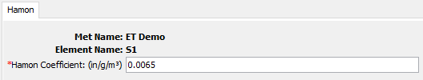
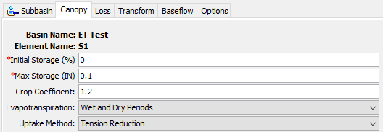
Calibration Considerations
Changing ET parameters can change overall water volumes
Two primary changes:
  ET method coefficients
  Crop coefficients
Notes:
Only consider making adjustments to ET parameters if there is volume error that you suspect is attributable to a mismatch in the type of vegetation in play. In some locations, using a crop coefficient equal to 1.0 is not reasonable when the vegetation tends towards higher ET, for example corn during the peak of its growth. You can also toggle between whether or not HMS will compute ET during periods when precipitation occurs.

Slide 8
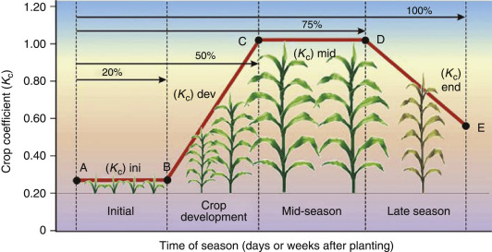
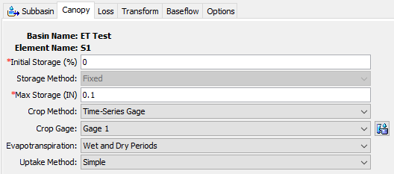
Dynamic Canopy
In long hydrologic simulations where vegetation changes drastically throughout the year, a dynamic canopy method may help
Notes:
For long-term continuous hydrologic modeling, HMS is capable of simulating a dynamic canopy, which varies the crop coefficient throughout the simulation using a time series gage or a gridset that you provide. I would only suggest using this approach in situations when modeling soil moisture deficits throughout the year can’t be captured with a single crop coefficient.

Slide 9
Takeaways
Evapotranspiration
  Important for continuous hydrology models
  Requires a canopy method in the subbasin
  Simple methods typically adequate
Notes:
Here are the three key takeaways for evapotranspiration modeling in HMS. First, ET is an important part of continuous hydrology models. Second, in order to compute actual evapotranspiration, a canopy method is required for your subbasins. Finally, the simplest methods for ET and canopy are typically adequate – use methods with fewer data requirements where you can.

Slide 10
HEC-HMS
Meteorologic Models:
Evapotranspiration
Gregory Karlovits, P.E., PH, CFM
Hydrologic Engineering Center
U.S. Army Corps of Engineers
Notes:
This has been an overview of evapotranspiration modeling in HEC-HMS. For more information, see the HMS user’s manual and the tutorials and guides online, or other videos in this series. Thanks, and have a great day.

