Slide 1
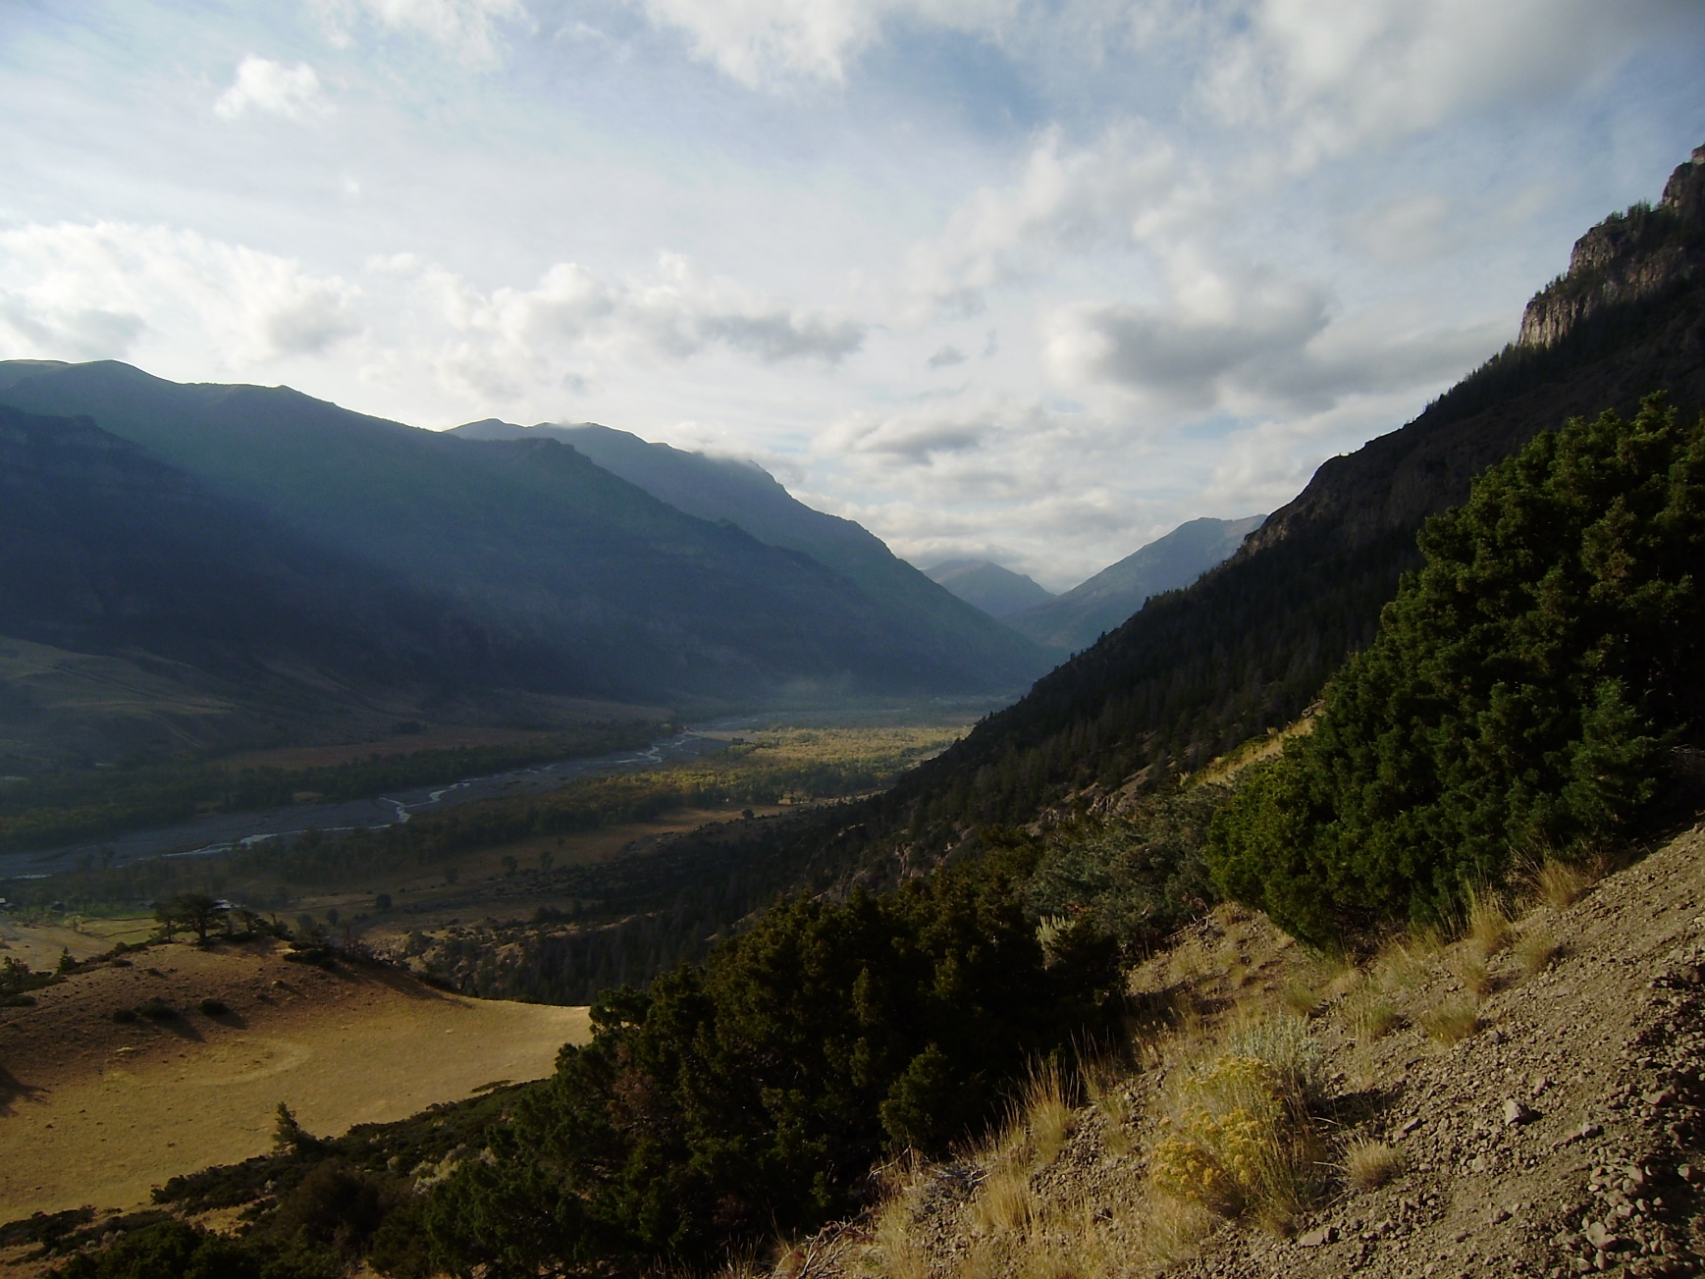
Introduction to Loss Methods within HEC-HMS
Notes:
Hey HMS modelers, this is Mike Bartles from the Hydrologic Engineering Center.
In this video, I'm going to introduce loss methods within HEC-HMS.
This lecture is part one within a series of lectures devoted to simulating losses and excess precipitation within HEC-HMS.

Slide 2
Objectives
Provide an overview of the hydrologic cycle.
Discuss how the hydrologic cycle is represented within HEC-HMS.
Describe how losses are simulated within HEC-HMS.
Notes:
This lecture is meant to serve as an introduction and will not be an exhaustive, detailed look at all the various options that are contained within the software.
We won’t be deriving equations or even delving into too much math.
Instead, we’ll focus more on concepts and how losses are accounted for within HEC-HMS.

Slide 3
Runoff Process – Hydrologic Cycle
Notes:
Let’s begin by taking a look at the hydrologic cycle, which begins with the evaporation and/or transpiration of water which can occur from the land surface, from vegetation, from lakes, from rivers, or the surface of the ocean.
As moist air is lifted, it cools and water vapor condenses to form clouds.
Moisture is transported around the globe until it returns to the surface as precipitation. This precipitation can fall in multiple forms like rain or snow.
Once the water reaches the ground, one of two processes may occur;
Some of the water may evaporate back into the atmosphere or
The water may penetrate the surface and become groundwater.
Groundwater either seeps its way to into the oceans, rivers, and streams, or is released back into the atmosphere through evapotranspiration.
The balance of water that remains on the earth's surface is runoff, which empties into lakes, rivers and streams and is carried back to the oceans, where the cycle begins again.

Slide 4
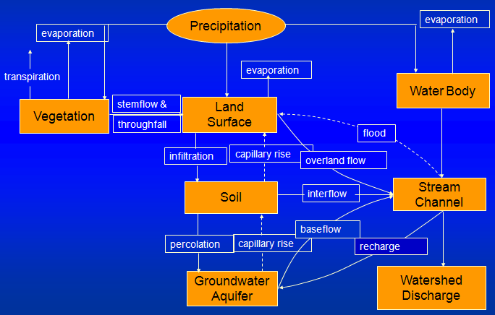
Runoff Process – HEC-HMS
Notes:
This is the hydrologic cycle, broken into a logical set of steps, and included within HEC-HMS.
These processes are all simulated within HEC-HMS, to varying levels of detail.
Pretty complicated, huh?
Don’t worry.
We’re only going to focus on the processes located in the center of the image.
Other lectures will discuss additional processes.
But, all of these processes work together to estimate the discharges from a watershed.

Slide 5
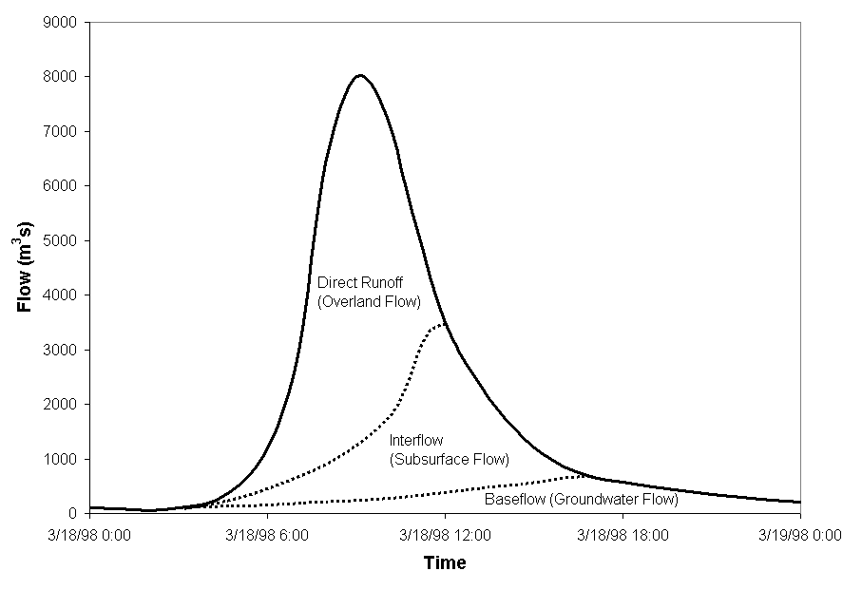
Hydrograph Components
Notes:
A hydrograph is a graphical representation of discharge with respect to time.
A streamflow hydrograph is a result of the runoff process, which is comprised of overland flow (direct runoff), interflow (flow in the upper soil layer), and groundwater flow (saturated flow through alluvial deposits or other water-bearing formations).
In this set of lectures, we’re going to pay particular attention to direct runoff (click to animate). As you can see, this volume is primarily responsible for the “peak” in the runoff hydrograph.
Water that is lost due to infiltration can still contribute to the total runoff hydrograph in the form of the slower responding interflow and baseflow. These volumes are also accounted for within HEC-HMS, but we’re not going to focus on them within these lectures.

Slide 6
Computing Runoff Volumes with HEC-HMS
Loss
Excess
Precipitation
Computation
Precipitation
Transformation
Interflow + Baseflow
Outlet
Channel
Total Subbasin
Flow
Routing
Runoff
Notes:
A key element for the simulation of the precipitation-runoff process is the determination of the portion of rainfall that contributes to direct runoff.
Direct runoff is the portion of runoff that enters the stream quickest and contributes the most to peak discharges.
The portion of precipitation that leads to direct runoff is called excess precipitation.
The difference between precipitation and excess precipitation is defined as loss.
Let’s look closer at the loss computations within HEC-HMS.

Slide 7
Losses within HEC-HMS
Interception / Canopy Storage
Evapotranspiration
Surface /
Depression Storage
Losses
Excess Precipitation
Infiltration / Soil Storage
Notes:
The principle loss components are:
Interception and canopy storage,
Surface and depression storage and
Infiltration and soil storage
Precipitation that is captured and stored in either the canopy, surface, or soil layers can be evaporated or transpired back into the atmosphere
Precipitation that exceeds the storage capacity or these layers becomes excess precipitation

Slide 8
Review
Introduced loss simulation within HEC-HMS
Three different ways precipitation can be “lost” within HEC-HMS:
  Canopy
  Surface
  Infiltration
Next lectures will focus on the ways in which canopy, surface, and infiltration losses are represented in HEC-HMS
Notes:
In this video, we introduced loss simulation within HEC-HMS
As we discussed, there are three ways in which precipitation can be lost: due to canopy, surface, and/or infiltration. You can simulate all of them, two of them, one of them, or none of them.
Within the next two videos in this series, we’ll look more closely at how canopy, surface, and infiltration processes are simulated within HEC-HMS.
Thanks for tuning in!

