Slide 1
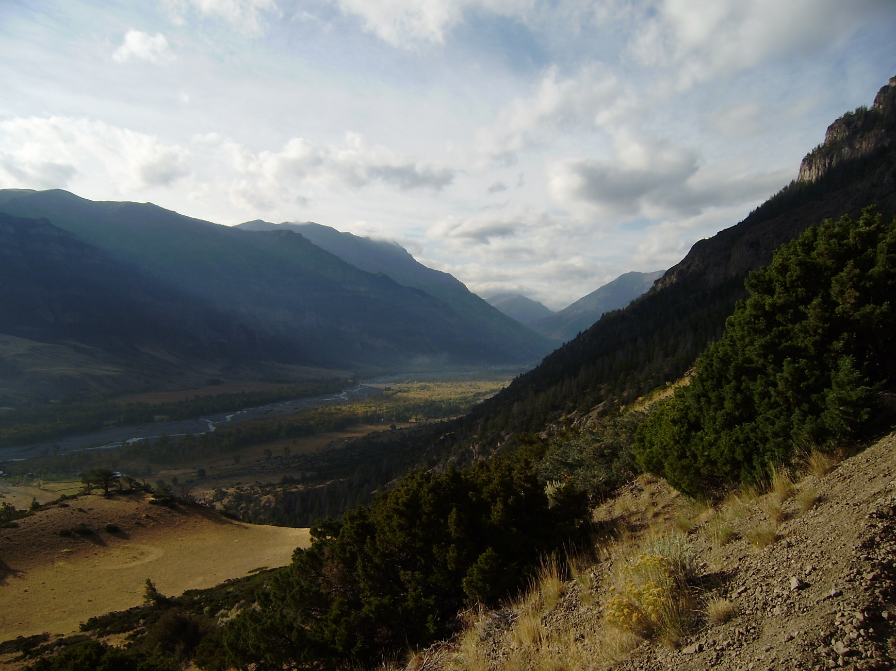
Infiltration Methods within HEC-HMS
Notes:
Hey HMS modelers, this is Mike Bartles from the Hydrologic Engineering Center.
In this video, we’re going to continue discussing how losses are simulated within HEC-HMS and delve into the available infiltration methods.

Slide 2
Losses within HEC-HMS
Interception / Canopy Storage
Evapotranspiration
Surface /
Depression Storage
Losses
Excess Precipitation
Infiltration / Soil Storage
Notes:
Quick review: precipitation can be lost to interception by the vegetation canopy, within surface depressions, and to the soil through infiltration
In this specific lecture, we’re going to focus on infiltration into the soil

Slide 3
Objectives
Provide an overview of the available infiltration methods within HEC-HMS
Discuss commonly used data sources and parameter estimation techniques
Discuss factors that affect infiltration losses
Notes:
By the end of this lecture, you should be familiar with the available infiltration methods within HEC-HMS
You should also be familiar with common data sources, parameter estimation techniques, and factors that affect infiltration

Slide 4
Infiltration
Infiltration is the process of water entering into the soil through the soil surface.
Notes:
So, what is infiltration?
Infiltration is the process of water entering the soil through the soil surface.

Slide 5
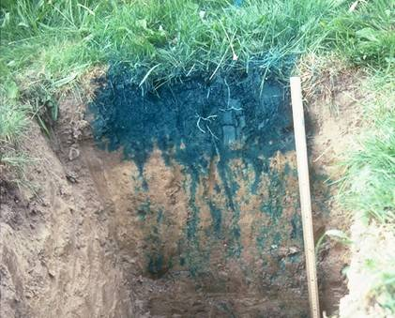
Infiltration in the Real World
Notes:
Infiltration in the real world is complicated!
Within this image, water with blue dye was placed on the top of soil and allowed to infiltrate. After a short time, a backhoe then excavated a trench to show how the blue dye had progressed downward.
This image was first shown to me in grad school almost a decade ago and has stuck with me ever since. I think it does an awesome job visualizing the complexities that the real world has to offer.
You can see how several flanges of blue dye have moved downward further than the bulk of the infiltrated water.
This is due to heterogeneities in this soil and is a pretty common thing out in the wild.
Even though this soil may be predominantly, say, silt loam, there are vertical and horizontal lenses of soil that allow water to move downward easier and faster.

Slide 6
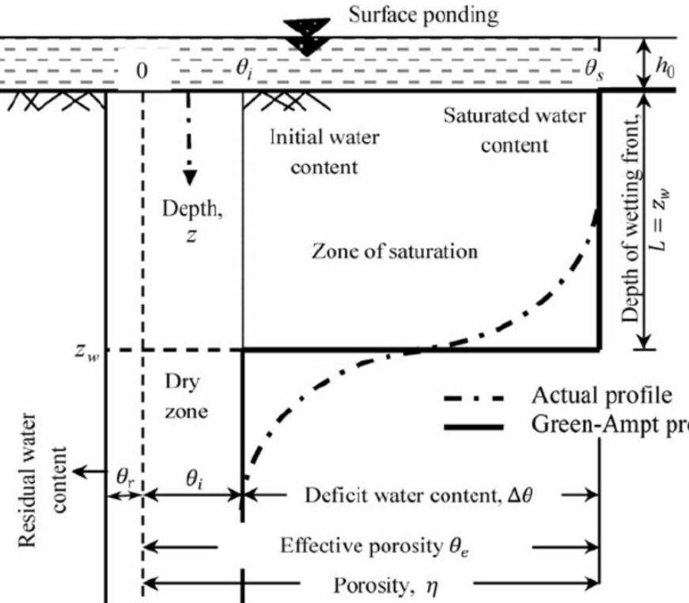
Infiltration in a Textbook
Notes:
It’s impossible to exactly predict infiltration in a heterogenous soil over the scales that we’re commonly expected to model, like hundreds to thousands of square miles.
As such, many simplifications are made to allow for efficient and tractable solutions.
This is the reason why it seems like everybody and their brother has a different infiltration method: each method simplifies the real world a little differently.
However, it’s important to remember that each method is a simplification of the real world.
For instance, this diagram shows the simplified downward movement of infiltrated water through a soil profile when using the Green and Ampt method. Notice that the wetting front is flat.
You need to understand how a specific method simplifies the real world to accurately apply it to your specific watershed.

Slide 7
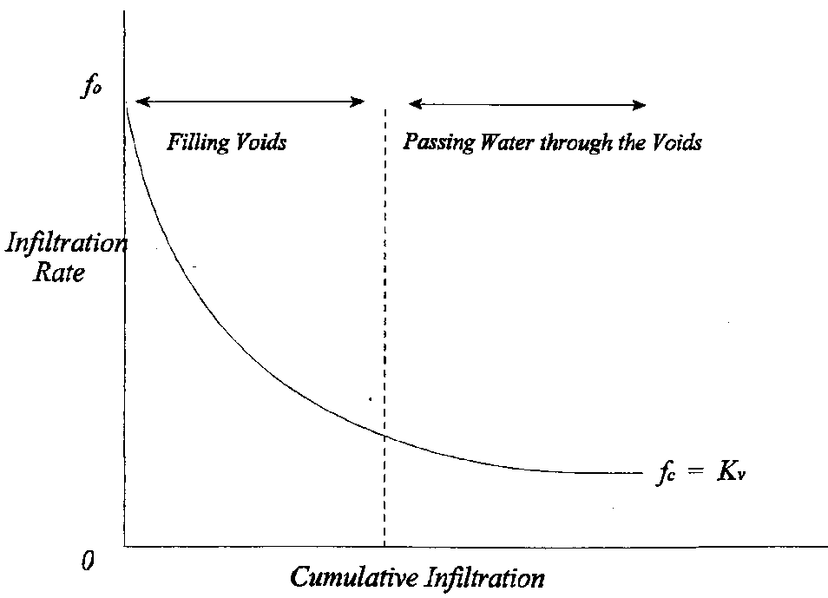
Infiltration
1) an exponential decrease in the infiltration rate with cumulative infiltration and
2) as moisture potential approaches zero, the infiltration rate decreases to a rate equivalent to saturated vertical hydraulic conductivity.
Notes:
Many, many experiments have shown that, under steady precipitation and with adequate drainage, infiltration starts at an initially high rate and decreases exponentially as more and more water is infiltrated.
However, the infiltration rate does not go to zero. This is a very important fact and one that I want to drive home.
In fact, the infiltration rate approaches an asymptotic limit which is known as the saturated hydraulic conductivity.
Saturated hydraulic conductivity is defined as the rate at which water moves through a unit area of saturated soil in a unit time under a unit hydraulic gradient.
We’ll come back to this figure in future videos as well.

Slide 8
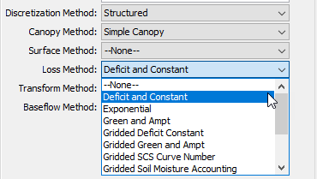

Available Infiltration Methods
Deficit and Constant
Exponential
Green and Ampt
Gridded Deficit Constant
Gridded Green and Ampt
Gridded SCS Curve Number
Gridded Soil Moisture Accounting
Initial and Constant
Layered Green and Ampt
SCS Curve Number
Smith Parlange
Soil Moisture Accounting
Notes:
There are twelve infiltration methods available for use within HEC-HMS. Within HEC-HMS, infiltration methods are referred to as loss methods.
These options range from simple, like Initial and Constant, to complex, like Soil Moisture Accounting.
We’ll go through a few of these methods in future lectures.

Slide 9
Simplifying Assumptions
For each subbasin or grid cell:
Uniform initial conditions
Uniform spatial distribution of precipitation
Uniform spatial distribution of losses due to interception/infiltration
Precipitation and losses are constant for each time step
Notes:
Regardless of the method, there are some universal assumptions made within HEC-HMS. Within a subbasin or grid cell:
All initial conditions are uniform, precipitation and losses are uniformly spatially distributed, and precipitation and losses are constant over a time step.

Slide 10
GIS Databases
Gridded Soil Survey Geographic
Info gathered by walking over the land and observing the soil
Some soil samples analyzed in laboratories
Collected at scales of 1:12,000 to 1:63,360
U.S. General Soil Map
Created by generalizing more detailed survey maps
Scales of 1:250,000 (CONUS) and 1:1,000,000 (Alaska)
Soils of similar areas were studied and the probable classification and extent of the soils were determined
USDA Geospatial Data Gateway: https://gdg.sc.egov.usda.gov/
USDA Web Soil Survey website: http://websoilsurvey.nrcs.usda.gov/app/HomePage.htm
Notes:
Commonly, geographic information systems are used to demarcate different soil types and, as such, different infiltration properties.
The two most commonly-used data sources in the U.S. Army Corps of Engineers are Gridded Soil Survey Geographic, gSSURGO, and U.S. General Soil Map, STATSGO. Both data sources are made available through the U.S. Department of Agriculture.
gSSURGO has much finer resolution than STATSGO and receives higher usage.
Hyperlinks are provided here for your use. But, if you Google “gSSURGO” or “STATSGO”, you’ll find your way to these data sets.

Slide 11
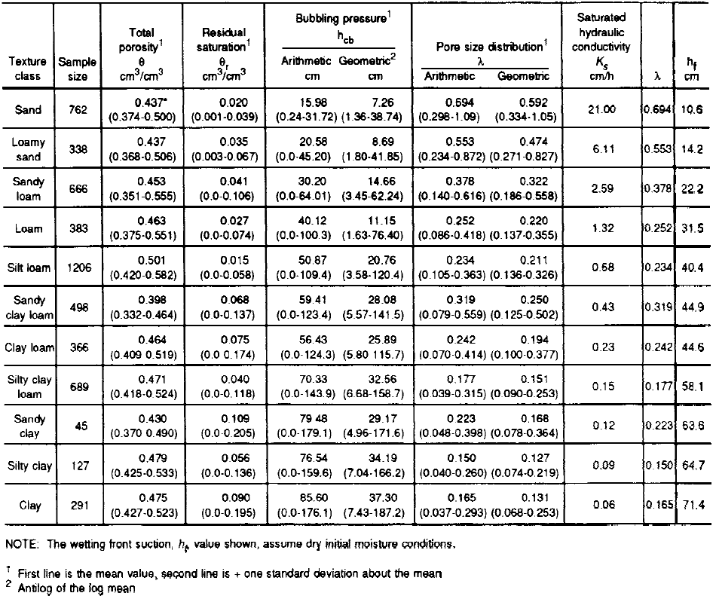
Parameter Estimation
Recommendation:
  Do not use actual parameter values within the soils database tabular data
  Get surficial texture from soils database
    e.g. silt, loam, sandy loam, etc
  Relate to literature values
    Engineer Manual 1110-2-1417
    Rawls, Brakensiek, and Miller (1983)
  Initial estimates must be calibrated and validated!
Notes:
My recommendation is: don’t use the actual parameter values, like saturated hydraulic conductivity or wetting front suction head, within the soils database.
Instead, get the surficial texture from the soils database and relate to literature values. For instance, within Engineer Manual 1110-2-1417, tables are presented that contain infiltration parameters for various soil textures. Use these instead.
But, don’t forget, these initial estimates, wherever they come from, must be calibrated and validated.

Slide 12
Factors Affecting Infiltration
Storm Character
Time of Year
Soil Compaction
Slope
Cracks
Roots
Vegetation
Soil Moisture
Litter
Temperature
Soil Compaction
Crusting
Soil Type
Imperviousness
Drought
Wildfire
Notes:
Infiltration into a soil is dependent upon a whole slew of factors like storm character, vegetation, and soil compaction.
Keep these in mind when estimating and using infiltration parameters. Were the initial infiltration parameter estimates based upon different soil or vegetation characteristics than those that prevail now?

Slide 13
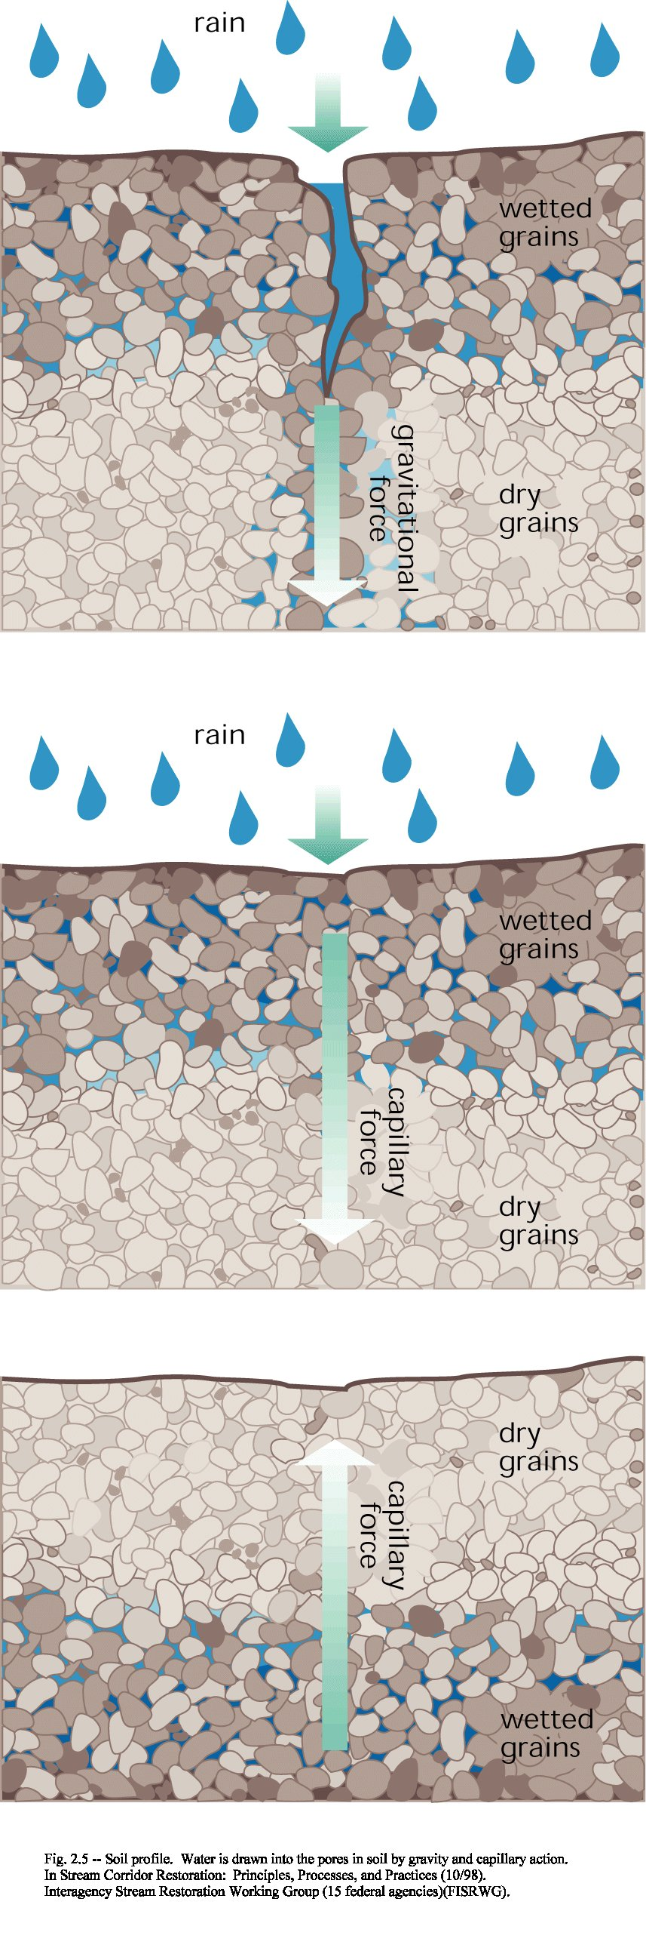
I. Hydrologic Processes
Notes:
As an example, here’s a graphic that demonstrates how much quicker precipitation can be infiltrated into a soil when cracks are present.
These cracks can be introduced by multiple mechanisms like machinery, extreme low or high temperatures, or extended drought.

Slide 14
How to Select an Infiltration Method
All methods are a simplification of the real world
An appropriate method:
  Captures the significant aspects of the system in question
  Provides the necessary information to meet study objectives
Questions to ask yourself:
  What is the required accuracy of the model?
  What are the required outputs?
  What type of physical and/or observed data is available?
  How much time and $$$ is available?
  With what methods are you familiar?
Notes:
Keep in mind that all infiltration methods are simplifications of the real world. But, appropriate methods capture the important aspects of the system and meet the study objectives.
So, ask yourself: what does my model have to provide, how accurate does it have to be, how much time and money is available for the study, and what methods am I most familiar with?
Ultimately, HEC-HMS presents you with many modeling choices. You can choose different methods, try them, and compare and contrast the consequences.

Slide 15
Review
Twelve infiltration methods are available within HEC-HMS
In general, infiltration losses are much larger than canopy and/or surface losses
GIS is commonly used to estimate infiltration method parameters
Next lecture will focus on Initial and Constant loss method within HEC-HMS
Notes:
In review, we discussed the available infiltration methods available for use within HEC-HMS.
We also took a look at common parameter estimation techniques that use soils databases and published literature.
Typically, the amount of precipitation lost to infiltration is much, MUCH larger than the amount that is lost to canopy or surface depressions. So, care must be taken to choose an appropriate method, estimate realistic parameters, and understand how these parameters can be impacted by various factors.
Within the next few lectures in this series, we’ll look at a couple infiltration methods available for use within HEC-HMS in greater detail. First up is the Initial and Constant method.

