Slide 1
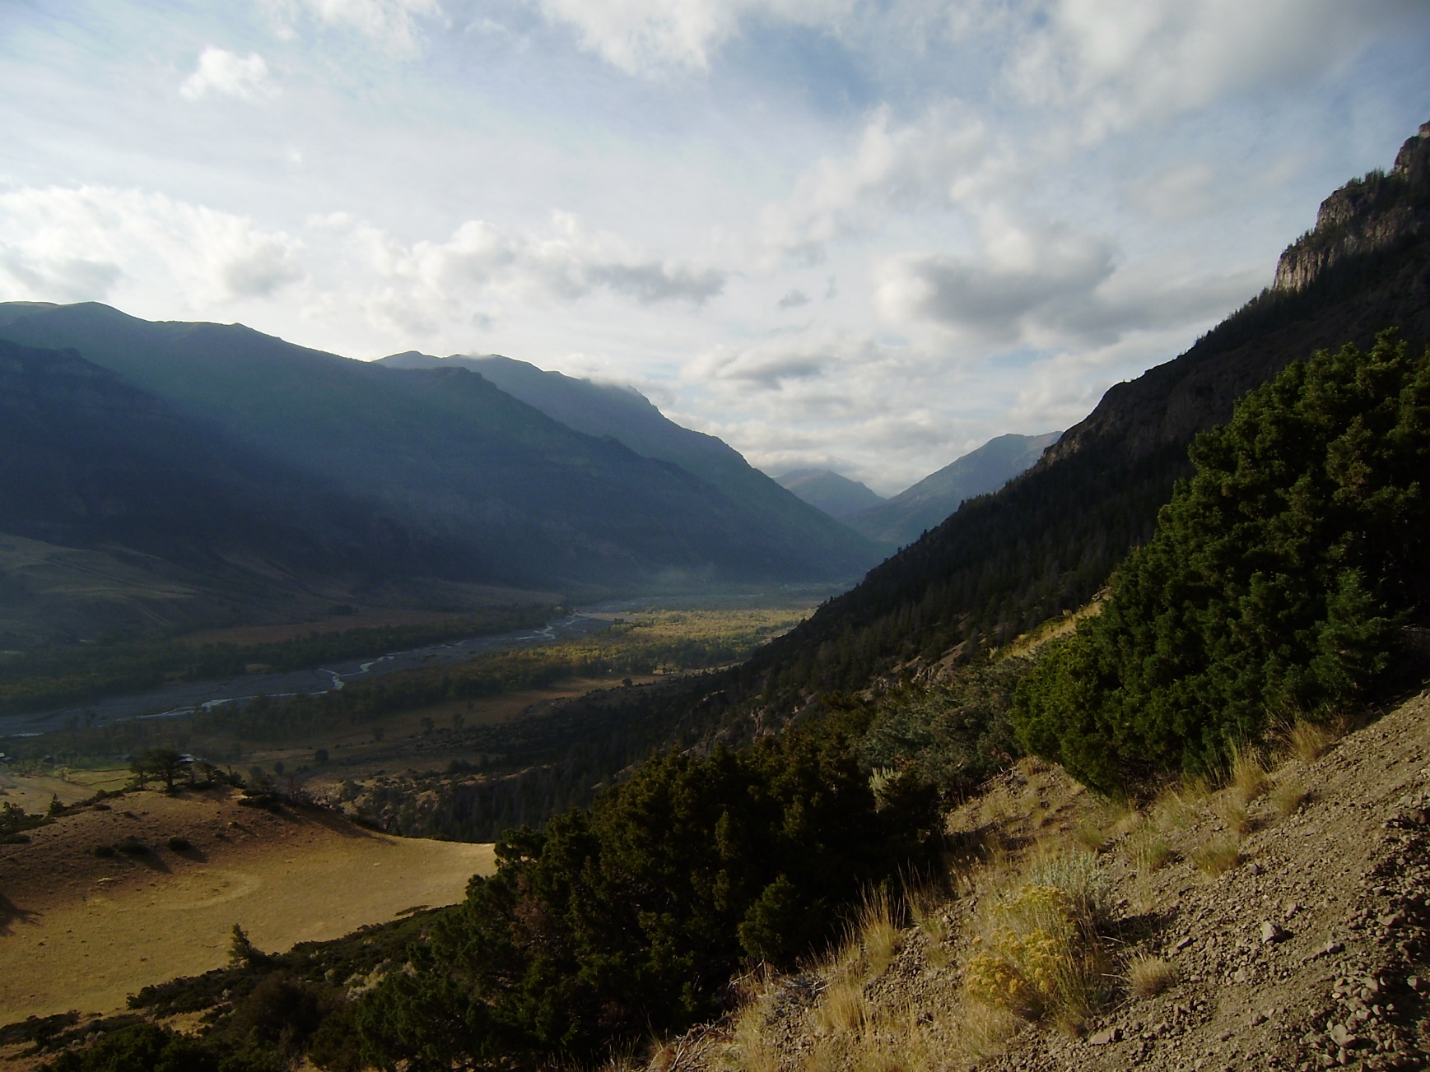
Initial and Constant Method within HEC-HMS
Notes:
Hey HMS modelers, this is Mike Bartles from the Hydrologic Engineering Center.
In this video, we’re going to continue discussing losses within HEC-HMS by delving into the initial and constant infiltration method.

Slide 2
Objectives
Introduce the Initial and Constant method
Present an example computation
Discuss common parameter estimation techniques
Summarize calibration techniques
Present advantages and disadvantages
Notes:
By the end of this lecture, you should be familiar with the Initial and Constant loss method.
I’ll present an example computation that should make things super clear.
We’ll also discuss common data sources, parameter estimation techniques, and calibration techniques.
Finally, we’ll finish up by comparing advantages and disadvantages when using this method.

Slide 3
Initial and Constant Loss Method
All rainfall is lost until an initial loss is satisfied.
A constant loss rate is applied to the remaining precipitation.
There isn’t a way to extract infiltrated water!
Notes:
When using the initial and constant method, all rainfall is lost until an initial loss volume is satisfied.
After that volume has been filled, any additional precipitation is lost at a constant rate. Anything that’s not infiltrated will become excess precipitation.
Simple, right?
I gotta mention up front that there isn’t a way to extract infiltrated water when using this method. If you want to do that, you’ll have to step up to something a bit more complicated. We’ll talk about another option that can do that within the next video.

Slide 4
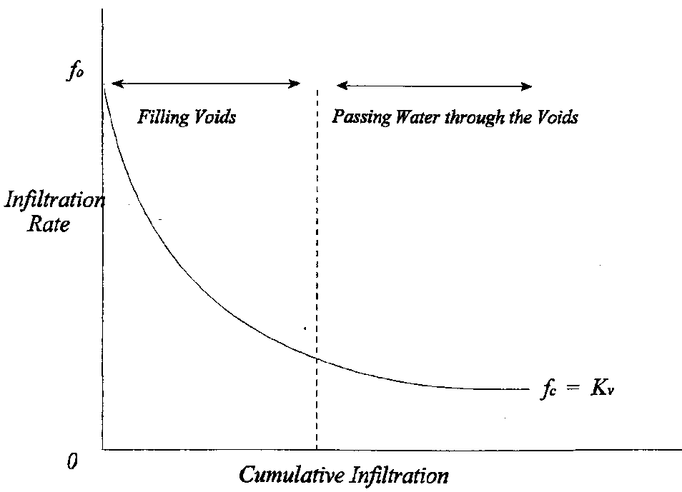
Initial and Constant Loss Method
Initial Loss
Constant Loss
Notes:
Let’s revisit a figure from a previous lecture. Recall that infiltration has been shown to start an initially high rate and decrease exponentially towards an asymptotic limit called the saturated hydraulic conductivity.
When using the initial and constant loss method, you only have an initial loss volume, which is the green rectangle in this image, and a constant rate, which is the top of the red rectangle in this image, to recreate this exponential curve.
As such, you’ll typically over estimate infiltration rates at some times and underestimate it at other times in order to provide a good fit throughout the entire simulation time window.

Slide 5
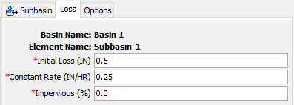
Example
Time | Precip (in) | Loss (in) | Excess (in)
0200 | 0.5 | 0.5 | 0.0
0300 | 0.5 | 0.25 | 0.25
0400 | 1.0 | 0.25 | 0.75
0500 | 0.5 | 0.25 | 0.25
0600 | 0.0 | 0.0 | 0.0
0700 | 0.0 | 0.0 | 0.0
0800 | 0.0 | 0.0 | 0.0
0900 | 0.0 | 0.0 | 0.0
1000 | 0.5 | 0.25 | 0.25
1100 | 0.5 | 0.25 | 0.25
1200 | 0.5 | 0.25 | 0.25
1300 | 0.5 | 0.25 | 0.25
1400 | 0.5 | 0.25 | 0.25
Notes:
This method requires two parameters, initial loss and constant rate. A directly connected impervious area can also be specified. When a non-zero value for directly connected impervious area is specified, infiltration computations won’t be carried out on that portion of the subbasin or grid cells and all precipitation will become excess.
This example shows how precipitation excess/loss is computed with this method.
In the first time step, half an inch of precipitation is lost to initial losses (animate). From there on out, precipitation is lost at a constant rate of 0.25 inches per hour.
In the next time step, another half inch of precipitation falls, 0.25 inches of constant loss is applied, and 0.25 inches of excess is generated (animate).
In the next time step, 1 inch of precipitation falls, 0.25 inches of constant loss is applied, and 0.75 inches of excess is generated (animate).
In the next time step, half an inch of precipitation falls and 0.25 inches is lost due to the constant rate resulting in 0.25 inches of excess being generated (animate).
Then, there’s a lull in precipitation for four hours. No infiltrated water is extracted because you can’t do that with this method. So, any additional precipitation is only subjected to the constant loss rate, as shown in the remaining time steps (animate).

Slide 6
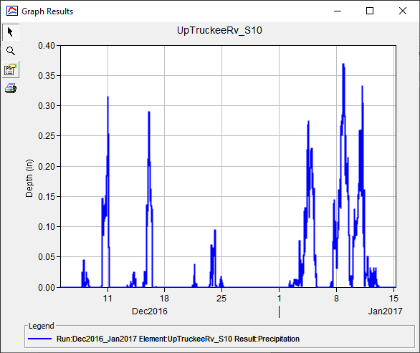
Parameter Estimation – Initial Loss
Based upon antecedent conditions and soil
Did it rain a day/week/month before the simulation start?
Precipitation
Notes:
When estimating an appropriate initial loss volume, you should scrutinize the prevailing antecedent conditions prior to the start of your simulation.
For instance, did it rain a week prior to the start, or has it not rained in several months?
Also, how long does it typically take for infiltrated precipitation to be removed from the system through either drainage or evapotranspiration?
In this image, a moderate amount of precipitation fell approximately 1 to 2 weeks prior to January 1st, which is the start of my simulation. Also, this particular watershed takes several weeks to dry out in between precipitation events. So, I should start by using a small initial loss volume because I’d expect there to be a good amount of moisture still within the soil at the start of my simulation.

Slide 7
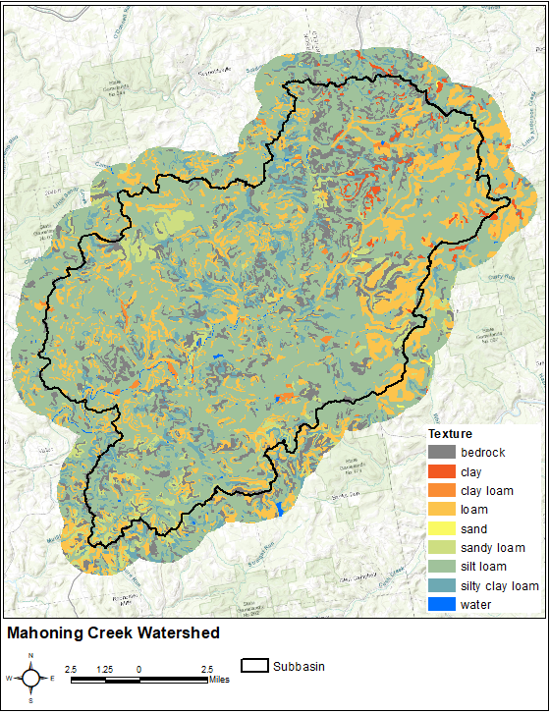
Parameter Estimation – Constant Rate
Get surficial texture from soils database
  e.g. silt, loam, sandy loam, etc
Relate texture to saturated hydraulic conductivity in literature values
  Engineer Manual 1110-2-1417
  Rawls, Brakensiek, and Miller (1983)
Notes:
When estimating a constant loss rate for your watershed, remember my recommendation from the previous lecture: don’t use the actual parameter values from a soils database to estimate this parameter!
Instead, get the surficial texture from the soils database and relate to published saturated hydraulic conductivity values for the predominant soils.
In this image, over half of the subbasin of interest is covered by silt loam. So, a decent place to start would be to use an estimate of saturated hydraulic conductivity for silt loam and begin calibrating from there.

Slide 8
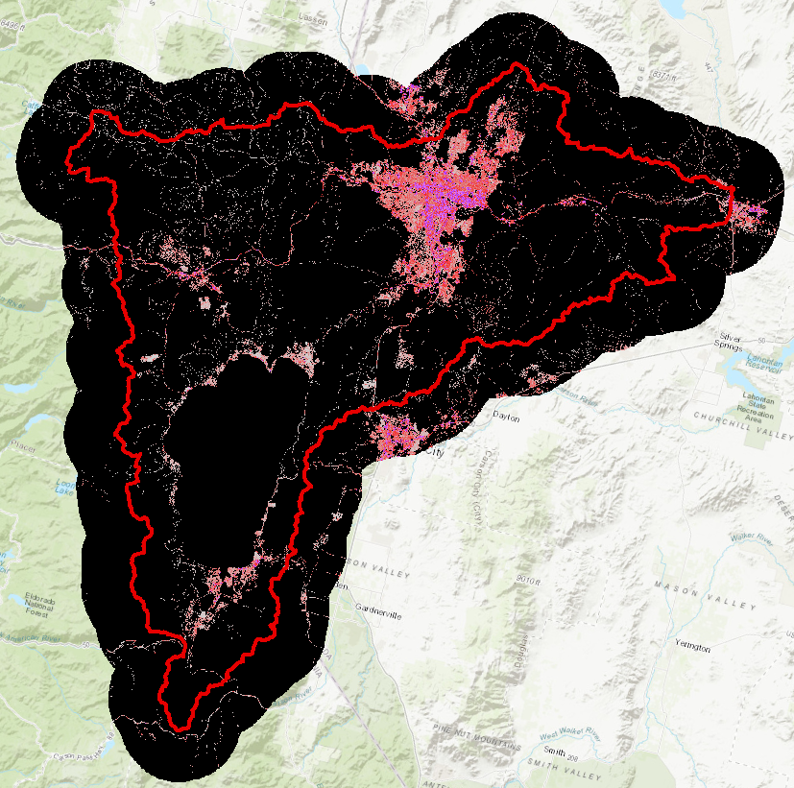
Parameter Estimation – Impervious Area
Estimate using GIS
National Land Cover Database (NLCD)
  NLCD 2016
Include large, standing water bodies
Notes:
When estimating percent impervious area, it’s okay to use a GIS source like the National Land Cover Database.
You should also include large, standing water bodies in these estimates as rain falling directly onto a large lake or reservoir should not be subject to infiltration.
In this image, percent impervious cover from the NLCD 2016 version is shown. Black areas indicate little to no impervious cover while magenta areas indicate high degrees of impervious cover.

Slide 9
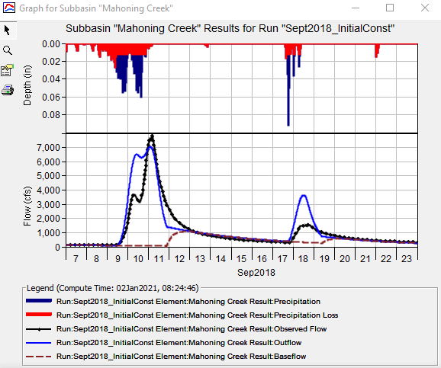
Calibration Techniques
Match initiation of runoff
Match observed runoff volume
Use multiple statistical metrics
  Nash-Sutcliffe Efficiency
  Root Mean Square Error
  Percent Bias
Notes:
When calibrating the initial and constant method, I like to start by modifying my initial parameter estimates until I get the initiation of runoff correct. Specifically, I’m trying to match the time at which the computed runoff starts to rise when compared to the observed runoff.
Then, I try to match the observed runoff volume.
In this example, observed flow is shown in black and computed flow is shown in blue.
I’ve matched the time of runoff initiation pretty well, but my initial runoff is too high. So, I need to increase my initial loss and/or constant rate.
When calibrating, it’s important to use more than just the eyeball test to gauge whether your model is accurate. Multiple statistical metrics, like Nash-Sutcliffe Efficiency, are reported in HEC-HMS for locations with observed data. Use all of these to measure model performance as they compare your results from different perspectives.

Slide 10
Advantages
"Mature" method that has been used successfully in thousands of studies throughout the U.S.
Easy to set up and use.
Parameters can be related to predominant soil textures and estimated using multiple literature sources.
Method is parsimonious; it includes only a few parameters necessary to explain the variation of runoff volume.
Disadvantages
Difficult to apply to ungaged areas due to lack of direct physical relationship of parameters and watershed properties.
Method may be too simple to predict losses within event, even if it does predict total losses well.
Does not allow for continuous simulation.
Notes:
The main advantage of this method is that it’s simple! Because it’s simple, it’s been successfully used all over the world for numerous purposes. The required parameters can be easily estimated from observed data. Also, this method is parsimonious in that a small number of variables (or parameters) are used to explain something. This allows for easy investigation of model uncertainty, which is an advanced topic that we’ll revisit in another video.
However, the primary disadvantage of this method is also that it’s simple. There will be some situations where you just can’t predict the infiltration within complicated scenarios using this method because there aren’t a lot of predictor variables or parameters.
So, being simple is a double edged sword, so to say.

Slide 11
Review
Initial and Constant method is one of the simplest infiltration methods available within HEC-HMS
Parameters can be easily estimated
Primary advantage (simplicity) is also its primary disadvantage
Next lecture will focus on Deficit and Constant loss method within HEC-HMS
Notes:
In review, I introduced the initial and constant infiltration method.
This is one of the simplest infiltration methods within HEC-HMS.
It’s quick to parameterize and calibrated and, as such, it’s been used all over the world with success.
However, it’s simplicity is also a disadvantage for complicated scenarios.
In the next video, we’ll focus on the Deficit and Constant loss method, which is pretty similar to the Initial and Constant method but with a major advantage: infiltrated water CAN be extracted over time through evapotranspiration.
Thanks for watching!

