Slide 1
HEC-HMS
Surface Runoff
Unit Hydrograph Derivation

Slide 2
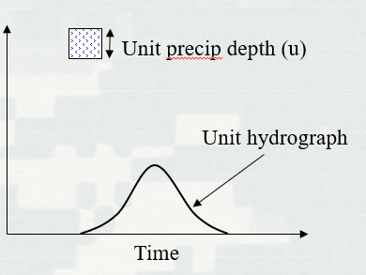
Unit Hydrograph
Defined as the “basin outflow resulting from 1.0 inch (1.0 mm) of direct runoff generated uniformly over the drainage area at a uniform rainfall rate during a specified period of rainfall duration.”
Often used for “lumped” parameter modeling
User Specified Unit Hydrograph, User-Specified S-Graph, Clark and ModClark, SCS, and Snyder’s

Slide 3
Unit Hydrograph Assumptions
Rainfall excesses of equal duration are assumed to produce hydrographs with equivalent time bases regardless of the intensity of the rain
Direct runoff ordinates for a storm of given duration are assumed directly proportional to rainfall excess volumes. Twice the rainfall produces a doubling of hydrograph ordinates (superposition)
The time distribution of direct runoff is assumed independent of antecedent precipitation (time invariance)
Excess precipitation is spatially distributed uniformly and has a constant intensity throughout the time interval

Slide 4
UH - Limitations
Normally do not see proportional behavior in river flow.
Time-invariance can be affected by the seasons
Areal distribution of rainfall rarely uniform over time and space

Slide 5
Unit Hydrograph – Derivation Example

Slide 6
Unit Hydrograph - Derived
Separate interflow and base flow
Excess precip depth (d)
Excess precip depth (d)
Direct runoff
Direct runoff
Flow
Flow
Interflow
Base flow
Time
Time

Slide 7
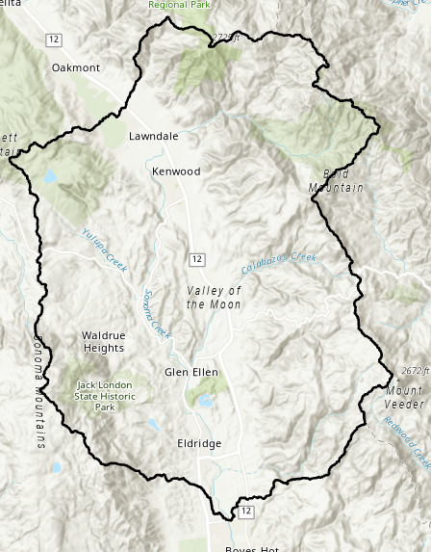
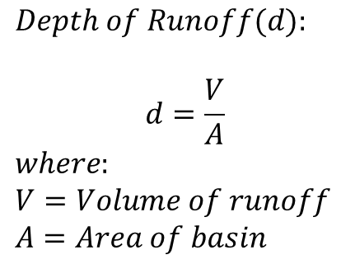
Unit Hydrograph - Derived
Measure the total volume of direct runoff under the hydrograph and convert this to depth over the watershed
$$Depth of Runoff(d):$$
$$d=\frac{V}{A}$$
$$where:$$
$$V=Volume of runoff$$
$$A=Area of basin$$
Area (A)
Excess precip depth (d)
Flow
Direct runoff (V)
Time

Slide 8

Unit Hydrograph - Derived
Divide the ordinates of the direct runoff by the depth of runoff (d)
Excess precip depth (d)
Unit precip depth (u)
Direct runoff
Direct runoff
Flow
$$×\frac{1}{d}$$
Flow/u
Time
Time

Slide 9
Unit Hydrograph - Derived
Estimate the duration of the unit hydrograph
Excess Rainfall Duration
Precip
Φ index
Time

Slide 10
Unit Hydrograph – Derivation Example

Slide 11
Unit Hydrograph – Derivation Example
Excess Rainfall Duration
= 0.84 inches (Step 2)
Precip
Rainfall total depth (5 hours) = 3.34 inches
Φ index = 0.5 in/hr
Time
Rainfall duration = 3-hr

Slide 12
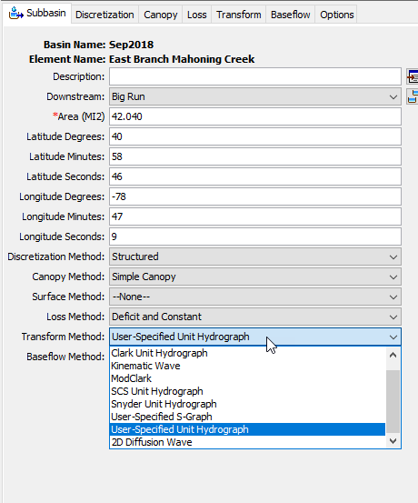
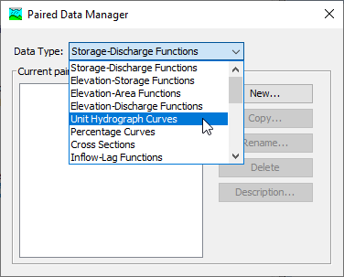
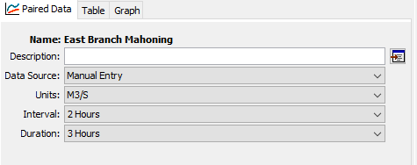
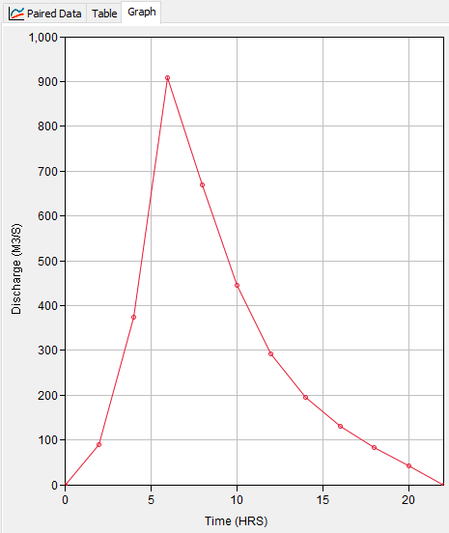
Unit Hydrograph in HEC-HMS

Slide 13
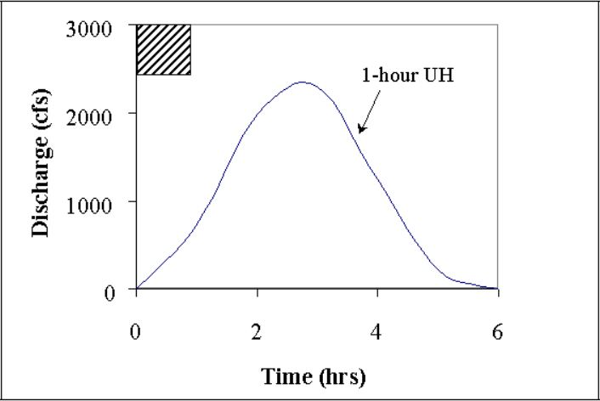
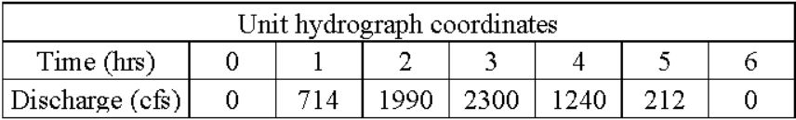
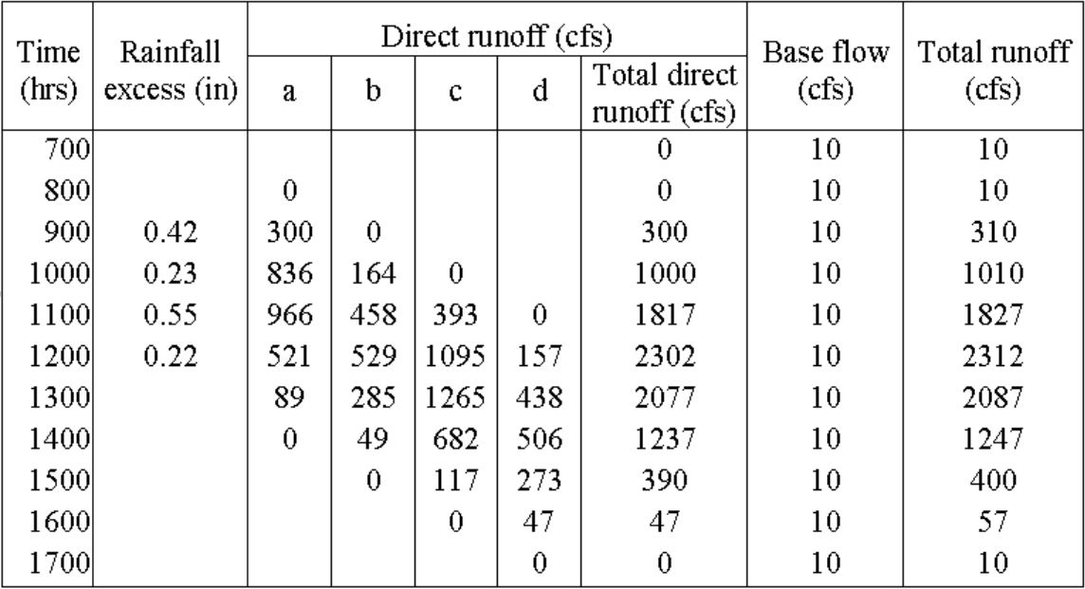
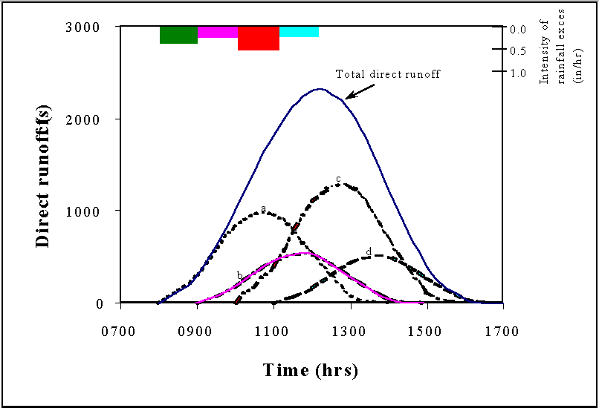
Unit Hydrograph – Convolution Example

Slide 14
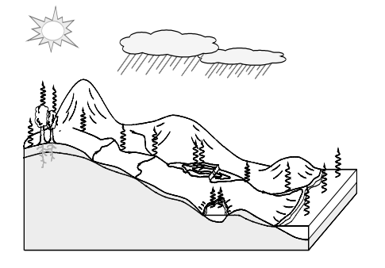
Thank you for listening!
Visit our website!
https://www.hec.usace.army.mil/confluence/hmsdocs/hmsum/4.7
https://www.hec.usace.army.mil/software/hec-hms/

