Slide 1
Rainfall-Runoff Modeling
Surface Runoff in HEC-HMS
Synthetic Unit Hydrographs –
Snyder's Unit Hydrograph

Slide 2
Snyder UH - Theory
Snyder’s UH originally looked at using hydrograph peak, watershed lag, and the time base as the critical characteristics for the unit hydrograph
Developed from study of watersheds in the Appalachian Highlands ranging from 10 to 10,000 mi²

Slide 3
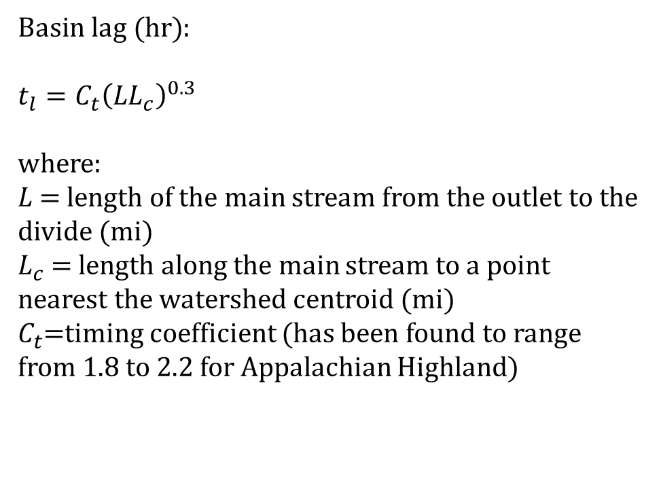
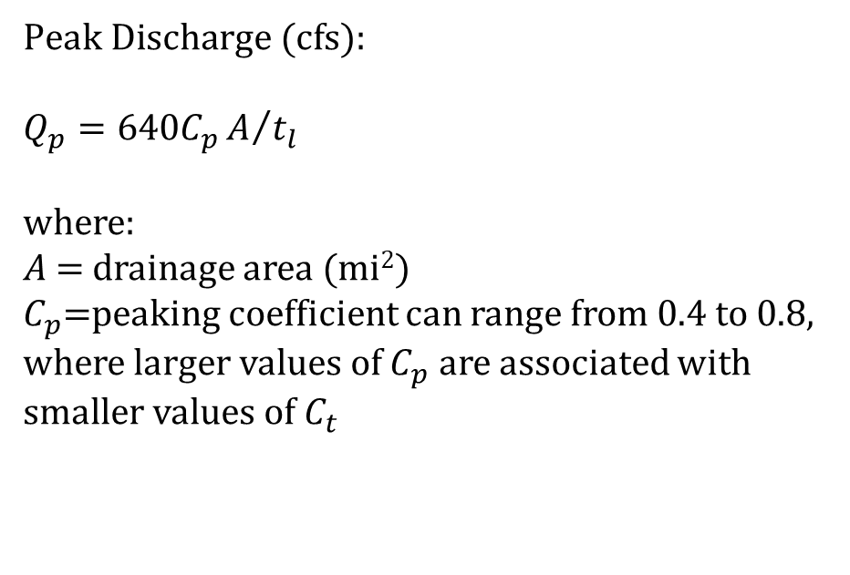
Snyder UH - Equations
$\text{Basin} \text{lag}\text{ (}\text{hr}\text{)}$:
$$t_{l}=C_{t}{\left(LL_{c}\right)}^{0.3}$$
where:
$L$= length of the main stream from the outlet to the divide (mi)
$L_{c}$ = length along the main stream to a point nearest the watershed centroid (mi)
$C_{t}$=timing coefficient (has been found to range from 1.8 to 2.2 for Appalachian Highland)
$\text{Peak} \text{Discharge}\text{ (}\text{cfs}\text{)}$:
$$Q_{p}=640C_{p}A/{t_{l}}$$
where:
$A$= drainage area (mi²)
$C_{p}$=peaking coefficient can range from 0.4 to 0.8, where larger values of $C_{p}$ are associated with smaller values of $C_{t}$

Slide 4
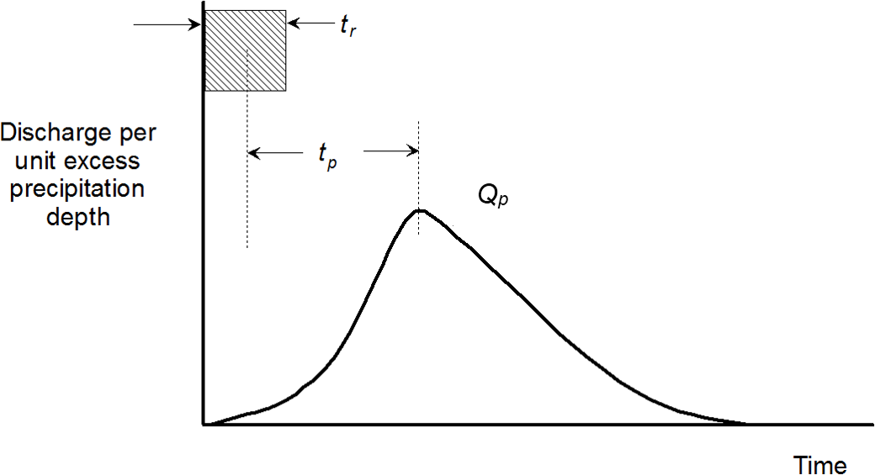
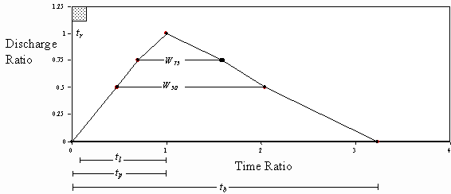
Snyder UH – Illustrated
Source: HEC (2000)

Slide 5
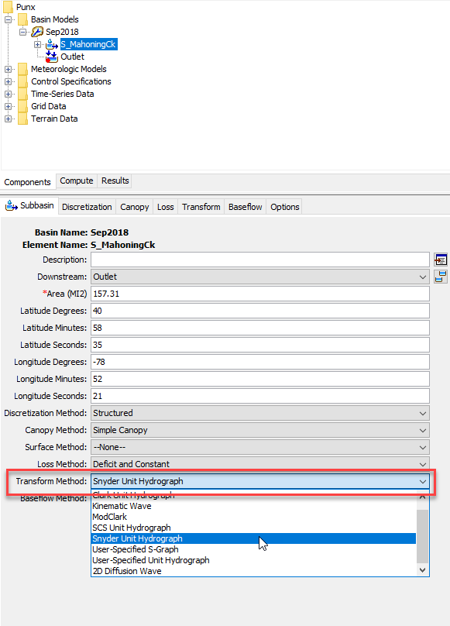
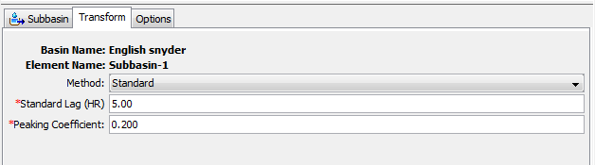
Snyder UH - Implementation in HEC-HMS

Slide 6
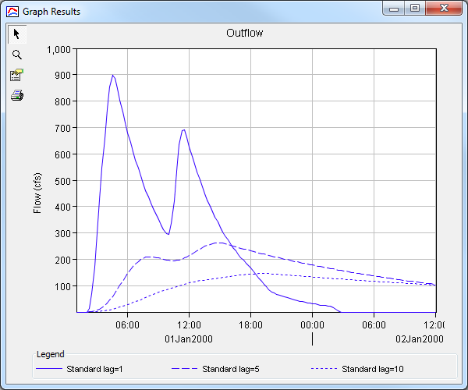
Snyder UH – Adjusting Standard Lag

Slide 7
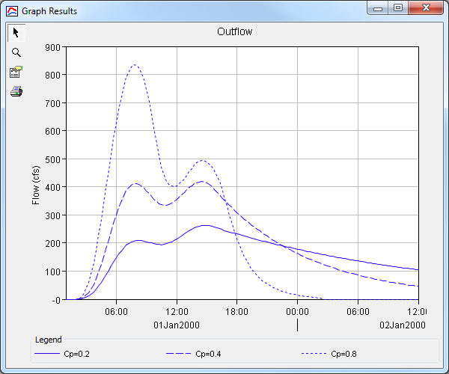
Snyder UH – Adjusting Peaking Coefficient

Slide 8
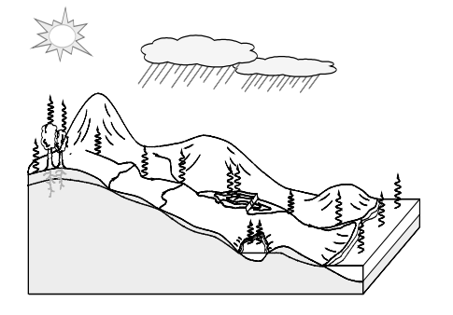
Thank you for listening!
Visit our website!
https://www.hec.usace.army.mil/confluence/hmsdocs/hmsum/4.7
https://www.hec.usace.army.mil/software/hec-hms/

