Slide 1
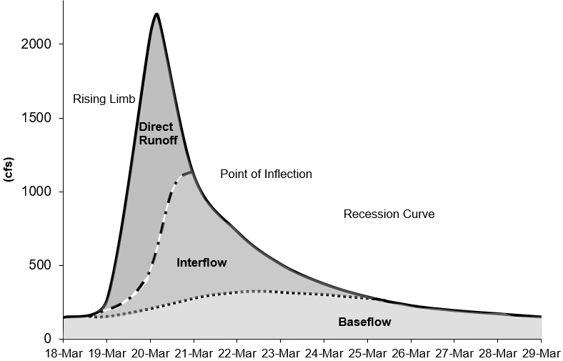
Recession Baseflow Method

Slide 2
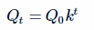
Recession Baseflow
The recession baseflow method models a hydrograph’s recession curve using the following equation:
Q_{t} = flow at time t
Q₀ = flow at the beginning of the recession curve
k = exponential decay constant
T = time

Slide 3
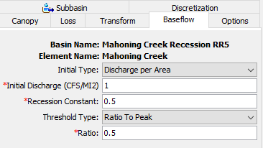
Recession Baseflow
Parameters for the Recession Baseflow Method:
  Initial Discharge (either specified as a rate or as a rate per area)
  Recession Constant
  Threshold for starting the baseflow recession curve (specified as a flow threshold or as a ratio to peak)

Slide 4
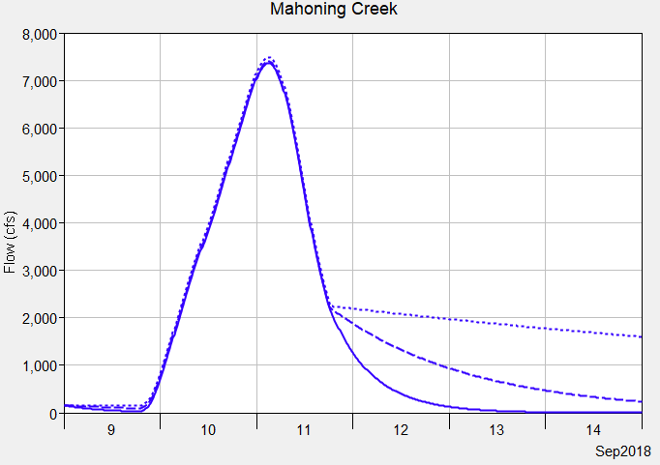
Recession Baseflow
The plot on this slide shows results from three different recession constants. A recession constant closer to 1 results in a flatter recession curve, a constant closer to 0 results in a steeper recession curve.
It is not possible to model both interflow and groundwater flow baseflow components using the recession baseflow method.
Notice the recession constant had little impact on the flood peak. The recession constant would impact a second flood event.
Recession Constant
0.9
0.5
0.1

Slide 5
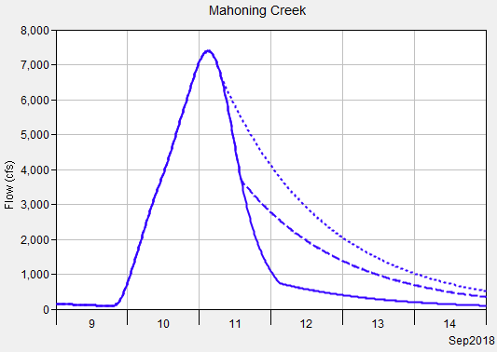
Recession Baseflow
The recession curve turns on when the receding limb of the hydrograph falls below a threshold/trigger flow.
You can choose a threshold type: ratio to peak or discharge (a ratio to peak of 0.5 means the threshold would be 50 cfs if the peak flow was 100 cfs).
Ratio to Peak is easier to apply across the basin model (generally consistent across subbasins), where a discharge threshold is dependent on subbasin size.
Ratio to Peak
0.9
0.5
0.1

Slide 6
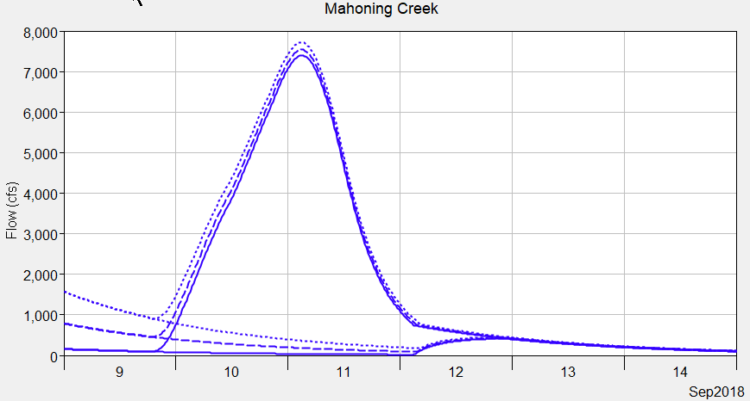
Recession Baseflow
You can choose an initial discharge type: Discharge per Area or Discharge (a discharge per area of 1 CFS/MI2 means the initial flow would be 100 cfs for a 100 square mile subbasin).
Discharge per Area is easier to apply across the basin model (generally consistent across subbasins), where a discharge initial type is dependent on the subbasin size.
The plot on this slide shows different initial discharge per area values.
Be strategic when setting the starting date of the simulation, reduce impacts from prior floods (only groundwater baseflow in the system).
Initial Discharge
10
5
1

Slide 7
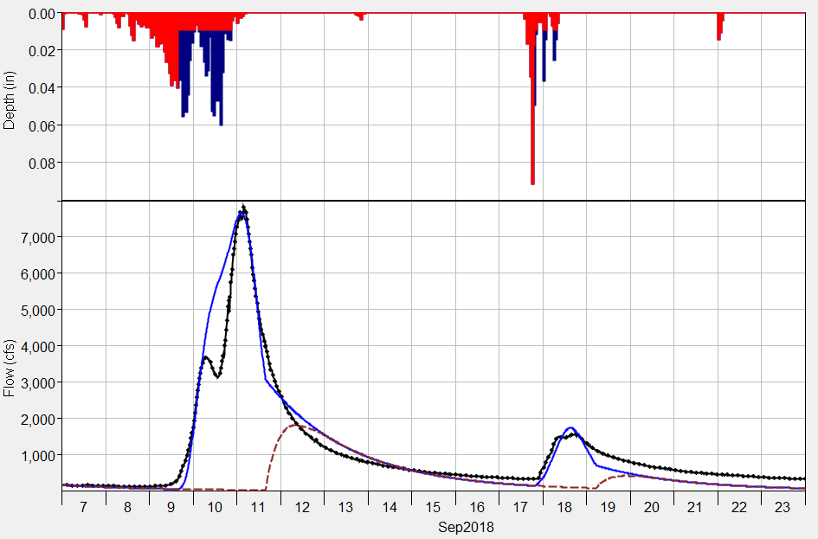
Recession Baseflow
Computed Total Flow
Computed Baseflow
Observed Flow
The recession baseflow method can be used for a continuous simulation. The method should be considered as an event model.
The recession curve resets between flood events, as shown in the plot.
The example on this slide also shows that the recession method cannot model both interflow and groundwater flow (there is only one recession constant).

Slide 8
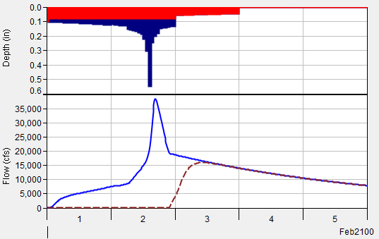
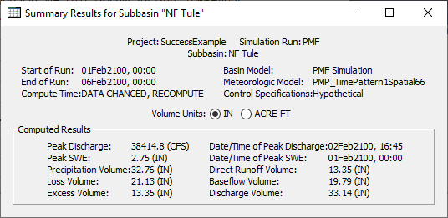
Recession Baseflow
Check the runoff volume when using the recession baseflow method to make sure the discharge volume does not exceed precipitation volume (there might be cases when this is ok) and computed volumes are similar to water balance studies in the region.
There might be tendencies to artificially increase baseflow to improve the model performance when precipitation data do not capture the storm event.
Applying the calibrated model to a hypothetical event with a much higher flood magnitude can cause unreasonable baseflow volumes. Reduce the ratio to peak for extreme hypothetical floods and check computed volume.

