Slide 1


HEC-HMS
Calibration:
Theory
Gregory Karlovits, P.E., PH, CFM
Hydrologic Engineering Center
U.S. Army Corps of Engineers
Notes:
Hello HMS modelers, I’m Greg Karlovits, senior hydraulic engineer at the U.S. Army Corps of Engineers Hydrologic Engineering Center. This video will cover an overview of the theory behind calibrating hydrologic models, using HEC-HMS.

Slide 2
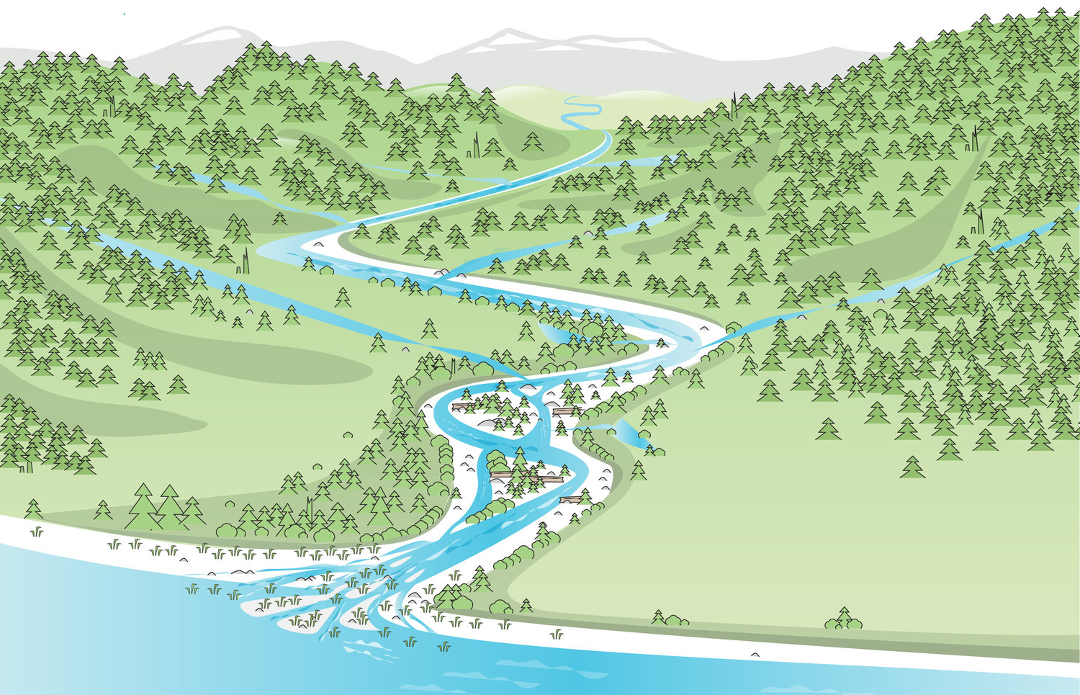
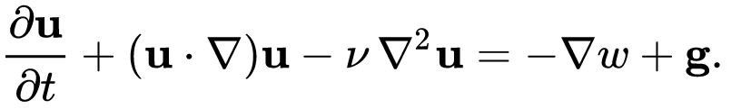
Hydrologic Modeling
We can’t experiment on a real watershed
Our model stands in for reality
Goal: represent our watershed accurately using algorithms
Notes:
Often, hydrologic modelers are interested in performing experiments on a watershed so we can see how its behavior changes when some property of it is changed. We can’t experiment on a real watershed for many reasons. We can’t apply design rainfall; we can’t evaluate engineering project impacts without building them; we can’t have a side-by-side comparison of a control and an experiment. In order to experiment on a watershed, we need to use a model as a stand-in for the real thing.
Instead of soil and plants, we have equations that govern how much water goes where. These equations represent the physical world in a deterministic way.

Slide 3
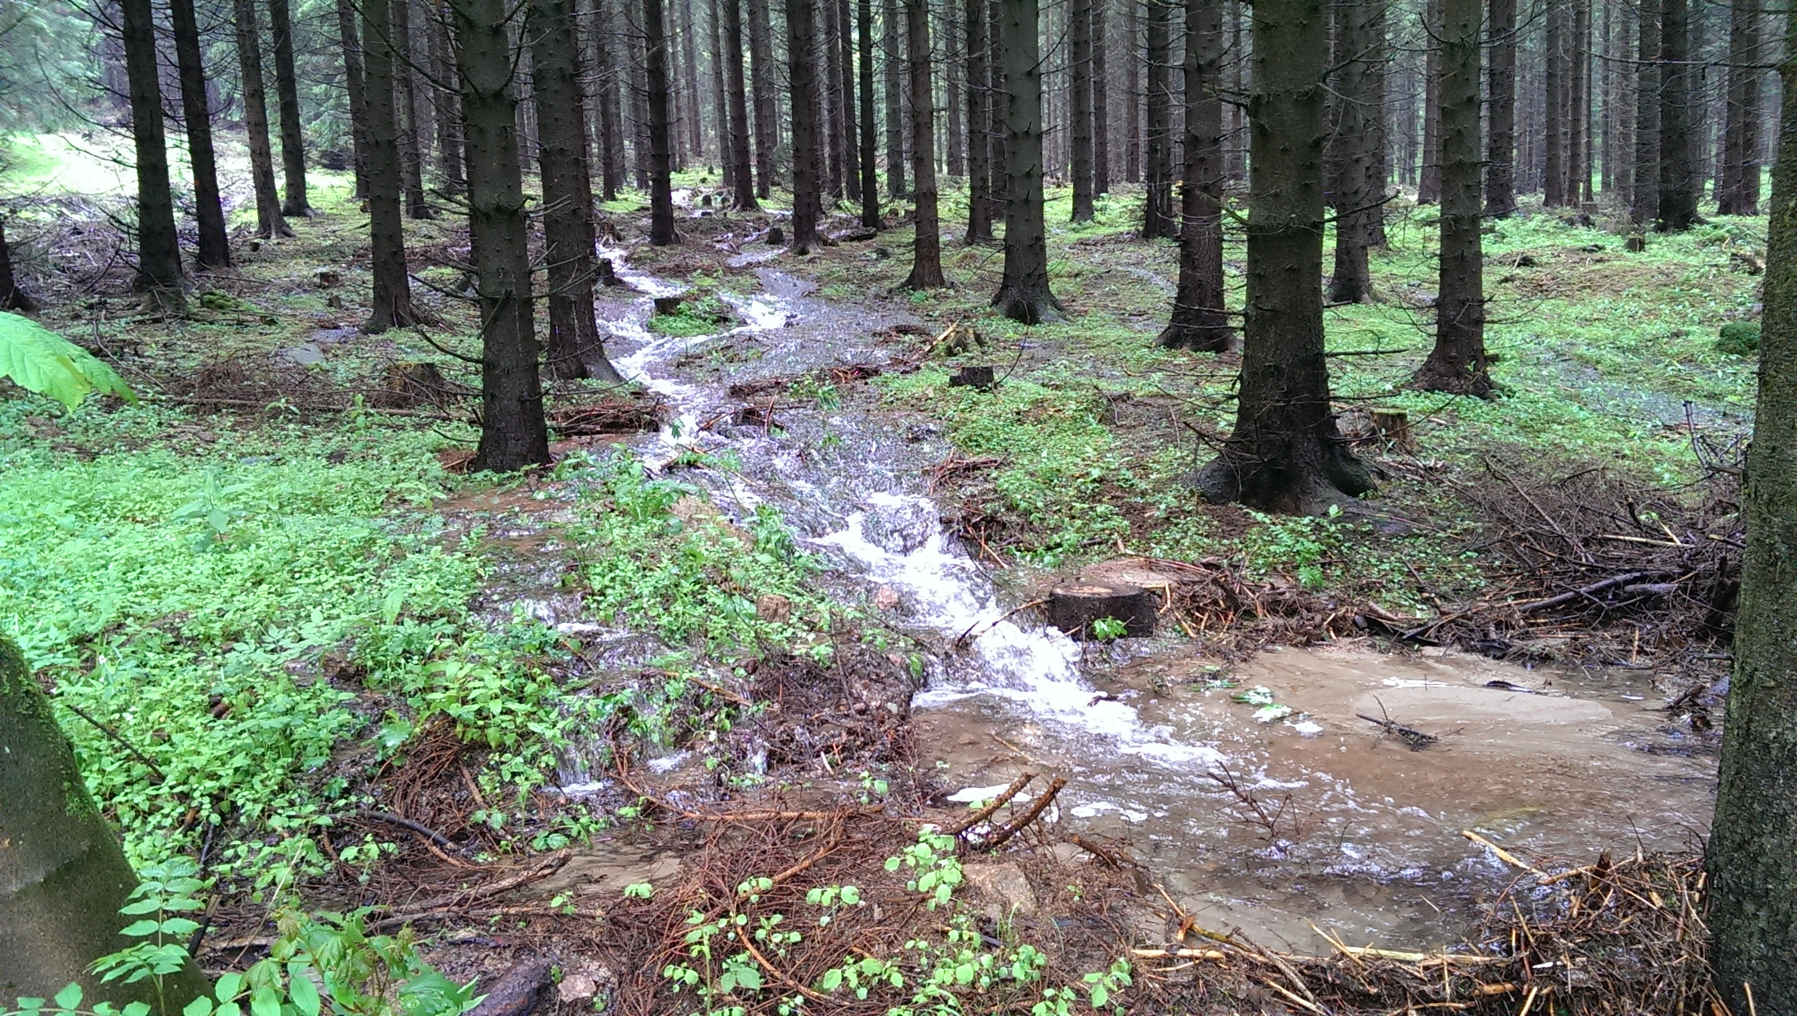
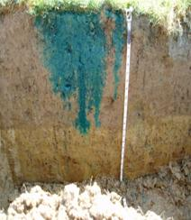
Hydrologic Modeling
Models contain approximations and simplifications
Simpler model → parameters represent more → more parameter uncertainty
Notes:
It is necessary for a model of something as complex as the flow of water through the environment to contain approximations and simplifications of the real world. Even if we could represent the entire watershed at the atomic level, the measurement of the physical properties of the watershed necessary to model all the physics would contain uncertainty. Then, applying the physics at that scale would be computationally prohibitive.
Models should be as simple of a representation of the system being modeled as needed to answer the question or perform the experiment. When several related processes are rolled into one algorithm to represent them, the parameters of that algorithm become more and more abstract and uncertain. While the parameters become more uncertain, their level of abstraction also lends them well to being determined empirically.

Slide 4
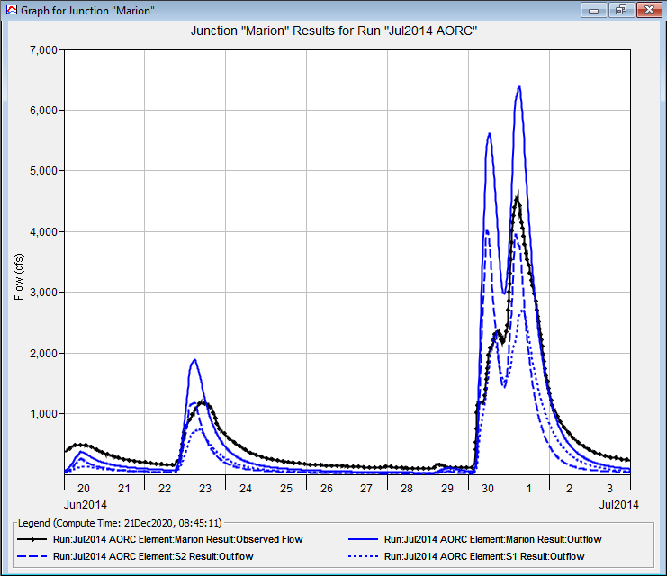
What is Calibration?
Adjustment of model parameters
Manual or automatic
Goal: match output with observed data
Notes:
Our hydrologic model is a collection of parametric algorithms that simulate the hydrologic cycle. It is up to us as modelers to determine what the appropriate parameters for those algorithms are. We want to make our algorithmic representation of the watershed match the actual watershed across a wide range of conditions. Usually, we determine if our model matches reality by comparing model output for observed past events and seeing if key results match. We may consider whether the simulation of streamflow at locations where we have flow observations match reasonably well. We may also compare observations for other hydrologic processes such as snowmelt and accumulation, and evapotranspiration.
There are some so called “automated” tools for performing calibration, but the most reliable way to produce a calibrated model with reasonable parameters is to change the parameters yourself until the model results match observed data.

Slide 5


Why Calibrate?
Uncertainty abounds
Models are simplifications
Initial estimates are only estimates
Boundary Conditions
Hydrologic Model
Observed Data
Notes:
There is uncertainty inherent in all parts of the hydrologic modeling process. The data used to define the model has measurement error – everything from elevation data and land use data to meteorologic and hydrologic boundary conditions. Process simplifications can create parameters that represent several things all rolled into one number. Models are also abstractions of the real world. Even the most detailed so-called physical models are simplifications of the hydrologic cycle.
When we make an initial estimate of a parameter from physical data, it is just that – an estimate. Using the same technique across many watersheds will on average get you close to a good value, but each individual estimate may be off.
We assume that any mismatch between the hydrologic results and the observed data are due to mis-specification of hydrologic model parameters. There are more advanced techniques involved in jointly assessing uncertainty in boundary conditions, hydrologic model parameters, and the observed data – but that’s out of scope here.
What we want in the end is a model that represents our watershed well even when we change the boundary conditions out from underneath it.

Slide 6
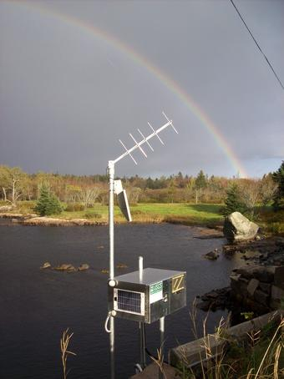
Observed Data
Observed data are necessary for calibration
USGS stream gages
Snow observations or models
Evaporation data
Notes:
Observed data are the key to knowing if our model represents reality or not. A known standard that we can compare the model to, will give us an assessment of its performance.
Usually, we are interested in calibrating flow, so we reach for instantaneous streamflow data when we can. Occasionally only coarse timestep data such as daily-average data are available, and we can aim for that instead.
Other times, the processes are more complicated. In snow-dominant watersheds we may want to calibrate the snow processes independently using observed (or modeled) snow data. For continuous calibration, it might be beneficial to calibrate the evapotranspiration process – although data to do so may be rare.

Slide 7
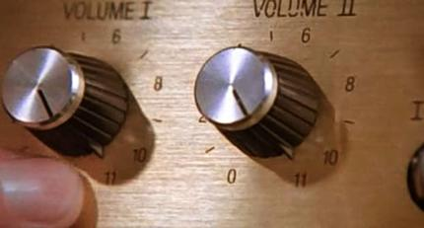
HMS Calibration
Basin model parameters
  Subbasins
  Reaches
  Reservoirs/diversions
Met model parameters
  Snowmelt
  ET
Notes:
When calibrating an HEC-HMS model, we are changing the parameter values for the processes inside the basin model and the meteorologic model.
In the basin model, the primary location we will make adjustments is in the subbasin elements. They handle the majority of the rainfall-runoff process. For more complicated watersheds where elements are connected with reaches, we may adjust reach parameters to get channel routing correct. In order to model historical events correctly, we may also need to make changes to reservoir or diversion operations.
Within the met model the most common changes are to snowmelt parameters in watersheds that need it. The temperature index method has several tunable parameters that can improve model performance not only in the explicit snowmelt and accumulation processes, but also in the resulting runoff. ET may be adjusted in a fine sense to match observations, or more coarsely to address mismatches in overall discharge volume.

Slide 8
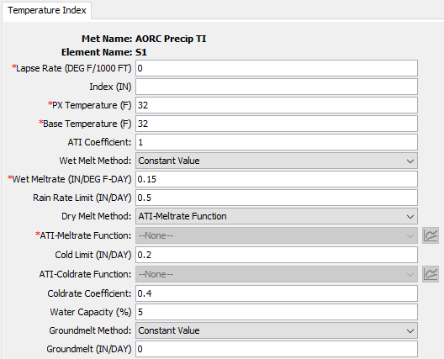
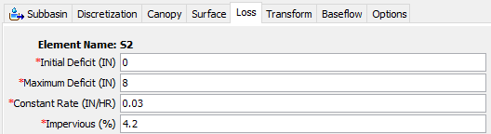
Model Parameters
Any numeric value or functional relationship that controls model behavior
Notes:
Some model parameters are typically treated as fixed, while others are allowed to freely vary during the calibration process.
For example, the area of a subbasin element is a model parameter, but it isn’t changed while calibrating.
On the left is a subbasin element, and the parameters for the loss process are shown. The user has selected the Deficit and Constant loss method as the most appropriate method for modeling the loss process in this watershed.
The method is not initially parameterized with any values and it is up to the user to provide initial estimates for those parameter values. Then, during the calibration process, these values are adjusted in order to improve model performance.
On the right is the subbasin settings for the temperature index snow model. This is a highly-parameterized model process and can include more than single-numeric-value parameters. ATI-meltrate functions and ATI-coldrate functions are an empirical representation of a mathematical function and can be calibrated to improve model performance. It is again up to the user to initially parameterize the model with parameter values, and then to adjust those parameters to improve model performance.

Slide 9
Calibration Process
Initial parameter estimates
Adjustment of parameters
Assessment of agreement
Validation
Iterate
Notes:
There is a four-step process to calibrating a hydrologic model.
First you must determine a set of initial parameters to get the model to run and assess the initial performance of the model. There are helpful tools for getting useful parameters based on data about the watershed.
Next you will begin to adjust the model parameters so that the agreement between the model and observed data begins to improve.
With each change in parameters, take the time to assess how the model performance changes. Then, go back to the parameter adjustment, and iterate. You will loop between step 2 and 3 many times, even if the initial parameter estimates aren’t bad.
Finally, once you have a candidate set of calibration parameters, you will run a validation simulation, which helps ensure your parameters are useful outside of the event you used for calibration.

Slide 10
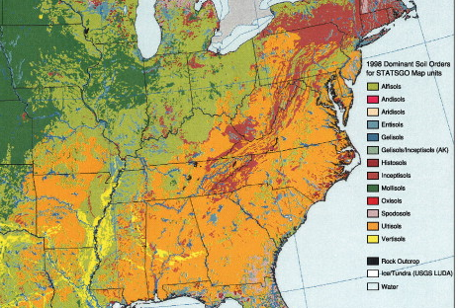
Initial Parameter Estimates
Gather informative data
  Soils
  Land use/imperviousness
  Basin characteristics
Estimate starting values from data
  Experience
  Regression
  Regional values
  Other heuristics
Notes:
HMS does not provide default values for model parameters. It is up to the user to provide reasonable starting values for model process parameters.
Experienced modelers can draw on knowledge of similar models to choose reasonable starting parameters. Models for similar watersheds may have similar parameters and parameter values from previous model calibrations may provide good starting points.
Data-driven approaches use physical information to estimate model parameter values. Typically, these estimates are driven by data such as soil surveys, land use/land cover and imperviousness data, basin physical characteristics, and so on.

Slide 11
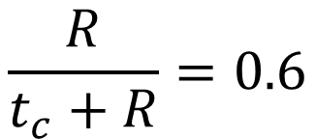


Parameter Regression
Calibrate models in a region
Predict calibrated parameters from physical data
$$t_{c}=0.39\sqrt{A}+{DD}^{2}$$
$$\frac{R}{t_{c}+R}=0.6$$
$$K_{1}=30t_{c}$$
Notes:
Regression equations are sometimes developed from regional studies. Several models are calibrated, and their physical properties retained. Then, a regression model is fit to the data so that the physical properties explain the variability in the calibrated parameters. These equations can then be used to estimate parameters in other watersheds. An example of a predictor equation for time of concentration based on basin drainage area and drainage density is shown on the right. Time of concentration tends to be easier to predict using regional regression than some other parameters are.
Over time, modelers have developed other useful guidelines for estimating starting parameters. Some parameters are easier to estimate from physical data, such as constant loss rate, percent impervious, time of concentration, and so on. Then, simple rules can be applied to these estimated parameter values to estimate other parameter values. Two examples of this are shown in the lower right. After estimating time of concentration, the storage coefficient can be estimated using an empirical relationship such as this. Typical values for this ratio are in the range of 0.5-0.8. For linear reservoir groundwater parameters, the fast-response layer coefficient can be initially estimated by 30 times the time of concentration.

Slide 12
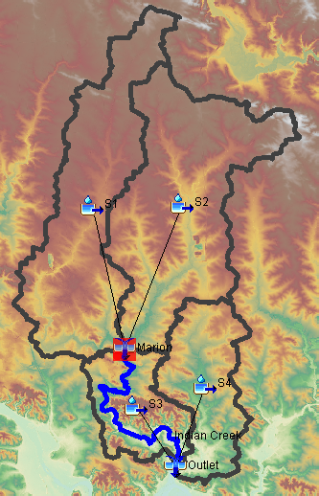
Adjustment of Parameters
Work upstream to downstream
Keep plausible ranges in mind
Consider physical evidence
Change one parameter at a time
S2
S1
S4
Marion
S3
Outlet
Notes:
Here are some simple rules for a successful calibration.
First, work upstream to downstream. Get a small area performing well, and then move downstream – and leave the smaller areas alone when adjusting parameters further downstream. In the image shown, you would calibrate S1 and S2 above the Marion junction first, and then calibrate S3, S4 and the Indian Creek reach next at the Outlet junction. When calibrating for the Outlet junction you should leave everything above the Marion junction alone once the performance at Marion is satisfactory.
When calibrating, keep in mind what ranges for a parameter are reasonable. If you are pushing against the boundary of reasonable values in your calibration, perhaps you need to be adjusting something else to bring that parameter back into range.
Consider why the model is behaving the way it is and consider the physical explanation for hydrologic behavior. Look at physical information to explain why the model behaves differently in different parts of the watershed. For example, parts of the watershed with poorly drained soils should probably have a lower infiltration rate than areas with well drained soils.
To really get a sense of the magnitude and direction of change on model performance you get by changing a parameter, change one parameter at a time and re-run the model. Then when you feel good about the model performance in one aspect (such as timing or volume) you can move on to another parameter to change that parameter. This isolates the effects of the parameters and gives you feedback on how sensitive the model performance is to it.

Slide 13
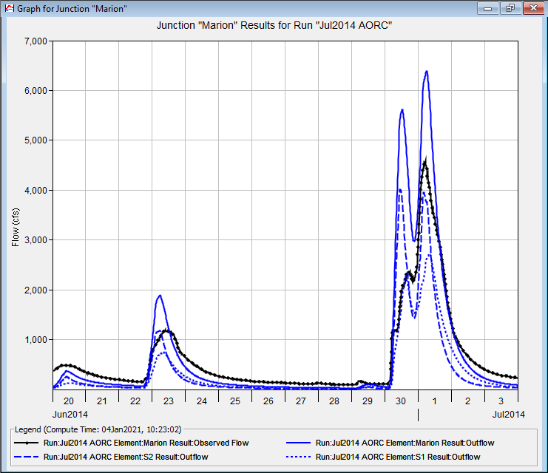
Assessment of Agreement
Visual agreement
Goodness-of-fit metrics
  Nash-Sutcliffe Model Efficiency
  Volume Error
  Root-Mean-Square Error
  Coefficient of determination (R²)
Notes:
In order to assess model agreement, you need to be able to compare the model output to observed data. In HEC-HMS, observed data is shown in black, with the simulated results in blue.
Visual agreement is the first step. It lets you qualitatively assess things like timing, volume, hydrograph shape, and so on. When you’re calibrating you can get a long ways just by using a visual comparison. Eventually you get to a point where it’s hard to know objectively whether one parameter set is better than another, and goodness-of-fit metrics can help. They can also give you an idea of how good your agreement is numerically.
Four common goodness-of-fit metrics are shown here.
There are guidelines for what values of these goodness-of-fit metrics describe good agreement between the model and observed data. These concepts will be discussed in another video.

Slide 14
Validation
Use calibrated parameters on another event
Do not adjust the parameters
Assess goodness of fit
Notes:
Validation is an extremely important and often overlooked step. It assures that you have not overfit your parameters to a single event, and that the model has predictive power outside of just the calibration period. A mistake often made is that a modeler will start to alter parameters during the validation process, but then the independent assessment of the model performance is ruined. The only parameters that MIGHT change in a situation like this are initial conditions (e.g., initial deficit, initial baseflow, etc.) Things like constant rate, unit hydrograph parameters, baseflow coefficients, and so on, should not change. The best way to represent the performance of a model for general use is to report its validation statistics.

Slide 15
HEC-HMS
Calibration
Theory
Gregory Karlovits, P.E., PH, CFM
USACE Hydrologic Engineering Center
Notes:
This has been an overview of the theory behind calibrating an HEC-HMS model. For more information, visit the HMS user’s manual, the HMS tutorials and guides online, and other videos in this series. Thanks, and have a great day!

