Slide 1


HMS Model Calibration Strategies
Emily Moe, P.E.
St. Paul District
U.S. Army Corps of Engineers

Slide 2
Objectives
Setting Initial Model Parameters
  Data Sources
  Estimation Methods
Setting Calibration Goals
  Calibration Metrics
Notes:
This lecture will cover how to set some of the more common initial model parameters—including data sources & estimation methods that you can use.
We’ll also cover how to set calibration goals and the calibration metrics that HMS provides.

Slide 3

Setting Initial
Model Parameters
Loss
Transform
Baseflow
Routing
Evapotranspiration/Snowmelt
Notes:
Setting initial model parameters—Where do those values come from?
We’ll discuss how you might estimate the initial loss, transform, baseflow & routing parameters for your model and will also touch briefly on ET & Snowmelt as well.

Slide 4
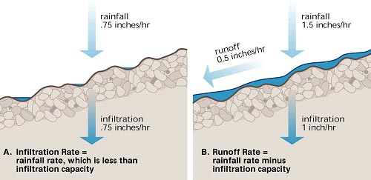
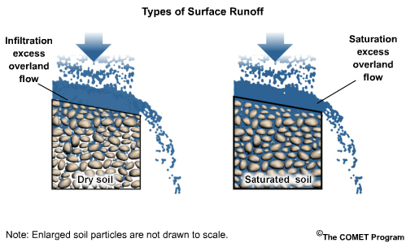
Initial Model Parameters - Loss
Loss Parameters
Regulate Infiltration
Various Methods Available
Physically-Based, Depend On:
  Rainfall
  Soil Compaction
  Slope
  Cracks
  Roots
  Vegetation
  Soil Moisture
  Litter
  Temperature
  Soil Porosity
  Soil Type
  Urban Areas
  & More!
Source: (Top)- http://ftp.comet.ucar.edu/memory-stick/hydro/basic_int/runoff/navmenu.php_tab_1_page_2.1.0.htm, (Bottom)-https://cals.arizona.edu/extension/riparian/chapt3/p07.html
Notes:
Loss parameters are very important within HMS—they regulate how much precipitation infiltrates into the soil and what becomes runoff.
There are several loss methods available within HMS. Loss parameters are physically-based and really depend on the soil properties and condition of your watershed.

Slide 5
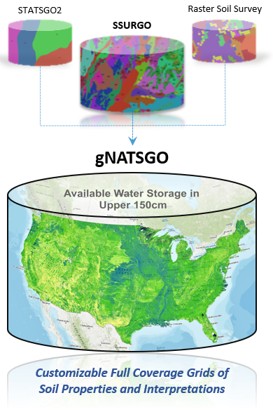
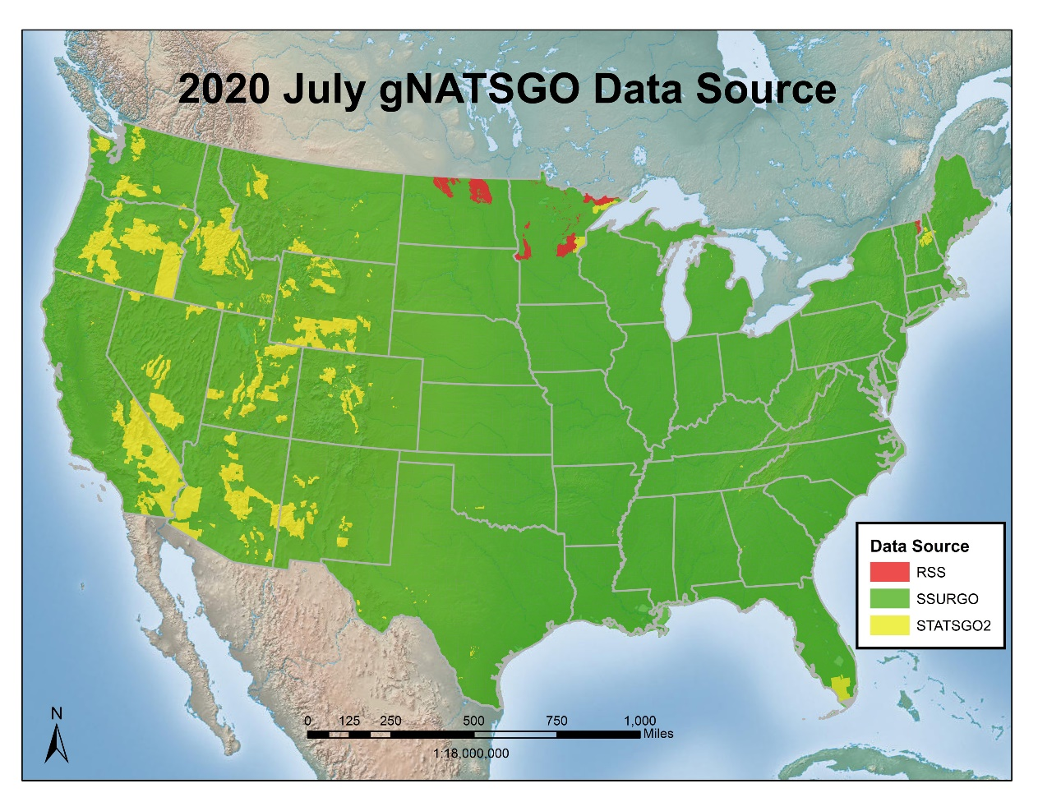
Initial Model Parameters - Loss
Loss Parameter Data Sources:
Gridded Soil Survey Geographic (gSSURGO) Database
Digital General Soil Map of the U.S. (STATSGO2)
*Gridded Nat'l Soil Survey Geo. Database (gNATSGO)*
National Land Cover Database (NLCD)
Local Resource Agencies/Studies
Source: https://www.nrcs.usda.gov/wps/portal/nrcs/detail/soils/survey/geo/?cid=nrcseprd1464625
Notes:
There are a number of nationwide, online products available that provide detailed soil information such as gSSURGO, STATSGO and gNATSGO that compiles the “best available” data to eliminate gaps.
The National Land Cover Database (NLCD) also provides valuable information on land use which can be used in estimating initial loss parameters.
Local resource agencies and nearby soil or watershed studies may also provide valuable information.

Slide 6
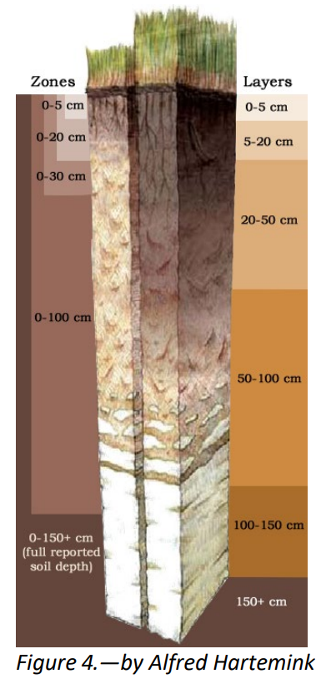
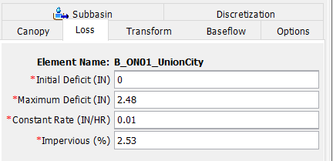
Initial Model Parameters - Loss
Initial Estimate Example:
Deficit and Constant Method
  Initial Loss: Dependent on Antecedent Conditions
    Fully Saturated? 0.0 in
    Very Dry? > 0.0 in
  Constant Loss
    Hydraulic Conductivity from gSSURGO
  Maximum Deficit
    gSSURGO Available Water Storage
  Impervious (%): Dependent on Land Cover/Use
    NLCD Urban Imperviousness
    NLCD Impervious Estimate by Type of LC
      Assign each type a %-impervious value, ratio by area within subbasin
Source: https://www.nrcs.usda.gov/wps/PA_NRCSConsumption/download?cid=nrcs142p2_051847&ext=pdf
Notes:
As mentioned earlier, there are several loss methods available within HMS, but here’s an example of how you might estimate initial loss parameters for the Deficit & Constant method.
Initial loss is very dependent on antecedent conditions within the watershed. This value ranges from Zero—when soils are already fully saturated—to higher values if the simulation is starting during a dryer period.
Constant loss rates can be estimated using soils data (such as gNATSGO)—the average hydraulic conductivity values within each subbasin is a good value to start with.
The Maximum Deficit value can also be estimated using soils data by estimating the average available water storage within each subbasin.
The Percent Impervious values can be estimated using the NLCD Urban Imperviousness data or by deriving values from the regular NLCD data by estimating the impermeability of each land class and deriving an estimate from spatial statistics.

Slide 7
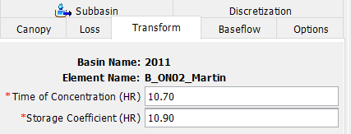
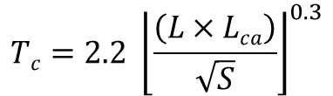

Initial Model Parameters - Transform
Transform Parameters Impact Hydrograph Timing & Attenuation
within Subbasins
Compute Initial Estimate:
Time of Concentration (T_{c}):
T_{c} = Time of Concentration (hr)
L = Longest Flowpath (mi)
L_{ca} = Centroidal Longest Flowpath (mi)
S₁₀₋₈₅ = 10-85 Stream Slope (ft/mi)
Storage Coefficient (R):
R = Storage Coefficient (hr)
T_{c} = Time of Concentration (hr)
Try Constant=0.5 to start
Other Initialization Methods:
Previous Models
Regression Equations
Tc:
Tc:
Flow
Flow
Time
Time
$$Tc=2.2 {\left\lfloor \frac{\left(L×Lca\right)}{\sqrt{S}}\right\rfloor }^{0.3}$$
R:
R:
Flow
Flow
Time
Time
$\frac{R}{\left(Tc+R\right)}$ = Constant
Notes:
Transform parameters are also critical within HMS—they impact the timing & attenuation of subbasin hydrographs.
You can compute initial estimates of the Time of Concentration (Tc) using subbasin physical properties.
The Storage Coefficient (R) is usually associated as a ratio with Tc and that ratio is usually set equal to a constant value. A good initial estimate would be setting the R/(Tc+R) ratio to 0.5 and solving for an initial R value.
Other methods to estimate these initial parameters include referencing previous models or referring to regression equations and studies from within your region as well. Some regions have even identified typical ranges of the R/(Tc+R) ratio—so local resources can be extremely helpful if you can find them!

Slide 8
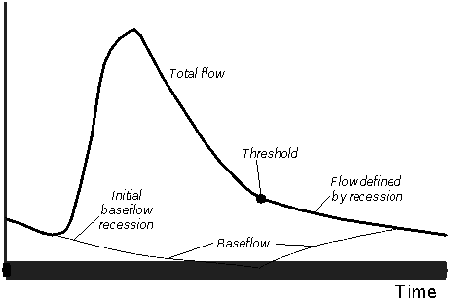
Initial Model Parameters - Baseflow
Baseflow Parameters Impact Hydrograph Attenuation & Recession within Subbasins
Common Baseflow Methods:
Recession:
  Recession Constant
    Baseflow recession slope
    Typically 0.7 to 1
    ↓ Value = ↑ Slope
    Start with 0.9, adjust in calibration
  Ratio to Peak
    Threshold at which BF recession begins
    Start with 0.2, adjust in calibration
Linear Reservoir:
  Conserves Volume (No Loss)
GW1 coefficient = 3 x T_{c}
GW2 coefficient = 10 x T_{c}
T_{c} = Time of Concentration
RC=1
Flow
Flow
RC<1
Time
Time
1.0
1.0
RTP=0.5
0.5
RTP=0.2
Flow
Flow
0.2
0.0
Time
0.0
Time
Flow
Notes:
HMS Baseflow parameters impact the hydrograph’s attenuation & recession within each subbasin.
HMS offers several baseflow methods, but we’ll focus on a couple of the most common.
The figures on this slide help illustrate the key components of the recession baseflow method—that has two primary parameters—the Recession Constant—which essentially defines the slope of the receding hydrograph. Recession constant values typically range from 0.7 to 1.0. A recession constant of 1 results in a completely horizontal tail. The further the value is from 1.0, the steeper the slope. Assuming an initial value of 0.9 & further adjusting in calibration is a good starting point for this parameter.
The Ratio to Peak parameter is essentially the threshold at which the Baseflow Recession begins—the pivot point of the hydrograph. Looking at the 2nd row of figures here—a Ratio to Peak of 0.5 places the pivot point at 50% of the peak flow value. A Ratio to Peak value of 0.2 lowers the pivot point to the 20% (of peak flow) value on the receding limb of the hydrograph.
Initial RTP values can be estimated by examining observed flow data or through adjustment during calibration.
The Linear Reservoir method is another popular HMS baseflow method and is particularly relevant when groundwater interaction is occurring within a watershed as it conserves volume throughout the simulation event. Rules of thumb for estimating the Groundwater Coefficients are shown here as 3 times the time of concentration for the 1st Coefficient and about 10 times Tc for the 2nd coefficient.

Slide 9
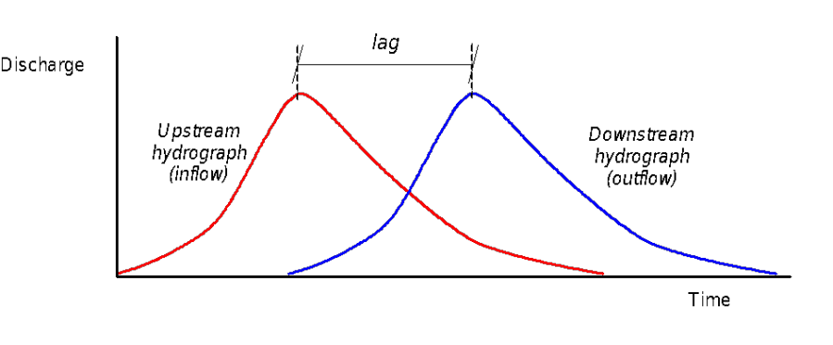
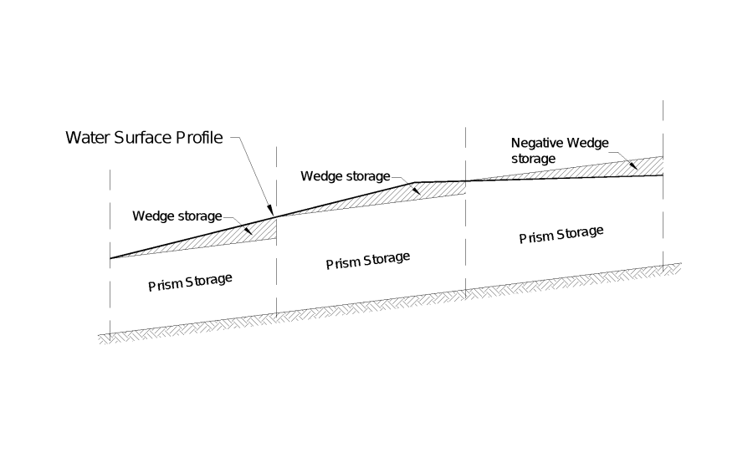
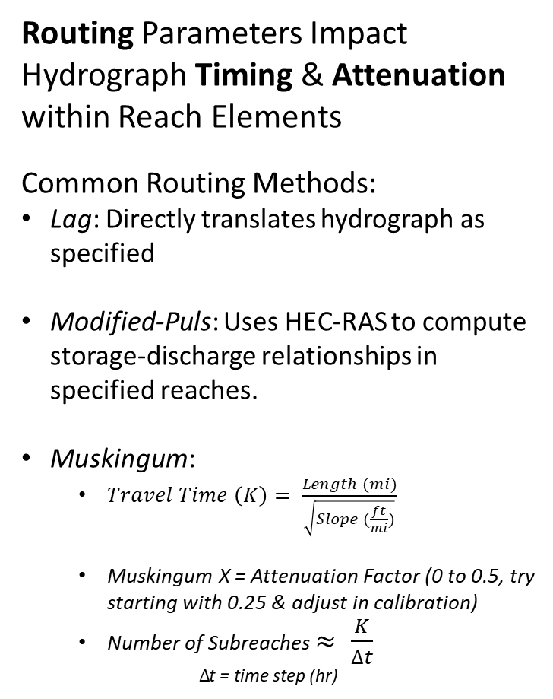
Initial Model Parameters - Routing
Routing Parameters Impact Hydrograph Timing & Attenuation within Reach Elements
Common Routing Methods:
Lag: Directly translates hydrograph as specified
Modified-Puls: Uses HEC-RAS to compute storage-discharge relationships in specified reaches.
Muskingum:
  $Travel Time \left(K\right)= \frac{Length (mi)}{\sqrt{Slope (\frac{ft}{mi})}}$
  Muskingum X = Attenuation Factor (0 to 0.5, try starting with 0.25 & adjust in calibration)
  Number of Subreaches $≈ \frac{K}{∆t}$
  $∆$t = time step (hr)
Notes:
The HMS Routing parameters impact the hydrograph timing & attenuation within Reach Elements.
Several routing methods are available, but we’ll touch on a few of the common ones.
The Lag method directly staggers the hydrograph by the specified Lag Time and does not include any attenuation or storage.
The Modified-Puls method uses HEC-RAS to determine storage-discharge relationships within specified reaches.
The Muskingum method uses the length and slope of each reach to estimate its travel time. Attenuation can be adjusted by adjusting the Muskingum X value between 0 and 0.5—I suggest starting with 0.25 and adjusting further during calibration. The number of subreaches for this method is estimated by dividing the Travel Time by the simulation timestep.

Slide 10


Initial Model Parameters – ET & Snow
Evapotranspiration (ET)
Accounts for water vaporization & plant absorption.
Data Sources:
  National Climatic Data Center (NCDC)
  Water Control Manuals/Local Reports
Snowmelt Parameters
Includes Temperature, Snow & Melt Parameters
Data Sources:
  Snow Data Assimilation System (SNODAS)
  Snow Telemetry (SNOTEL)
  Add’l Local & Nationwide Sources
ET & Snow can be calibrated independently of streamflow.
Notes:
Evapotranspiration (ET) and Snowmelt Parameters can also be applied within HMS.
ET accounts for water vaporization & plant absorption—initial ET values can be derived from Evaporation Data found on the NCDC website. ET estimates are also often included in USACE Water Control Manuals or reports on other local studies.
Snowmelt parameters include temperature, Snow and Melt components. Snowmelt data sources include SNODAS—which is national snow modeling output or SNOTEL which includes direct snow measurements and is widely available in the Western US.
Both the ET & Snowmelt components can be calibrated independently from the runoff/streamflow calibration within HMS.

Slide 11
Setting
Calibration Goals
Goals Vary by Project Objective
Goal Examples:
  Quantitative Goodness-of-Fit
    Statistics
  Timing
  Volume
  Magnitude
Notes:
Now that you’ve developed initial parameters for your model--It’s very helpful to set goals when calibrating an HMS model. Calibration goals might include:
-Quantitative goodness-of-fit goals—using statistics
and goals for how important it is to capture the timing, volume and magnitude of the calibration events.
Examples of goals are included in the next few slides, but goals should be determined based on the objectives of the HMS project.

Slide 12
Calibration Goals
Quantitative Goodness-of-Fit
  Coefficient of Determination, Nash-Sutcliffe Efficiency, Root Mean Square Error, Percent Bias
Performance Ratings for Evaluation Metrics for a daily and weekly time step
Performance Rating | R² | NSE | RSR | PBIAS
Very Good | 0.65<R2≤1.00 | 0.65<𝑁𝑆𝐸≤1.00 | 0.00<𝑅𝑆𝑅≤0.60 | 𝑃𝐵𝐼𝐴𝑆< ±15
Good | 0.55<𝑅2≤0.65 | 0.55<𝑁𝑆𝐸≤0.65 | 0.60<𝑅𝑆𝑅≤0.70 | ±15≤𝑃𝐵𝐼𝐴𝑆<±20
Satisfactory | 0.40<𝑅2≤0.55 | 0.40<𝑁𝑆𝐸≤0.55 | 0.70<𝑅𝑆𝑅≤0.80 | ±20≤𝑃𝐵𝐼𝐴𝑆<±30
Unsatisfactory | 𝑅2≤0.40 | 𝑁𝑆𝐸≤0.40 | 𝑅𝑆𝑅>0.80 | 𝑃𝐵𝐼𝐴𝑆≥±30
Performance Ratings for Evaluation Metrics for a monthly time step
Performance Rating | R² | NSE | RSR | PBIAS
Very Good | 0.75<𝑅2≤1.00 | 0.75<𝑁𝑆𝐸≤1.00 | 0.00<𝑅𝑆𝑅≤0.50 | 𝑃𝐵𝐼𝐴𝑆< ±10
Good | 0.65<𝑅2≤0.75 | 0.65<𝑁𝑆𝐸≤0.75 | 0.50<𝑅𝑆𝑅≤0.60 | ±10≤𝑃𝐵𝐼𝐴𝑆<±15
Satisfactory | 0.50<𝑅2≤0.65 | 0.50<𝑁𝑆𝐸≤0.65 | 0.60<𝑅𝑆𝑅≤0.70 | ±15≤𝑃𝐵𝐼𝐴𝑆<±25
Unsatisfactory | 𝑅2≤0.50 | 𝑁𝑆𝐸≤0.50 | 𝑅𝑆𝑅>0.70 | 𝑃𝐵𝐼𝐴𝑆≥±25
Source: Moriasi et al (2007)
Notes:
Statistics used for model evaluation:
Coefficient of Determination (R²)
Nash-Sutcliffe Efficiency (NSE)
Root Mean Square Error (RSR)
Percent Bias (PBIAS)
Instead of simply using the “eyeball test” to visually look at whether or not model results match observed data, it is helpful to set quantitative goodness-of-fit goals using statistics such as R2, Nash-Sutcliffe & more.
Shown here is a handy table by Moriasi that proposes a range of statistical values that quantitatively categorize how well the calibration mirrors the observed event.
For example, to be satisfactory, the Nash-Sutcliffe efficiency for models with a daily or weekly timestep should be greater than 0.40 and if it’s above 0.65 it is considered a Very Good fit.

Slide 13
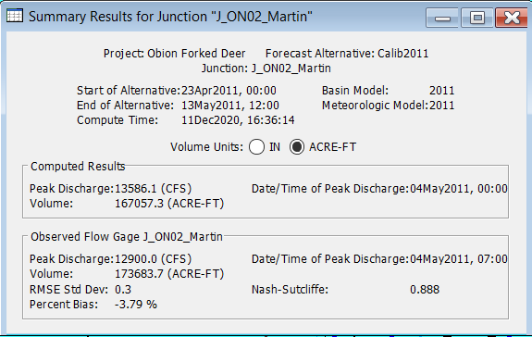
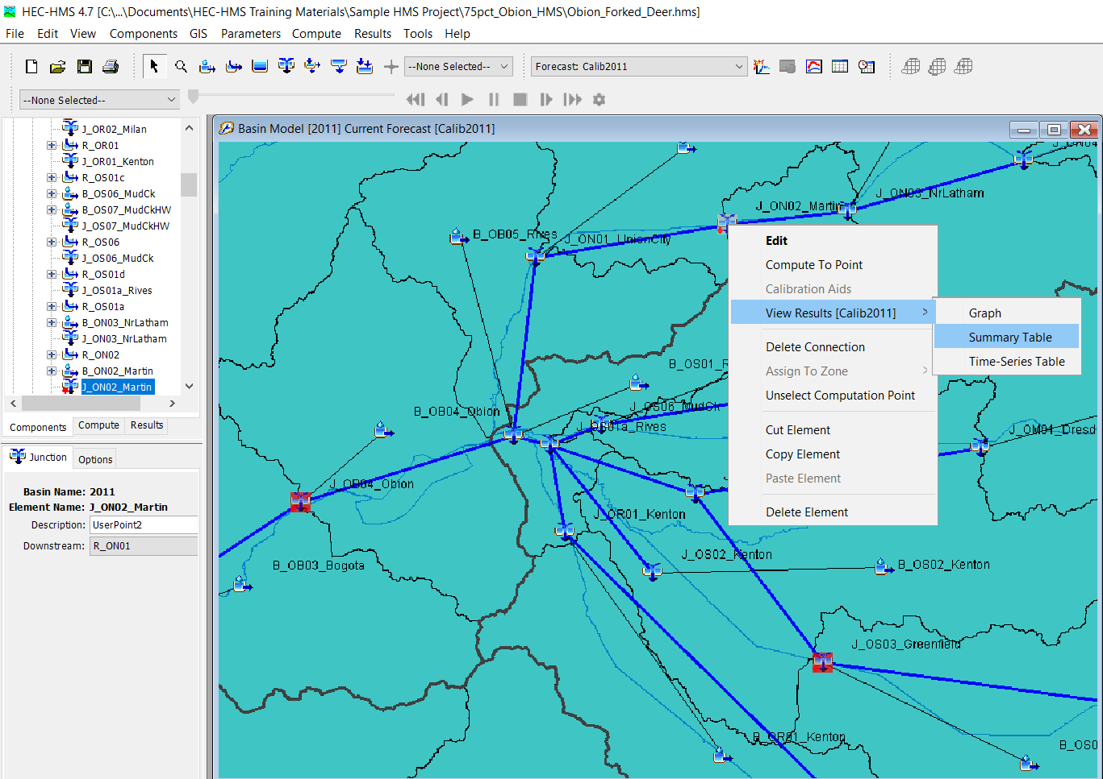
Calibration Goals
Right-Click!
Notes:
Thankfully, if you have observed flow data linked to a junction in HMS, the program will compute several goodness-of-fit statistics for you!
These statistics can be found in the junction’s Summary Table by right-clicking on the junction, selecting “View Results” and then “Summary Table.”

Slide 14

Calibration Goals
Performance Ratings for Evaluation Metrics for a daily and weekly time step
Performance Rating | R² | NSE | RSR | PBIAS
Very Good | 0.65<R2≤1.00 | 0.65<𝑁𝑆𝐸≤1.00 | 0.00<𝑅𝑆𝑅≤0.60 | 𝑃𝐵𝐼𝐴𝑆< ±15
Good | 0.55<𝑅2≤0.65 | 0.55<𝑁𝑆𝐸≤0.65 | 0.60<𝑅𝑆𝑅≤0.70 | ±15≤𝑃𝐵𝐼𝐴𝑆<±20
Satisfactory | 0.40<𝑅2≤0.55 | 0.40<𝑁𝑆𝐸≤0.55 | 0.70<𝑅𝑆𝑅≤0.80 | ±20≤𝑃𝐵𝐼𝐴𝑆<±30
Unsatisfactory | 𝑅2≤0.40 | 𝑁𝑆𝐸≤0.40 | 𝑅𝑆𝑅>0.80 | 𝑃𝐵𝐼𝐴𝑆≥±30
Source: Moriasi et al (2007)
Notes:
For example, this location has a Nash-Sutcliffe efficiency of 0.888 which falls into the Very Good category—so this would be considered quantitatively well-fit to the observed data.

Slide 15
Calibration Goals
  Timing
    Ex: +/- 12 hours of Observed Peak
Notes:
Beyond simple statistics, it’s also very useful to set calibration goals for other event components based on the objectives and needs of your project.
For example, in some of our forecasting HMS models, we’ve set an initial goal of calibrating the timing of events to within 12 hours of the observed peak.
Again, timing goals may vary significantly based on what the objectives of your project are.
HMS makes it very easy to compare the modeled and observed peak timing by displaying both timestamps within the Summary table window as shown here.

Slide 16
Calibration Goals
  Volume
    Ex: +/- 10% of Observed Event Volume
Notes:
Volume is another key component that you should consider setting calibration goals for---particularly if you’ll be using the HMS model for forecasting models or reservoir studies, the event volume is a critical component you’ll want to capture as closely as possible.
For some of my forecasting models, we set an initial goal of capturing total event volume within 10% of the observed event volume.
Again, HMS makes it very easy to obtain the modeled and observed volumes for the event from directly within the Summary Table.

Slide 17
Calibration Goals
  Peak Magnitude
    Ex: +/- 10% of Observed Peak
Notes:
Event Magnitude is another component you may consider setting calibration goals for—often peak magnitude corresponds to peak stage and inundation levels, so depending on the scope of your study, the magnitude goal may vary.
In the past, for forecasting models, we’ve set an initial calibration goal of coming within 10% of the observed peak magnitudes.
Again, looking at the Summary table again here, HMS makes it easy to do a quick peak magnitude comparison between modeled results and observed values if you have the gage data linked to the junction.

Slide 18
Takeaways
Setting Initial Model Parameters
  “Best Guess” Starting Values
  Parameters Will Evolve Throughout Calibration
Setting Calibration Goals
  Quantifying Fit (vs. “Eyeball Test”)
  Goals Depend on Scope of Project
Notes:
Let’s wrap up with the key takeaways from this lecture—
When setting initial parameters, it’s important to remember that these as simply your “best guess” numbers—the parameters will evolve further as you calibrate and hone in on the processes within your watershed.
When setting calibration goals—it’s helpful to set quantifiable goodness-of-fit goals vs. relying on the “eyeball test.” We provided some examples of goals, but the goals you set definitely depend on the scope and objectives of each unique project.

Slide 19
References
Moriasi, D. N., J.G. Arnold, M.W. Van Liew, R.L. Bingner, R.D. Harmel, and T.L. Veith, Model evaluation guidelines for systematic quantification of accuracy in watershed simulations, Transactions of the ASABE 50 (3), 885-900, 2007

Slide 20
HMS Model Calibration Strategies
Emily Moe, P.E.
St. Paul District
U.S. Army Corps of Engineers

