Slide 1
Model Calibration aids
Thomas Brauer, P.E.
Hydrologic Engineering Center
Notes:
Hi, this is Tom Brauer with the Hydrologic Engineering Center. In this video I’m going to demonstrate some tools that can help with model calibration.

Slide 2
Model calibration aids
Element Results
Continuous Calibration Aid
Statistics Report
Statistics Plot
Notes:
The calibration aids that I’ll demonstrate today are the element results, the continuous calibration aid, the statistics report, and the statistics plot.

Slide 3
Model calibration aids
Element Results
Continuous Calibration Aid
Statistics Report
Statistics Plot
Notes:
First the element results.

Slide 4
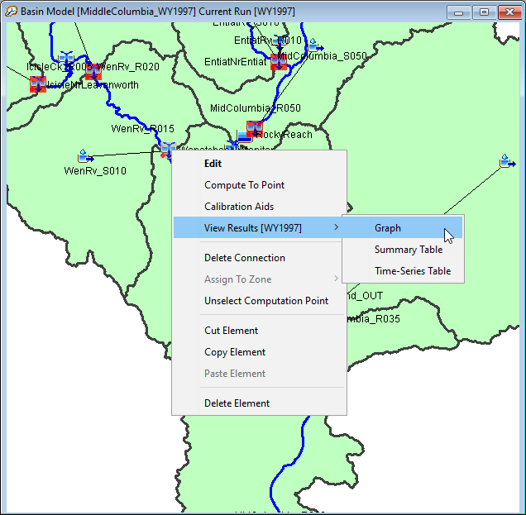
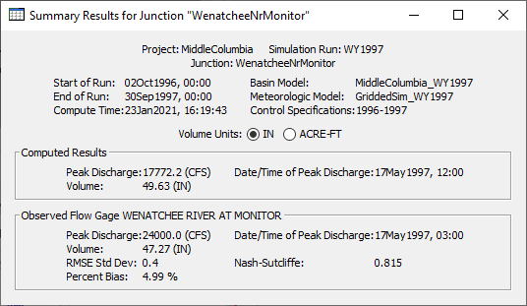
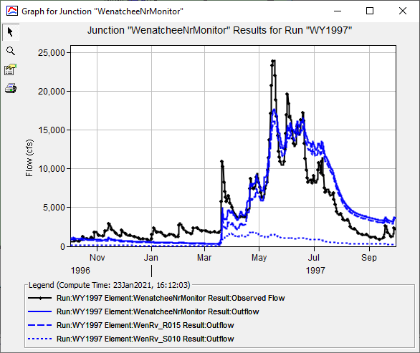
Element results
Notes:
The element results summary table and graph are integral to HMS. Any time I have observed flow for an element the graph will show both observed and computed flow, and the table will provide goodness of fit metrics such Nash Sutcliffe Efficiency and Percent Bias.
Requirements:
Must have observed flow at a location
Pros:
Easy to access
Automatically updates with each compute
Cons:
There is no ability to change the computation time interval for statistics. The statistics are computed at the simulation time interval. This causes discrepancies when the observed data is in a different interval than the computed results.
There is only a single point per view. The only way to view multiple points at one time is to open multiple results windows.

Slide 5
Model calibration aids
Element Results
Continuous Calibration Aid
Statistics Report
Statistics Plot
Notes:
The next calibration tool that I’ll demonstrate is the continuous calibration aid.

Slide 6
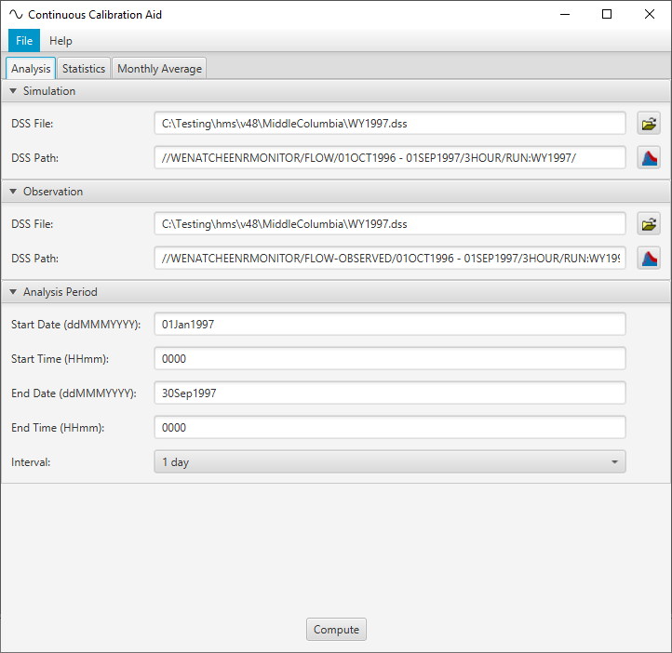
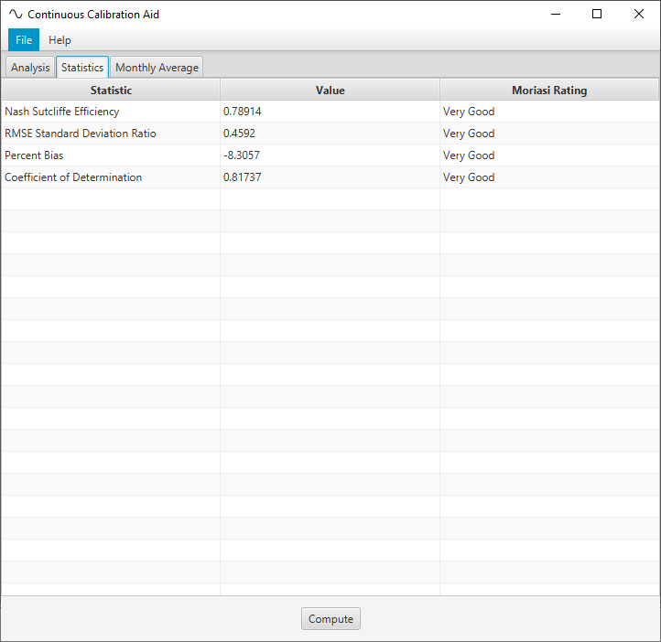
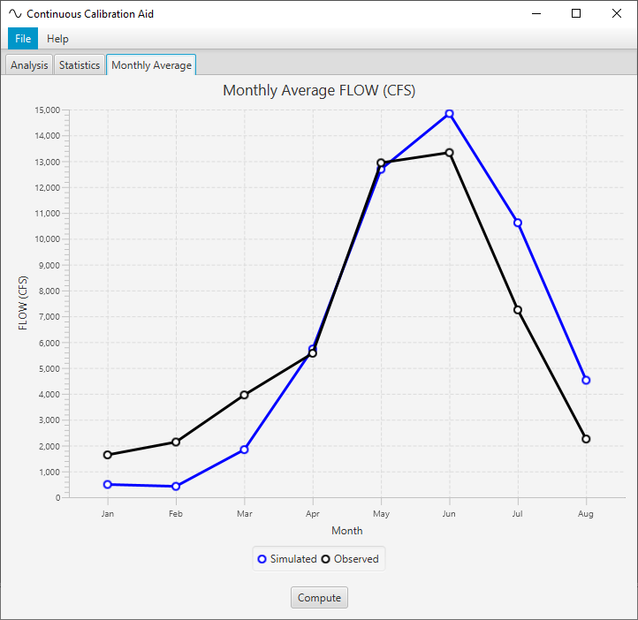
Continuous calibration aid
Notes:
The continuous calibration aid was built for a modeling project on the Columbia River where the calibration events were entire water years. For this case it was helpful to be able to quickly view a hydrograph based on monthly average flow. The simulation was also performed at a one day time step while the observed flow was often hourly. The continuous calibration aid allows us to select a statistics time interval that is different from the simulation time interval.
Pros:
Ability to change the computation time interval for statistics.
Ability to change the computation time window for statistics.
Rapidly performs cyclic analysis for continuous simulation
Cons:
Not a tight integration with HEC-HMS. The calibration is a stand-alone utility.
Single point. The only way to view multiple points at one time is to open multiple instances of the tool.
Must recompute with every HMS compute.

Slide 7
Model calibration aids
Element Results
Continuous Calibration Aid
Statistics Report
Statistics Plot
Notes:
The next calibration tool that I’ll demonstrate is the statistics report.

Slide 8
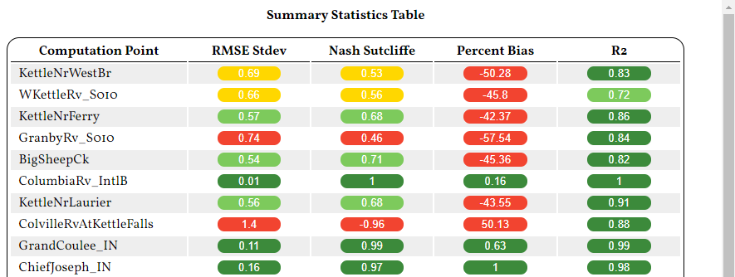
Statistics Report
Notes:
To generate a statistics report in HMS you must have already computed the simulation run. The statistics report is available from the Tools | Reports menu
Pros:
You can view multiple calibration points in one consolidated view.
Cons:
No ability to change the computation time interval for statistics. This causes discrepancies when the observed data is in a different interval than the computed results.
Must recompute with every HMS compute.

Slide 9
Model calibration aids
Element Results
Continuous Calibration Aid
Statistics Report
Statistics Plot
Notes:
Finally I’ll talk about the statistics plot.

Slide 10
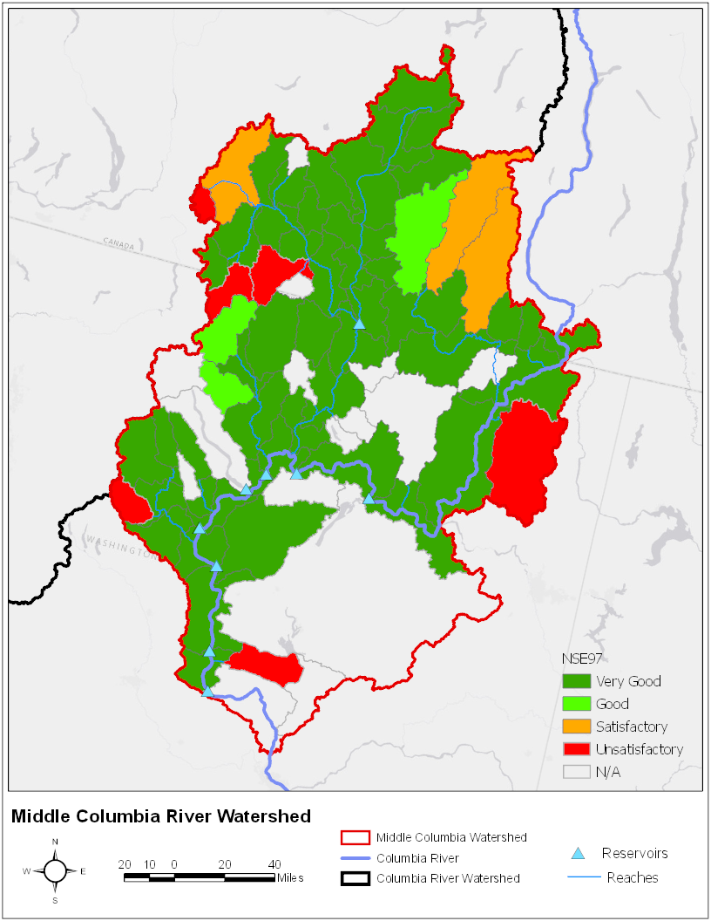
Statistics plot
Notes:
There is currently no automation for the statistics plot but it can be generated in a GIS if you are willing. In the statistics plot subbasins or calibration points are colored based on their performance for a given summary statistic. Pros of this approach is that it gives a spatial notion of calibration. Because the statistics plot is not currently automated it is typically something that we only do for reporting purposes once the calibration is complete.

Slide 11
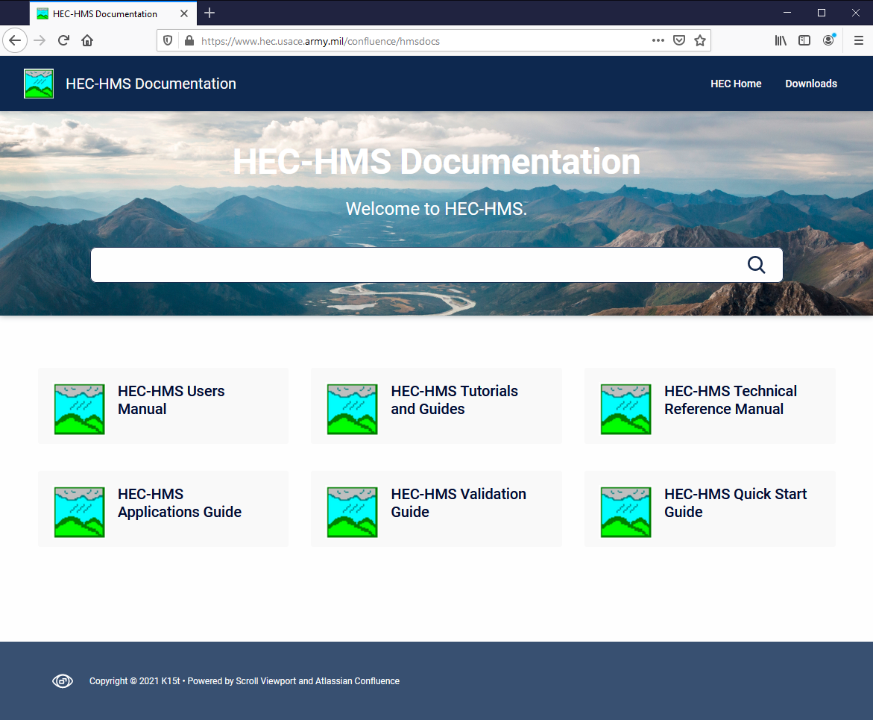
FOR MORE…
Notes:
This concludes the presentation on model calibration aids. For more resources on HEC-HMS check out the HEC-HMS documentation website.

