Slide 1
Parameter Optimization in HEC-HMS
HEC-HMS Quarterly Webinar
June 2022
Matt Fleming, P.E.
Gregory S. Karlovits, P.E., PH, CFM
US Army Corps of Engineers
Hydrologic Engineering Center

Slide 2
Outline
Overview of parameter optimization in HEC-HMS
New features in versions 4.9 and 4.10
Practical parameter optimization advice
Example applications
Closing comments

Slide 3
Overview of
Parameter Optimization

Slide 4
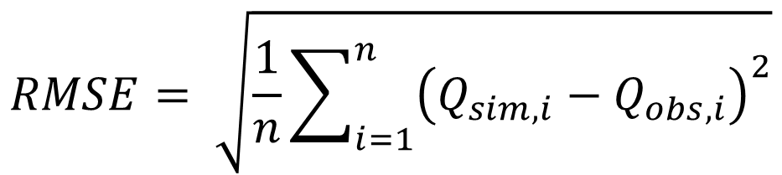
What is Parameter Optimization?
Mathematical routine for fitting a model to data
Search for parameter values that create the best fit
Minimize the error according to an objective function
$$RMSE= \sqrt{\frac{1}{n}\sum_{i=1}^{n}{{\left(Q_{sim, i}−Q_{obs, i}\right)}^{2}}}$$

Slide 5
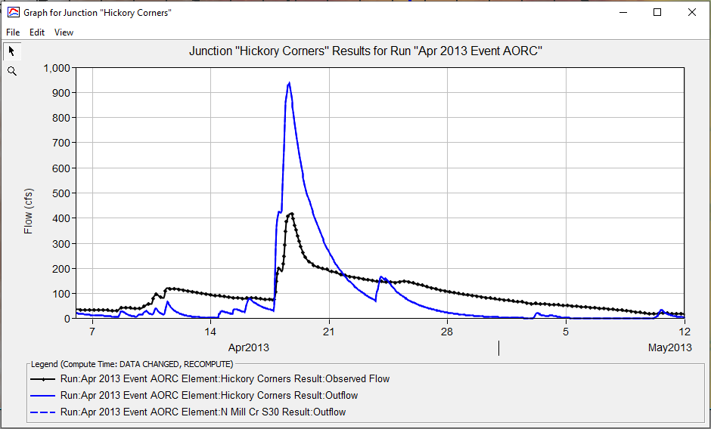
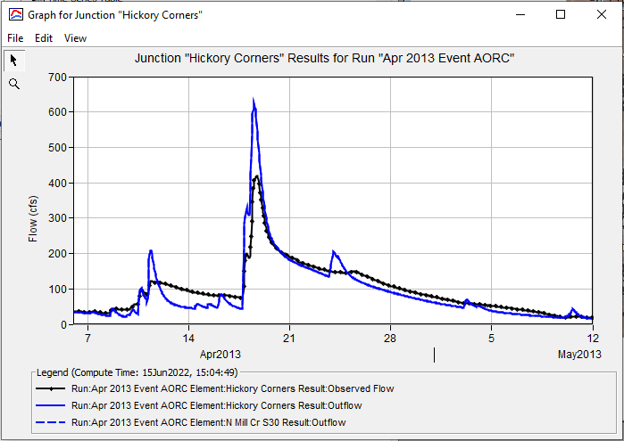
Objective Function
Quantify agreement between modeled/observed in single number
Notes:
As hydrologists we can look at the difference between modeled (blue) and observed (black) and get an idea of what needs to be adjusted in our model – we’re overestimating high periods and underestimating low periods in the result on the left. We probably need to be infiltrating a lot more, and increasing the amount of water in the model in the initial conditions. The timing doesn’t look bad so we need to preserve that timing aspect as we make those adjustments.
If we adjust parameters and get the second plot on the right, we probably feel like we’re doing better because we’re closer on the peak magnitude, capturing the recession on the right side of the hydrograph, and a little closer on the initial conditions.
The objective function doesn’t have that level of nuance – it simply looks at the difference between the two graphs and measures that magnitude with a single number. Its goal is to be able to tell us which parameter set between multiple sets is better, or best. In the two plots the objective function needs to be able to tell us that the parameter set creating the plot on the right is better than the plot on the left.

Slide 6
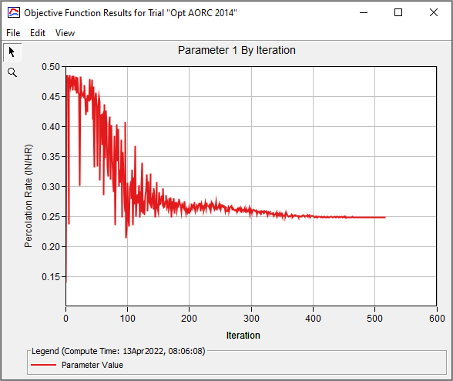
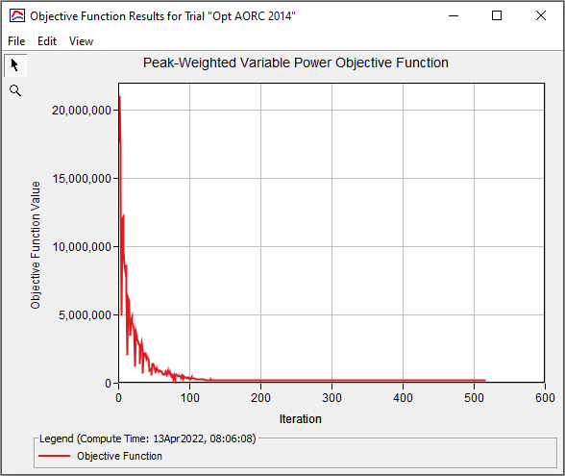
Search
Notes:
The search is an iterative process. Each iteration of the search sets the model parameters, runs the model, and gets back an objective function value. The change in the objective function value (better or worse than before) tells the searcher what new parameters to propose to use.
The first plot is an illustration of a constant loss rate converging to a best fit value of about 0.25 inches per hour. Notice that the initial guess was much higher, but the search iterated until it was able to get down to that value. On the right is a plot of the objective function value. In this case, higher values of the objective function are worse – they are proportional to the amount of model error. The goal of the search is to find parameter values that reduce the objective function value.

Slide 7
Convergence
How does a search decide to stop?
Simplex: is the relative difference between the OF values at the nodes small enough?
DE: is the variability in the OF values small enough?
Hint: start with a big value for tolerance and reduce!
  Tolerance is relative to the objective function
Notes:
Note – this does NOT look at the parameter values, only the variability in the values of the objective function. If multiple parameter sets produce similar OF values, the solver may think it’s converging to a single solution!

Slide 8
Optimization Limitations
Optimization can’t replace good judgement
Good inputs from an expert required for meaningful results
Objective function must fully encode model fitness
Equifinality

Slide 9
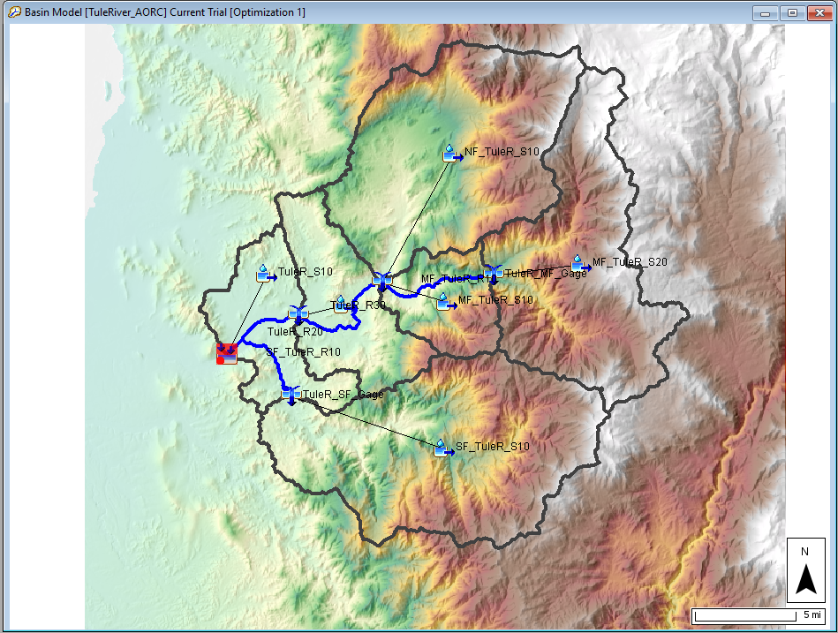
Equifinality
There are multiple parameter sets providing equally good or acceptable model outputs
But not all parameter sets are reasonable or conceptually sound
Can happen when multiple parameters have similar impacts and when there are multiple upstream elements
Notes:
In this example, there are six subbasins upstream of a location with observed flow. Adding all loss, transform, and baseflow parameters for all six subbasins into an optimization search would result in an unlimited number of unrealistic combinations of parameters that generate “adequate” flow results. High TC and R values for one subbasin can be offset by low TC and R values in another subbasin. You can limit unrealistic parameter sets by:
Limiting multiple upstream elements. – make use of the scale factor adjustment that is available for a few of the model parameters.
Limiting parameter that impact the same hydrologic response (Storage Coefficient and loss rate both affect peak flow).
Define realistic ranges for parameter values. For example, a 100 square mile watershed has a TC parameter in the range of X hours to X hours.

Slide 10
How Optimization Can Help You
Get moving in the right direction for calibration
  Sensitivity
  Direction of change
Make final calibration tweaks
Find parameter values that aren’t easy to intuit
  HMR52 storm parameters

Slide 11
Other Uses of Optimization
Find parameters that maximize flow or stage properties
  Peak discharge
  Flow volume
  Peak stage
Usually used for probable maximum flood (PMF) analysis

Slide 12
New Features in 4.9 and 4.10

Slide 13
New Features and Enhancements
Version 4.9
Version 4.10
Optimize SWE
Differential Evolution search
Data transformations
Adaptive Simplex search
Improved Simplex initialization
Resume stopped DE search
New objective functions
  Normalized Nash-Sutcliffe
  Peak-Weighted Variable Power

Slide 14
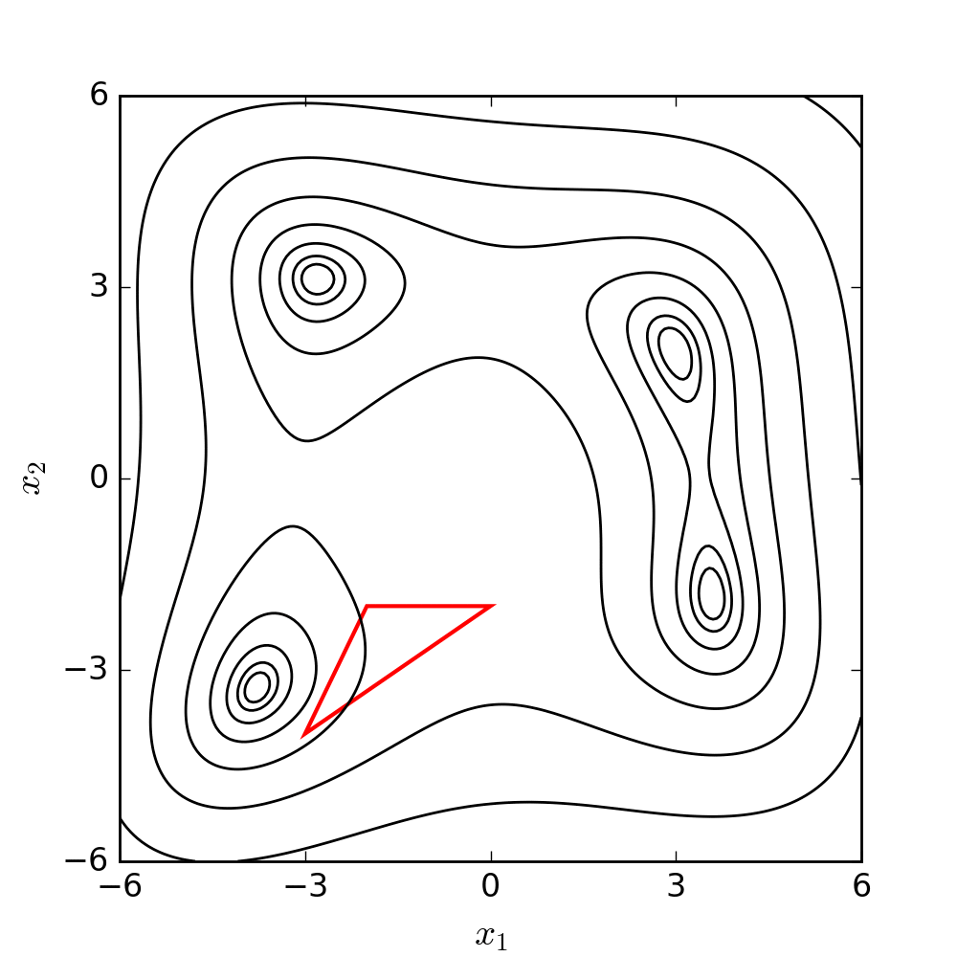
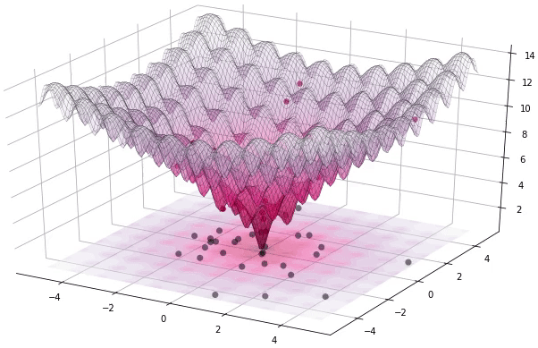
Search Methods
Nelder-Mead Simplex
Differential Evolution

Slide 15
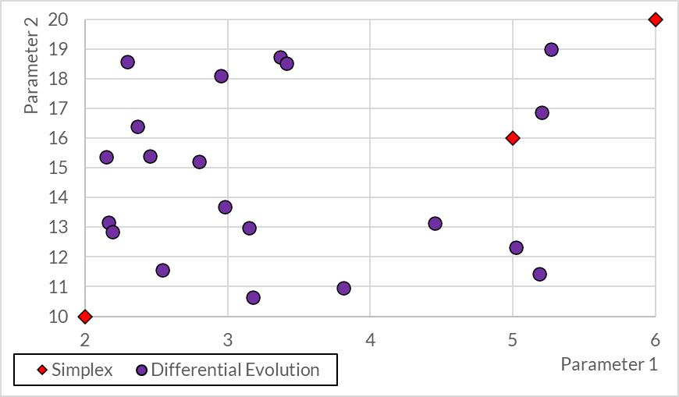
Search Initialization
 | Low | Best | High
Parameter 1 | 2 | 5 | 6
Parameter 2 | 10 | 16 | 20
Notes:
The size of the problem is different for the two methods. For Simplex, it evaluates n+1 positions as it evolves (where n is the number of parameters.) Differential evolution evaluates P positions (where P is the population size – in this plot it’s 20). Simplex will generally have to run your HMS model at most 2 times per iteration (very rarely it will run it n-1 times, which is a big deal if you have a lot of parameters.) Differential evolution will run your HMS model P times, every iteration.
When the searches are initialized, Simplex will give you the same starting case every time. Differential evolution will give you a different starting case every time. Also, Differential Evolution does not care about your initial guess or best estimate – only the low and high values for the range. So if you have good information, use Simplex. If you don’t, and can afford to wait, use Differential Evolution. If you can’t afford to wait, get more information and use Simplex.

Slide 16
Search Methods
Nelder-Mead Simplex
Differential Evolution
Deterministic search method
1, 2, or n-1 evaluations per iteration
Local search method
  Initialization important
More efficient, but
  Requires more information
Stochastic search method
P evaluations per iteration
  P = population size
Global search method
Less efficient, but
  Requires less information
Notes:
Deterministic vs. stochastic search – a deterministic search run several times with the same settings will always produce the same optimum value. A stochastic, or random search, will produce different results each time. The difference between each run can be reduced by reducing the search tolerance.

Slide 17
Other New Features
Simplex improvements
  Performance of Simplex in 4.10 will be better than all prior versions
Data transformations
  Used to make the residuals look better, but might help your search too
Objective Functions
  Normalized Nash-Sutcliffe lets you use NSE with bounded optimization
  Peak-weighted variable power very strongly emphasizes the peak(s)

Slide 18
Practical Optimization Advice

Slide 19
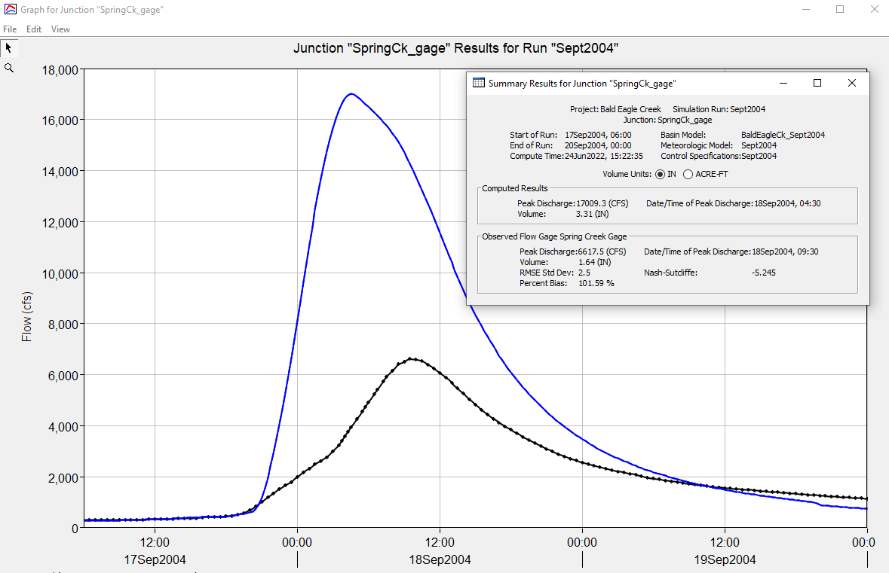
Rule #1
Build a conceptual understanding of the model
  If the saturated hydraulic conductivity is increased, what happens to the peak flow?
  If the Clark Time of Concentration is decreased, what happens to the time of the peak flow?
  Which initial parameter estimates am I confident in? Which are most uncertain?

Slide 20
Pro Tip: Model Performance
Optimization works best if your model runs quickly
  Single events vs. long-term continuous
  Specified hyetograph + Clark vs. gridded precipitation + ModClark
  Avoid complex elements (diversions, reservoirs) if possible
Simplify your model, get a better feel for parameter estimates, and then apply to the complex model

Slide 21
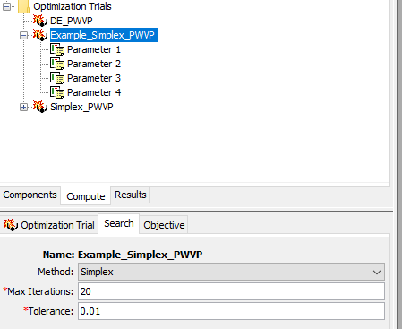
Rule #2
Start small (keep costs low initially)
  Small number of only the most important parameters
  Small parameter ranges
  Small number of maximum iterations
  Loose tolerance

Slide 22
Pro Tip: Which Parameters?
Start with the most sensitive parameters
Transform parameters or infiltration rate (dependent on the Objective Function)
Initial conditions usually converge the slowest
  Try not to choose these (set them based on knowledge of the initial state of the watershed)
  If you do choose these, iterate and then lock them to focus on other model parameters
Be careful with highly interconnected parameters
  Storage coefficient <-> constant rate <-> baseflow coefficients
Notes:
Avoid adjusting both loss rate and unit hydrograph peaking parameters at the same time unless you have a really tight range on parameter values.
Instead:
Calibrate the model’s performance for volume first by adjusting loss and baseflow parameters. – Use the mean of absolute residuals OF
Calibrate the model’s performance for time of peak flow second. – use a peak weighted OF (peak weighted RMSE or peak weighted variable power)
Calibrate the model’s performance for magnitude of peak flow third. – use a peak weighted OF (peak weighted RMSE or peak weighted variable power)
Iterate between these separate trials.

Slide 23
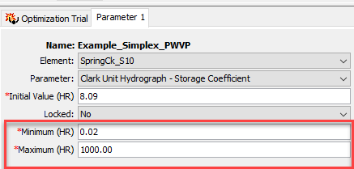
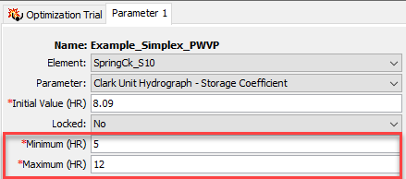
Rule #3
Provide a good initial guess and realistic parameter ranges
Initial guess is extremely important for Simplex
Good ranges are important for any search
If your search pushes a parameter to the end of a range:
  Shift (don’t expand) the range in that direction
  Add a parameter that can counteract that parameter
Notes:
Good initial guesses can come from parameter estimation based on soils and geographic information, regional regressions, or other ways to identify reasonable starting parameter values for your watershed.
Ranges can be estimated heuristically – for example choosing an infiltration rate related to a plausible range for the dominant soil type, or time of concentration computed from a plausible range of overland flow velocities.

Slide 24
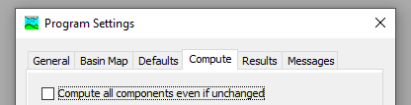
Pro Tip: Resuming a Search
You can make an Optimization Trial pick up where it stopped if:
The trial hits the max number of iterations without converging
  Increase max iterations and run the trial
The trial converges without hitting the max number of iterations
  Decrease tolerance and run the trial

Slide 25
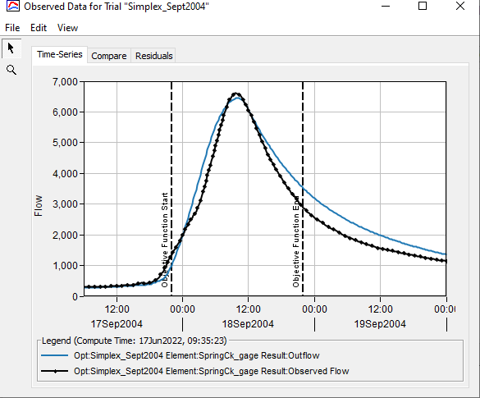
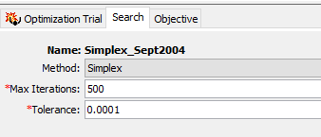
Rule #4
Iterate (user-guided calibration)
  Change ranges
  Add parameters
  Lock parameters in place
  Change the OF time window
  Reduce tolerance as you iterate towards a solution

Slide 26
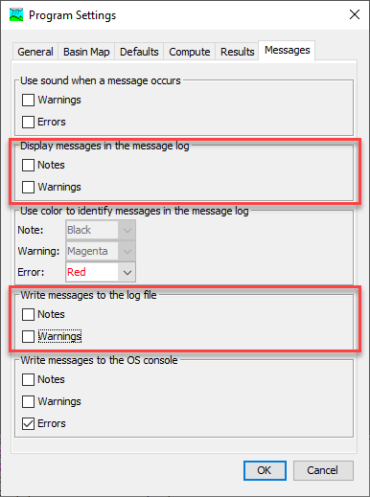
Pro Tip: Turn Off Messages
Depending on the methods selected in the basin model, many, many messages can be generated during an optimization trial
You can turn off the messages from the Program Settings editor

Slide 27
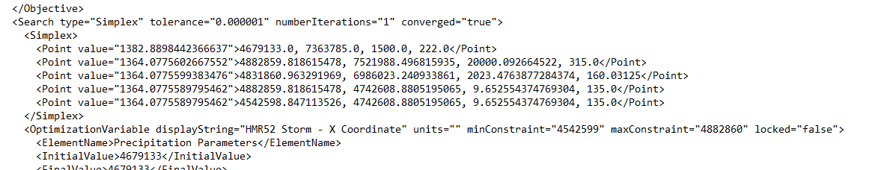
Pro Tip: Become Familiar with Results
The Optimization Trial’s *.results file contains valuable information
Notes:
This shows a Simplex search – the first value in the “Point” entry is the objective function value. The next four are the parameters being optimized, which are listed in order in this file after the simplex part.

Slide 28
Searcher In Action
Experiment: generate a hydrograph with known parameters
  SCS type II storm, 5 in depth
  20 mi² subbasin
    Deficit and Constant loss: initial 1 in, max 6 in, const rate 0.1 in hr-1, 5% imperv
    Clark transform: t_{c} 4 hr, R 6 hr
    Linear reservoir baseflow
Can the Simplex search recover the original parameters?
  Initial loss, constant loss, time of concentration, storage coeff
Notes:
Use peak-weighted RMSE, maxiter 200, tolerance 10. Will run about 42 iters in 0:09. Show OF and parameter values.
Drop tolerance to 1, will run to 55 iters (0:03).
Drop tolerance to 0.1, will run to 72 iters (0:04).
Drop tolerance to 0.01, will run to 154 iters (0:15).

Slide 29
Calibration Example – Observed Flow
Create and run a simulation first to make sure basin and meteorologic models are configured and parameterized
Create an optimization trial (time window and time-step)
Choose a search method (set tolerance and max iterations)
Choose either a minimization or maximization analysis
Choose the location with observed flow
Choose the objective function
Add/set parameters to adjust and set min and max ranges

Slide 30
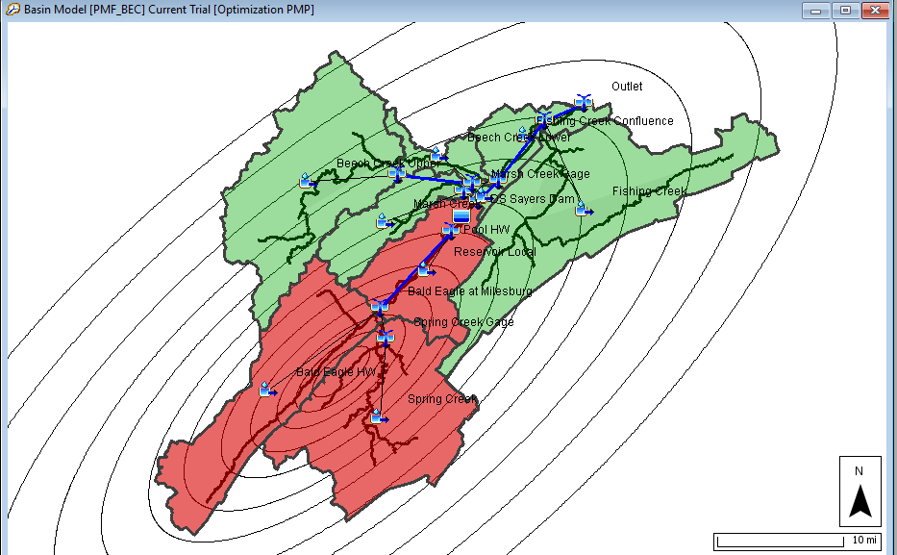
HMR 52 Storm Optimization
Use the optimization trial to find the storm centroid location, storm area, and storm orientation to maximize peak reservoir stage.
Must have a georeferenced project
HEC-HMS automatically intersects the HMR-52 storm with watershed when computing the basin average hyetographs
Reduce the default tolerance, and try the DE search
Notes:
The optimization trial can optimize the HMR52 storm parameters for Max volume and Peak inflow as well. If you were to compare results between maximizing peak stage, volume, and flow, then you need to make sure that the tolerance is tailored for each objective function so that the model performs approximately the same number of iterations.
DE search parameters will converge with a small enough tolerance
Talk through two recent questions about optimization for HMR 52 storm parameters:

Slide 31
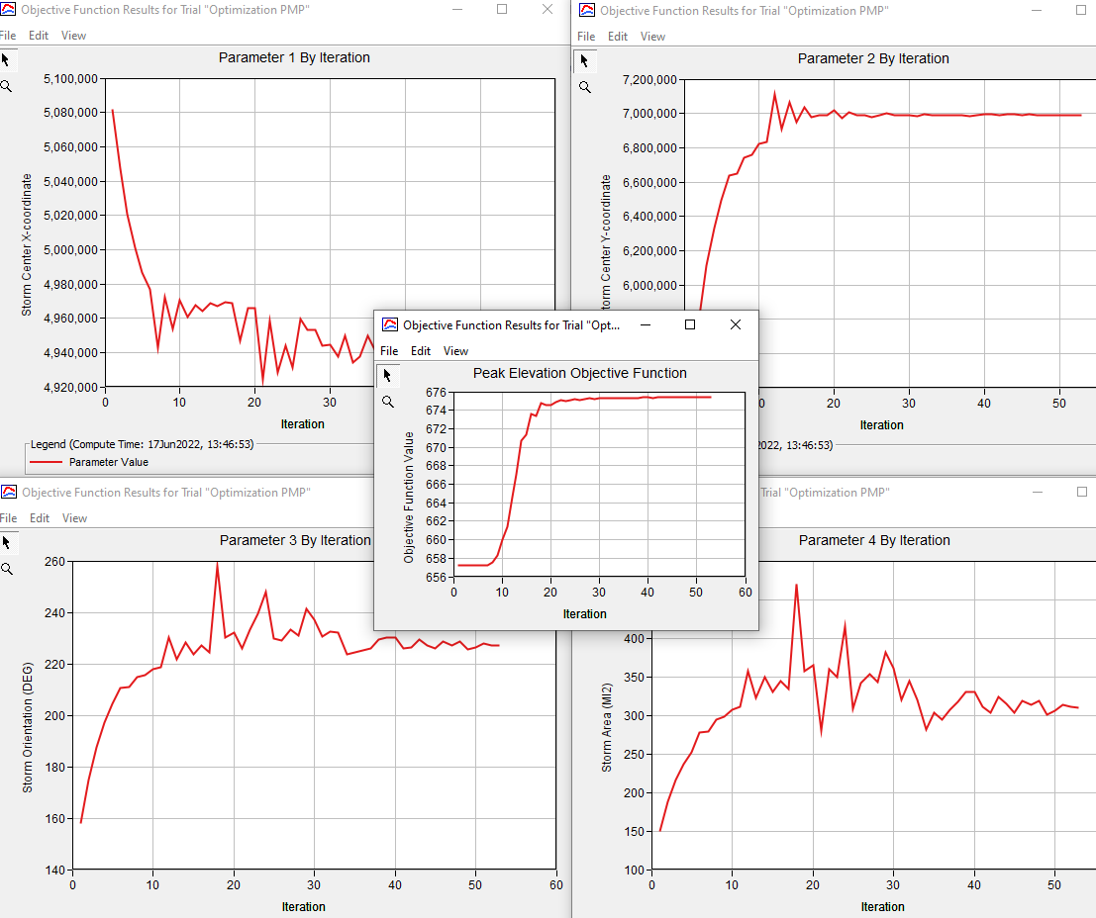
HMR 52 Storm Optimization

Slide 32
Future Improvements
HEC-HMS Version 4.11 Quality of Life Improvements
  Relative and Absolute tolerance options – Simplex
  Final iteration with optimization parameter set
Add scale factors for all parameters
Add the ability to link and scale parameter to one another
Incorporate a zonal/computation point approach for multiple locations with observations
Reduce computation time

Slide 33
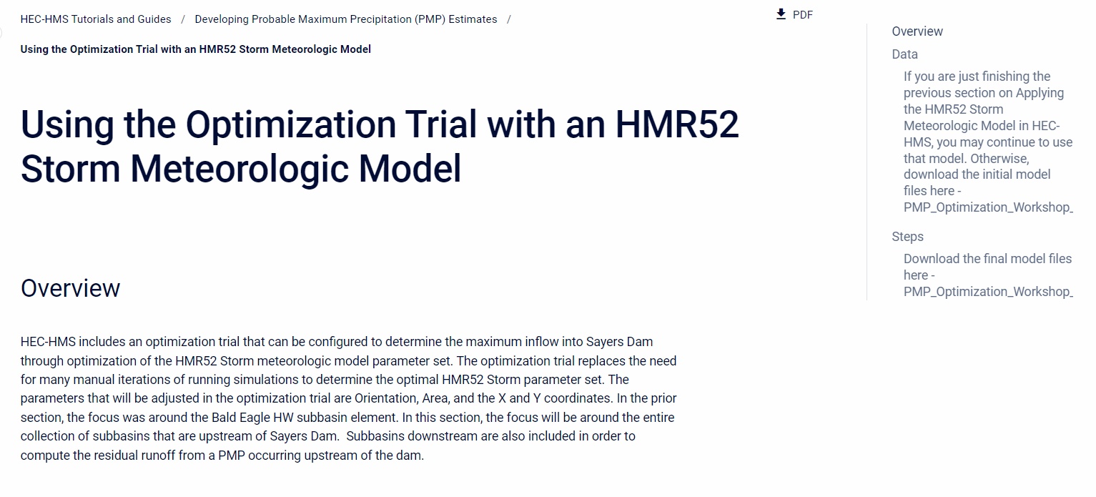
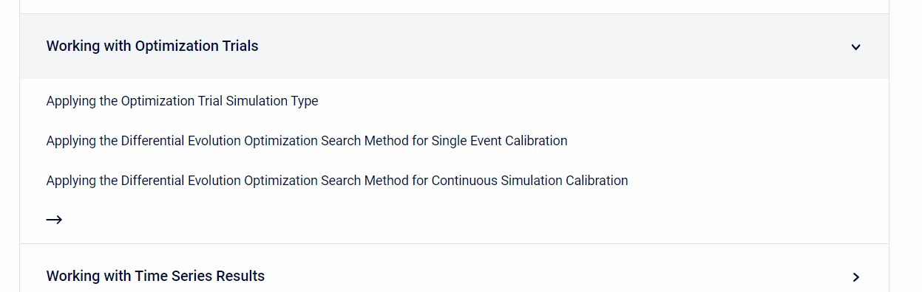
Resources
https://www.hec.usace.army.mil/confluence/hmsdocs/hmsguides

Slide 34
Questions

