Slide 1
New Meteorologic Methods in v4.11 and v4.12
Melissa Mika
Lauren Coe
Mike Bartles
USACE, Institute for Water Resources, Hydrologic Engineering Center

Slide 2
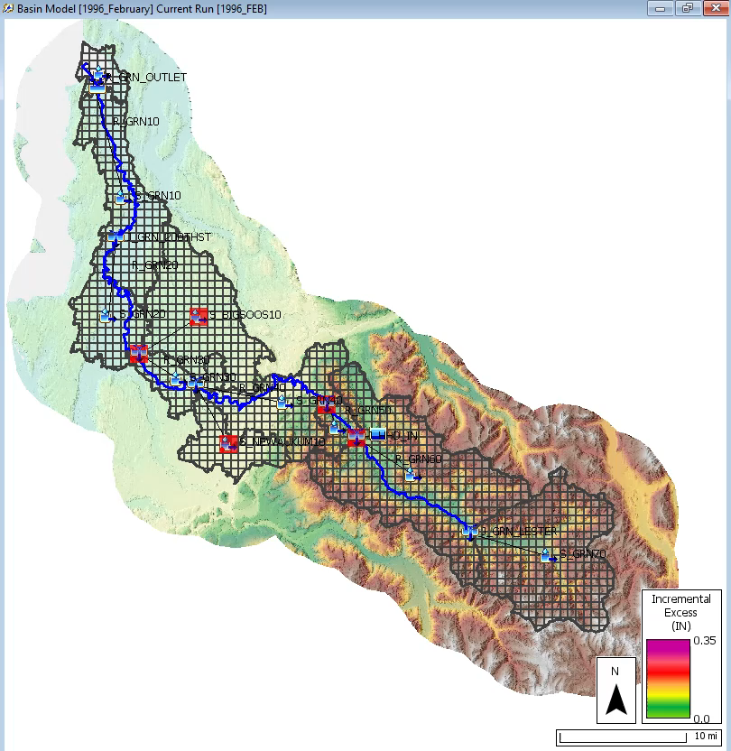
Overview
All available Meteorologic methods
Why did we add these new methods?
New Meteorologic methods w/in v4.11 and v4.12
Demo
How can these new Meteorologic methods help you?
Question/Answer
2

Slide 3
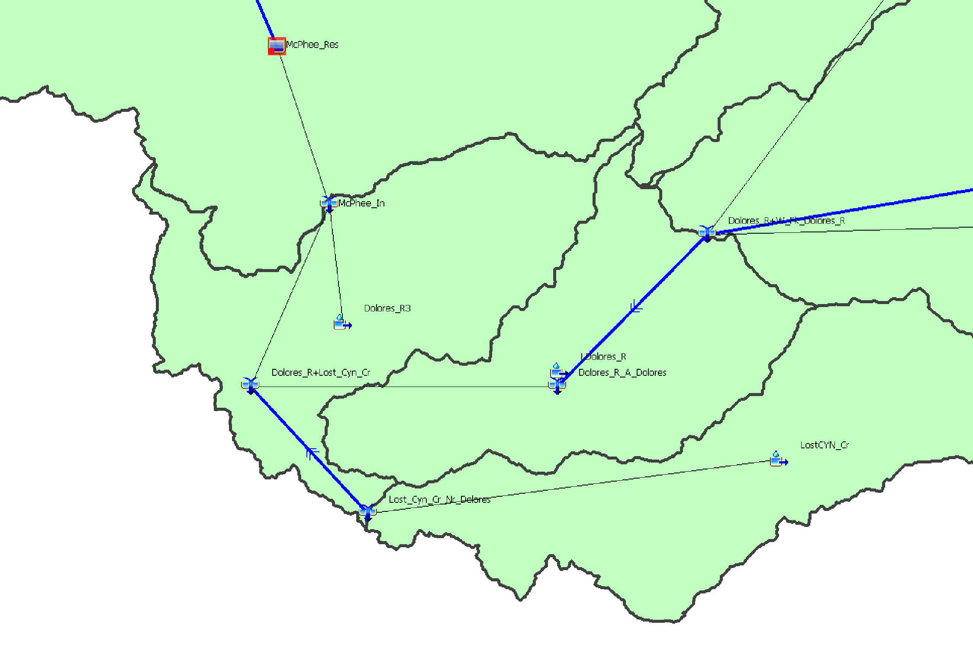
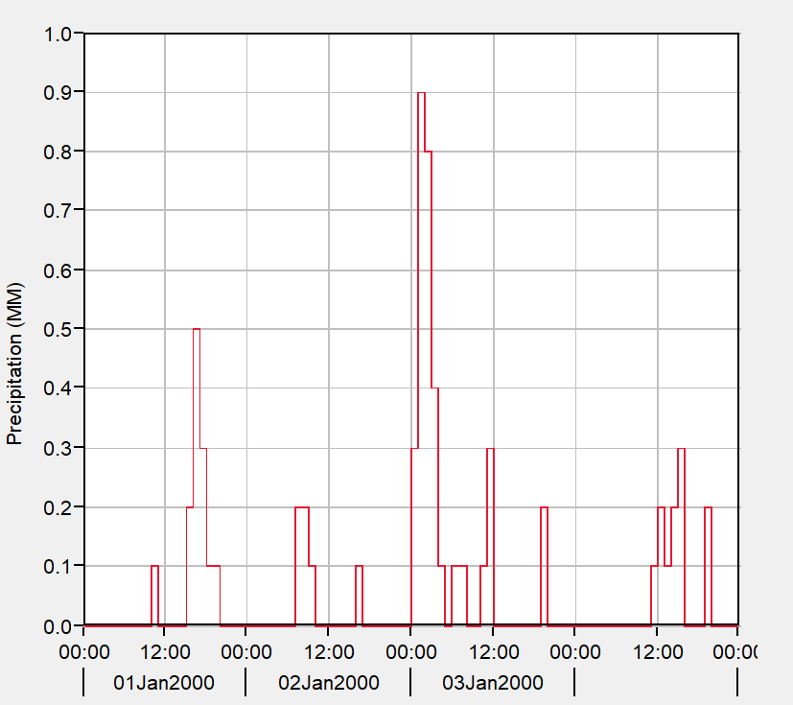
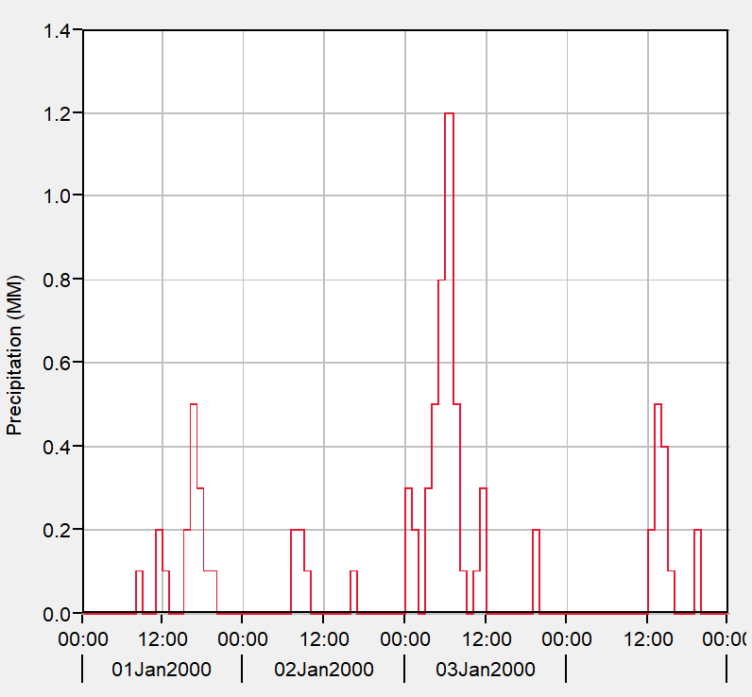
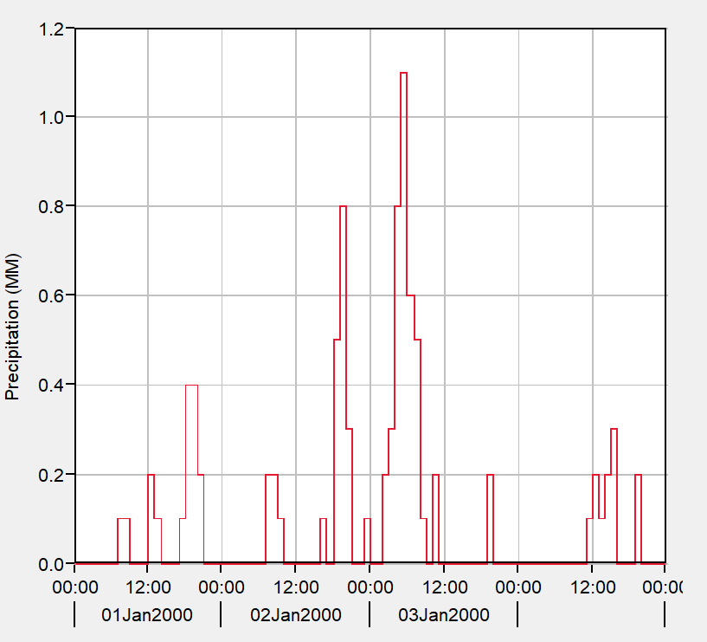
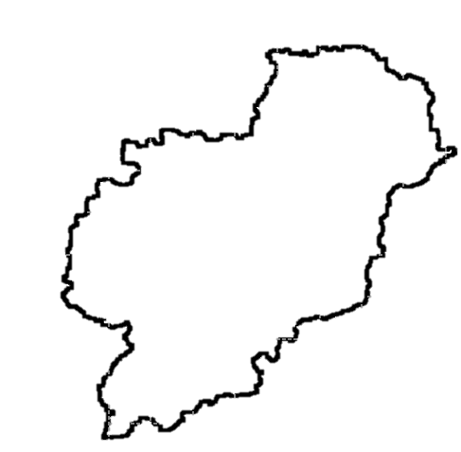
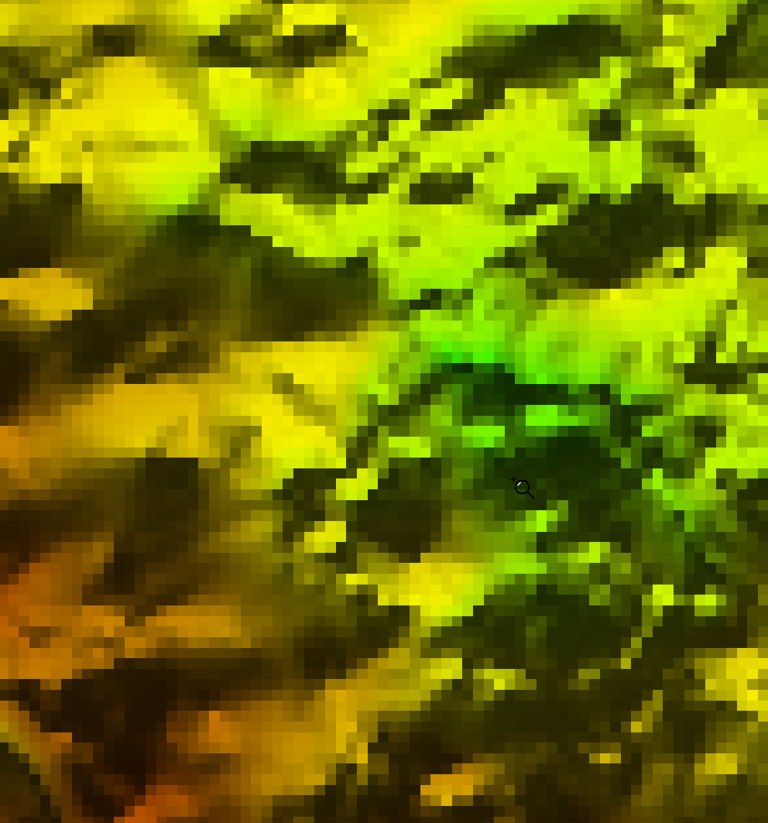
All Available Meteorologic Methods
Point/Specified methods
Gridded methods
Interpolated methods
  a.k.a. gageInterp methods
“Computed” methods
  FAO56, Shapiro, Satterlund Longwave radiation, etc.
  New “simple” methods
  MetSim methods
3

Slide 4
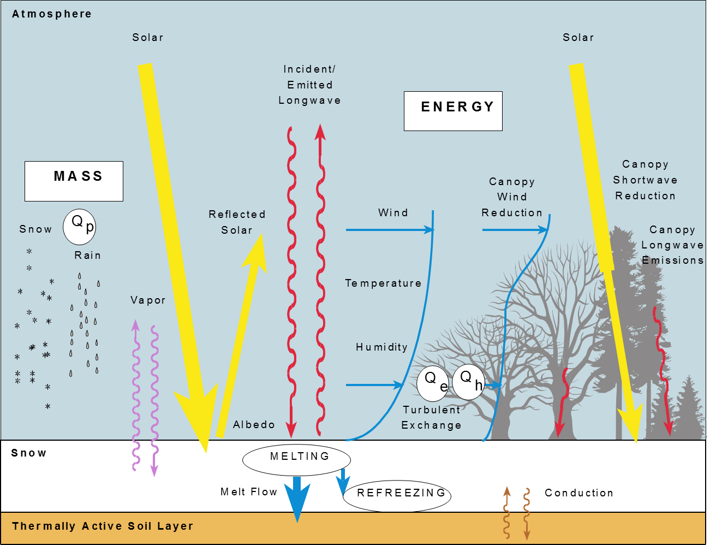
Why Did We Add These New Methods?
Several physically-based land surface processes require lots of boundary conditions (e.g., longwave, shortwave, relative humidity, air pressure, etc.)
These boundary conditions aren’t always readily available for historical or future scenarios
Infer these boundary conditions from precipitation and temperature
4

Slide 5
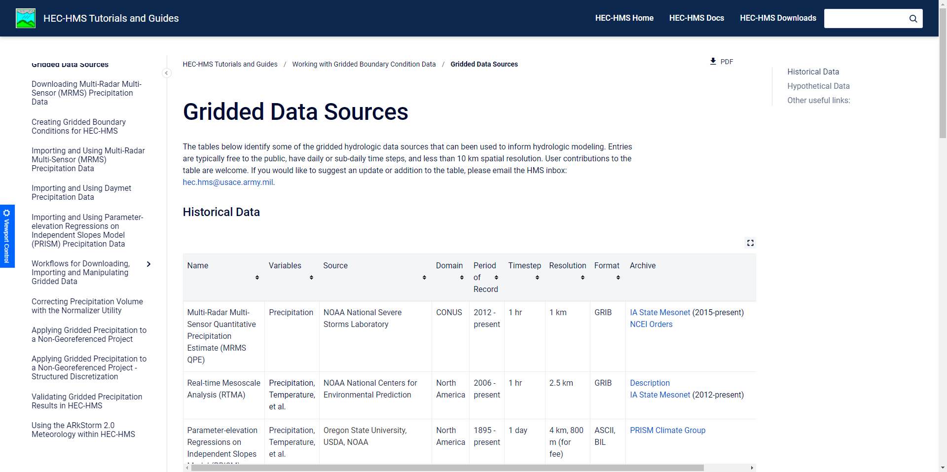
Why Did We Add These New Methods?
Gridded Data Sources
5
Notes:
There are a ton of gridded precipitation and temperature data sources that are available for both historical and future time periods
However, gridded precipitation and temperature data sources are often provided at a daily time step
Livneh-unsplit is provided at a daily time step from 1915 - 2018
AORC is the most trustworthy data set with an hourly resolution, but it only covers 1979 - current
Thus, if we can infer these other boundary conditions like relative humidity from precipitation and/or temperature, we can use physically-based land surface methods for many more time periods and locations throughout the world
Also, if we can temporally disaggregate
This is how pretty much every single hydrologic quantitative climate change study is performed at a reasonable spatial resolution
Downscaled longwave radiation, etc. boundary conditions are not provided for 100+ years into the future. They are inferred from other boundary conditions.

Slide 6
New “Simple” Methods

Slide 7
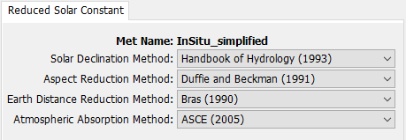
Reduced Solar Constant Shortwave
A Shortwave Radiation method is required for Energy Balance Evapotranspiration and Snowmelt methods
Comes from TVA (1972) and Follum et al. (2015)
Reduces solar constant (1366 W/m²) by:
  Distance from the Earth to the sun
  Atmospheric scattering
  Slope/aspect of the terrain
Works for both lumped and gridded subbasins
Recommend to use with georeferenced basin model and terrain
7
Notes:
Energy Balance Methods for Snowmelt and ET (Penman Monteith) require Shortwave Radiation
Recommend to use with georeferenced basin model with associated terrain, if no terrain is used calculations will proceed assuming the location is at the equator and at sea-level
Atmospheric scattering based on elevation, solar declination based on sun hour angles and latitude, earth distanced based on day of year, aspect is based on slope of

Slide 8
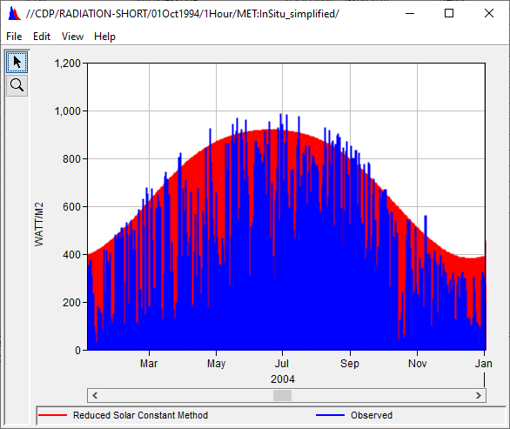
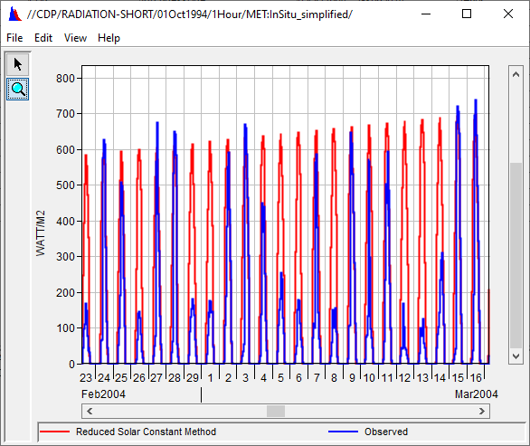
Reduced Solar Constant Shortwave
Observed
Reduced Solar Constant Method
Observed
Reduced Solar Constant Method
8
Notes:
Modeled solar radiation follows general shape well, peaks in summer months and dips in winter months
A few terms of the Reduced Solar Constant equation are not accounted for in HMS – cloud and canopy coverage which likely account for the discrepancies in observed vs. Reduced Solar Constant

Slide 9
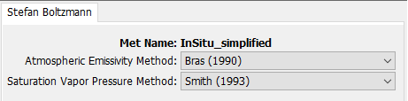
Stefan-Boltzmann Longwave
A Longwave Radiation method is required for Energy Balance Evapotranspiration and Snowmelt methods
Comes from TVA (1972) and Follum et al. (2015)
Relates air temperature and relative humidity to longwave radiation assuming black-body radiation
Works for both lumped and gridded subbasins
9
Notes:
Relative humidity is needed in order to estimate air emissivity
Temperature is needed to estimate saturation vapor pressure and, in turn, air emissivity

Slide 10
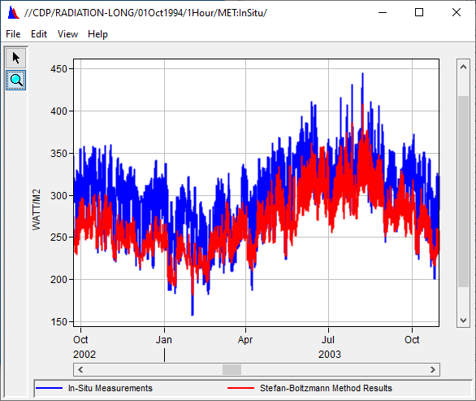
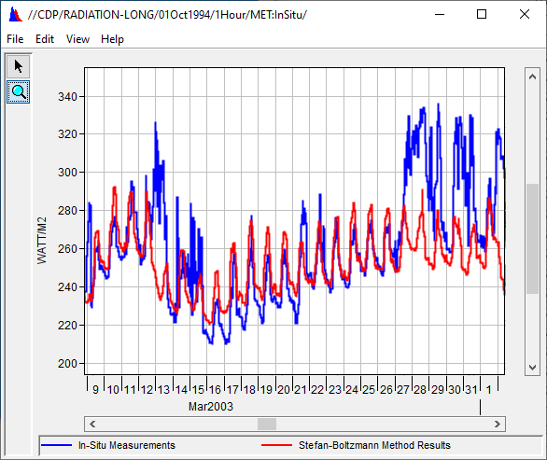
Stefan-Boltzmann Longwave
Observed
Stefan-Boltzmann Method
Observed
Stefan-Boltzmann Method
10
Notes:
Stefan Boltzmann assertion that longwave radiation emitted is dependent on temperature is a good approximation of observed data

Slide 11
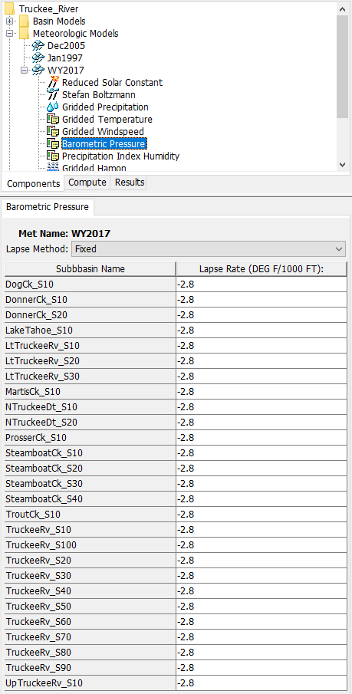
Barometric Pressure
A Pressure method is required for Energy Balance Evapotranspiration and Snowmelt methods
Comes from Anderson (2005) and Follum et al. (2015)
Estimate atmospheric pressure using elevation of the subbasin or grid cell and a specified lapse rate
Works for both lumped and gridded subbasins
Vary lapse rate to reproduce atmospheric pressure- if available
Produces a constant atmospheric pressure time series
Recommend to use with georeferenced basin model and terrain
11
Notes:
If the basin model is not georeferenced and/or doesn't have an associated terrain model, these calculations will proceed assuming the location is at sea-level.

Slide 12
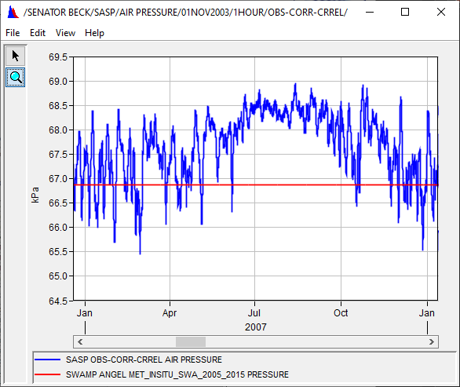
Barometric Pressure
Observed
Barometric Pressure Method
12
Notes:
Notice the y-axis scale
Observed varies between approximately 65.5 and 69 kilopascals while the Barometric Pressure method produces a constant of 66.85 kPa

Slide 13
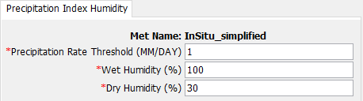
Precipitation Index Humidity
A Dew Point (Relative Humidity) method is required for Energy Balance Evapotranspiration and Snowmelt methods and Stefan-Boltzmann Longwave
Comes from Anderson (2005) and Follum et al. (2015)
Estimate relative humidity using precipitation
For each time step, if the precipitation rate is:
  Greater than the specified threshold, use the wet humidity
  Less than the specified threshold, use the dry humidity
Vary the parameters to reproduce relative humidity- if available
Produces a “binary” time series
13
Notes:
Produces a time-series where either the wet or dry humidity percentage is applied based on daily precipitation rates

Slide 14
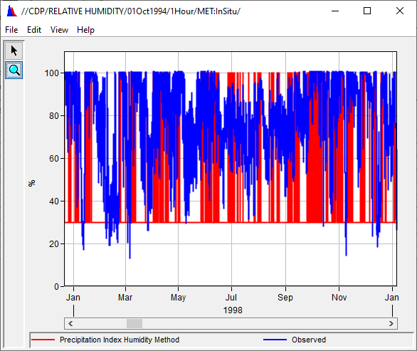
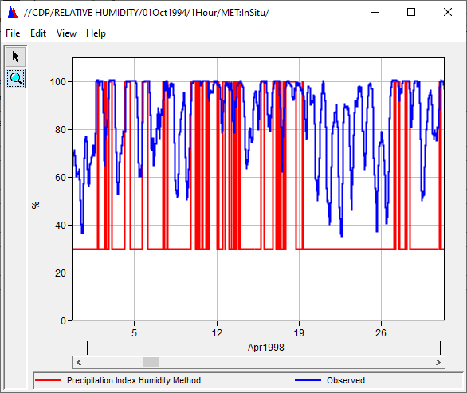
Precipitation Index Humidity
14
Notes:
Fluctuating between 100% and 30% gives a good approximation.
Can further adjust the dry value to better match the observed data.

Slide 15
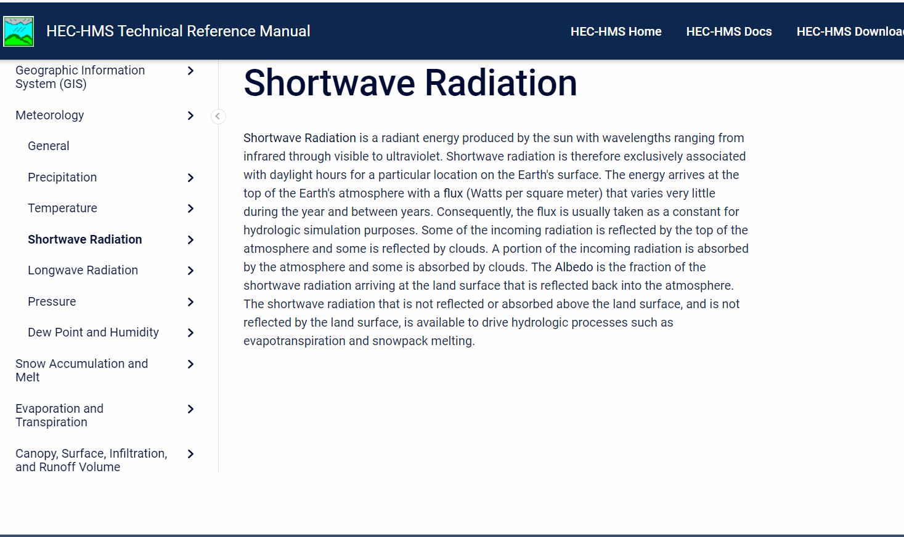
Technical Reference Manual
HEC-HMS Technical Reference Manual details various methods in HEC-HMS and underlying mathematical equations and assumptions
Guidance to assist in selecting a method for application and estimating parameters
Notes:
Find details about the equations and references for these new meteorologic methods and how they are applied within the software.

Slide 16
MetSim Methods

Slide 17
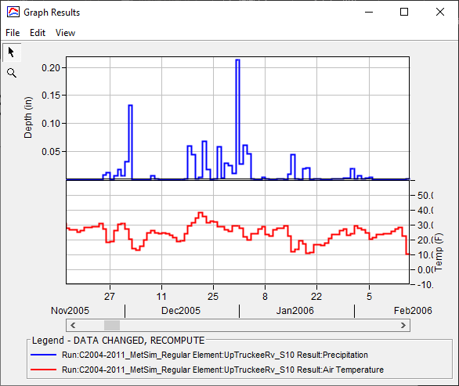
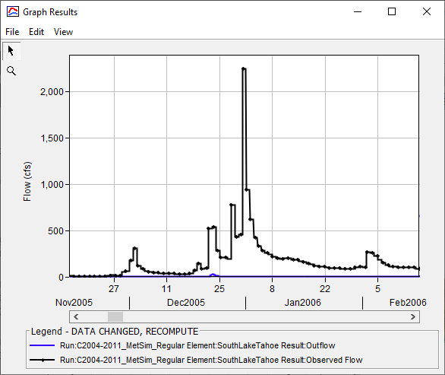

Why Did We Add These New Methods?
Daily Precipitation Accumulation
Daily Average Temperature
Computed Discharge
Observed Discharge
17
Notes:
Gridded daily boundary conditions have a much longer period of record when compared to sub-daily boundary conditions
We want to use them
But, uniformly disaggregating daily boundary conditions in time (i.e., dividing daily precipitation accumulations by 24 to infer hourly precipitation) results in underestimates of discharge
This occurs because the resultant hourly precipitation rates are extremely small and likely infiltrated
This is especially true for small modeling domains

Slide 18
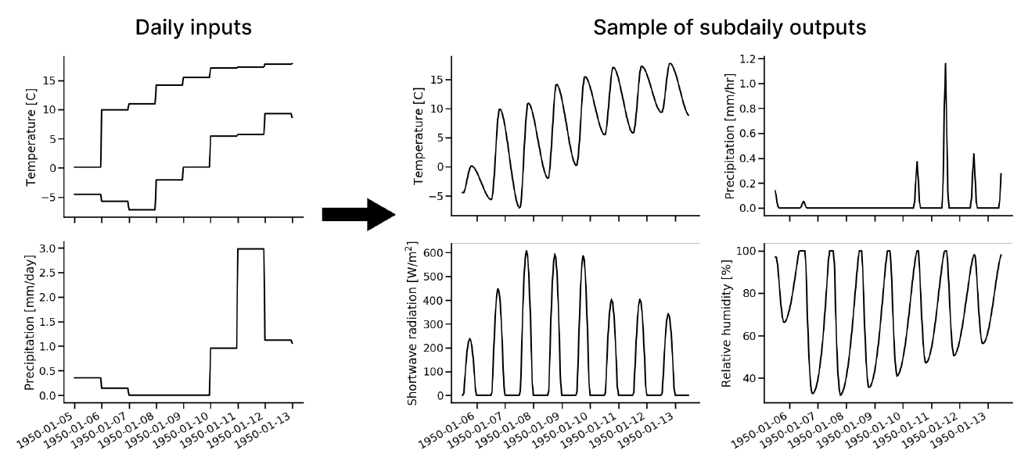
MetSim Overview
Open-source library that simulates and disaggregates gridded boundary conditions
Pre-processor to VIC
Bennett et al. (2020)
We integrated the precipitation and temperature disaggregation methods in HEC-HMS
18
Notes:
MetSim is an open source python library that both simulates and disaggregates gridded boundary conditions into sub-daily time steps
It’s commonly used as the meteorologic pre-processor to the Variable Infiltration Capacity, or VIC, model
MetSim is documented in Bennet et al. (2020)
We took the precipitation and temperature disaggregation components and integrated them within HEC-HMS

Slide 19
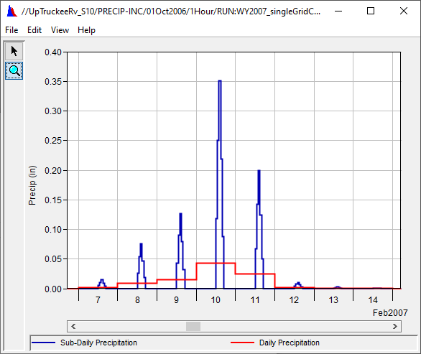
MetSim Precipitation
Based upon the Precipitation Isosceles Triangle (PITRI) method (Bohn et al., 2019)
Sub-daily precipitation is estimated using an isosceles triangle with user-specified duration and time of peak intensity
This is a gridded method
Sub-daily Precipitation
Daily Precipitation Accumulation
19
Notes:
First, let’s talk about the precipitation disaggregation method
This new precip method is based upon the PITRI method laid out in Bohn et al. (2019)
PITRI method was shown to better predict runoff than assuming precipitation is evenly distributed throughout the day
This method disaggregates a daily precipitation accumulation using an isosceles triangle
The user specifies the duration, or base width, of the triangle and the time of peak
This is inherently a gridded method

Slide 20
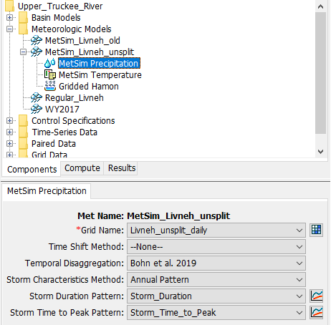
MetSim Precipitation
Required inputs
  Daily precipitation accumulations
Required parameters
  Temporal Disaggregation Method
  Storm Characteristics Method
  Storm Duration
  Storm Time to Peak
Duration and time to peak can be provided as either constants, Parameter Value Patterns, or grids
Bohn et al. (2019) developed gridded data sets
  Download them here: Bohn et al. (2019) grids
20
Notes:
The required inputs for this method are gridded daily precipitation accumulations
Two parameters, storm duration and storm time to peak, must be specified by the user

Slide 21
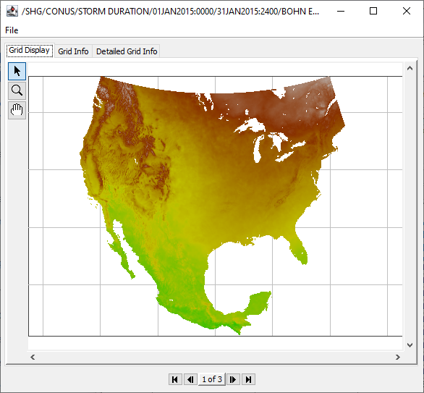
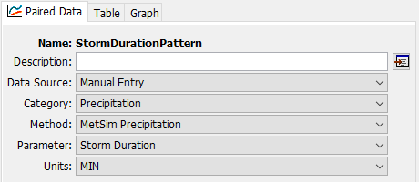
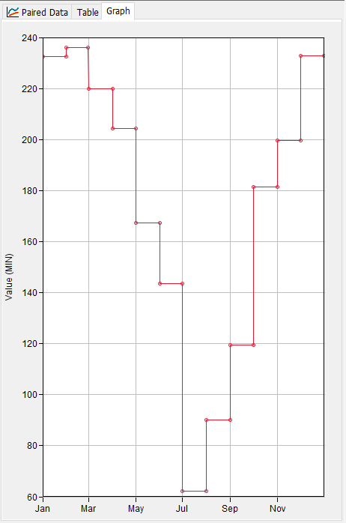
MetSim Precipitation
21

Slide 22
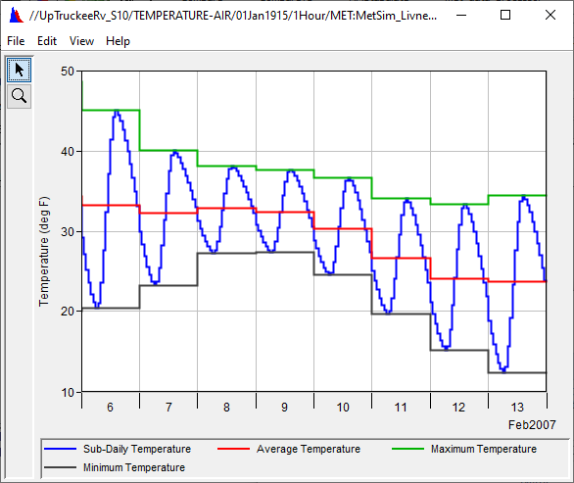
MetSim Temperature
Based upon Bohn et al. (2013)
Sub-daily temperature is estimated using a spline fit and:
  Previous day’s max temperature
  Current day’s min and max temperature
  Next day’s minimum temperature
Assumes the minimum temperature:
  Occurs at solar sun rise
  Occurs before the maximum temperature in a day
This is a gridded method
Minimum Daily Temperature
Maximum Daily Temperature
Average Daily Temperature
Sub-daily Temperature
22

Slide 23
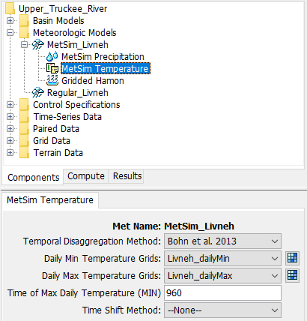
MetSim Temperature
Required inputs
  Daily Minimum Temperature grids
  Daily Maximum Temperature grids
Required parameters
  Time of maximum daily temperature (0 – 1439)
23

Slide 24
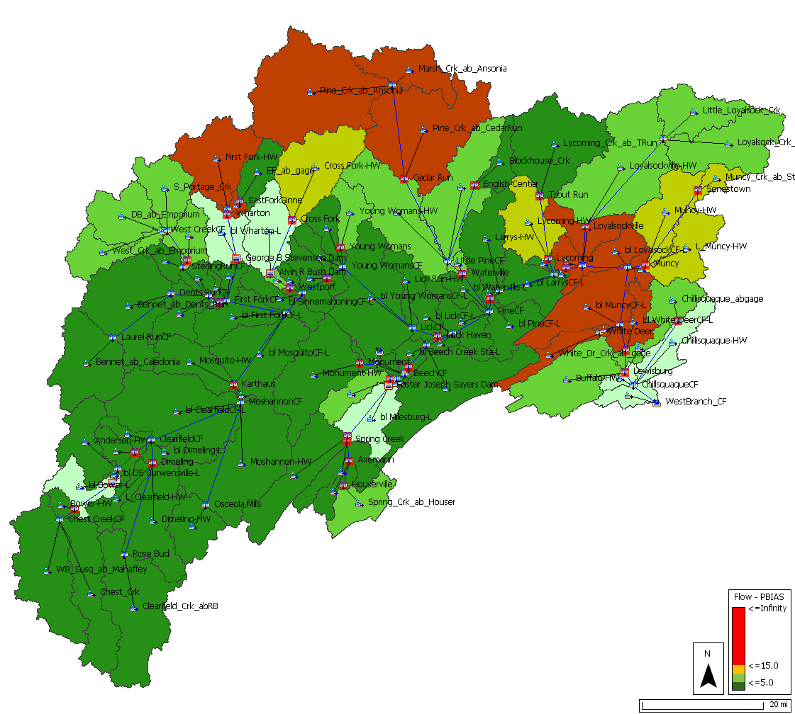
MetSim Methods Demonstration

Slide 25
What can you do with these new methods?

Slide 26
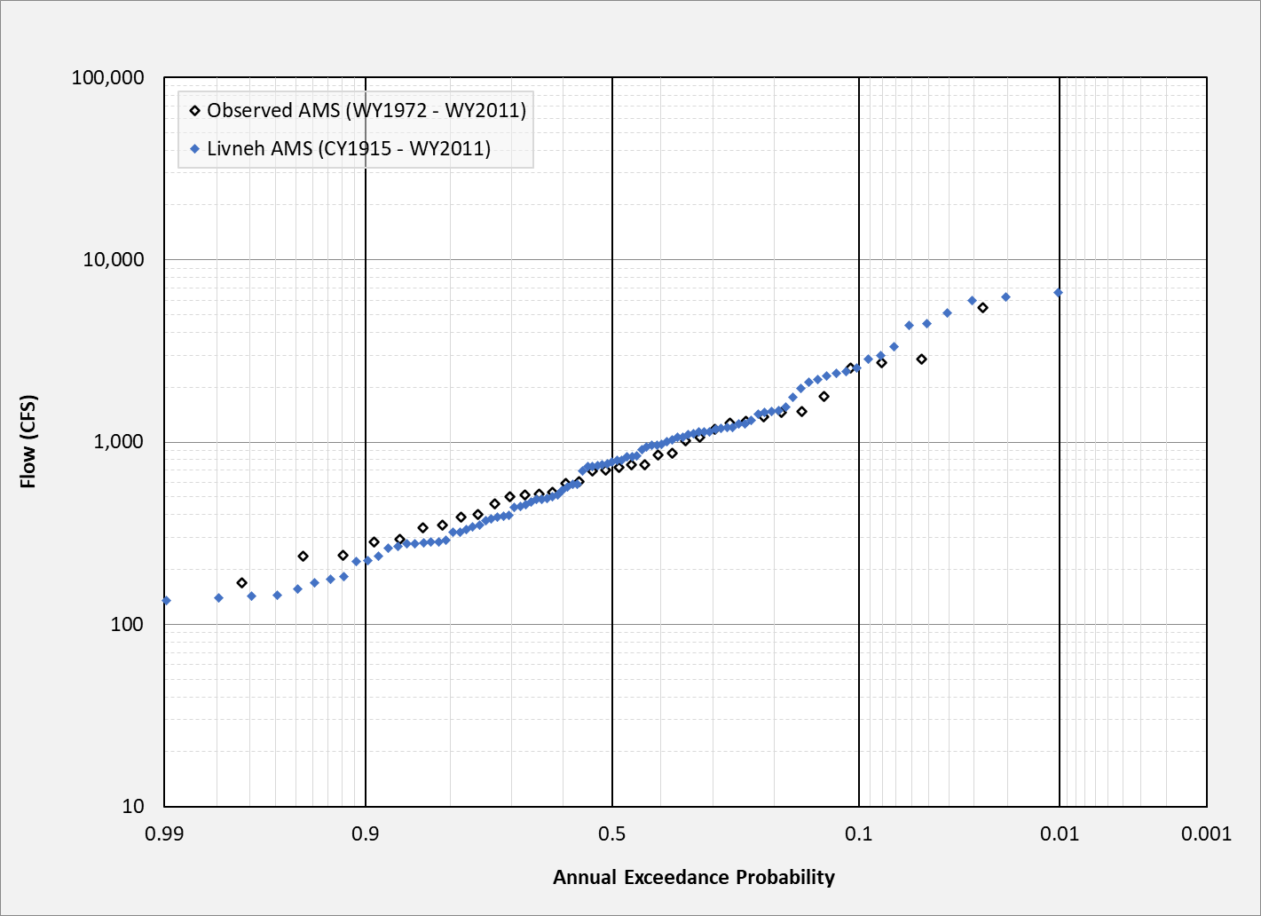
What Can You Do With These New Methods?
Continuous simulations
  Many daily average/min/max gridded boundary conditions are available
    e.g., Livneh unsplit: 1915 – 2018
  If you have a calibrated continuous simulation model, you can now simulate 100+ years’ worth of precipitation-runoff processes more accurately
  Produce flow-, stage, and reservoir pool elevation-frequency curves for with and without project conditions
  Using the New MetSim Precipitation and Temperature Methods
  Calibrating a Continuous Simulation Model
Computed AMS
Observed AMS
26

Slide 27
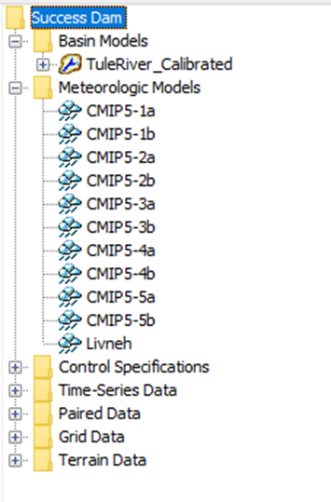
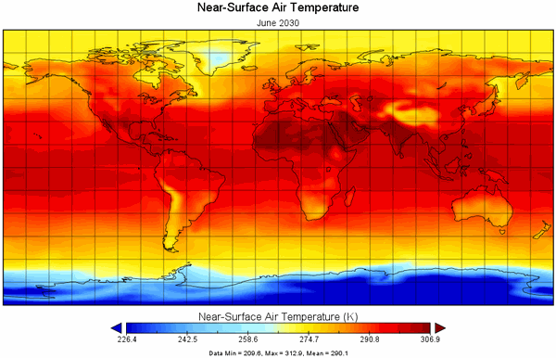
What Can You Do With These New Methods?
Quantitative climate change studies
  Typically daily spatially-downscaled data
  e.g., CMIP5 Climate Projection daily data (1850-2300)
Applying the Ensemble Compute Option to Downscaled Climate Model Datasets
27

Slide 28
Review
There are many different types of Meteorologic methods available within HEC-HMS
New Meteorologic methods were added within v4.11 and v4.12 to enable efficient use of longer and more accurate simulations
These new methods, combined with readily available gridded boundary conditions, can be used to generate 100+ years’ worth of historical model results for any location within CONUS
They can also be used to more accurately estimate runoff, etc. for future climate scenarios
28

Slide 29
Thank You!
USACE Mississippi River Geomorphology and Potamology (MRG&P) Program
USACE HH&C Science and Engineering Technology (SET) Program
USACE Northwestern Division – Columbia River
USACE Arid Regions Work Unit
Dr. Mike Follum
Dr. Andrew Bennett
Chris Dunn
29

Slide 30
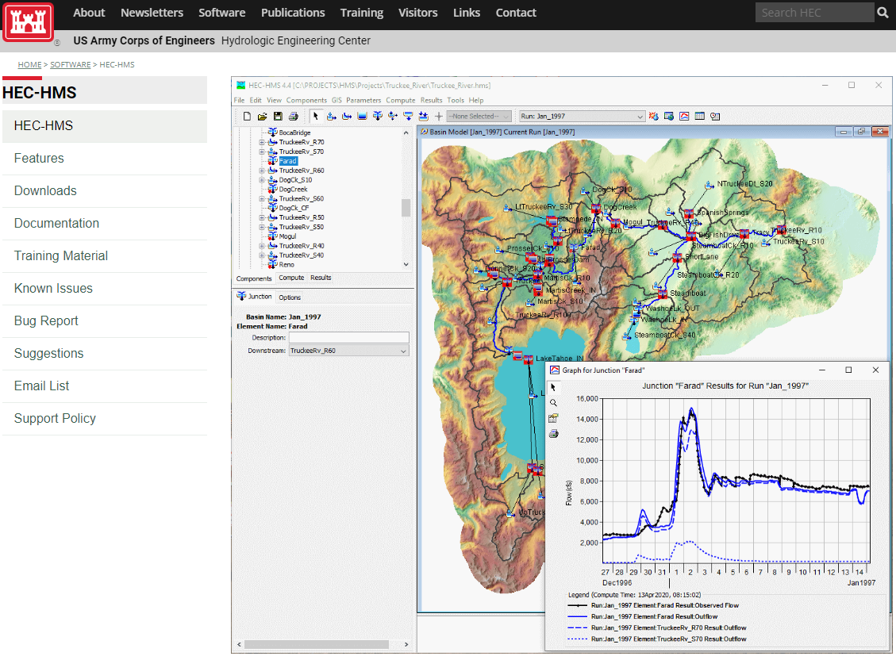
For more…
https://www.hec.usace.army.mil/software/hec-hms/
https://www.hec.usace.army.mil/software/hec-hms/email_list.aspx
30

