Slide 1
U.S. Army corps of engineers
HEC-HMS Presentation for NRCS
8 March 2022
Matt Fleming, P.E.
Hydrologic Engineering Center

Slide 2
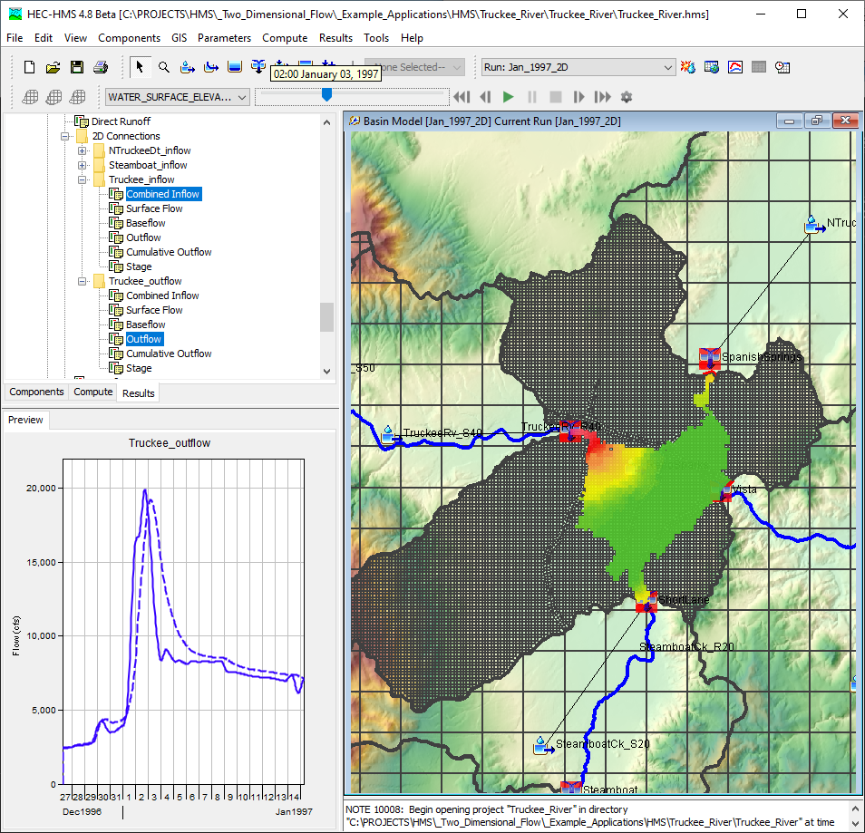
Outline
Background
Documentation
Tech support
Tech transfer
HEC-HMS basics
New features NRCS staff should know about
Questions

Slide 3
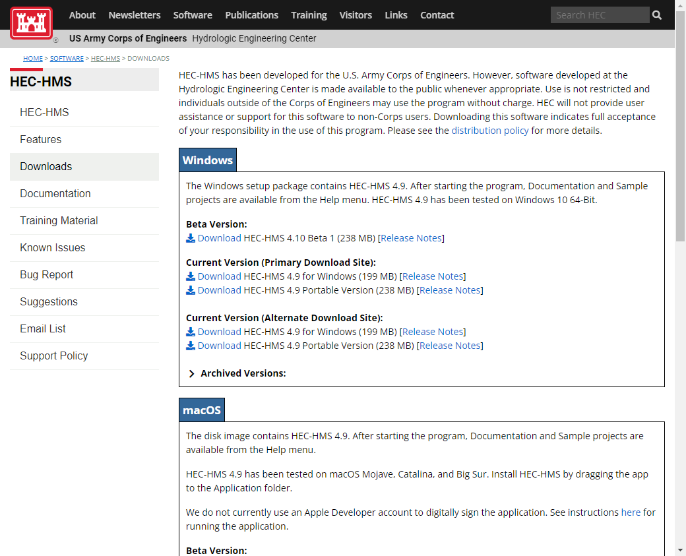
HEC-HMS
Latest Release
Version 4.9
Beta Release
Version 4.10
MacOS and Linux versions available
HEC-HMS Webpage

Slide 4
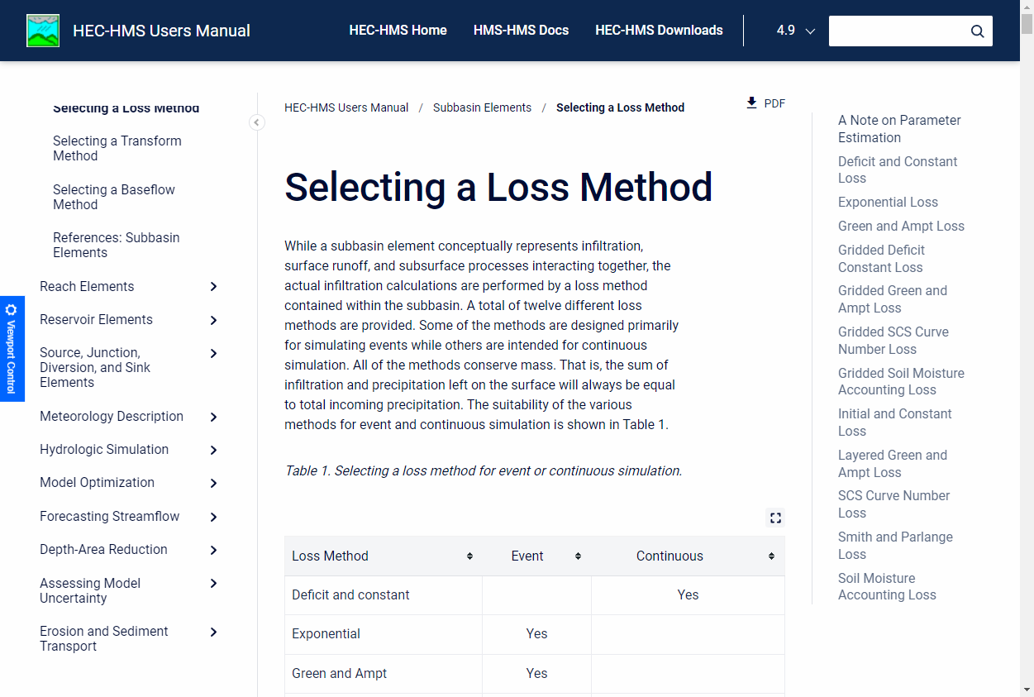
Documentation
Release Notes
User’s Manual
Technical Reference Manual
Applications Guide
Validation Guide
HEC-HMS Documentation

Slide 5
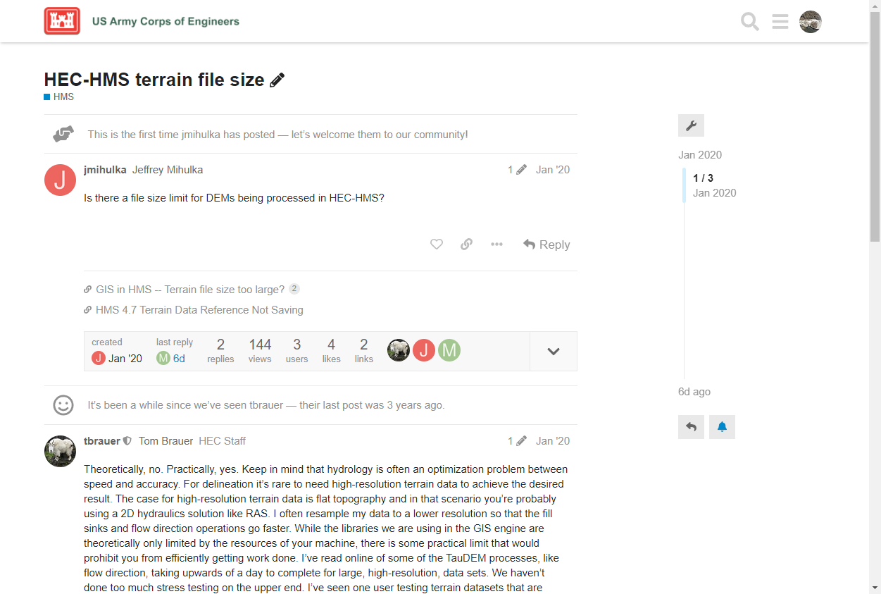
Tech Support
Discourse

Slide 6
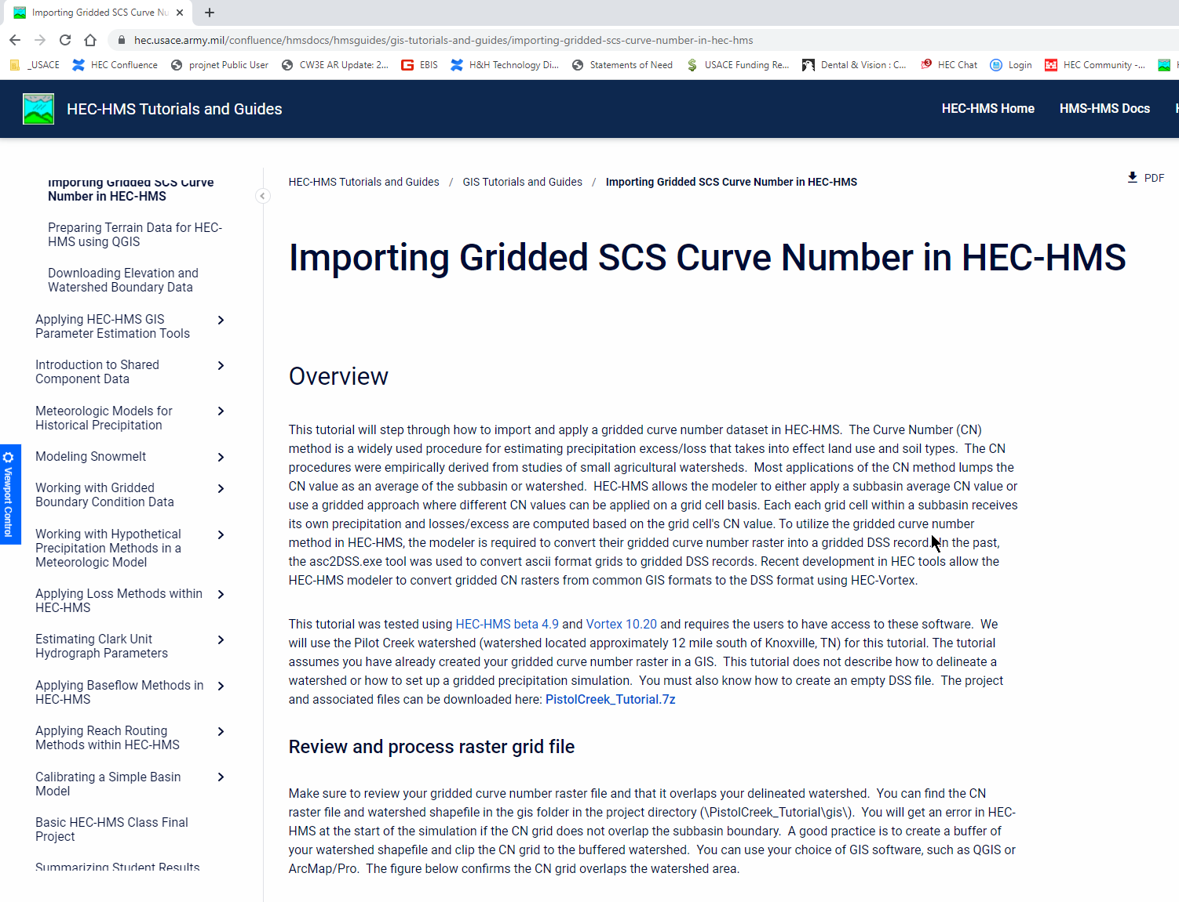
Tech Transfer
Tutorials and Guides

Slide 7
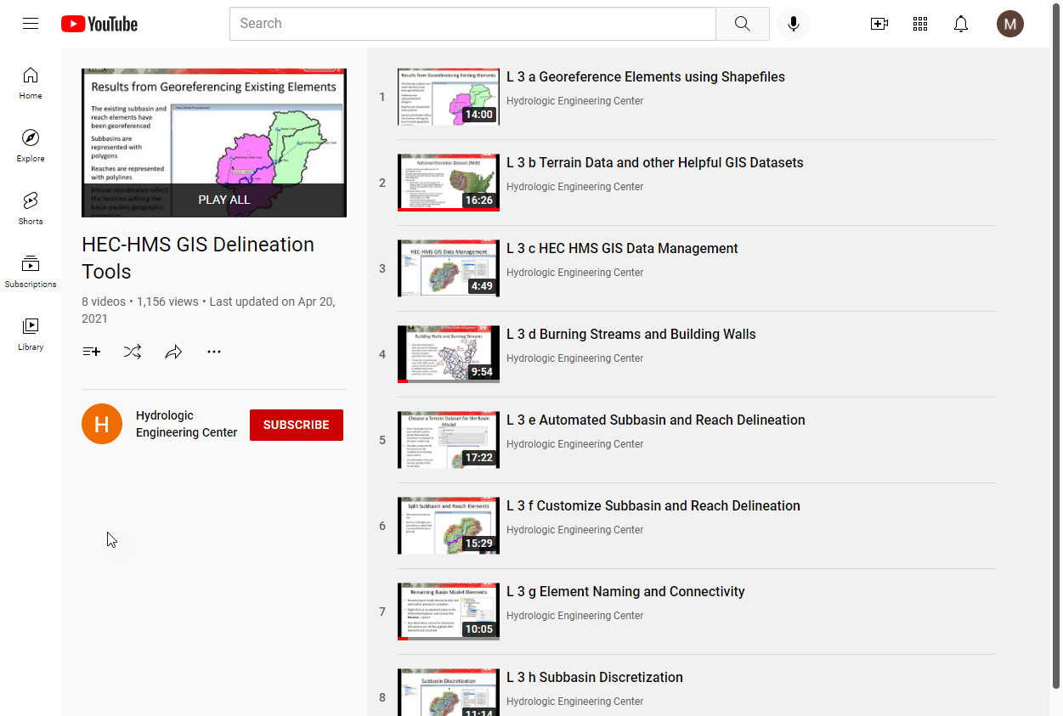
Tech Transfer
Basic HEC-HMS Class Materials

Slide 8
Tech Transfer
The HEC-HMS team has been providing quarterly webinars since 18Feb2021
Increase awareness of new features and materials
Focus on 2 to 3 new features and demo their usage
Dedicated time for Q&A
Next webinar: April 2022

Slide 9
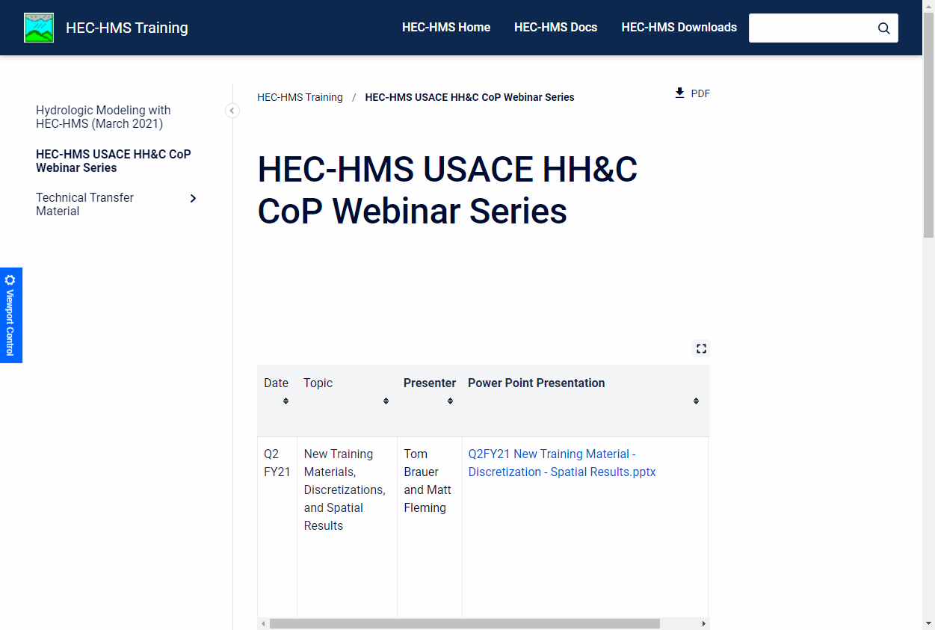
Tech Transfer
HEC-HMS USACE HH&C CoP Webinar Series

Slide 10
Outline
Background
Documentation
Tech support
Tech transfer
HEC-HMS basics
New features NRCS staff should know about
Questions

Slide 11
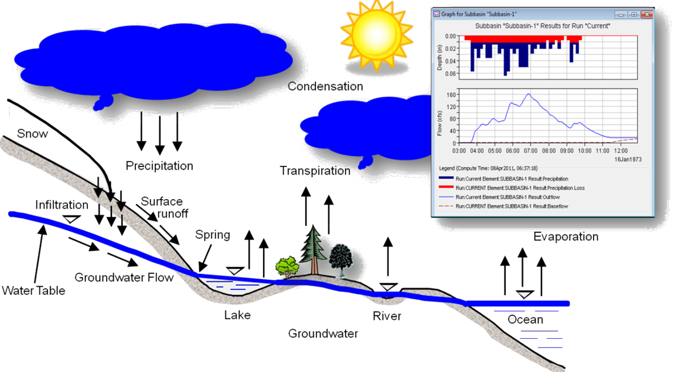
Hydrologic Modeling System

Slide 12
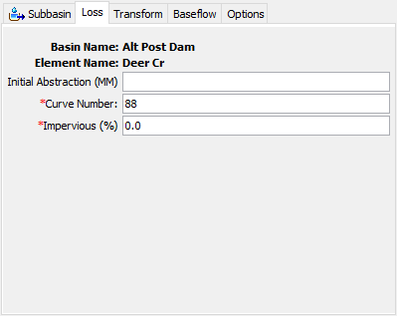
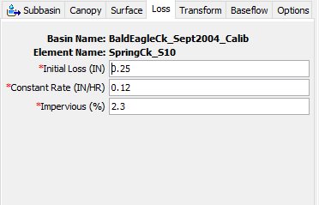
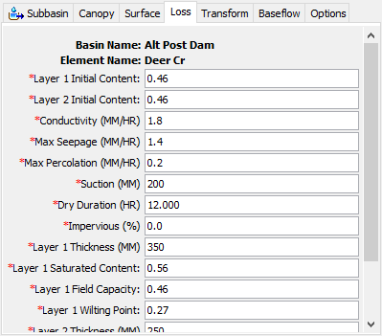
Empirical, conceptual, or physically based

Slide 13
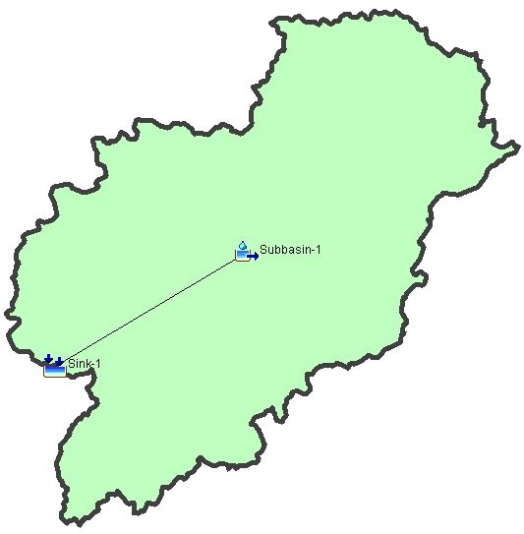
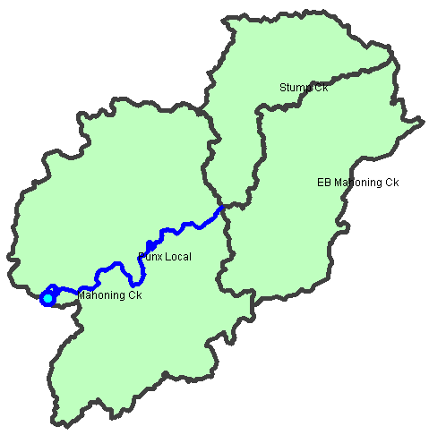
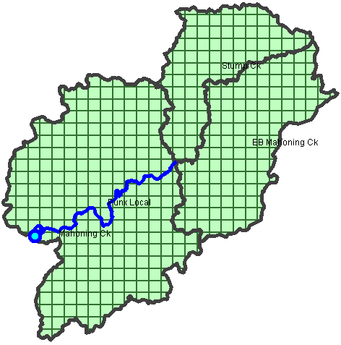
Subbasin-average or Gridded

Slide 14
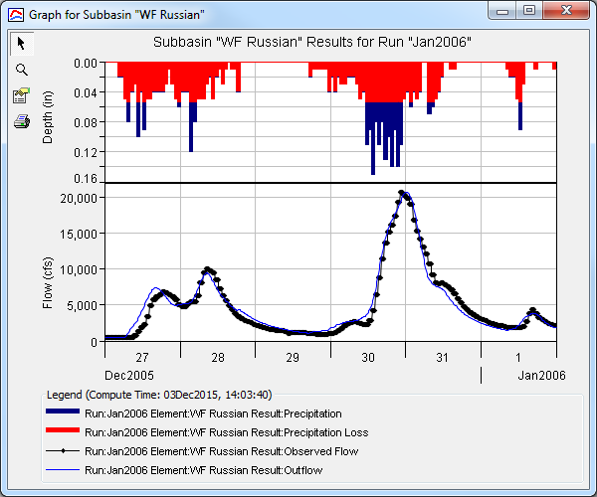
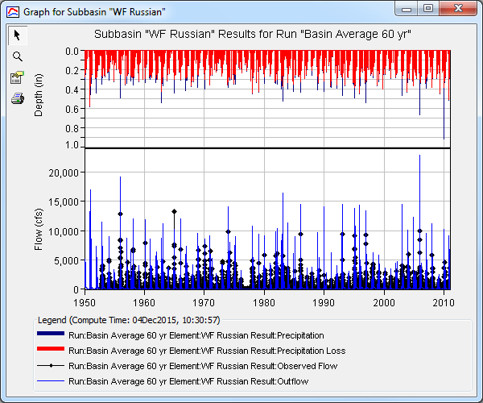
Event OR Continuous

Slide 15
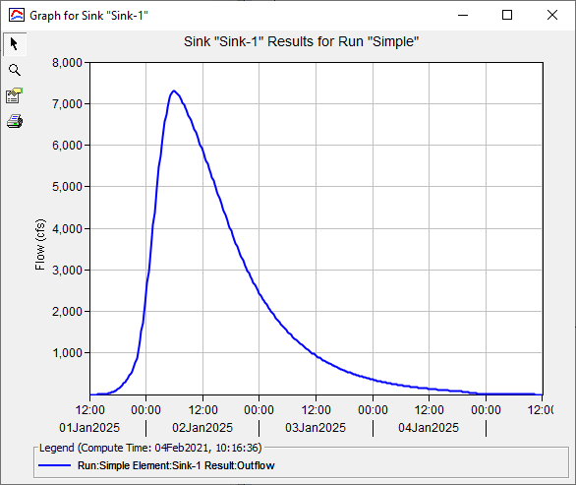
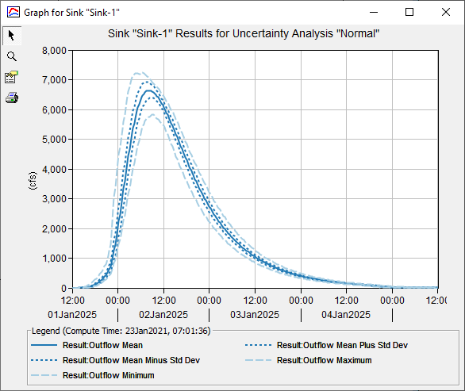
Deterministic or Stochastic

Slide 16
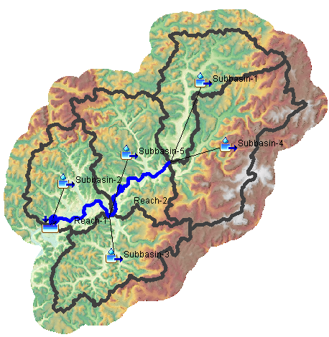
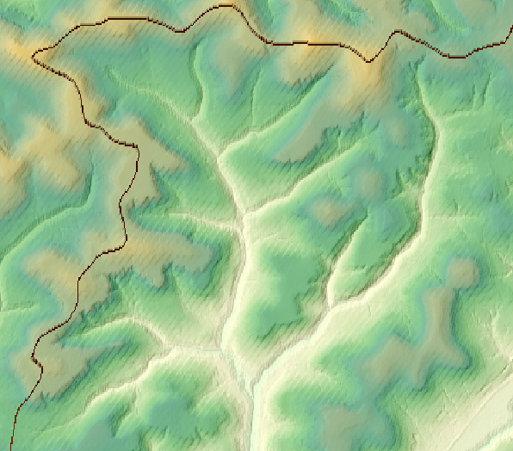
GIS Processing
Terrain modification
Sink fill and flow direction
Subbasin and reach delineation
Subbasin and reach splitting and merging
Subbasin and reach characteristics
Parameter estimation

Slide 17
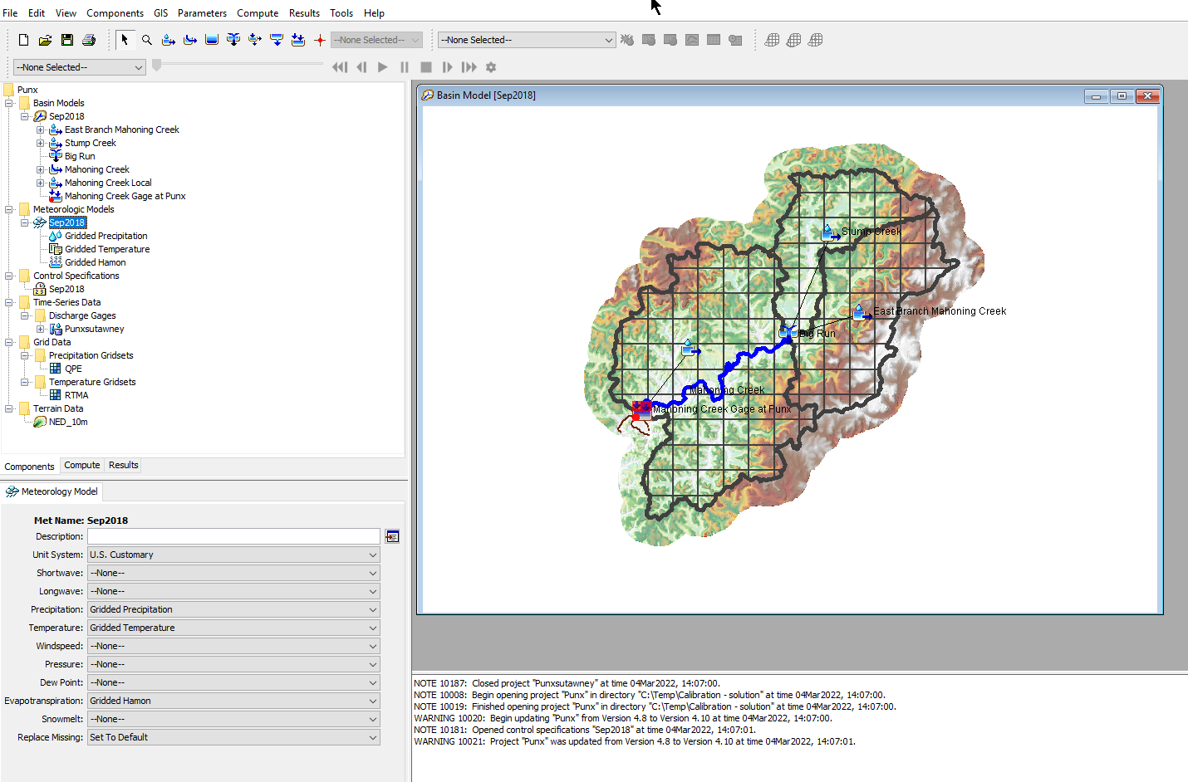
User Interface
Menus
Toolbars
Watershed Explorer
Basin Model Map
Component Editor
Message Window

Slide 18
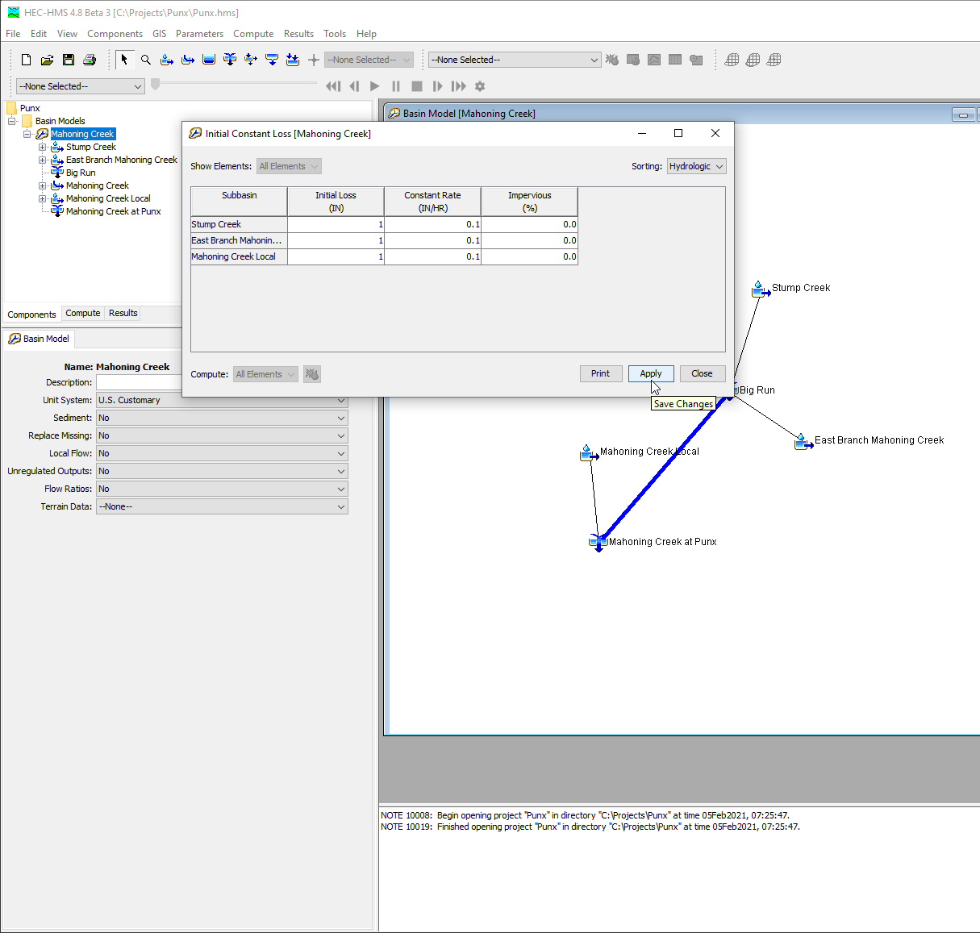
Simple Basin Model
Non-georeferenced models can be created by added element icons and connecting them to form a network.
Parameters are manually entered in the component editors or global editors.

Slide 19
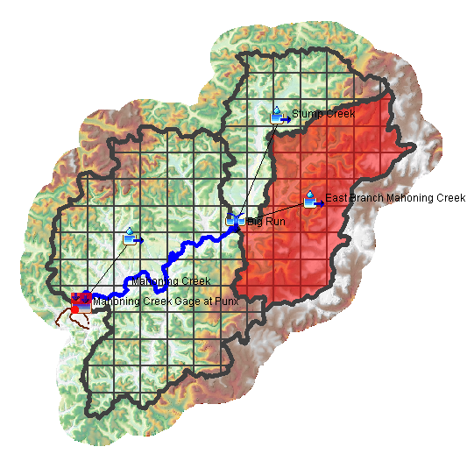
Georeferenced Basin model
GIS tools can be used to Georeference an existing basin models or create a new basin model using terrain data and shapefiles.
Parameter are manually entered in the component editors or global editors. GIS parameter estimation tools are available.
Gridded meteorologic variables can be applied.
Spatial results can be computed and visualized.

Slide 20
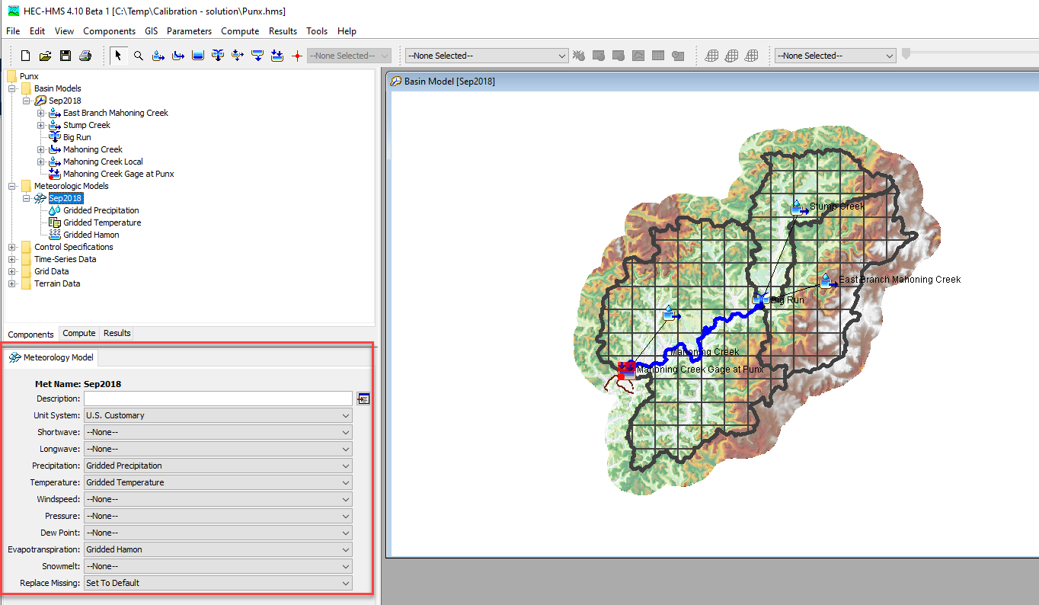
Meteorologic Model
Meteorologic model is used to compute boundary conditions for the basin model
Precipitation
Temperature
Evapotranspiration potential
Snowmelt (moving to the basin model)

Slide 21
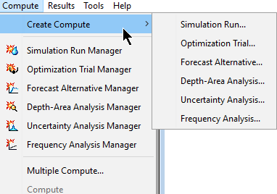
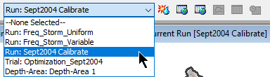
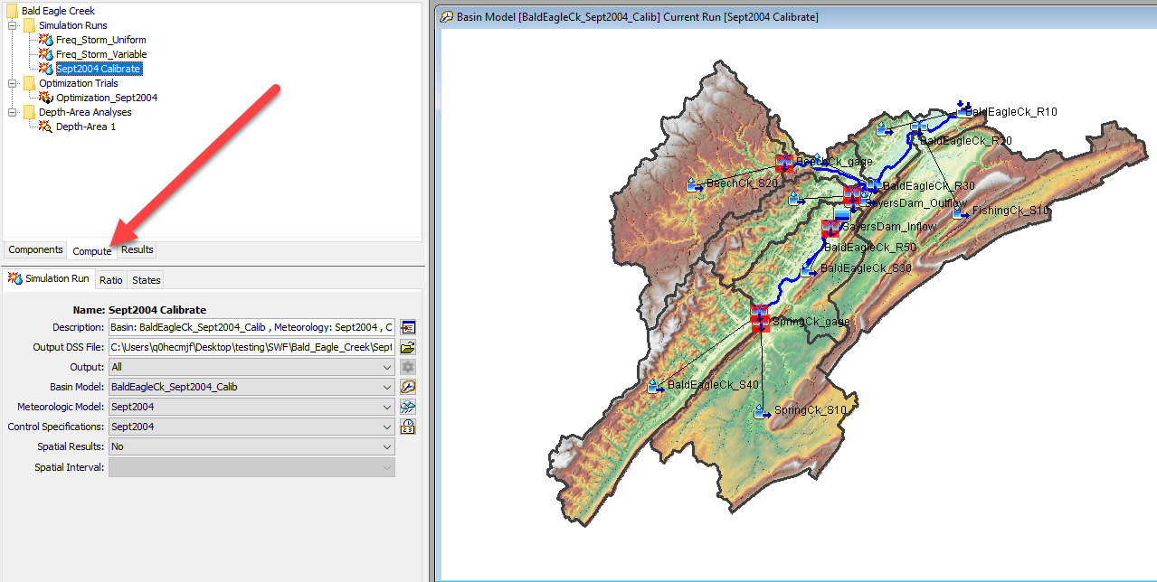
Simulations
Managers
Compute Toolbar
Compute tab, Watershed Explorer

Slide 22
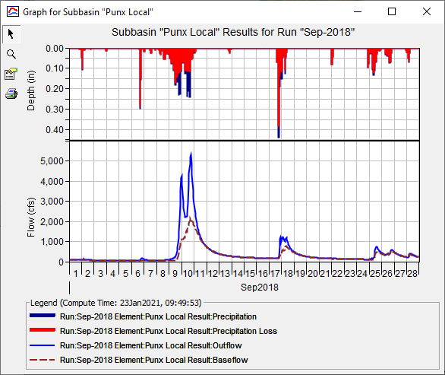
Simulation Run
Simulation Run
Meteorologic Model
Basin Model
Control Specifications

Slide 23
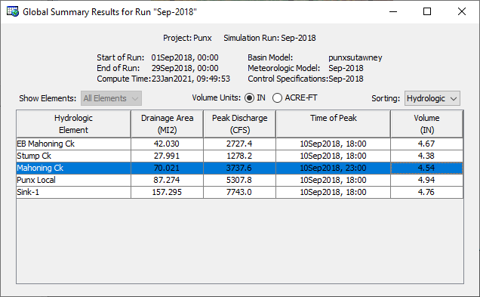
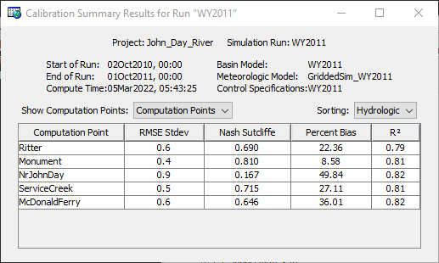
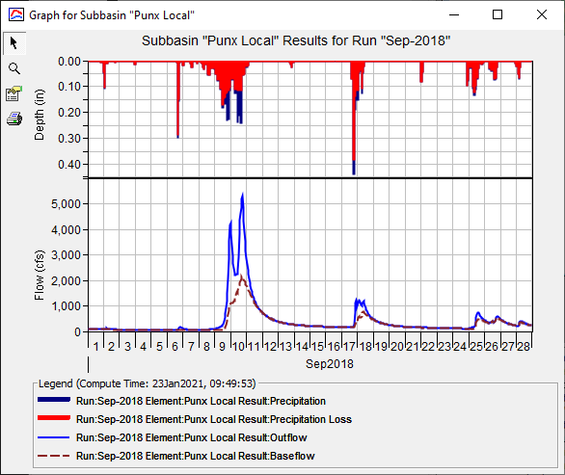
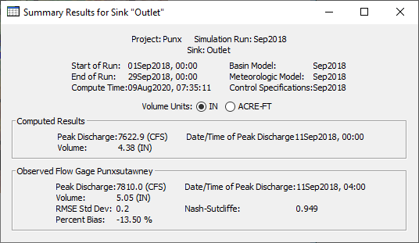
Five Result Displays in HEC-HMS
Global summary tables
Element graph
Element summary table
Element time series
Spatial Results

Slide 24
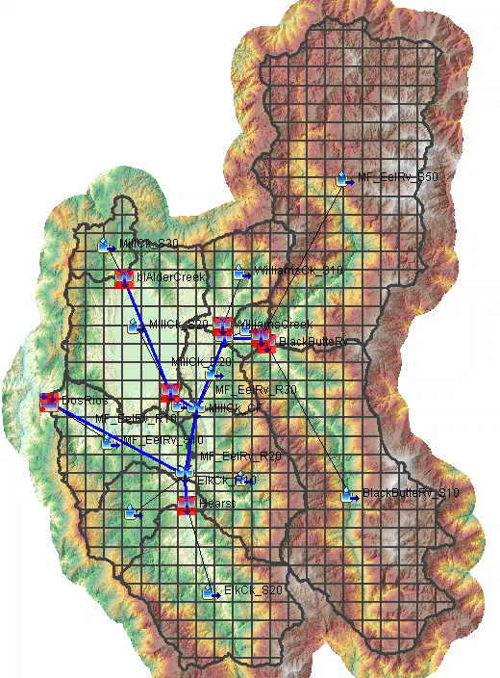
Spatial Results
Precipitation, excess, loss, snow, 2D output, etc.
Feature within v4.7 release
Precip Depth (in)
0
50

Slide 25
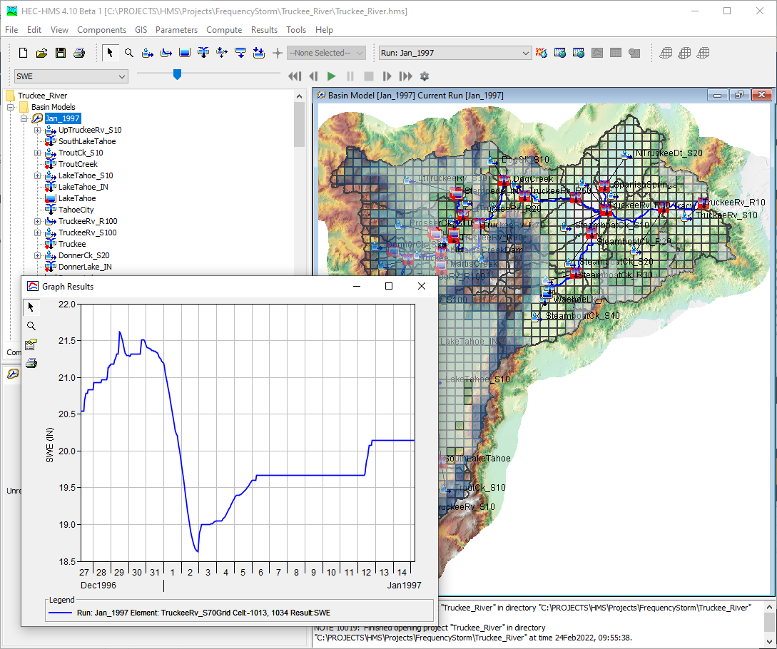
Spatial Results
Visualize time series of spatial results
Feature within v4.9 release

Slide 26
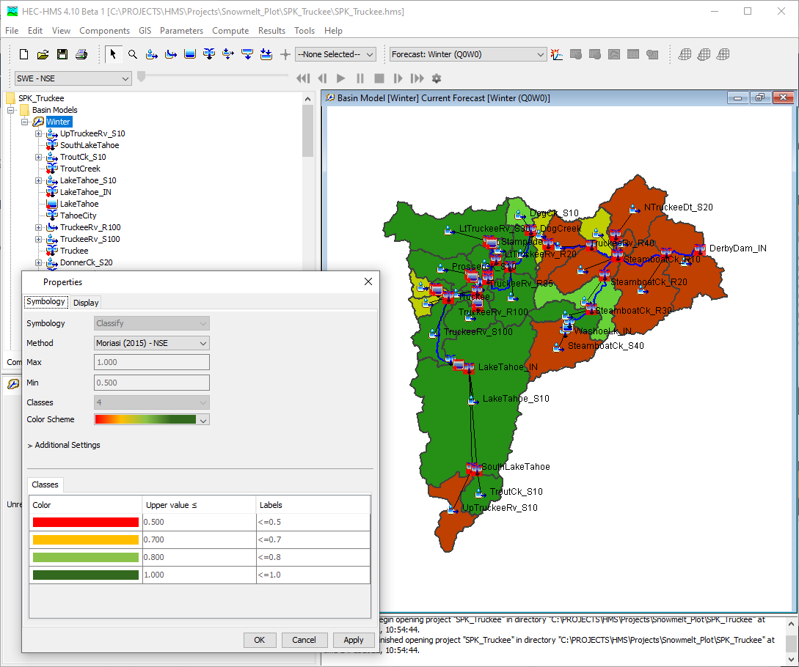
Spatial Results
Visualize flow and SWE statistical metrics
Feature within v4.10-beta.1 release

Slide 27
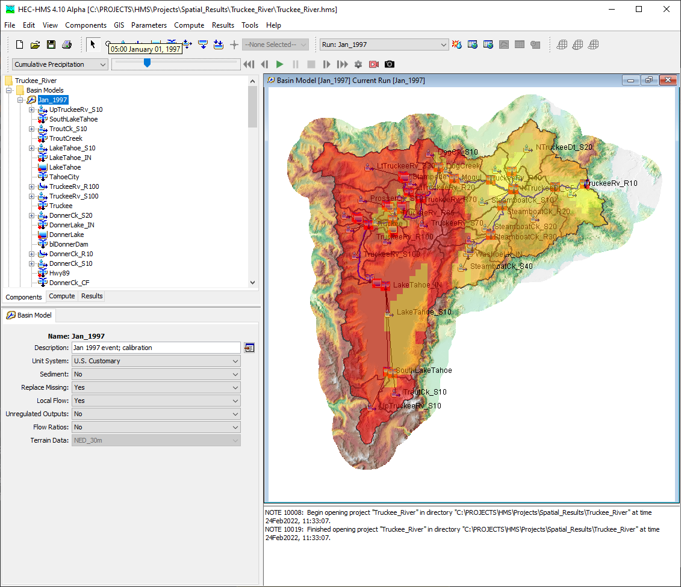
Spatial Results
Export static map (e.g. .tif)
Export animation (e.g. .mp4)
Feature within an upcoming v4.10-beta release

Slide 28
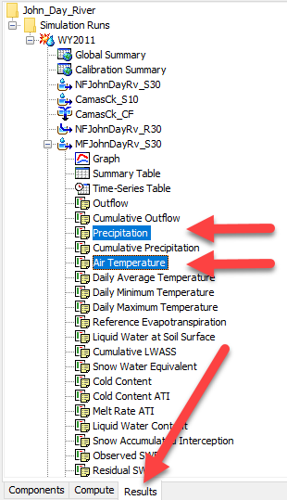
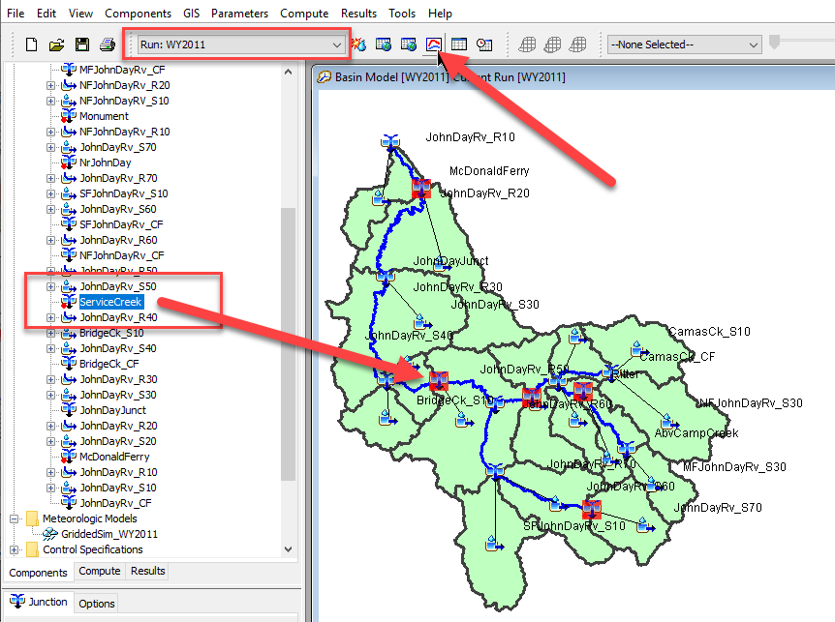
Six WAYS to Access results
Watershed Explorer Results tab
Right-click option in basin map
Compute toolbar
Results menu
Animation Toolbar
Reports

Slide 29
Outline
Background
Documentation
Tech support
Tech transfer
HEC-HMS basics
New features NRCS staff should know about
Questions

Slide 30
New features NRCS staff should know about
GIS delineation (including reconditioning)
GIS characteristics
GIS parameterization
Hypothetical storm
Atlas 14 grid
User-defined temporal pattern
User-defined area-reduction curve
Reports
PMP (HMR 52) optimization
Online documentation and training material

Slide 31
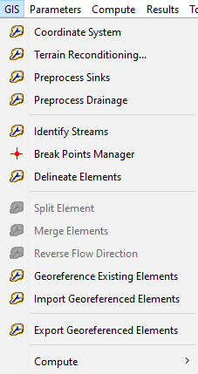
HEC-HMS GIS Tools
TauDEM GIS library is used to define the flow direction, flow accumulation, and stream grids
The user defines the stream threshold
A default delineation is performed
Tools are available to customize the delineation by merging elements or splitting subbasins and reaches
GIS tools are available for computing physical characteristics
GIS tools are available for estimating model parameters

Slide 32
Automated Delineation
78
69
71
58
72
71
4
4
4
5
5
74
67
56
49
46
4
4
4
5
5
8-point pour model
69
53
44
37
38
3
3
4
5
6
8
1
2
64
58
55
22
31
2
2
3
4
5
68
61
47
21
16
2
3
3
3
5
7
3
Digital elevation model (DEM)
Flow direction grid
6
5
4
Flow direction codes
0
0
0
0
0
0
1
1
2
1
0
3
8
5
2
0
1
0
19
0
0
0
1
2
24
Flow accumulation grid
Stream Network

Slide 33
Automated Delineation
0
0
0
0
0
0
1
1
2
1
0
3
8
5
2
0
1
0
19
0
0
0
1
2
24
Flow accumulation grid
Stream Network
How many subbasins and reaches would be delineated if the stream threshold was set to 3 cells?

Slide 34
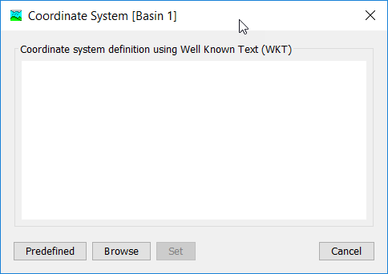
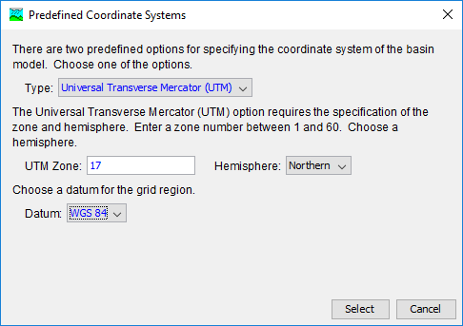
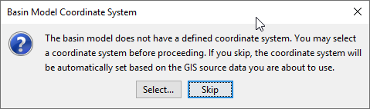
Define the Coordinate System
There are three ways to define the coordinate system:
Choose from a predefined system; UTM or Albers projections
Choose an existing projection file with well known text
Use the terrain data’s projection

Slide 35
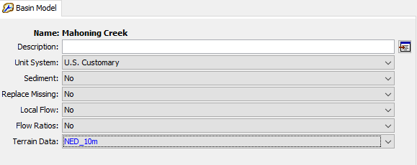
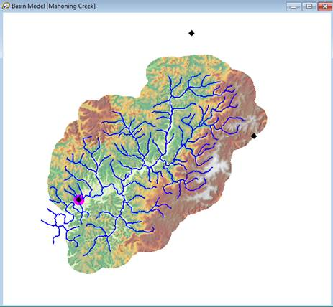
Choose a Terrain Dataset for the Basin Model
Once the projection has been defined and the terrain data selected, the terrain is displayed in the basin model map
The draw properties for the terrain can be modified from the Map Layers editor
GIS delineation tools can now be applied to the terrain data

Slide 36
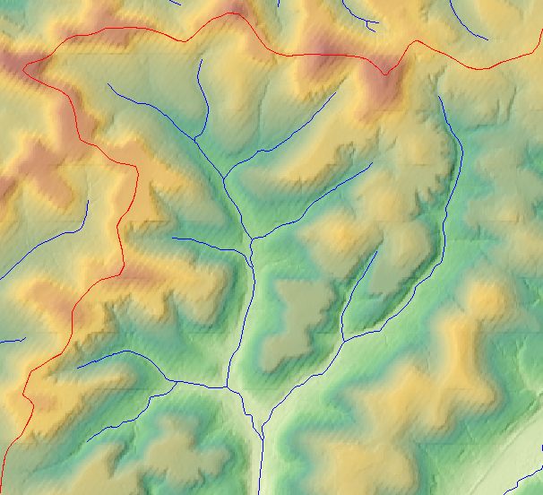
Terrain Reconditioning
Original Terrain with desired subbasin boundaries (red) and a stream network (blue)
Reconditioned Terrain

Slide 37
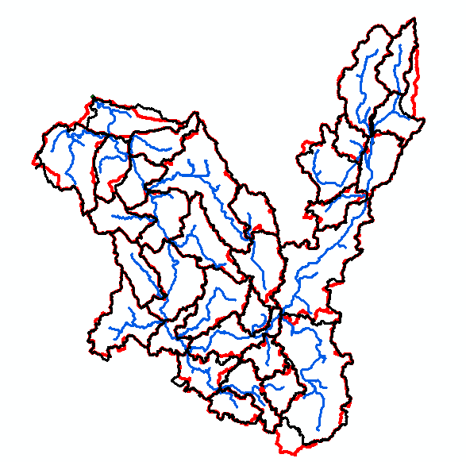
Terrain Reconditioning
Automated delineation tools can result in subbasin boundaries and reach lines that do not match published information
The terrain reconditioning tool in HEC-HMS can be used to modify the terrain so subbasin and reach delineation better matches published information
Auto = 35.7
NRCS = 35.7
Total
Auto = 809
NRCS = 798
Auto = 62.9
NRCS = 61.2
Auto = 17.9
NRCS = 17.8
Auto = 69.6
NRCS = 78.8

Slide 38
Burning Streams with a Smooth and Sharp Drop
5 ft
1 ft
Buffer = 2 cells
Smooth drop = 5 ft
Sharp drop = 1 ft

Slide 39
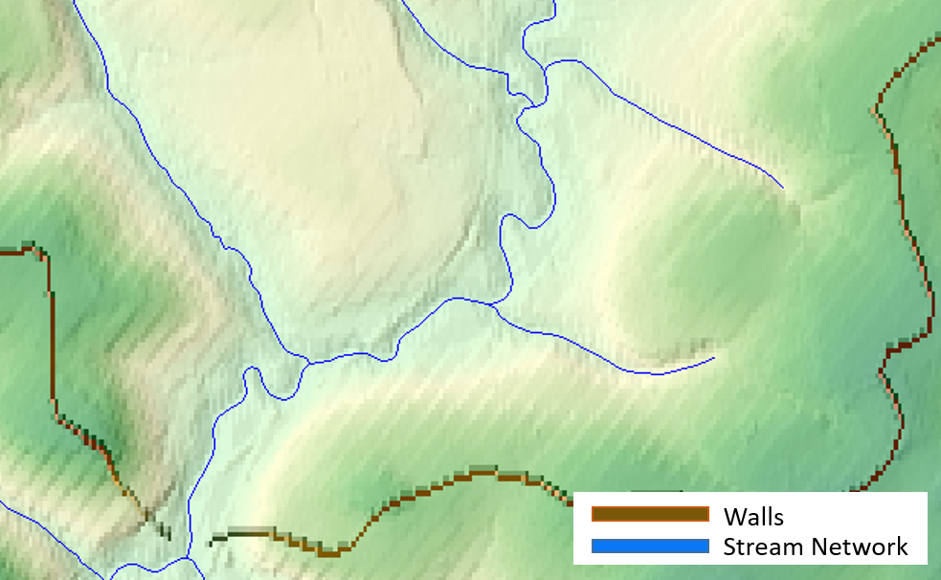
Terrain Reconditioning

Slide 40
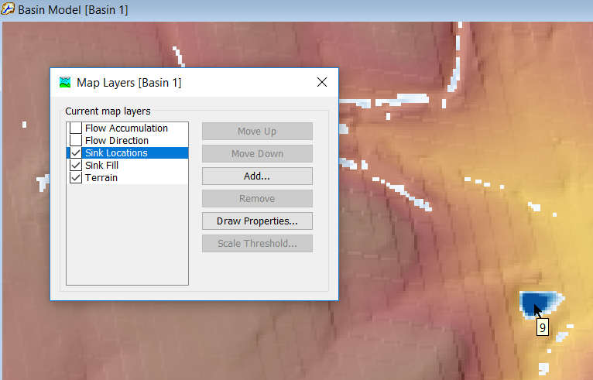
Preprocess Sinks
Preprocess Sinks automatically fills in low spots that prevent water from flowing across the terrain
A Sink Fill terrain layer is created, this is the hydrologically corrected DEM
A Sink Location raster is created showing the locations of the sinks and amount of fill needed

Slide 41
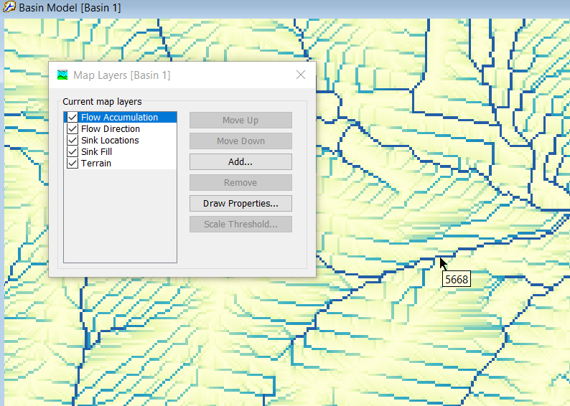
Preprocess Drainage
Preprocess Drainage runs the flow direction and flow accumulation processes
New grid layers are added to the project and displayed in the basin model map
The flow accumulation grid shows the detailed stream network
Notes:
After

Slide 42
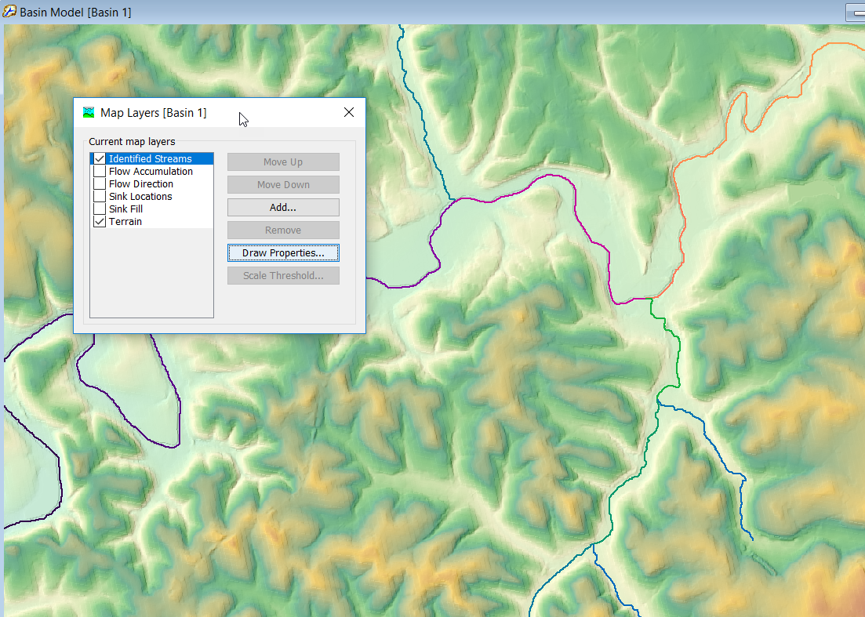

Identify Streams
The user must define the drainage area threshold for initiating a stream segment
Once the drainage area exceeds the threshold, the program will identify a stream segment
A new stream segment is identified when there is a confluence
A subbasin will be created for the drainage area of each stream segment
Notes:
After

Slide 43


Break Points
Break points are used to define the outlet of the basin model and any location where the user knows a subbasin outlet is required, like at a gage location
The break point must be added so that it falls on top of the identified streams layer
Use the break point creation tool and click within the basin model map to add a new break point

Slide 44


Delineate Elements
Delineate Elements will create the default element network (based on the stream threshold)
There are options to set prefix names for subbasins, reaches, and junctions
Insert junction elements between subbasin and reach elements is a user option
Converting break points to computation points is a user option

Slide 45


Merging Subbasin and Reach Elements
Subbasin and reach elements must be hydrologically adjacent in order to merge
Select the elements to merge in the watershed explorer or through the basin model map
Two or more elements can be merged at one time
The program automatically names the new element

Slide 46

Merging Subbasin and Reach Elements
Check reach elements after merging subbasin elements
HEC-HMS will automatically delete reach elements when merging headwater subbasins
There can be multiple reach elements within interior subbasins, these can be merged
Four reach segments in this interior subbasin

Slide 47


Split Subbasin and Reach Elements
New subbasin and reach elements can be added using the Split Element tool
First, select an element in the basin model
Then, select the Split Element option on the GIS menu
Zoom into the location where the split will occur and click on an existing identified stream grid cell (or on a stream identified in the flow accumulation grid)

Slide 48

Split Subbasin and Reach Elements
A temporary GIS feature will show the results of the split
Accept the action and a new subbasin and reach elements will be added to the project
A new junction will be added if that option was selected when initially delineating the network

Slide 49


Split Subbasin and Reach Elements
HEC-HMS will add a new subbasin element with an outlet at the split subbasin point

Slide 50

GIS Data Management
Manually add background shapefiles to the maps folder before adding them to a basin model (makes the files relative to the project)
HEC-HMS will save GIS files created during automated delineation to the gis folder
HEC-HMS will save terrain files to the terrain folder
The *.sqlite file contains information for georeferenced elements, including discretization
Typical HEC-HMS Project Directory

Slide 51

Subbasin Characteristics
Longest Flowpath Length
Longest Flowpath Slope
Centroidal Flowpath Length
Centroidal Flowpath Slope
10-85 Flowpath Length
10-85 Slope
Basin Slope
Basin Relief
Relief Ratio
Elongation Ratio
Drainage Density

Slide 52

Reach Characteristics
Reach Length
Reach Slope
Reach Sinuosity
Reach Relief

Slide 53


Parameter Expression Calculator
HEC-HMS has a built-in Expression Calculator that can be used to facilitate canopy, surface, loss, transform, baseflow, and routing parameter estimation from GIS data.
The Expression Calculator can be launched from global editors.

Slide 54

Parameter Expression Calculator
When clicking “Calculate” within the Expression Calculator, the parameter estimates are computed and automatically populated in the Global Editor table.

Slide 55


Parameter Expression Calculator
In the Expression Calculator, grids can also be used as variables if they have been previously imported into HEC-HMS. Grids are available from the Grids tab. When a grid is included in the expression, a zonal average value of the feature on the grid is used in the calculation.

Slide 56

Hypothetical Storm
User-specified temporal pattern (could be NRCS patterns)
Storm duration
User-specified storm depth or extract from a grid
Depth-area reduction
TP 40 or user-specified
Enter storm area or choose a computation point

Slide 57


Hypothetical Storm
Download precipitation-frequency grids from https://hdsc.nws.noaa.gov/hdsc/pfds/pfds_gis.html

Slide 58

Hypothetical Storm
New Precipitation-Frequency Grid Importer
Choose the grid, name, units and scale factor
The program will copy the file into the project directory and create the grid object

Slide 59



Hypothetical Storm
User-specified temporal patterns can be created using Percentage Curves

Slide 60



Hypothetical Storm
Depth Area Reduction – TP40 or User-Specified

Slide 61


Frequency Analysis Compute
Frequency Analysis Compute
Combines multiple Met/Basin combinations to compute a frequency curve
Presentation

Slide 62


Basin Model Reports
Standard Report Option

Slide 63

Simulation Results Report
Statistics Report Option

Slide 64


HMR 52 Storm Optimization
HMR 52 Storm parameters can be automatically adjusted to maximize peak flow, volume, and reservoir stage

Slide 65
Link to Training Material
GIS related tutorials:
https://www.hec.usace.army.mil/confluence/hmsdocs/hmsguides/creating-a-georeferenced-model-using-hec-hms-gis-tools
https://www.hec.usace.army.mil/confluence/hmsdocs/hmsguides/gis-tutorials-and-guides
GIS Parameter Estimation tutorials:
https://www.hec.usace.army.mil/confluence/hmsdocs/hmsguides/applying-hec-hms-gis-parameter-estimation-tools
Hypothetical Storm tutorials:
https://www.hec.usace.army.mil/confluence/hmsdocs/hmsguides/working-with-hypothetical-precipitation-methods-in-a-meteorologic-model
HMR 52 Storm tutorials:
https://www.hec.usace.army.mil/confluence/hmsdocs/hmsguides/developing-probable-maximum-precipitation-pmp-estimates

Slide 66
Conclusion
Latest release: v4.9
More enhancements are being delivered within version 4.10 (April 2022)
Documentation is continuously updated
HEC-HMS training is continuously updated
We would appreciate any feedback and ideas for improvement

Slide 67

Questions?
Docs: https://www.hec.usace.army.mil/confluence/hmsdocs
To be added to the list, send an email to hec.hms@usace.army.mil with “subscribe” in the title or body.

