Slide 1
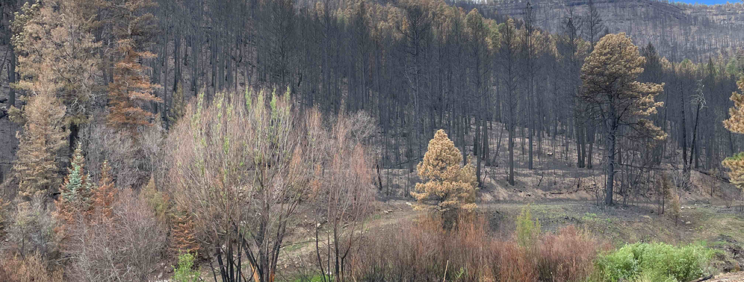
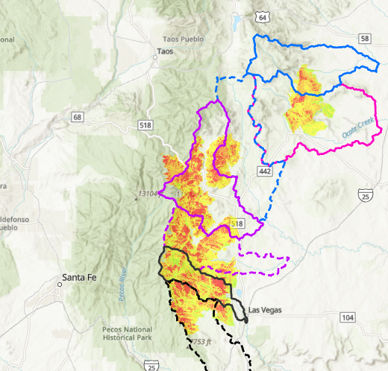
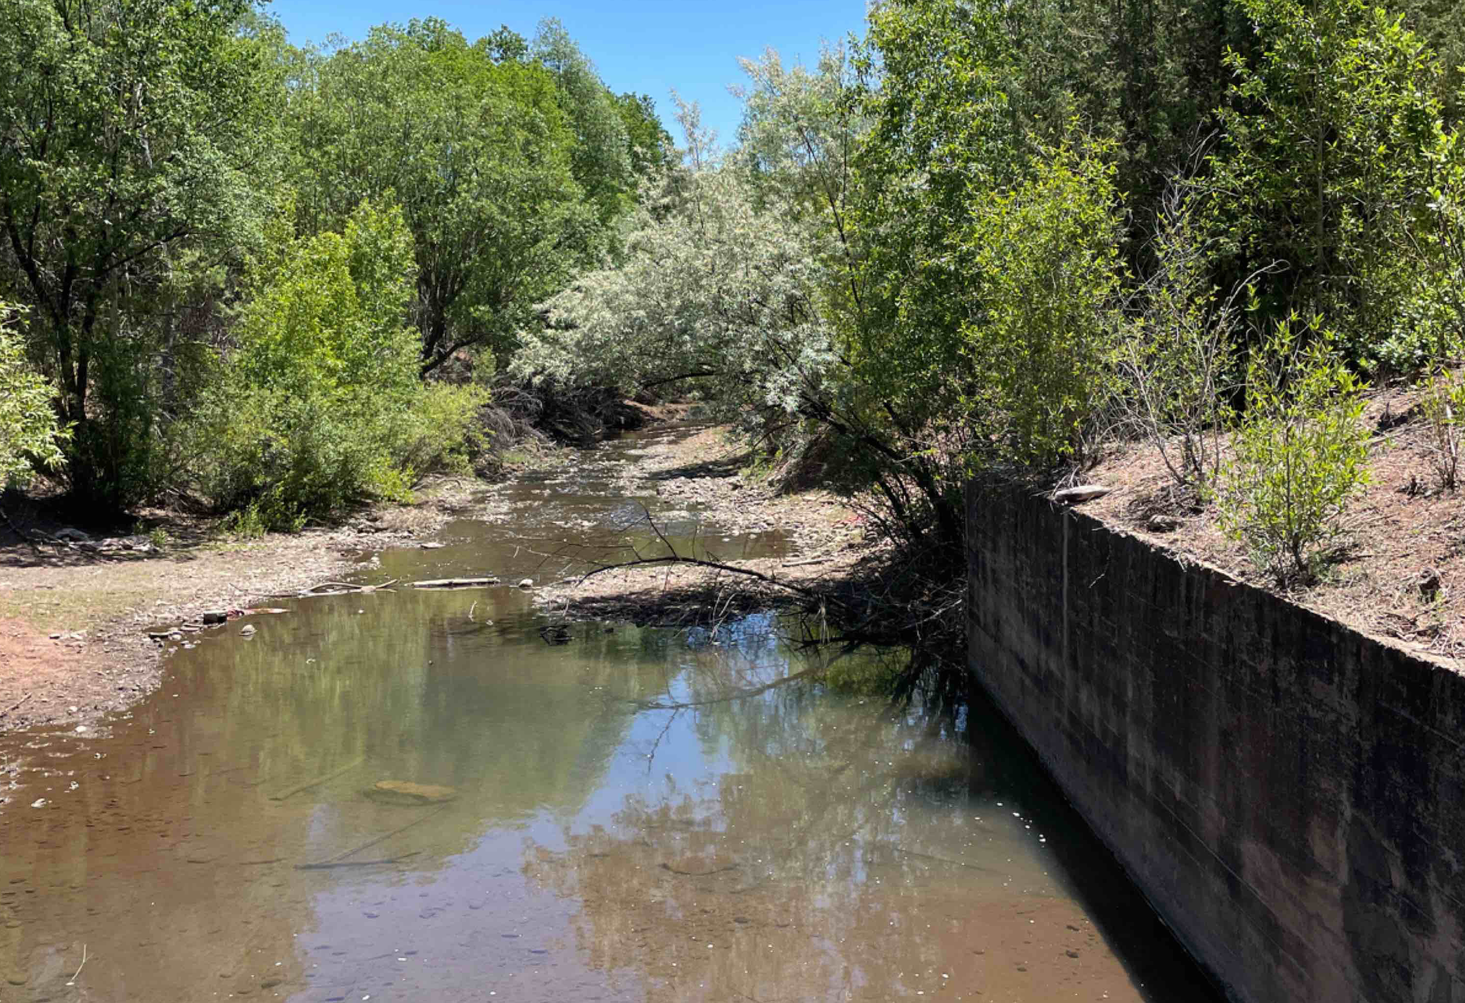
Rapid H&H Modeling for Post-Wildfire Conditions: Hermit’s Peak/Calf Canyon and Cook’s Peak Fires, NM
Prepared by:
Jonathan AuBuchon Jose Paredez Kellie Jemes Jackie Oehler Jay Pak Moosub Eom
15 September 2022
Notes:
Introduce team and mention that separate team from ERDC (Joseph Gutenson, Julia Zimmerman, Kate Staebell, and others) worked on the AutoRoute

Slide 2
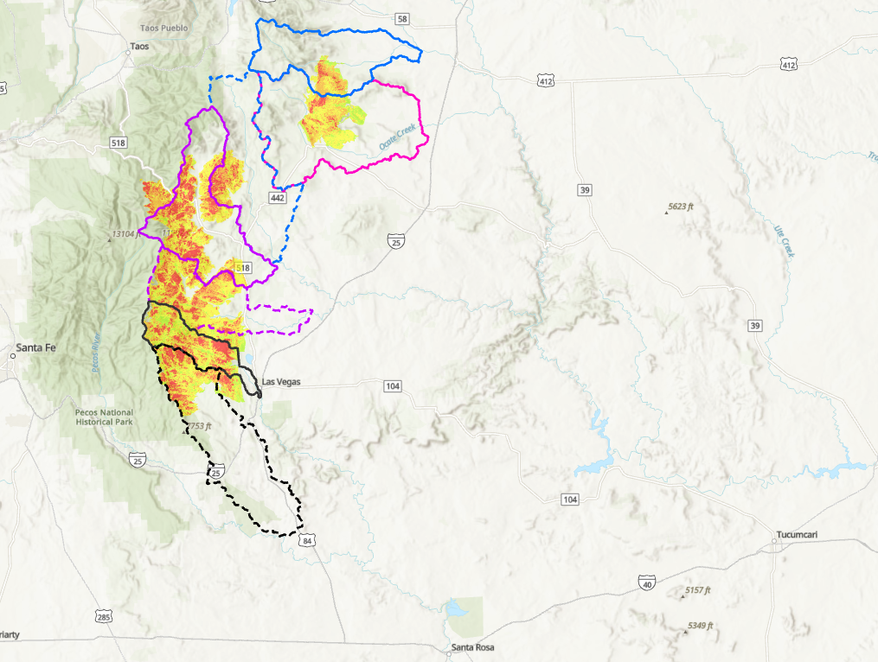
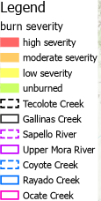
Background
Cook’s Peak Fire
Hermit’s Peak Fire started from a prescribed burn in the Santa Fe National Forest.
The Calf Canyon Fire started from a winter pile burn project.
Fires merged into one on 19 April 2022
The Cook’s Peak Fire is to believed to be human caused but investigation is under way
Calf Canyon
Hermit’s Peak
Conchas Dam
Santa Rosa Dam
Notes:
Discuss how fires started (early April) Calf Canyon and Hermit’s Peak were on Santa Fe NF but burned a portion of Carson NF. USACE tie-in was downstream dams: Conchas on the Canadian and Santa Rosa on the Pecos.
Goal was real-time risk information provided to communities. This was interpreted as a floodplain inundation map

Slide 3
TIMELINE
6 April
11 May
18 May
31 May
13 June
14 July
18 July
17 April
13 May
22 May
9 June
16 June
17 July
29 July
Hermit’s Peak Fire 93% contained (341,735 Ac burned)
Delivery for public distribution
Cook’s Peak Fire initiates
Cook’s Peak soil burn severity maps received
Last HMS modeling ready for AutoRoute
Resourcing obtained for HMS modeling
Initial H&H discussions
Kick-off meeting for HMS modeling
Initial AutoRoute inundation maps received
Final AutoRoute inundation maps received
Phase I Hermit’s Peak soil burn severity maps released
Phase II Hermit’s Peak soil burn severity maps released
Hermit’s Peak/Calf Canyon Fire initiates
Cook’s Fire 100% contained
(59,539 Ac burned)
First HMS modeling ready for AutoRoute
Notes:
Red text and arrows relate to fire (initiation, SBS maps)
Blue arrow and text refers to fire containment
Green arrow and text relate to H&H actions
The ask was to help inform risks – i.e., inundation maps post-wildfire
Note a head’s up e-mail was received 25 April 2022 concerning impacts to fire.
Mr. Michael Connor is currently the Assistant Secretary of the Army for Civil Works. He is a NM native (from Taos Pueblo) and was contacted directly by people in NM. He directed that action be taken.
Hydrologic modeling funding obtained from MMC DART (Data Access in Real Time) as burned watershed are upper portions of two separate CWMS (Corps Water Management System) model. DART funds were allocated as $25k for each basin and then augmented with another $15k per basin at the end of May.
Hydraulic modeling was obtained through use of a UROC (USACE Reachback Operations Center) request from ERDC that funded the AutoRoute modeling
Advanced Measures/Technical Assistance funding was used for site visits and to develop RAS models for Gallinas and Mora

Slide 4
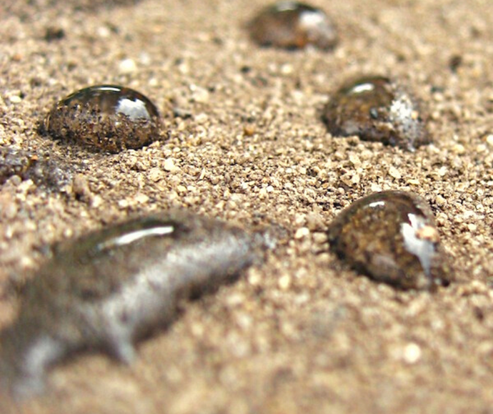
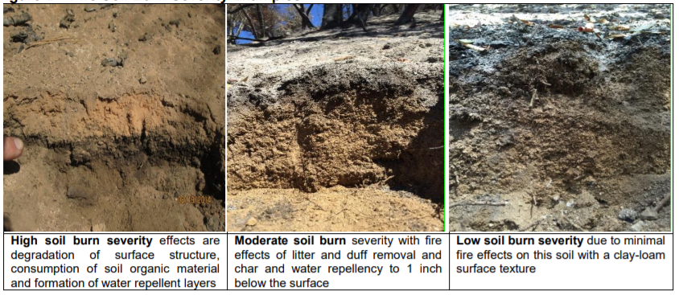
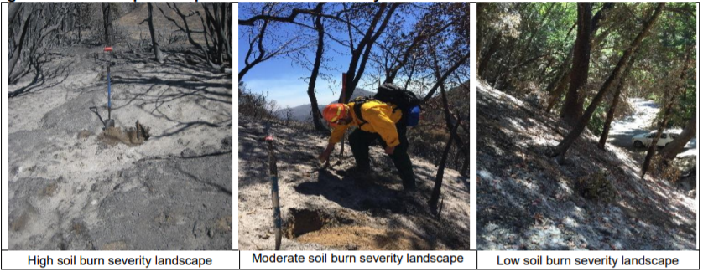
effects on watersheds
Hydrophobic Soil
Notes:
Hydrologically, wildfires change the infiltration properties of soils and reduce the amount of interception material such as canopy, litter, duff and organic material which protect soil from raindrop impact and slow down runoff.
Infiltration commonly decreases due to changes in the chemical and physical properties of the soil, making the soil hydrophobic (water-repellent).
This decrease in infiltration and interception material in the watershed results in increased
discharges,
velocities, and
often result in increased erosion.
The overall degree and longevity of this impact is determined by numerous factors including
fire severity,
temperature,
fire frequency,
soil type and moisture,
vegetation type and amount of vegetation,
topography,
season of burning,
and pre- and post-fire weather conditions.
In addition, the highest risk occurs immediately after the fire
Post-fire hazards will decrease with time as re-vegetation stabilizes hillslopes, and material is removed by floods.

Slide 5
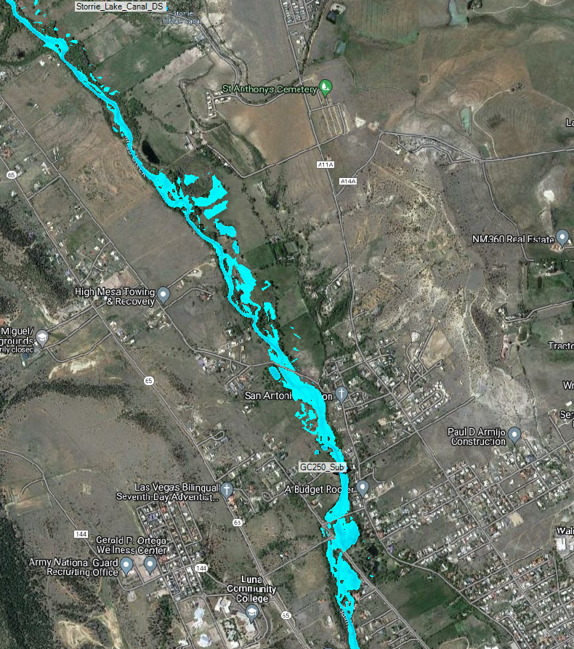
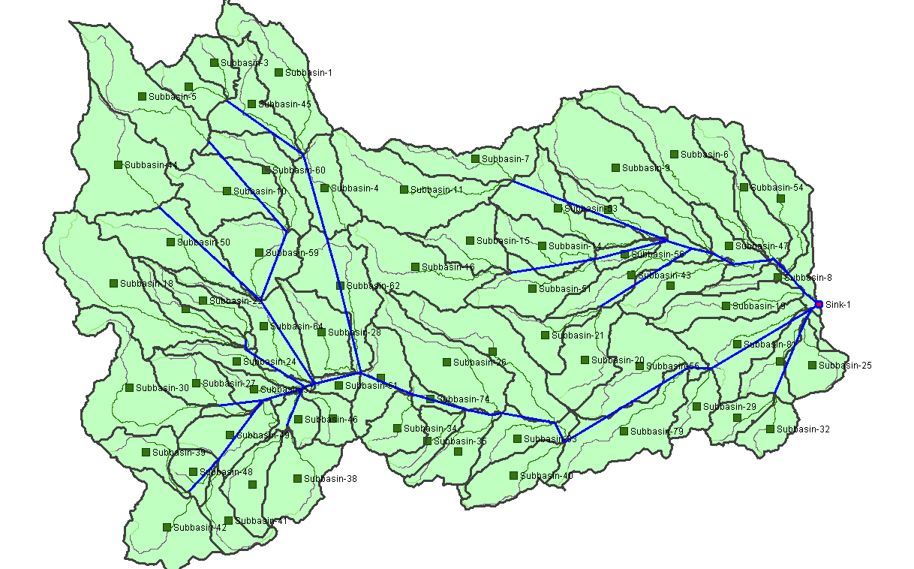
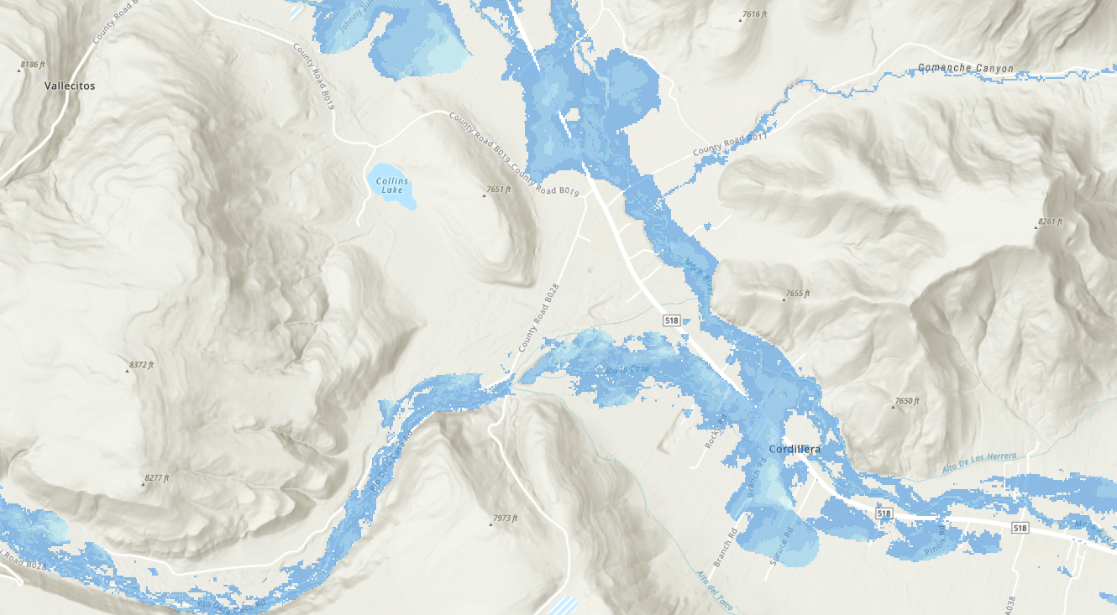
H&H Work Accomplished
Hydrologic modeling (Using HEC-SSP and HEC-HMS – Team composed of SPL, SPK, SPA, and HEC)
Debris yield post-wildfire (Using HEC-HMS – Team composed of SPL, SPK, SPA, and HEC)
Hydraulic modeling (Using AutoRoute – Team composed of ERDC with SPA collaboration)
Hydraulic modeling (Using HEC-RAS – Team composed of NWK with SPA collaboration)
Real-time forecast (SPA implementing HMS and RAS into CWMS)
2017
From E. Griffin, 2014
Notes:
Sediment data incorporated as bulking factors used to increase HMS peak flows for input to AutoRoute
An Initial AutoRoute (mid June) based on StreamStats and NHD flowlines, and flow peaked by 5 - intent was for quick and dirty inundation area
The HEC-HMS modeling was envisioned as a more refined post-wildfire hydrology approach. Post-wildfire peak flows extracted at set locations for generation of AutoRoute inundation maps. This included a bulking factor for debris (mid to end of July)
This presentation is focused on first three bullets which were done to provide a rapid response.
RAS models developed in more populated areas to get a more refined inundation mapping (July/August)
The HMS/RAS models pulled into a “new” CWMS model to obtain estimated inundation based on forecasted precipitation (Ongoing).

Slide 6
H&H Approach for first three bullets
NM regression equations and AutoRoute
Flow Frequency Analysis (Bulletin 17C)
Hydrologic modeling with HEC-HMS
Terrain and subbasin delineation
Hypothetical storm
Flow Routing - Muskingum-Cunge
Loss method - SCS Curve Number
Transform method - SCS Unit Hydrograph
Model Calibration (pre-fire)
Post-fire modeling
Debris yield modeling with HEC-HMS
HEC-HMS results and AutoRoute
Next steps
Notes:
Provide an outline for the H&H approach described in the following slides

Slide 7
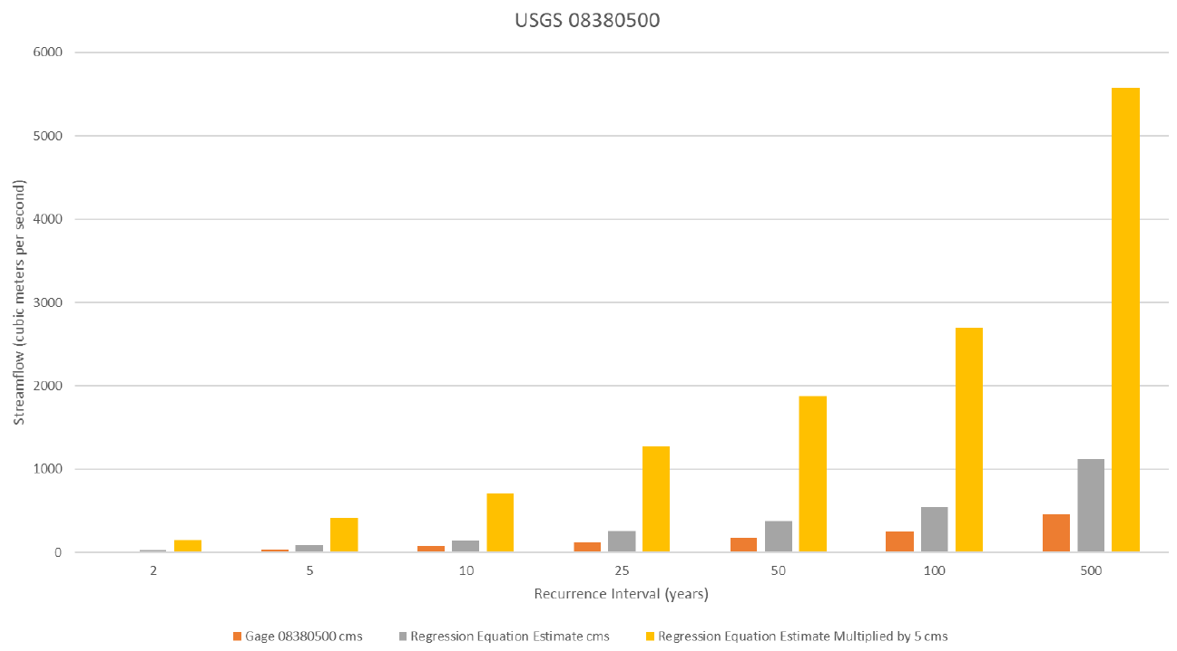
AutoRoute and NM Regression Equations
2017
From E. Griffin, 2014
Notes:
Conversion from cms to cfs is a factor of 35.3
Note how NM Regression equation differs on peak flow values after about the 10% AEP, with the NM Regression being larger

Slide 8
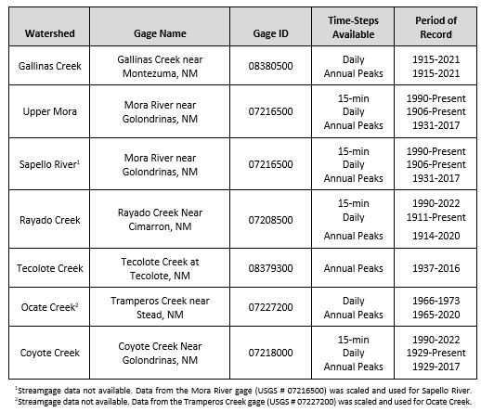
Flow Frequency Analysis (Bulletin 17C)
Most watersheds had a statistically relevant period of record.
Flow Frequency curves scaled by watershed for Sapello River and Ocate Creek.
Scaling done by drainage area.
Used a watershed of similar characteristic for scaling.
2017
From E. Griffin, 2014
Notes:
Discuss the USGS gage records used and the period of record (note annual peaks used in the Bulletin 17C analysis).
Discuss translation by drainage area for Sapello River and Ocate Creek

Slide 9
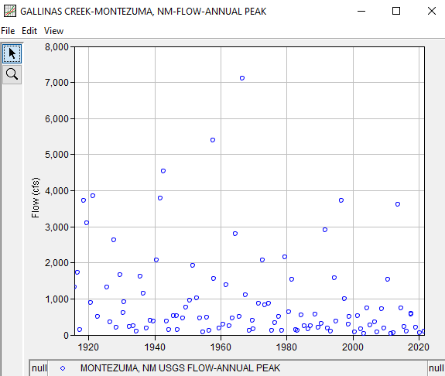
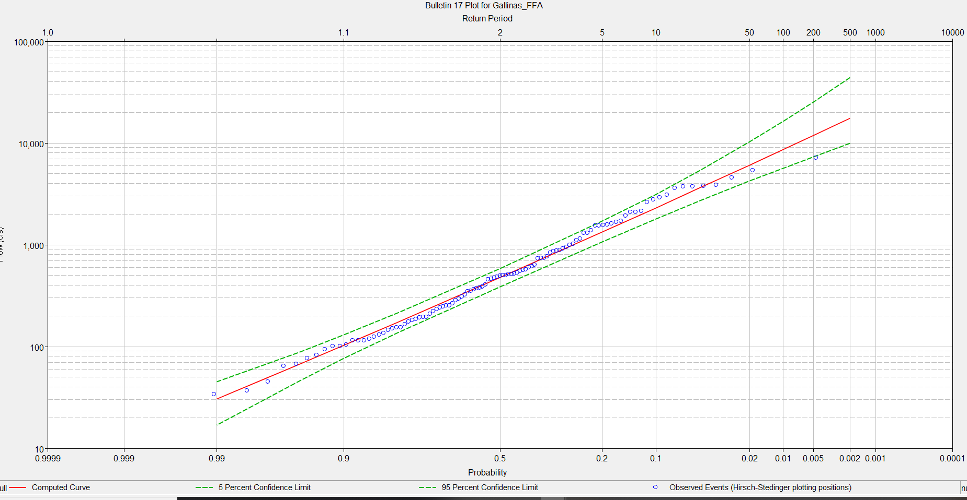
Flow Frequency Analysis (Bulletin 17C)
2017
From E. Griffin, 2014
Notes:
Used SSP version 2.3
Flow-frequency curves were developed using the Bulletin 17C Analysis in the HEC Statistical Software Package (HEC-SSP) (version 2.3) at the selected calibration gages for each watershed. The annual peak flow data for the period of record for each gage was downloaded and used in the Bulletin 17C Analysis.
The regional skew was set to zero and the regional skew mean squared error (MSE) was set to 0.31. These values were selected based on a study by Waltemeyer that analyzed the magnitude and frequency of peak discharge in New Mexico.
Separate models needed to achieve a better calibration

Slide 10
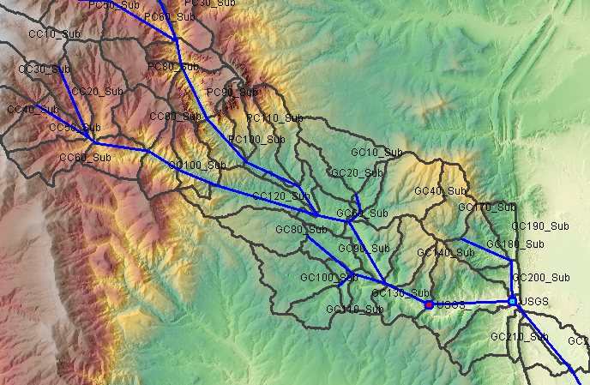
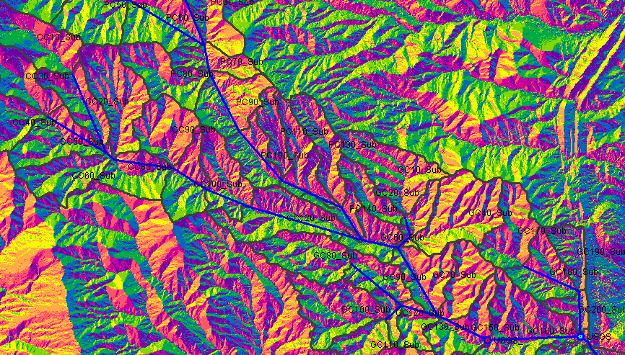
HEC-HMS Model Development: Terrain
Used HEC-HMS version 4.10 beta
Seven watersheds modeled (Total: 1,357 square miles; Watershed range: 98 to 367 square miles)
Used 3DEP, 10 m USGS topography
Used GIS tools in HEC-HMS to delineate subbasins and reaches
Target sub-basin size was 3 sq mi
2017
From E. Griffin, 2014
Notes:
USGS DEMs covering the study area were reprojected to State Plane New Mexico East with units of feet and a horizontal datum of NAD83. Elevations were converted to units of feet and use a vertical datum of NAVD88.
Desire for 3 sq mile driven by debris yield. Most equations have been field tested on this size watershed. Empirical equations largely untested at the larger watershed areas.

Slide 11
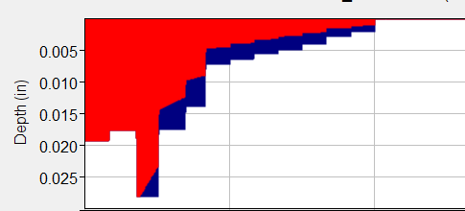
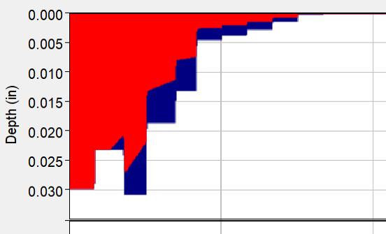
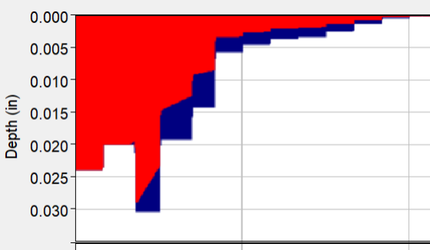
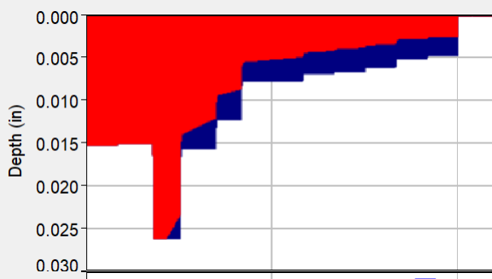
HEC-HMS Model Development: Meteorologic Model
NOAA14 70% in first quartile
From Yeo 1936, UNM
Colorado
Hypothetical storm
NOAA Atlas 14 annual maximum precipitation grids
Used a 6-hour storm duration
Temporal patterns sensitivity
TP 40 Area reduction factor applied to all basins (except for debris yield).
Area reduction factors applied at the watershed outlet and at the calibration gage.
Frequency analysis done for post-wildfire conditions to get a peak flow (simulations were 1-2 days)
6-hour duration
NOAA14 50% in first quartile
NOAA14 60% in first quartile
NOAA14 80% in first quartile
Notes:
How precip was developed and entered into HMS

Slide 12
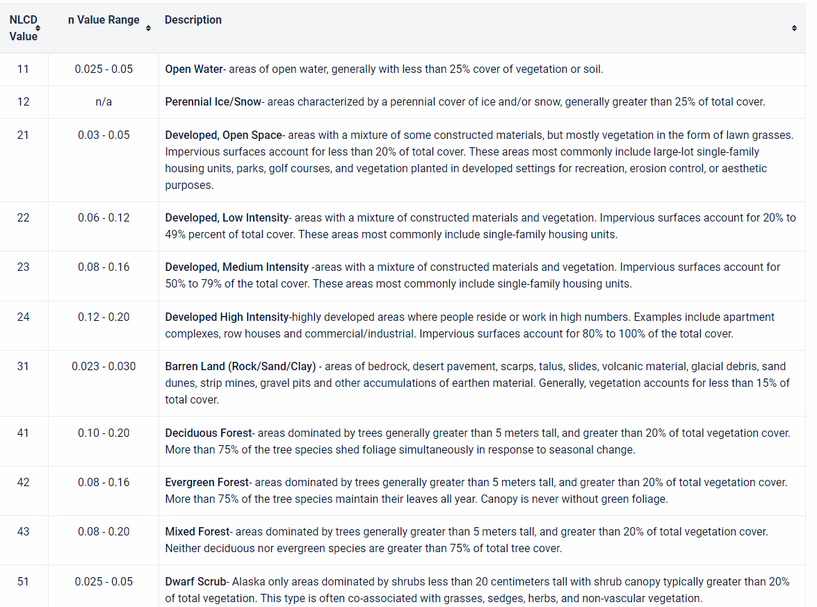
HEC-HMS Model Development: Routing Flow
No baseflow method used (relative to flow peaks, this is small)
Muskingum-Cunge used for channel routing
Roughness values extracted using Manning’s n based on aerial imagery and relationship to land cover
Celerity used for index method (5 ft/sec chosen as midpoint between base flow and peak flow)
Trapezoid channel shape used: bottom width and side slope estimated from several cross-section checks, using the HMS DEM
Deleted reaches less than 500 ft (reduce numerical instabilities)
No other reach modifications
Notes:
Clear-water routing within HMS

Slide 13
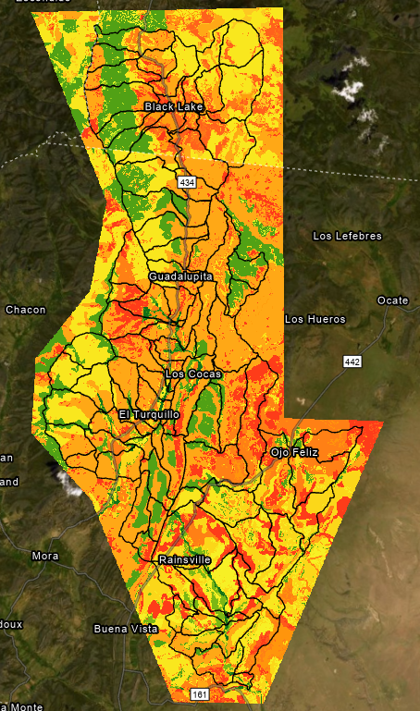
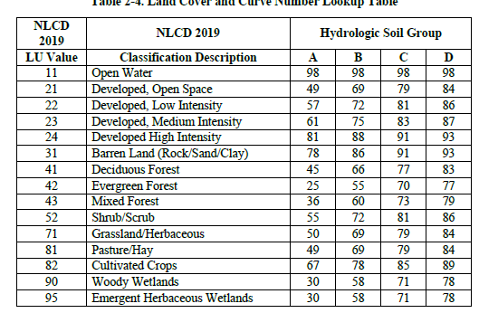
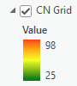
HEC-HMS Model Development: Loss Method
The SCS Curve Number loss method was used
Initial pre-fire CN values assigned based on the NLCD and gSSURGO (hydrologic soil group)
Percent Impervious, canopy, and surface losses are all accounted for in the CN not explicitly accounted for in the HMS model
Initial abstraction computed by HMS based on the CN
Notes:
2019 National Land Cover Database (NLCD) and the hydrologic soil group from the 2021 Natural Resources Conservation Service’s (NRCS’s) Soil Survey Geographic Database (SSURGO) data sets.
Initial CN determined in GeoHMS
Talking Points: 1) The SCS curve number loss and transformation method was used due to ease of use and existing literature on adjusting existing CN (pre-fire) values to post-fire CN values. 2) The CN value is considered a "lumped" parameter therefore % Impervious, canopy, and surfaces losses are accounted for within the CN value.

Slide 14

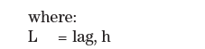
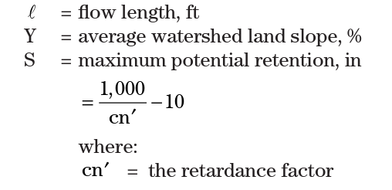
HEC-HMS Model Development: SCS Transform method
SCS Unit Hydrograph used as the transform method
Lag Time also adjusted as a function of CN
Calibration adjusted lag time and CN. Required treating less frequent events (1/25 to 1/100 AEP) differently than more frequent events (1/2 to 1/10 AEP)
Lag time decreased for less frequent events
Notes:
PRF. (peak rate factor) adjusted during calibration but ultimately the standard was utilized (PRF 484)
Talking Points: 1) The "lag" parameter in the SCS curve number transformation method is estimated using equation 15-4a (see slide). The 3 parameters needed are longest flow path, average watershed slope, and CN values. The CN value is inversely proportional to Lag. Therefore, as the CN value increases (due to a fire) the lag decreases. This is what you would expect to occur out in the field. So we are not only decreasing losses but also "peaking" the unit hydrograph with the lower lag.

Slide 15
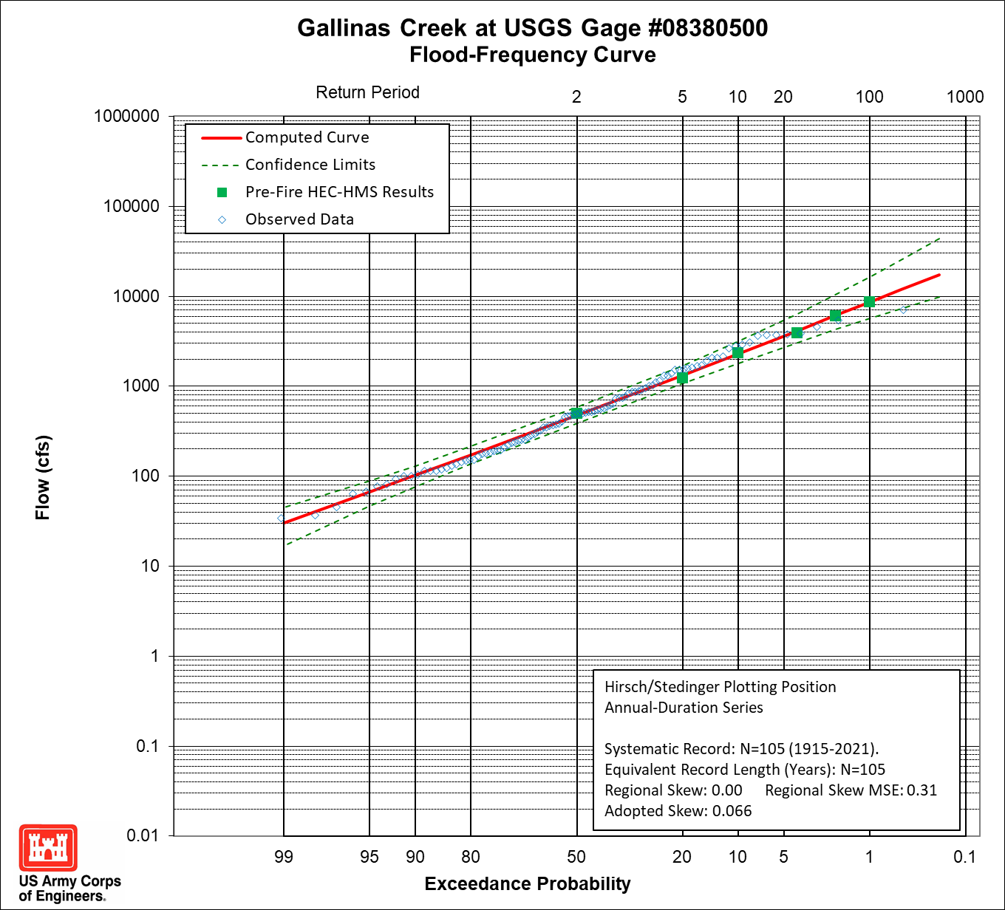
HEC-HMS Model Development: Calibration
Calibrated to a Flow Frequency Curve
Multiple events better but time consuming
Only pre-fire calibration
Lack of post-wildfire storms
Model improvement could be made after the fact.
Pre-fire CN values were adjusted globally by a ratio to maintain variability at each subbasin.
Notes:
Separate models needed to achieve a better calibration
Time constraints - We had a few weeks to develop 7 "calibrated' models. Calibrating and validating to multiple events would be time consuming. There are no post-fire storm events to calibrate to. However, we can discuss how this is a "tiered" approach and models can be improved as data becomes available

Slide 16
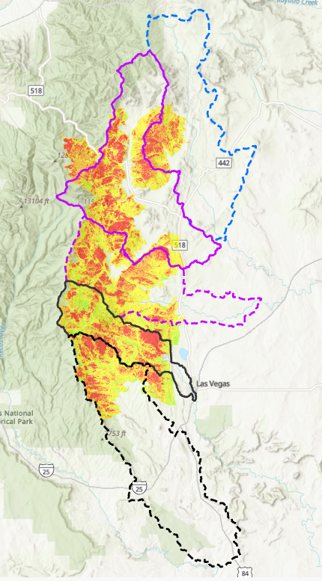
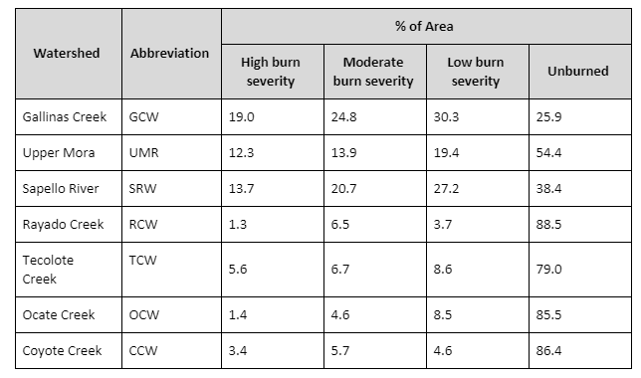
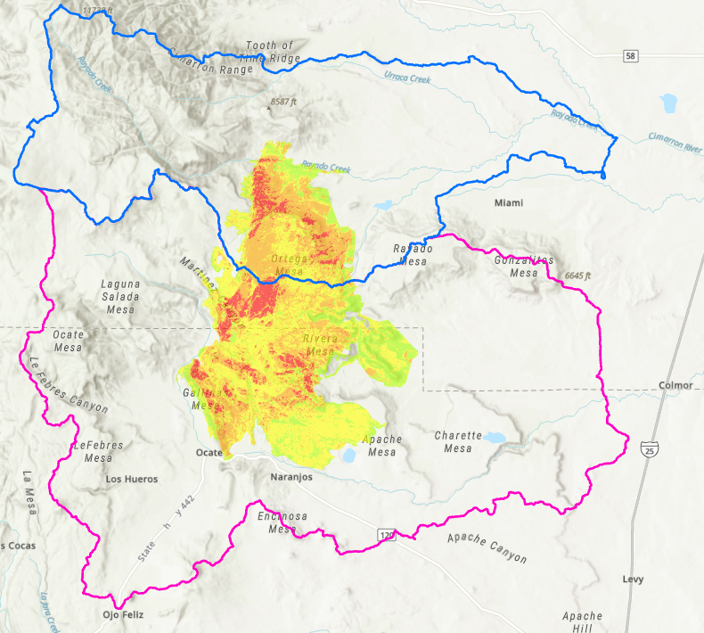
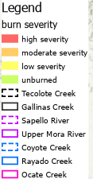
HEC-HMS Model Development: Post-Fire Curve Number
Post-wildfire CN adjusted using Livingston et al. (2005) method that utilizes the burn severity mapping
Greatest increase in CN in areas with low pre-fire CN and within high burn severity
2017
From E. Griffin, 2014
Notes:
Talk about the subbasins/conditions that resulted in the greatest increase in post-fire CN number. Such as subbasins with severe burn severity and low pre-fire curve numbers had the greatest increase in CN

Slide 17
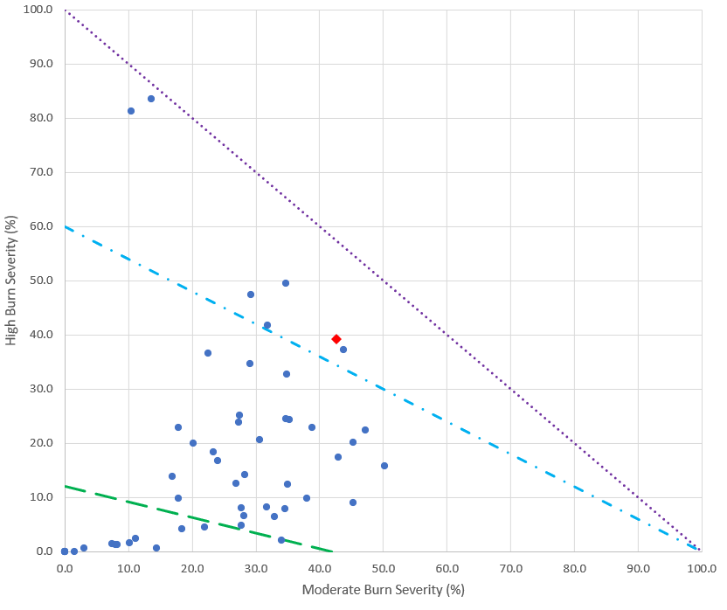
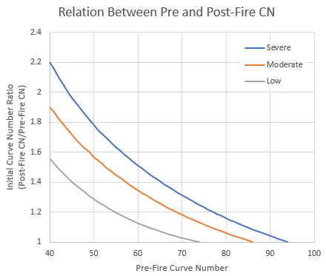
HEC-HMS Model Development: Post-Fire Curve Number
Post-wildfire CN adjusted using Livingston et al. (2005) method that utilizes the burn severity mapping
CN ratio of ~ 1.62 gives post-wildfire CN of 90.2
Point used for translating Wildfire Hydrologic Impact factor to CN translation graphic
WHI = Severe
WHI = Low
WHI = Moderate
Calibrated pre-fire CN of 55.7
Notes:
Translation example from pre-fire CN to post-fire CN

Slide 18
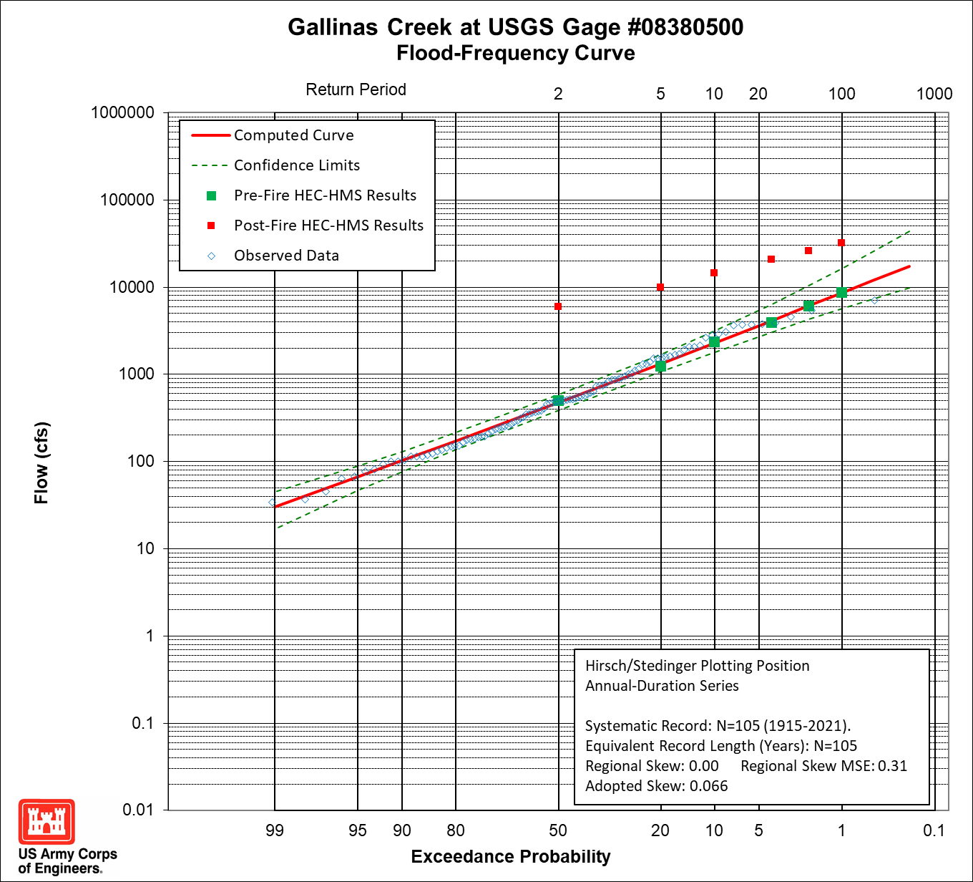
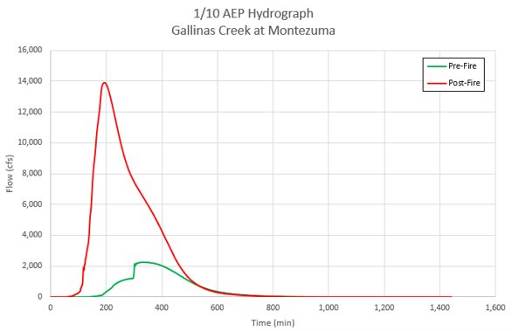
HEC-HMS Model Development: Post-fire results
Notes:
Want to explain findings with this curve.
What do we see from the results – higher frequency curves resemble lower frequency events pre-fire conditions
The difference between pre and post fire conditions diminishes as the AEP decreases (or return period increases). Does this make sense? My answer: Yes, to some extent. The lower frequency events would naturally overwhelm the ability of the soil and existing vegetation to intercept the rainfall and thus they generate more runoff. The post-fire conditions change the vegetation canopy and the soil characteristics which influences the ability of the watershed to absorb and intercept rainfall. So more rainfall runs off. As a percent of the rainfall volume the amount running off in pre-fire conditions increases as we move towards the rarer events. The same is true for the post-wildfire condition, although the curve would be expected to be flatter because the % increase is not as great as we move towards the rarer events.
Would it be reasonable to assume these curves would converge at some very extreme event? – I think they could get close. At some rare event, the percent of runoff from either pre or post fire is so large compared to the rainfall volume that the pre-fire and post-fire curves are practically the same.

Slide 19
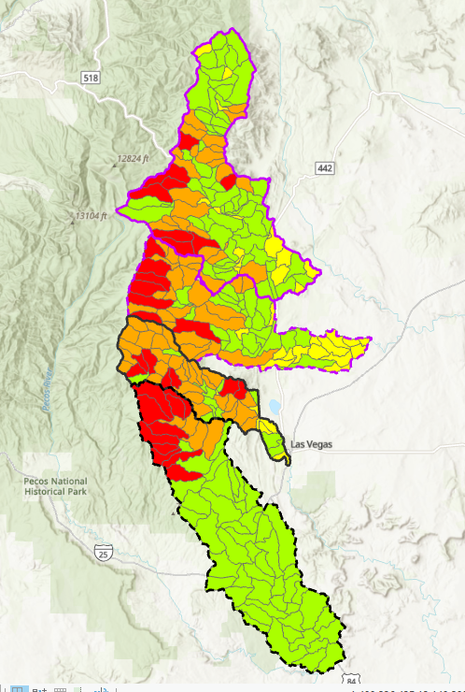
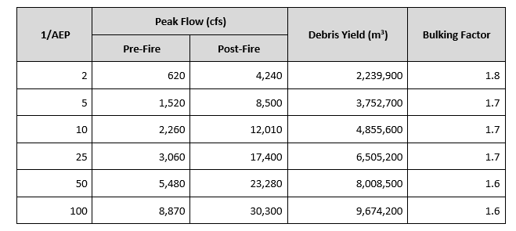
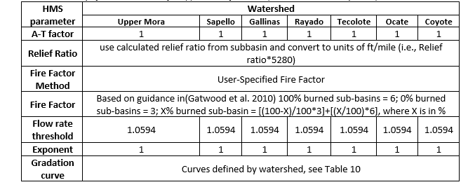

Debris Yield Modeling
Used LA Equation 2-5 developed for debris yields post-wildfire
Method estimates a volume based on % burned
Yield only for sub-basins
Summation of debris yield and flow volume to obtain bulking factor
Gave bulking factor at outlet for AutoRoute modeling
2017
From E. Griffin, 2014
Notes:
The LA Debris Method EQ 2-5 is a regression equation that is applicable to subbasins up to 200 square miles (Gatwood et al., 2000). The method is intended for steep, mountainous terrain and for use in conjunction with frequency events greater than the 1/5 AEP and within watersheds that have significant antecedent rainfall such that the soils are saturated.
Used A-T of 1 but this is not known. It is set relative to the San Gabriel Mountains in LA
Used default HMS flow threshold and exponent that can flatten or steepen sedigraph in relation to the flow hydrograph

Slide 20
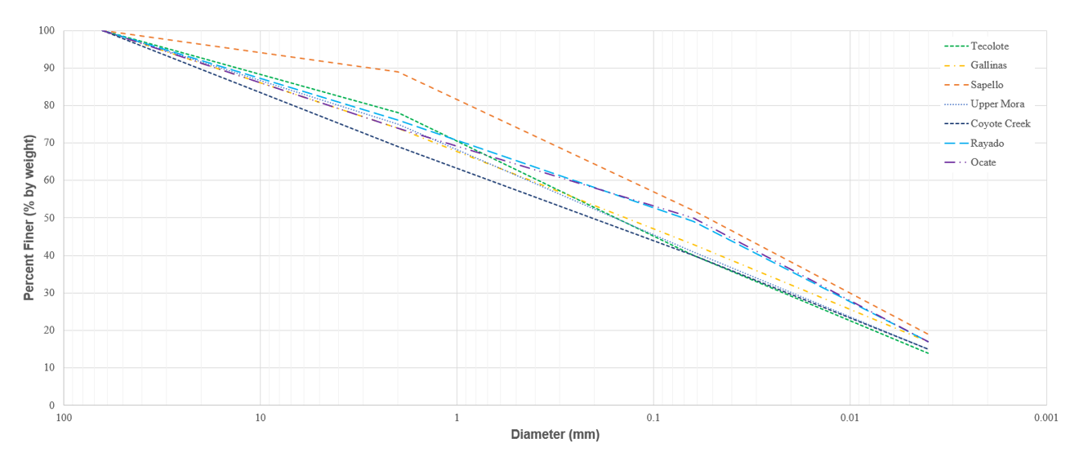
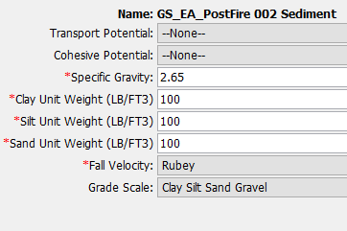
Debris Yield Modeling
Defined gradations for the entire watershed (1 per watershed using the 4 grain classes: gravel, sand, silt, clay)
Defined a generic unit weight (used to translate volume to mass). LA equation 2-5 estimates volume. HMS translates to mass. For bulking factor translated back to volume
2017
From E. Griffin, 2014
Notes:
General discussion on the gradations. Not needed for volume calcs, but required for running sediment in HMS

Slide 21
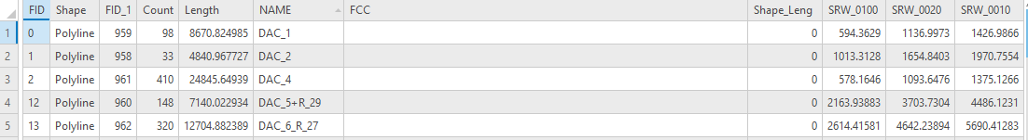
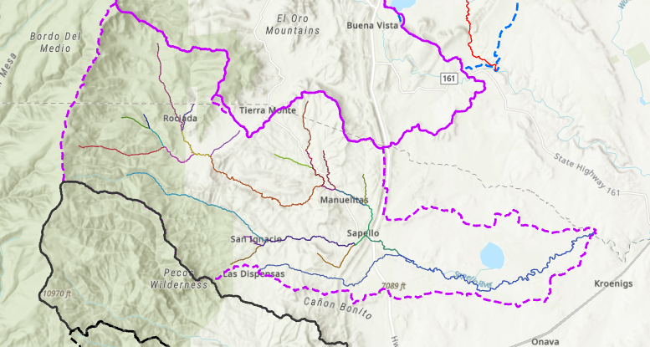
Hydraulic Modeling: HEC-HMS results to AutoRoute
Pre-fire and post-fire flows for discrete events at identified locations
From E. Griffin, 2014
Notes:
Chose peak flow for a given location
Limitations:
No post-fire flow calibration
CN is a lumped parameter and not process based
No sensitivity analysis of the existing evaluation methods
Parameter calculations done outside HEC-HMS environment
No uncertainty bands for risk communication

Slide 22
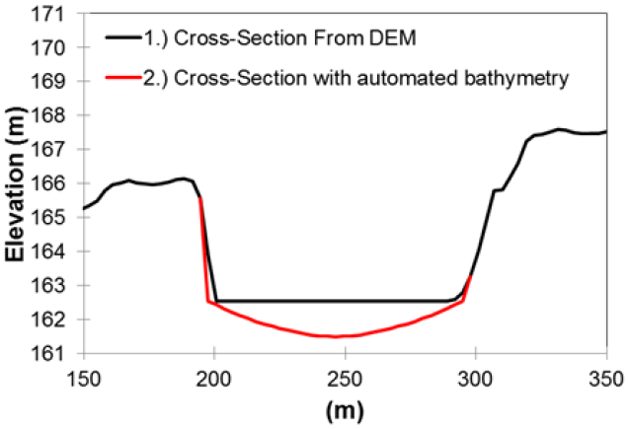
Hydraulic Modeling - AutoRoute
AutoRoute version 2.0.0.0 (rapid flood inundation mapping)
Normal depth calculations
Geometry:10 m DEM with underwater prism
Baseflow added (avg hourly stream flow (Feb 1979-Dec 2020)
Roughness from literature
Only for specific NHD streamlines
Watershed​ | 10 yr Peak Flow Range (cfs)​ | 50 yr Peak Flow Range (cfs)​ | 100 yr Peak Flow Range (cfs)​
Tecolote​ | 170 – 13,600​ | 440 – 26,800​ | 570 – 33,000​
Gallinas​ | 170 –19,400​ | 400 – 35,900​ | 530 – 44,500​
Sapello​ | 100 – 11,500​ | 240 – 22,100​ | 320 – 28,200​
Upper Mora​ | 35 – 8,500​ | 85 – 16,500​ | 120 – 21,400​
CoyoteCreek​ | 15 – 4,600​ | 40 – 8,700​ | 70 – 11,600​
Ocate​ | 160 – 2,800​ | 430 – 7,800​ | 600 –11,800​
Rayado​ | 70 – 3,300​ | 150 – 6,900​ | 200 – 9,700​
From E. Griffin, 2014
Notes:
Brief discussion on AutoRoute process

Slide 23
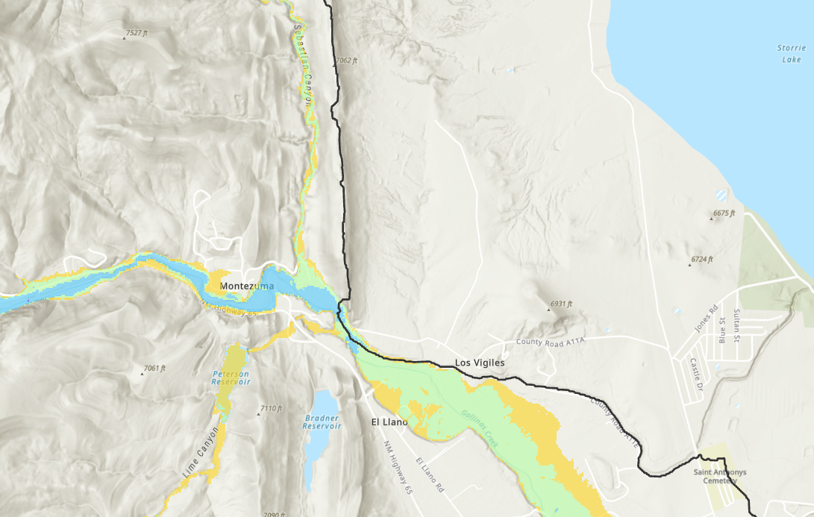
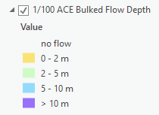
Hydraulic Modeling - AutoRoute
Limitations
No bridges, culverts, or backwater effects
Steady state
No complex flow paths
Increased uncertainties in low relief areas
Notes:
Note limitations. Hydrographs from HMS but only the peak is used for AutoRoute. The map shows 100 yr flood depths. No bridges, culverts, diversions, etc. were modeled in AutoRoute.

Slide 24
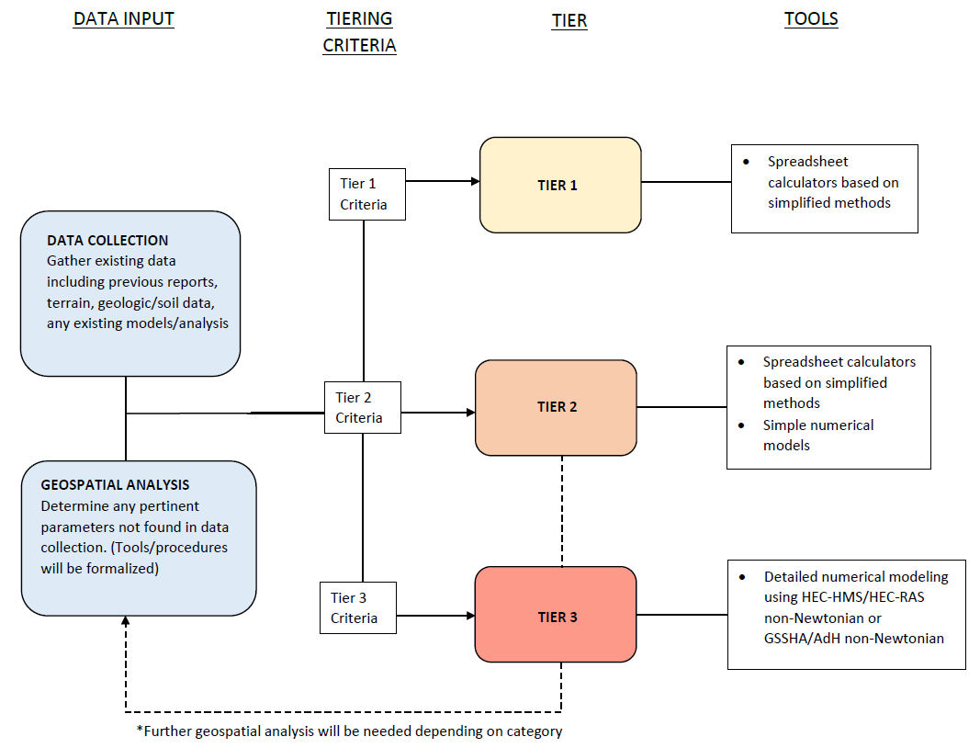
Next Steps
Use of a multi-tier approach: start simple and add in complexity (time and funding permitting)
Notes:
Discuss options
Tier 1 - An example is the use of the Rational Method eqn (Q=CIA) to estimate pre and post wildfire estimates. C and I (specifically the time of concentration) are adjusted for post-wildfire conditions using existing relationships. Area calculated using GIS tools. Example application was the 2016 Moon Mountain Fire in Ruidoso, NM
Tier 2 – An example is the first cut AutoRoute approach. A regression equation is developed for the pre-fire condition and an adjustment factor applied to estimate post-fire conditions. This is then routed through a simplified numerical model (AutoRoute)
Tier 3 – This tier has multiple levels. An example is this effort that developed an HEC-HMS model, ran debris yield estimates, and employed the simplified numerical model AutoRoute to get inundation maps.
This effort was refined slightly by developing 2D RAS models in more highly populated areas (Las Vegas and Mora, NM areas). These were developed using the hydrographs from HEC-HMS and used for an unsteady flow scenario.
With more time and funding the HMS model could be refined (model verification with actual storm events for pre-fire), development of more physical process-based methods (like Green & Ampt), and with collection of post-fire data, performing a post-fire model verification.
With updates to HMS, debris yield could be routed through the model. Then a sedigraph could be implemented into RAS and a non-Newtonian flow simulation run.
Lot of variations on each of these tiers.

Slide 25
Next Steps
Develop a step-by-step SOP for post-wildfire modeling and place on HEC website (note: this is envisioned to be a living document)
Post-wildfire hydrologic modeling training
Work on HEC-HMS enhancements to streamline the post-wildfire modeling process
Collection of post-wildfire data (flow and sediment) to provide post-wildfire calibration
Notes:
Discuss other steps
SOP – living document – need to adjust as we better understand the effects of wildfire on precip-runoff and add software capabilities, this SOP will change.
Enhancements – adding geospatial tools to HMS that can process curve number from a NLCD or extract hydraulic conductivity values from a soil database (SSURGO) or can modify the CN based on a burn severity map. Having HMS calculate the percent of a sub-basin that is burned would also be useful
Post-wildfire data – flow, sediment volumes/gradations/concentrations, - ash transport and effects. - Some will be available via NWIS, others may be publicly available in research docs of journal articles. Envision Gallinas watershed could be utilized for future studies since precip, flow, turbidity, and water quality indices have and are being measured on a frequent basis in this entire watershed. Sediment data (other than turbidity) is lacking though. Information collected through a lot of groups: USGS (ABQ water science center, Denver debris flow center), Forest Service (RMRS), clean up crews (DOT, FEMA, etc.) Connect the data across multiple agencies.

Slide 26
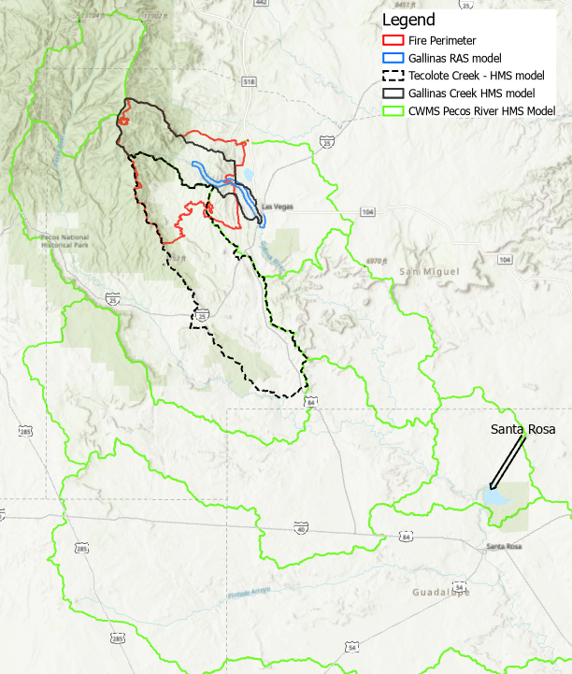

Next Steps
Utilize CWMS for real-time post-wildfire forecasting
Notes:
Discuss other steps
One of the issues with CWMS is how to translate the forecast precip volume into a real-time hyetograph that can be applied unto the watershed. Other issues include easy real-time modeling tools. Currently CWMS allows “calibration” to observed data based on tweaking certain HMS parameters from loss and transform methods. The SCS curve number approach is not on this list. So this “calibration” needs to occur outside the CWMS environment by manually changing HMS parameters to better match observed data and then proceeding to a forecast flow. The larger issue is how do we incorporate this into operations? Should it? For example, the Gallinas watershed was developed into a CWMS model separate from the CWMS Santa Rosa model.

Slide 27
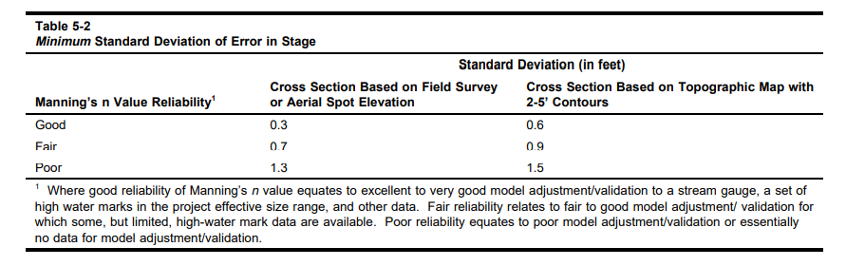
Next Steps
Develop uncertainty bands for risk communication
Comprehensive uncertainty
Uncertainty Areas
Data Collection
Hydrologic Modeling
Sediment Yield/Routing
Hydraulic Modeling
Notes:
Discuss Uncertainty –
Epistemic – Error that can be reduced through training, programmatic corrections (reviews, SOPs, automated routines that streamline calculations), and better precision/ confidence in data collection
Aleatory – Error that cannot be reduced because we are dealing with a natural system that has a certain amount of randomness and therefore uncertainty.
EM 1110-2-1619 – Risk-Based Analysis for Flood Damage Reduction Studies
Describe specific uncertainty with each aspect
Data Collection –
assumptions about timing and shape of hydrograph. (rainfall volume has to be distributed – how accurate is this?),
assumed no baseflow (but there is a small amount <20%)
Translation of gage record to ungaged areas by watershed area. This the only thing that matters? Are their regional differences?
Hydrologic Modeling –
Discharge uncertainty even with no wildfire (confidence intervals generated from SSP)
Assumption on post-wildfire curve numbers (process has not been tried or tested apart from journal article in which process was developed. How accurate is it? A very quick calibration within CWMS showed that post-wildfire CN had to be adjusted 70% (multiplied by 0.3) down to match observed flow data.
Transform flow - assumptions about lag and time of concentration
Pre-fire calibration – different models
Extraction of information at points other than calibration and basin outlets
Sediment Yield/Routing –
Assumed to be like the San Gabriel Mountains in CA – correct?
Regression equation for debris yield based on peak discharge and not rainfall intensity – better/worse?
Gradations for watershed
Translation of volume to mass and back
Hydraulic Modeling –
Only rainfall – snow-melt runoff in winter?
Bulked flow and not simulated as non-Newtonian flow
Autoroute vs RAS (normal depth, backwater, etc.)
Bridges – local influences. Are they important? Tend to be in populated areas where floodplain mapping desirable.
Culverts – blockages?
Steady state versus unsteady state
Flow diversions and other structures
Typical uncertainty captured in Manning’s n values
Comprehensive Uncertainty – EM 1619 or HEC-WAT is envisioned as a tool to run multiple programs together and there is the ability to define variability around certain parameters in each of the models from which to derive a comprehensive uncertainty.

Slide 28
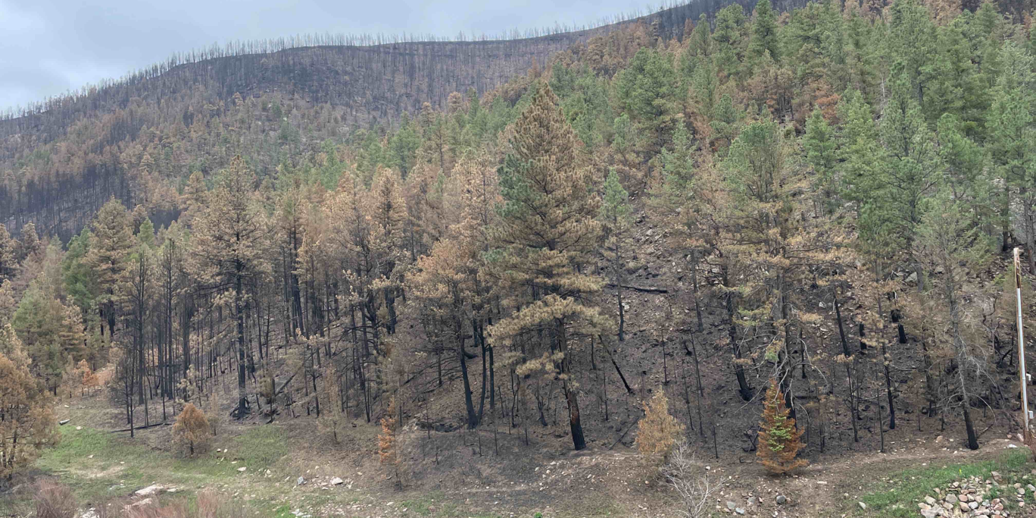

Questions?
Notes:
Time for questions. Photographs are top right: Gallinas watershed around City of Las Vegas, NM drinking water facility. Photograph taken 3 June before any rains
Bottom left is on the Sapello River during a rainfall-runoff event that blocked a road into San Ignacio, NM. Photograph taken 8 August. Rain has been falling in this area for 6 weeks

