Slide 1
HEC-HMS Terrain Data Management
CWMS Modeling Webinars
Alex Davis, E.I.T.
Matt Fleming, P.E.
Hydrologic Engineering Center
U.S. Army Corps of Engineers

Slide 2
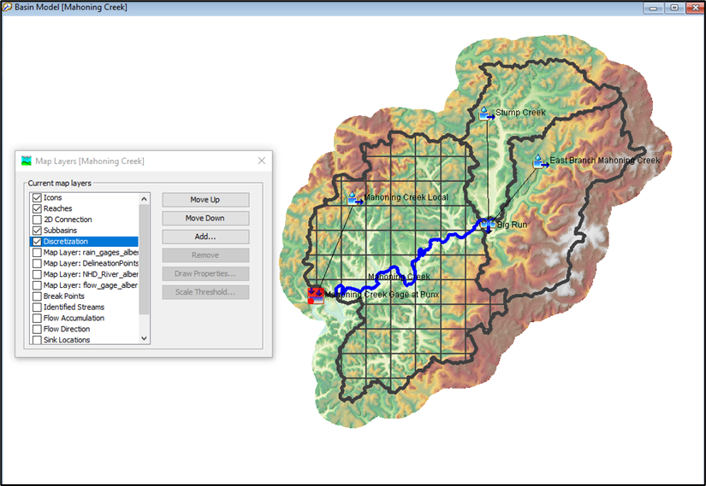
Why this Topic is important
Decrease the amount of time to delineate HEC-HMS basin models (so you can spend more time calibrating and validating your model)
Decrease file sizes and upload/download times
  Happens when creating a forecast
Utilize new spatial results visualization tools

Slide 3
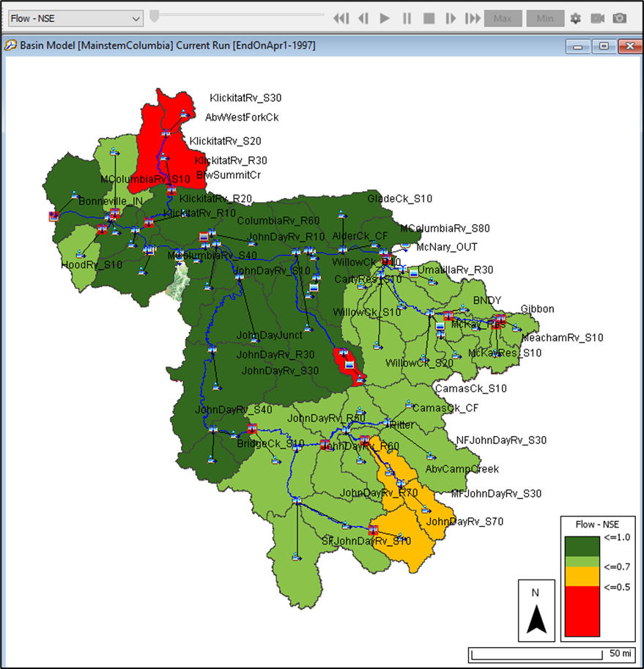
Outline
Technology Transfer
HEC-HMS GIS Menu
HEC-HMS GIS Data Management
Geo-Reference Existing Models
Terrain File Size and Processing Times
Reducing your Model’s Footprint
Spatial Results
Questions

Slide 4
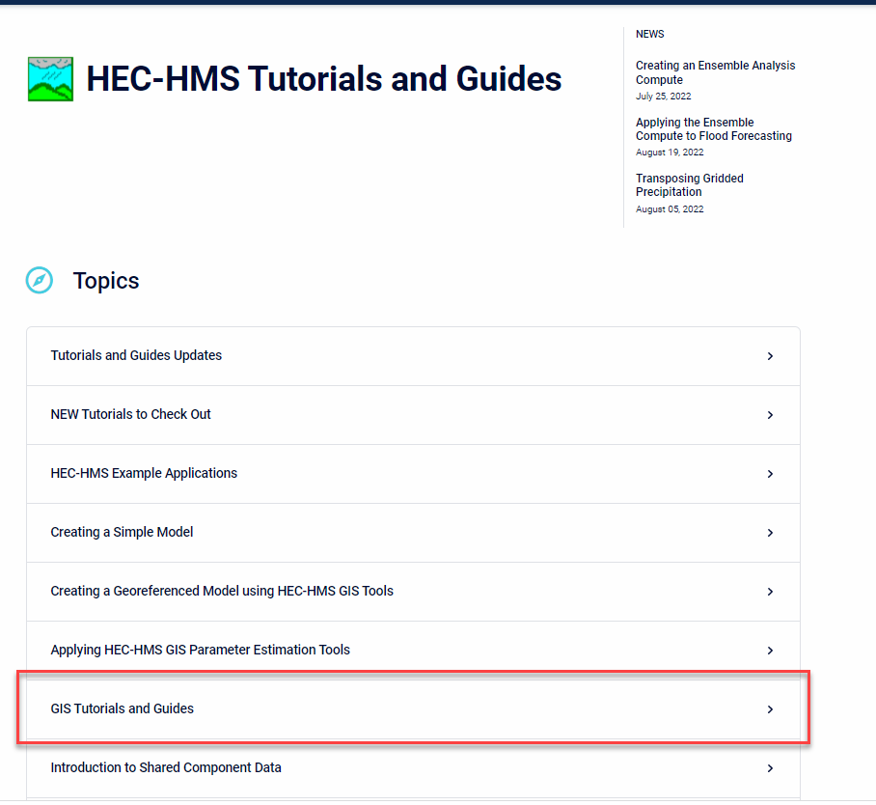
Technology Transfer
Geo-Referencing Existing Basin Model Elements using Shapefile Information
Comparing GIS Processing Run Times with Different Size Terrain Models and Computers
Reducing Your Project's Footprint
Viewing Spatial Results for a Structured Discretization
HEC-HMS Webpage

Slide 5
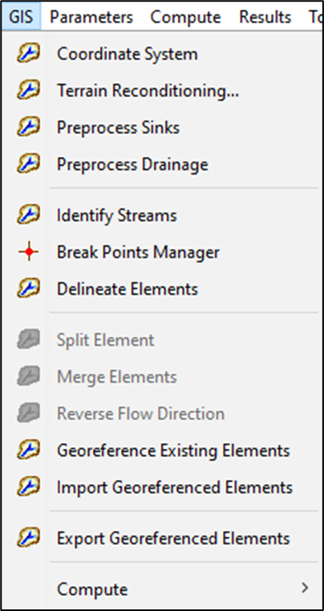
HEC-HMS GIS Menu
Terrain reconditioning creates a modified terrain
TauDEM GIS library is used to define the flow direction, flow accumulation, and stream grids
The user defines the stream threshold
A default delineation is performed
Tools are available to customize the delineation by merging elements or splitting subbasins and reaches
Compute grid cell information
HEC-HMS Webpage

Slide 6
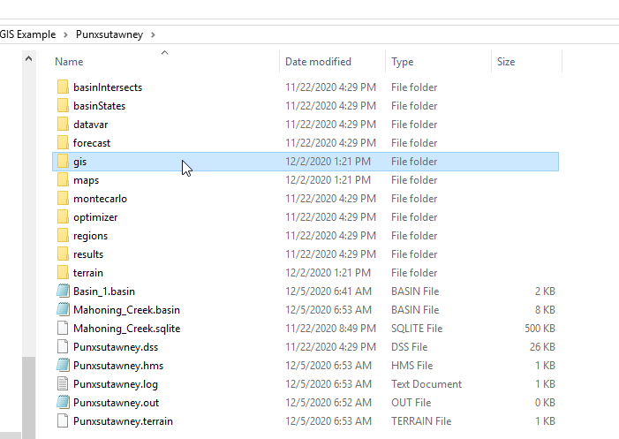
HEC-HMS GIS Data Management
Typical HEC-HMS Project Directory
Manually add background shapefiles to the maps folder before adding them to a basin model (makes the files relative to the project)
HEC-HMS will save GIS files created during automated delineation to the gis folder
HEC-HMS will save terrain files to the terrain folder
The *.sqlite file contains information for georeferenced elements, including discretization
HEC-HMS Webpage

Slide 7
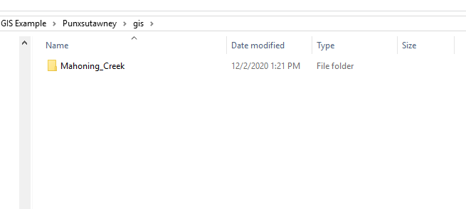
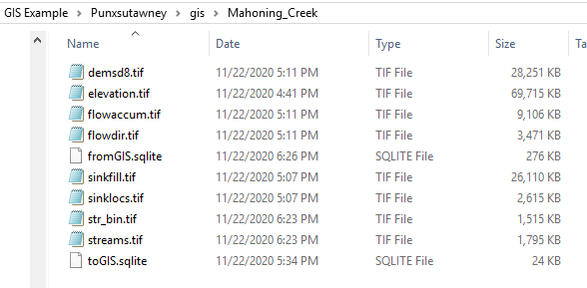
HEC-HMS GIS Data Management
The gis directory is where HEC-HMS saves files created during the delineation process
elevation.tif – terrain layer converted to basin model’s projection
Other files are created during the preprocessing sinks and drainage, identify streams, and delineate elements steps
HEC-HMS Webpage

Slide 8
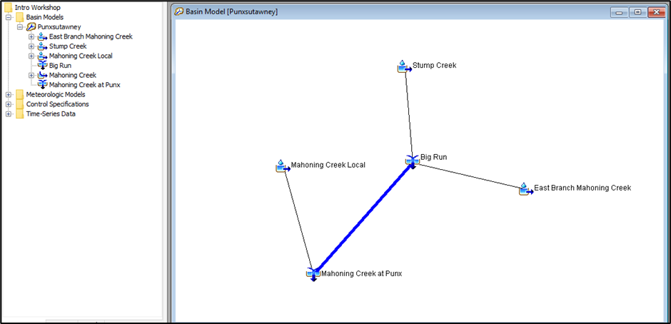
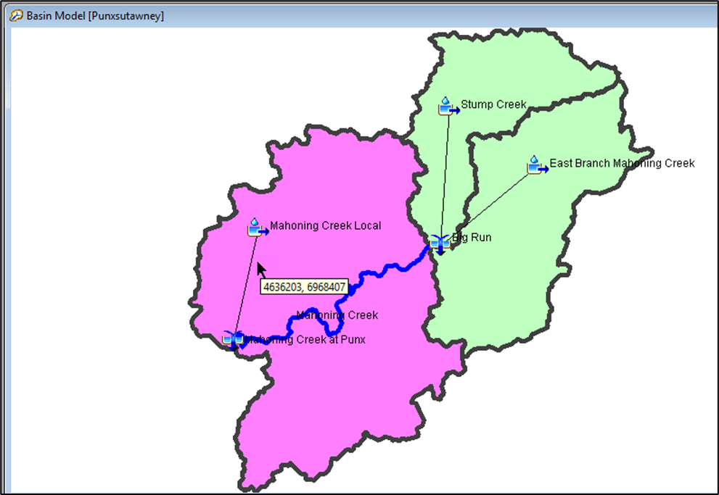
Geo-Reference Existing Models
Shapefile projection must match basin model’s projection
GIS features are saved in the SQLite file
If you want to see spatial results, load a terrain model and generate the flow direction and flow accumulation raster datasets
Draw time for georeferenced elements is much faster than shapefiles
HEC-HMS Webpage

Slide 9
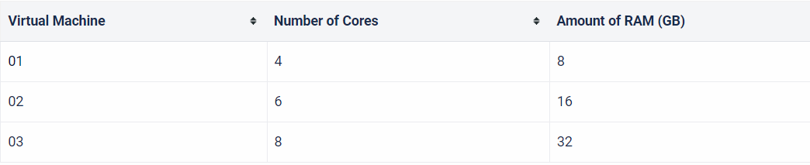
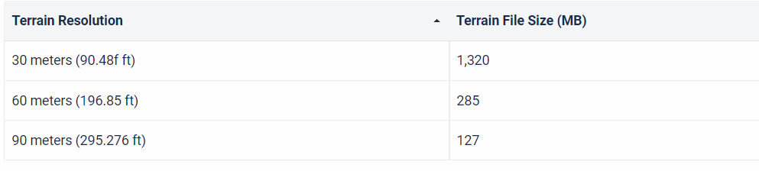
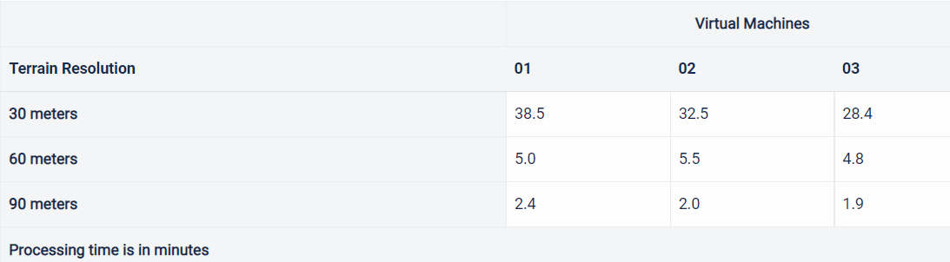
Terrain File Size and Processing Times
There is a program setting for choosing the number of cores
HEC-HMS Webpage

Slide 10
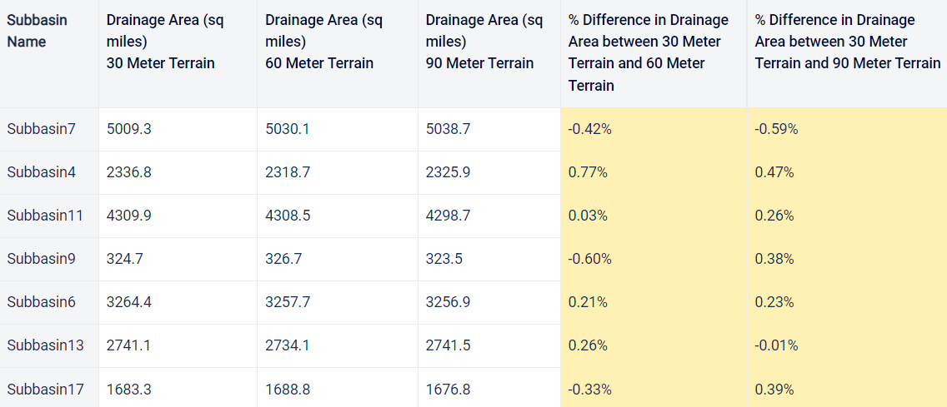
Terrain File Size and Processing Times
Subbasin area is similar when burning in a detailed stream network from the National Hydrography Dataset.
HEC-HMS Webpage

Slide 11
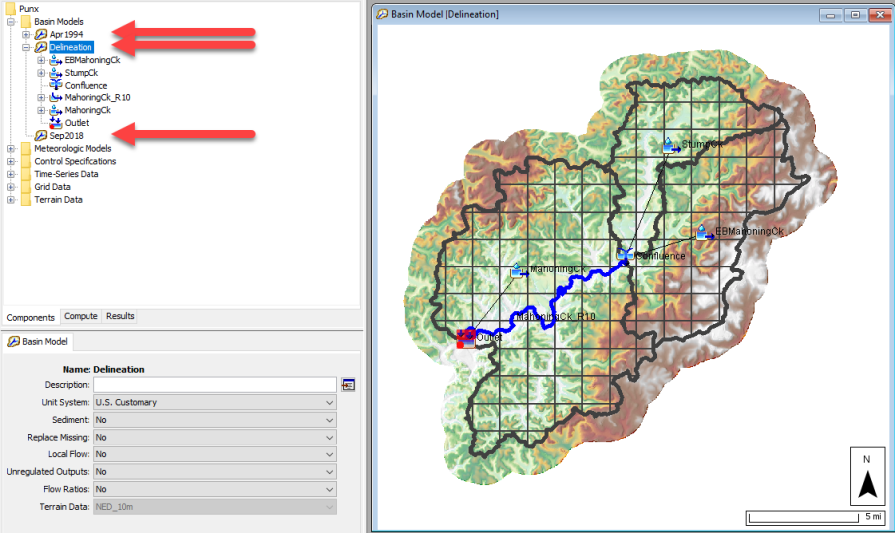
Reducing your model’s footprint
Manually delete GIS files in working basin models
Keep original GIS files for “base” basin model
Resample Terrain dataset in working basin model GIS directories to improve render times
If you change subbasin names, then you will need to update the grid cell information
HEC-HMS Webpage

Slide 12
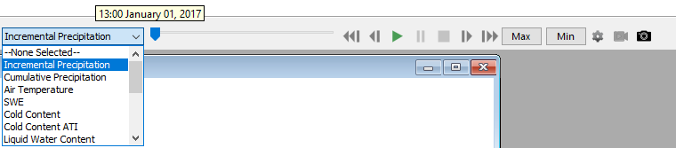
Spatial Results
  Incremental/Cumulative Precipitation, Loss and Excess
  Temperature
  Snow
  2D Transform Output
  Calibration Metrics
Animation Controls
Min/Max Results
Display Properties
Capture and Export Animation
Export Grid

Slide 13
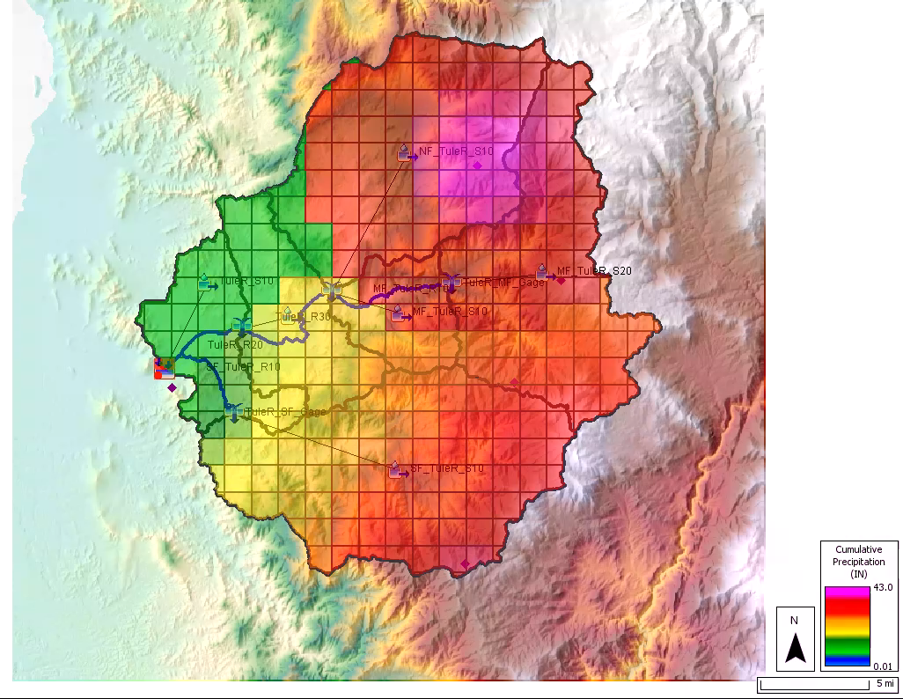
Spatial Results

Slide 14
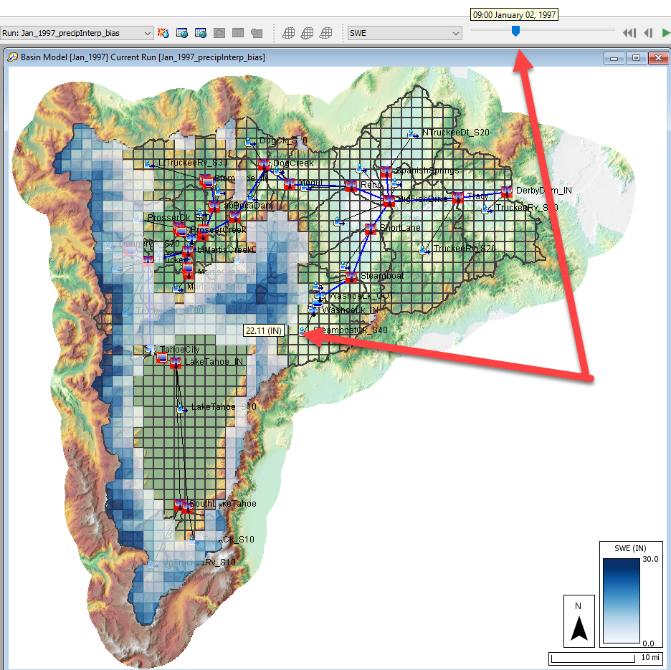
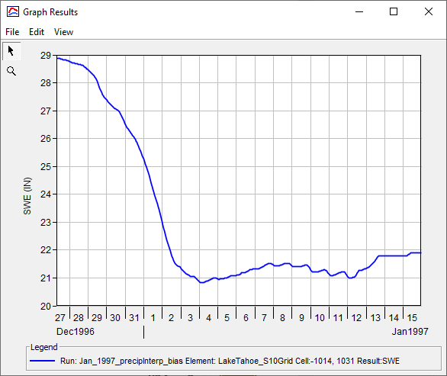
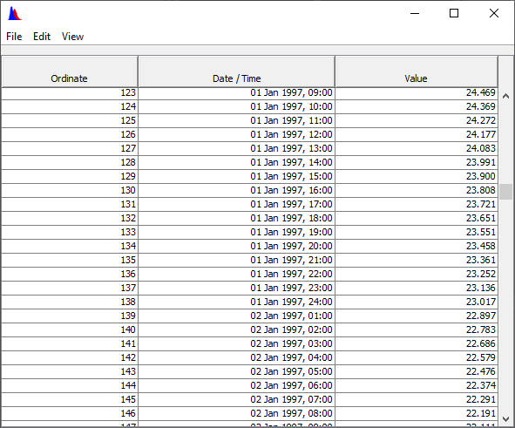
Spatial Results

Slide 15
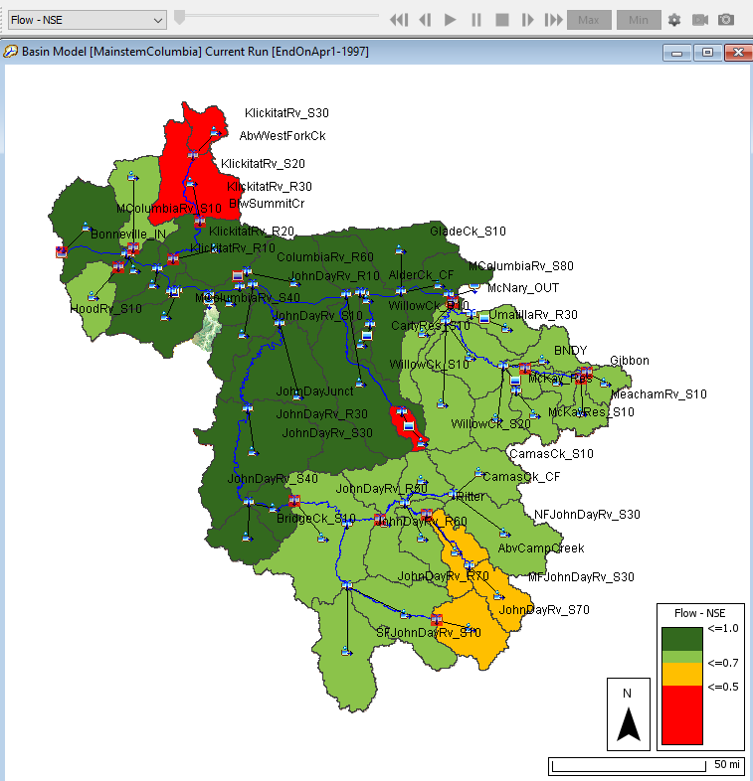
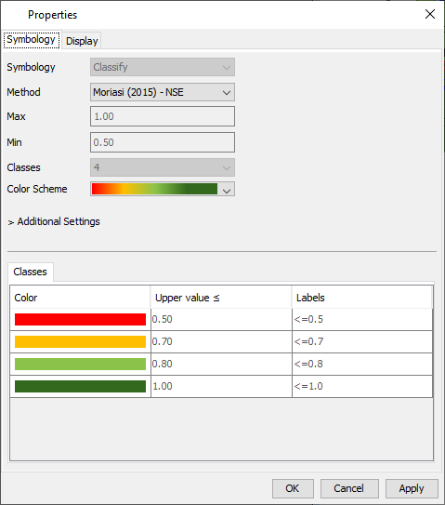
Spatial Results

Slide 16
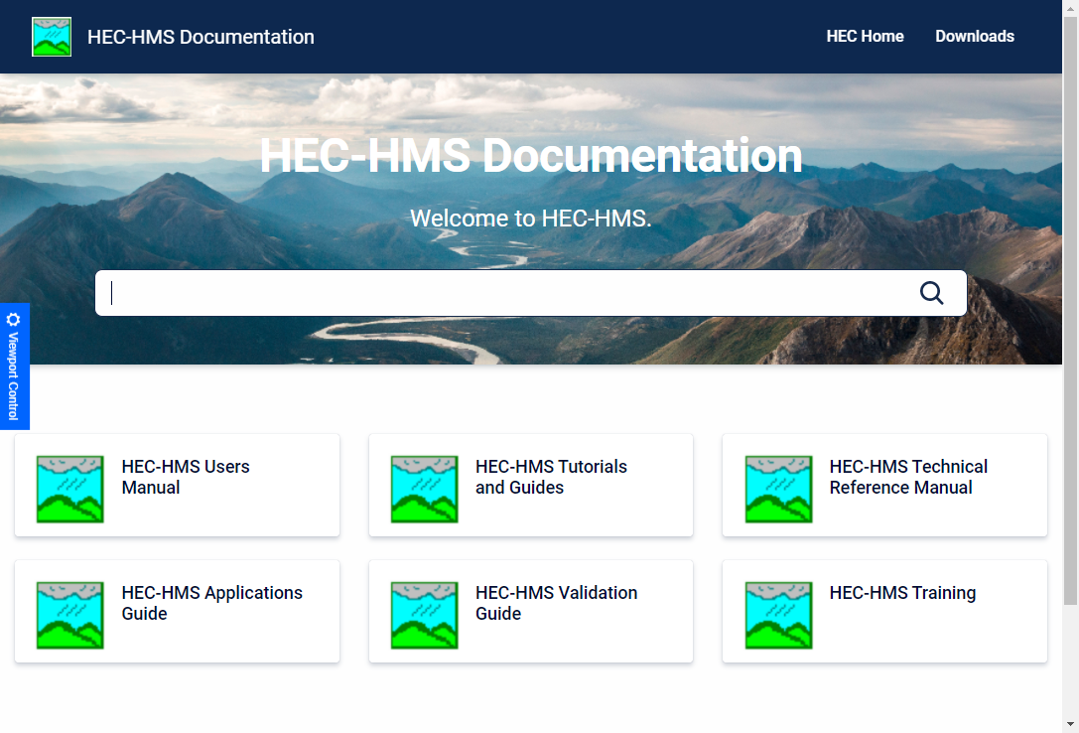
Questions?
Docs: https://www.hec.usace.army.mil/confluence/hmsdocs
To be added to the list, send an email to hec.hms@usace.army.mil with “subscribe” in the title or body.

