Slide 1
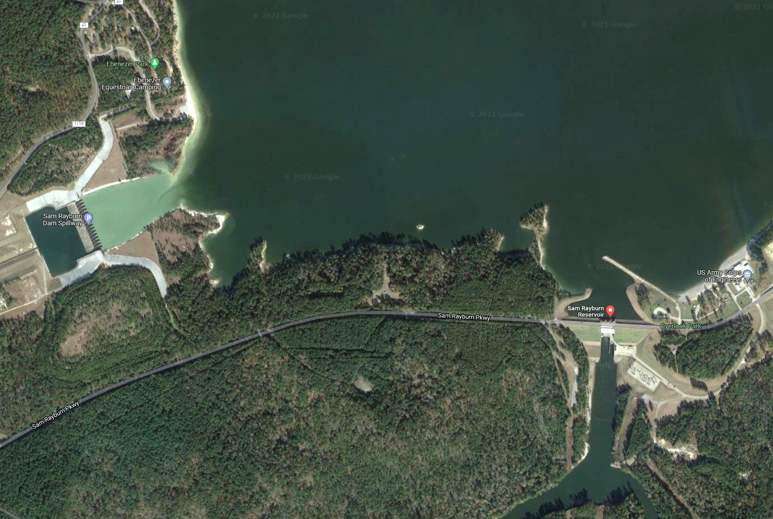
HEC-hms Forecasting Enhancements webinar
Hydrologic Engineering Center
09 November 2021
Notes:
Hi, this is Tom Brauer from the Hydrologic Engineering Center. This is the first video in a series of videos where I’m going to build a basic HEC-HMS model. In this video I’m going to create a new project, and build a basin model. As we go through the process you should gain familiarity with HEC-HMS project components.

Slide 2

Webinar outline
Demo of new HEC-HMS features
  Automated Forecast Tool
  DSS Grid Record Validator
  Global File Reference Table
  Spatial Results
Highlight of May 2021 Flood and Forecasting at Sam Rayburn Reservoir
Future HEC-HMS enhancements related to forecasting
Open Discussion/Questions

Slide 3
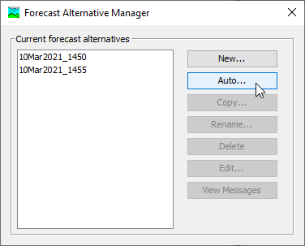
Demo: Automated Forecast Tool
Automated Forecast Tool → this tool automatically pulls data from the web and generates a continuous forecast with look back and forecast period data.
Documentation
  https://www.hec.usace.army.mil/confluence/display/HMSUM/.Forecast+Alternatives+v4.9

Slide 4
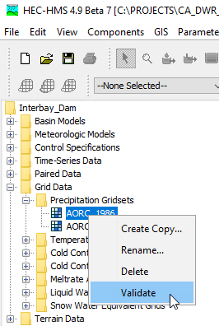
Demo: DSS Grid Record Validator
Grid Record Validator→ this utility helps modelers quickly identify issues with gridded boundary conditions that would prevent a simulation from successfully completing
Documentation
  https://www.hec.usace.army.mil/confluence/display/HMSUM/.v.4.9.0+Release+Notes+v4.9

Slide 5
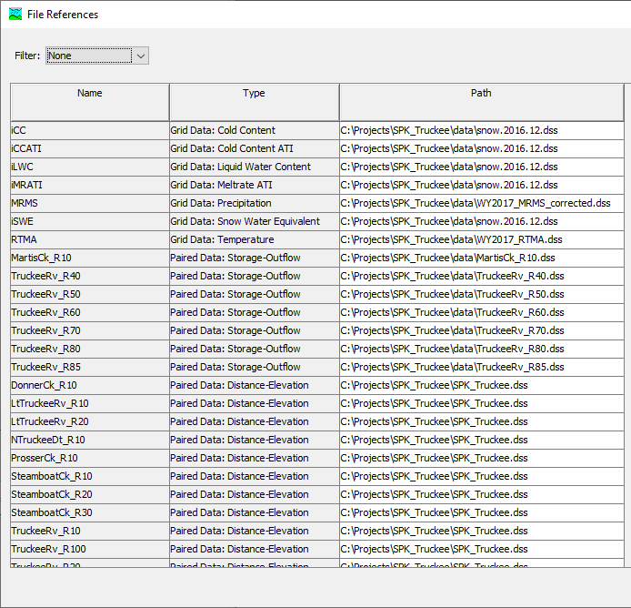
Demo: Global File Reference Table
File Reference Table→ this table displays file references for shared data and simulations
Documentation
  https://www.hec.usace.army.mil/confluence/display/HMSUM/.v.4.9.0+Release+Notes+v4.9

Slide 6
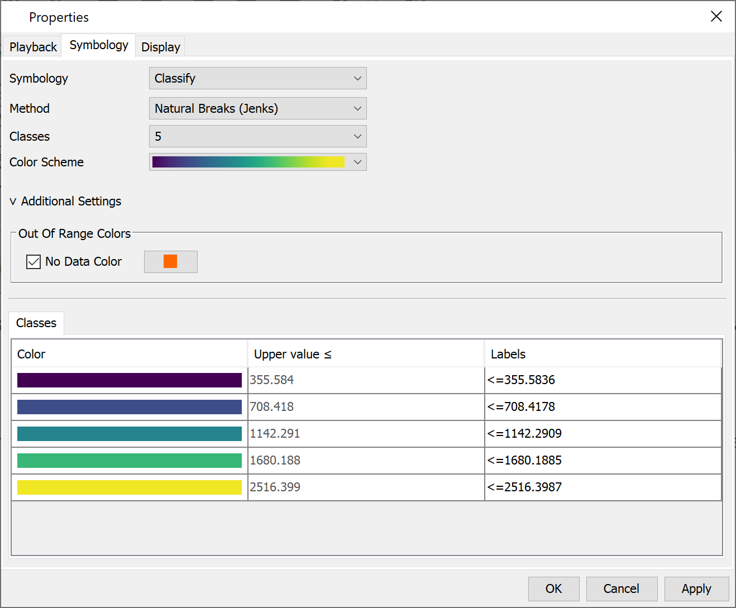
Demo: Spatial Results Enhancements
Spatial Results→ some new features include tool tips at spatial result cells, time-series plots at user-selected cells, and an updated raster display editor.
Documentation
  https://www.hec.usace.army.mil/confluence/display/HMSUM/.v.4.9.0+Release+Notes+v4.9

Slide 7
Webinar outline
Demo of new HEC-HMS features
  Automated Forecast Tool
  DSS Grid Record Validator
  Global File Reference Table
  Spatial Results
Highlight of May 2021 Flood and Forecasting at Sam Rayburn Reservoir
Future HEC-HMS enhancements related to forecasting
Open Discussion/Questions

Slide 8
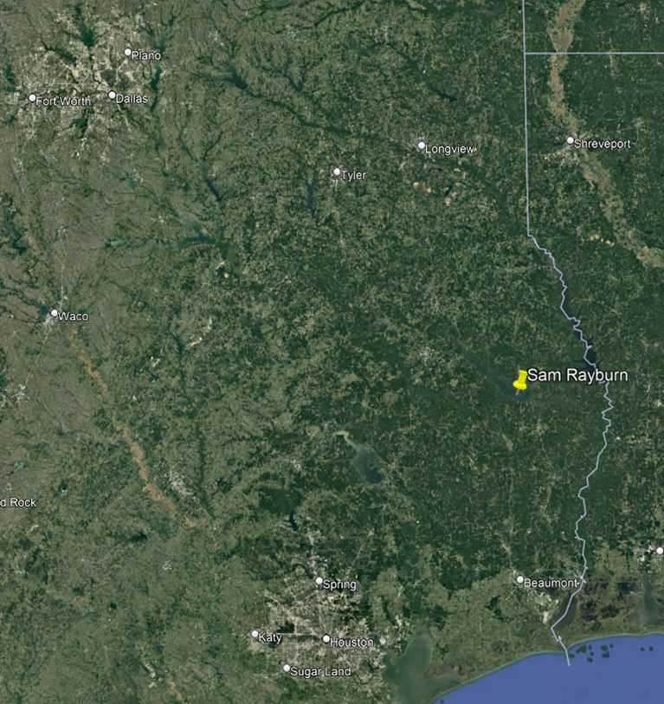
Sam Rayburn Reservoir and the Neches Watershed
Neches watershed –10,011 square miles
Sam Rayburn Reservoir – 3,449 square miles
Perched, labyrinth spillway, nearly 12 feet above top of conservation.
Spillway at elevation 176.0 above MSL and has never been overtopped.
Surcharge releases begin at 173.0 MSL

Slide 9

Sam Rayburn Flood Situation Overview – May 2021
Forecasted from May 11 to June 8 – Forecast.dss over 2GB
SWF Lake O&M needed rain-on-ground ONLY forecasts throughout the event for decision making
HQ requested daily forecast updates including 2 QPF scenarios:
  Best-estimate QPF from local RFC
  95% QPF from the NWC
Tropical Storm Ana (May22-23) caused excitement from HQ and NWC.
  SWF doubled the 95% QPF rainfall to exceed 10” at the center and shifted it over Sam Rayburn using MetVue. Forecasted Peak elevation still did not overtop the spillway
Sam Rayburn peaked on June 3rd at 175.35 less than a foot away from the spillway

Slide 10
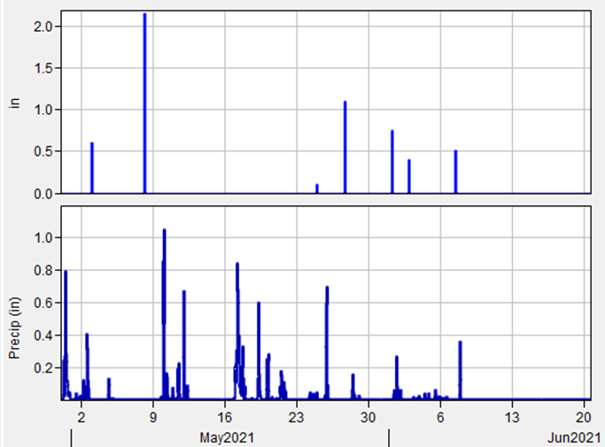
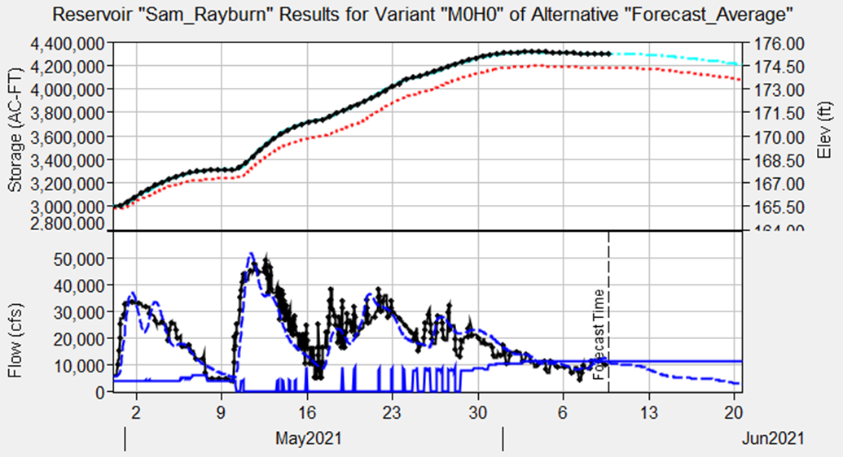
Forecast Overview
Setup/Extract
Calibrate using the zonal editors
Soil Moisture “Accounting” using Deficit Constant, Simple Canopy and ET Gages for each zone
Overriding the DSS Filenames
Sam Rayburn Reservoir Releases – Iterative Process for surcharge releases – No ResSim setup for the run.

Slide 11
Webinar outline
Demo of new HEC-HMS features
  Automated Forecast Tool
  DSS Grid Record Validator
  Global File Reference Table
  Spatial Results
Highlight of May 2021 Flood and Forecasting at Sam Rayburn Reservoir
Future HEC-HMS enhancements related to forecasting
Open Discussion/Questions

Slide 12
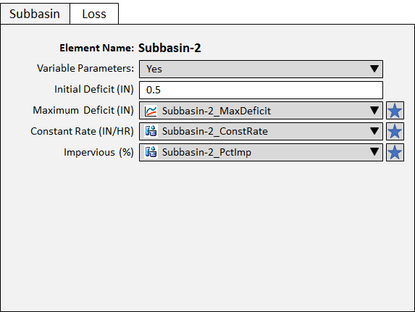
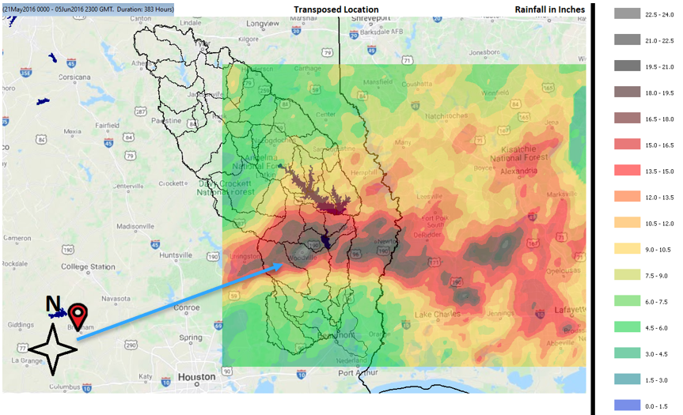
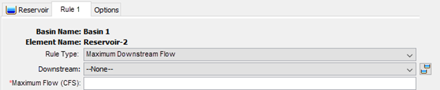
Future HEC-HMS Enhancement Plans
Time varying parameters
  Ability to specify a parameter value (i.e. constant loss rate) at each time step within a time-series or annual pattern
Storm shifting
  Although the emphasis is in laying the foundation for SST analysis in HEC-HMS, the ability to shift and optimize gridded precipitation such as QPE grids might be useful for forecasters
Simplified rule-based reservoir operations
  This will open up the ability to specify a downstream control point and set a threshold (i.e. max flow)

Slide 13
Forecasting-Related Tutorial and Guides
Check out this new tutorial on using save states within a forecast alternative
  https://www.hec.usace.army.mil/confluence/hmsdocs/hmsguides/working-with-save-states/applying-the-save-states-option-to-initialize-snowmelt-parameters
Check out this new flood forecasting case study in the HEC-HMS applications guide
  https://www.hec.usace.army.mil/confluence/hmsdocs/hmsag/flood-forecasting-applications/case-study-flood-forecasting-in-the-kaskaskia-watershed
Future Tutorial and Guide Topics
  How is blending useful and how is it incorporated within HEC-HMS?
  Why are local flow time-series important and how are they computed within HEC-HMS?
  Computing and interpreting unregulated flow within HEC-HMS
  How are basin model parameters, zonal adjustments, element overrides, saved state adjustments, reservoir initialization/reset, and automatic baseflow initialization combined to produce parameter estimates within a forecast alternative?

Slide 14
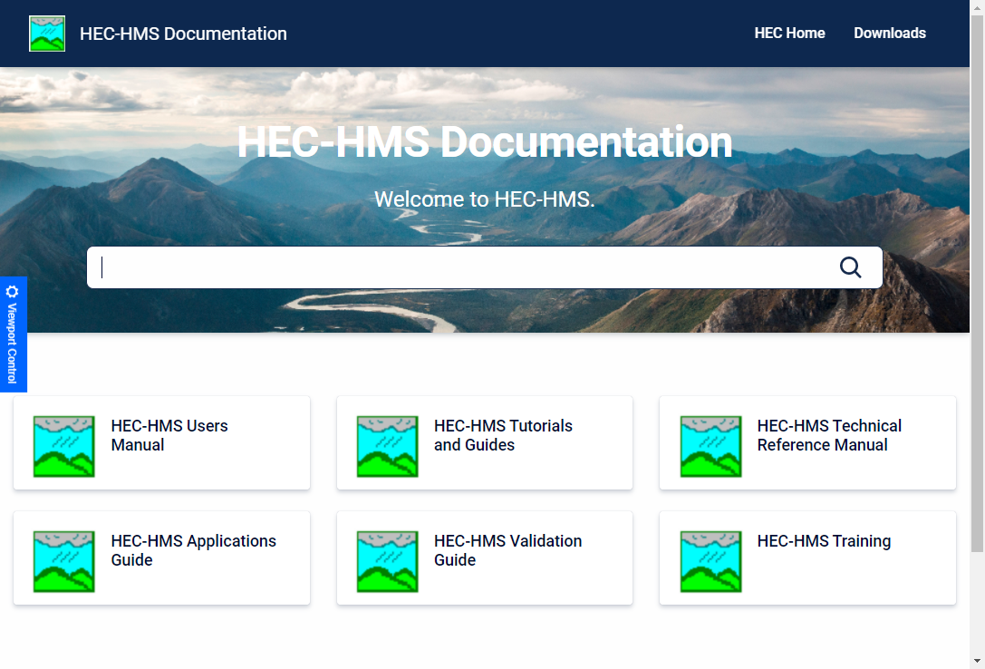
Questions?
Docs: https://www.hec.usace.army.mil/confluence/hmsdocs
Videos: https://www.youtube.com/channel/UCwZPbGxI5IzjwhYtHUMSh4g/videos

