Slide 1
Hypothetical Storm and Uncertainty Analysis Enhancements in HMS
David Ho
Greg Karlovits
Natasha Sokolovskaya
Daniel Black
USACE, Institute for Water Resources, Hydrologic Engineering Center

Slide 2
Frequency Storm Enhancements
Version 4.10
  ASCII precipitation-frequency grid importer
  Precipitation-Frequency grid zonal average
  User-Specified Area-Reduction
Version 4.11
  Inclusion of 10-minute, 30-minute, and 3-day storm depths.
Version 4.13
  Removed Partial and Annual Conversions
  Allow flexible input of precipitation frequency depths
    Provide at least two depths
    Interpolate between input depths
  Option to redistribute depths symmetrically
Notes:
Frequency Storm has been around since at least HMS 2.1

Slide 3
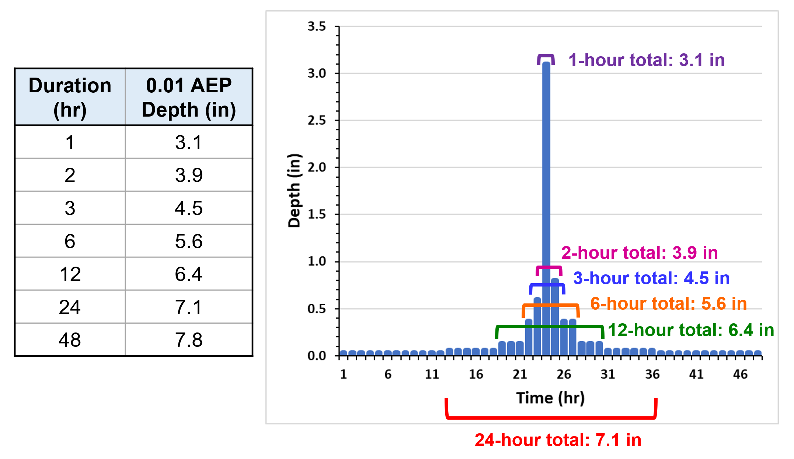
Current Frequency Storm Capabilities
https://www.hec.usace.army.mil/confluence/display/HMSTRM/Frequency+Storm

Slide 4
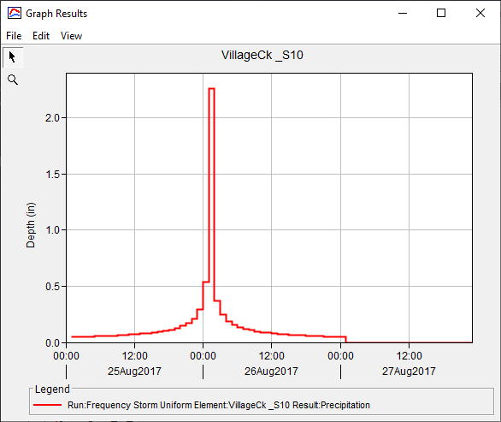
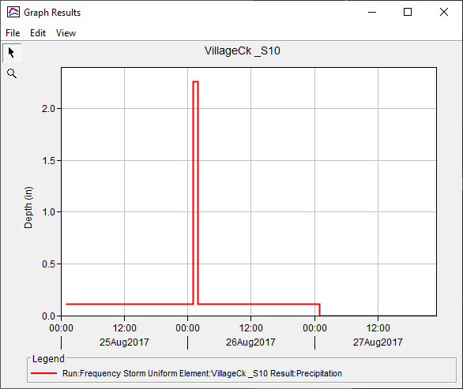
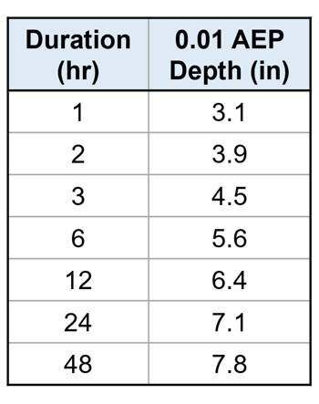
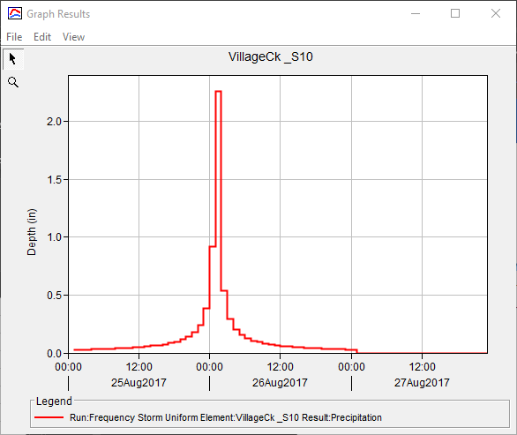
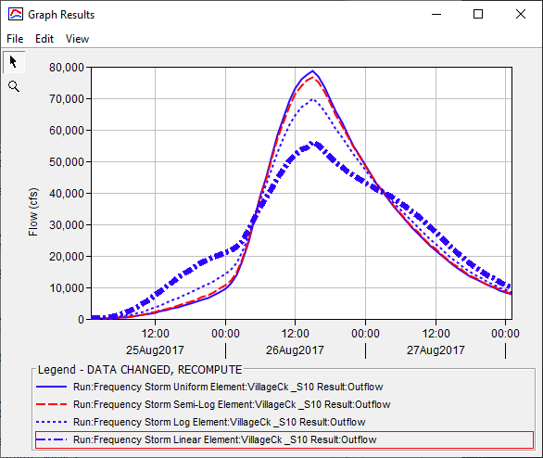
Log
Linear
Interpolate!
Semi-log

Slide 5
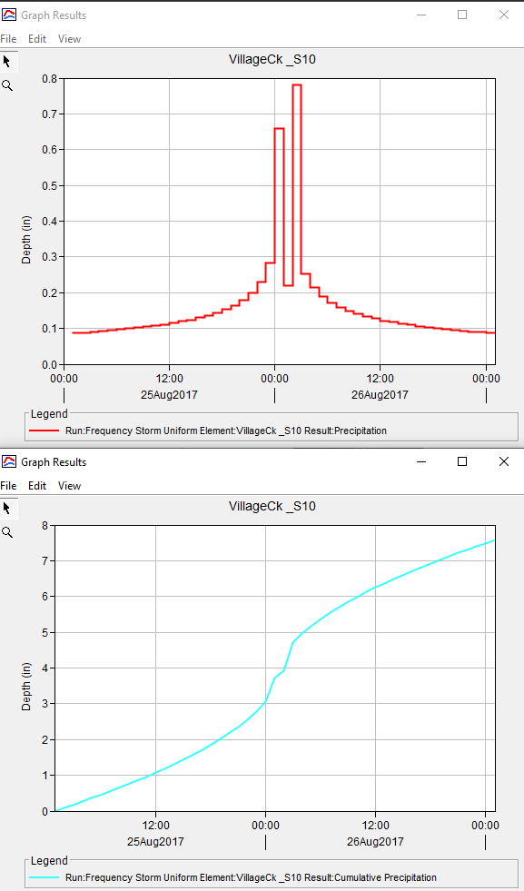
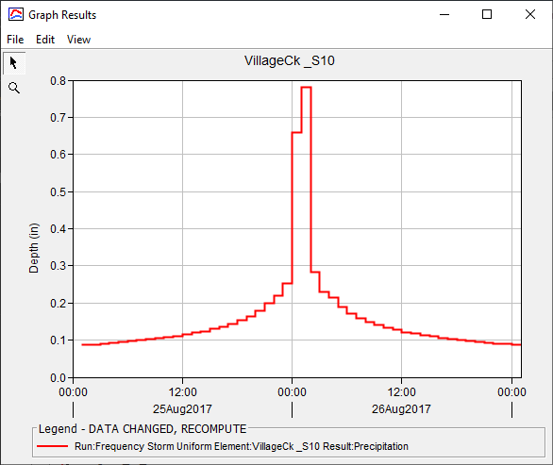
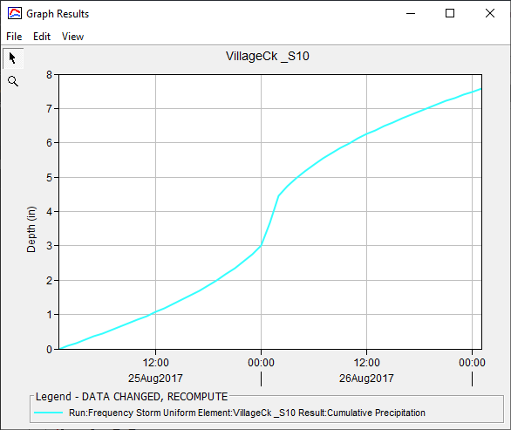
Re-Sort!

Slide 6
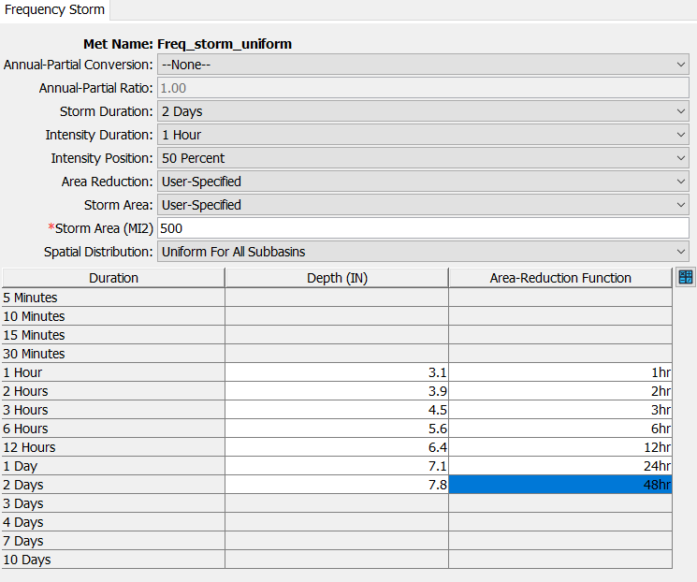
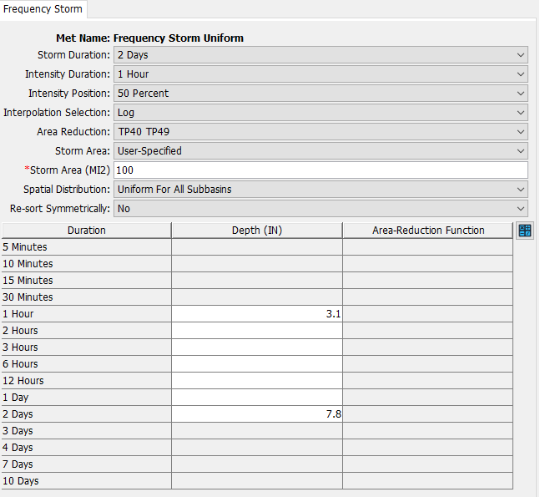

Slide 7
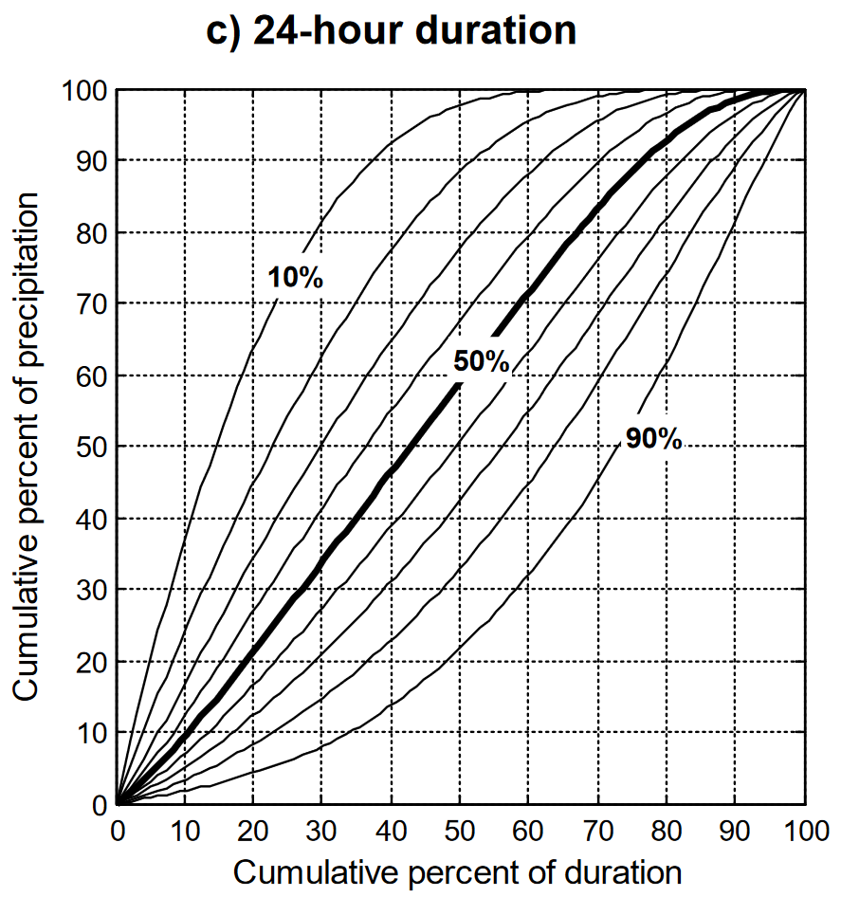
NOAA Atlas 14
Temporal Patterns
Regional summary of storms
Classified by:
  Duration
  Quartile
  Percentile
Useful for sensitivity and
uncertainty analysis
Notes:
David showed a few twists on the “classic” way of developing design storm time patterns using a staggered block hyetograph.
We’re going to talk about a different way to define time patterns, using a single duration for frequency rainfall and then use a time pattern to define all the increments shorter than that.

Slide 8
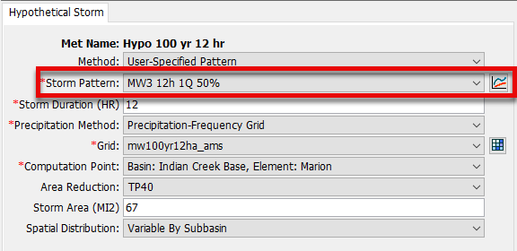
Temporal Patterns
Hypothetical Storm precipitation
  Storm Pattern parameter
Results are sensitive to choice
Determines shorter duration
rainfall

Slide 9
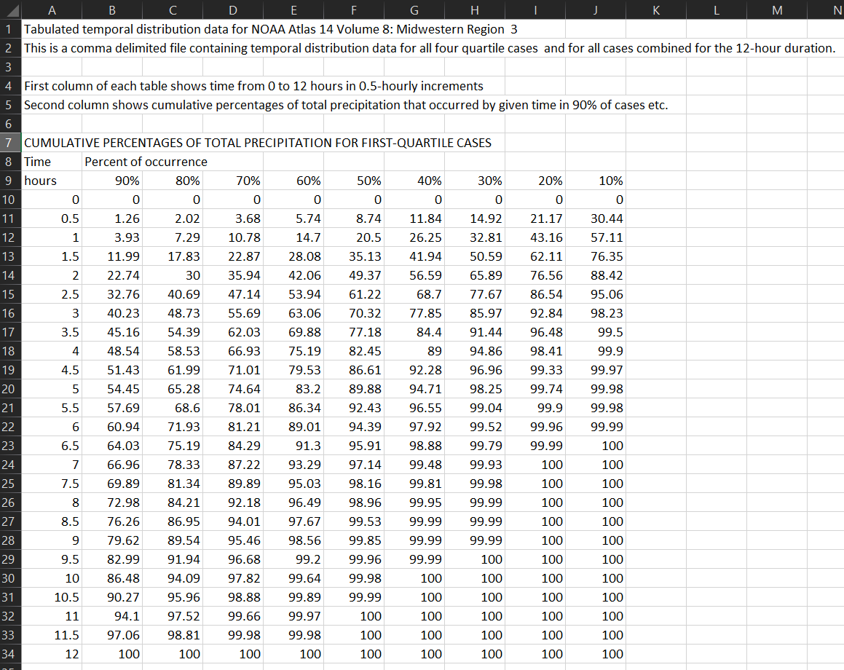
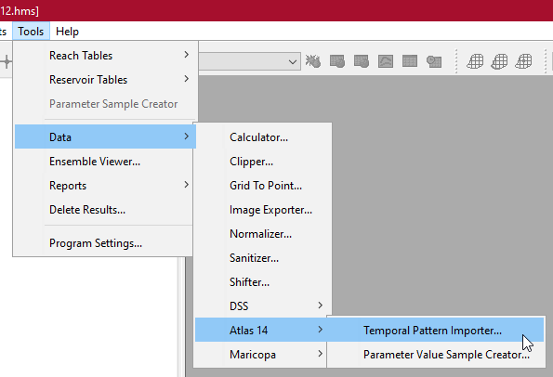
NOAA Atlas 14
Temporal Pattern Importer
Simplify adding patterns to project
Native A14 .csv files
Demo Time!
Notes:
The tools I’m demoing are available in HMS v4.12.
No data wrangling is involved – you can download these csv files from NOAA and directly import them.

Slide 10
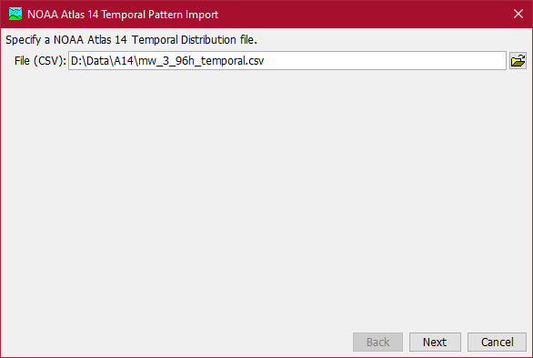
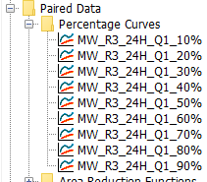
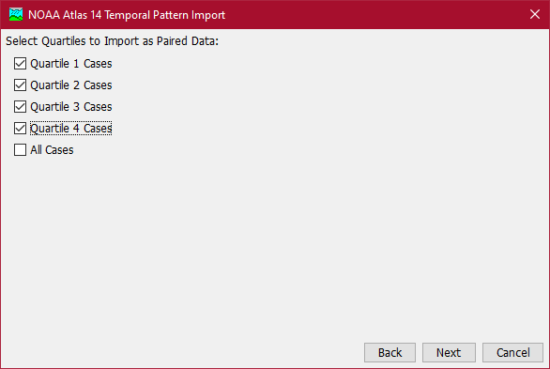
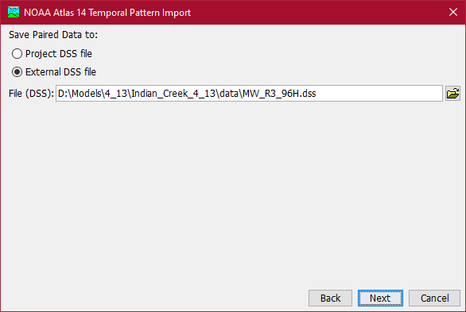
Notes:
In case the demo goes wacky

Slide 11
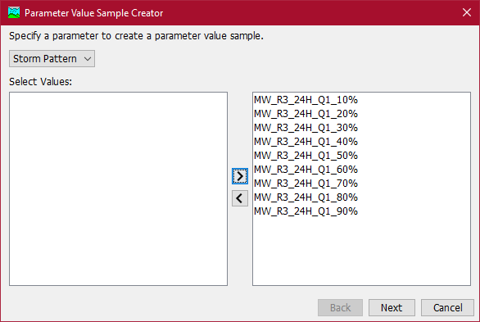
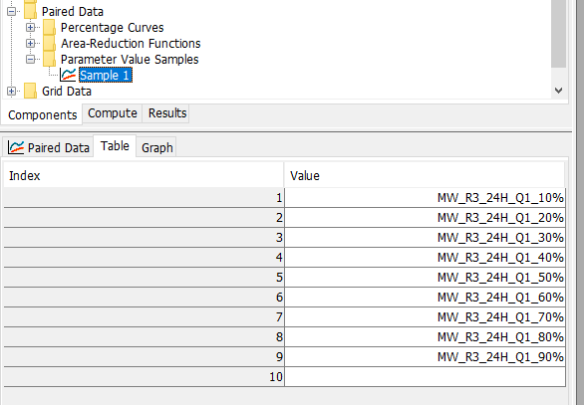
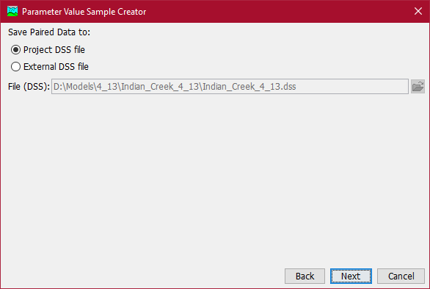
Notes:
In case the demo goes wacky

Slide 12
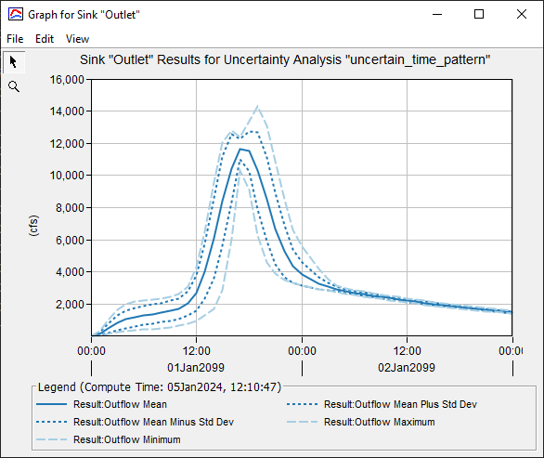
Temporal Pattern Sampling
Temporal pattern sampling added in 4.12
Quantify the uncertainty associated with temporal pattern selection
Notes:
As Greg mentioned, we may be interested in quantifying the uncertainty resulting from the choice of temporal pattern for a hypothetical storm.
As of version 4.12 we can do that by including multiple temporal pattern curves in an uncertainty analysis.

Slide 13
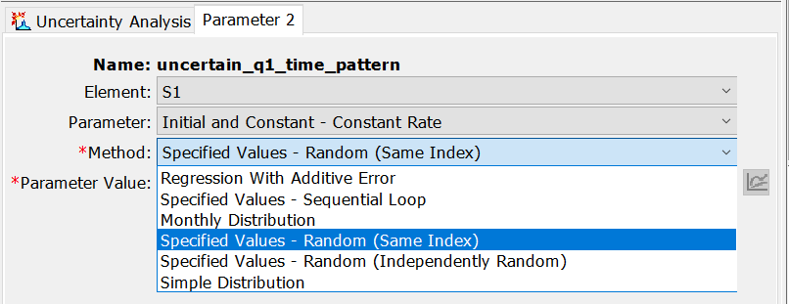
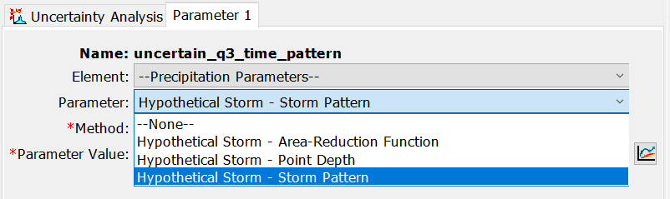
Temporal Pattern Sampling
Sample from a table of specified values
Added precipitation grids (4.11) and select paired data (4.12)
Notes:
Just a bit of background: HEC-HMS uncertainty compute has an option to sample from a table of specified values, in addition to all the other sampling options.
Those are the ones titled ‘Specified Values’ in this screenshot, and Daniel will go over some of them in more detail later today.
In previous versions, you could only sample numerical parameters in a specified values uncertainty compute.
In 4.11 the options were extended to precipitation grids and in 4.12 we also added two paired data types, temporal storm patterns and depth-area reduction functions.

Slide 14
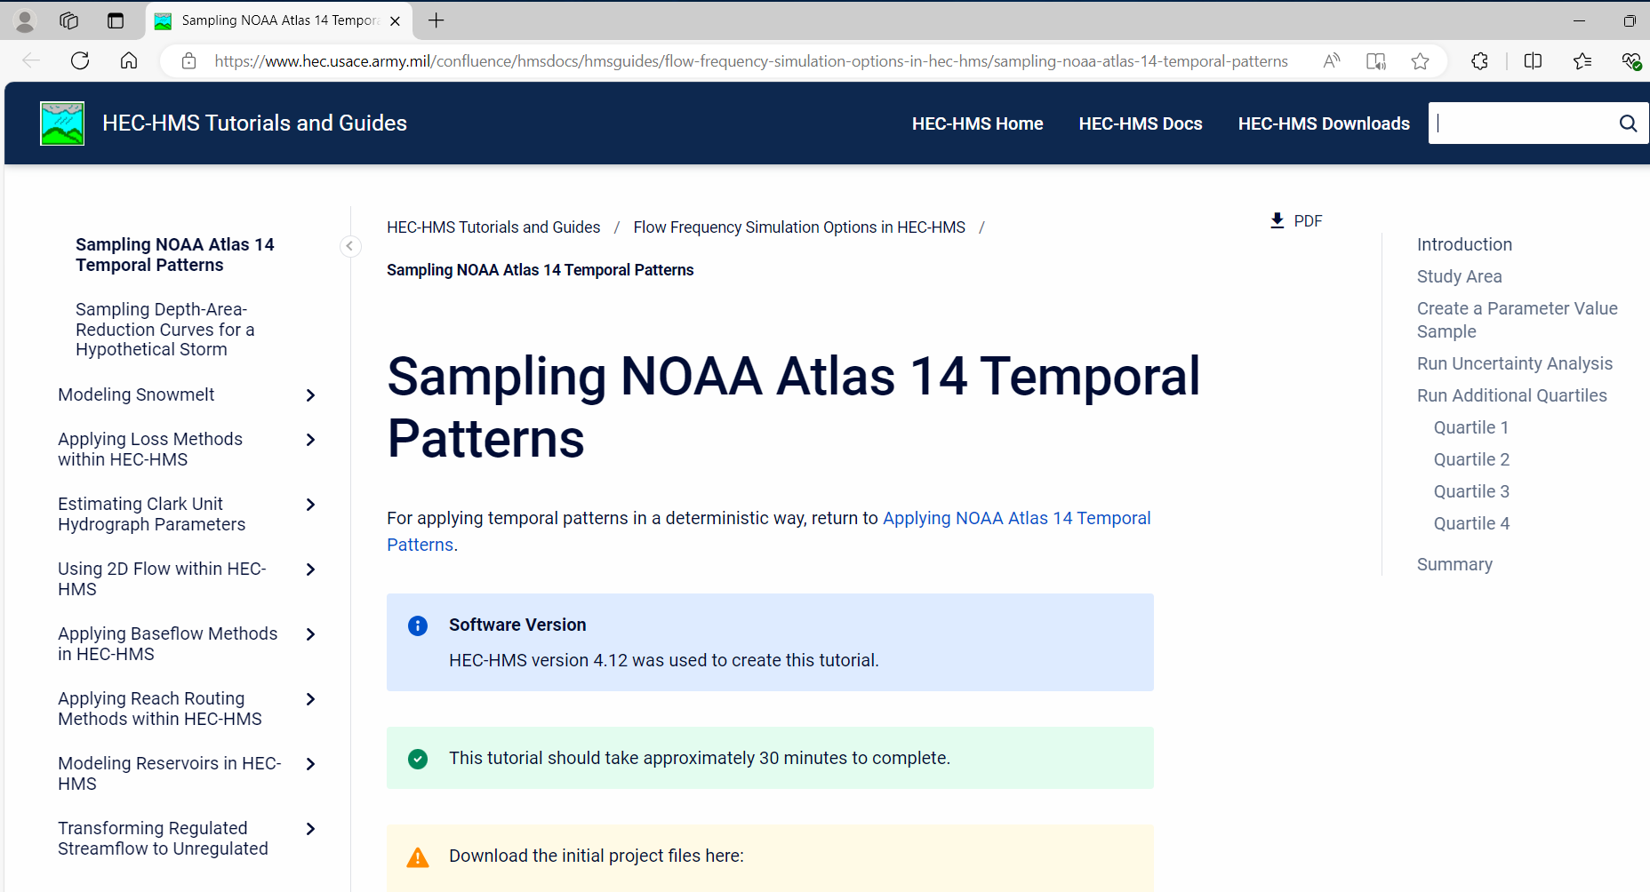
Temporal Pattern Sampling
Try it yourself! Sampling NOAA Atlas 14 Temporal Patterns Tutorial (army.mil)
Notes:
I’ll demo random sampling of NOAA14 3rd quartile temporal patterns.
Recall that this means that most rainfall occurred in the 3rd quarter of the storm event.
The project is taken from one of our tutorials that Tom Brauer put together and you can always try it yourself.

Slide 15
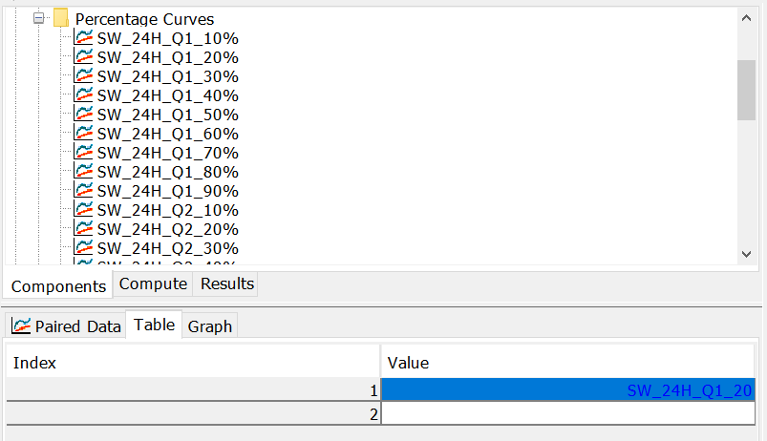
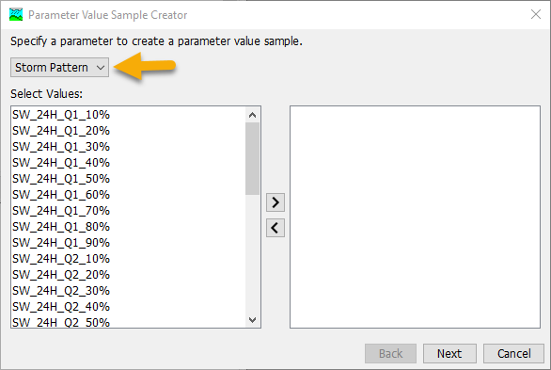
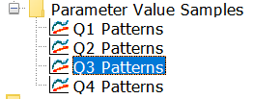
Temporal Pattern Sampling
DEMO
Two ways to create Parameter Value Samples table
Manually enter or paste curve names
Import with Parameter Value Sample Creator wizard
Notes:
Demo script -1:
This is Cottonwood Creek in Arizona, which is in NOAA 14 volume 1 region.
NOAA 14 temporal patterns have already been imported in the way that Greg just demoed.
You can see them under Paired Data | Percentage Curves
I will run the uncertainty analysis for temporal distributions in the 3rd quartile, so I’ll select only Q3 curves in the Parameter Value Sample Creator, the way Greg just showed.

Slide 16
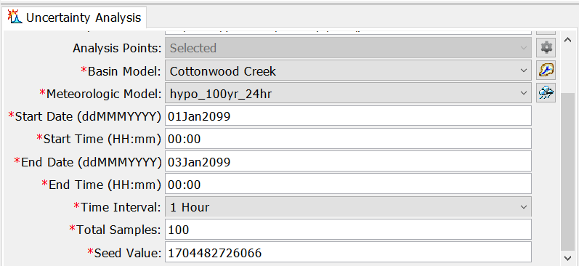
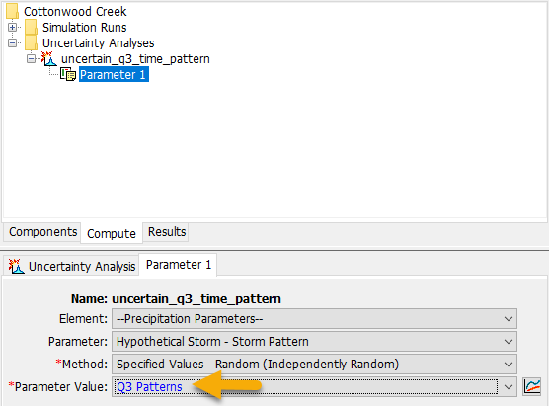
Temporal Pattern Sampling
DEMO
Run uncertainty analysis:
Notes:
Demo script-2:
An uncertainty analysis has already been set up to run with the basin model and the met model for 100 random samples.
Daniel will talk about what these different sampling options mean. I am selecting Independently Random
I will add a new parameter and select Hypothetical storm pattern.
You can see that the other available option is Area reduction function.
Finally, select Q3 Pattern as the source table of the temporal pattern curves to be sampled.

Slide 17
Temporal Pattern Sampling
DEMO
Results:
Notes:
This takes a bit to run, so I’ll just show the results from an earlier run:
These are the curve names that have been sampled in a random order.
And this is the figure showing uncertainty in the outlet flow. You can see there is quite a range of flows depending on the choice of the temporal pattern.

Slide 18
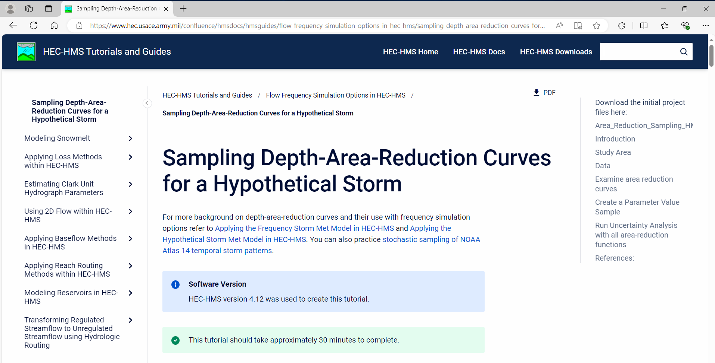
Depth-Area Reduction Curve Sampling
We have a tutorial for that!
Notes:
The underlying logic that enabled temporal pattern sampling can be applied to sampling all kinds of paired data names, as well as grids and time-series.
In 4.12 we’ve added an option for the Depth-Area Reduction factors.
depth-area reduction factors are required to reduce the point precipitation to an average depth that occurs over the watershed.
As a friendly reminder, you should always apply a depth-area reduction when using frequency-based precipitation.

Slide 19
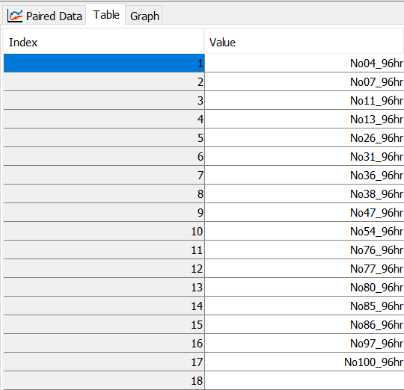
Depth-Area Reduction Curve Sampling
DEMO
Manually enter or paste individual curve names in Parameter Value Sample table
Notes:
The process for sampling depth-area reduction functions in an uncertainty analysis is very similar, except the Parameter Sample Creator wizard is not set up to work with them yet, so you’d need to create a new Parameter Value Samples table and enter or paste curve names.
I’ll quickly demo.

Slide 20
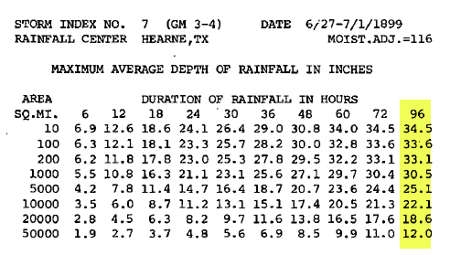
Depth-Area Reduction Curve Sampling
Some sources for depth-area reduction functions:
  NOAA HMR 51 has depth-area reduction functions for some historical storms
  HEC-HMS tutorial Creating Depth-Area Reduction Curves from Gridded Precipitation Data (army.mil)
Notes:
Optional, if have extra time:
These are some of the ways you can get depth-area reduction functions or make your own.
Now passing it back to Greg for the sneak peak of the variable spatial patterns for the hypothetical storm

Slide 21
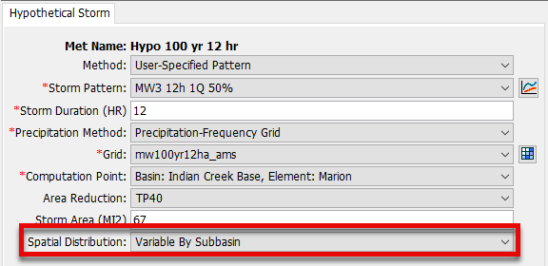

Variable Spatial Patterns
Added in HMS v4.11
Uses precipitation-frequency grid
Alternative is uniform distribution
Notes:
Using a spatial distribution that isn’t uniform is useful in areas where there’s a significant gradient to the Atlas 14 grid you’re working with. Your goal is to produce an estimate of the area-averaged frequency rainfall above a drainage point, and the spatial pattern doesn’t change the total amount, just where it falls in the watershed.

Slide 22
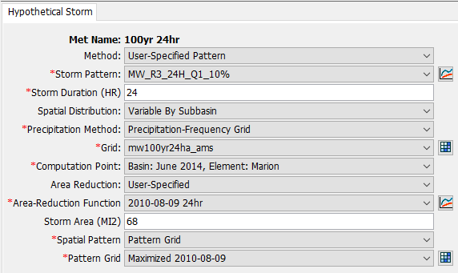
User-Specified Spatial Patterns
Coming in HMS v4.13
Enable historic storms as patterns
Eventually include in UA
Demo Time!
Notes:
This will let you explore a variety of scenarios where the frequency rainfall above a point is the same average amount, but it falls in different places in the watershed.

Slide 23
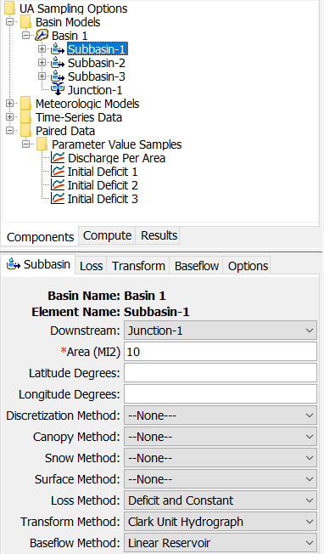
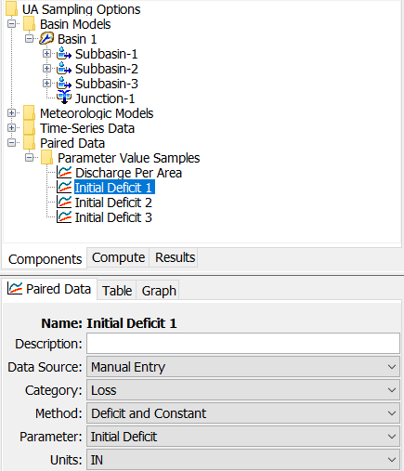
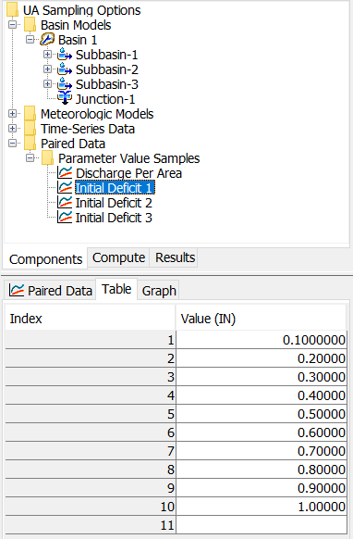
Specified Values Sampling

Slide 24
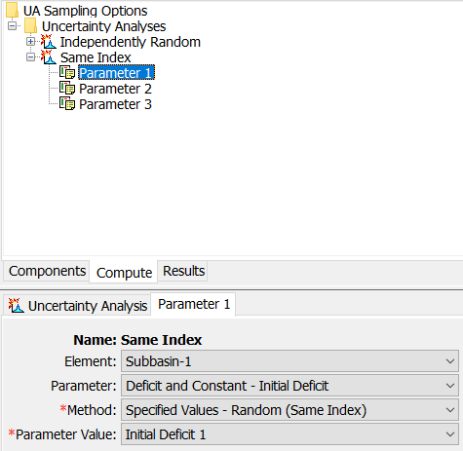
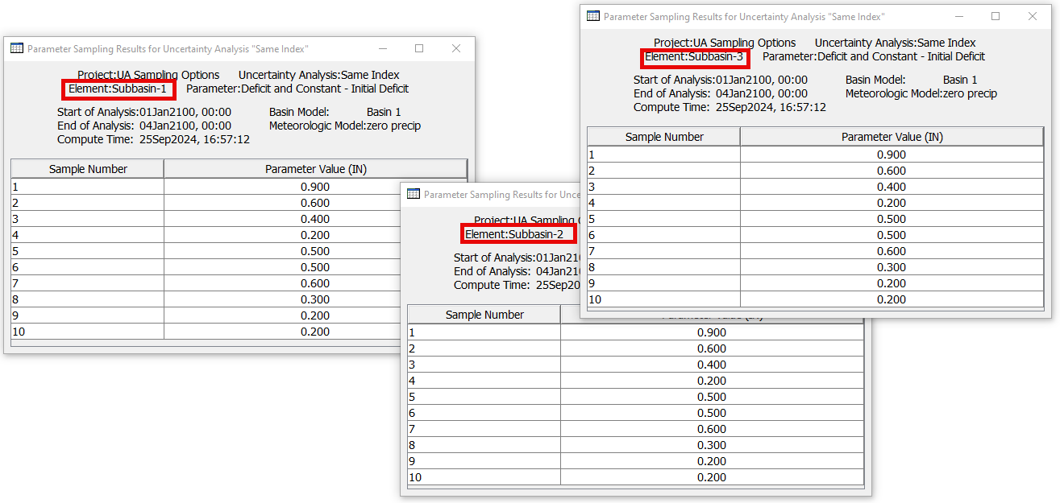
Same Index Sampling

Slide 25
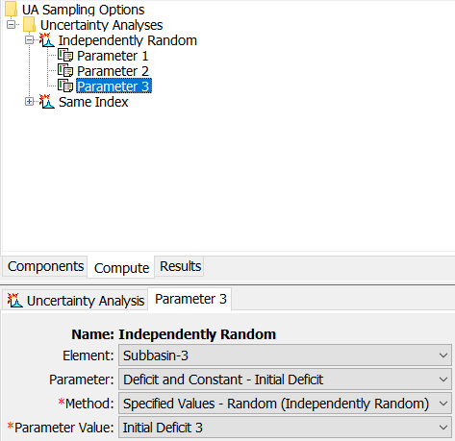
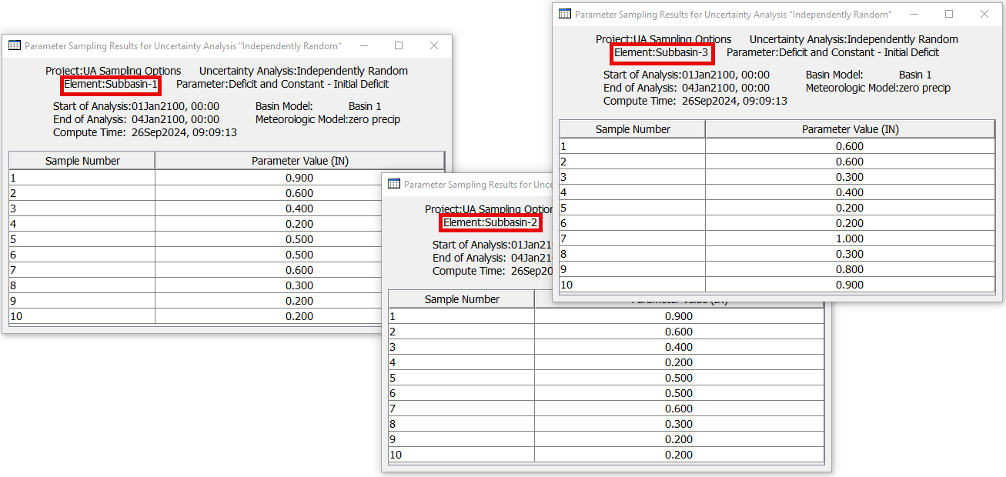
Independent Sampling

Slide 26
Thank You!
USACE Flood and Coastal R&D Hypothetical Storms program
FEMA Future of Flood Risk Data initiative
USACE HH&C Science and Engineering Technology (SET) Program
26

Slide 27
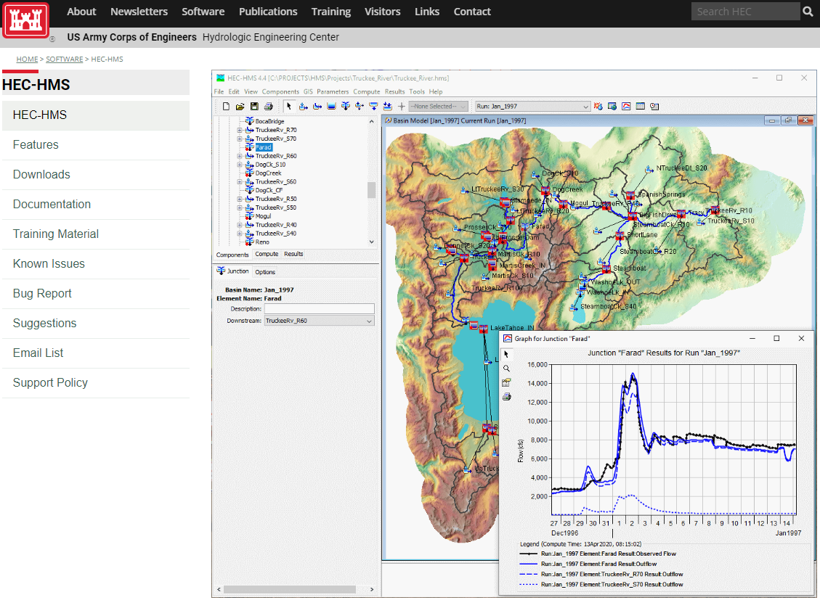
For more…
https://www.hec.usace.army.mil/software/hec-hms/
https://www.hec.usace.army.mil/software/hec-hms/email_list.aspx
27

