Slide 1
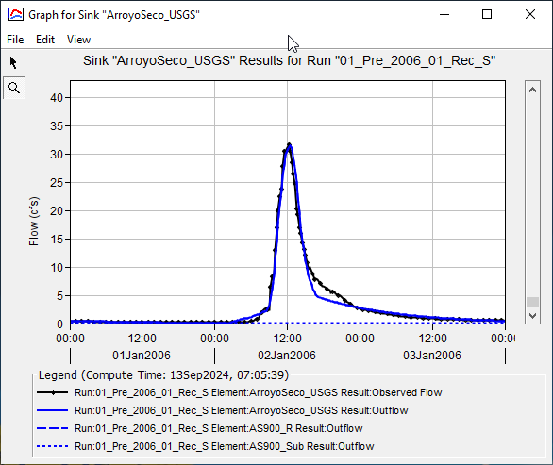
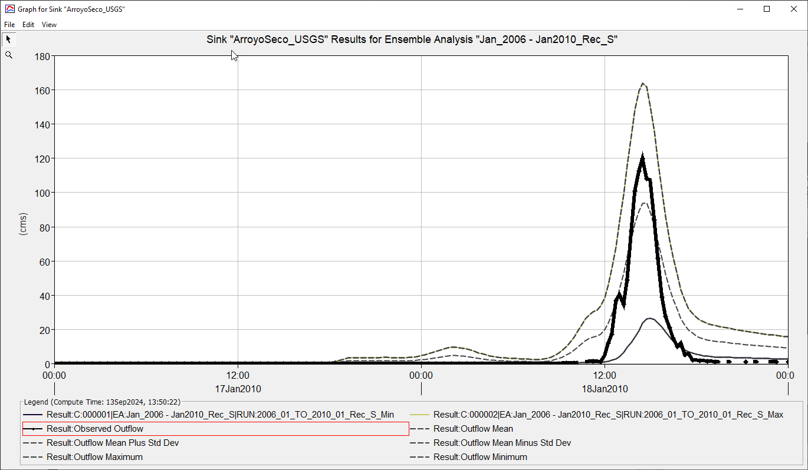


GREEN & AMPT LOSS MeTHOD IN HEC-HMS FOR POST-WILDFIRE HYDROLOGY MODELING APPLICATIONS
Pre-Wildfire Condition
Post-Wildfire Condition
How ?
SCS-CN
G&A
Etc.
Presenter:
Jay Pak (HEC)
Jose Paredez (SPL)
Jackie Oehler (SPL)
HEC-HMS FY25 Q2 Webinar, 25 Mar 2025

Slide 2
overview
    Fire Impacts on Debris Basins/Reservoirs
    Study Motivation
    Modification of Green & Ampt Equation with “Wetting Front Suction” & “Sorptivity” (Guidance Table: Work in Progress by Dr. Ross Shillito (CHL))
    Guidance Table using Walnut Gulch Rainfall Simulator Dataset
    Validation through Arroyo Seco Case Study
    Improvements Needed for Guidance Table
    Summary
    Case Study: 2025 Los Angeles Eaton Fire - Bailey Canyon
      SCS-CN Method
      G&A Method with “Wetting Front Suction” option
    Questions & Feedback

Slide 3
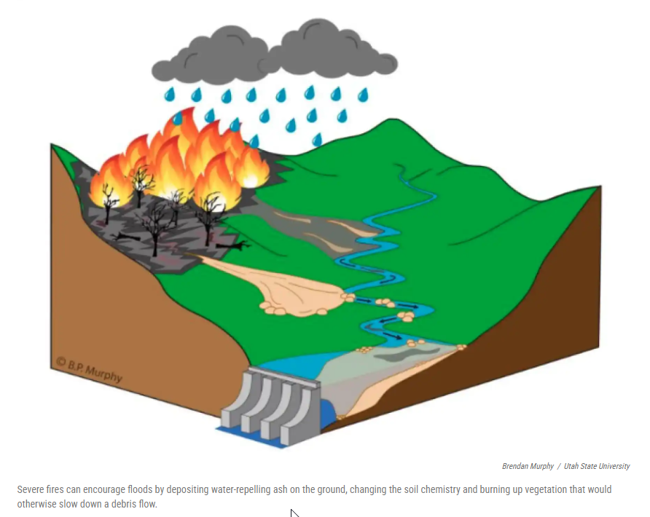
Fire Impacts on Reservoir
  What’s happening here?
    Indicators
      Early Snowmelt
      Longer Dry Seasons
      Wildfire Pattern: More Extreme Wildfires
        Water Repellence
      Storm Pattern: extreme short-duration high-intensity rainfall values
    Flash Flood (Faster & Higher Peak, More Volume)
    Sediment/Debris Flow
    Decreased Reservoir Capacity
    And other related impacts
How do flow and sediment inflow change under post-fire conditions?
Source: https://www.kunc.org/science/2019-09-24/how-wildfires-may-muck-up-the-wests-reservoirs

Slide 4
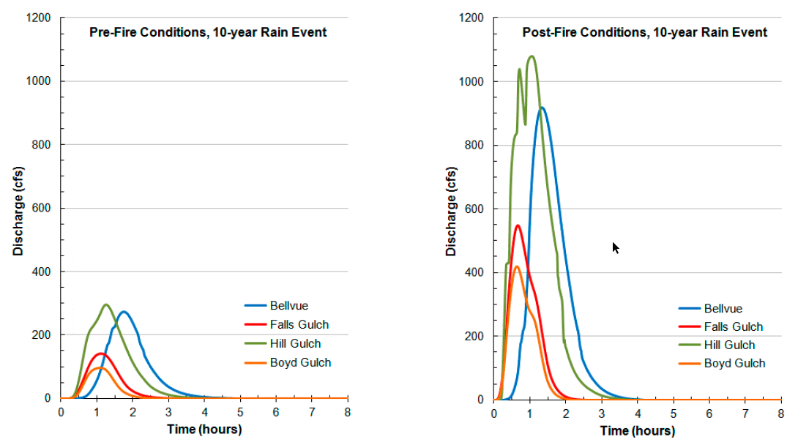
High Park Fire (June-July, 2012), Colorado
Estimated pre-and post-fire hydrographs
Source: USGS NRCS Hydrology Technical Note 4 -Hydrologic Analyses of Post-Wildfire Conditions, August 2016

Slide 5

Study Motivation
Current Guidance for the Post-Wildfire Hydrology:
USDA, Hydrology Technical Note No. 4
“Existing methods for adjusting CNs to account for wildfire effects are for the most part based heavily upon the hydrologic judgment of practitioners who have studied burned watersheds.”
- USDA (2016)
    To develop a physically based post-wildfire hydrological method using the Green & Ampt infiltration model as an alternative solution.
    This alternative approach is crucial in cases where no data is available for mountain watersheds affected by wildfires.

Slide 6
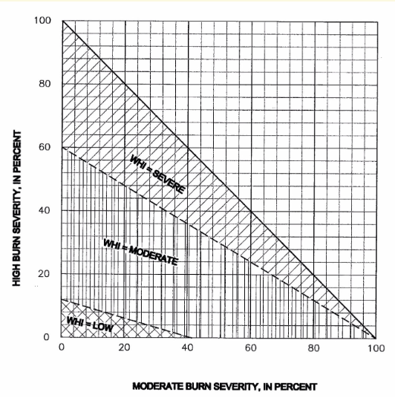
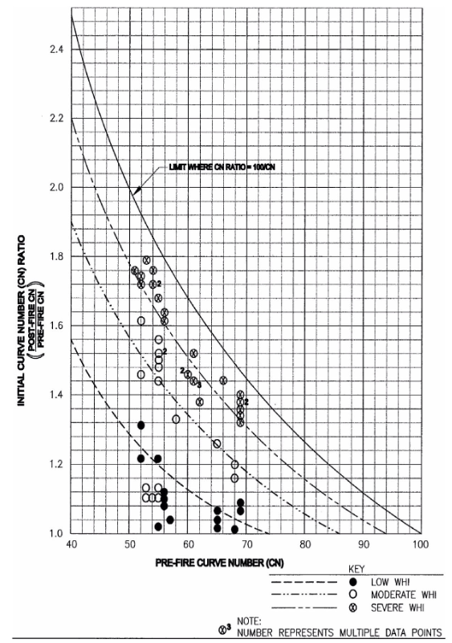
Post-Fire Curve Number Adjustments
Method 1
Method 2
Condition | CN Value
High Burn Severity | pre-fire CN + 15
Moderate Burn Severity | pre-fire CN + 10
Low Burn Severity | pre-fire CN + 5
Higginson and Jarnecke (2007)
Livingston and others (2005)

Slide 7
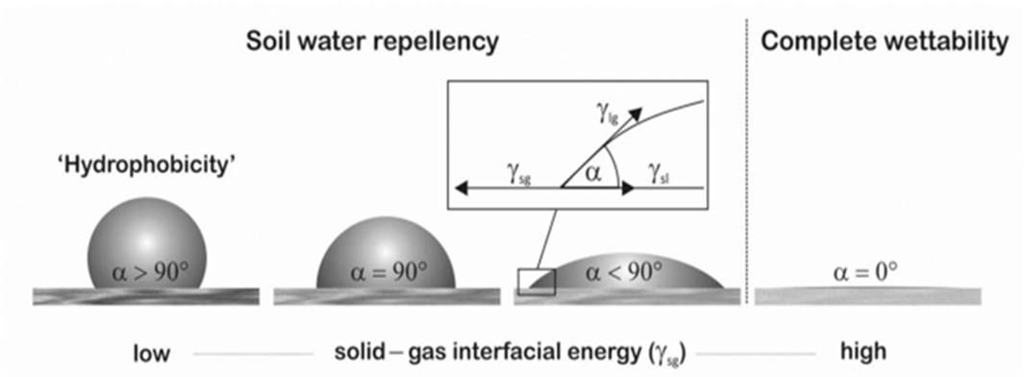


Modification of G & A Equation in HEC-HMS with Wetting Front Suction & Sorptivity
Green & Ampt infiltration equation (1911)
$$I=Kt+ ψ∆θln\left(1+\frac{I}{ψ∆θ}\right)$$
Using
$$I=Kt+ \frac{S^{2}}{2K}ln\left(1+\frac{I2K}{S^{2}}\right)$$
$S^{2}=2KψΔθ$
(Philip, 1957)
Sorptivity is a function of contact angle
Where:
I = cumulative infiltration, K = hydraulic conductivity, ψ = the effective suction at the wetting front, Δθ= change in soil water content, S = sorptivity, and t = time

Slide 8
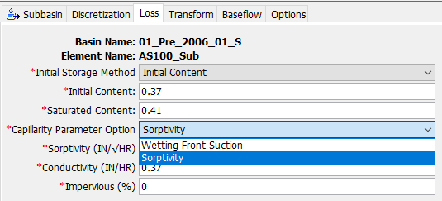
1st Question?
How can the G&A Loss Method with “Wetting Front Suction” & “Sorptivity” in HEC-HMS be used to develop a post-fire hydrology model from the pre-fire model?
Condition | CN Value
High Burn Severity | pre-fire CN + 15
Moderate Burn Severity | pre-fire CN + 10
Low Burn Severity | pre-fire CN + 5
?
Answer: "Absolutely, simpler guidance is essential for effectively applying this approach as like the SCS-CN method!"

Slide 9
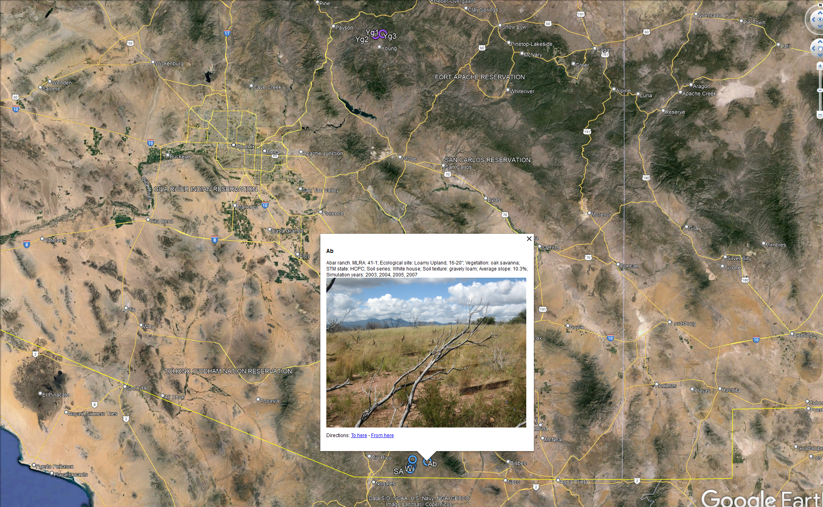
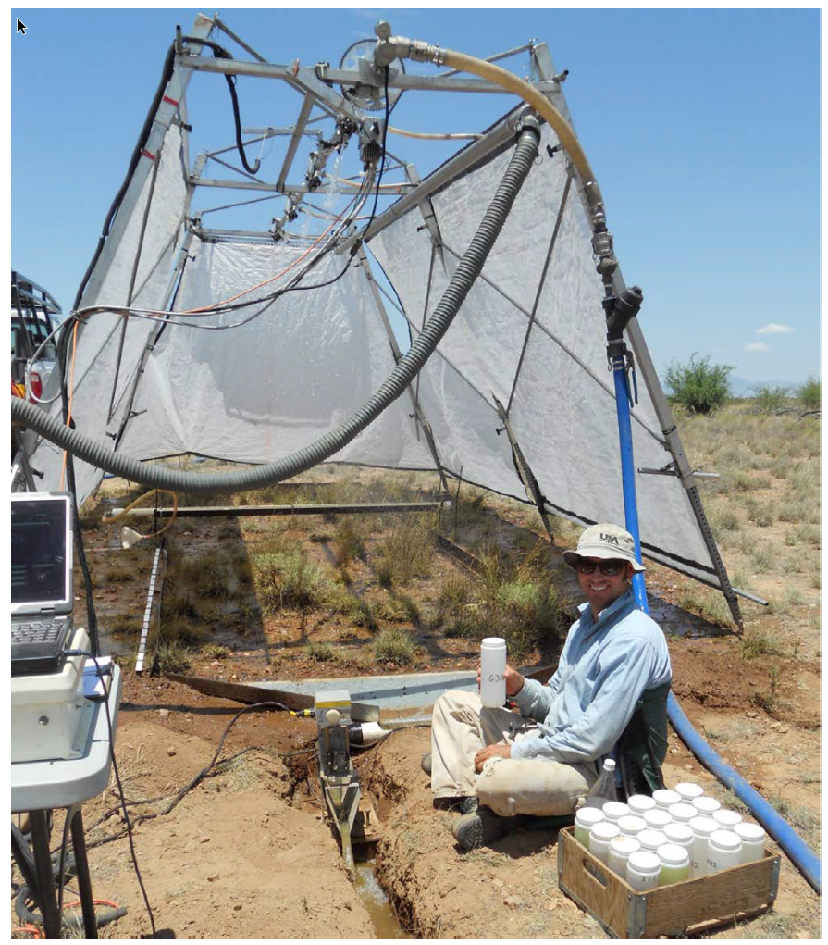
Development of Guidance Table using Walnut Gulch Rainfall Simulator Dataset
Source: Earth Syst. Sci. Data, 10, 19–26, 2018, https://doi.org/10.5194/essd-10-19-2018

Slide 10
Walnut Gulch Case Studies: Abar Ranch
Site name | Site | Coordinates |  | Soil | Soil | Slope | MLRA | Ecological | Precipitation | Vegetation | State | Plot | Plot # | Slope, % |  |  |  |  |  |  | Simulation year
 | ID | Latitude | Longitude | series | texture | aspect |  | site | zone, in |  | STM | condition |  |  | 2002 | 2003 | 2004 | 2005 | 2006 | 2007 | 2008 | 2009 | 2010 | 2011 | 2012 | 2013
Abar ranch | Ab | 31.4411516 | -110.52191 | White house | gravely loam | E | 41-1 | Loamy Upland | 16-20 | oak savana | HCPC | natural | 1 | 9.3 |  |  | x
 | 2003 Fire |  |  |  |  |  |  |  |  |  |  | natural | 2 | 9.2 |  |  | x
 |  |  |  |  |  |  |  |  |  |  |  | natural | 3 | 12.5 |  |  | x
 |  |  |  |  |  |  |  |  |  |  |  | natural | 4 | 14.2 |  |  | x
 |  |  |  |  |  |  |  |  |  |  |  | burn | 1 | 10.2 |  | x | x | x |  | x
 |  |  |  |  |  |  |  |  |  |  |  | burn | 2 | 9.1 |  | x | x | x |  | x
 |  |  |  |  |  |  |  |  |  |  |  | burn | 3 | 8.1 |  | x | x | x |  | x
 |  |  |  |  |  |  |  |  |  |  |  | burn | 4 | 9.8 |  | x | x | x |  | x
20 cases
Post-Fire Parameters For the 1st year after fire (Arid & Semi-Arid Areas) | Actual Range for 1st Year after Fire
 | Min | Max
Moisture Deficit Values | 0.12 | 0.08
Sorptivity Multiplier | 0.84 | 0.75
Hydraulic Conductivity Multiplier | 0.8 | 0.31
Note: The recommended range was developed based solely on the Abar ranch within the Walnut Gulch Area. Further research is needed with more data.

Slide 11
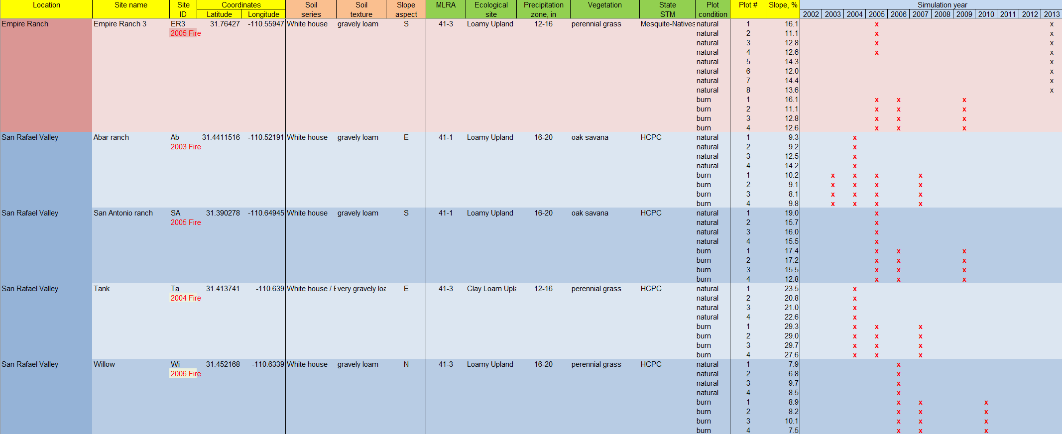
Walnut Gulch Rainfall simulator data
Calibration for 5 locations & 84 events with measured data
Wet Condition: 68 events & Dry Condition: 16 events (need more data)

Slide 12
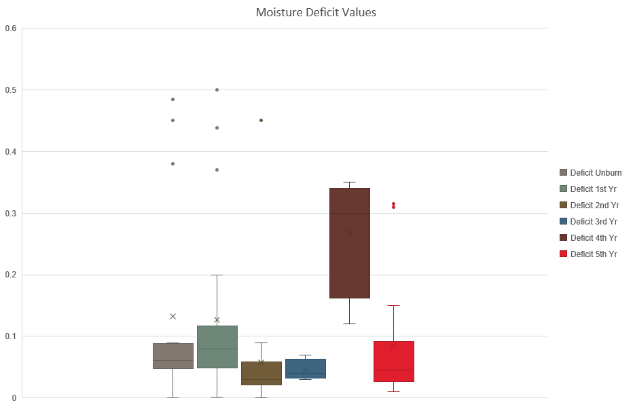
Moisture Deficit Values (all Conditions)

Slide 13
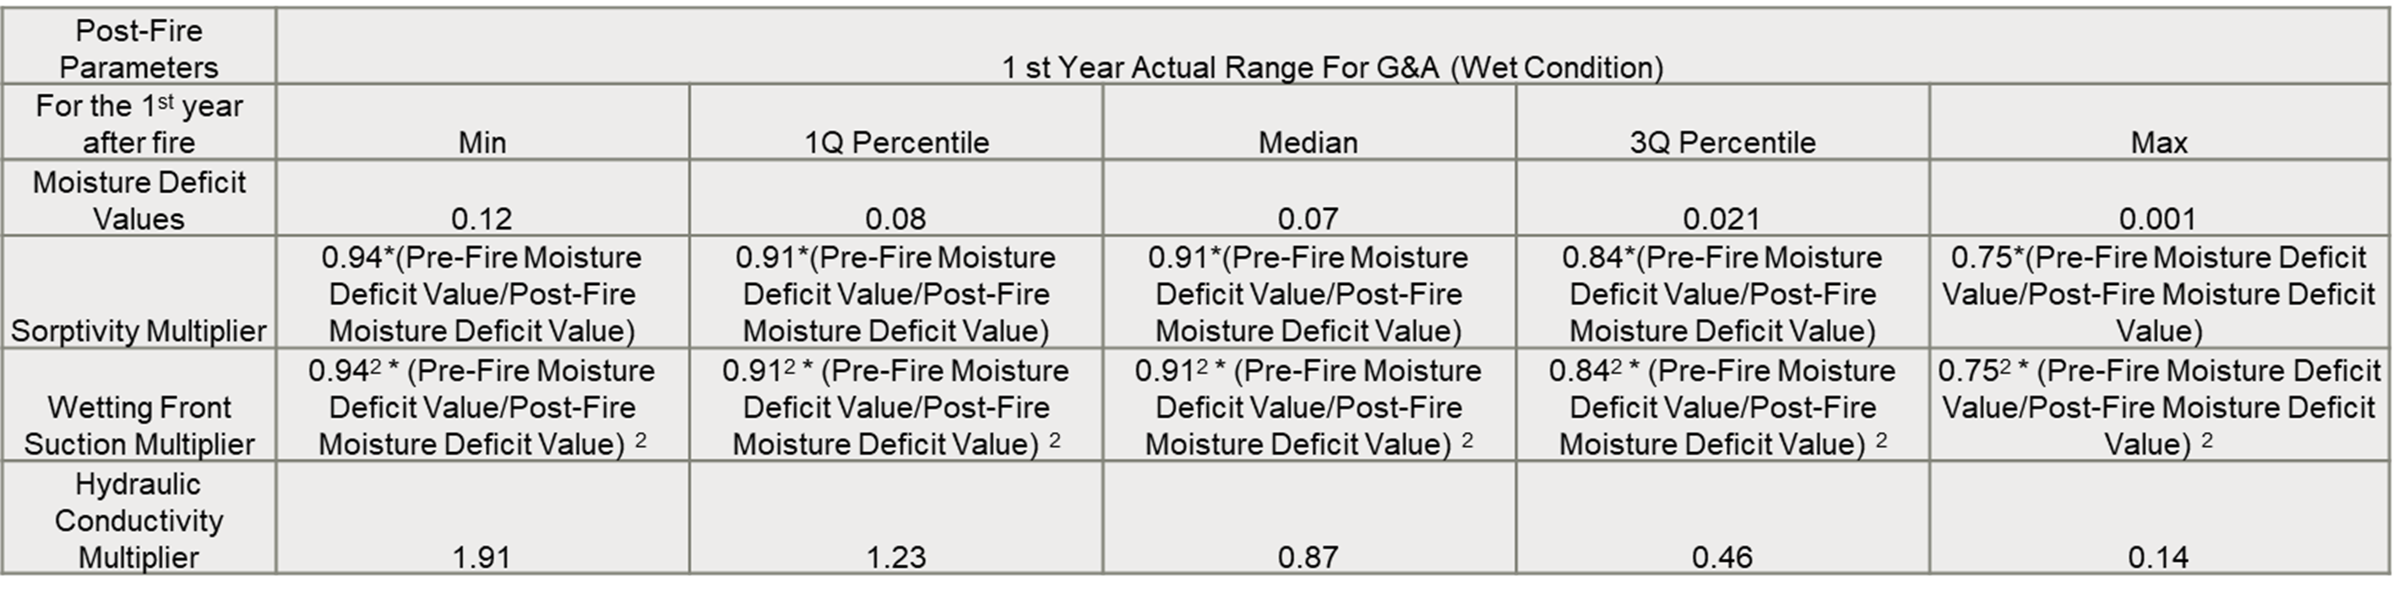
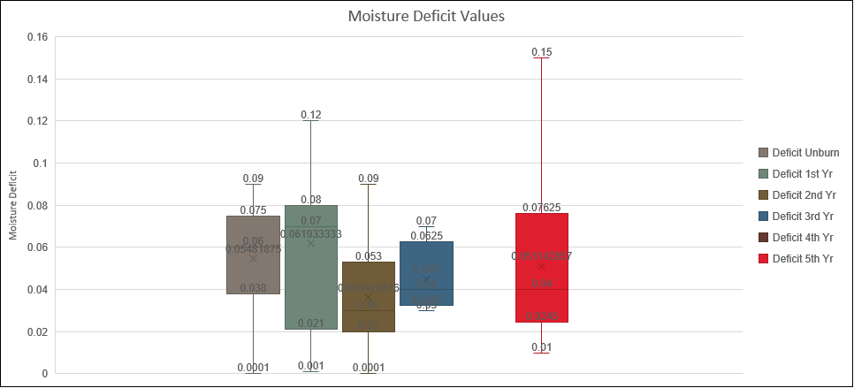
Moisture Deficit Values (Wet Condition)

Slide 14
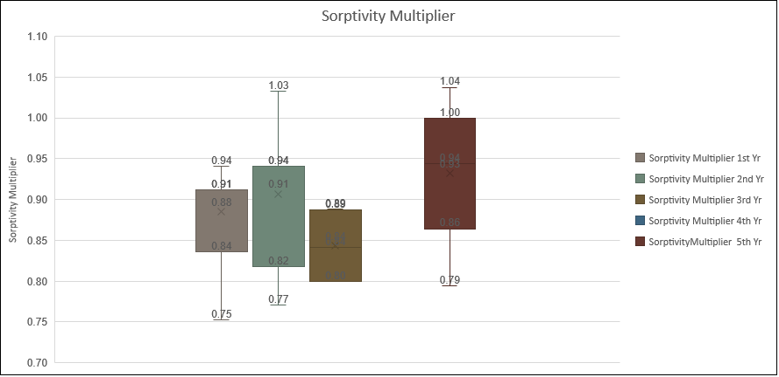

Sorptivity multiplier (Wet Condition)
Conversion from Sorptivity to Wetting Front Suction using
$S^{2}=2KψΔθ$
(Philip, 1957)

Slide 15
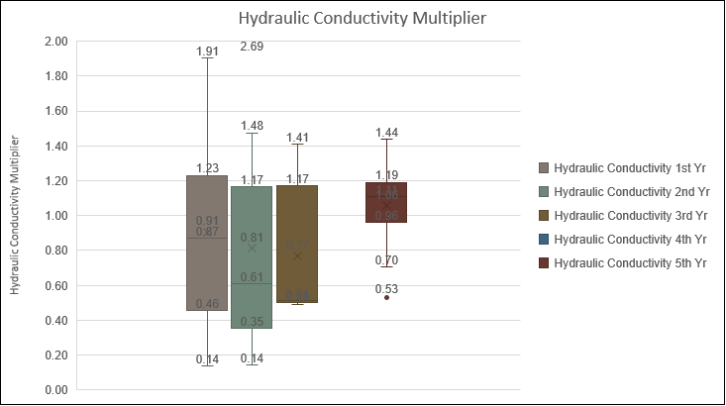
Hydraulic conductivity multiplier (wet Condition)

Slide 16

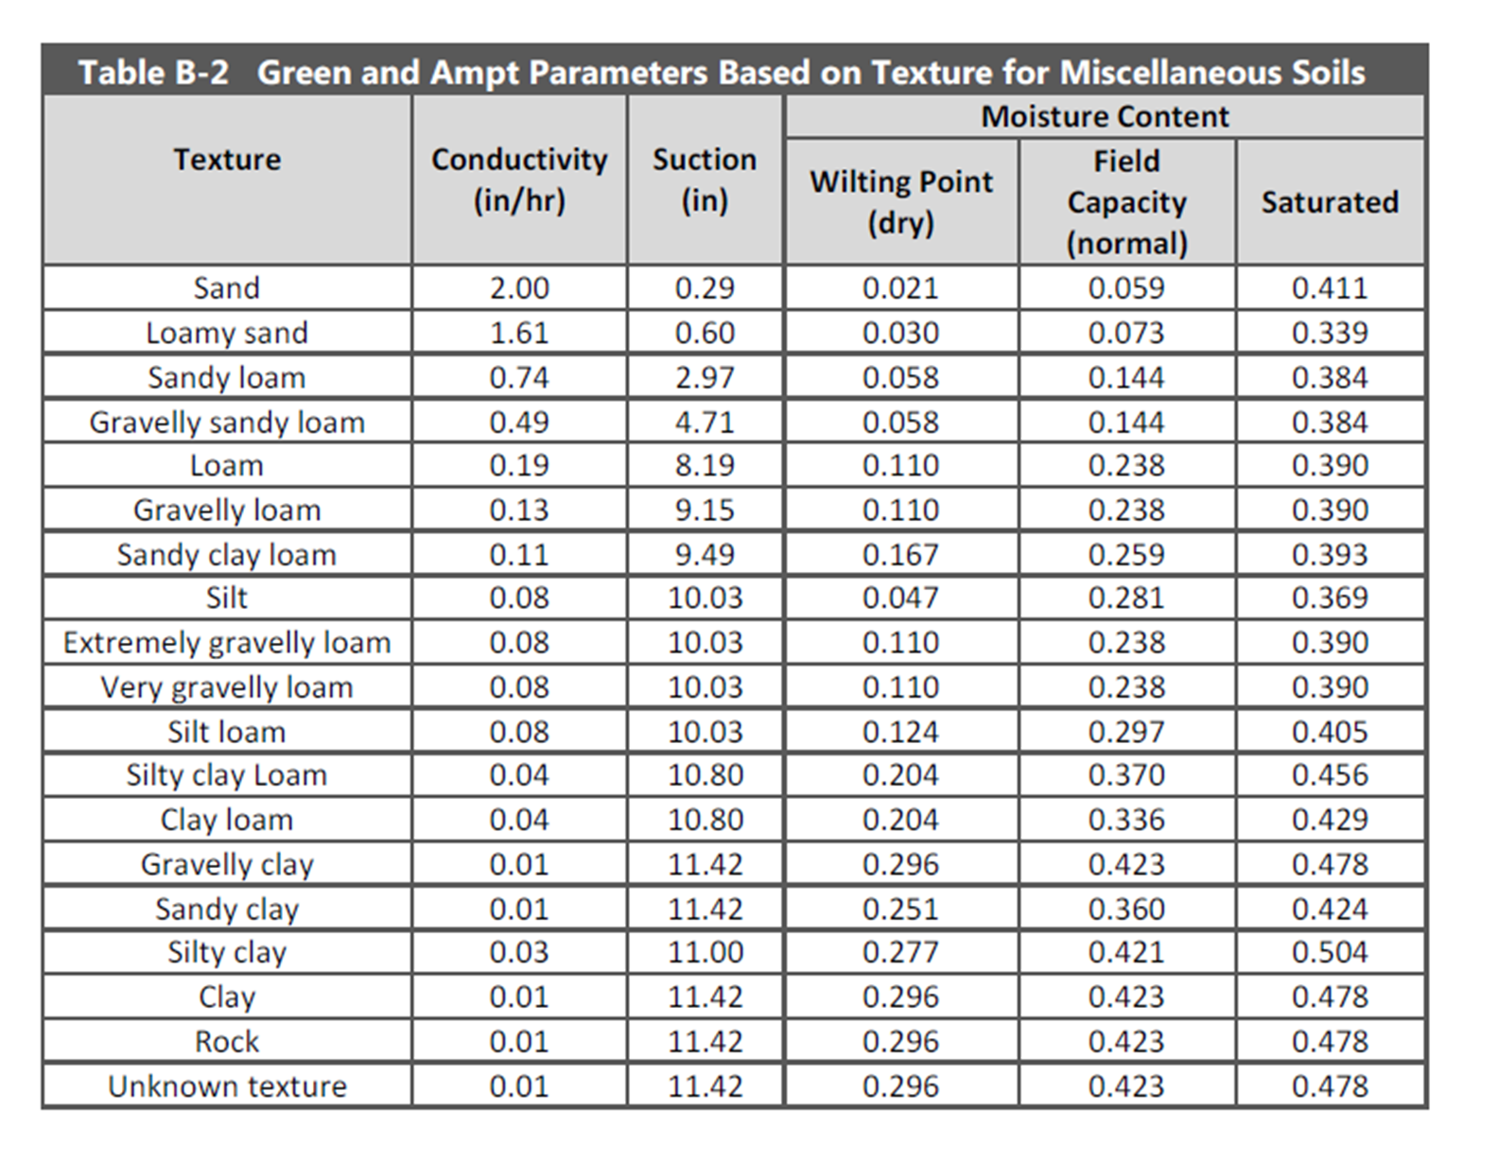
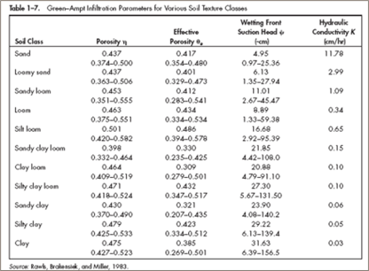
2nd Question?
Is this guidance table applicable using “Wetting Front Suction” to other events?
Answer: Yes, it is ready to be applied to case studies.
Sources: Rawls, Brakensiek, and Miller’s Table (1983) / Highway Drainage Design Manual, ADOT, 2014

Slide 17
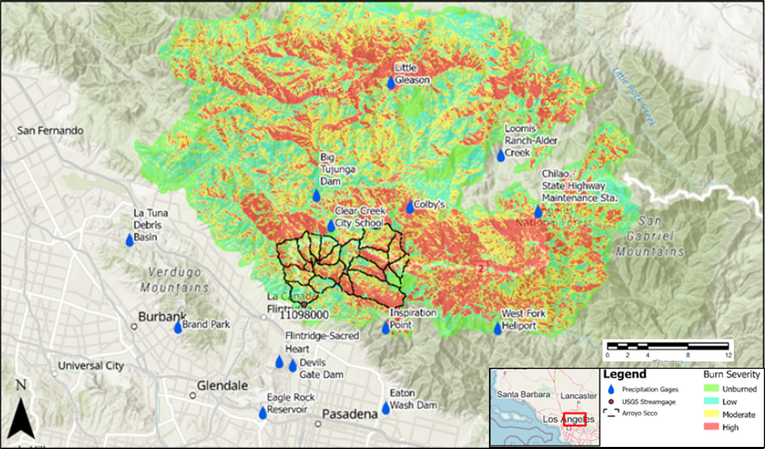
validation: Arroyo Seco Watershed
Watershed | County | Drainage Area (mi²) | Wildfire | Percent Burned | Burn Severity
Arroyo Seco | Los Angeles | 16.0 | Station Fire (August 2009) | 95% | Unburned: 5% Low: 18% Moderate: 42% High: 36%

Slide 18
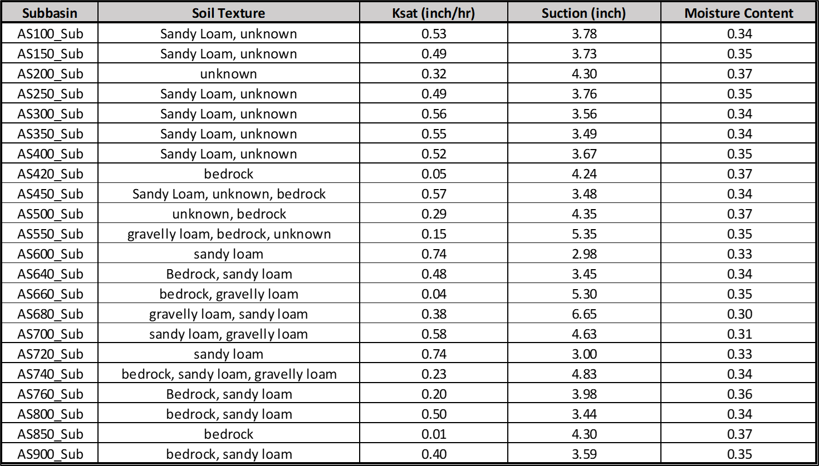
Step 1: Estimate initial G & A parameters for pre-wildfire hydrology using gSSURGO data and Table B-2 (Highway Drainage Design Manual, ADOT, 2014).

Slide 19
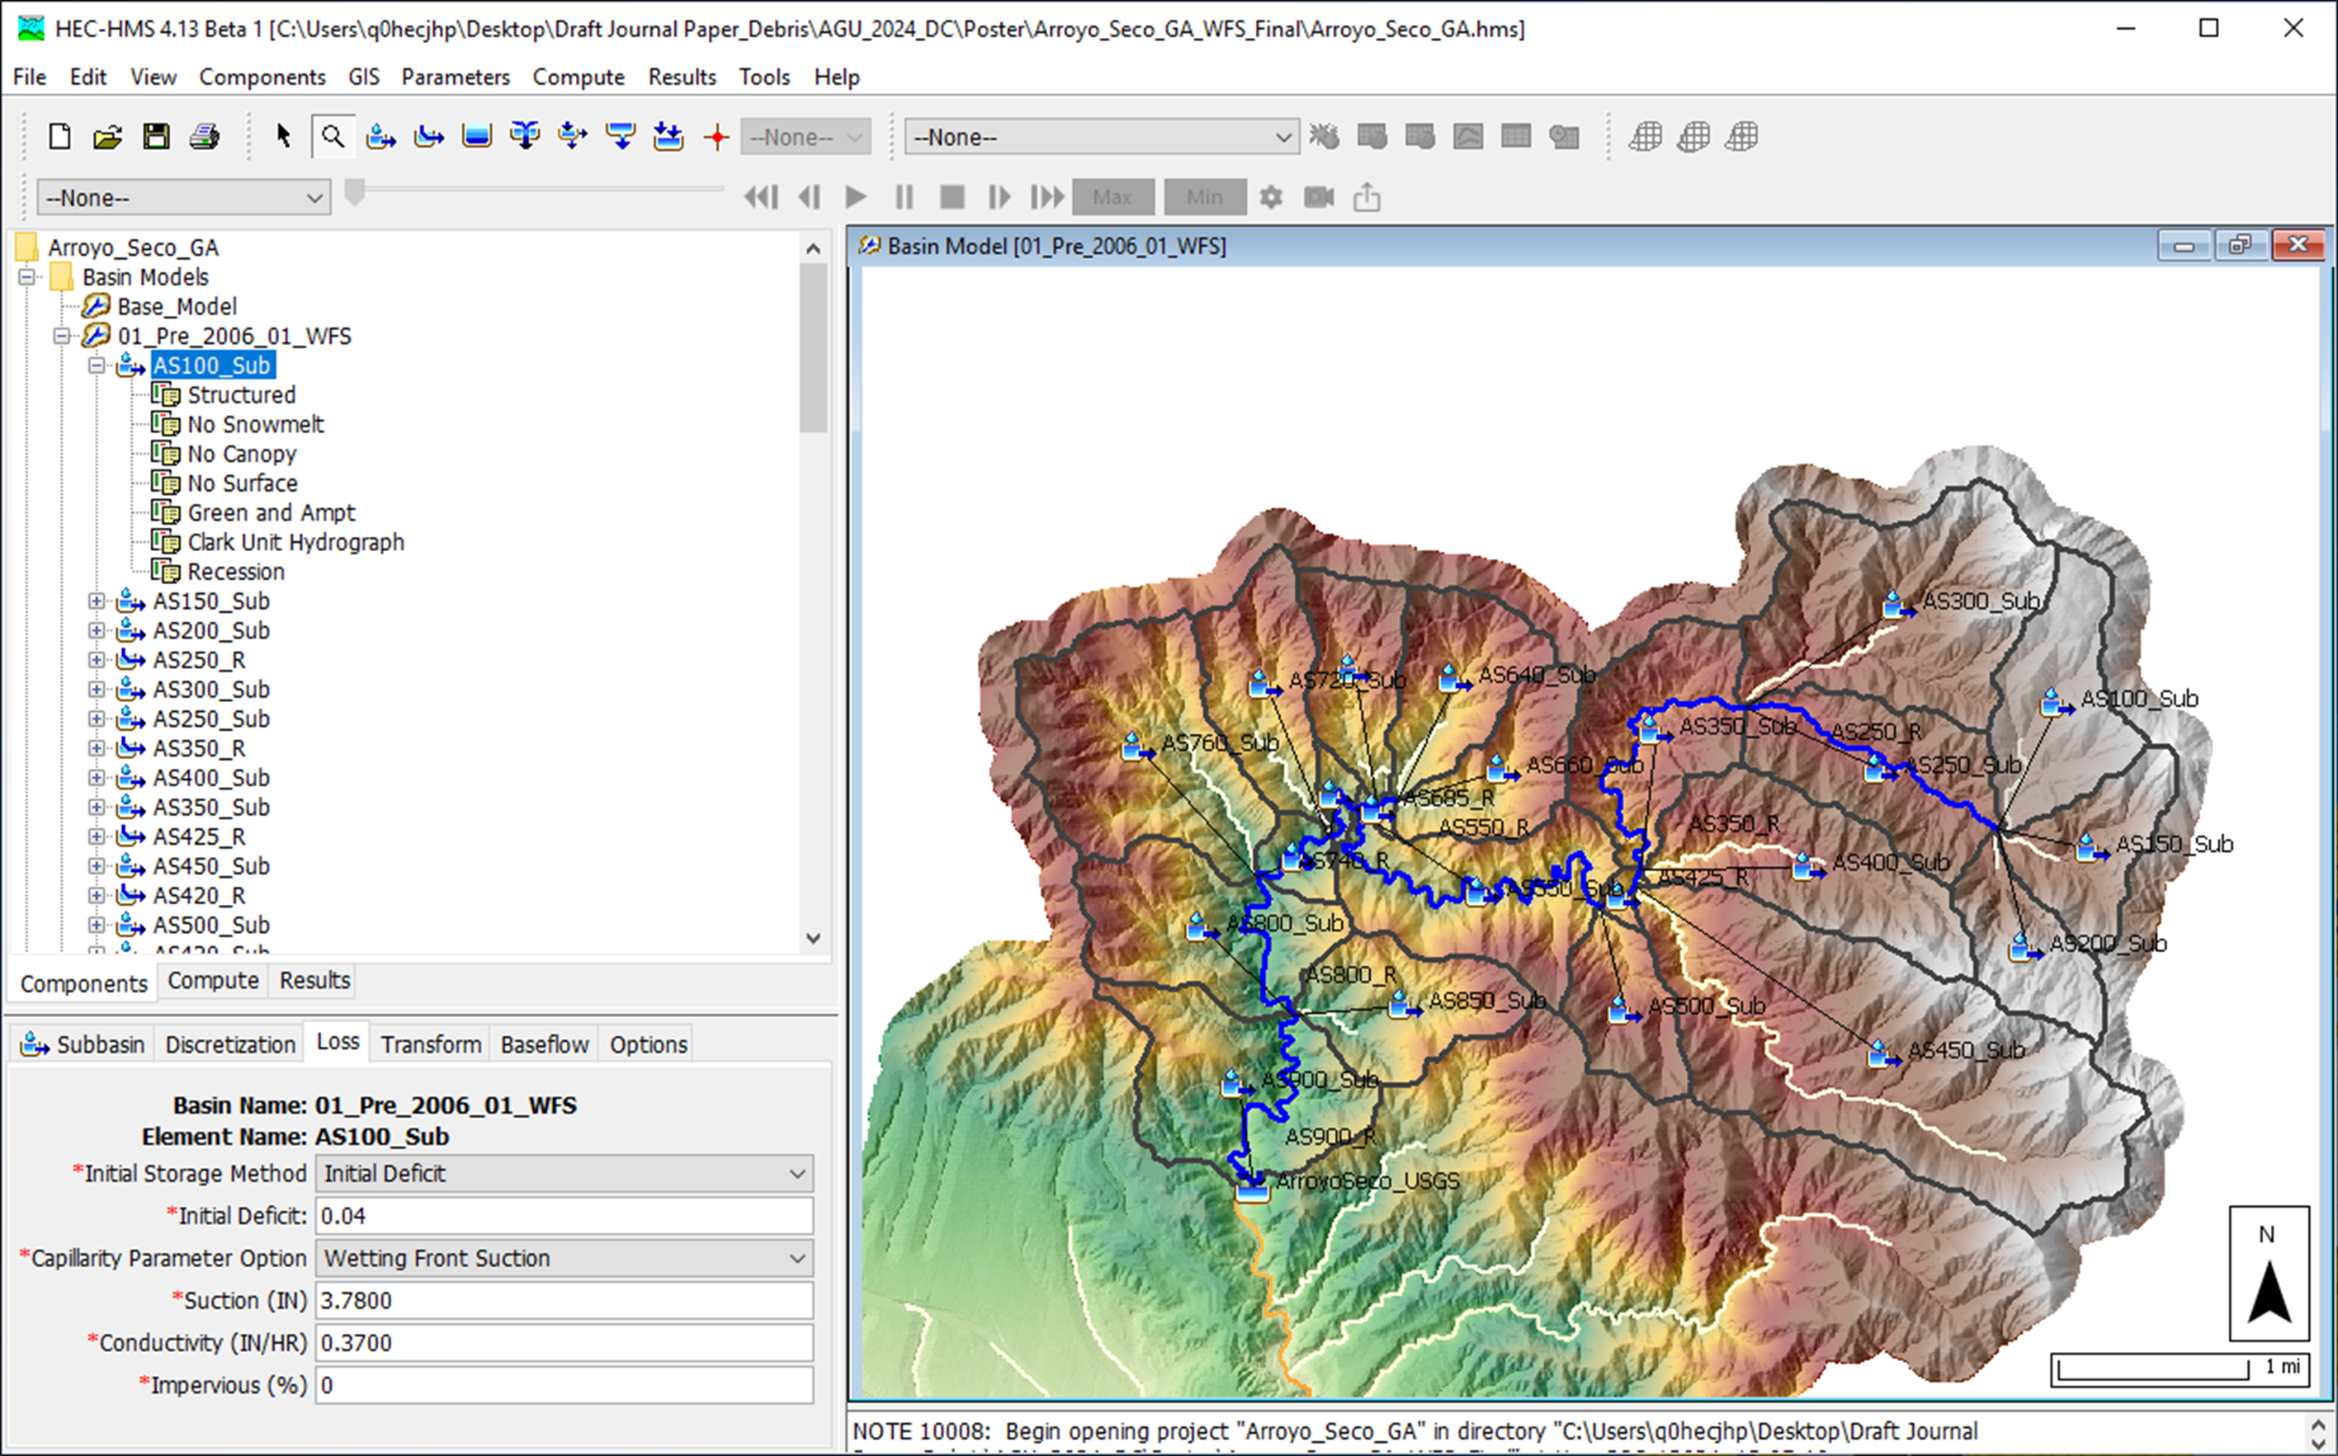
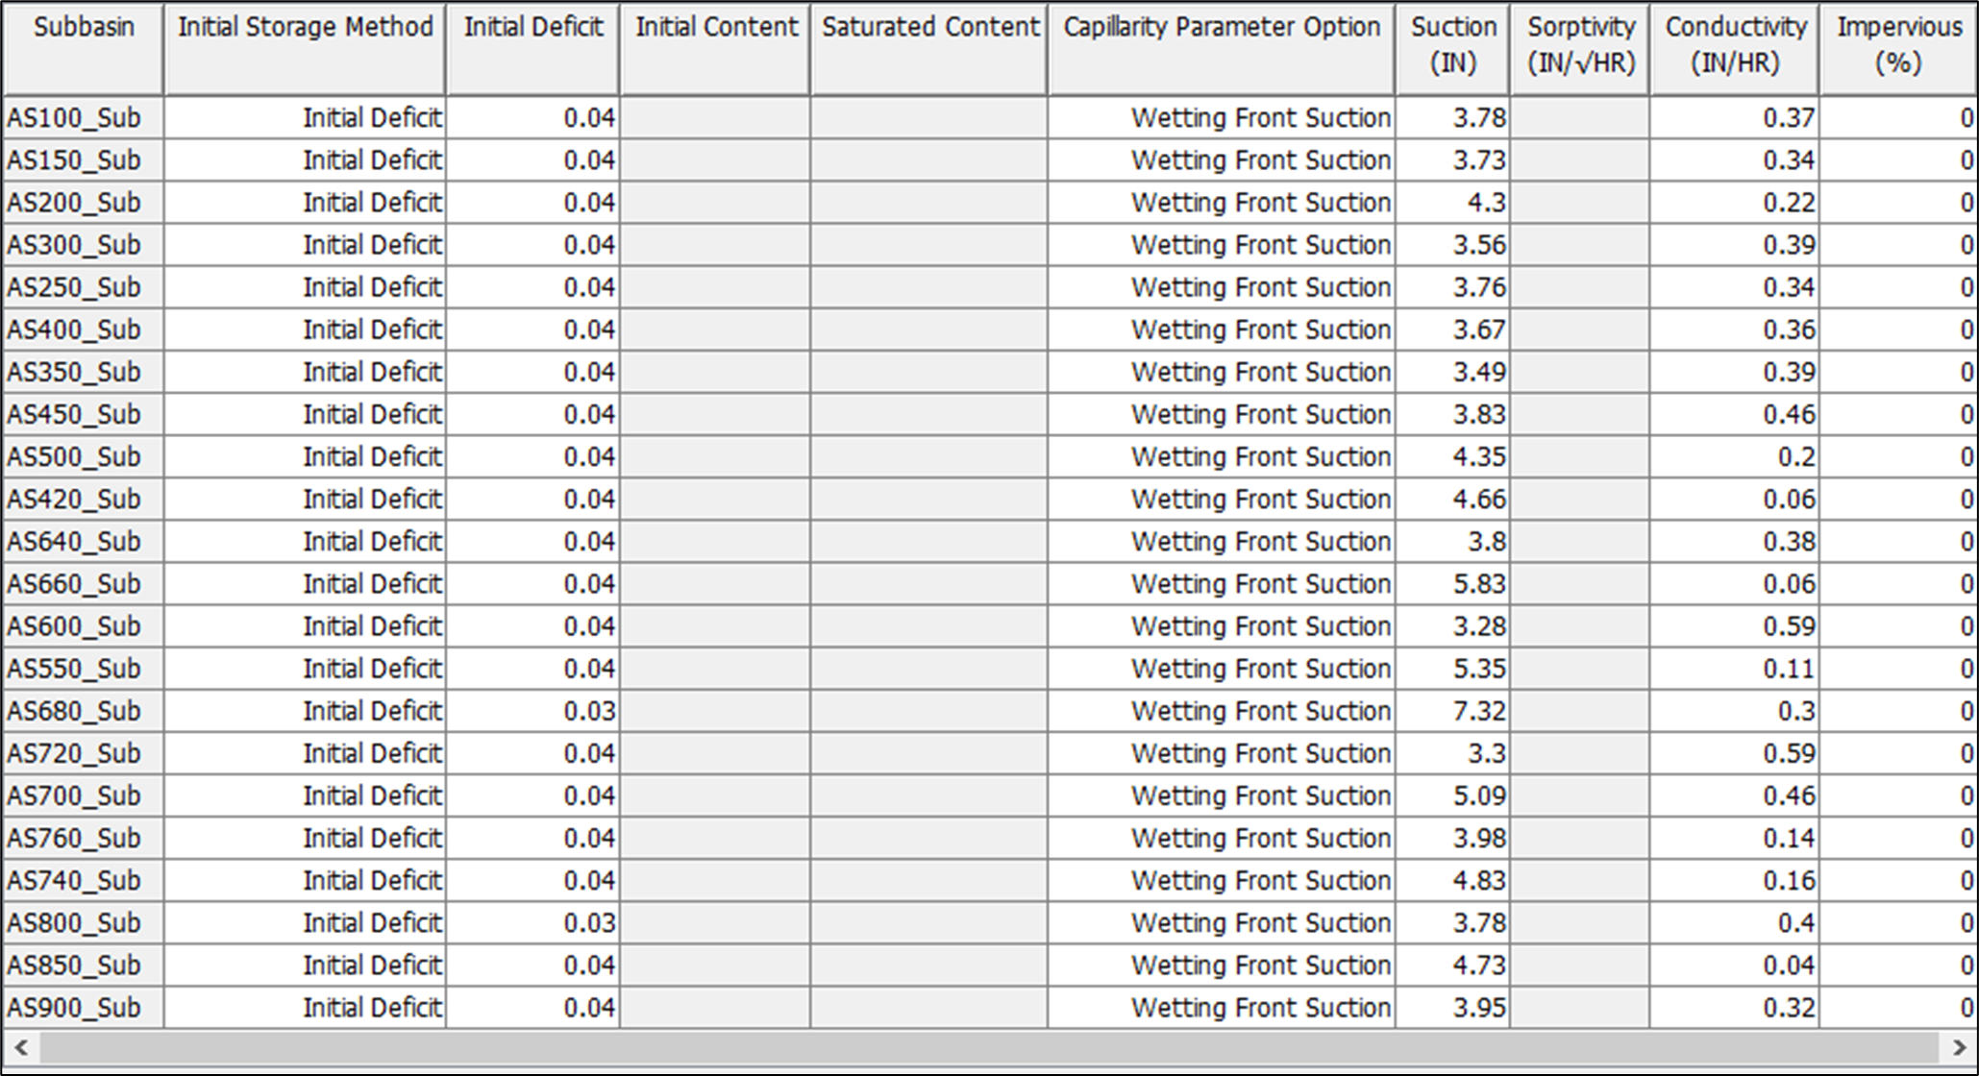
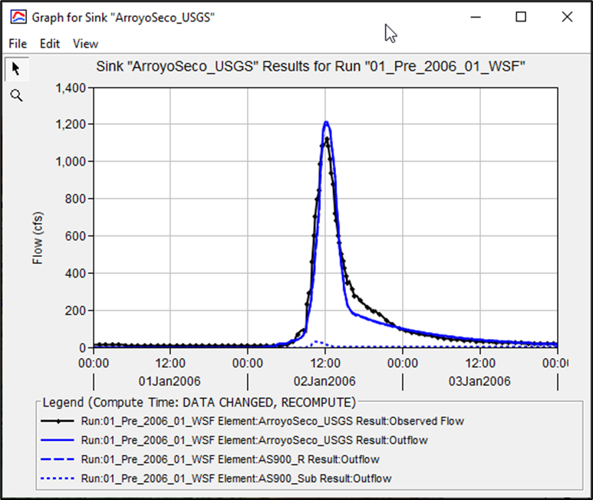
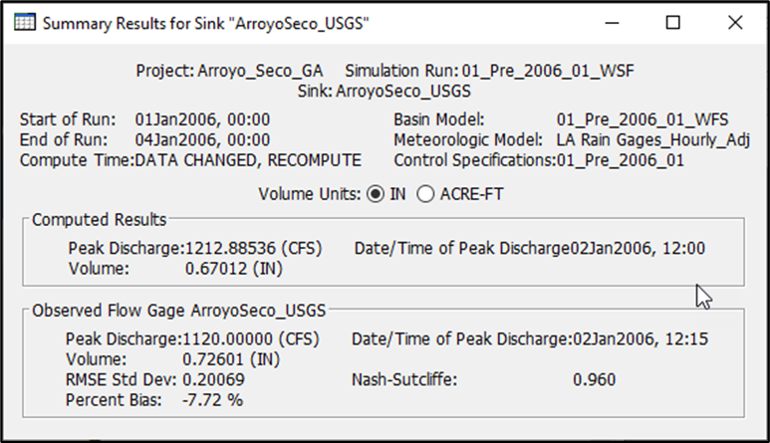
Step 2: Calibrate the pre-wildfire hydrology model using the precipitation and flow gage data.

Slide 20
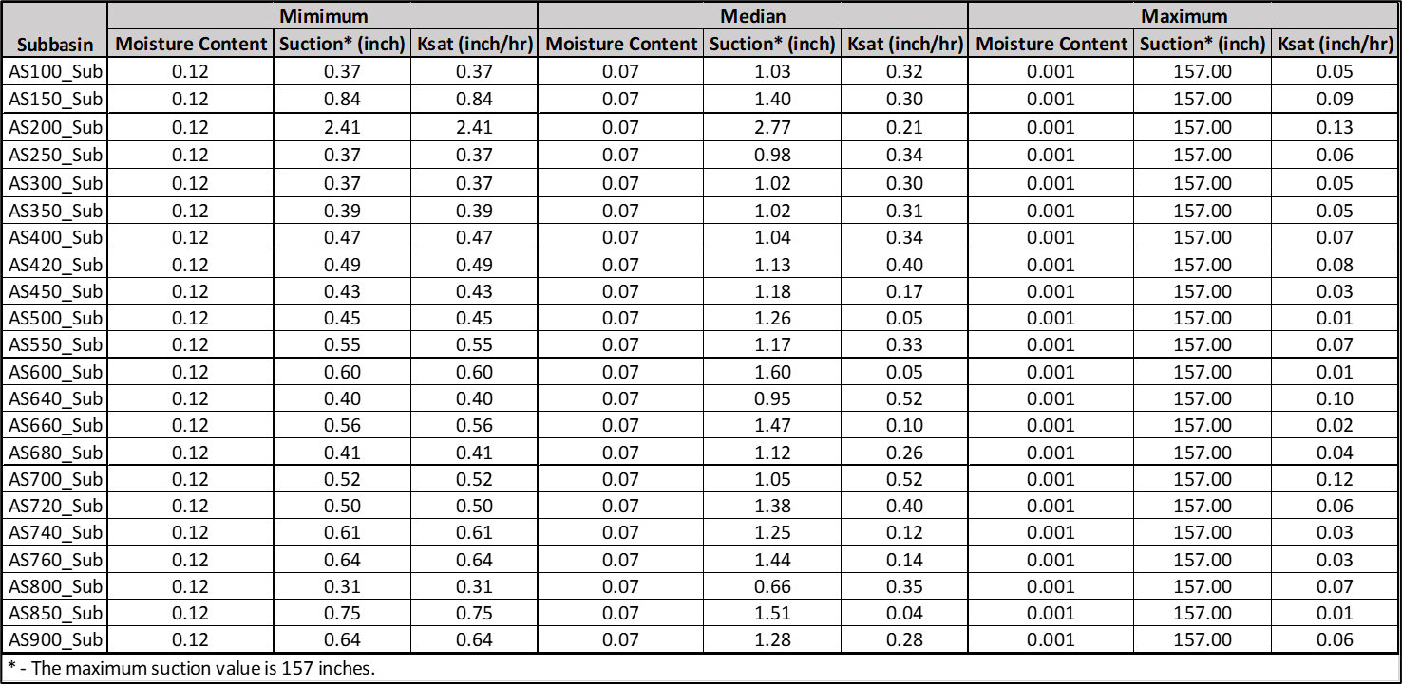
Step 3: Prepare Post-Wildfire Hydrology Model using the guidance Table

Slide 21
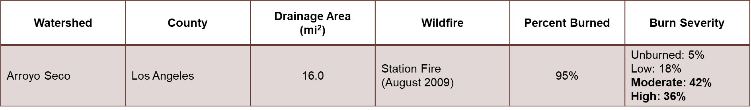
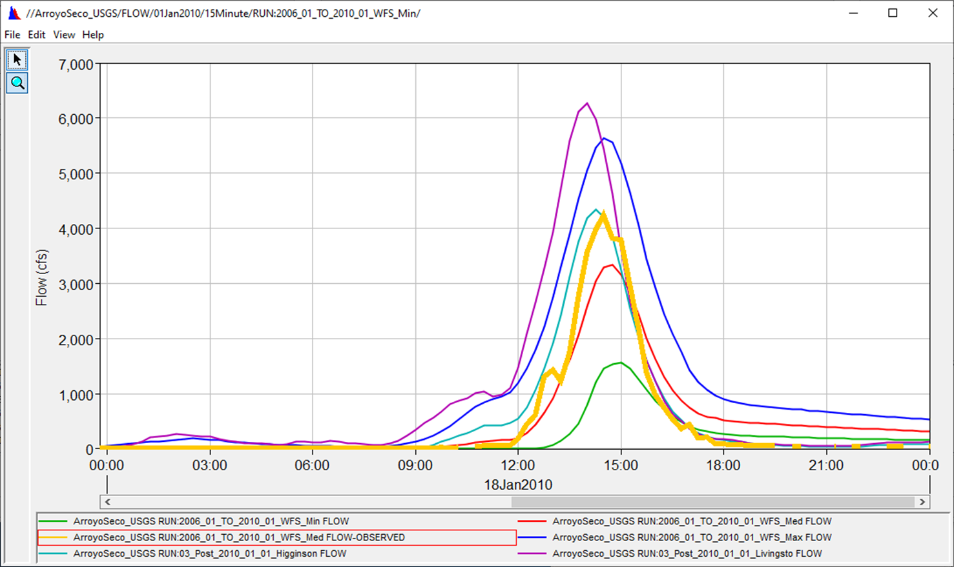
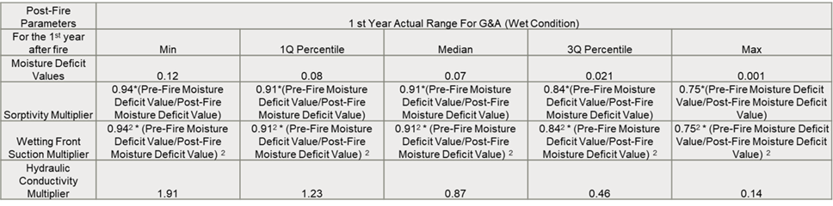
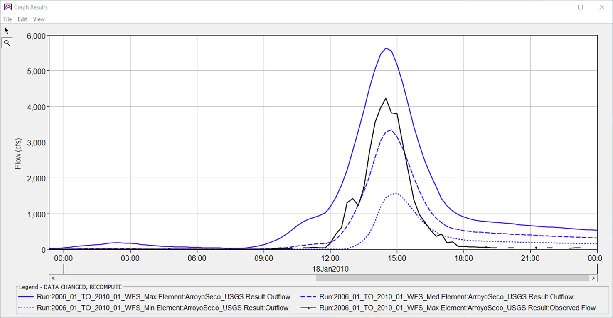
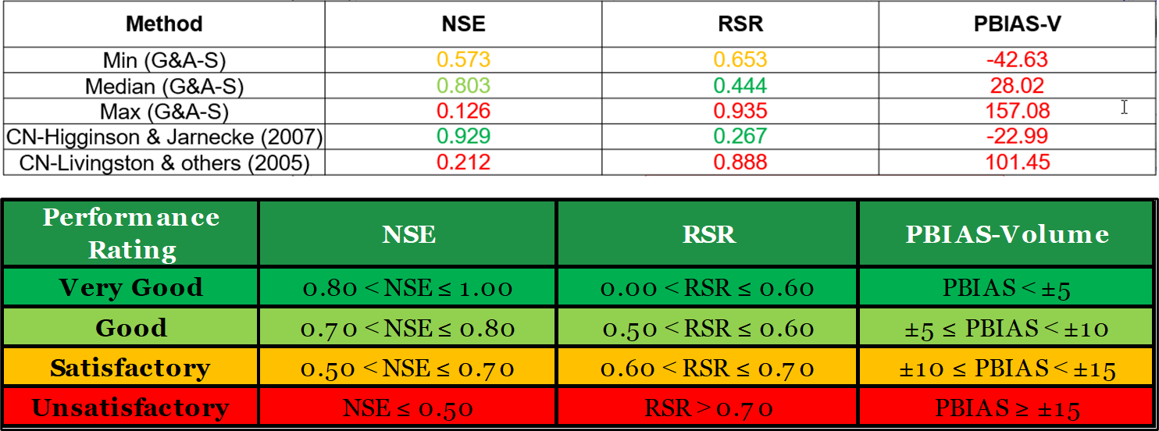
Step 4: Compare post-wildfire results with measured data & SCS-CN Methods

Slide 22
Need To Improve for Guidance Table
Update the guidance table with more case studies, especially dry condition & different areas to generate the better direction for the post-fire hydrology
Seeking a dataset to update the guidance table with varying soil burn severities (Minor, Moderate, and Severe)
Prepare the guidance table for 2nd, 3rd, 4th, and 5th year
Post-Fire Parameters | 1 st Year Actual Range For G&A-Sorptivity (Wet Condition)
For the 1st year after fire | Min | 1Q Percentile | Medium | 3Q Percentile | Max
Moisture Deficit Values | 0.12 | 0.08 | 0.07 | 0.021 | 0.001
Sorptivity Multiplier | 0.94*(Pre-Fire Moisture Deficit Value/Post-Fire Moisture Deficit Value) | 0.91*(Pre-Fire Moisture Deficit Value/Post-Fire Moisture Deficit Value) | 0.91*(Pre-Fire Moisture Deficit Value/Post-Fire Moisture Deficit Value) | 0.84*(Pre-Fire Moisture Deficit Value/Post-Fire Moisture Deficit Value) | 0.75*(Pre-Fire Moisture Deficit Value/Post-Fire Moisture Deficit Value)
Wetting Front Suction Multiplier | 0.94² * (Pre-Fire Moisture Deficit Value/Post-Fire Moisture Deficit Value) ² | 0.91² * (Pre-Fire Moisture Deficit Value/Post-Fire Moisture Deficit Value) ² | 0.91² * (Pre-Fire Moisture Deficit Value/Post-Fire Moisture Deficit Value) ² | 0.84² * (Pre-Fire Moisture Deficit Value/Post-Fire Moisture Deficit Value) ² | 0.75² * (Pre-Fire Moisture Deficit Value/Post-Fire Moisture Deficit Value) ²
Hydraulic Conductivity Multiplier | 1.91 | 1.23 | 0.87 | 0.46 | 0.14

Slide 23
Case Study
Post-Wildfire Hydrology Modeling Application for Bailey Debris Basin in Eaton Fire Areas
  CN Application – Jose Paredez
  G&A Loss Method Application with “Wetting Front Suction” – Jackie Oehler
Source: California Geological Survey (CGS)

Slide 24


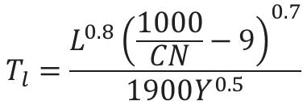


NRCS (SCS) Curve number
The SCS-CN Method is an event-based, lumped rainfall-runoff model, based on the water balance equation. Originally developed for small agricultural watersheds
  Apply to drainage areas ranging in size from 1 to 2,000 acres (0.001 to 3 mi²)
  Does not cover modeling runoff from snowmelt or rain on snow events
  Primarily uses precipitation-frequency data (rainfall amount by return period)
  Uses a storm duration of 24 hours for the synthetic rainfall distributions
$$Q=0$$
for P ≤ I_{a}
$$T_{l}=\frac{L^{0.8}{\left(\frac{1000}{CN}−9\right)}^{0.7}}{1900Y^{0.5}}$$
$$I_{a}=λS$$
$$CN=\frac{1,000}{10+S}$$
$$Q=\frac{{\left(P−I_{a}\right)}^{2}}{\left(P−I_{a}\right)+S}$$
for P > I_{a}
Ia = Initial Abstraction
CN = Curve Number
T_{l} = Lag Time
L= Longest Flow Path (ft)
Y = Mean Basin Slope (%)
λ = initial abstraction ratio, unitless
(λ = 0.2 is a standard value based on studies)
Q = runoff, in
P = rainfall, in
Ia = initial abstraction, in
S = potential maximum retention after runoff begins, in

Slide 25
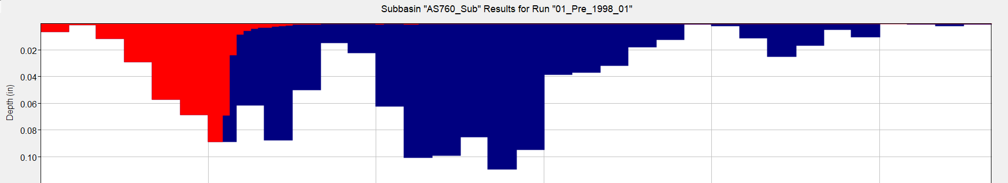

Loss Method: Initial abstraction (I_{a})
Initial abstraction is the amount of rain that falls before runoff begins.
It includes all losses such as water retained in surface depressions, water intercepted by vegetation and other cover, and water lost to evaporation and infiltration
Ia is highly variable
λ = 0.2 is a standard value based on studies of many small agricultural watersheds
1-in
Losses (1 in)
I_{a} = 1 in
CN = 100 (no infiltration)
Precipitation (5 in)
$$I_{a}=λS=0.2S$$
λ = initial abstraction coefficient, unitless
S = potential maximum retention after runoff begins, in
Notes:
The NRCS CN method assigns a representative runoff curve number for a given soil and cover type for design purposes.

Slide 26
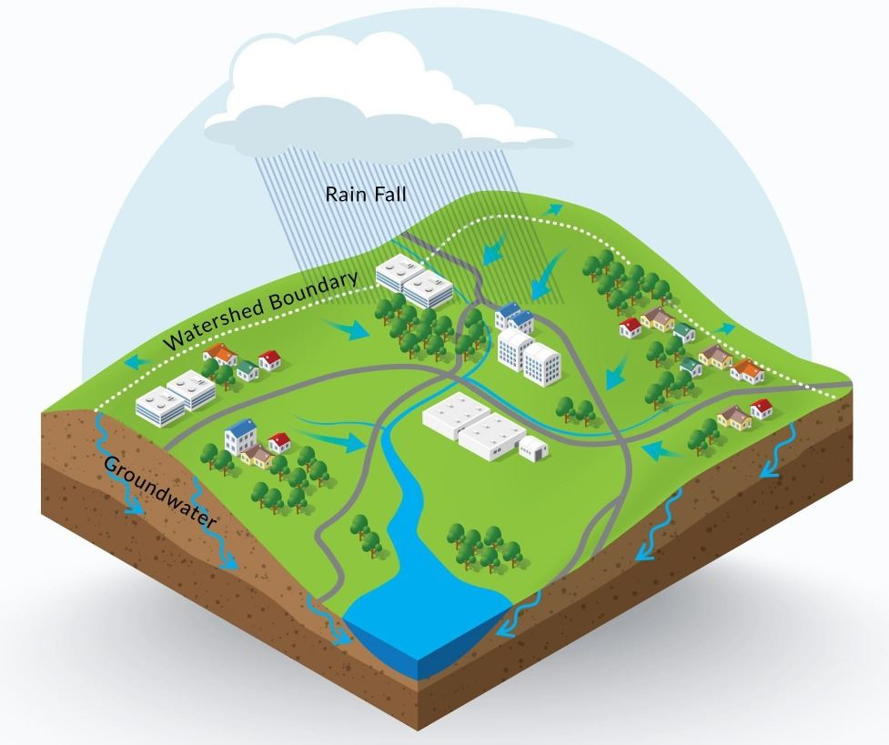

Loss Method: Initial abstraction ratio
Due to the uncertainty and unknown origin, several investigators have re-evaluated the selection of the initial abstraction ratio (Baltas et al., 2007;Mishra et al., 2006; Mishra & Singh, 2004; Woodwardet al., 2004; Hawkins et al., 2002; Jiang, 2001).
Runoff estimates are inaccurate where watershed retention is a large fraction of the rainfall, as in semiarid watersheds.
The use of a universal (λ = 0.2) initial abstraction ratio may not be appropriate.
Studies found that the initial abstraction ratio varied from storm to storm and from watershed to watershed.
$$I_{a}=λS$$
λ = initial abstraction ratio, unitless
S = potential maximum retention after runoff begins, in

Slide 27
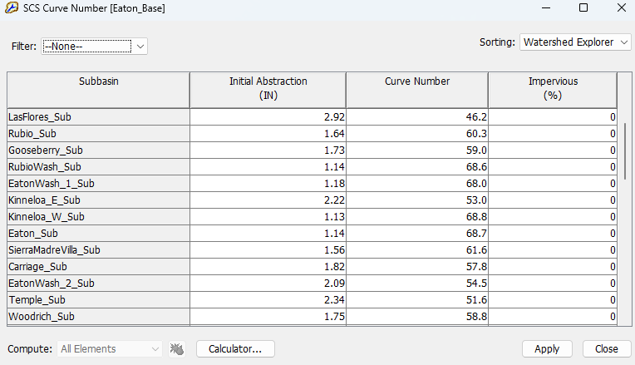
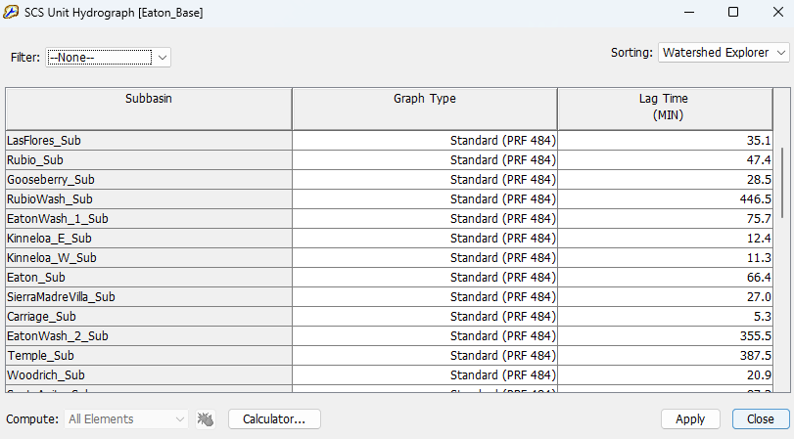
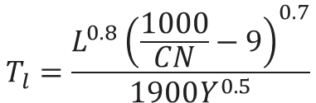
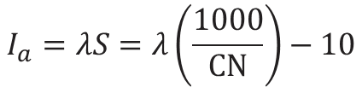
Post-Wildfire Application
$$I_{a}=λS=λ\left(\frac{1000}{CN}\right)−10$$
$$T_{l}=\frac{L^{0.8}{\left(\frac{1000}{CN}−9\right)}^{0.7}}{1900Y^{0.5}}$$
CN
*CN estimated based on land use/cover and hydrologic soil group

Slide 28
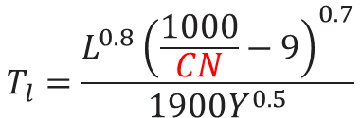
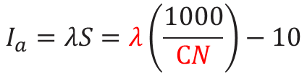
Post-Wildfire Application
$$I_{a}=λS=λ\left(\frac{1000}{CN}\right)−10$$
$$T_{l}=\frac{L^{0.8}{\left(\frac{1000}{CN}−9\right)}^{0.7}}{1900Y^{0.5}}$$
CN
*CN estimated based on land use/cover and hydrologic soil group

Slide 29
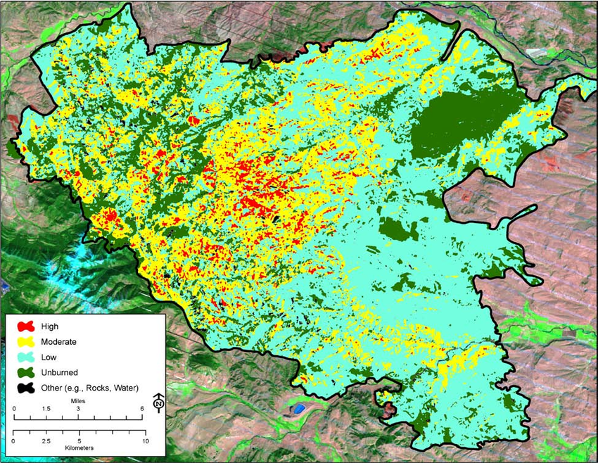
Post-Wildfire Application
Burn Severity | CN Adjustment
Unburned | Pre-fire CN + 0
Low | Pre-fire CN + 5
Moderate | Pre-fire CN + 10
High | Pre-fire CN + 15
Higginson and Jarnecke (2007)
*Adjust initial abstraction ratio (λ) based on antecedent conditions.

Slide 30
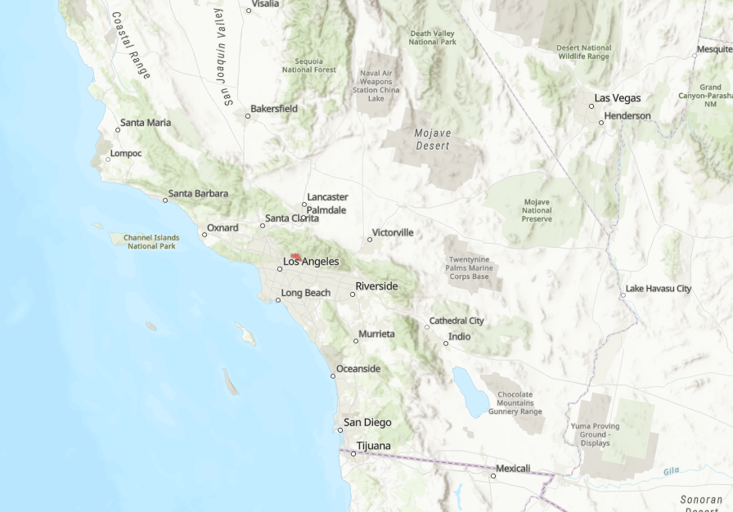
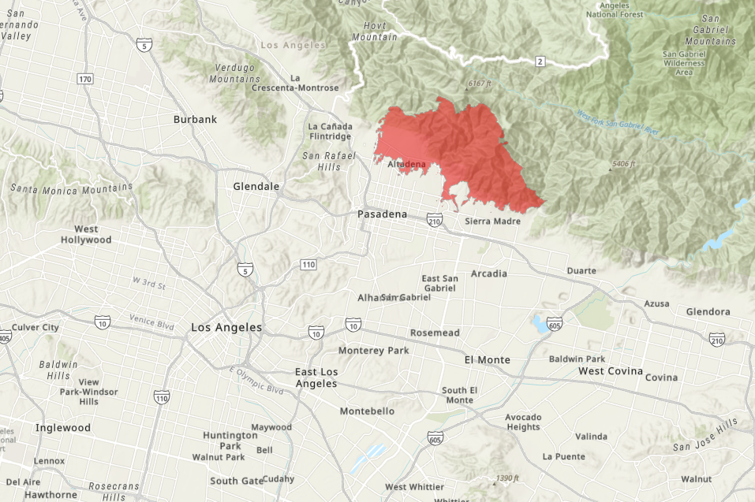




Case study – 2025 Eaton Fire
Eaton Fire
Los Angeles District | CA DWR | HEC | Albuquerque District
Tim Fairbank Michael Thompson Van Crisostomo Moosub Eom Nick Olsen Jackie Oehler Jose Paredez | Essayas Ayana Om Prakash | Jay Pak | Jonathan AuBuchon Lavonna Begay Adam Jones
Los Angeles District
Hydrologic Engineering Center
Albuquerque District

Slide 31
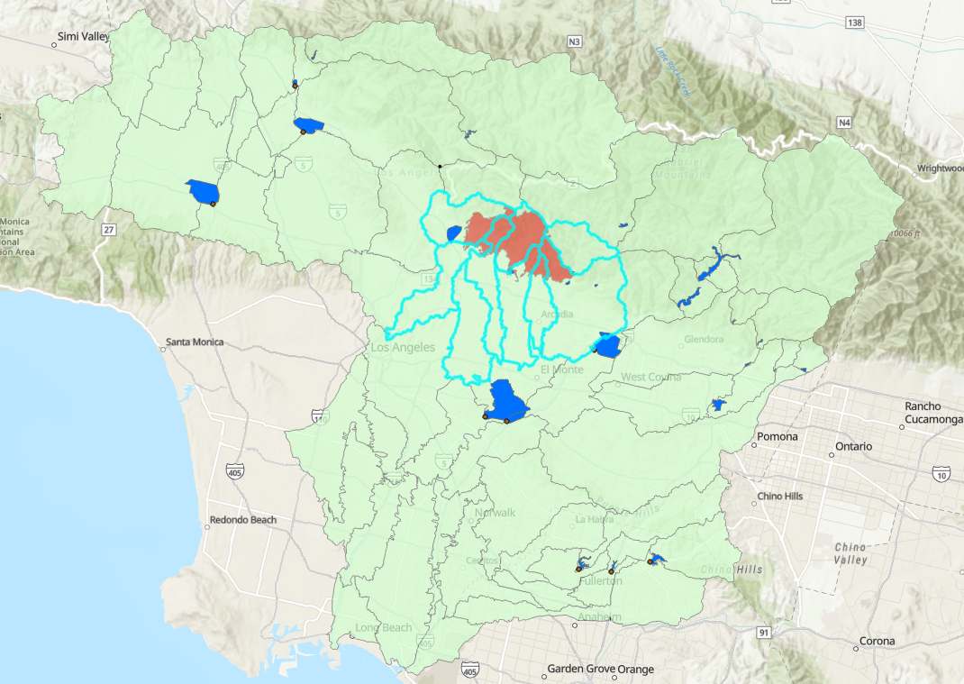
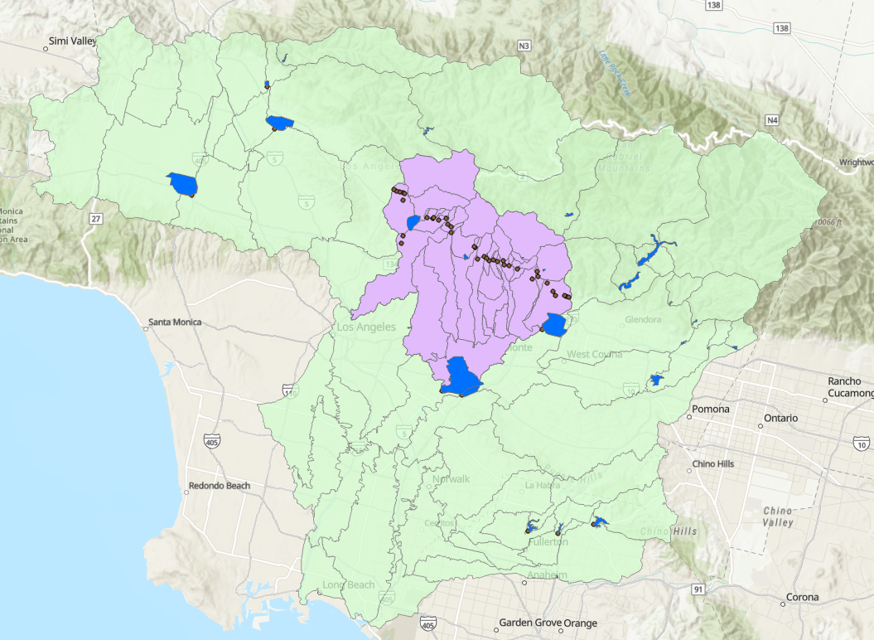
Background – CWMS Model
Sepulveda Dam
Eaton Fire
Sepulveda Dam
Santa Fe Dam
Santa Fe Dam
Whittier Narrows Dam
Whittier Narrows Dam

Slide 32
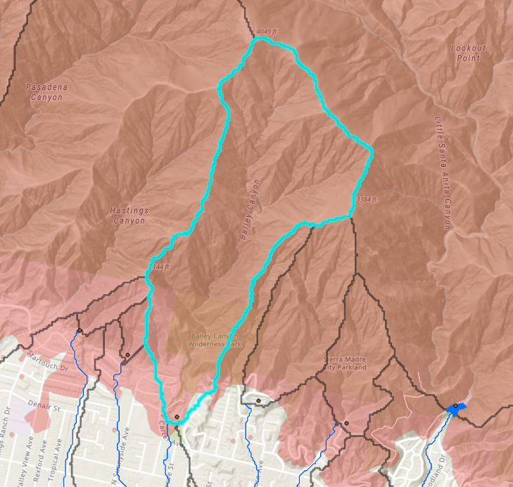
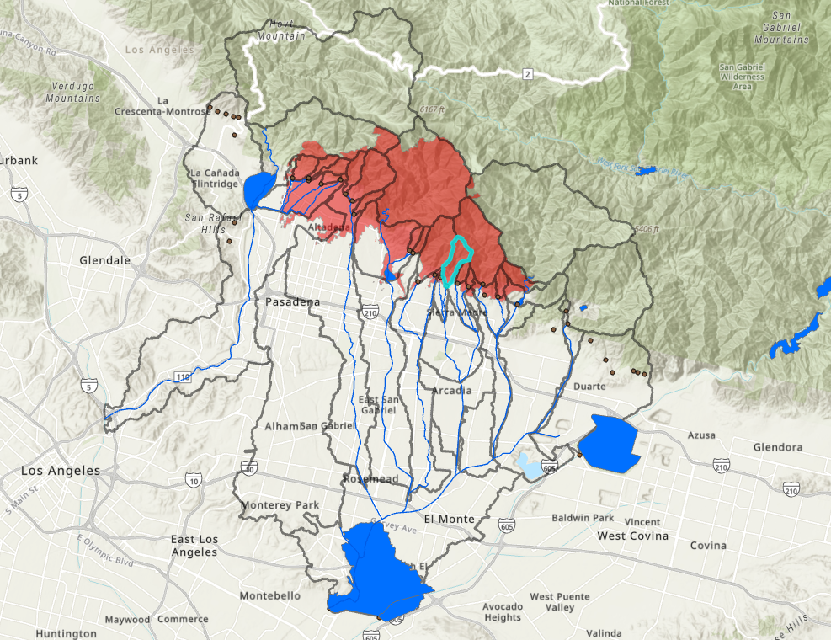
HEC-HMS Model
Bailey
Canyon
Eaton Fire
Santa Fe
Dam
Bailey Canyon
Bailey Debris Basin
Whittier Narrows
Dam

Slide 33
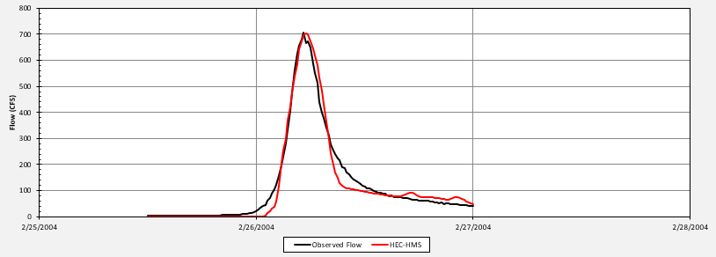
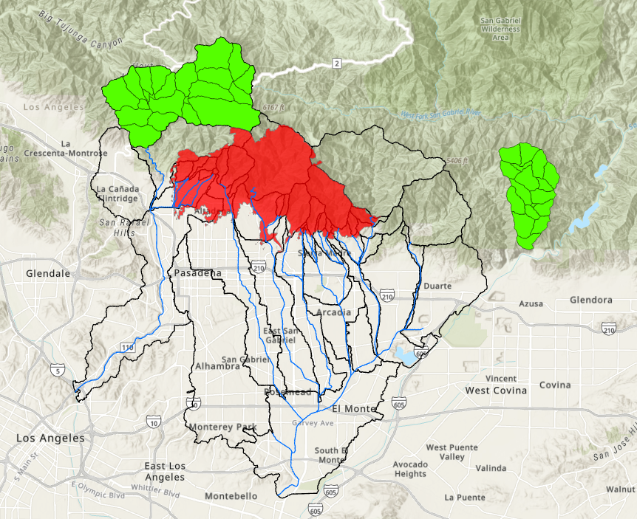
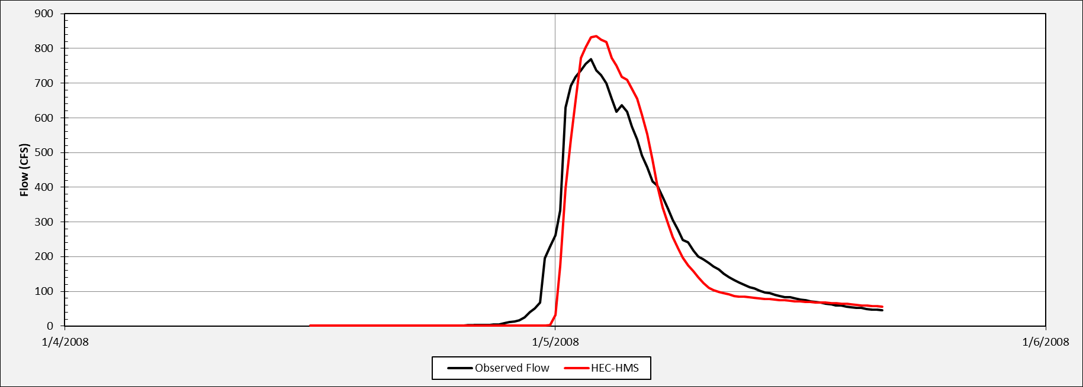
Pre-Fire Model “Calibration”
Arroyo Seco
Roberts Canyon
Eaton Fire
Whittier Narrows
Dam

Slide 34



Pre-Fire Model “Calibration”
65
52
86
Curve Number
69
Bailey
Canyon
Bailey
Canyon
69
68
86
85
85
68
69
86
69
86
Initial Curve Number Estimates
Adjusted Curve Number Estimates*
(Pre-Fire Curve Number)
*Based on similar watersheds (Arroyo Seco & Roberts Canyon)

Slide 35


Post-Wildfire Estimates
Burn Severity | CN Adjustment
Unburned | Pre-fire CN + 0
Low | Pre-fire CN + 5
Moderate | Pre-fire CN + 10
High | Pre-fire CN + 15
+9.1
Bailey
Canyon
+9
+9.4
+8.6
Higginson and Jarnecke (2007)
+9.5
+9.2
+9.6

Slide 36

Post-Wildfire Estimates
78.1
61
+9.1
Bailey
Canyon
Bailey
Canyon
+9
76.6
+9.4
78.4
+8.6
+9.5
+9.2
77.5
78.2
+9.6
78.6
Bailey Canyon = 68 + 9.5 = 77.5

Slide 37

Validation – February 13, 2025, Event

Slide 38

Green & Ampt Method
Initial Storage Method
  Initial Content
  Initial Deficit
Capillarity Parameter
  Wetting Front Suction (Suction)
  Sorptivity
Saturated Hydraulic Conductivity (Conductivity)
Impervious (%)

Slide 39

Surface Texture Data
Surface texture data was downloaded from the NRCS Web Soil Survey.
Bailey subbasin consists of:
  Loam
  Very Gravelly Loam
  Sandy Loam
  Gravelly Loam
Bailey
Subbasin

Slide 40

Green & Ampt Parameters
Table is from the ADOT Highway Drainage Design Manual (2014)
An area weighted average for each parameter was computed.
 | Conductivity (IN/HR) | Suction (IN)
Initial Parameters | 0.2 | 8.12

Slide 41

Pre-Fire Calibration
Observed data was not available to calibrate the model.
Arroyo Seco model ratios were applied to the Bailey subbasin initial parameters.
 | Conductivity (IN/HR) | Suction (IN) | Initial Deficit
Calibrated Pre-Fire Parameters | 0.18 | 8.73 | 0.02

Slide 42
Post-Wildfire Estimates

Slide 43
Post-Wildfire Estimates
Bailey_Sub Parameters
 | Conductivity (IN/HR) | Suction (IN) | Initial Deficit | % Burned
Post-Fire Min | 0.34 | 0.26 | 0.12 | 99.5
Post-Fire Median | 0.16 | 0.63 | 0.07 | 99.5
Post-Fire Max | 0.03 | 157.00 | 0.001 | 99.5

Slide 44
Burn Severity
Green & Ampt post-fire method does not take burn severity into consideration.
However, we expect areas with high burn severity to be closer to the maximum scenario and areas with low burn severity to be closer to the minimum scenario.
Bailey
Subbasin

Slide 45

Validation - February 13, 2025 Event (Min)

Slide 46

Validation - February 13, 2025 Event (Med)

Slide 47

Validation - February 13, 2025 Event (MAX)

Slide 48

Comparison of Results

Slide 49

Questions & Feedback
!
Thank You!
Funding Sources:
Code Development: Post-Wildfire Hydrology R&D Program (CHL)
Walnut Gulch Rainfall Simulator Calibration & Guidance Table: GI Fund (HQ) & Innovation Fund (HEC)
Acknowledgments: Rose Shillito (CHL), Markus Berli (DRI), David Ho (HEC), Jose Paredez (SPL), Moosub Eom (SPL), Jonathan AuBuchon (SPA), Jackie Oehler (SPL)

