Slide 1
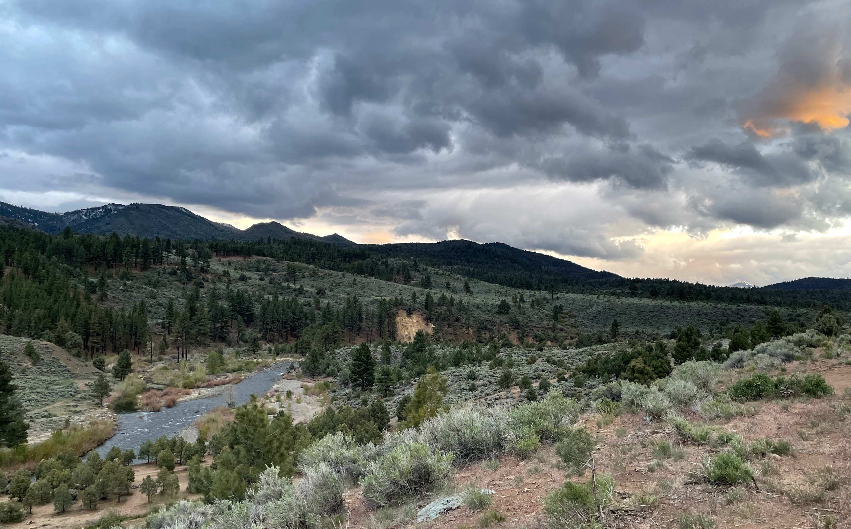
HEC-hms quarterly webinar
Thomas Brauer, P.E.
Josh Willis
Hydrologic Engineering Center
Notes:
Hi, this is Tom Brauer from the Hydrologic Engineering Center. This is the first video in a series of videos where I’m going to build a basic HEC-HMS model. In this video I’m going to create a new project, and build a basin model. As we go through the process you should gain familiarity with HEC-HMS project components.

Slide 2
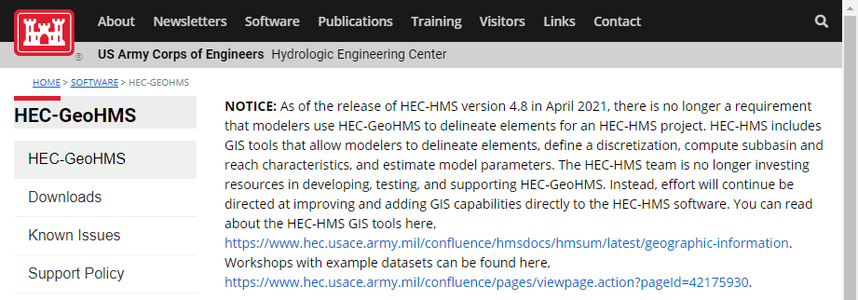
HEC-Geohms is no longer supported

Slide 3
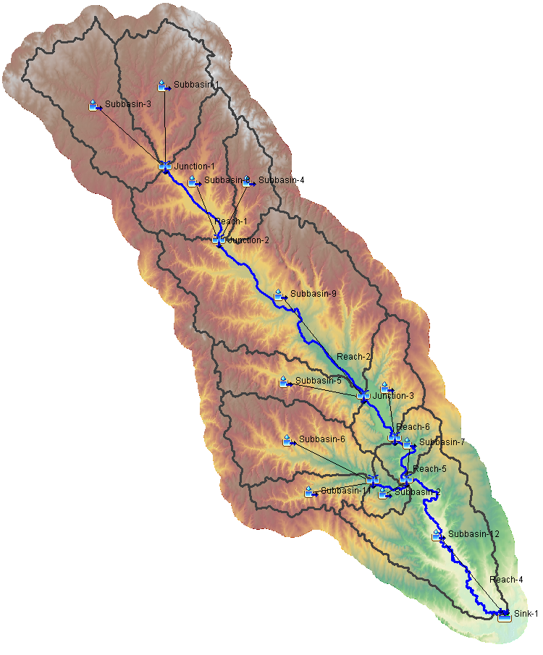
Basin delineation
Create a new Project
Import terrain
Create a new Basin model and link terrain
Run terrain processes from GIS menu
Import breakpoints
Delineate elements
Specify and compute discretization
Notes:
Here are the list of steps that we will take to create our basin model.

Slide 4
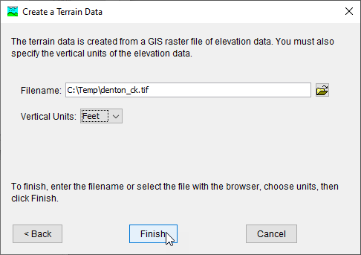
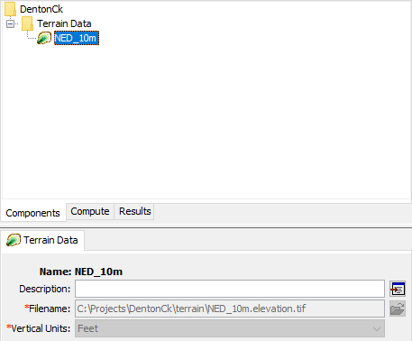
Create and import terrain data
Notes:
Components, Terrain Data Manager, New…
Name the terrain NED_10m
Select terrain GeoTIFF file
Specify vertical units Feet

Slide 5
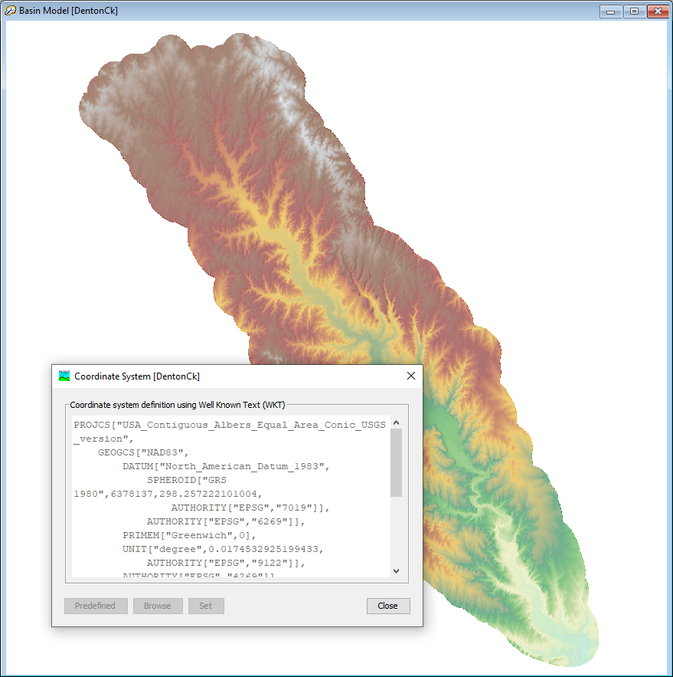
CREATE BASIN Model, link terrain
Notes:
Components, Basin Model Manager, New…
Name the basin model DentonCk
In the basin model component editor, select NED_10m terrain data
Click Save
When prompted for Basin Model Coordinate System, select Skip
Basin model adopts the coordinate system of the terrain

Slide 6
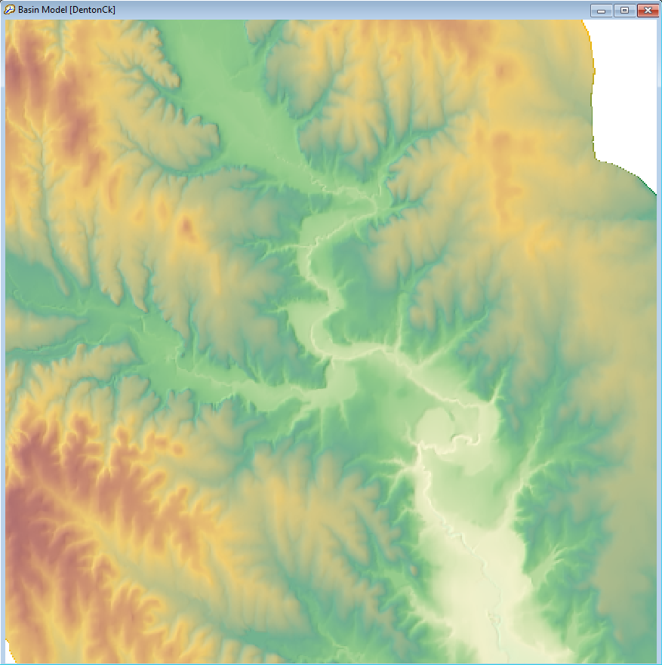
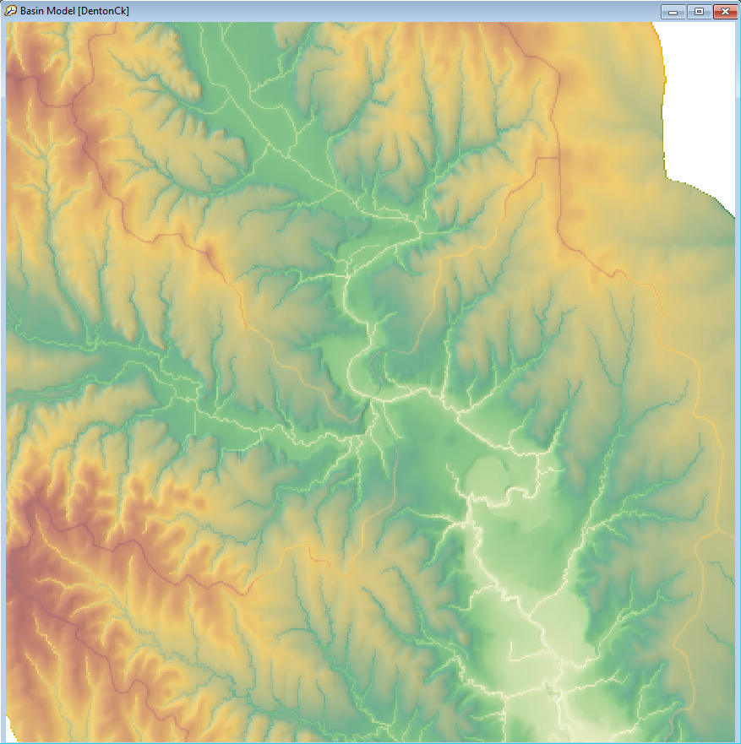
Recondition Terrain
Notes:
GIS | Terrain Reconditioning…
For build walls select HUC 12 Layer, Smooth raise cell buffer: 1, Smooth raise height: 20, Sharp raise height: 10
For burn streams select NHD flowlines layer, Smooth drop cell buffer: 3, Smooth drop height: 10, Sharp drop height: 25
Terrain reconditioning is not always neccesary. It is most effective when:
Delineating a flat topography
Using very coarse terrain data

Slide 7
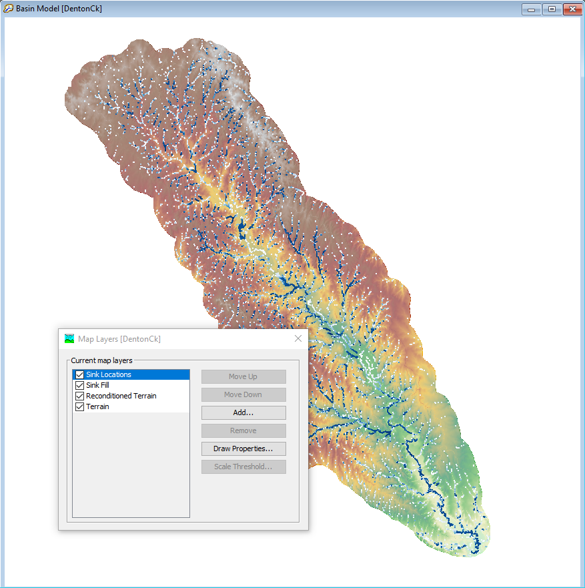
Preprocess sinks
Notes:
GIS | Preprocess sinks
Sink Locations and Sink Fill rasters created

Slide 8
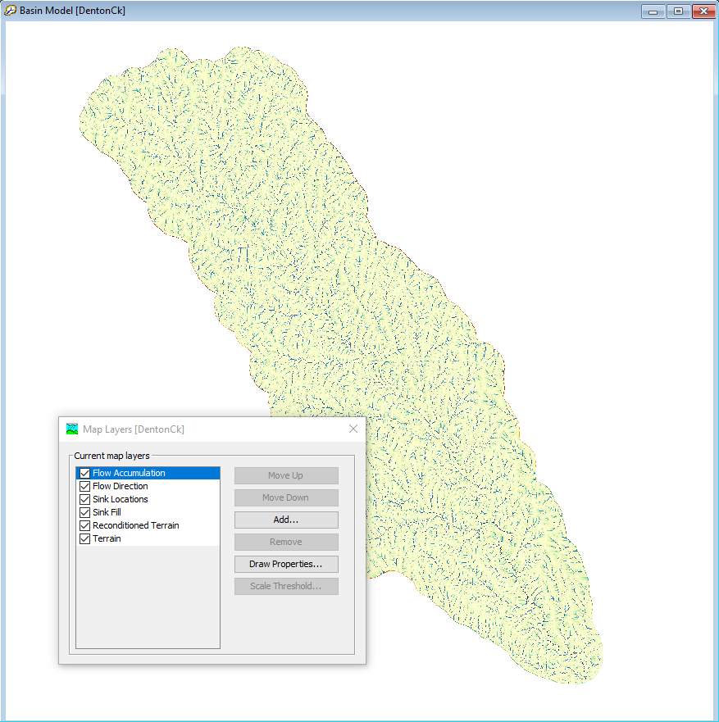
Preprocess drainage
Notes:
GIS | Preprocess drainage
Flow direction and Flow accumulation rasters created

Slide 9
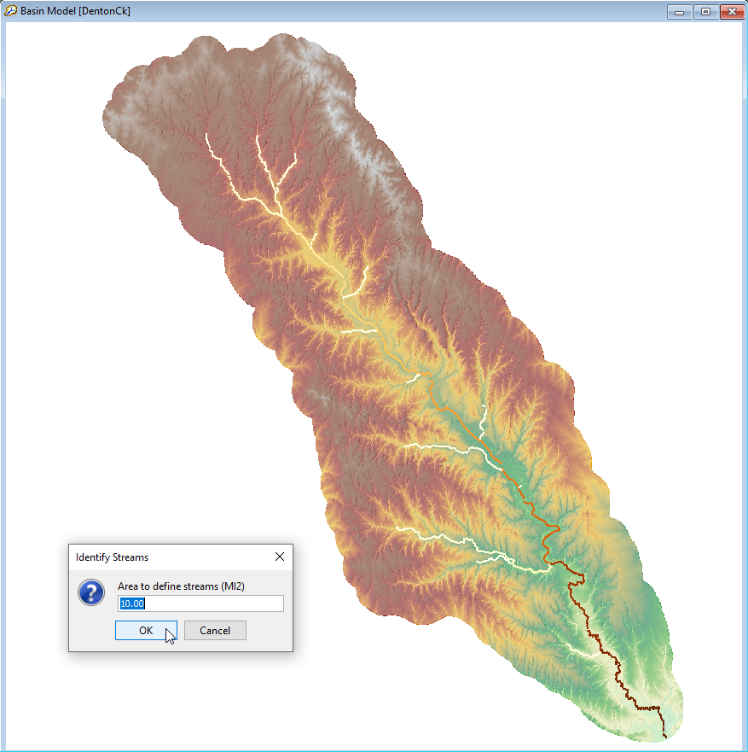
Identify streams
Notes:
GIS | Identify Streams
Area to define streams: 10 sq. mi.
This parameter is compared to the value in the flow accumulation grid to determine if the cell should be considered a stream cell. Streams are identified as grid cells for which flow accumulation grid value is >= this threshold.

Slide 10
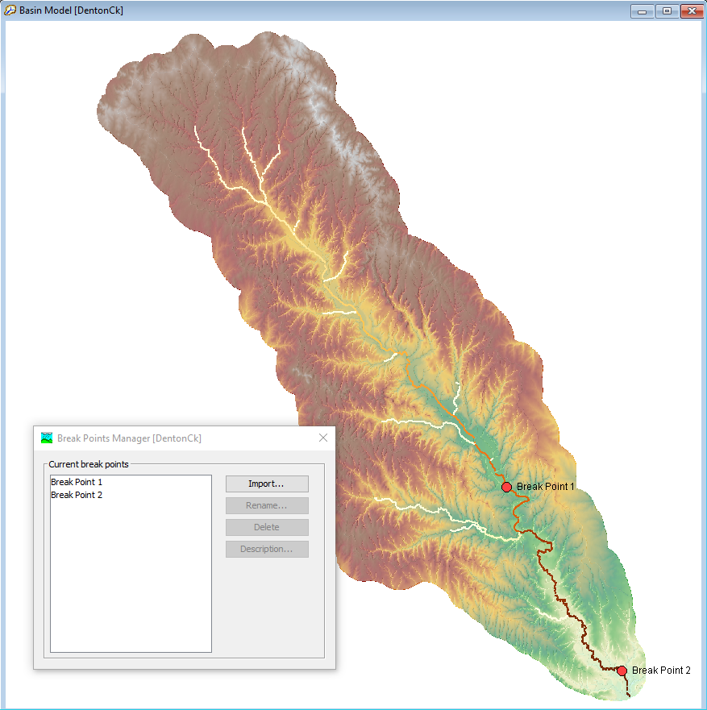
Import breakpoints
Notes:
GIS | Breakpoint Manager, Import…
Select stream gages shapefile

Slide 11
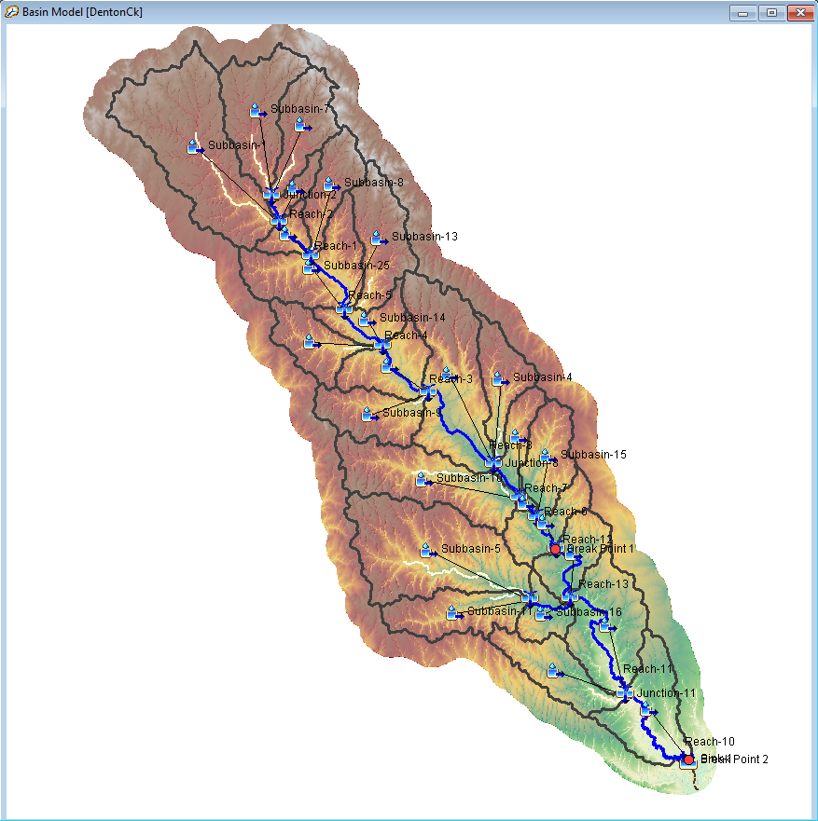
Delineate elements
Notes:
GIS | Delineate Elements
The resolution of the subbaisn delineation is a function of the threshold value that was used to identify streams.

Slide 12
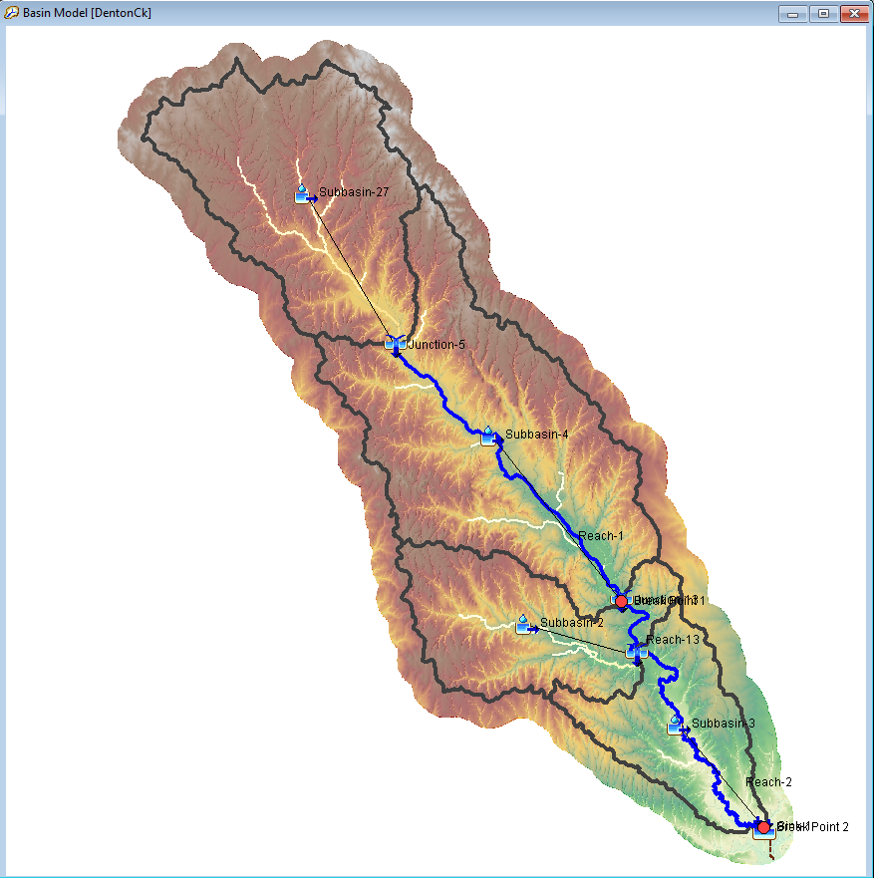
MERGE elements
Notes:
Select multiple elements, GIS |Merge

Slide 13
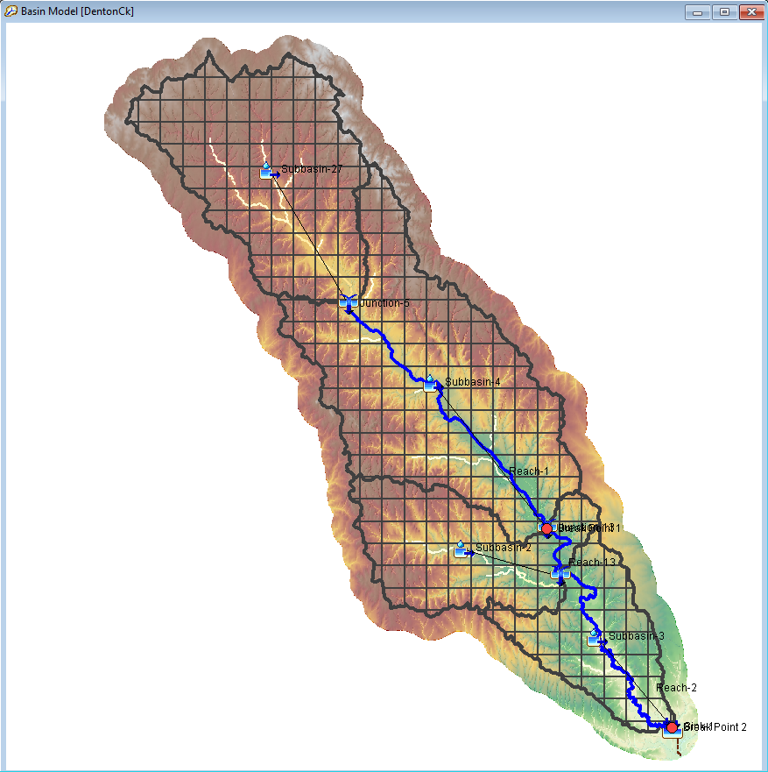
Specify and compute discretization
Notes:
Parameters | Discretization, Change Method…
Select Structured
GIS | Compute Grid Cells
Turn on Discretization Layer

Slide 14
KEY points
HEC-GeoHMS is no longer supported, use HEC-HMS
High-resolution terrain data is a common pitfall - use the minimum terrain data resolution neccesary to meet project goals
The new import breakpoints option snaps breakpoints to the nearest location on the stream
The new two-to-many merge elements capability makes merging elements faster

Slide 15
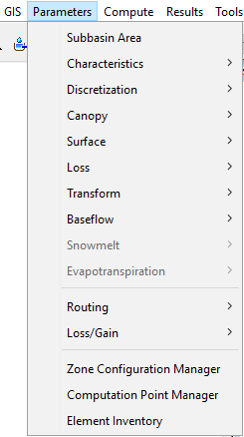
parameterization
Subbasin/Reach characteristics
Initialize canopy
Initialize losses
Initialize transform
Initialize baseflow
Initialize routing reaches
Notes:
Now that Tom built a basin model using the GIS menu workflow, we can parameterize our model.
These are the six steps we will perform to completely populate our model with initial parameter estimates, starting with subbasin and reach characteristics.

Slide 16
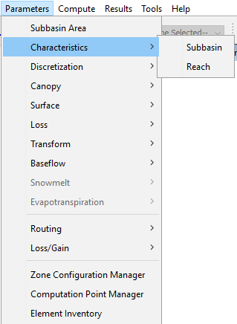
Parameterization
1. Subbasin/Reach characteristics
  Basin model must have geo-referenced elements
  Pre-process drainage must have been computed
  Recommended to also pre-process sinks
Notes:
Prior to computing characteristics, there are a few pre-requisite steps listed here that need to be completed.
Your basin model must have geo-referenced subbasins and reaches as well as flow direction and flow accumulation rasters which are created during the GIS | Pre-process drainage step.
I would also highly recommend that the GIS | Pre-process sinks step is completed before computing characteristics.
If not, many of the characteristics values will be based on the distances between sinks instead of the distance between the most hydraulically remote point and the subbasin outlet.

Slide 17
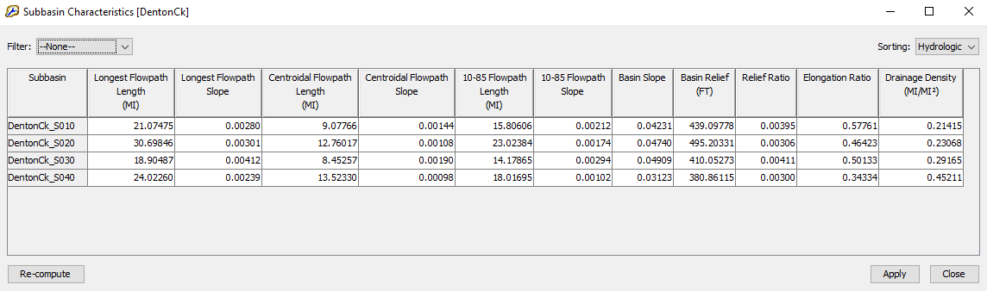
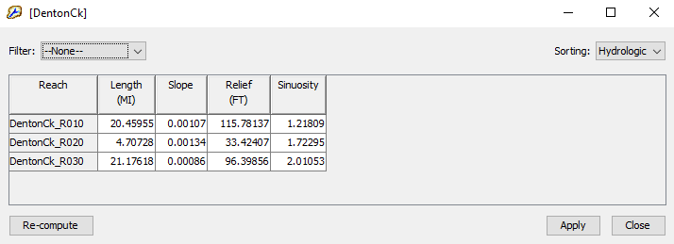
Parameterization
1. Subbasin/Reach characteristics
Notes:
The first time that the Parameters | Characteristics | Subbasin or Reach menu is accessed, the characteristics are automatically computed on the fly.
If at any time you decide to go back to the GIS menu, to re-delineate your basin elements for example, subbasin characteristics can be re-computed based on the new information by clicking Re-compute.
We have included about a dozen of the most seen subbasin characteristics in literature, but if there is a characteristic that your District uses that you would like to be in HEC-HMS, please let us know.

Slide 18
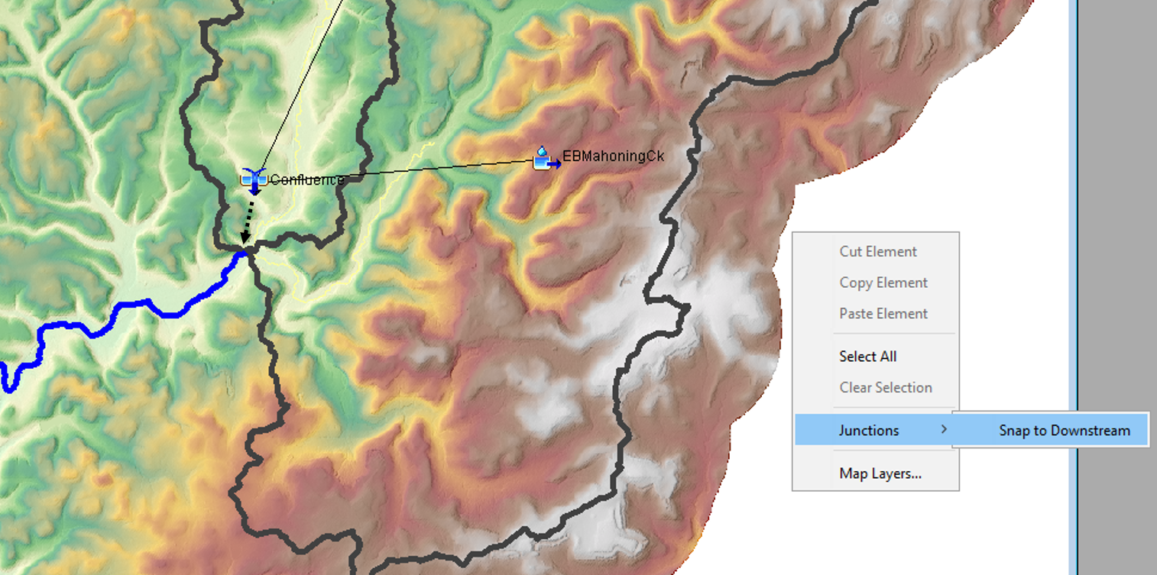
Exporting basin layers
Junctions → Snap to Downstream
Notes:
Prior to exporting the junction layer, it is a good idea to perform a right click | Junctions | Snap to Downstream which will move any displaced junctions to the nearest end of their downstream reach.

Slide 19
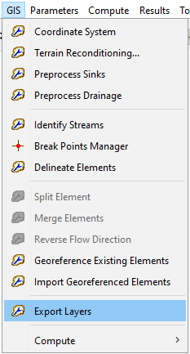
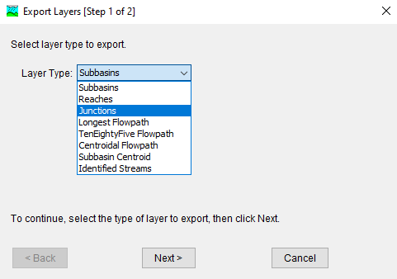
Exporting basin layers
GIS | Export Layers
Notes:
GIS | Export layers allows you to export shapefiles from HEC-HMS for use in external GIS software.

Slide 20
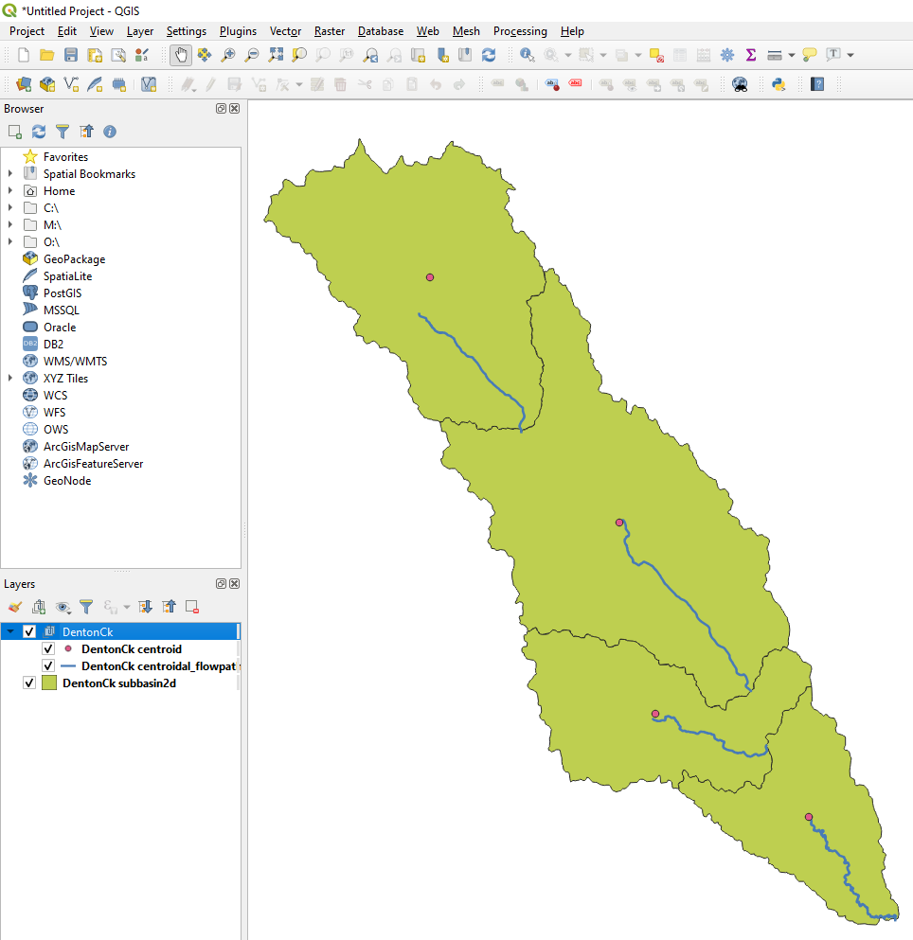
Exporting basin layers
The basin .sqlite file houses a lot of the geo-spatial information for a given basin model
Notes:
The subbasin and reach delineations, along with the characteristic flowpaths are stored in the basin sqlite file. The geospatial data in this file can easily be viewed by dragging and dropping the sqlite file into QGIS.

Slide 21
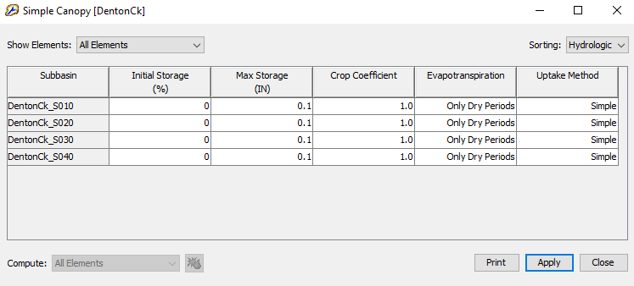
Parameterization
2. Initialize Canopy
  Allows for extraction of water from the soil
Notes:
Here we parameterize a canopy method. Even though the Max Storage parameters are set to 0.1 inches, which is essentially nothing, this simple canopy model will allow us to extract water from the soil.

Slide 22
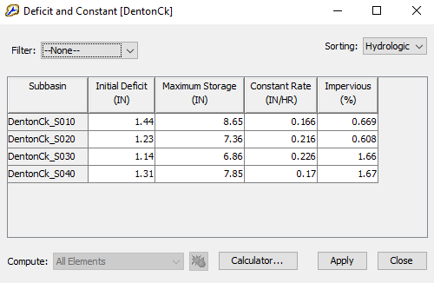
Parameterization
3. Initialize Losses
  Some global editor windows now have a Calculator… button
  This button launches an Expression Calculator that accesses previously imported grids and previously computed characteristics
Notes:
Next up, let’s parameterize losses. Notice how this global editor for Deficit and Constant Loss has a Calculator… button at the bottom of the window. Clicking that will allows us to use the new Expression Calculator tool to populate our loss parameters.

Slide 23
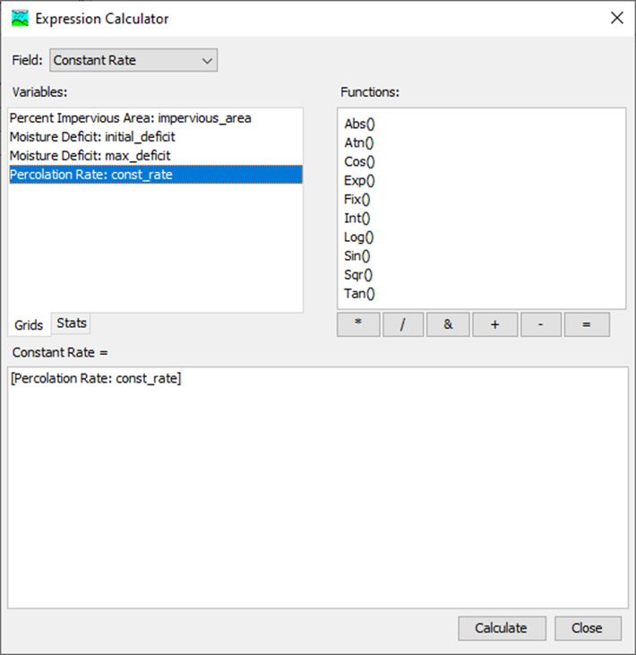
Parameterization
3. Initialize Losses
  The Expression Calculator is a tool that can be used to quickly populate your HEC-HMS model parameters with initial estimates
Notes:
The expression calculator can access two types of data: 1) previously computed characteristics and 2) previously imported grids.
In this example, when you hit calculate, the constant rate grid values that fall within each subbasin discretization will be averaged and populated in the global editor.

Slide 24
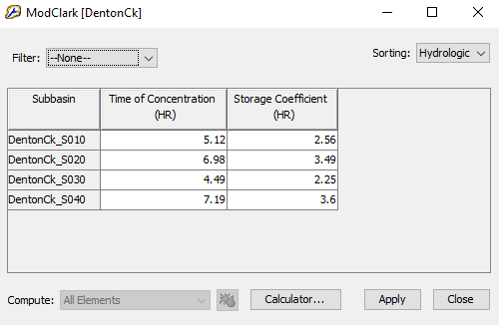
Parameterization
4. Initialize Transform
  When launched from the ModClark global parameter window, the Expression Calculator can access subbasin characteristics to quickly populate TC and R values
Notes:
The ModClark global editor can also access the Expression Calculator to populate the table with initial parameter estimates.
1.1*pow([Longest Flowpath Length (MI)] * [Centroidal Flowpath Length (MI)] / pow([10-85 Flowpath Slope (FT/MI)], 0.5),0.38)

Slide 25
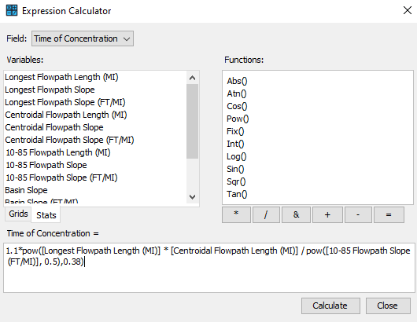
Parameterization
4. Initialize Transform
Notes:
In this example, a regression equation for Time of Concentration has been entered that uses several subbasin characteristics values (Longest Flowpath Length, Centroidal Flowpath Length, and 10-85 Flowpath Slope).
Similarly, the Field: dropdown menu at the top of the expression calculator can be changed from Time of Concentration to Storage to calculate and populate that parameter.
1.1*pow([Longest Flowpath Length (MI)] * [Centroidal Flowpath Length (MI)] / pow([10-85 Flowpath Slope (FT/MI)], 0.5),0.38)

Slide 26
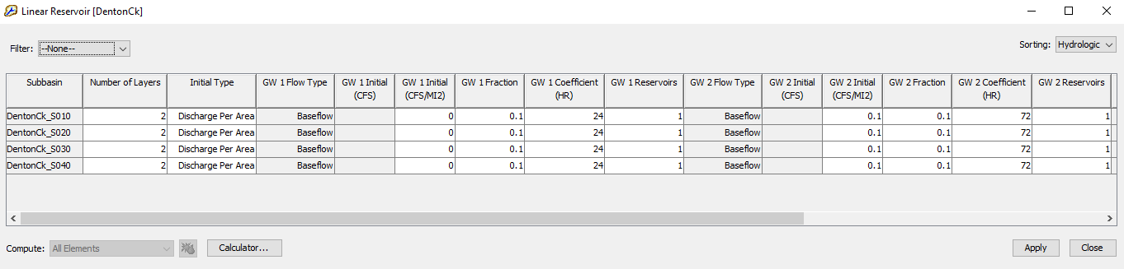
Parameterization
5. Initialize Baseflow
Notes:
For baseflow, this Denton Creek model will use Linear Reservoir, which is often a good baseflow method to use because it is the only one that conserves volume.
The Linear Reservoir global editor can also access the expression calculator, but for this example we will quickly populate some values.

Slide 27
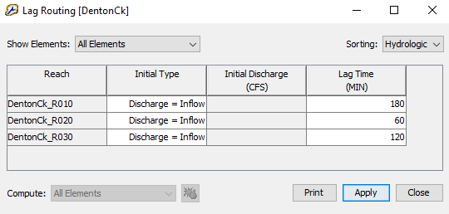
Parameterization
6. Initialize Routing
Notes:
Lastly, let’s parameterize our Routing reaches using a simple Lag method. Lag routing is the simplest routing method in HEC-HMS and does not account for any attenuation from upstream to downstream.
For most models, you will likely want to use a better routing method such as Muskingum-Cunge or Mod-puls.
As of HEC-HMS v4.8, none of the routing global editors are set up to access reach characteristics. In the near future, we will have this functionality in place.

Slide 28
Key points
Global editors can be quickly populated with initial parameter estimates via the Expression Calculator
The expression calculator can access two sources of data
  Characteristics
  Parameter Grids
GIS | Export Layers can be used to export various geospatial features from HEC-HMS
The basin sqlite file also stores geospatial features and can be viewed in external GIS software

Slide 29
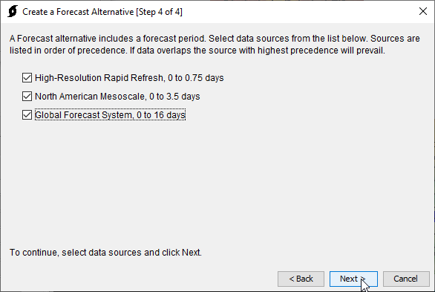
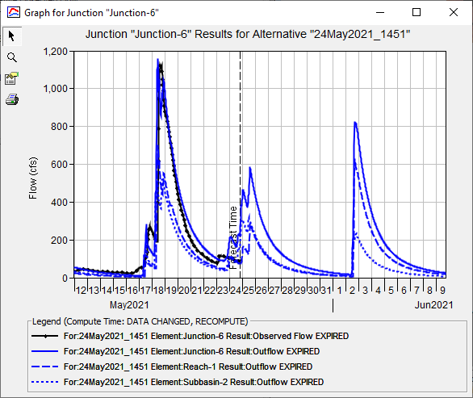
Automated forecast
Notes:
Compute | Forecast Alternative Manager, Auto
Select default name
Select DentonCk basin model
Select 14-day lookback period
Select RTMA look back data
Select HRRR, NAM, GFS forecast data

Slide 30
Key points
Automated forecast pulls in data for look back period and forecast period
Data is layered in an order of precedence
Currently only CONUS data sources are implemented
Basin model must use continuous simulation methods

Slide 31
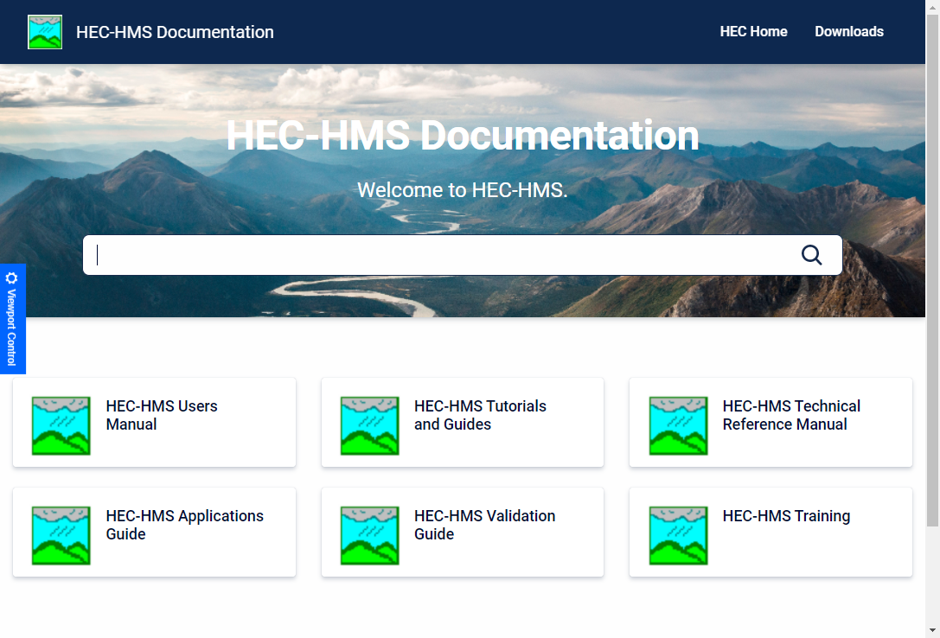
questions
Docs: https://www.hec.usace.army.mil/confluence/hmsdocs
Videos: https://www.youtube.com/channel/UCwZPbGxI5IzjwhYtHUMSh4g/videos

