Slide 1
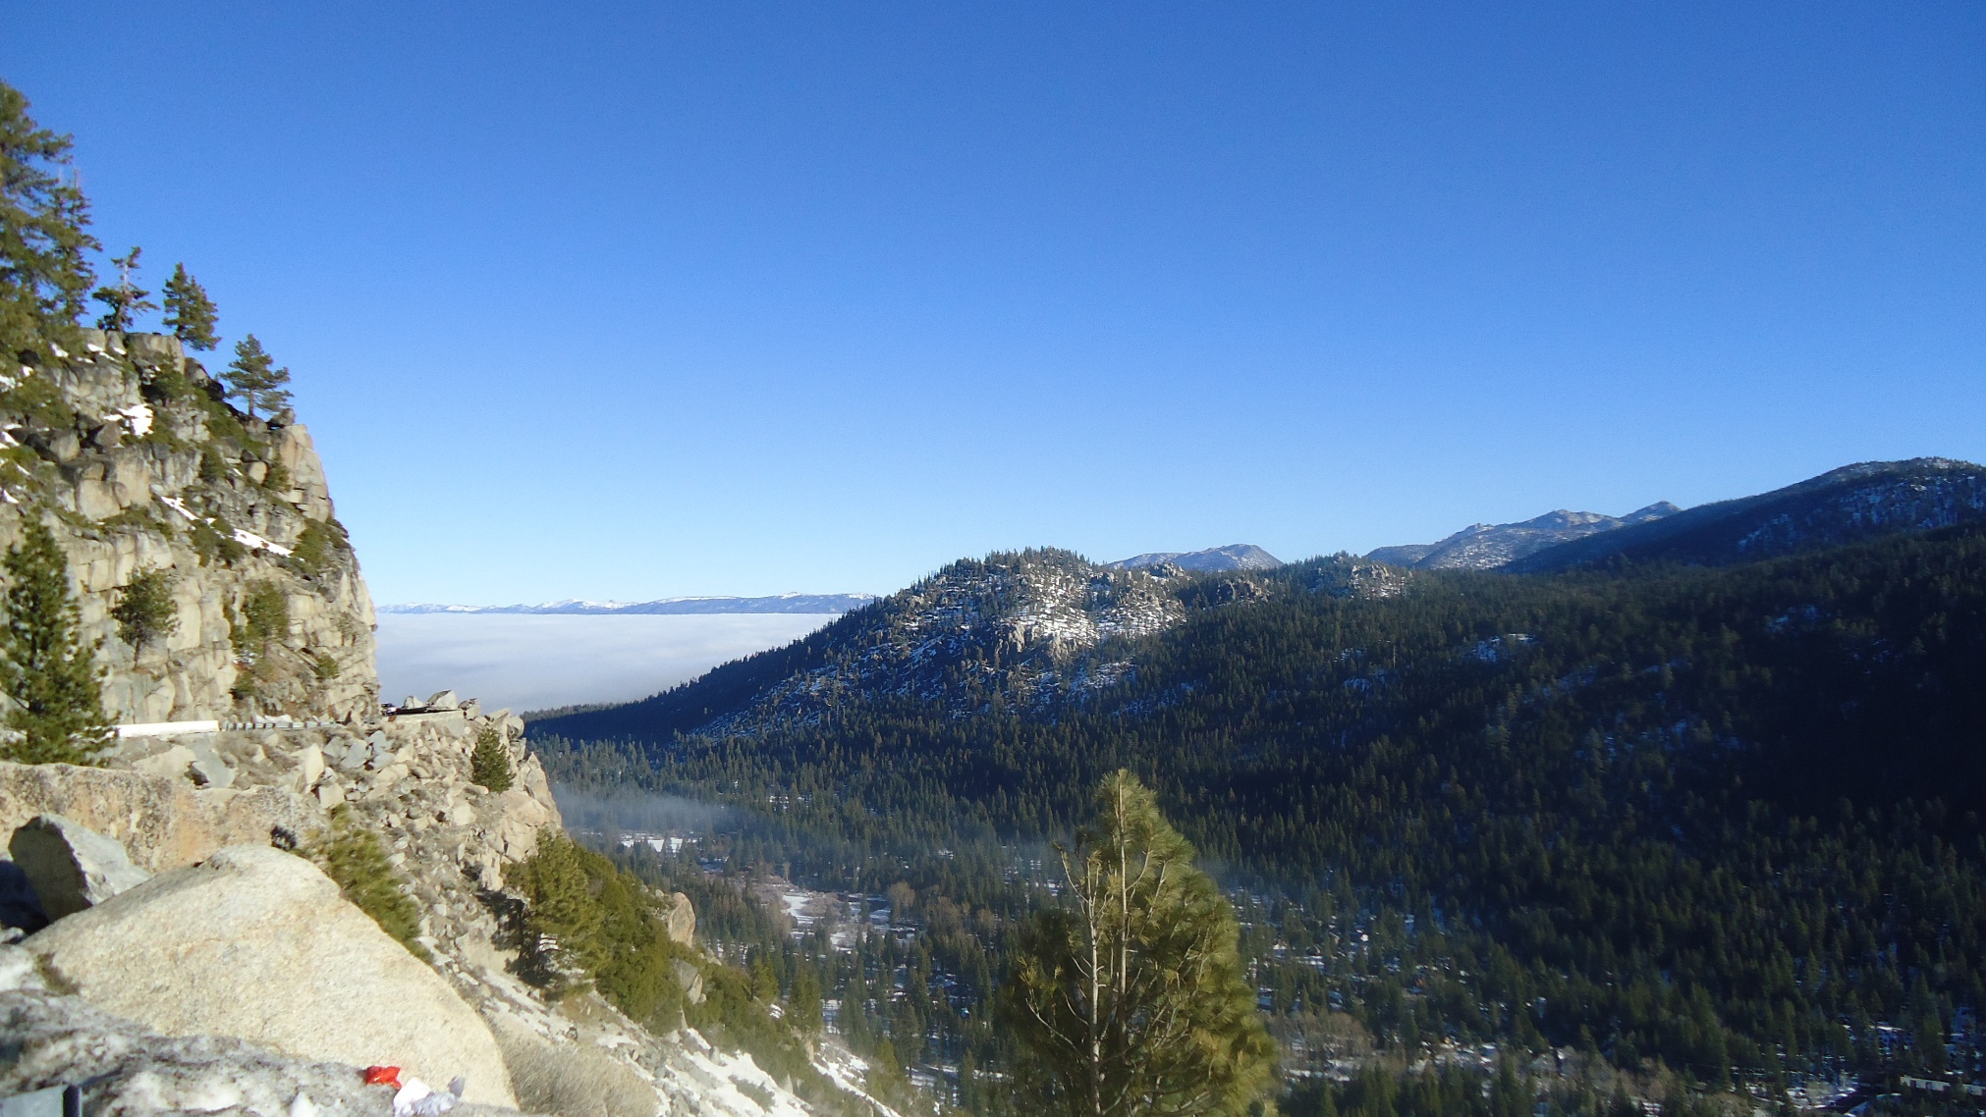
HEC-HMS Quarterly Webinar
2D Flow and Sediment
Mike Bartles, P.E.
Jay Pak, PhD, P.E.
Hydrologic Engineering Center

Slide 2
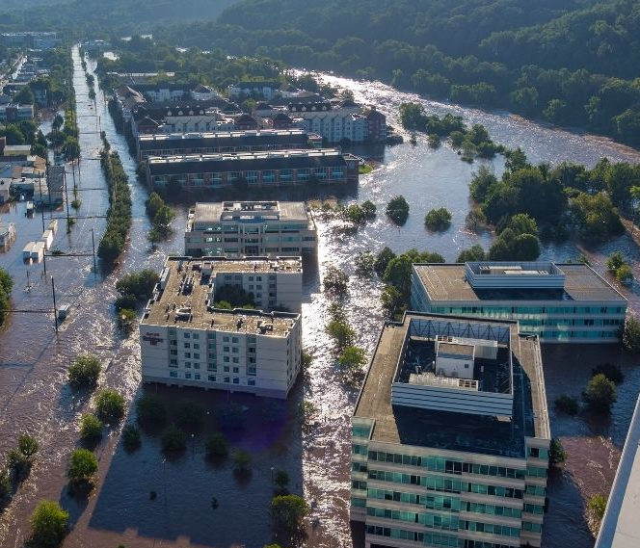
Overview
Objectives
Technical background
Significance of these features
Demo
Tech transfer
Next steps
Questions
400FootViews
https://www.youtube.com/watch?v=0tdCPitAwLg
Notes:
Within this presentation:
Discuss why we added the 2D flow and sediment transport capabilities to HEC-HMS
Go over some of the technical background and significance of these features
Then, we’ll demo these new capabilities within the software
We’ll finish with tech transfer documentation, discussion of our next steps and planned future improvements, and take questions
I’ll be presenting 2D flow while Jay Pak will be presenting 2D sediment. I’ll go first and Jay will go second. After Jay, we’ll switch to Nick Van for a quick demo of these features within MacOS.
Image is the Schuylkill River flooding in Conshohocken, PA on Sept 2, 2021
Remnants of Tropical Storm Ida

Slide 3
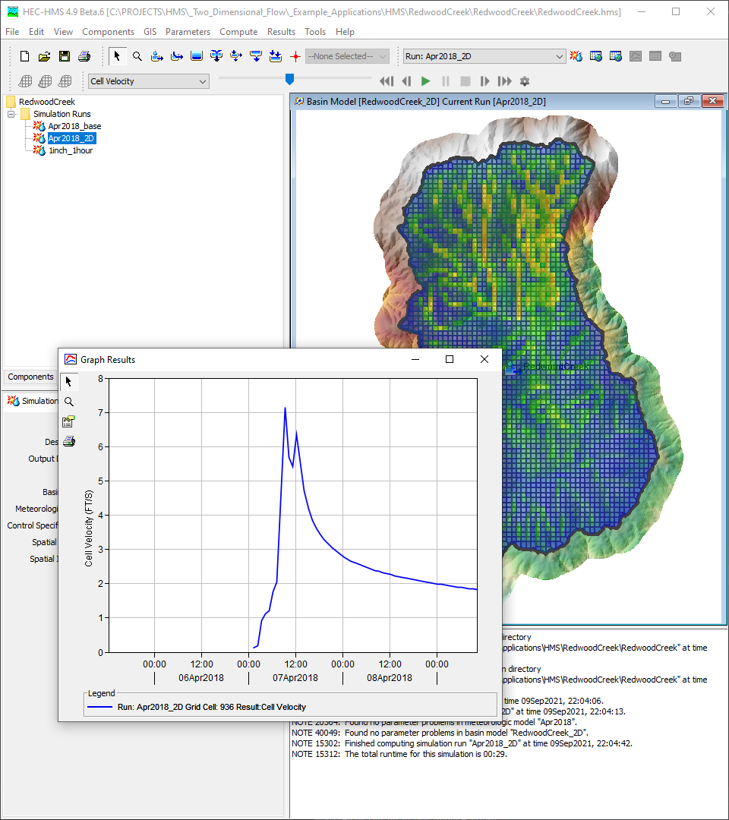
Objectives
Leverage HEC’s 2D solver to add 2D flow and sediment transport capabilities to HEC-HMS
Shared computational engine between HEC-HMS and HEC-RAS
Release 2D capabilities for multiple platforms
3
Notes:
We set out to implement the 2D solver that was pioneered by the HEC-RAS team within HEC-HMS as part of a USACE R&D project
This would expose the 2D solver to a new array of hydrologic applications
As improvements are made to the solver, both teams benefit and the solver becomes more robust
We also set out to release the 2D flow and sediment transport capabilities to a wide range of platforms including Windows, MacOS, and Linux. Nick Van will show a quick demo at the end of these capabilities within MacOS.

Slide 4
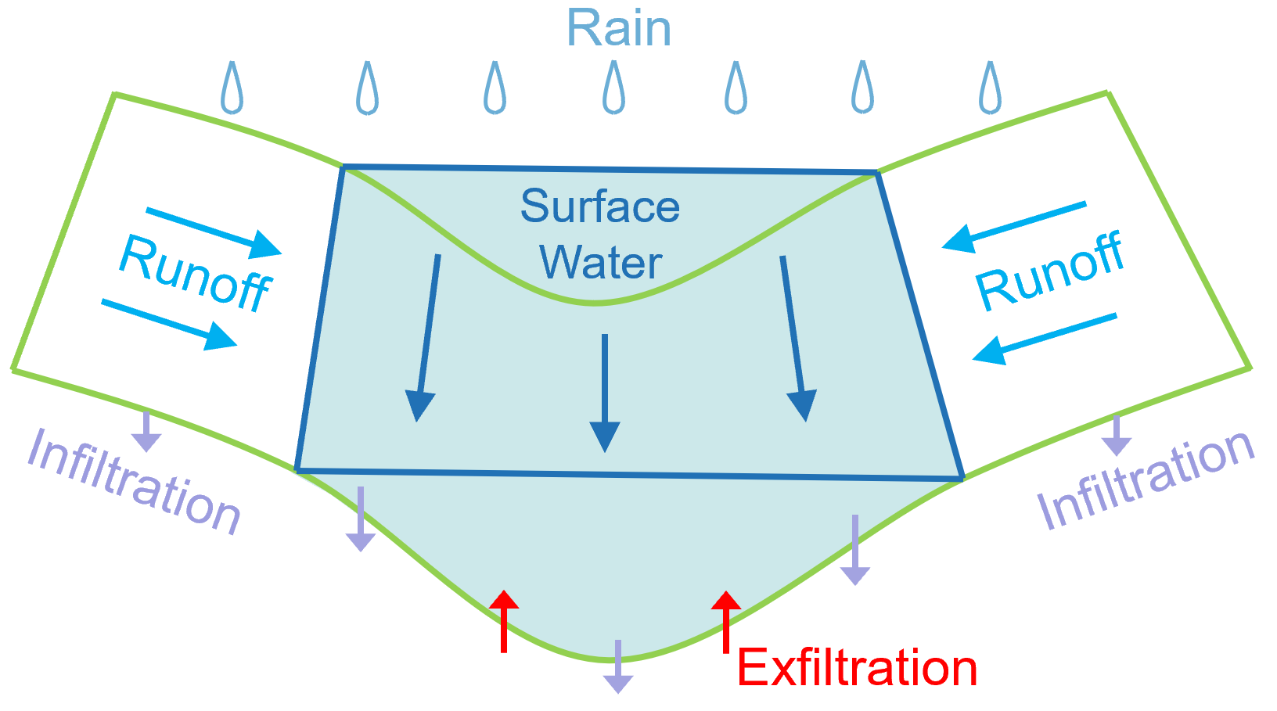
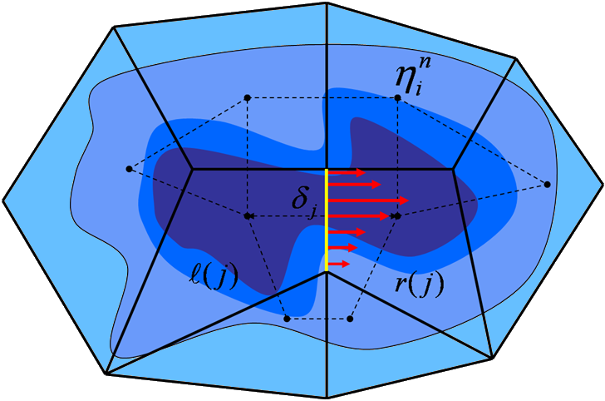
2D Flow Features
2D Diffusion Wave Equation
Full Momentum not yet available
Fixed or Courant-based Adaptive Time Step
Algorithm slightly different from HEC-RAS
Infiltration
Separate calculations for hydraulically wet and dry portions of each cell
Additional infiltration methods available
HEC-RAS computes single infiltration rate per cell and ignores local water depths
Canopy and Surface Depression Storage
Baseflow
Linear Reservoir method can allow infiltrated water to return to the surface
Notes:
This slide highlights the major differences between the 2D flow capabilities within HEC-RAS and HEC-HMS

Slide 5
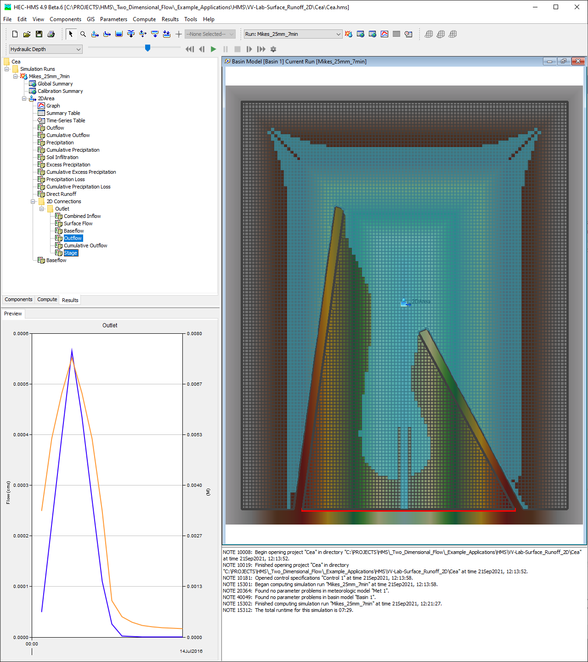
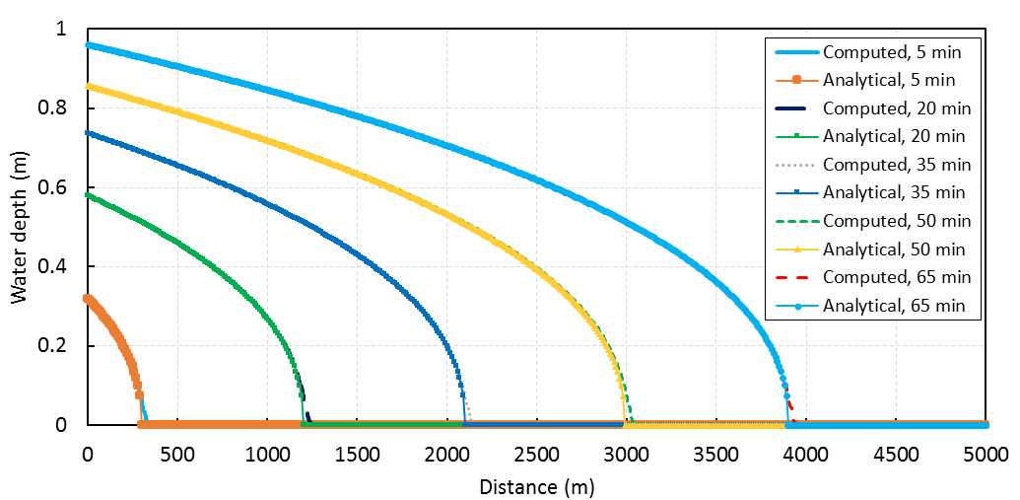
2D Flow V&V
Analytical Flood Wave (Hunter, 2005)
2D Surface Runoff (Cea et al, 2008)
Notes:
The 2D flow engine within HEC-HMS was verified using several published data sets include Hunter (2005) and Cea (2008)

Slide 6
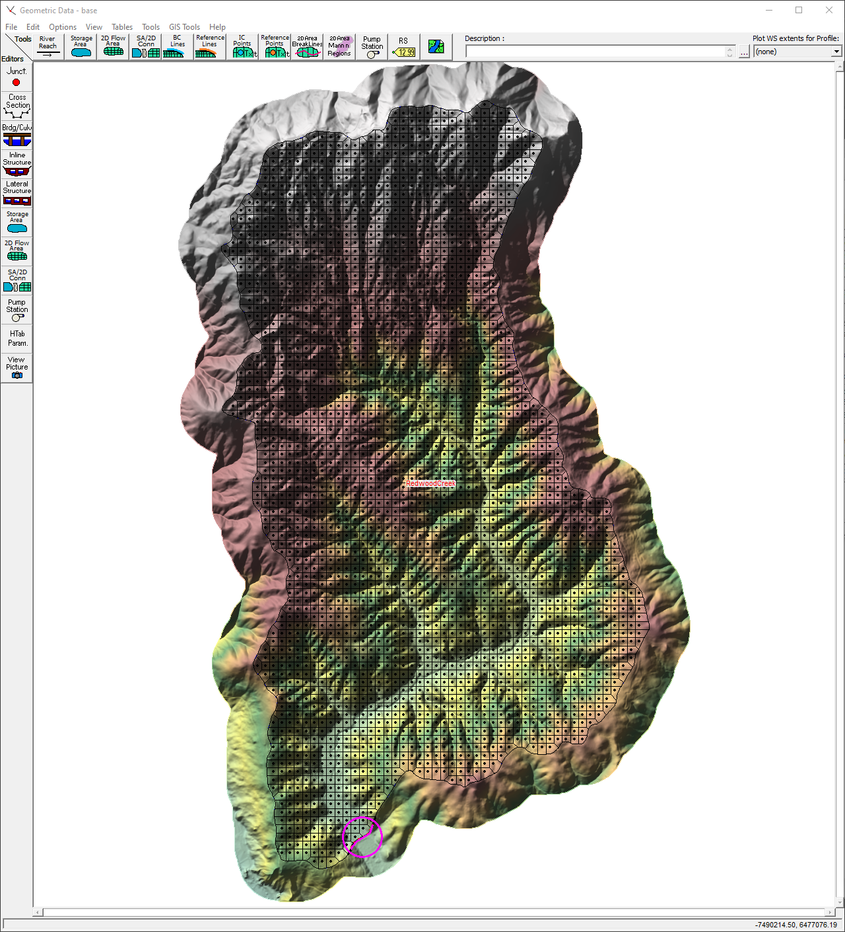
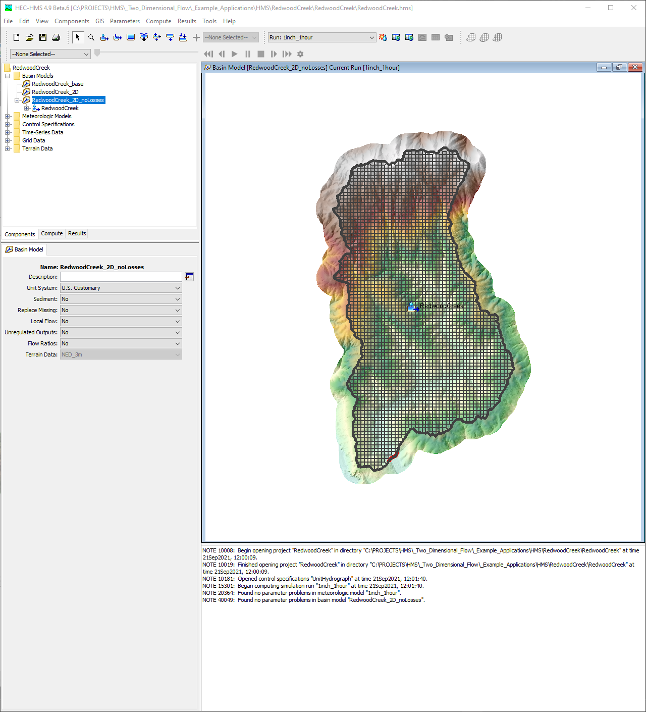
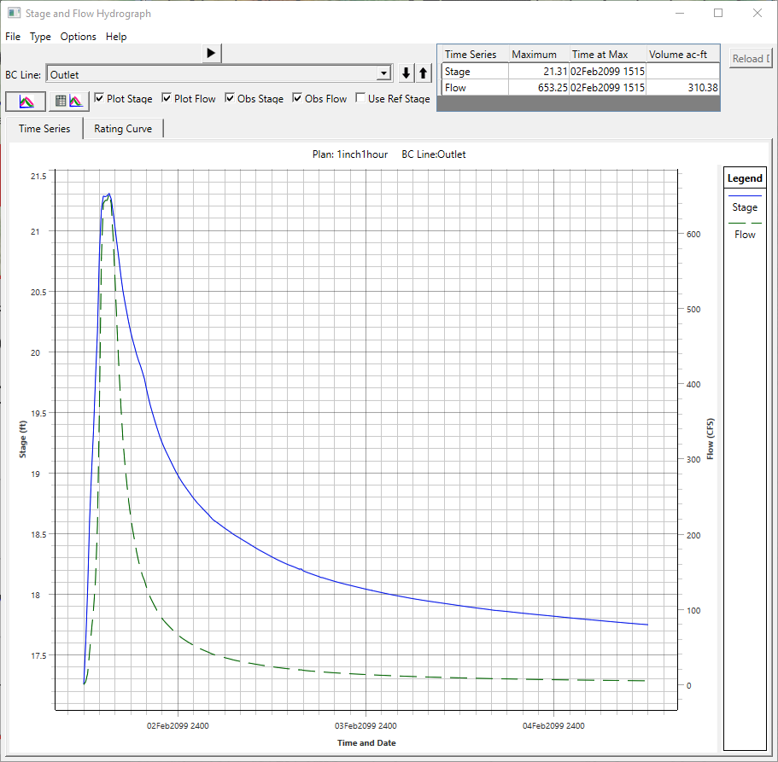
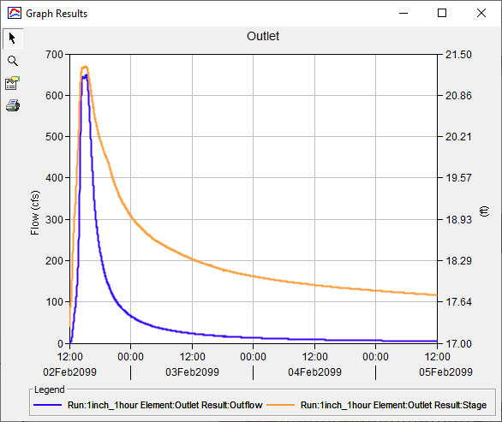
2D Flow V&V
Notes:
The 2D flow engine within HEC-HMS was also verified using HEC-RAS
Essentially, we’d create models using both HEC-HMS and HEC-RAS, hold as many inputs as possible constant, compute, and compare the differences
That’s shown here for the Redwood Creek project

Slide 7
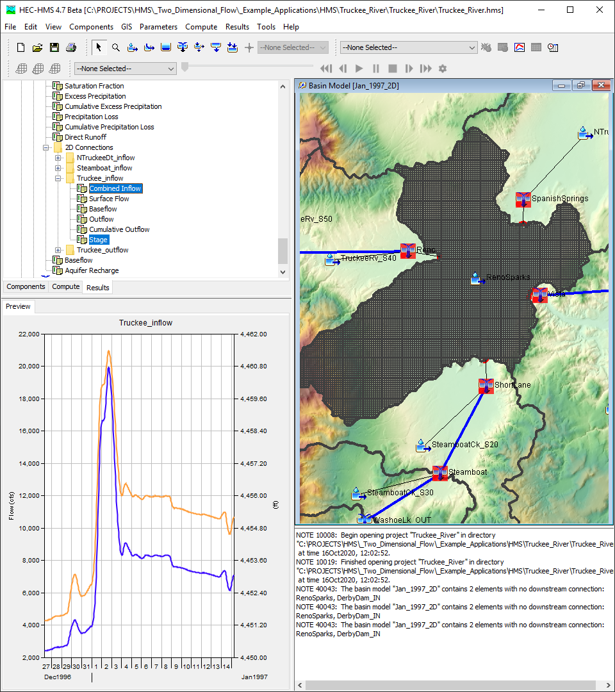
What Can the Modeling Community Achieve Now that it couldn’t before?
Users can simulate complex situations where necessary
Not every situation warrants the most complex solution
Users shouldn’t be required to change the entire model to simulate complex hydrodynamic situations in localized areas
Numerous aspects of HEC-HMS needed modification to support 2D flow and sediment transport
User interface
Model/computational code
Plotting/tabulating data
Spatial results
Notes:
HEC-HMS is a unique tool within the H&H community’s toolbox (so to say) in that users can choose the processes and parameterizations that are most appropriate for their uses in both space and time; just by choosing HEC-HMS doesn’t mean that you’re locked into a specific set of processes and/or parameterizations
Not all situations warrant the most complex solutions; in many cases, hydrologic routing techniques like unit hydrograph transform work just fine
However, that’s not always the case. If users would like to use these new complex features, they should be able to use them in only the places that are necessary.
Also, users shouldn’t have to modify EVERYTHING to simulate localized complex situations
Almost all aspects of HEC-HMS needed to be modified to effectively utilize and realize the benefits of these enhancements
This includes the UI, the model code that communicates between the UI and computation code, the way in which plots and tables are generated and populated, and the way in which results are shown in space

Slide 8
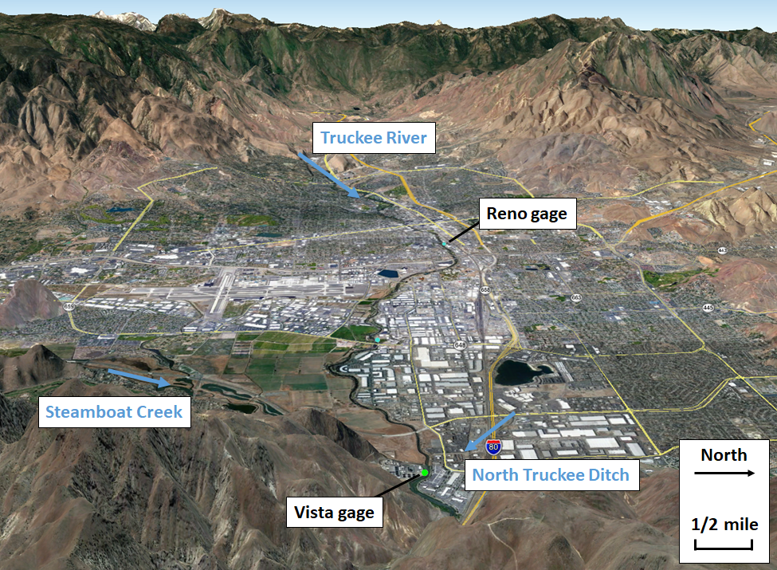
Notes:
A great example of the types of things that users can achieve now that they couldn’t before is exemplified by the area in and around Reno and Sparks, NV
The Truckee River flows through the city and has periodically exceeded channel capacities and caused significant damage

Slide 9
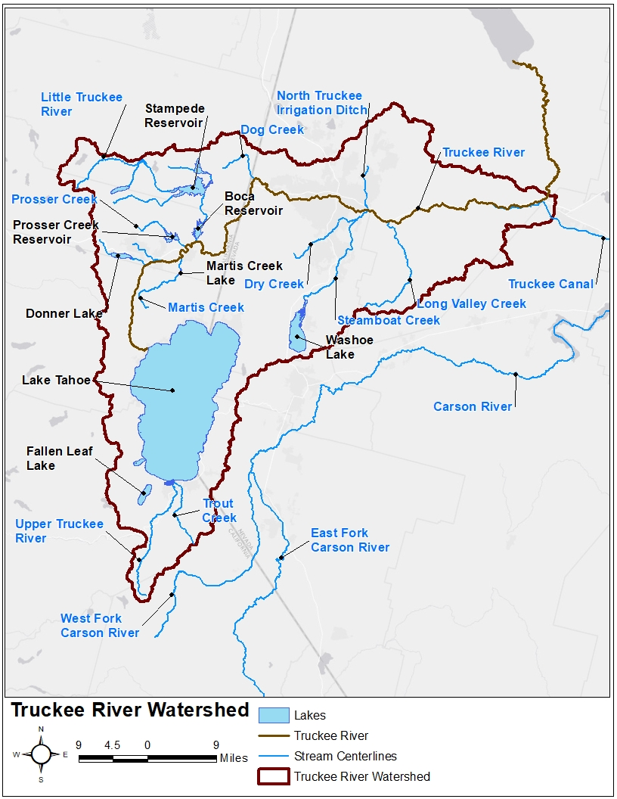
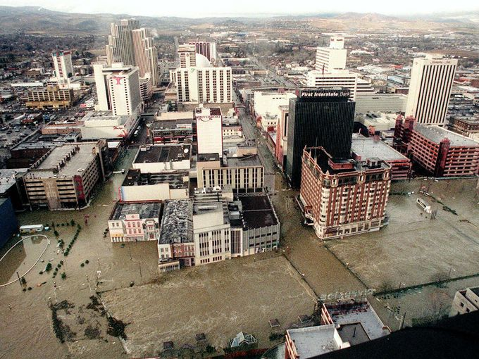
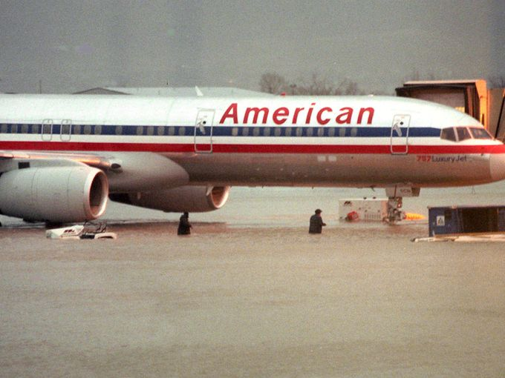
Notes:
The Jan 1997 flood event is the largest flood to have affected the city in the last few decades
You can see flood waters moving through the downtown Reno area in the first image
You can also see flood waters inundating the Reno Airport

Slide 10
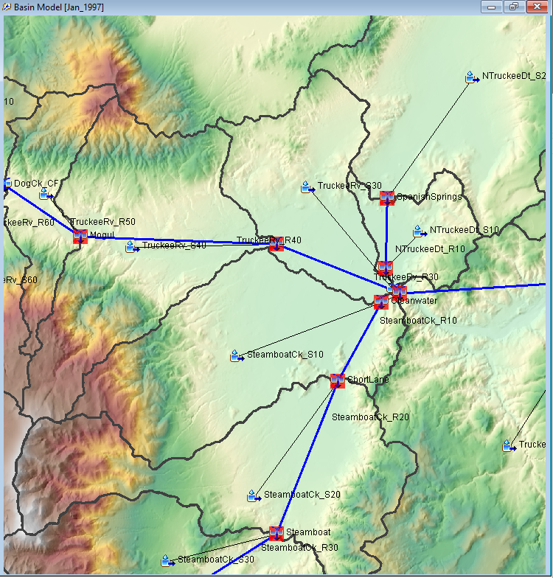
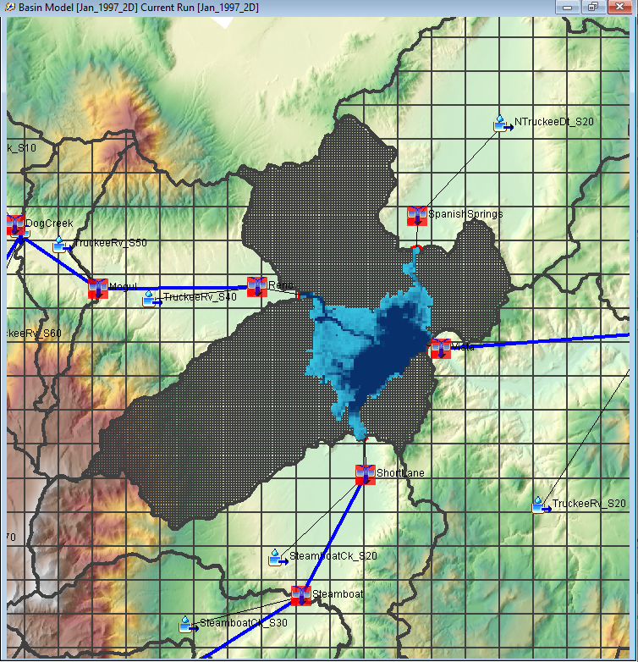
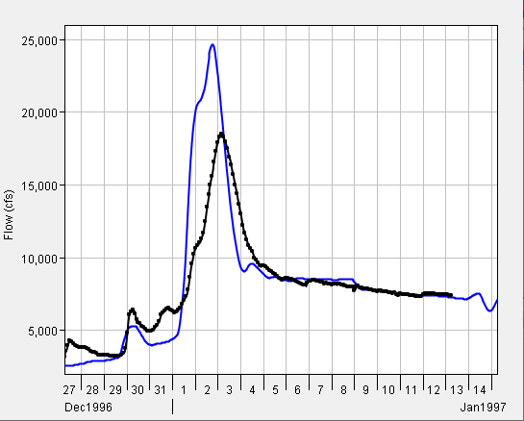
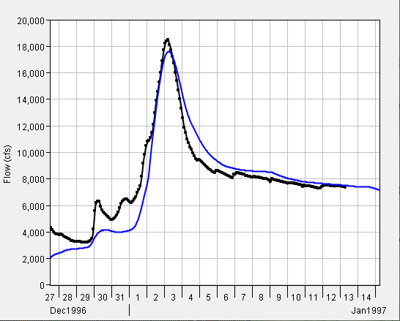
Observed
Computed
Observed
Computed
Notes:
An HEC-HMS model was created as part of the Truckee River CWMS implementation which used unit hydrograph transform and hydrologic routing through the Reno/Sparks area
The Truckee River upstream of Reno/Sparks is heavily incised and these methods worked fine to compute runoff rates.
However, the slope of the Truckee River DRASTICALLY flattens and the floodplain opens up through Reno/Sparks
Hydrologic routing methods don’t work too well when channel slopes decrease this much and water gets out of bank and spreads laterally
As such, the results obtained through hydrologic routing throughout and downstream of the Reno/Sparks aren’t that great; in particular, runoff rates are overpredicted, as shown in the image in the lower left
The existing HMS model was modified by merging the three subbasin elements within the Reno/Sparks area, importing a 2D mesh and several 2D connections, and utilizing the 2D Diffusion Wave transform method
The movement of water throughout this flat area is MUCH better handled with 2D Diff Wave
You can see how flood water spreads throughout the area and translation/attenuation processes are much better captured in the image on the lower right

Slide 11
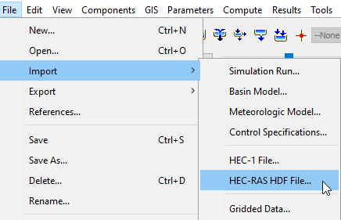
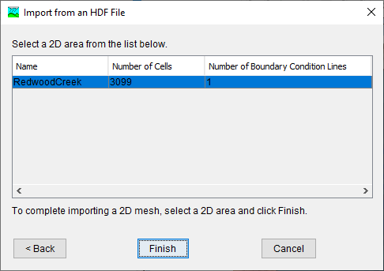
2D Flow Demo Importing A Mesh from HEC-RAS
Notes:
Things to note:
Meshes must currently be built within HEC-RAS. RAS Mapper has a ton of great mesh generation features like problem identification, breaklines, and refinement regions that are must-haves for complex scenarios.
Meshes with internal boundary conditions or structures within the mesh cannot currently be used. We have plans in the future to allow for these features, but they’re not in there right now.
Once a mesh is created in HEC-RAS, run it once to create the plan HDF file. This file will have a “p##.hdf” extension. Then, copy this file to your HEC-HMS project.
The mesh can then be imported to HEC-HMS for use by clicking File | Import | HEC-RAS HDF File.
A wizard will guide you through the process of selecting a basin model, a subbasin element from the selected basin model, and a 2D mesh from the selected HDF file.
Only one mesh can be used within a basin model at this moment. We have plans for allowing the use of many meshes in a single basin model soon.

Slide 12
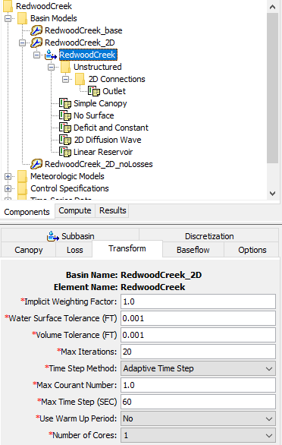
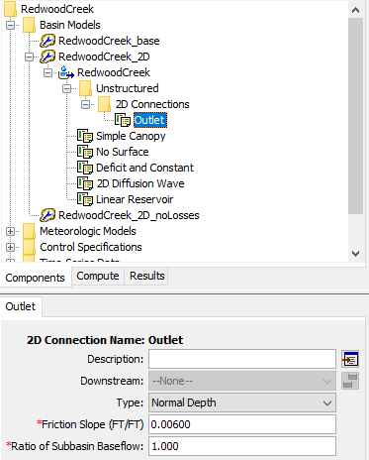
2D Flow Demo new Component Editors
Notes:
Things to note:
Discretization node within the subbasin element tree
After importing, the node changes to a folder labeled Unstructured since this subbasin now uses an unstructured discretization
Also, there is a 2D Connections node beneath the Unstructured discretization node
This node contains the various 2D Connections which can be either boundary conditions or connections to other elements
In this example, there’s only one 2D Connection
Clicking on the Outlet node loads the 2D Connection component editor
In this editor, you can change the type of connection (e.g. normal depth, flow, stage, or rating curve) and enter parameters
2D Diffusion Wave Transform node
Contains controls for the 2D computations like theta, inner and outer loop tolerances, max number of iterations, time step, warm up, and number of cores
We don’t expose every control there is to these computations; we only expose those that are the most pertinent to hydrologic modeling in an effort to keep things as simple as possible
The default time step method is adaptive, which varies the time step using the Courant condition
The other option is Fixed time step
The number of cores drop down menu populates with 1 to as many cores as you have on your computer; not all simulations warrant the maximum number of cores; some simulations may go slower with additional cores

Slide 13
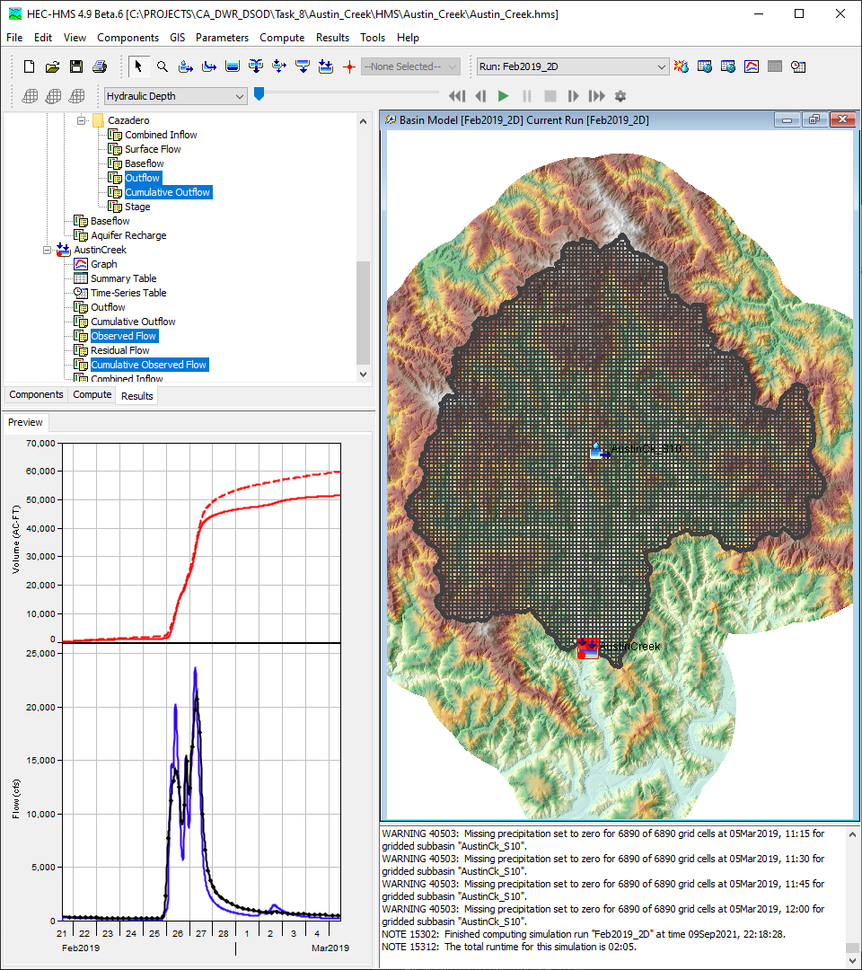
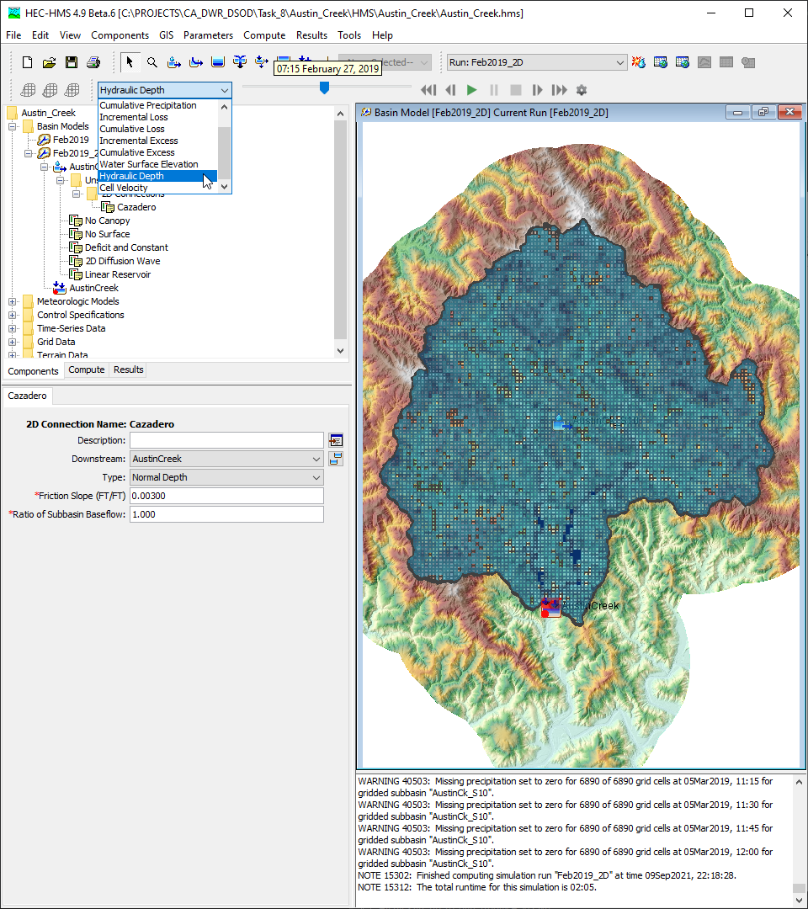
2D Flow Demo Results
Notes:
Things to note:
Time series within the Results tab:
2D Connections will all have Combined Inflow, Surface Flow, Baseflow, Outflow, Cumulative Outflow, and Stage; if sediment is enabled, 2D connection-specific sediment time series will be included as well
Spatial results:
Must be enabled on the Compute tab
Drop down menu for selection of spatial results
Tool tips
Right click | Plot Time Series
Upcoming redesigned Raster Properties editor

Slide 14
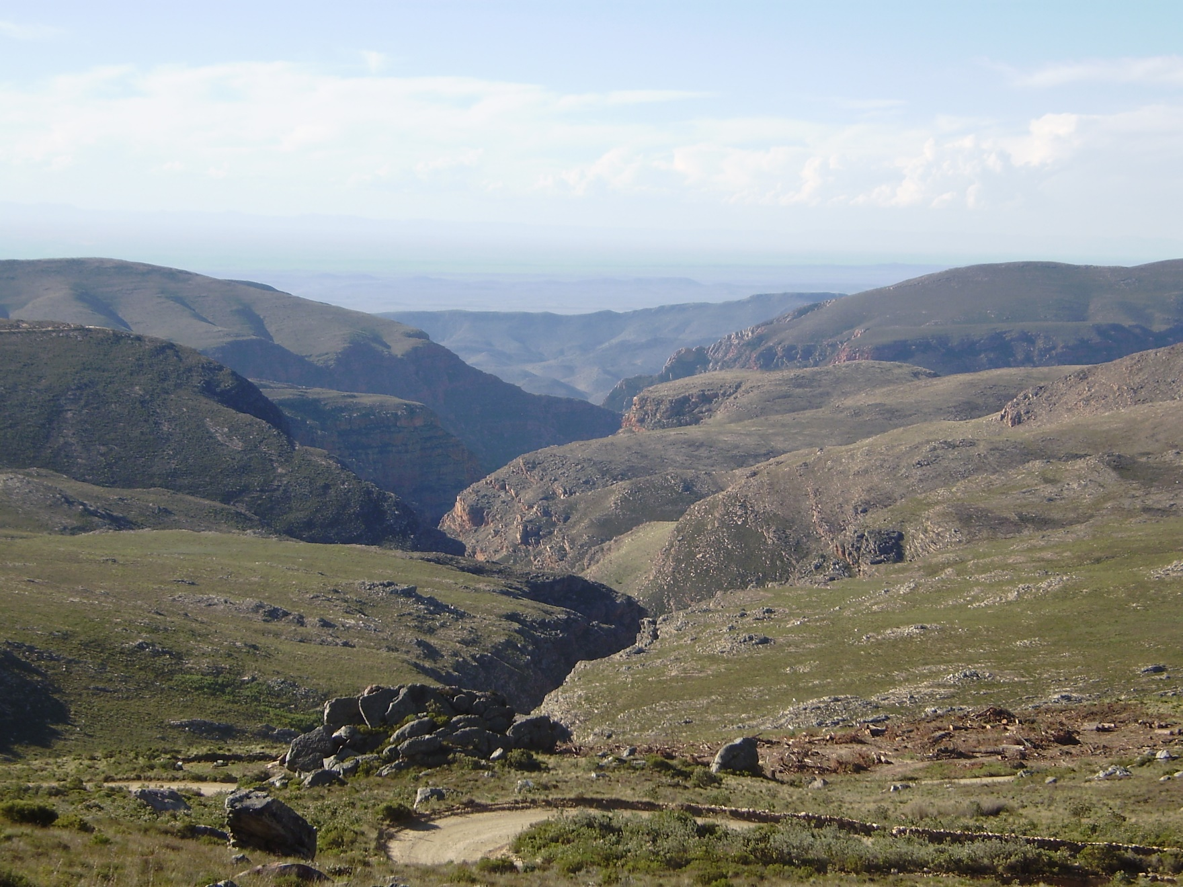
Transfer from Mike to Jay

Slide 15
2D Sediment Transport Features
Non-equilibrium Total-load Transport
No diffusion
Mixed cohesive/non-cohesive
Subgrid bathymetry, bed sorting, erosion, and deposition
Fixed bed elevation/One layer & gradation per cell
Sheet and splash erosion
Several Transport Functions
Clay, Silt, Sand, and Gravel
Bed sorting and layering algorithm
Constant bed porosity
Hiding and exposure corrections
Implicit Finite-Volume Method
Elevation
Area
Hydraulic Erosion and Deposition
Sheet and Splash Erosion
Bed Layers
Fraction Wet
Fraction Dry
Notes:
HMS is using the simple approach to reduce the computational complexity and memory
No diffusion term (for the computational reason): only the first-order simple advection scheme without high order advection schemes
Compute all sub-grid bathymetry, bed sorting, erosion, and deposition but not update bed elevation (Fixed bed elevation) and provide only one-layer and one gradation information per cell (but keep tracking sub-grid information (wet & dry portion and three-bed change including the total bed change, wet bed change, and dry bed change
Sheet and splash erosion based on excess flow.
Constant porosity (no iteration to convert from mass to volume).
Hiding and exposure corrections: Armoring effect based on particle size proportion – lager grains block small grains. The threshold/critical shear stress will be corrected based on the particle size proportion. Without the Hiding and exposure corrections, always small particles will be eroded first than the bigger particles. (Equal Mobility concept)
Sheet and splash erosion based on excess flow.

Slide 16
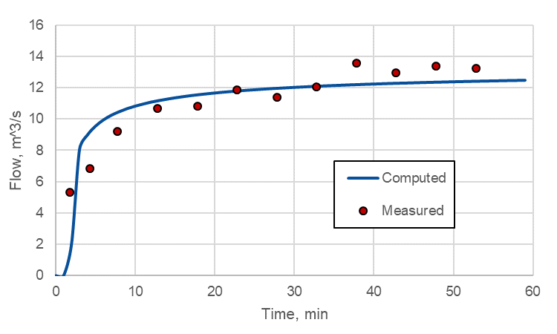
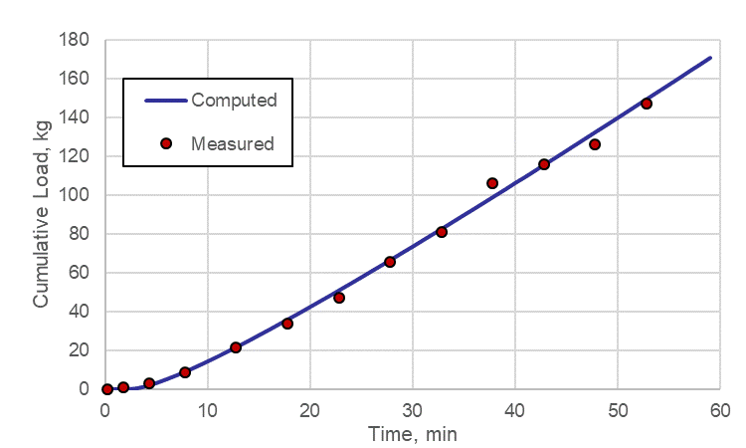
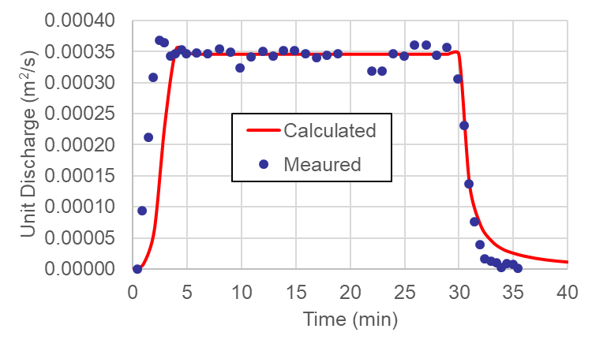
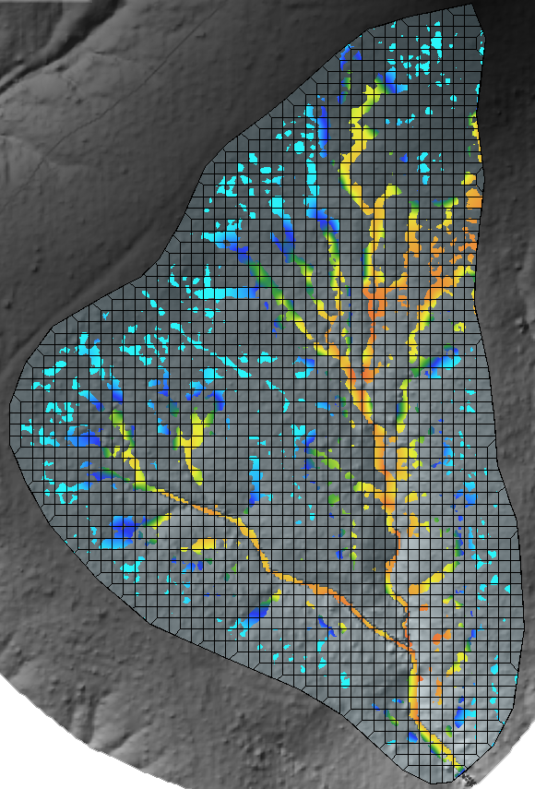
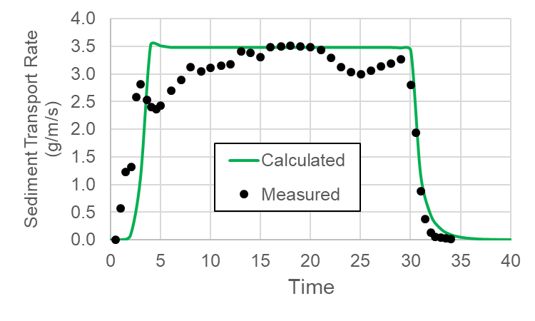
2D Sediment Transport V&V
Liu et al. (2006)
LH104
USDA Walnut Gulch Exp. Watershed
Barfield et al. (1983)
Notes:
Liu et al. (2006): Flume experiment
Barfield et al. (1983): Agricultural research - Plot using sprinkler rainfall.

Slide 17
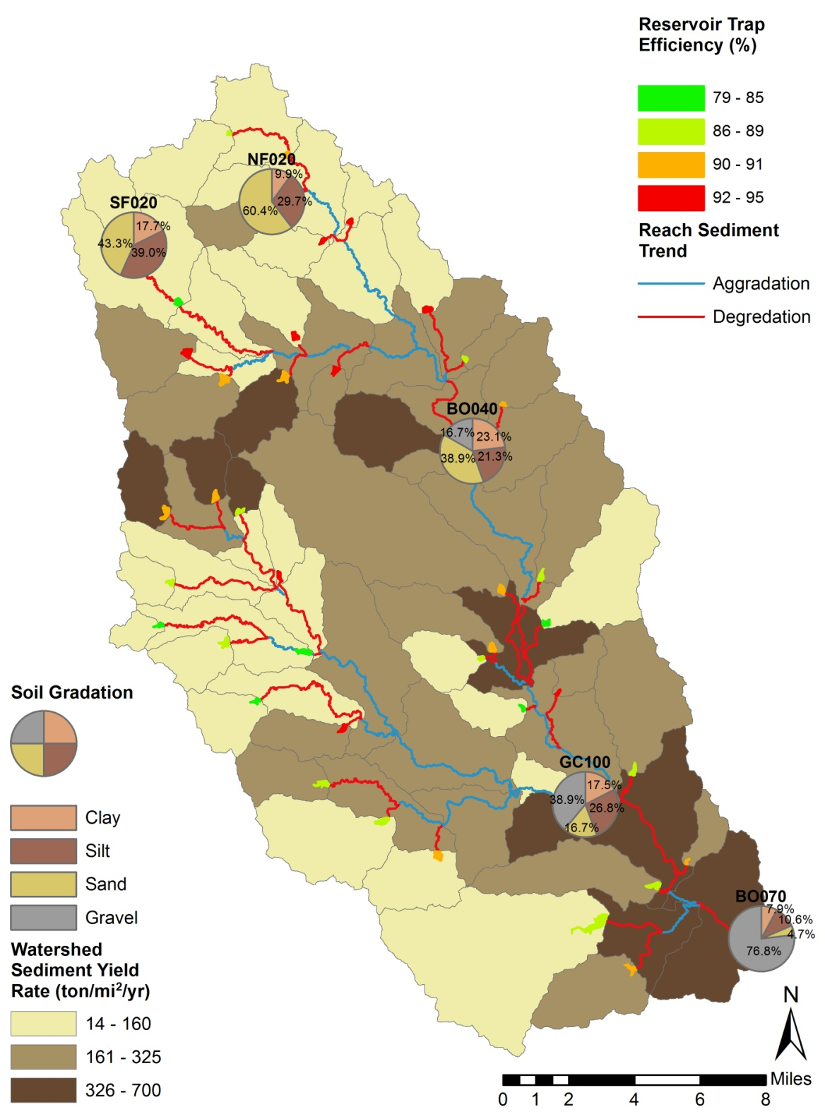
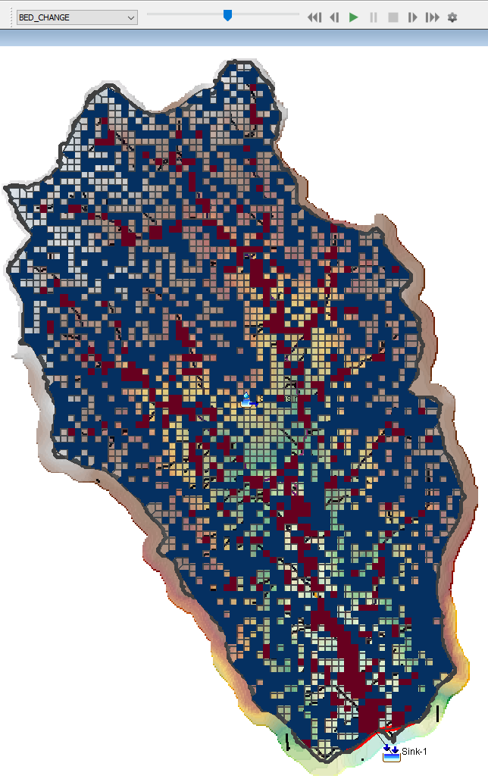
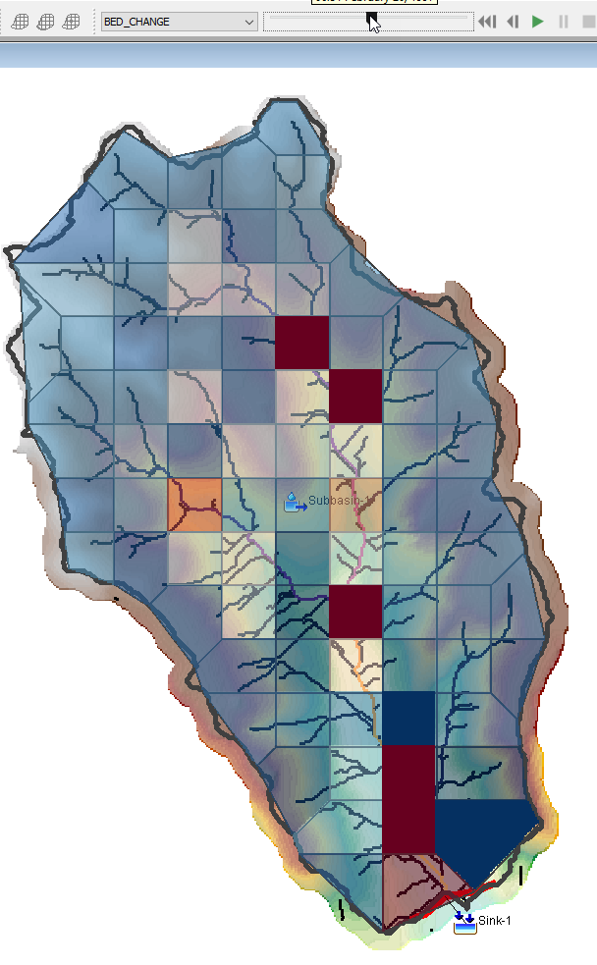
Why Do We Need the 2D Sediment Transport Method in HEC-HMS?
Advantages
Disadvantages
Specially distributed result
Guide for Sediment TMDL & BMPs
Sediment Catch Basin Design (Locations & Load Amounts)
Use remote sensing data (LIDAR, Aerial Photo, etc.) & soil gradation data for calibration & validation
Time and Cost Issues (Longer Run time:16.5 hours – 3.3 mi², 150ft X150ft, 2-yr, 1 min, 1-core) (CPU@2.40GHz)
Solutions
Selecting proper grid size and time step with minimizing precision loss (18.5 minutes – 3.3 mi^{2,} 1000ft X 1000ft, 2-yr, 15-min, 8-core)

Slide 18
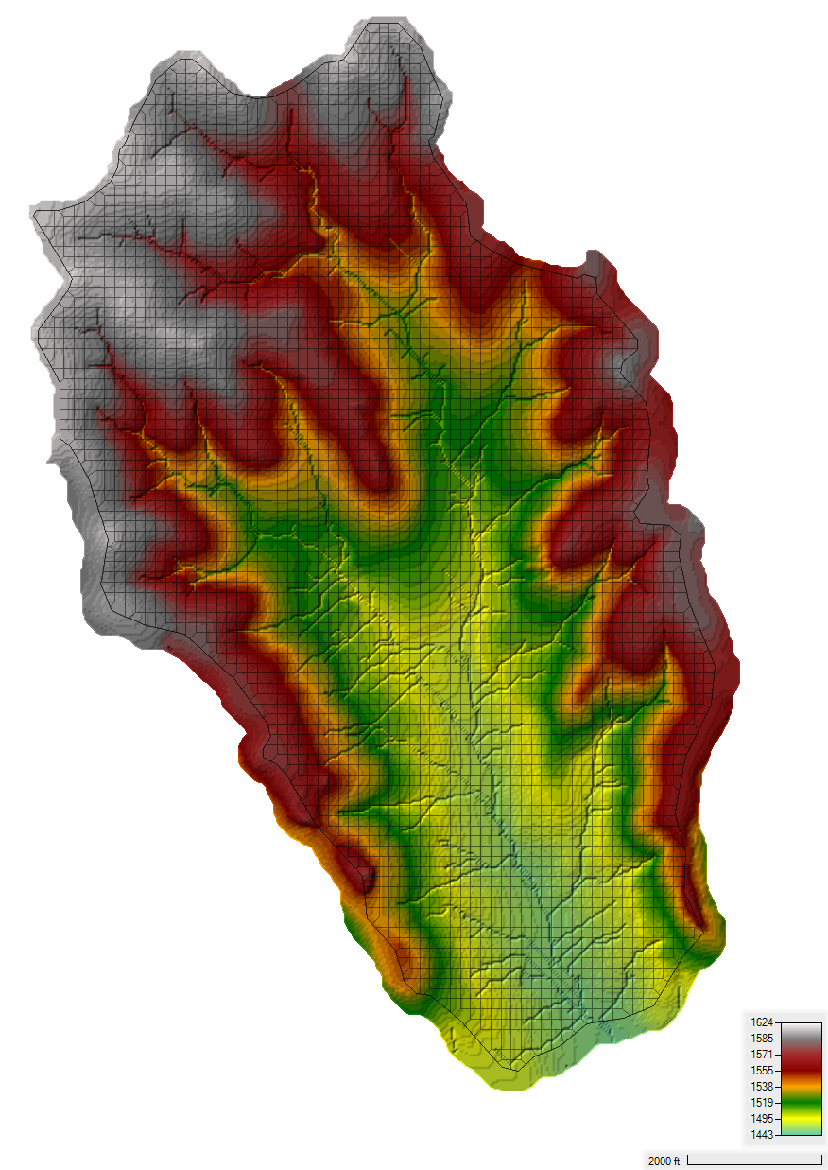
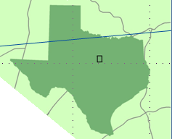
Case Study: UNBRW
1-D Results
2-D Results
Outlet
2-D STM Results
Water Depth
Flow Velocity
Concentration
Bed Change
Upper North Bosque River Watershed
(UNBRW)
Precipitation: 750 mm/year
Soil Type: fine sandy loams
2D Area: 3.3 mi² (8.5 km²)
Elevation: 1457 ft – 1624 ft (444 m – 495 m)
Terrain Model: 10 m DEM
Grid Cell Number: 4035
Grid Cell Size: 150 ft X 150 ft
Notes:
14 Precipitation Gages & 5 Stream Gages
356 mi2

Slide 19
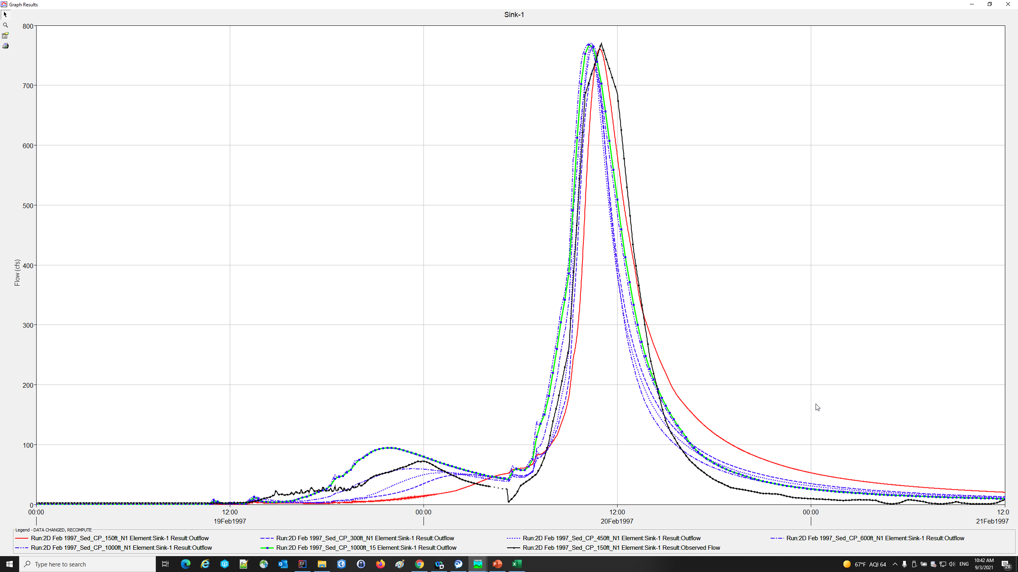
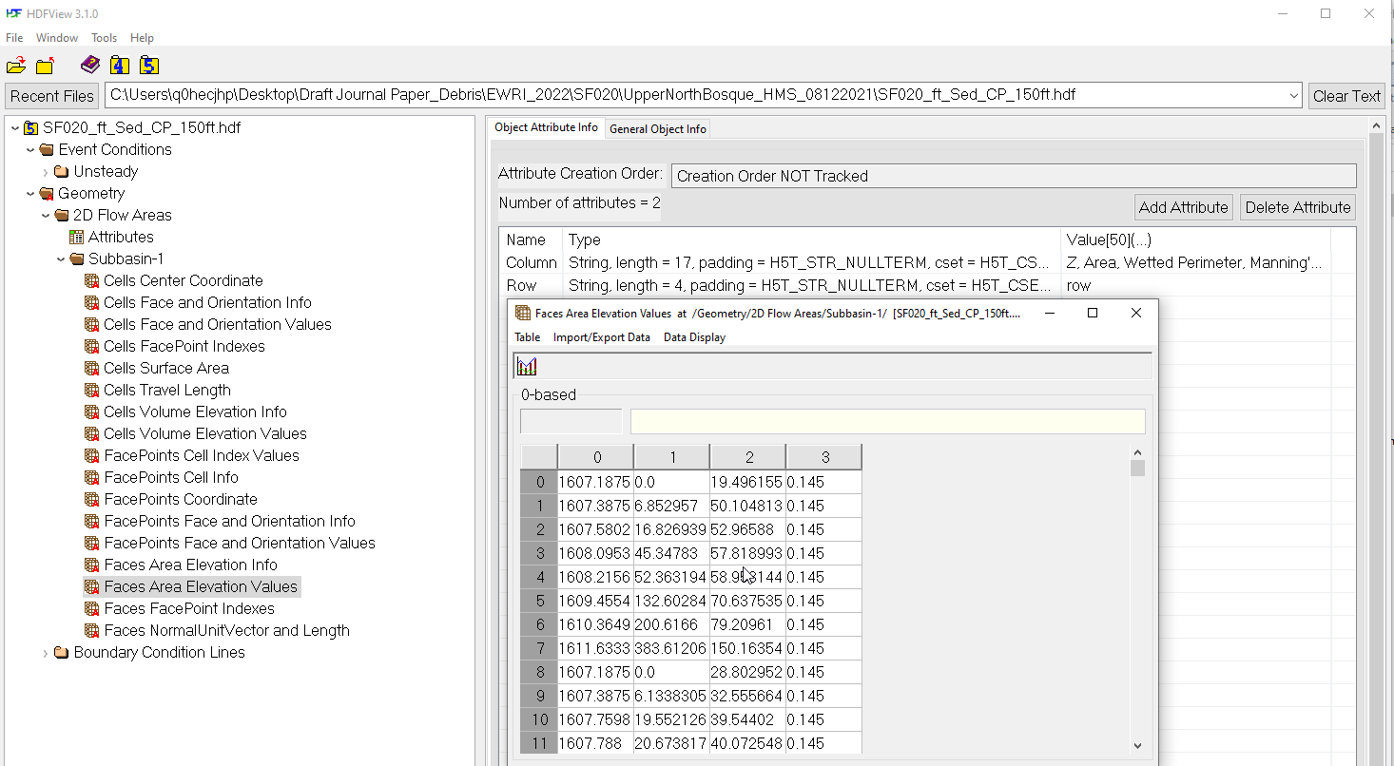
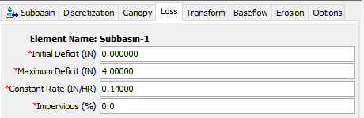
Case Study: UNBRW

Slide 20
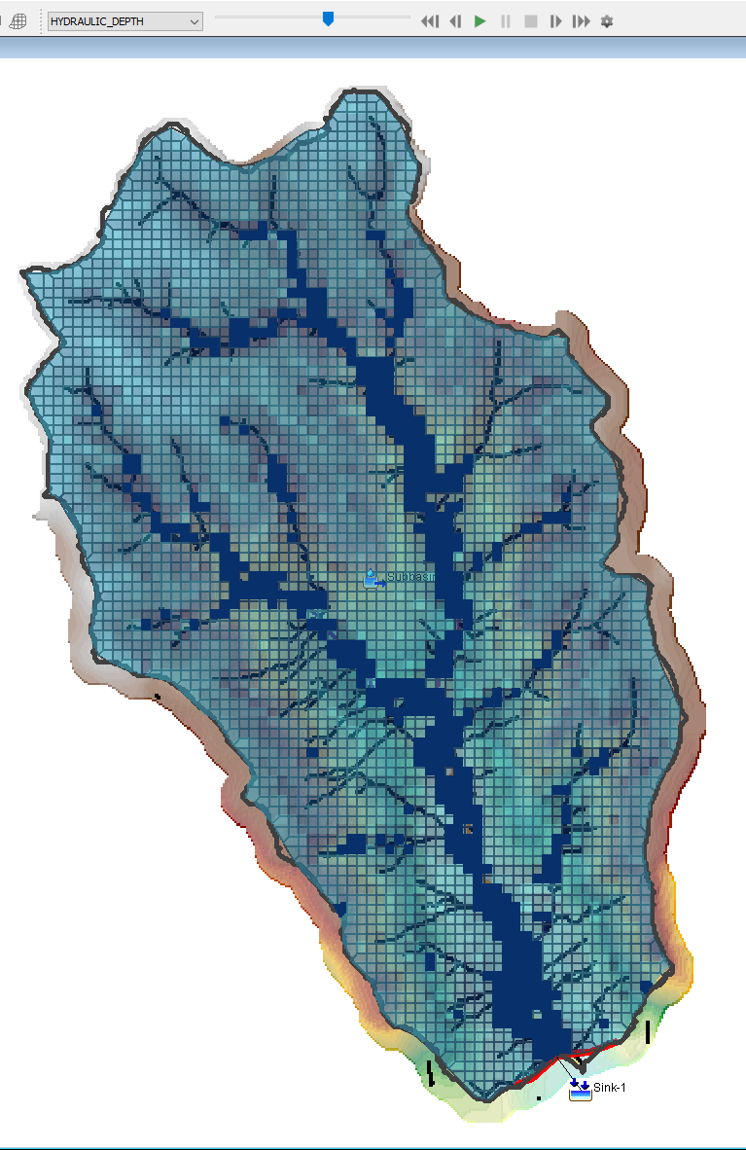
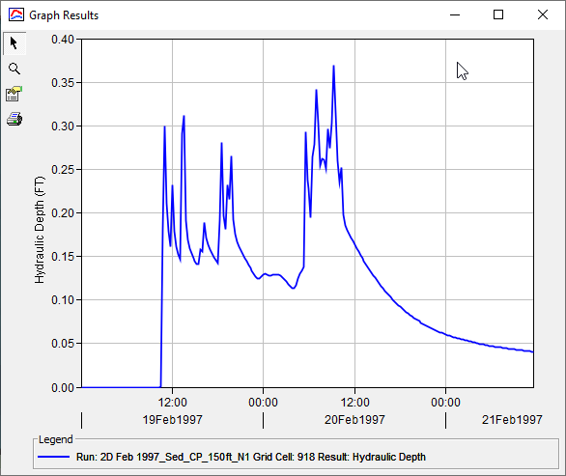
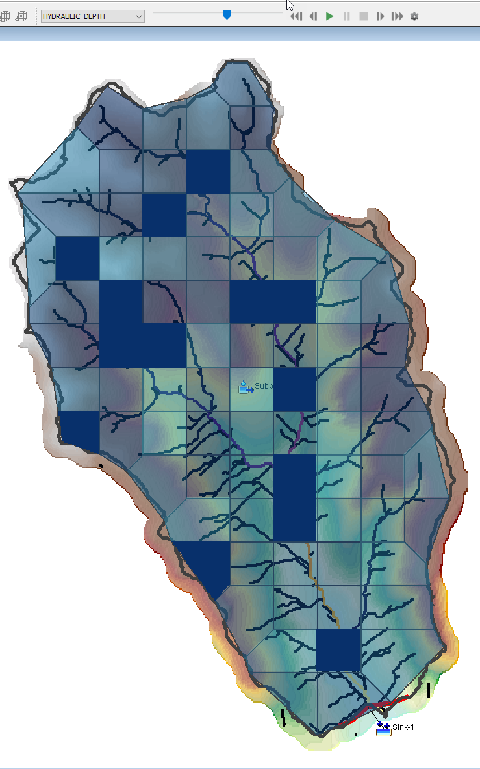
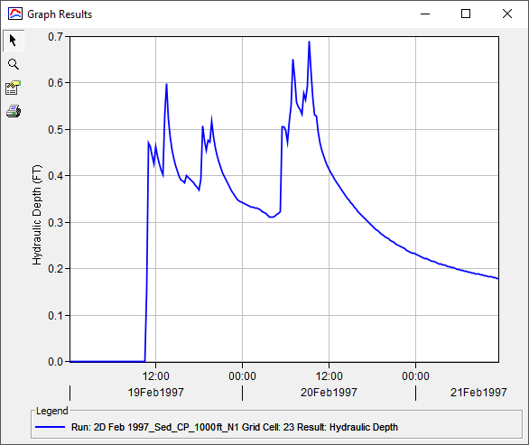
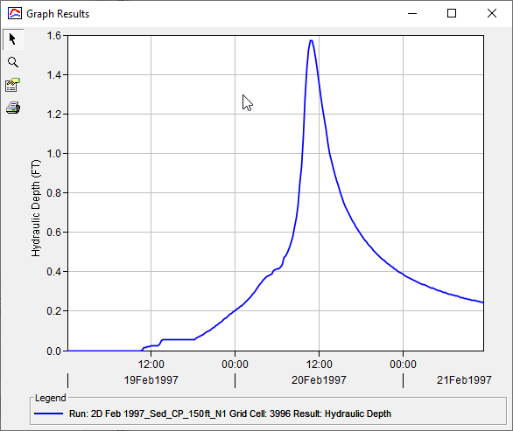
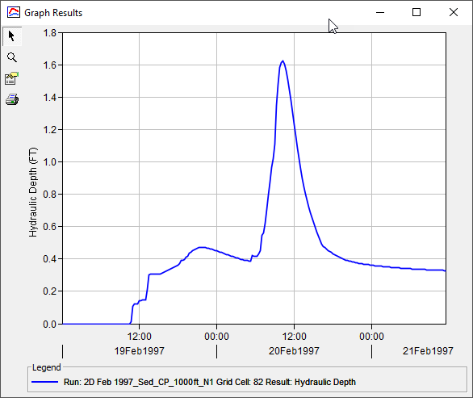
Case Study: UNBRW
150 ft X 150 ft
1000 ft X 1000 ft

Slide 21
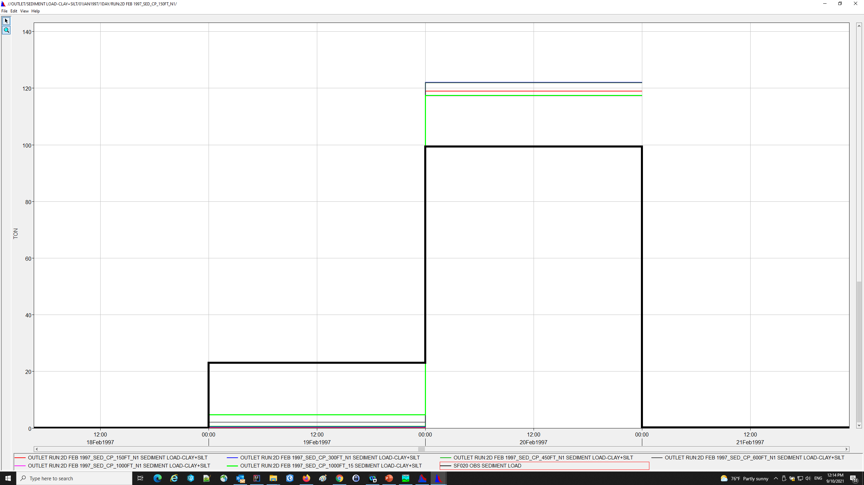
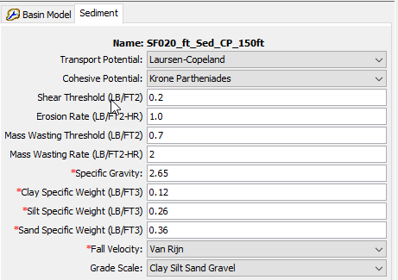
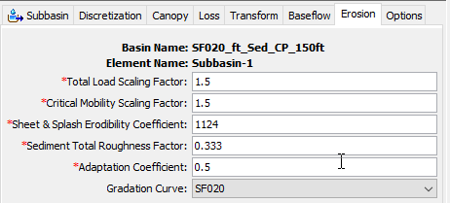
Case Study: UNBRW

Slide 22
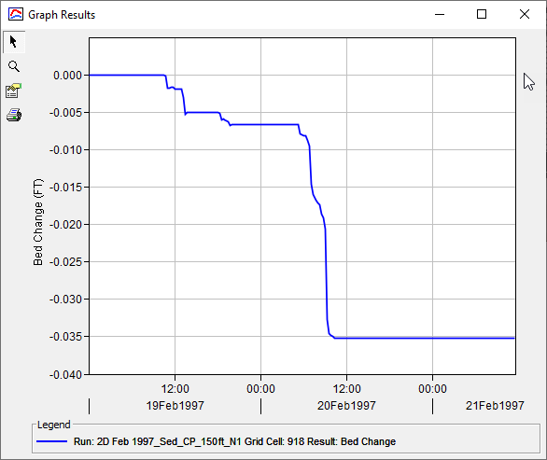




Case Study: UNBRW
150 ft X 150 ft
1000 ft X 1000 ft

Slide 23


Case Study: UNBRW

Slide 24
Case Study: UNBRW
Computed flows and sediment load at the outlet agree well with field measurements.
The grid size can be optimized/maximized according to your optimal resolution will give you the best output.
A 2D sediment model will be very useful if one is interested in localized sediment issues. (sediment reduction goals, Location & Capacity of Sediment Basin, etc.).

Slide 25

Transfer from Jay to Nick

Slide 26

MacOS and Linux

Slide 27

Transfer from Nick to Mike

Slide 28

What Types of Studies Will Benefit From this Work?
Studies that have existing models but require more detail in specific areas
CWMS National Implementation Plan
Substantial physical changes within an area
Post fire
Land use changes
Extreme event simulations
Reservoir sedimentation studies
Non-point source sediment studies
Detroit Dam
Oregon Dept. of Forestry
Notes:
There are numerous types of studies that will benefit from this work
A great example are those areas that already have existing models but need a bit more definition in a particular area
For instance, there are currently over 150 HEC-HMS models that were created as part of the CWMS national implementation plan
Beyond forecasting, these models are also used within planning studies where different with project alternatives are compared
If users need more definition in a particular area to predict the effects of the with project conditions, they can incorporate the HEC-HMS 2D capabilities without having to change anything else
Other examples of the types of studies that will benefit from this work include areas where substantial physical changes have occurred either due to wildfires or land use changes, studies where unit hydrograph theory limitations cannot be tolerated (e.g. dam safety), and non-point source sediment studies

Slide 29


Tech Transfer
2D Flow Tutorials and Guides
HEC-HMS Download
Notes:
These capabilities have been available since the release of v4.7
The latest official release is v4.8, but we are hoping to release v4.9 very soon
The image on the left shows our website where users can download the latest version of HEC-HMS which contains these 2D capabilities
We’ve also developed documentation, tutorials, and guides specific to these 2D capabilities and posted them to our website as well

Slide 30

Next Steps
Use multiple meshes in a single basin model
Mesh generation/modification
Roughness value modifications
Structures w/in a 2D mesh
Shallow Water Equations
2D groundwater flow
Non-Newtonian flow
Reservoir sedimentation
Spatially variable sediment parameters
Post fire recovery
Rill erosion
Hindered settling
Aggregates
Montecito, CA
Matt Udkow, SBFD
Notes:
USACE R&D paid for the development and implementation of these features
THANK YOU!
We’re currently using these new features to evaluate additional topics within other R&D work units, namely Ian’s Arid Regions work unit
Customers both within USACE and outside USACE have seen these features and are providing funding to develop and integrate additional features like those shown on the slide

Slide 31
Conclusion
2D Flow and Sediment capabilities have been added to HEC-HMS
Upcoming v4.9 release
Multiple District partners are currently using these enhancements
Customers are investing in additional 2D enhancements
Notes:
To summarize, we’ve added 2D flow and sediment capabilities within HEC-HMS
Users are evaluating these features
Folks within USACE and outside USACE have invested in additional 2D enhancements to meet their specific needs

