Slide 1
U.S. Army corps of engineers
Hydrologic Modeling System
Quarterly Webinar
March 3, 2022
Mike Bartles, P.E.
Nick Van
Daniel Black
Natasha Sokolovskaya, P.E.
David Ho, P.H.
Hydrologic Engineering Center

Slide 2
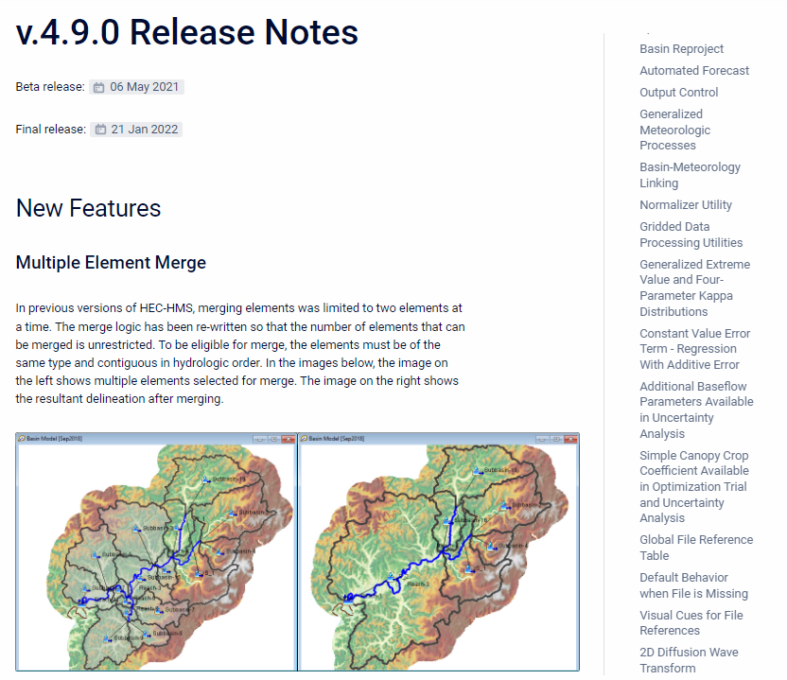
Outline
Gridded data tools
  Importer
  Normalizer
  Grid to point converter
  Sanitizer
  Calculator
File referencing
Element rename
HEC-HMS runtime tracking

Slide 3
Gridded data importer
Purpose
  Streamline the process of converting various gridded dataset formats to HEC-DSS format for use within HEC-HMS.
Supported Dataset Formats
  netCDF, HDF, GRIB, ASC, TIF, BIL, SNODAS, DSS
Additional Features
  Project gridded data to SHG or UTM projections
  Clip to watershed boundary
  Set correct data units and type
Examples provided - https://www.hec.usace.army.mil/confluence/hmsdocs/hmsguides/working-with-gridded-boundary-condition-data
Notes:
Add a screen shot of that table showing gridded data sources.

Slide 4
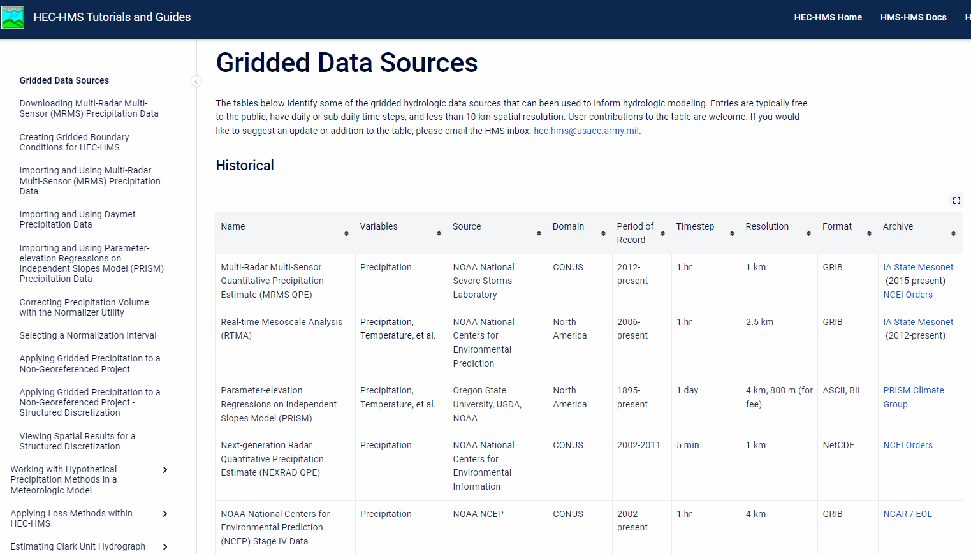
Gridded data importer
Notes:
Add a screen shot of that table showing gridded data sources.

Slide 5
normalizer
Purpose
  Develop a precipitation dataset that captures one gridded data source's timing/temporal variability while also capturing the volume of another gridded data source.
Typical Usages
  Have two sources of data: Hourly Stage IV Radar and Daily PRISM
  Hourly Stage IV Radar: captures temporal variability well, but might under/over-estimates volume
  Daily PRISM: captures volume well, but not temporal variability due to larger timesteps

Slide 6
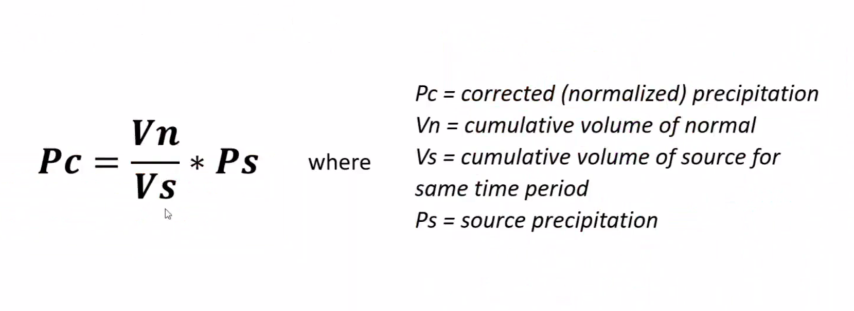
normalizer
Solution: Normalize the Stage IV Radar data using the PRISM data
  Adjust the magnitude of each grid cell in the Stage IV Radar grid so that the cumulative volume matches the PRISM grid's cumulative volume over a user-defined time interval.
Formula

Slide 7
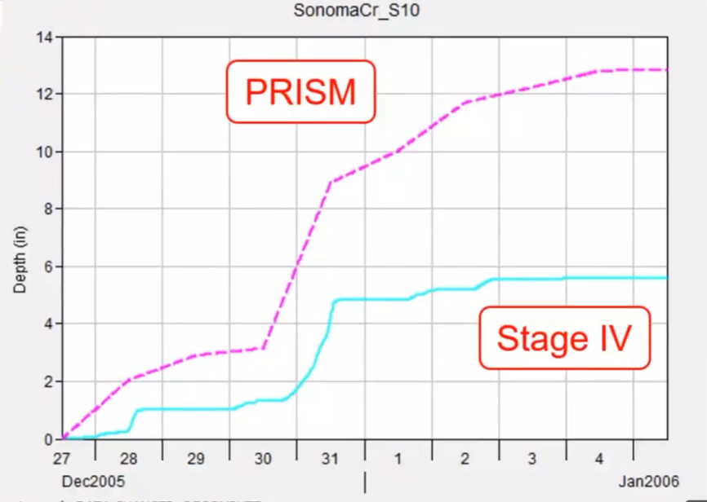
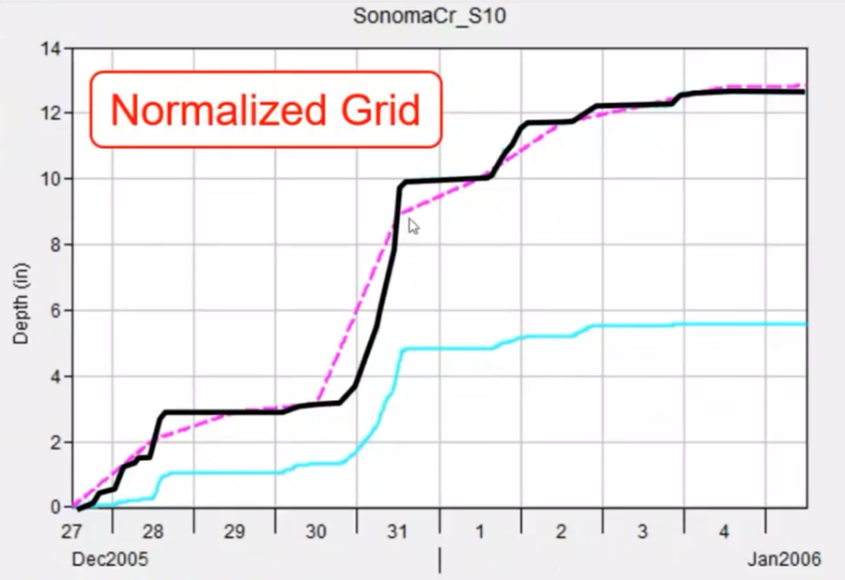
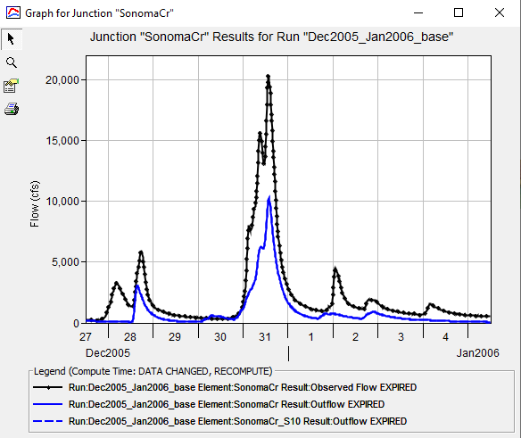
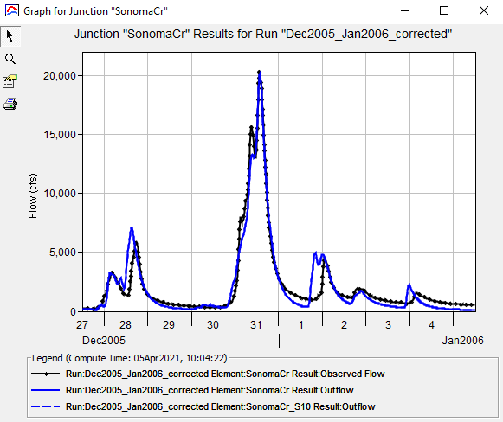
normalizer

Slide 8
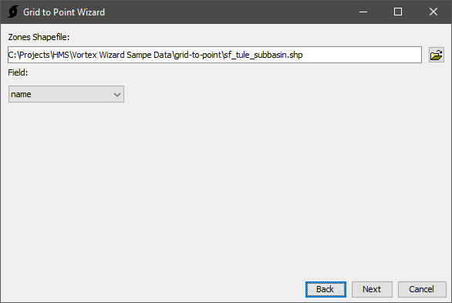
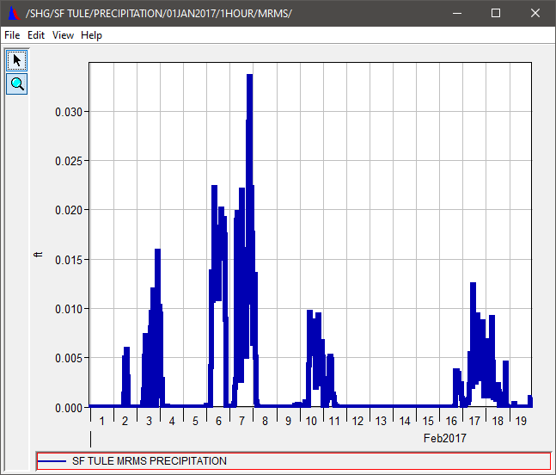
Grid-to-point converter
Gridded data to basin-average time-series data
X-Y plottable data
Faster computes
Convert SWE to time series for observed data

Slide 9
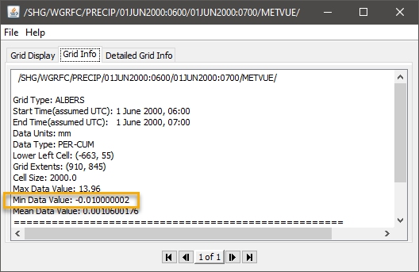
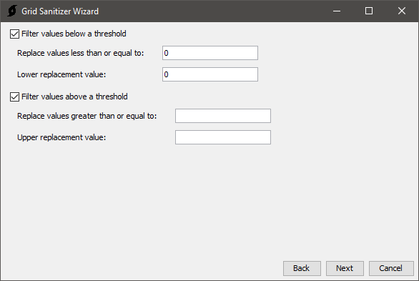

Sanitizer
Screen and replace values above or below a threshold
Quickly replace outliers/erroneous data

Slide 10
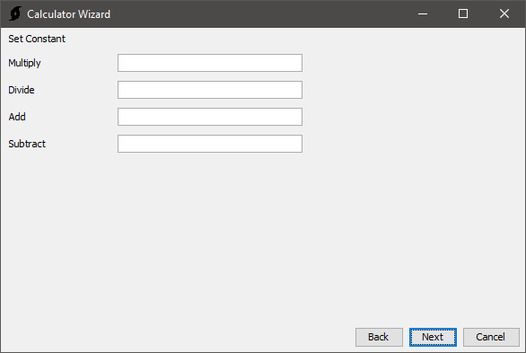
Calculator
Perform simple arithmetic on data
Alternative datasets
  Scale precip/temp data
Unit conversion

Slide 11
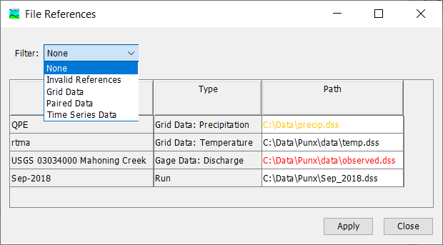
File references Dialog
Important improvement!
Most data source files for the project in a single table
External references in orange
Invalid references in red
Notes:
Can filter directly for missing refs or by data type

Slide 12
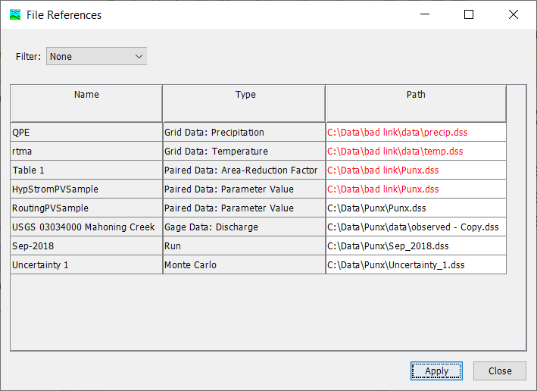
File references dialog
Access from File | References
Also, automatically on project opening if it has invalid references

Slide 13
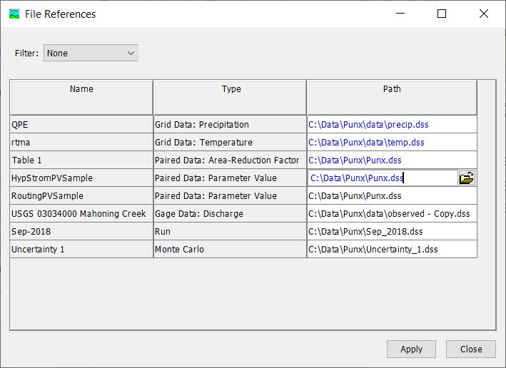
File references dialog
Fix each reference by browsing to the correct location
Add capability to fix multiple broken links in future releases

Slide 14
File references Dialog
Why is it useful?
    An invalid reference will prevent project from running properly
    Reference files can be ‘lost’ when copying, moving or sharing project
    File References dialog simplifies finding and correcting the problem

Slide 15
File references Dialog
    REMINDER: It’s always best to save data sources internally in project’s Data folder

Slide 16
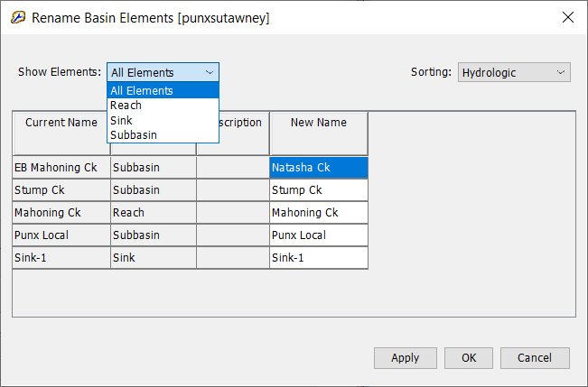
Rename Basin Elements dialog
  Rename multiple basin elements
  Group and organize elements
  Copy and edit in external program (e.g. Excel)
Notes:
By element type, alphabetically and hydrologically

Slide 17
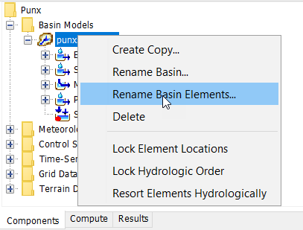
Rename Basin Elements dialog
  Access by right-clicking on the basin and selecting Rename Basin Elements
  Demonstration video here:
  https://www.youtube.com/watch?v=vNco8VmgB80

Slide 18
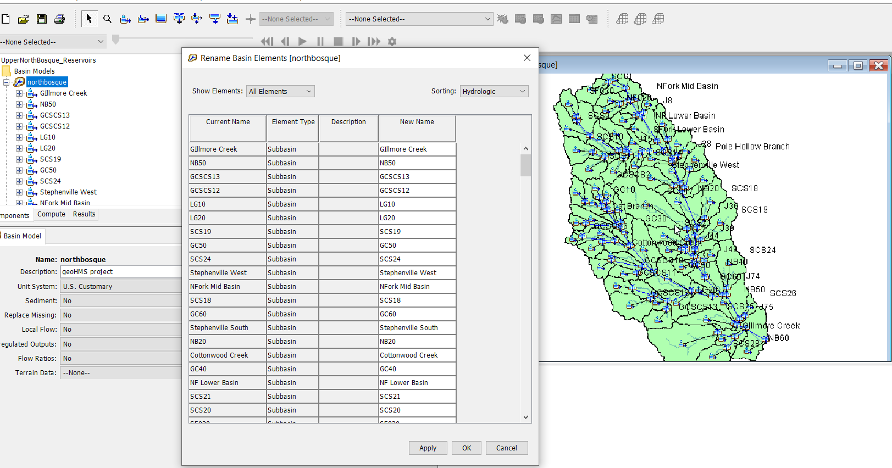
Rename Basin Elements dialog
Why is it useful?
Notes:
Faster and less tedious than selecting individual elements from the tree
Especially helpful for large projects with multiple elements

Slide 19
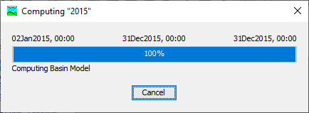
HEC-HMS Runtime tracking
Setting up a way to keep track of project runtimes
Projects benefit from reduced runtimes
  Calibrating CWMS hydrologic modeling for real time operations and forecasts
  Running monte carlo simulations within HEC-WAT
  Continuous simulation models
  And much more!
Provide Fast and Continuous Feedback to developers

Slide 21
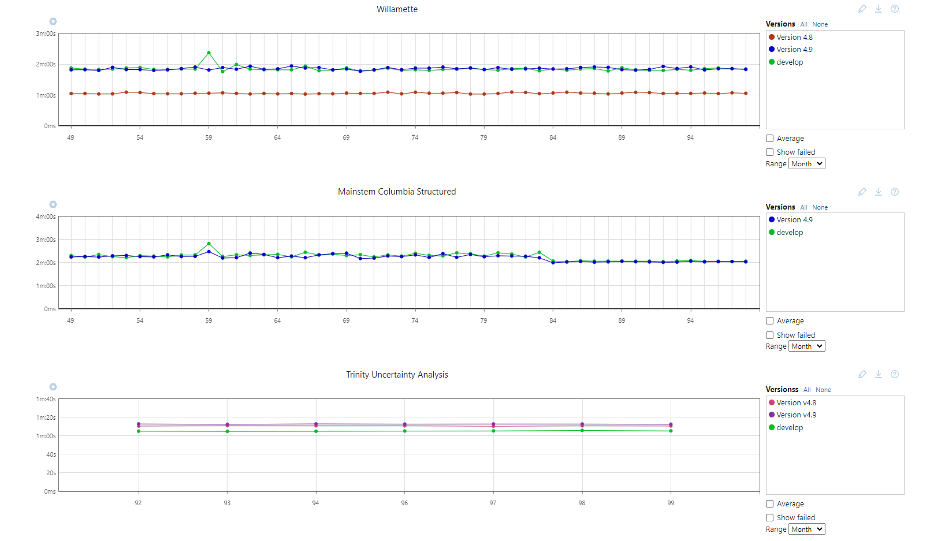

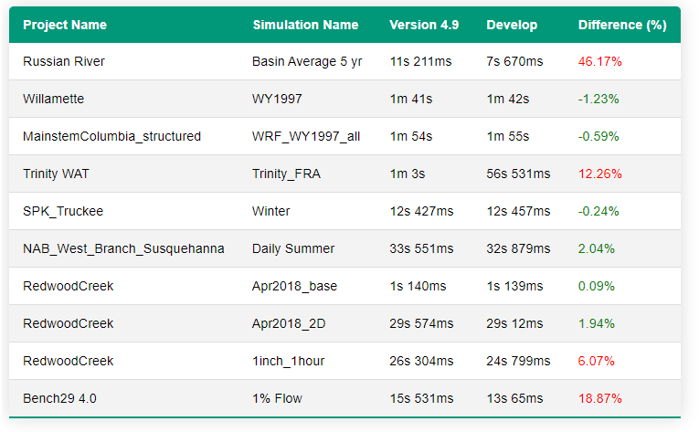
Project
Versions
Runtime
Comparing current developed HEC-HMS runtimes against the current released version

Slide 22
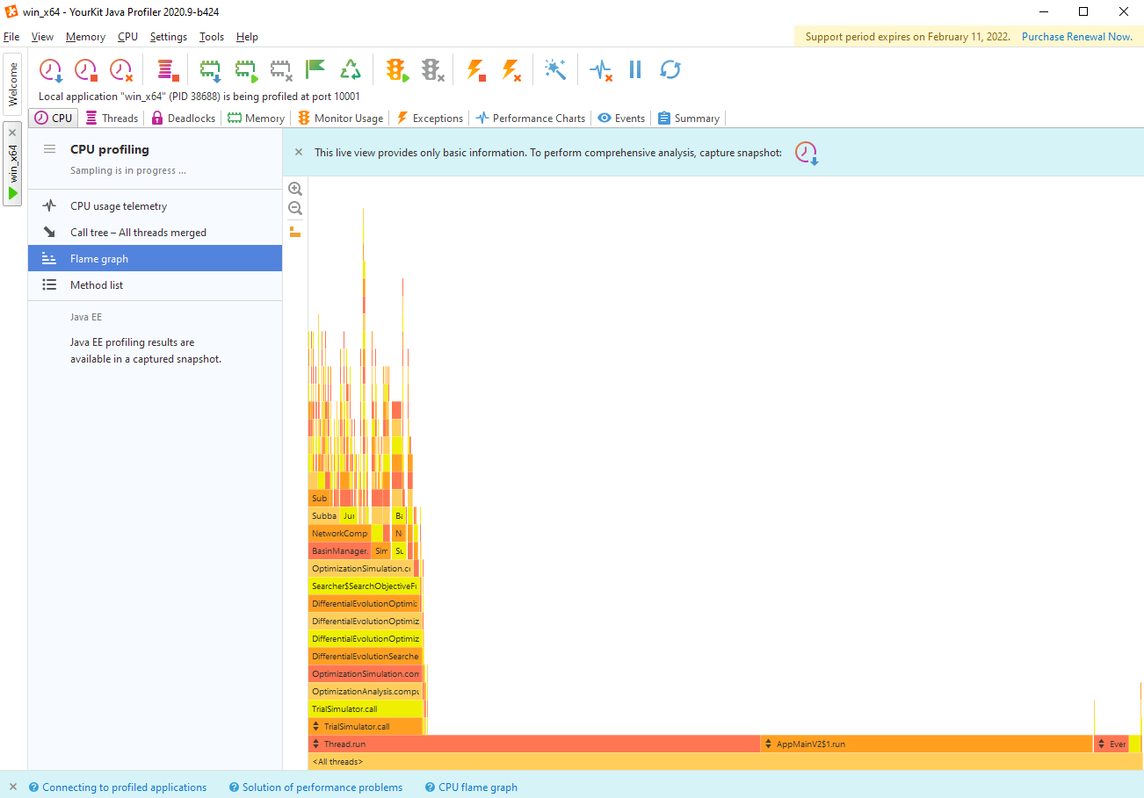
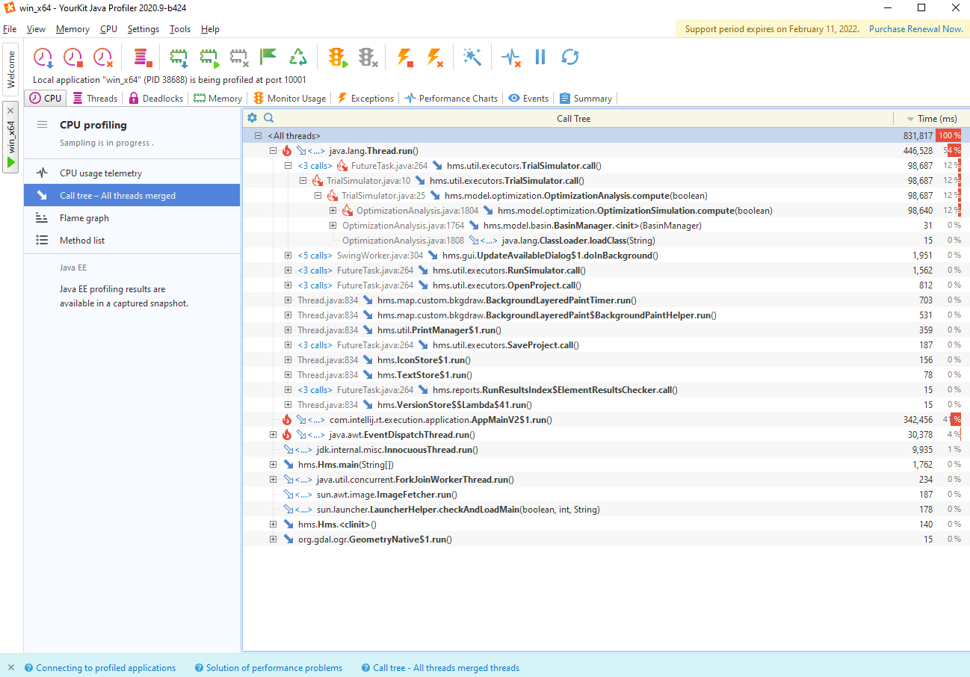
Profiling software to see which classes are taking up most time

Slide 23
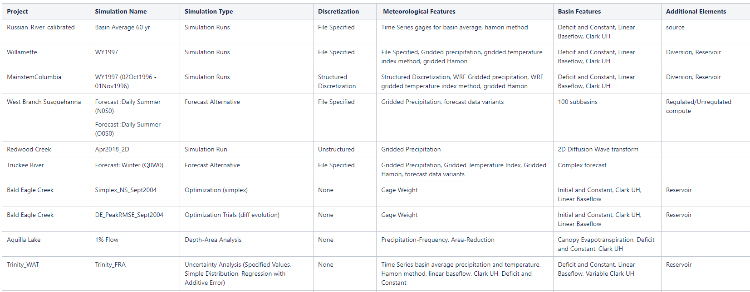
Types of Projects we are Tracking

Slide 24
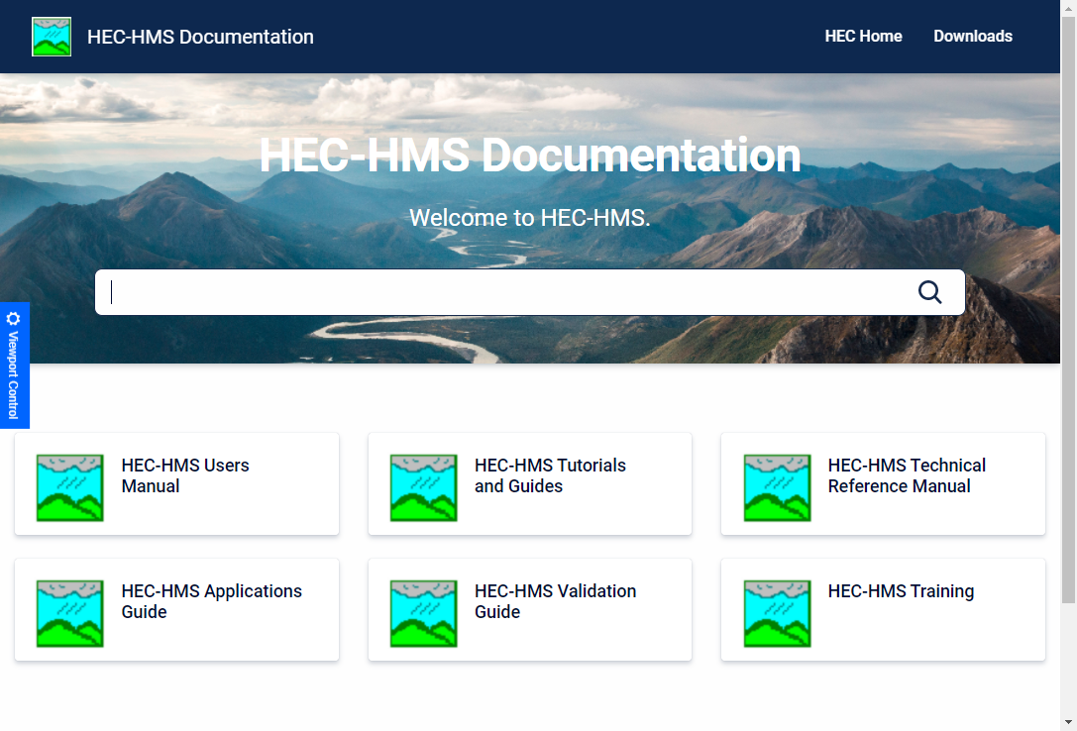
Questions?
Docs: https://www.hec.usace.army.mil/confluence/hmsdocs
To be added to the list, send an email to hec.hms@usace.army.mil with “subscribe” in the title or body.

Slide 25
HEC-HMS Version 4.9 New Capability
Multiple Element Merge
Enhanced Element Split
Basin Reproject
Automated Forecast
Output Control
Generalized Meteorologic Processes
Basin-Meteorology Linking
Normalizer Utility
Gridded Data Processing Utilities
Generalized Extreme Value and Four-Parameter Kappa Distributions
Constant Value Error Term - Regression With Additive Error
Additional Baseflow Parameters Available in Uncertainty Analysis
Simple Canopy Crop Coefficient Available in Optimization Trial and Uncertainty Analysis
Global File Reference Table
Default Behavior when File is Missing
Visual Cues for File References
2D Diffusion Wave Transform Enhancements
2D Flow Support for macOS and Linux
Pre-packaged Native Dependencies for Linux
Optimization using Snow Water Equivalent Time Series
Maricopa Tools
Debris Yield Global Editors
Calibration Summary Table
Differential Evolution Optimization Search Method
Optimization Data Transforms
Spatial Results Tooltips and Time Series
2D Sediment Transport
Rename Basin Model Elements
Updated Raster Display Settings Editor
DSS Grid Record Validator

Slide 26
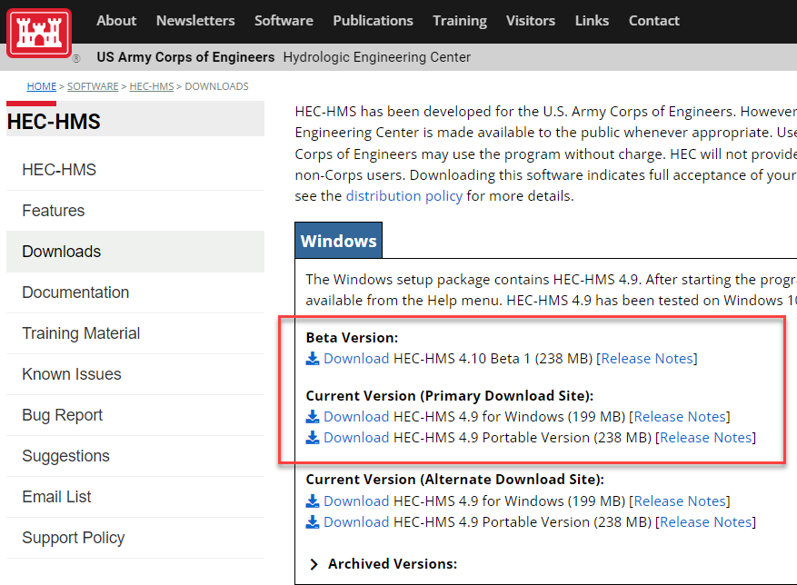
HEC-HMS Version 4.10 New capability
Frequency Analysis Compute
Interpolated Meteorology
Frequency Storm Enhancements
Legend, Scale Bar, and North Arrow
Time Series Plot Enhancements
Display Minimum and Maximum Spatial Results
Brune Trap Efficiency Method
Dynamic Reservoir Volume Reduction Method
Simplex Optimization Improvements
Resume Differential Evolution Optimization
Normalized Nash-Sutcliffe Efficiency Optimization Objective Function
Calibration Results Map Layer for Flow and SWE
Global Basin Editors
Default Snowmelt Graph

