Slide 1
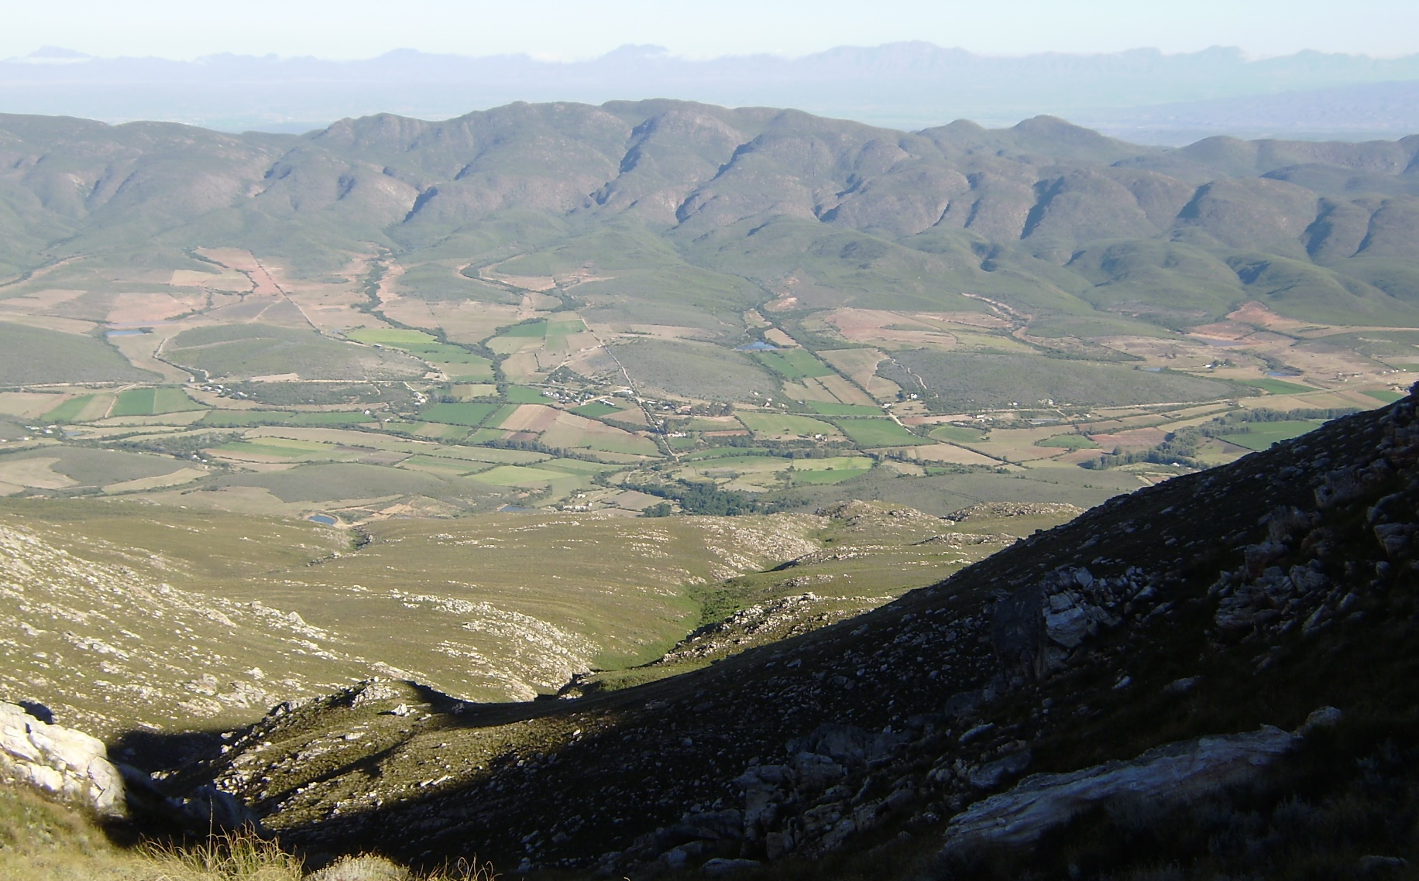
Two-Dimensional Flow Enhancements and Applications within HEC-HMS
Mike Bartles, P.E.
Hydrologic Engineering Center

Slide 2
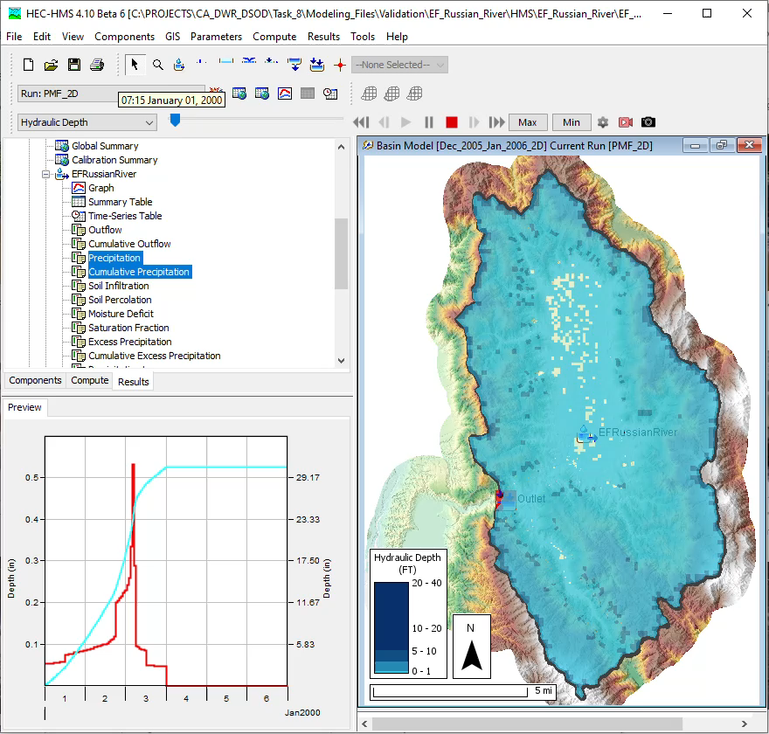
Overview
Objectives
Technical background
Significance of these features
Case studies
Tech transfer
Next steps
Questions
Notes:
Within this presentation:
Discuss why we added the 2D flow and sediment transport capabilities to HEC-HMS
Go over some of the technical background and significance of these features
I’ll show two case studies that demonstrate the new capabilities within HEC-HMS software
I’ll then finish with tech transfer documentation, discussion of our next steps and planned future improvements, and take questions

Slide 3
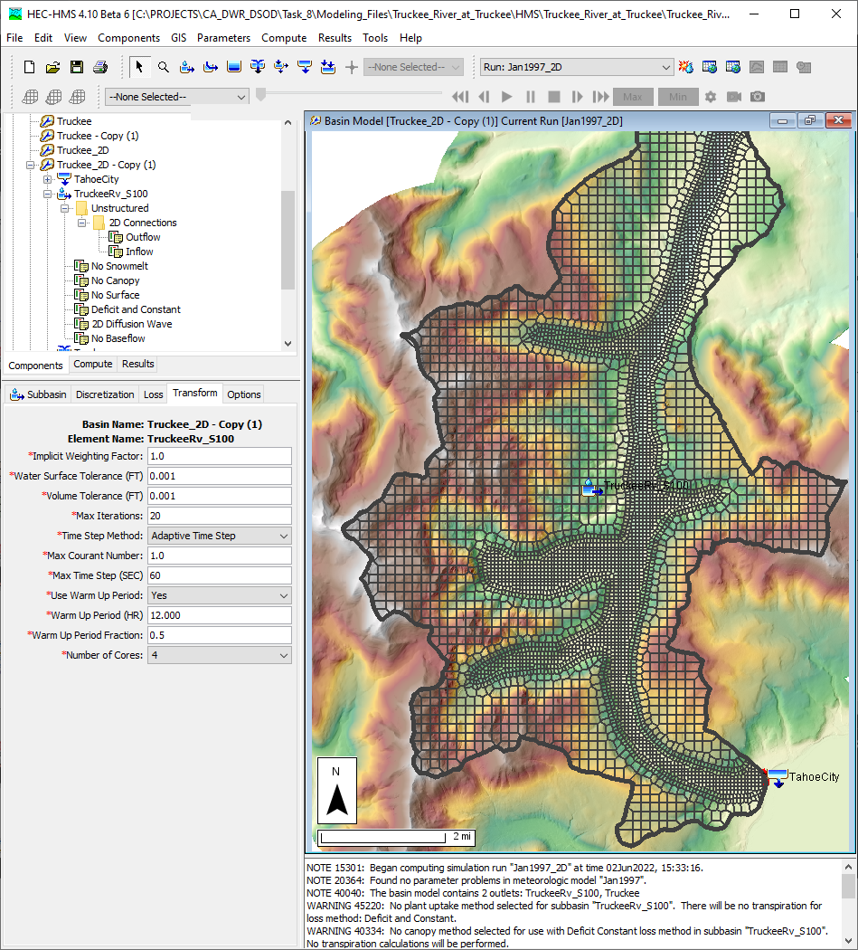
Objectives
Leverage HEC’s 2D solver to add 2D flow and sediment transport capabilities to HEC-HMS
Shared computational engine
between HEC-HMS and HEC-RAS
Release 2D capabilities for multiple platforms
3
Notes:
We set out to implement the 2D solver that was pioneered by the HEC-RAS team within HEC-HMS as part of a USACE R&D project
This would expose the 2D solver to a new array of hydrologic applications
As improvements are made to the solver, both teams benefit and the solver becomes more robust
We also set out to release the 2D flow and sediment transport capabilities to a wide range of platforms including Windows, MacOS, and Linux. Previously, these capabilities were only available for Windows operating systems.

Slide 4
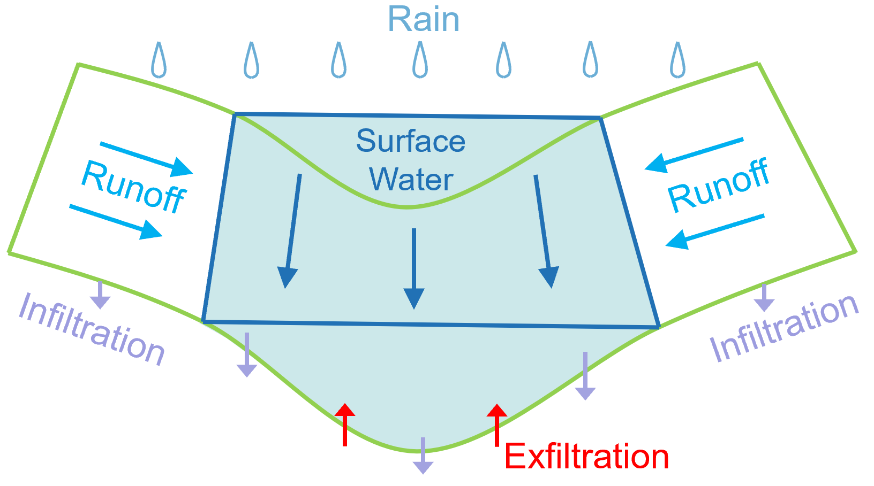
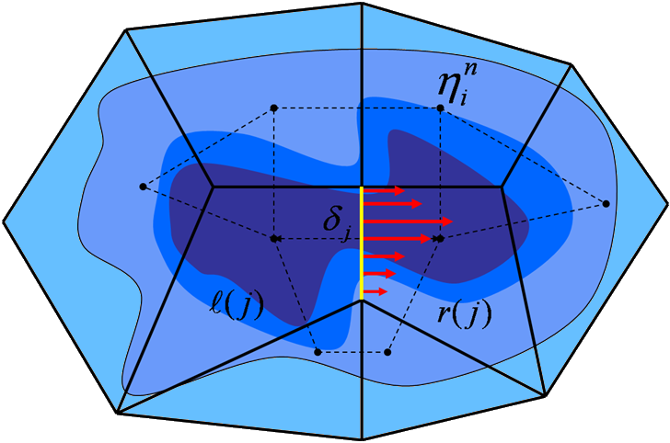
2D Flow Features
2D Diffusion Wave Equation Set
  Additional equation sets coming soon…
Fixed or Courant-based Adaptive Time Step
Use all existing meteorology, canopy, surface, infiltration, and baseflow* methods
Infiltration
  Separate calculations for hydraulically
  wet and dry portions of each cell
  Additional infiltration methods available
  HEC-RAS computes single infiltration rate per cell and ignores local water depths
Baseflow
  Linear Reservoir | Interflow option can allow infiltrated water to return to the surface
Notes:
This slide highlights the major differences between the 2D flow capabilities within HEC-RAS and HEC-HMS
Currently, the only equation set that is available is the 2D Diffusion Wave
However, we have plans of adding the Full Momentum (or shallow water) and Local Inertial Approximation equation sets in the near future
Just like HEC-RAS, the time step can be fixed or adaptable based the Courant condition
However, it’s changed ever so slightly differently than HEC-RAS
When you use the 2D engine within HEC-HMS, you’re able to combine it with all existing meteorology, canopy, surface, infiltration, and baseflow* methods with a minor caveat
There are only a few baseflow methods that are truly compatible with the 2D engine since several baseflow methods depend upon the computation of a direct runoff hydrograph
Infiltration is calculated separately for hydraulically wet and dry portions of each cell
Also, infiltration can occur at any time and in any cell within HEC-HMS
This differs from the infiltration algorithms available within HEC-RAS in that, within that application, an excess precipitation hyetograph is first computed and then applied directly to the mesh and no further infiltration computations occur
Finally, one more thing about baseflow within HEC-HMS
We’ve added a special baseflow method within HEC-HMS that can only be used with 2D flow that can allow infiltrated water to return to the surface

Slide 5
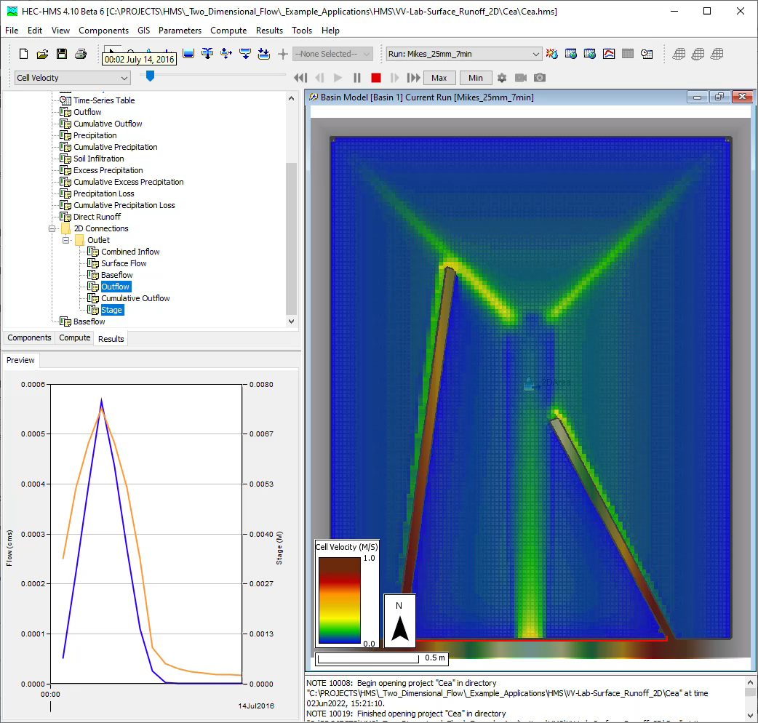
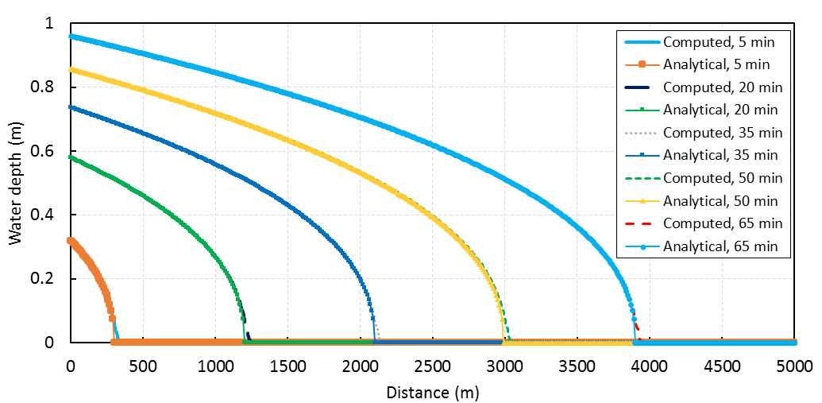
2D Flow V&V
Analytical Flood Wave
  Hunter (2005)
2D Surface Runoff
  Cea et al (2008)
HEC-RAS comparisons
Notes:
The 2D flow engine within HEC-HMS was verified using several published data sets include Hunter (2005) and Cea et al (2008)
The 2D flow engine within HEC-HMS was also verified using HEC-RAS
Essentially, we’d create models using both HEC-HMS and HEC-RAS, hold as many inputs as possible constant, compute, and compare the differences

Slide 6
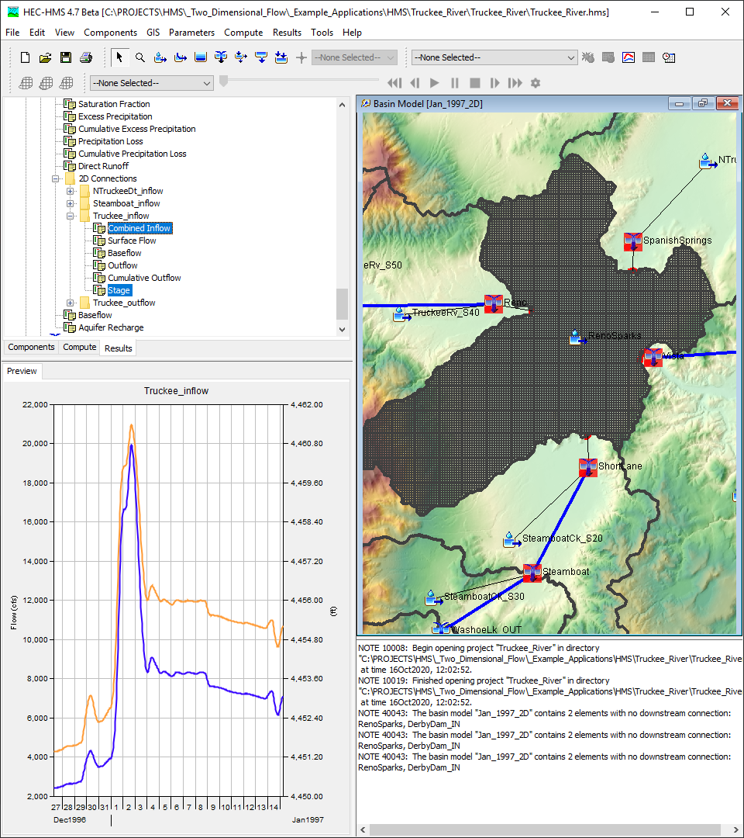
What Can the Modeling Community Achieve Now that it couldn’t before?
Users can simulate complex situations where necessary
  Not every situation warrants the most complex solution
Users shouldn’t be required to change the entire model to simulate complex hydrodynamic situations in localized areas
Numerous aspects of HEC-HMS needed modification to support 2D flow and sediment transport
  User interface
  Model/computational code
  Plotting/tabulating data
  Spatial results
Notes:
HEC-HMS is a unique tool within the H&H community’s toolbox (so to say) in that users can choose the processes and parameterizations that are most appropriate for their uses in both space and time; just by choosing HEC-HMS doesn’t mean that you’re locked into a specific set of processes and/or parameterizations
Not all situations warrant the most complex solutions; in many cases, hydrologic routing techniques like unit hydrograph transform work just fine
However, that’s not always the case. If users would like to use these new complex features, they should be able to use them in only the places that are necessary.
Also, users shouldn’t have to modify EVERYTHING to simulate localized complex situations
Almost all aspects of HEC-HMS needed to be modified to effectively utilize and realize the benefits of these enhancements
This includes the UI, the model code that communicates between the UI and computation code, the way in which plots and tables are generated and populated, and the way in which results are shown in space

Slide 7
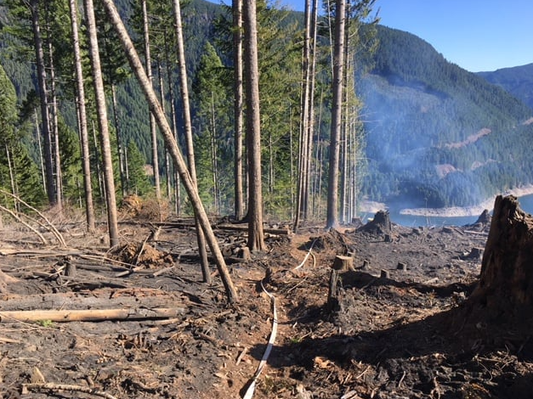
What Types of Studies Will Benefit From this Work?
Studies that have existing models but require more detail in specific areas
  CWMS National Implementation Plan
  FEMA Future of Flood Risk Data (FFRD)
Substantial physical changes within an area
  Post fire
  Land use changes
Extreme event simulations
  Dam and Levee safety studies
Reservoir sedimentation studies
Non-point source sediment studies
Detroit Dam
Oregon Dept. of Forestry
Notes:
There are numerous types of studies that will benefit from this work
A great example are those areas that already have existing models but need a bit more definition in a particular area
For instance, there are currently over 150 HEC-HMS models that were created as part of the CWMS national implementation plan
Beyond forecasting, these models are also used within planning studies where different with project alternatives are compared
If users need more definition in a particular area to predict the effects of the with project conditions, they can incorporate the HEC-HMS 2D capabilities without having to change anything else
Other examples of the types of studies that will benefit from this work include areas where substantial physical changes have occurred either due to wildfires or land use changes, studies where unit hydrograph theory limitations cannot be tolerated (e.g. dam safety), and non-point source sediment studies

Slide 8
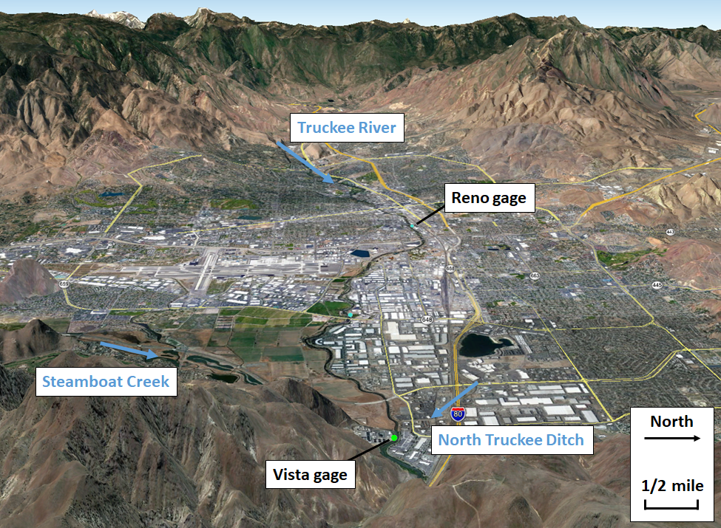
Notes:
A great example of the types of things that users can achieve now that they couldn’t before is exemplified by the area in and around Reno and Sparks, NV
The Truckee River flows through the city and has periodically exceeded channel capacities and caused significant damage

Slide 9
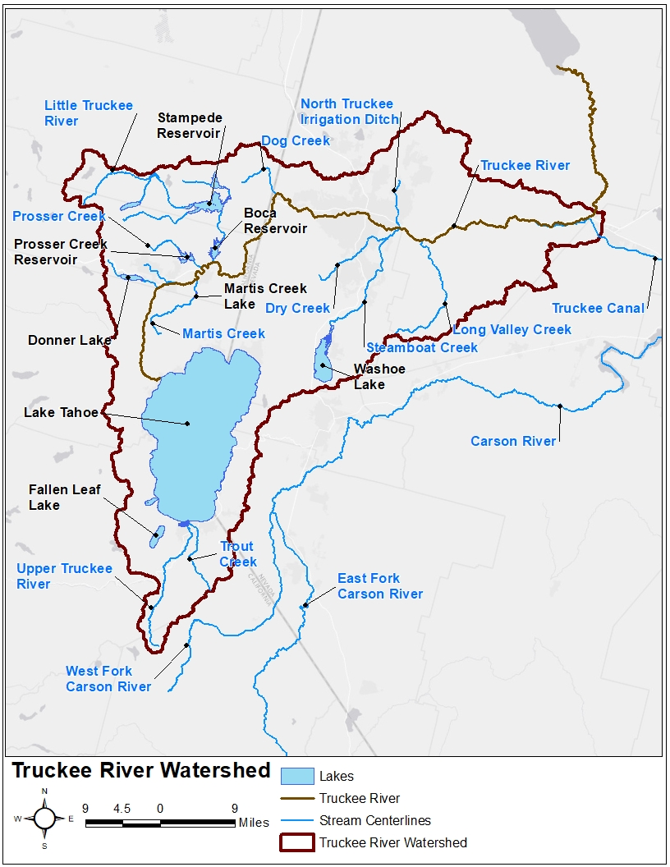
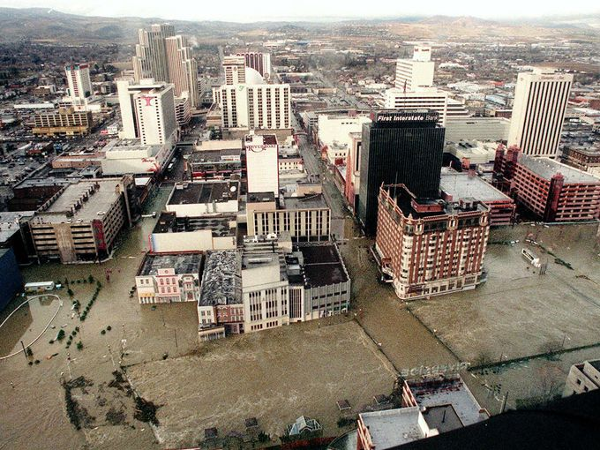
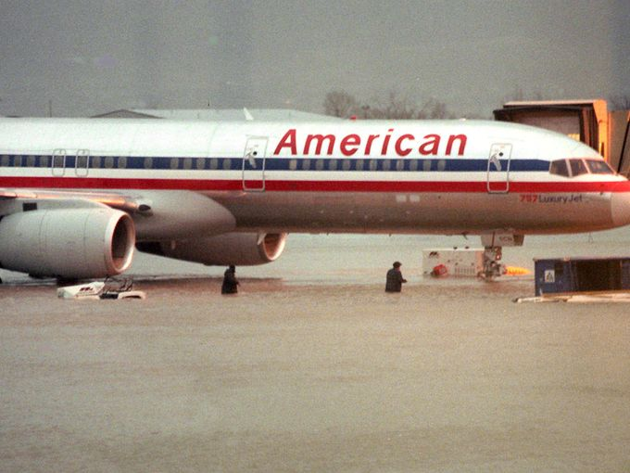
Notes:
The Jan 1997 flood event is the largest flood to have affected the city in the last few decades
You can see flood waters moving through the downtown Reno area in the first image
You can also see flood waters inundating the Reno Airport

Slide 10
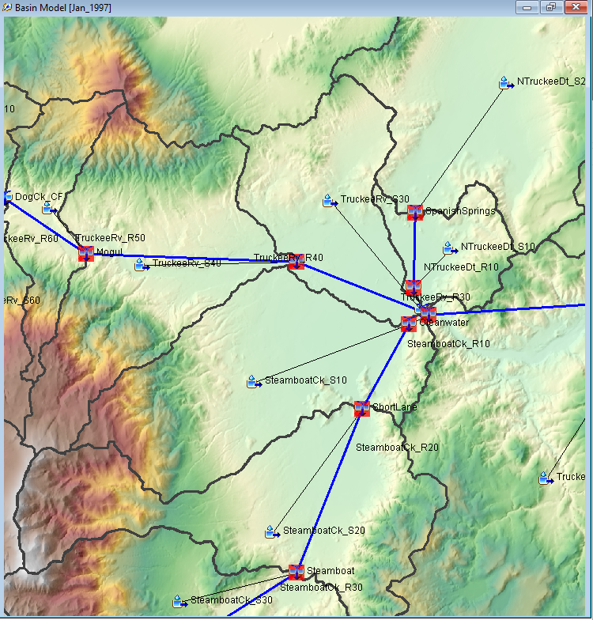
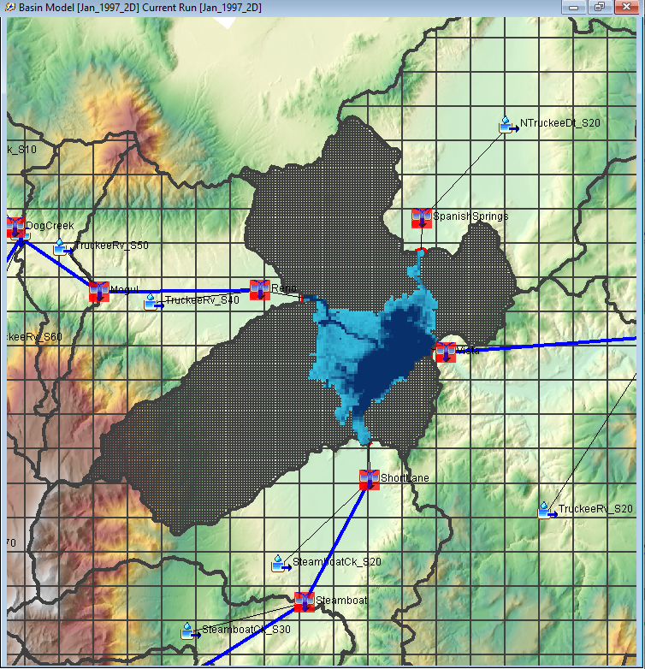
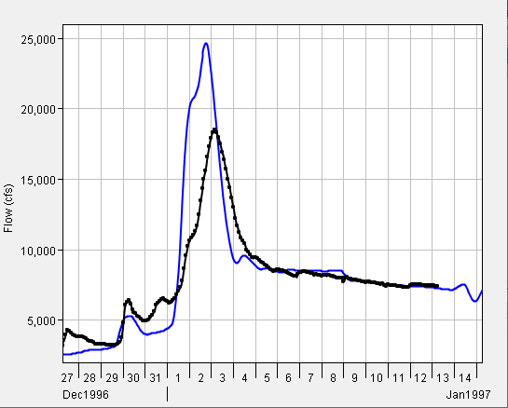
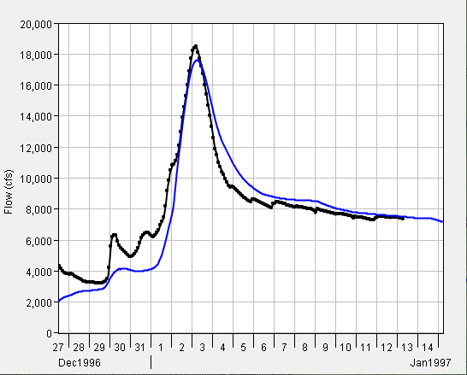
Observed
Computed
Observed
Computed
Notes:
An HEC-HMS model was created as part of the Truckee River CWMS implementation which used unit hydrograph transform and hydrologic routing through the Reno/Sparks area
The Truckee River upstream of Reno/Sparks is heavily incised and these methods worked fine to compute runoff rates.
However, the slope of the Truckee River DRASTICALLY flattens and the floodplain opens up through Reno/Sparks
Hydrologic routing methods don’t work too well when channel slopes decrease this much and water gets out of bank and spreads laterally
As such, the results obtained through hydrologic routing throughout and downstream of the Reno/Sparks aren’t that great; in particular, runoff rates are overpredicted, as shown in the image in the lower left
The existing HMS model was modified by merging the three subbasin elements within the Reno/Sparks area, importing a 2D mesh and several 2D connections, and utilizing the 2D Diffusion Wave transform method
The movement of water throughout this flat area is MUCH better handled with 2D Diff Wave
You can see how flood water spreads throughout the area and translation/attenuation processes are much better captured in the image on the lower right

Slide 11
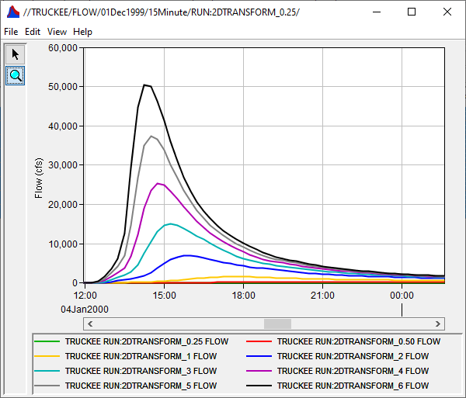
Variable Clark Parameters
Develop regression equations for California that can predict how Clark unit hydrograph parameters vary w.r.t. excess precipitation
Use 2D transform simulations to inform variable Clark unit hydrograph parameters
Variable Clark Unit Hydrograph Workshop
Notes:
Another example of a study that benefited from these capabilities is one that we recently completed for the state of California
Within this study, we set out to develop regression equations that can predict how Clark unit hydrograph parameters vary with respect to excess precipitation, which is demonstrated in the right hand image
This is an important thing to consider when extrapolating beyond the range of observed data, as is common within dam and levee safety studies
We used the 2D transform method within HEC-HMS to inform variable Clark unit hydrograph parameters

Slide 12
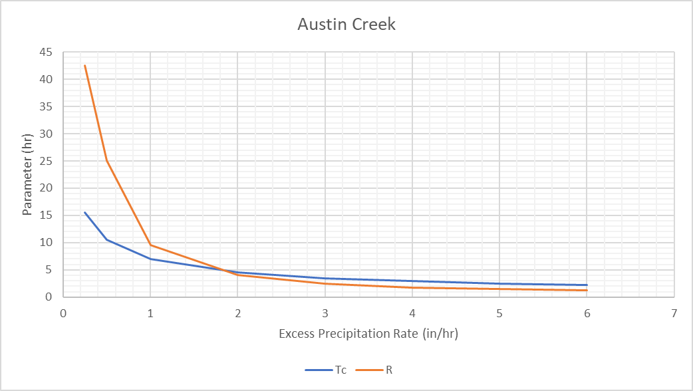
Variable Clark Parameters
Notes:
Following the calibration of each historical event HEC-HMS model, 0.25-, 0.5-, 1.0-, 2.0-, 3.0-, 4.0-, 5.0-, and 6.0-inches of excess precipitation over one hour was applied to each modeling domain and routed using the calibrated 2D diffusion wave transform parameters.
No losses or baseflow processes were included within these simulations.
The resultant outputs of these 2D hypothetical event simulations were then used to calibrate Clark unit hydrograph parameters for each excess precipitation rate.
This ended up producing Tc and R values for all the aforementioned excess precipitation rates at each location

Slide 13
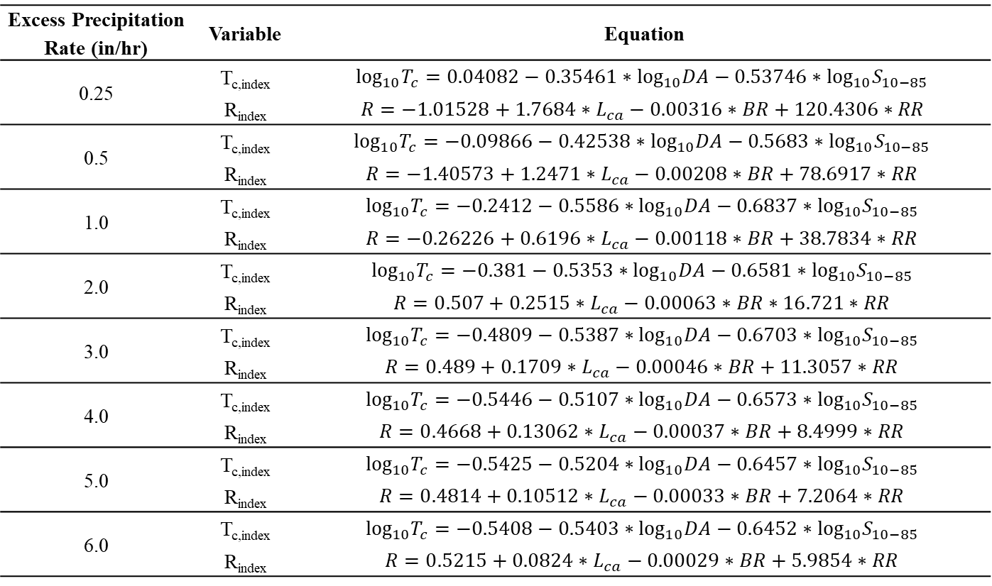
Results
Excess Precipitation Rate (in/hr) | Variable | Equation
0.25 | T_{c,index} | $$\log_{10}T_{c}=0.04082−0.35461∗\log_{10}DA−0.53746∗{\log_{10}S}_{10−85}$$
 | R_{index} | $$R=−1.01528+1.7684∗L_{ca}−0.00316∗BR+120.4306∗RR$$
0.5 | T_{c,index} | $$\log_{10}T_{c}=−0.09866−0.42538∗\log_{10}DA−0.5683∗{\log_{10}S}_{10−85}$$
 | R_{index} | $$R=−1.40573+1.2471∗L_{ca}−0.00208∗BR+78.6917∗RR$$
1.0 | T_{c,index} | $$\log_{10}T_{c}=−0.2412−0.5586∗\log_{10}DA−0.6837∗{\log_{10}S}_{10−85}$$
 | R_{index} | $$R=−0.26226+0.6196∗L_{ca}−0.00118∗BR+38.7834∗RR$$
2.0 | T_{c,index} | $$\log_{10}T_{c}=−0.381−0.5353∗\log_{10}DA−0.6581∗{\log_{10}S}_{10−85}$$
 | R_{index} | $$R=0.507+0.2515∗L_{ca}−0.00063∗BR∗16.721∗RR$$
3.0 | T_{c,index} | $$\log_{10}T_{c}=−0.4809−0.5387∗\log_{10}DA−0.6703∗{\log_{10}S}_{10−85}$$
 | R_{index} | $$R=0.489+0.1709∗L_{ca}−0.00046∗BR+11.3057∗RR$$
4.0 | T_{c,index} | $$\log_{10}T_{c}=−0.5446−0.5107∗\log_{10}DA−0.6573∗{\log_{10}S}_{10−85}$$
 | R_{index} | $$R=0.4668+0.13062∗L_{ca}−0.00037∗BR+8.4999∗RR$$
5.0 | T_{c,index} | $$\log_{10}T_{c}=−0.5425−0.5204∗\log_{10}DA−0.6457∗\log_{10}S_{10−85}$$
 | R_{index} | $$R=0.4814+0.10512∗L_{ca}−0.00033∗BR+7.2064∗RR$$
6.0 | T_{c,index} | $$\log_{10}T_{c}=−0.5408−0.5403∗\log_{10}DA−0.6452∗{\log_{10}S}_{10−85}$$
 | R_{index} | $$R=0.5215+0.0824∗L_{ca}−0.00029∗BR+5.9854∗RR$$
Notes:
Here are all the regression equations that were developed

Slide 14
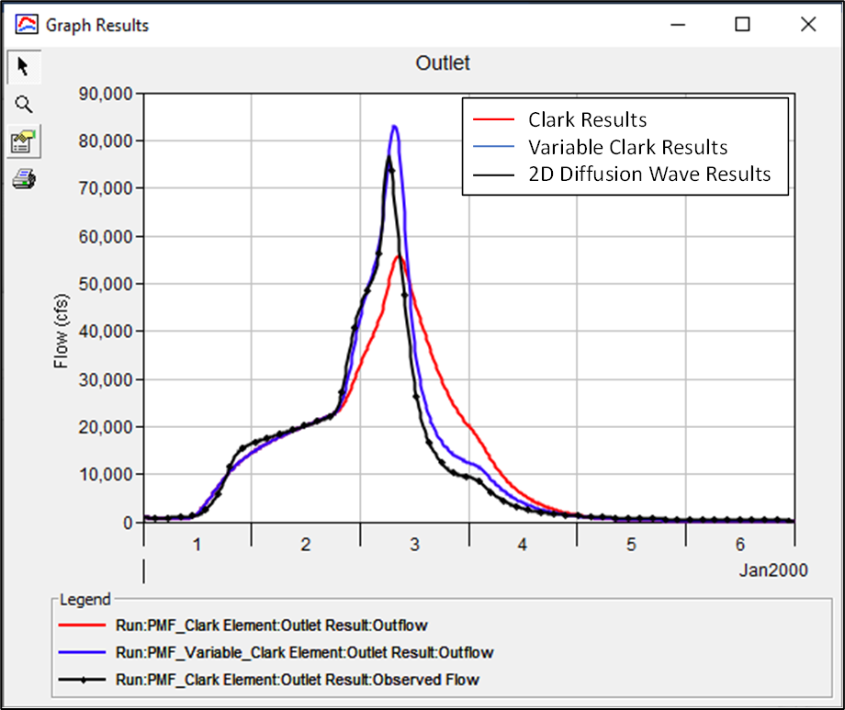
Validation Results
Notes:
This is an example of the validation process for the EF Russian River location
The event simulated is the approximate PMF
As you can see, the predicted Variable Clark parameters agree pretty well when compared against the 2D Diffusion Wave transform results. The Variable Clark peak is actually slightly larger than the 2D Diffusion Wave results.
As expected, the “base” Clark results underpredict the peak when compared against the 2D Diffusion Wave transform results. This is to be expected since the Clark parameters were calibrated for an event that is much less intense than the PMF event
Excess precipitation rates = 0.44 in/hr (Dec2005-Jan2006) vs 2.1 in/hr (PMF)

Slide 15
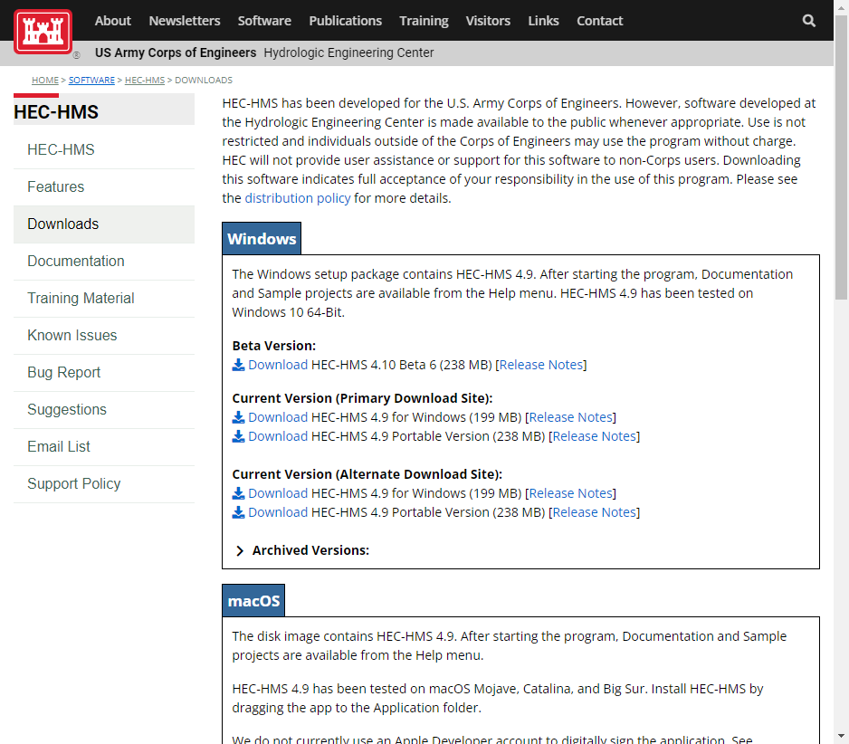
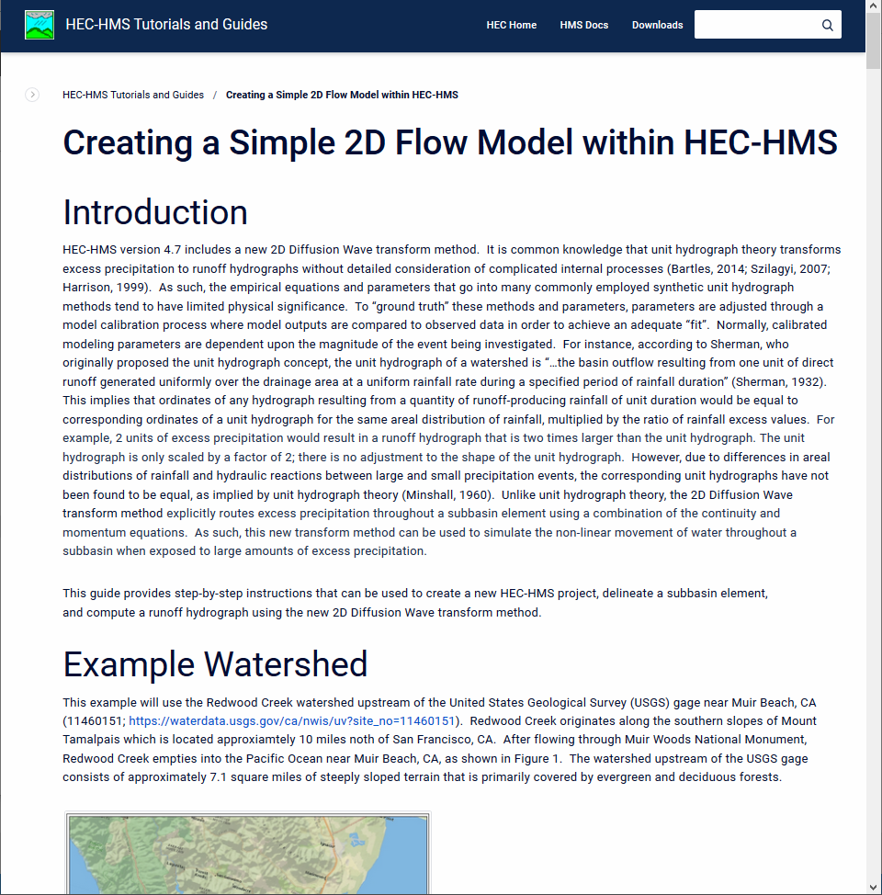
Tech Transfer
2D Flow Tutorials and Guides
HEC-HMS Download
Notes:
These capabilities have been available since the release of v4.7
The latest official release is v4.9, but we are hoping to release v4.10 in the next month or so
The image on the left shows our website where users can download the latest version of HEC-HMS which contains these 2D capabilities
We’ve also developed documentation, tutorials, and guides specific to these 2D capabilities and posted them to our website as well

Slide 16
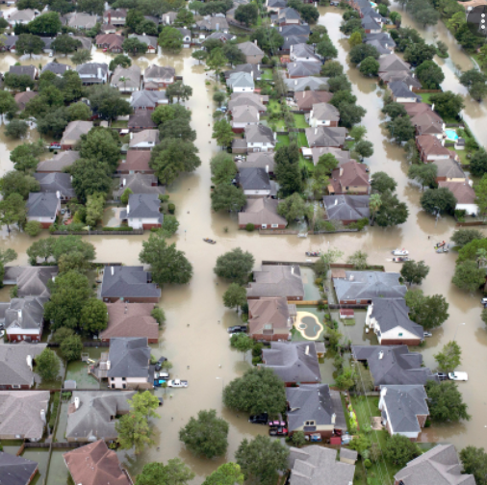
Upcoming Version 4.11 2D Features
Use multiple meshes in a single basin model
Create and edit meshes and 2D connections within UI
Allow for roughness value modifications
Create, edit, and use hydraulic structures w/in a 2D mesh
Incorporate additional equation sets
  Local Inertial Approximation
  Shallow Water Equations
2D groundwater flow
Notes:
USACE R&D paid for the development and implementation of these features
THANK YOU!
We’re currently using these new features to evaluate additional topics within other R&D work units, namely Ian’s Arid Regions work unit
Customers both within USACE and outside USACE have seen these features and are providing funding to develop and integrate additional features like those shown on the slide

Slide 17
Conclusion
2D Flow and Sediment capabilities have been added to HEC-HMS
Latest release is v4.9
Upcoming v4.10 release
Multiple partners are currently using these enhancements
Customers are investing in additional 2D enhancements
Notes:
To summarize, we’ve added 2D flow and sediment capabilities within HEC-HMS
Users are evaluating these features
Folks within USACE and outside USACE have invested in additional 2D enhancements to meet their specific needs

