Slide 1
Impactful New Modeling Capability in HEC-HMS
World Environmental & Water Resources Congress 2022
Matt Fleming, P.E.
Hydrologic Engineering Center
U.S. Army Corps of Engineers

Slide 2
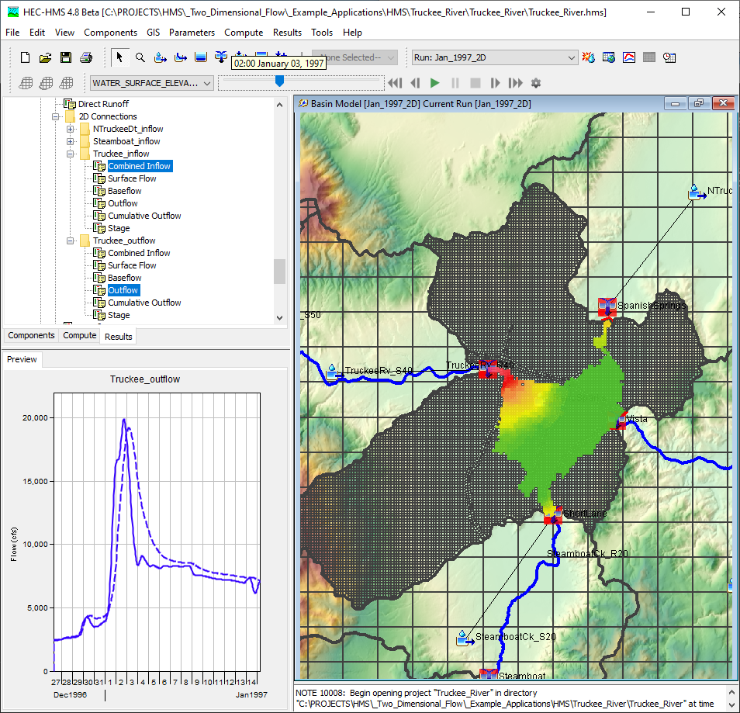
Outline
Background
Tech Transfer
GIS Tools
Spatial Results
Output Control
Reports
Questions

Slide 3
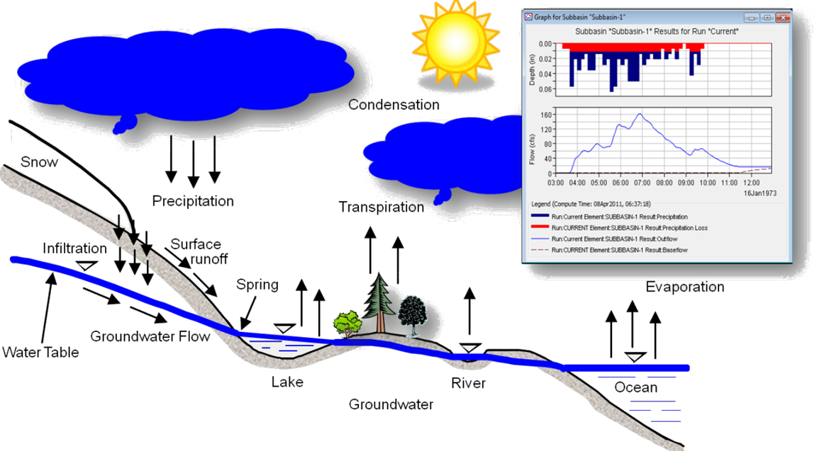
Hydrologic Modeling System

Slide 4
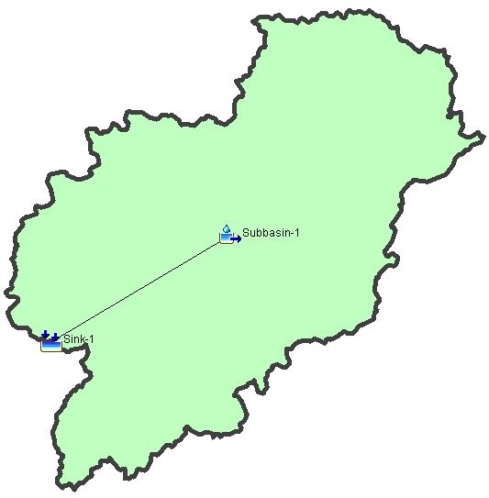
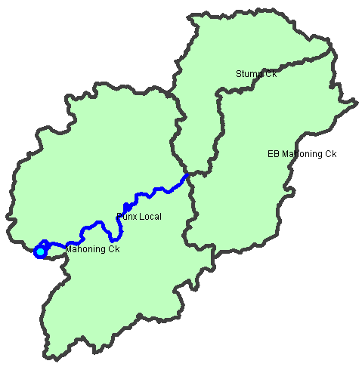
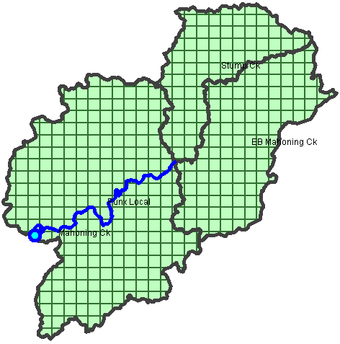
Subbasin-average or Gridded

Slide 5
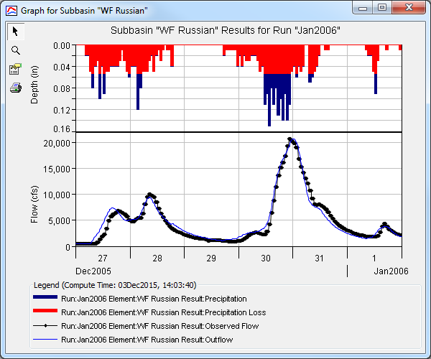
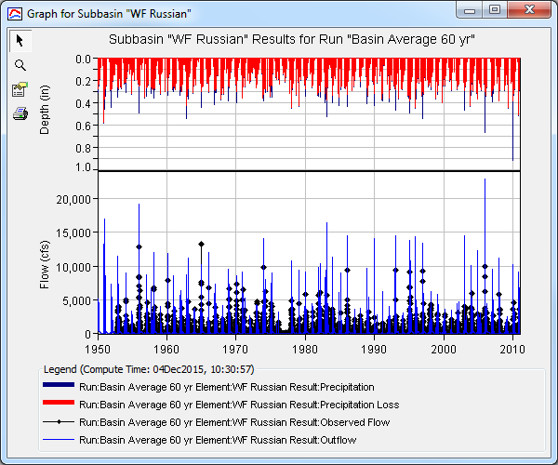
Event OR Continuous

Slide 6
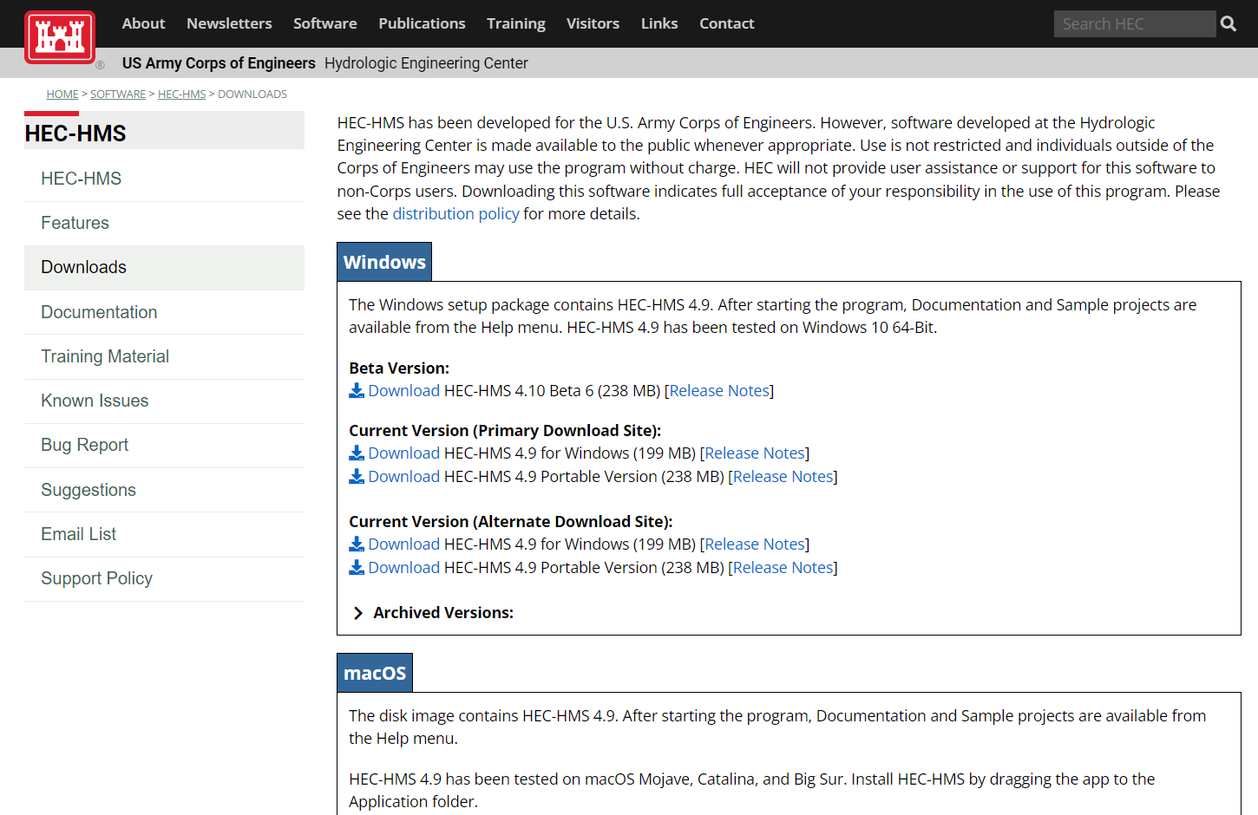
Technology Transfer
Latest Release
  Version 4.9
Beta Release
  Version 4.10
MacOS and Linux versions available
HEC-HMS Webpage

Slide 7
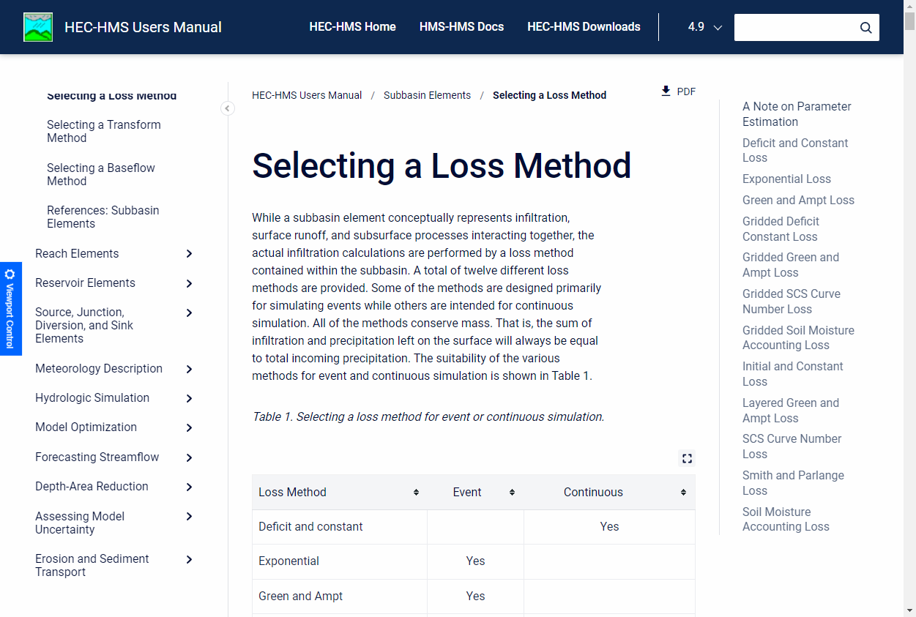
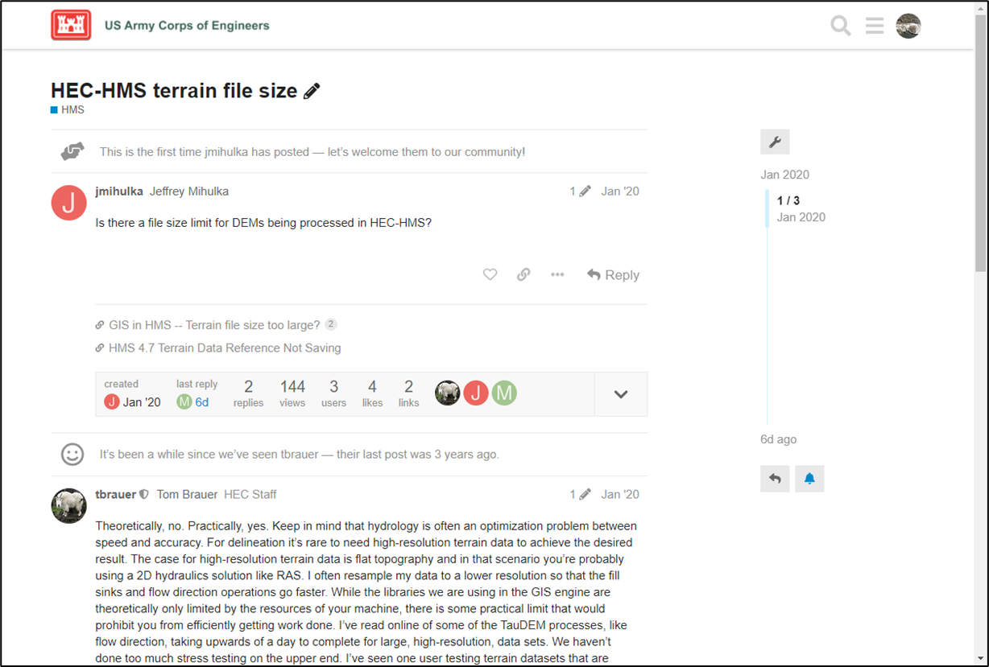
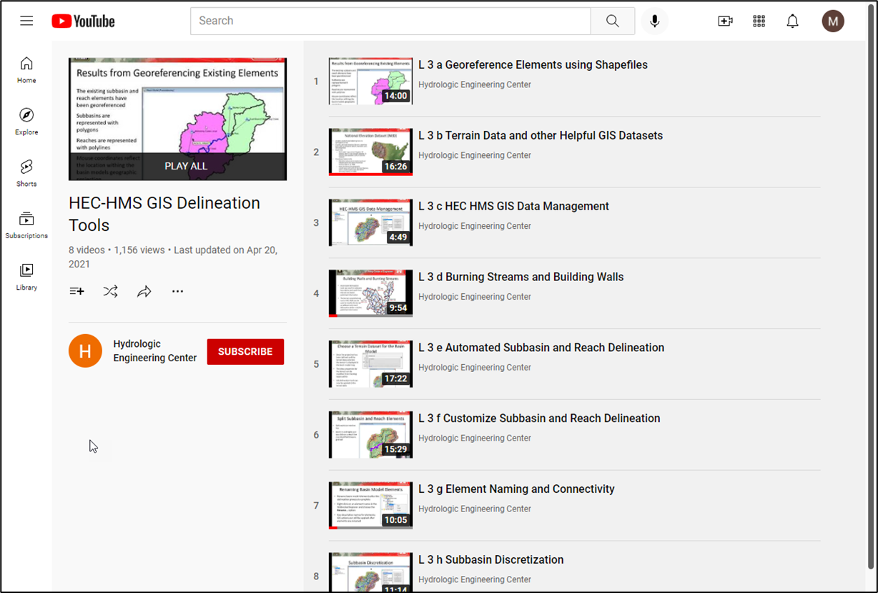
Technology Transfer

Slide 8
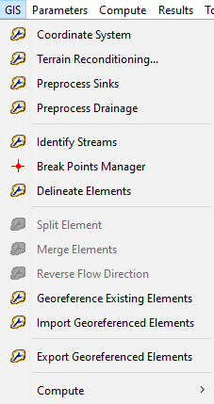
HEC-HMS GIS Tools
TauDEM GIS library is used to define the flow direction, flow accumulation, and stream grids
The user defines the stream threshold
A default delineation is performed
Tools are available to customize the delineation by merging elements or splitting subbasins and reaches
GIS tools are available for computing physical characteristics
GIS tools are available for estimating model parameters

Slide 9
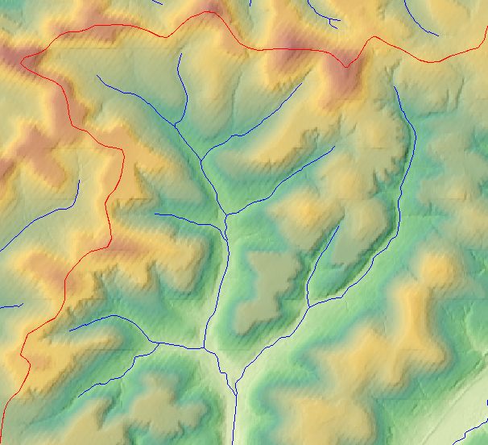
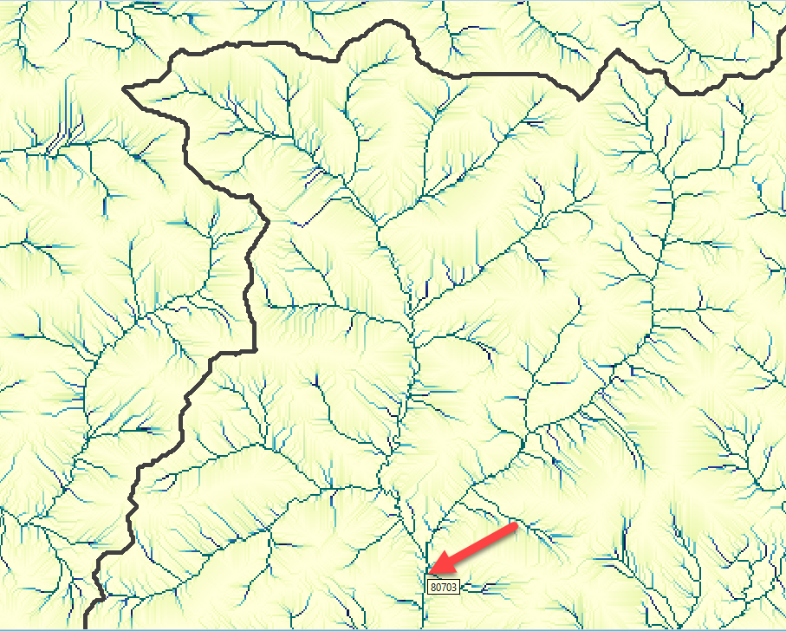
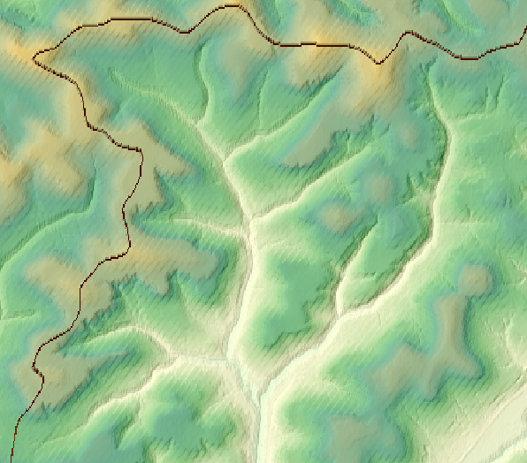
HEC-HMS GIS Tools
Original Terrain with desired subbasin boundaries (red) and a stream network (blue)
Flow Accumulation computes the number of upstream grid cells
Reconditioned Terrain

Slide 10
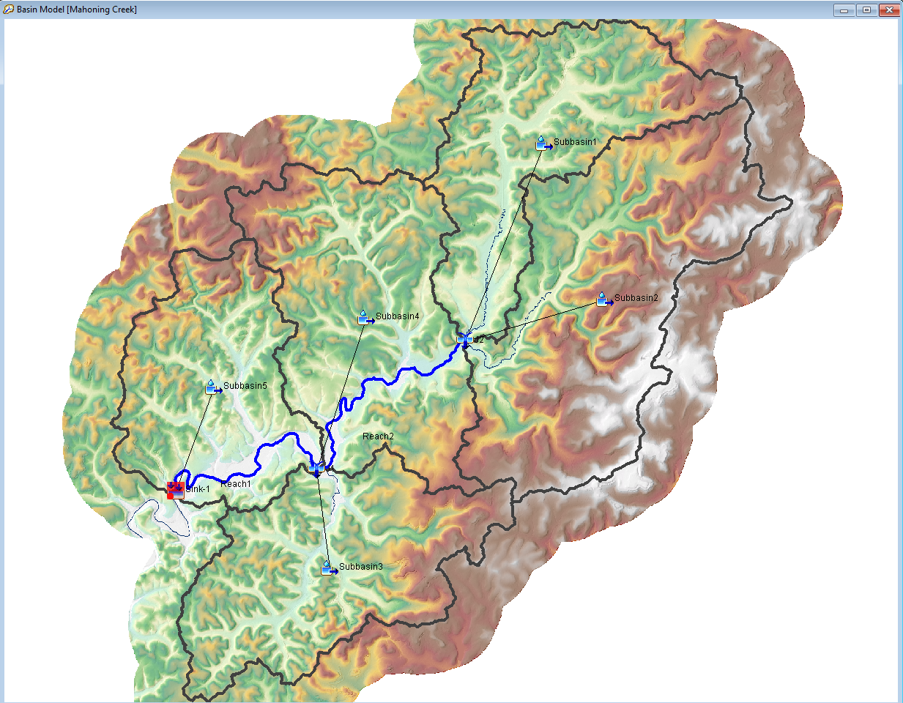
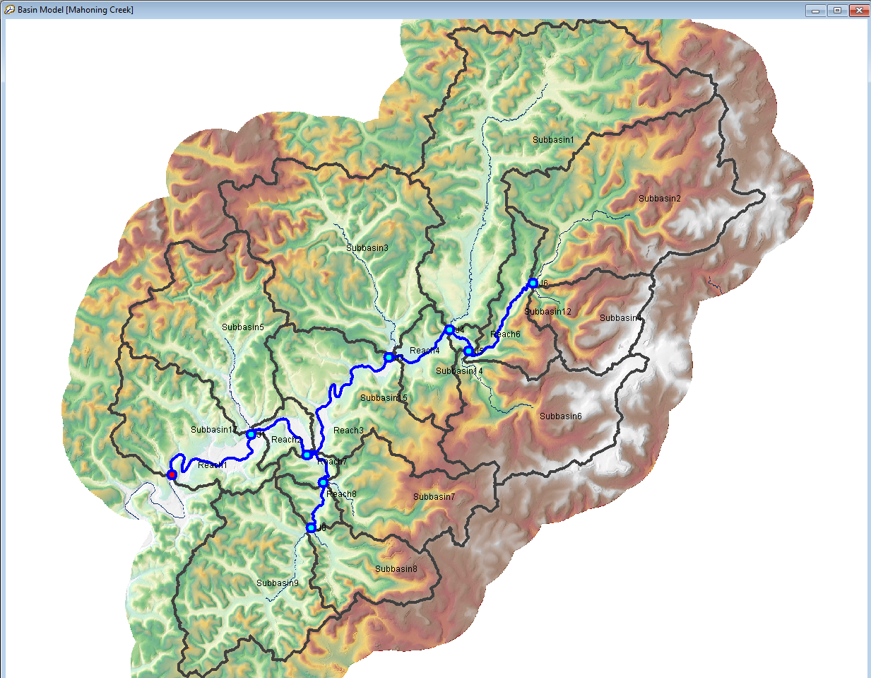
HEC-HMS GIS Tools
Stream threshold set to 15 square miles resulted in 5 subbasins
Stream threshold set to 5 square miles resulted in 17 subbasins

Slide 11
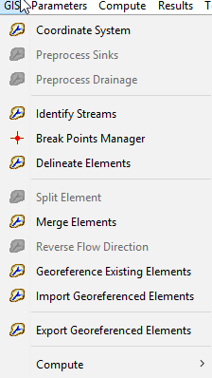
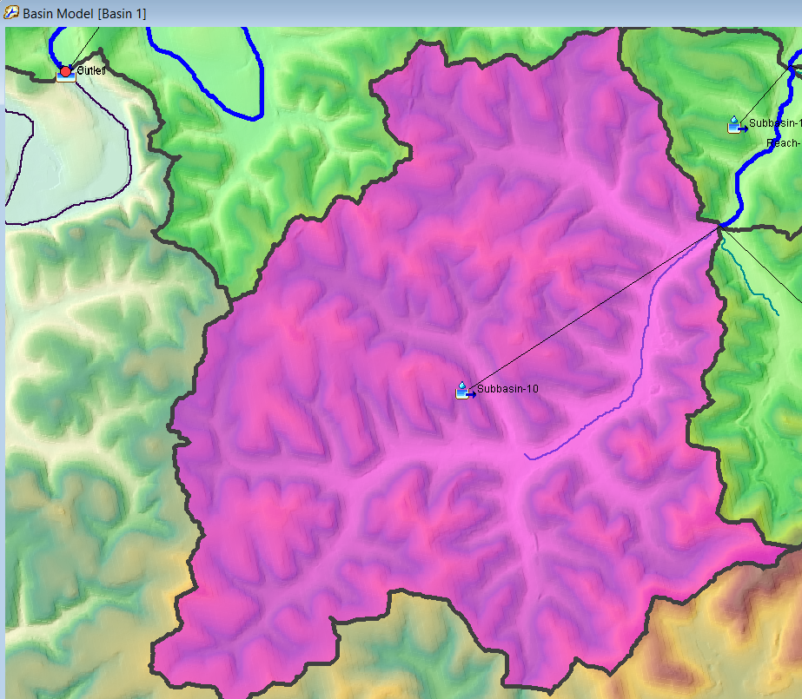
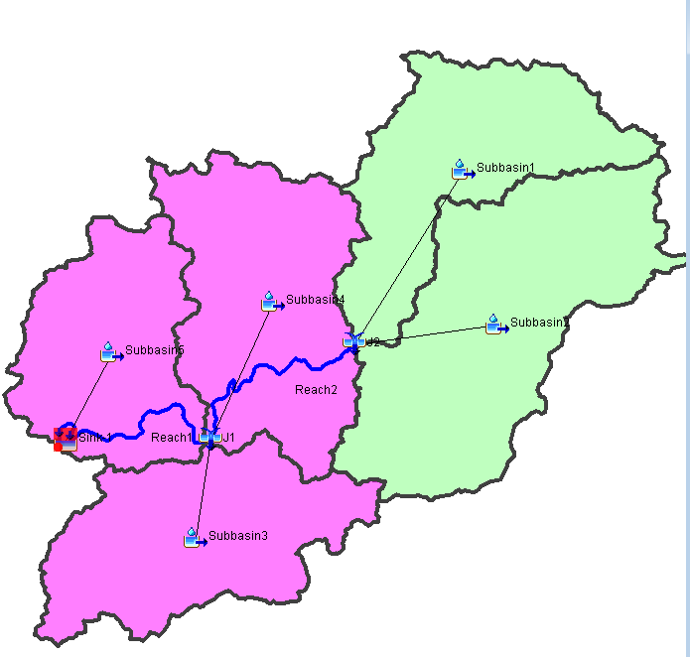
HEC-HMS GIS Tools
Merge hydrologically adjacent elements
Split element
Notes:
Subbasin and reach elements must be hydrologically adjacent in order to merge
Select the elements to merge in the watershed explorer or through the basin model map
Two or more elements can be merged at one time
New subbasin and reach elements can be added using the Split Element tool
First, select an element in the basin model
Then, select the Split Element option on the GIS menu
Zoom into the location where the split will occur and click on an existing identified stream grid cell (or on a stream identified in the flow accumulation grid)

Slide 12
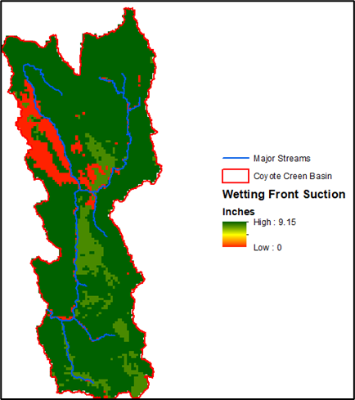
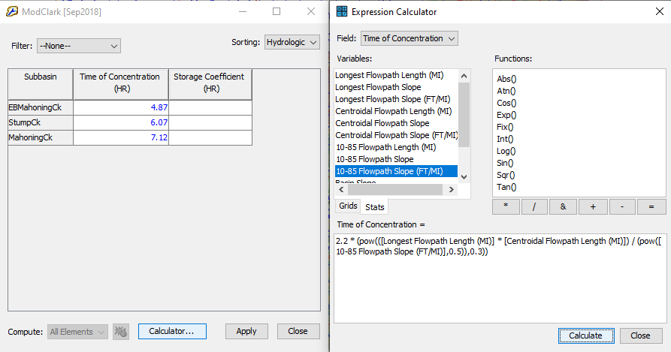
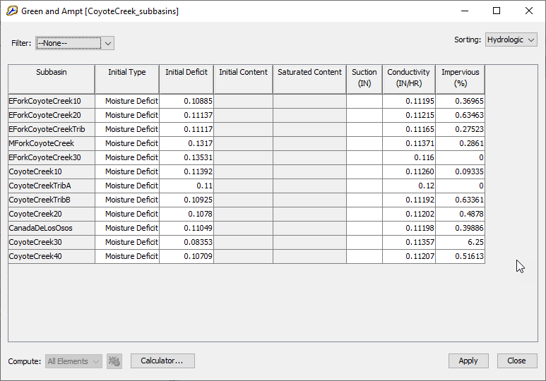
HEC-HMS GIS Tools
The Expression Calculator can be used to facilitate parameter estimation from Subbasin/Reach Characteristics and GIS datasets.

Slide 13
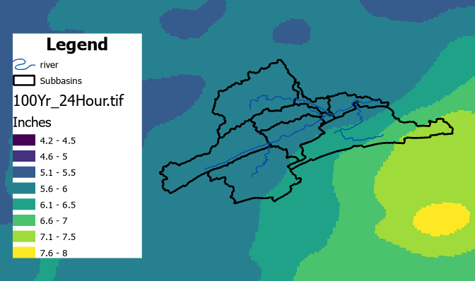
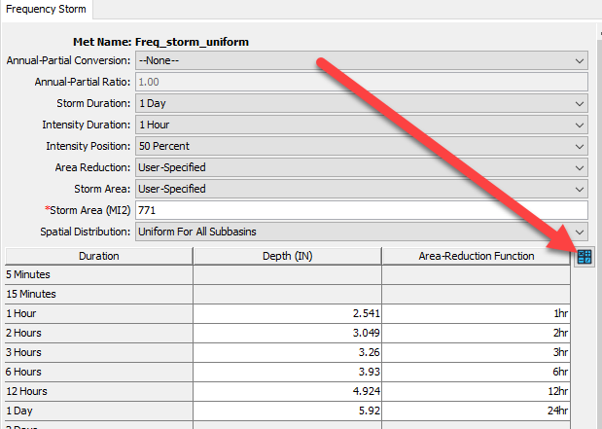
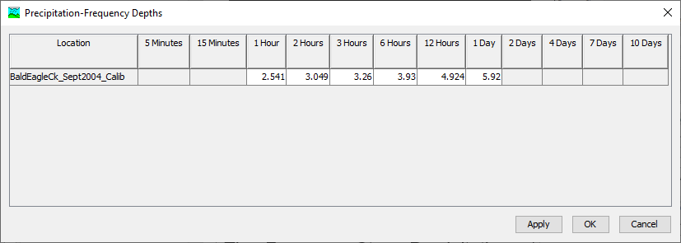
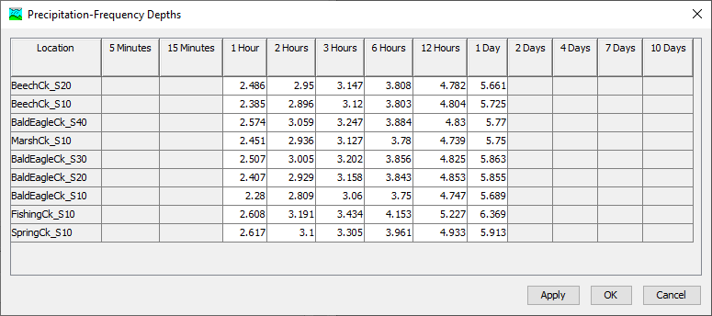
HEC-HMS GIS Tools
The Frequency Storm Precipitation Depth Calculator can compute watershed and subbasin average precipitation depths from raster datasets.

Slide 14
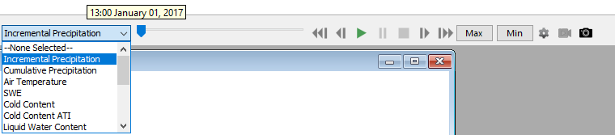
Spatial Results
  Incremental/Cumulative Precipitation, Loss and Excess
  Temperature
  Snow
  2D Transform Output
  Calibration Metrics
Animation Controls
Min/Max Results
Display Properties
Capture and Export Animation
Export Grid

Slide 15
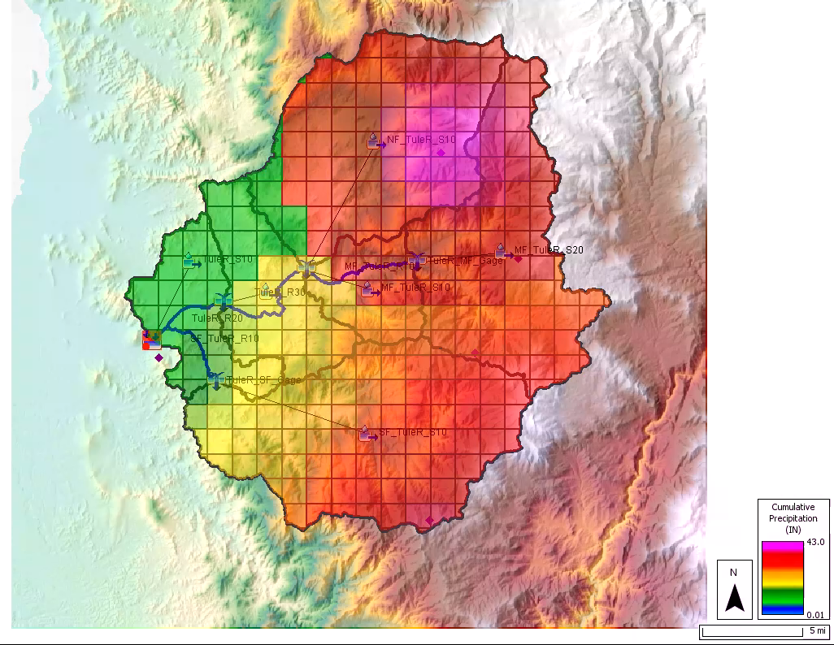
Spatial Results

Slide 16
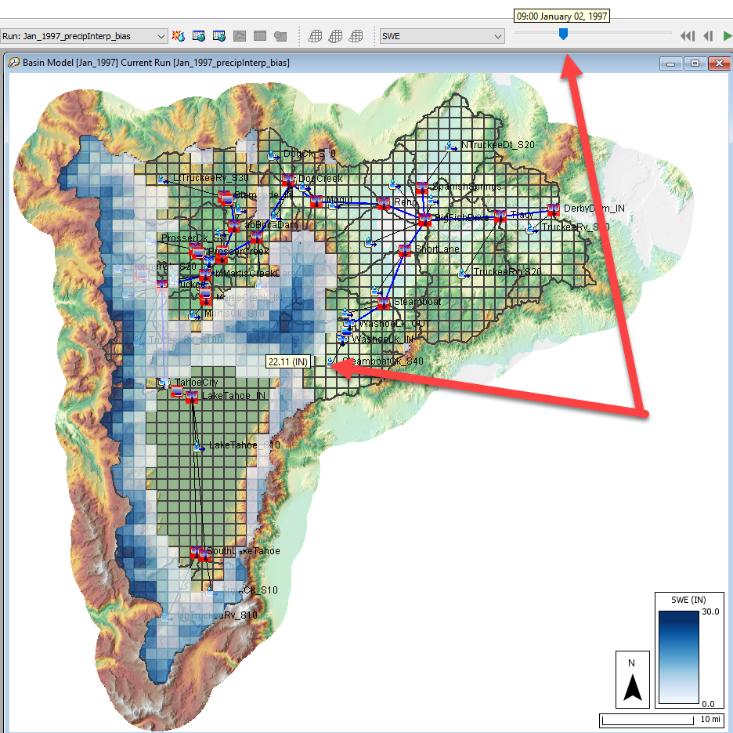
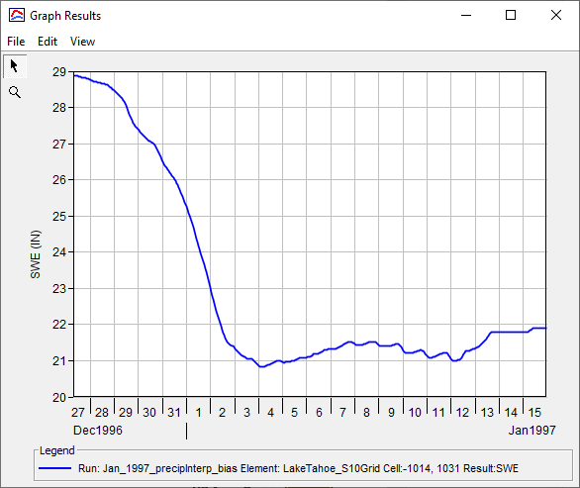
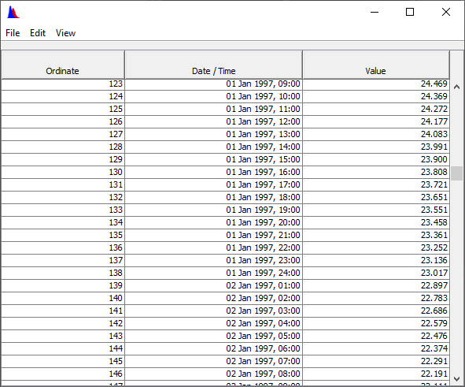
Spatial Results

Slide 17
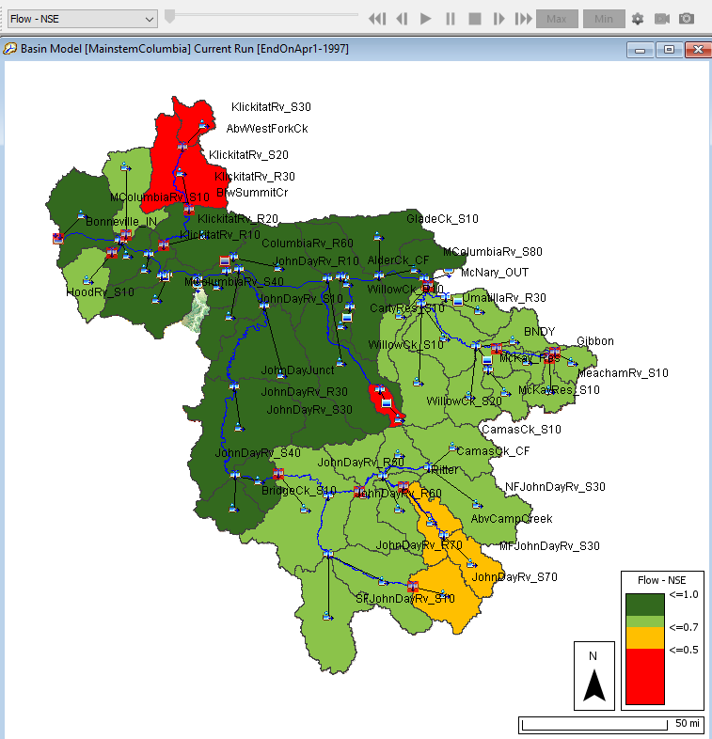
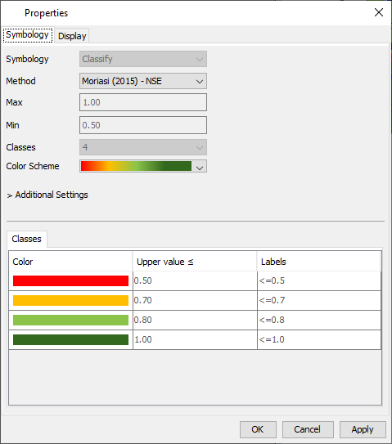
Spatial Results

Slide 18
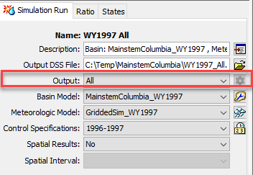
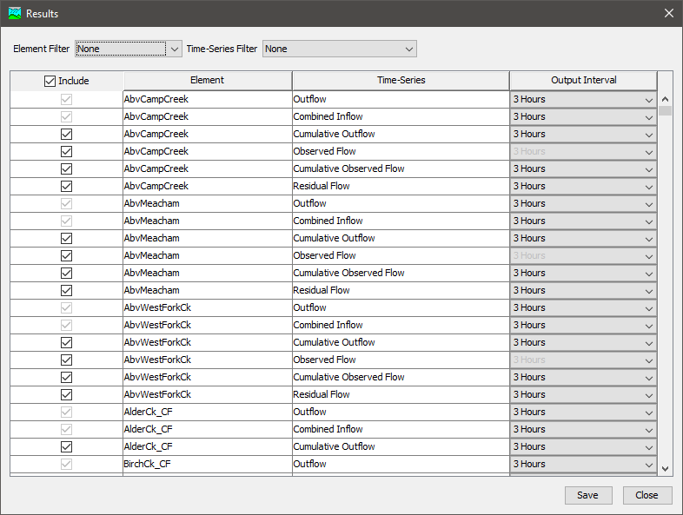
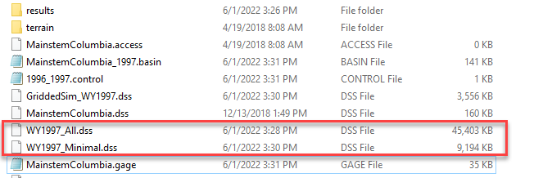
Output Control
All, Minimum, and Selected options are now available

Slide 19
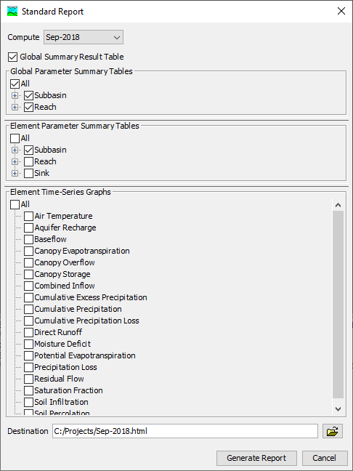
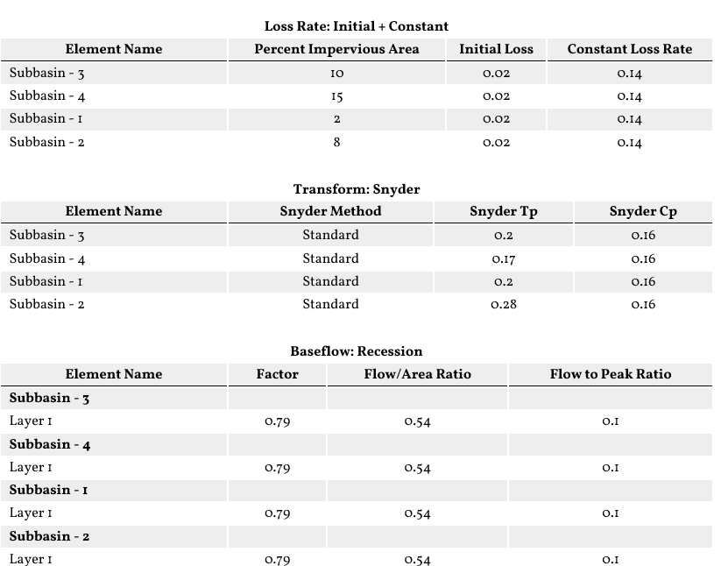
Reports
Standard Report Option

Slide 20
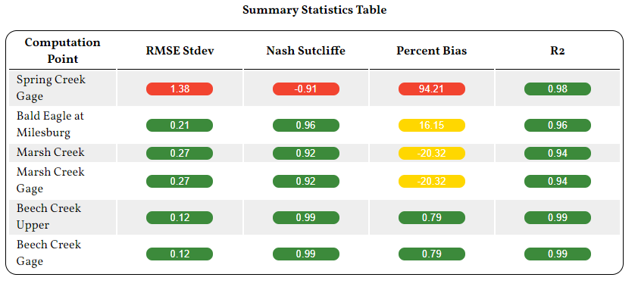
Reports
Statistics Report Option

Slide 21
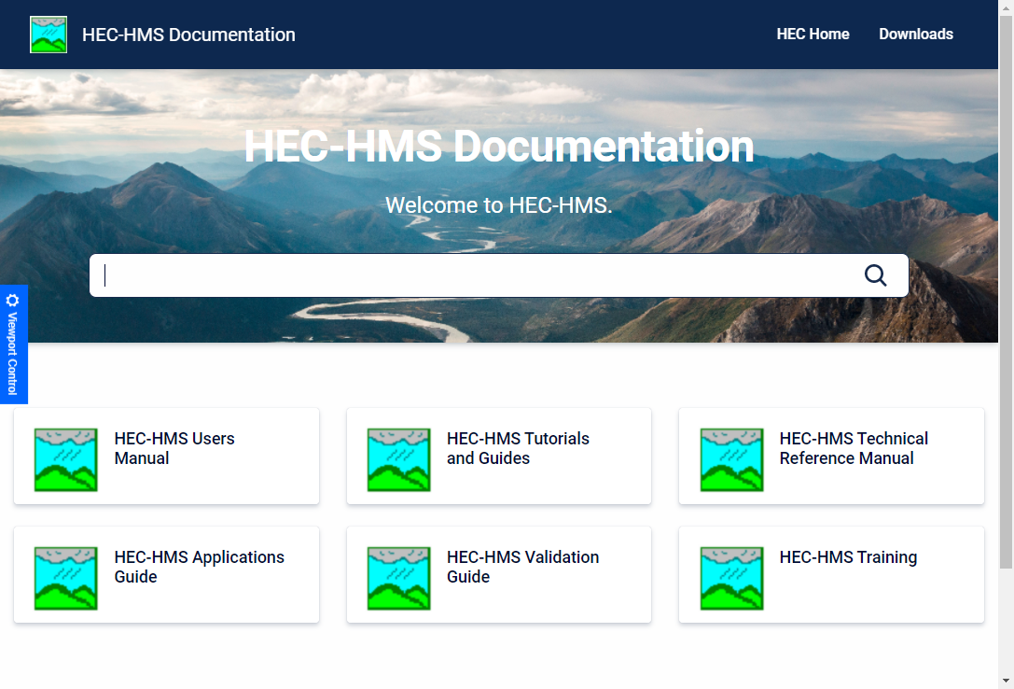
Questions?
Docs: https://www.hec.usace.army.mil/confluence/hmsdocs
To be added to the list, send an email to hec.hms@usace.army.mil with “subscribe” in the title or body.

