Slide 1

HEC-HMS: A CI/CD Journey
7-Jun-2022
Thomas Brauer, P.E.
US Army Corps of Engineers
Hydrologic Engineering Center

Slide 2
background
HEC-HMS is 20+ year old desktop application written in Java with native dependencies
Release cycle: 1+ years and trending upward
Internal bugfix-build cycle: 1+ week
External bugfix-build cycle: months to years
Testing: 1+ week to run semi-automatic regression tests, only run at the end of a waterfall release cycle
Onboarding new staff: Very difficult, IDE configurations undocumented and widely varying
Generally unsustainable path
Notes:
Tom Intro, then Greg and Tom tell story
Tom
Personal:
Came to HEC with practitioner of the software with experience in school and at the USACE district office.
Could write scripts code to do almost anything but no experience with full-production, enterprise, software.
HEC:
Expectation: something like a Silicon Valley tech giant
Reality: most of my co-workers were much like me. They could write code but there was no enterprise knowledge for building, testing and deploying applications, especially in an automated way.
Is HEC current with standards in the industry? Can we do better?
This was a journey for myself. Many of my co-workers were asking similar questions and thinking similar thoughts.
Outcome of emerging leaders discussion: There are many things we could try to fix. Technology and business practices are within our control and are effective. This is where we should start.
Started using Vortex as testbed.
Greg
Build process was localized to one developer, on one machine
Build process seemed to overwhelm the developer that was doing it
Team experienced inconsistent results when trying to apply the software on a different computers

Slide 3
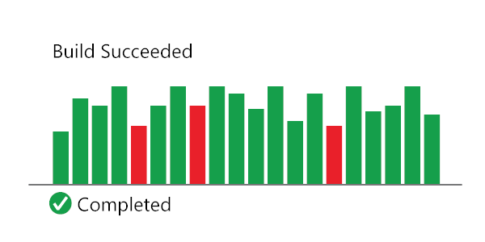
Continuous integration
“Continuous Integration (CI) is the process of automating the build and testing of code every time a team member commits changes to version control. CI encourages developers to share their code and unit tests by merging their changes into a shared version control repository after every small task completion.”
-Sam Guckenheimer
Product Owner, Azure DevOps
Source: https://docs.microsoft.com/en-us/azure/devops/learn/what-is-continuous-integration
Notes:
Continuous integration definition.
The important concept is that code changes are continuously integrated and tested.
The return time between development and finding bugs is minimalized.

Slide 4
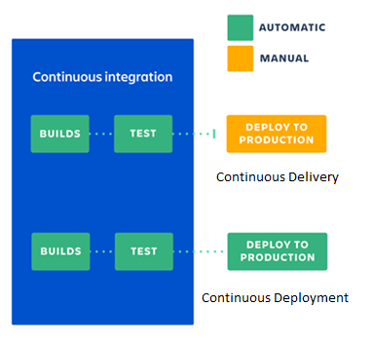
Continuous Delivery
Continuous Deployment
Source: https://www.atlassian.com/continuous-delivery/principles/continuous-integration-vs-delivery-vs-deployment
Notes:
Distinguishing “Continuous Delivery” from “Continuous Deployment”
Continuous Delivery – Deployment is not automated. This is how HMS is currently managed.
Continuous Deployment – This is easiest with web-based software, but, we could automated pushing our builds to the web at the end of the dev process. I would feel confident doing this.
Our web-based documentation is an example of continuous deployment.

Slide 5





Continuous integration
Continuous delivery
release
Compile
Build
Test
trigger
beta
repo
commit
error
error
developer
tester
Notes:
CI/CD in a graphic.
Developer writes code and tests their code prior to submitting to central repository.
Code submission triggers an automated compile – build – test cycle on build server.
If there are errors on build server developer “swarms” to resolve issues.
If all tests pass, software goes to internal testers for QA/QC. At HEC this is often done in the course of applications work.
Software is deployed to field for testing.

Slide 6
Automated Building
Automated Testing
Automated building is a user-independent process for converting software source code and dependencies into executable software.
Automated testing is a user-independent process for checking the actual results of software behavior against known and expected results.
Notes:
Tests compare a known "expected" result to the results from executing part of the code.
Tests allow developers to:
Ensure computation is correct
Prevent a fixed bug from coming back
Detect the effects of changing code
Test behavior of code or software in isolation
Test if new features work before UI is developed
Think differently about the way they write code
Varying levels of complexity for tests, but the foundation remains the same - expected vs actual.

Slide 7
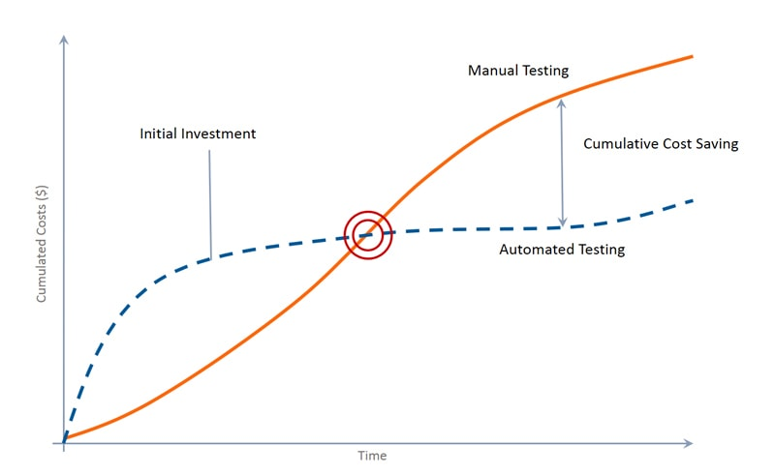
Automated Building
Automated Testing
Image: https://blog.qatestlab.com/2018/06/12/when-automate-testing/
Notes:
The above graphic is using testing as the comparison, but it’s true of automated build as well.
The initial investment of writing tests and developing an automated build process can be costly. However, over the long term, the costs of growing and maintaining those automations are much smaller than continuing to do things manually. Once a culture of testing is created in a development team, it becomes a regular part of the process, adding minimal burden during development. It can also aid developers in writing better code, by ensuring what they write is testable, and that it behaves as intended before ever building the software
Ideally, software would be written from day one with tests in place to make sure everything works and nothing regresses. Where this isn’t the case, it obviously isn’t practical to write tests for everything immediately upon adopting a testing strategy. However, many existing processes (such as the HMS computational benchmarks) can be converted to tests. New features can be written with tests in place. When bugs are fixed, tests can be written to ensure they don’t happen again. These efforts reduce the initial cost significantly.
Automated tests reduce the burden on human testers by giving a base level of confidence that parts of the software covered by tests are functioning correctly, and time can be spent testing the more integrated parts of the software that are harder to machine-test.

Slide 8
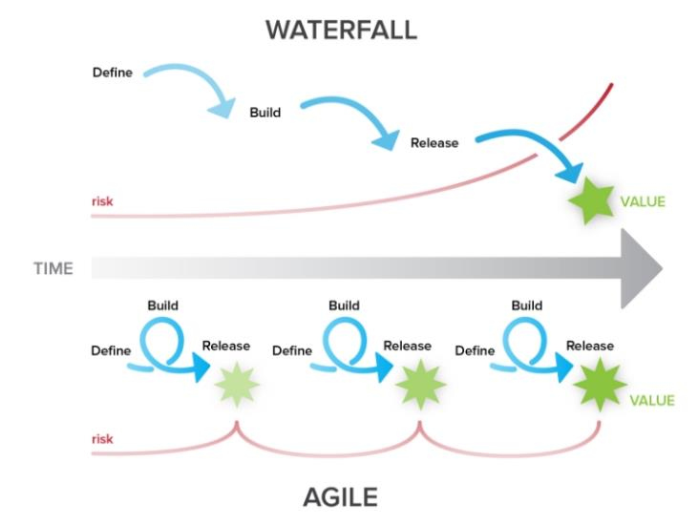
Project management
Image: https://blog.ganttpro.com/en/waterfall-vs-agile-with-advantages-and-disadvantages/
Notes:
CI/CD affords us an Agile project management approach.
In the traditional waterfall project management paradigm all capability from major to optional are designed, built, and released. Value is realized at the end of the development cycle.
In the agile project management paradigm capability is designed, built, and released incrementally. With each incremental release, risk comes back down.

Slide 9
HEC-HMS Ground truth
Process | Previous Duration | Current Duration
Compile + Build | Hours to Days | 5 minutes
Run unit tests | - | Minutes
Run validation tests | Days to Weeks | 20 minutes
Internal bug fix, build, test | Days to Weeks | Minutes to hours
External bug fix, build, test | Months to years | Minutes to hours
Patch release | 6+ Months | 1 Month
Release | 1+ Years | Months
Onboard Developer | Days | 15 minutes
"After all of these constraints have been broken, our constraint will likely be Development or product owners... When the constraint is here, we are limited only by the number of good business hypothesis we create and our ability to develop the code necessary to test these hypotheses with real customers"
-DevOps Handbook, p.23
Notes:
Order-of-magnitude time differences between previous HEC-HMS process and current.

Slide 10
HEC-HMS POST 4.4
Version | Beta | Release | Duration | Features | Bugfixes
4.4 | 9-Aug-19 | 17-Apr-20 | 526 | 17 | 16
4.4.1 | - | 15-May-20 | 28 | 3 | 11
4.5* | 15-May-20 | 19-Jun-20 | 35 | 5 | 4
4.6* | 19-Jun-20 | 28-Aug-20 | 70 | 6 | -
4.6.1 | - | 18-Sep-20 | 21 | - | 7
4.7* | 25-Sep-20 | 4-Dec-20 | 77 | 6 | 3
4.7.1 | - | 15-Jan-21 | 42 | 1 | 12
4.8* | 15-Jan-21 | 8-Apr-21 | 83 | 8 | 15
4.9* | 6-May-21 | 21-Jan-22 | 260 | 30 | 25
4.10* | 28-Jan-22 | ~29-Jul-22 | ~182 | 26 | 47
*Betas continuously delivered throughout the release cycle
Notes:
Release duration, features, and bugfixes post v.4.4
Continuously delivering new beta builds
v4.4 5 team members
v4.10 10+ team members

Slide 11

questions

Slide 12
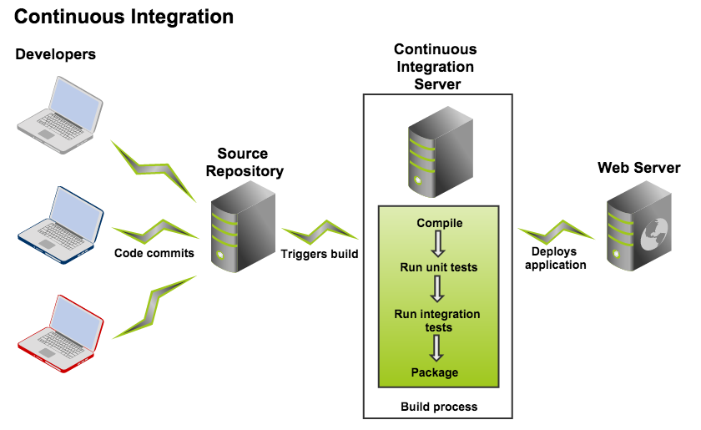







Build Server
Image: https://confluence.atlassian.com/bamboo/understanding-the-bamboo-ci-server-289277285.html
Notes:
Primary technology: TeamCity
Merges Git + Gradle + Nexus + Testing in an automated process on a server
Server is "clean" environment, independent of any developer-specific configuration
Team can retrieve the latest builds for testing

