Slide 1
Hydrologic Modeling Software and Analysis Update
SPD H&H CoP Meeting
Matt Fleming, P.E.
Hydrologic Engineering Center
U.S. Army Corps of Engineers

Slide 2
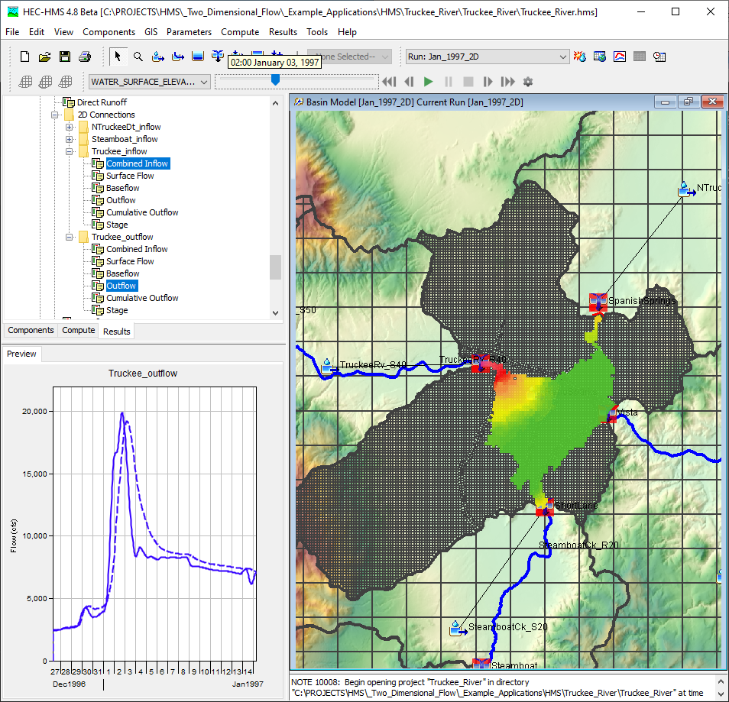
Outline
Tech Transfer
Output Control
Meteorologic Model Improvements
Spatial Results
Ensemble Compute
Clark Unit Hydrograph Study Results
Questions

Slide 3
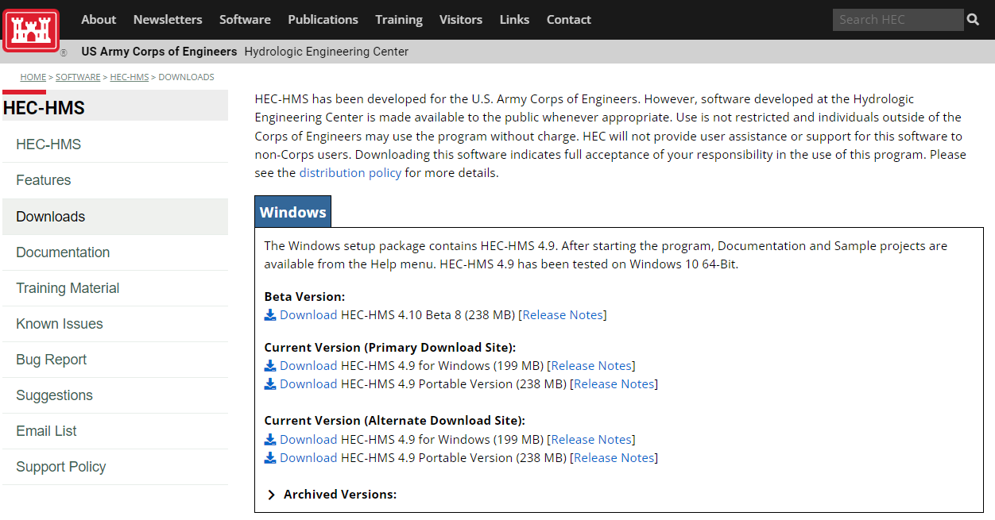
Technology Transfer
Latest Release
  Version 4.9
Beta Release
  Version 4.10
MacOS and Linux versions available
HEC-HMS Webpage

Slide 4
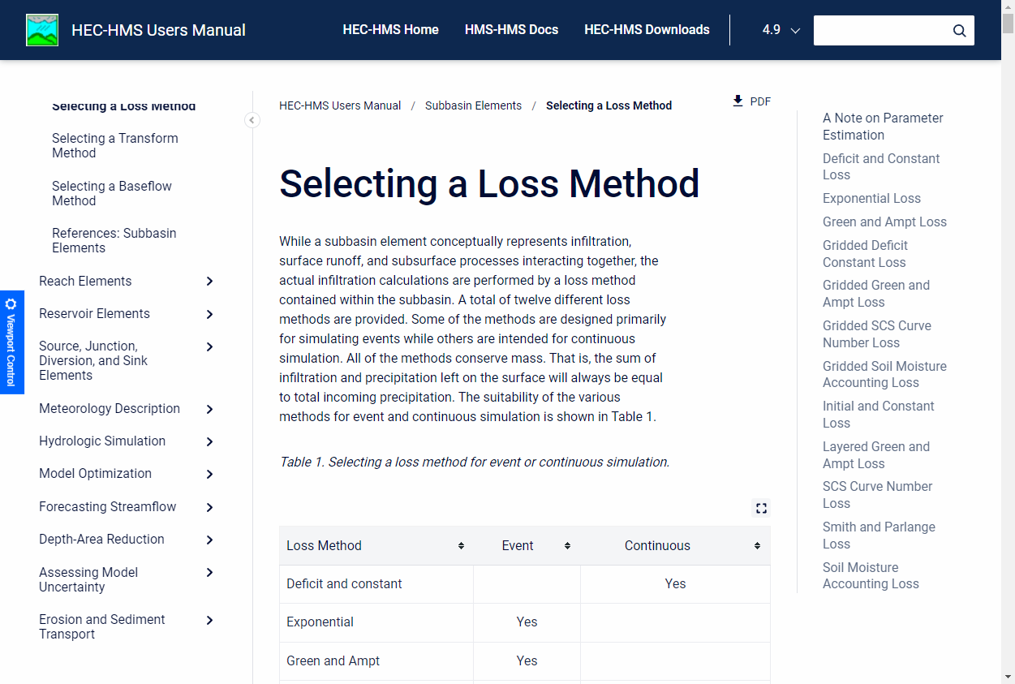
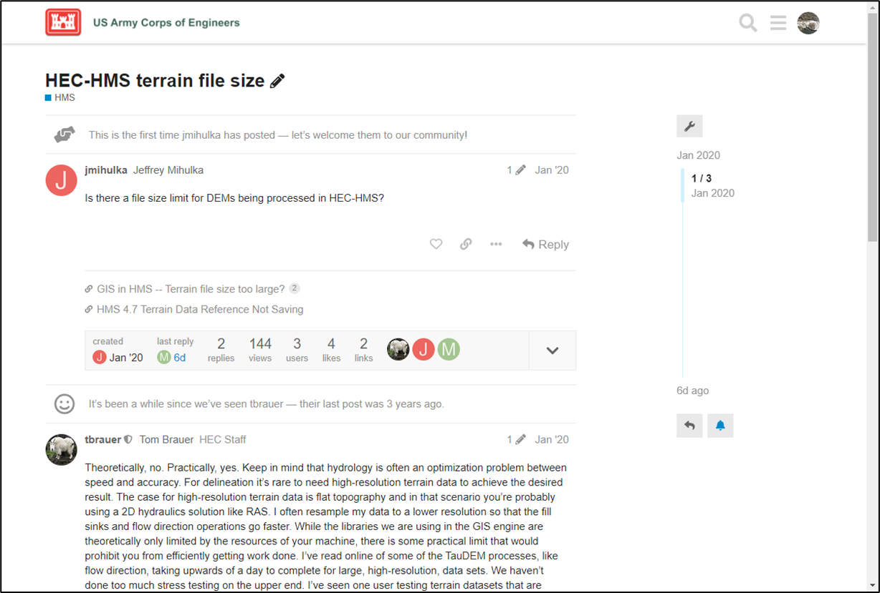
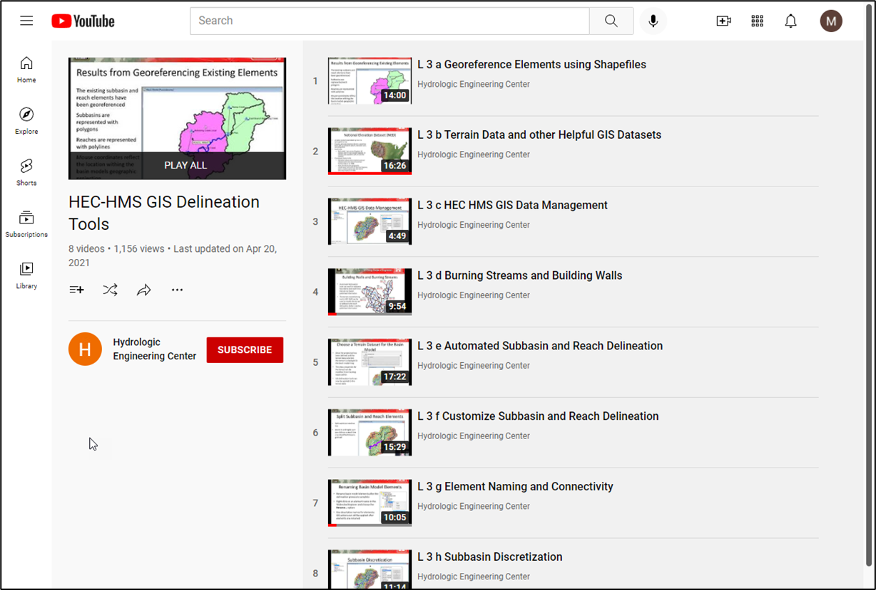
Technology Transfer

Slide 5
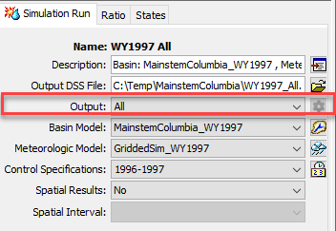
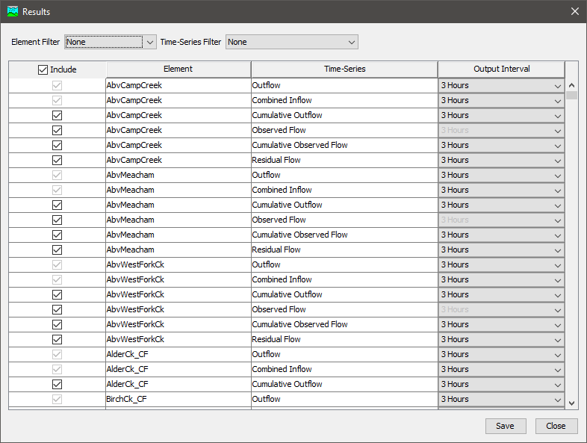
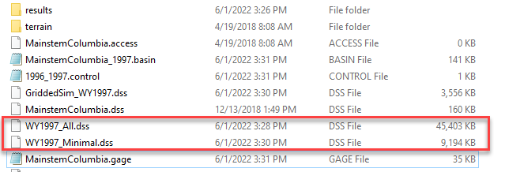
Output Control
All, Minimum, and Selected options are now available
Link to Example Tutorial

Slide 6
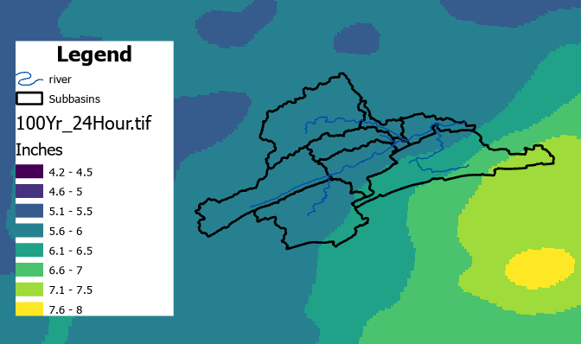
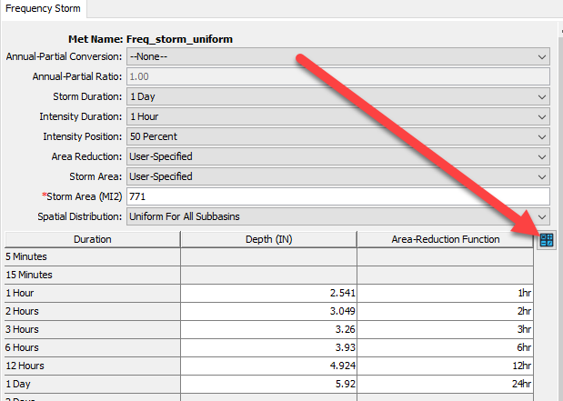
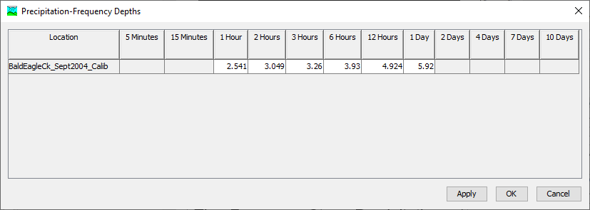
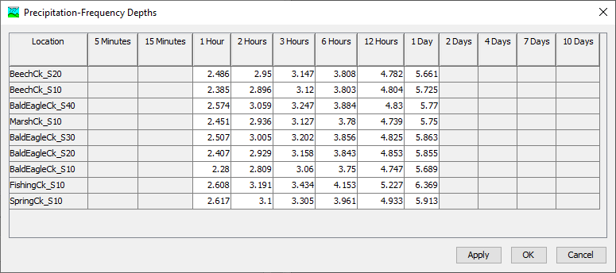
Frequency Storm
The Frequency Storm Precipitation Depth Calculator can compute watershed and subbasin average precipitation depths from raster datasets
Link to Example Tutorial

Slide 7
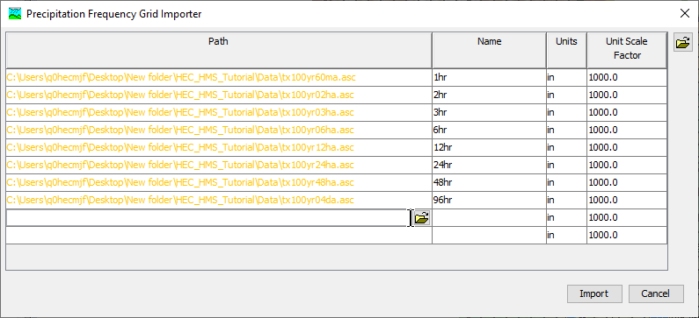
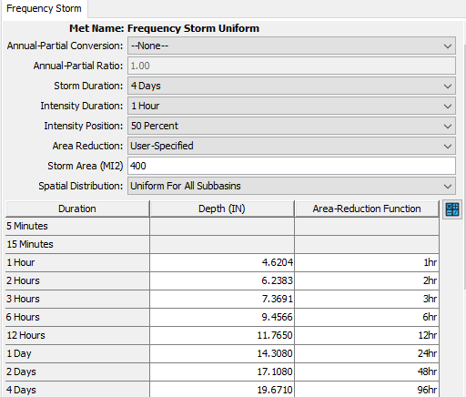
Frequency Storm
You can batch import precipitation-frequency grids into the HEC-HMS project.
A new option is available for selecting user-define depth-area reduction information. Regional historical storms can be used to define how the storm intensity is reduced over a storm area.

Slide 8
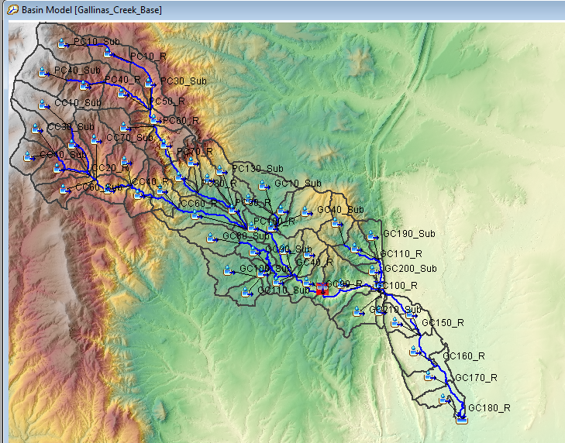
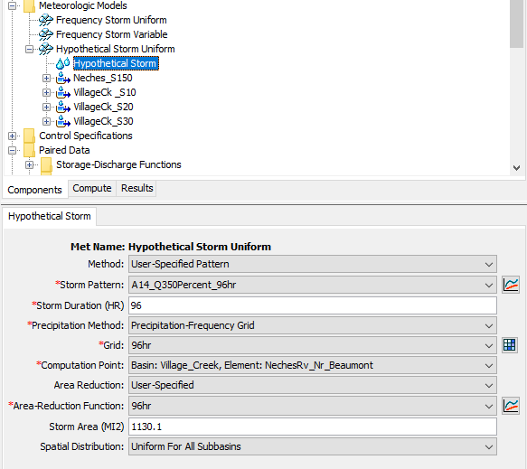
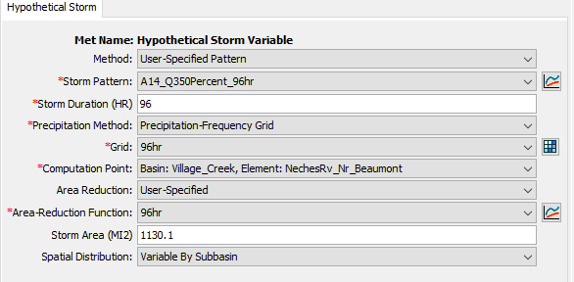
Hypothetical Storm
A new option was added (HEC-HMS 4.11) to the Hypothetical Storm to vary precipitation depths by subbasin

Slide 9
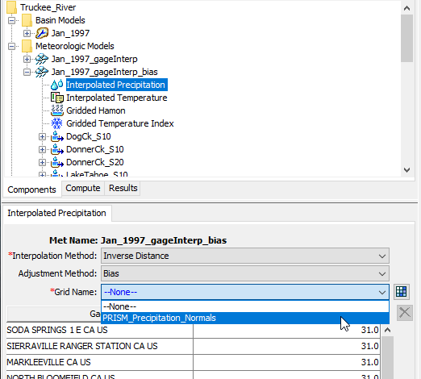
Interpolated Meteorology
Use precipitation gages and GIS information to interpolate meteorologic data
Bias adjustment is available for Precipitation
Lapse rate adjustment is available for Temperature

Slide 10
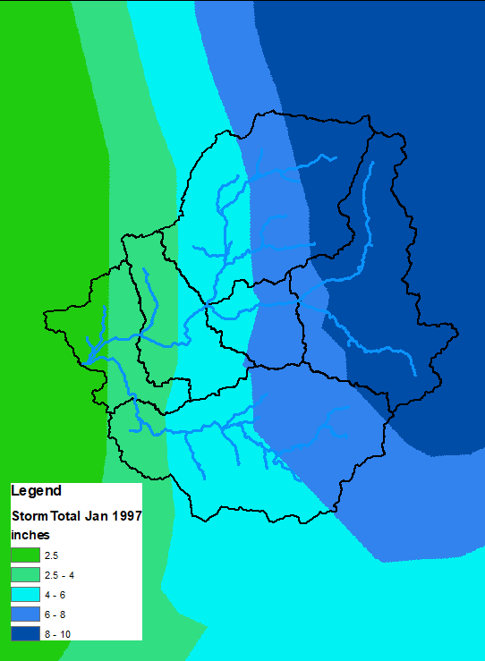
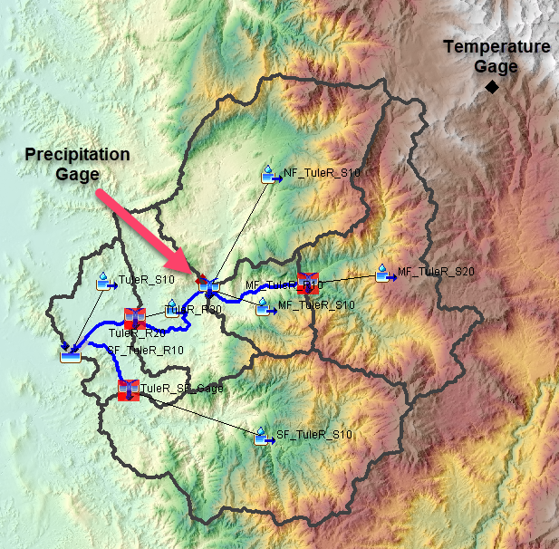
Interpolated Meteorology
Link to Example Tutorial

Slide 11
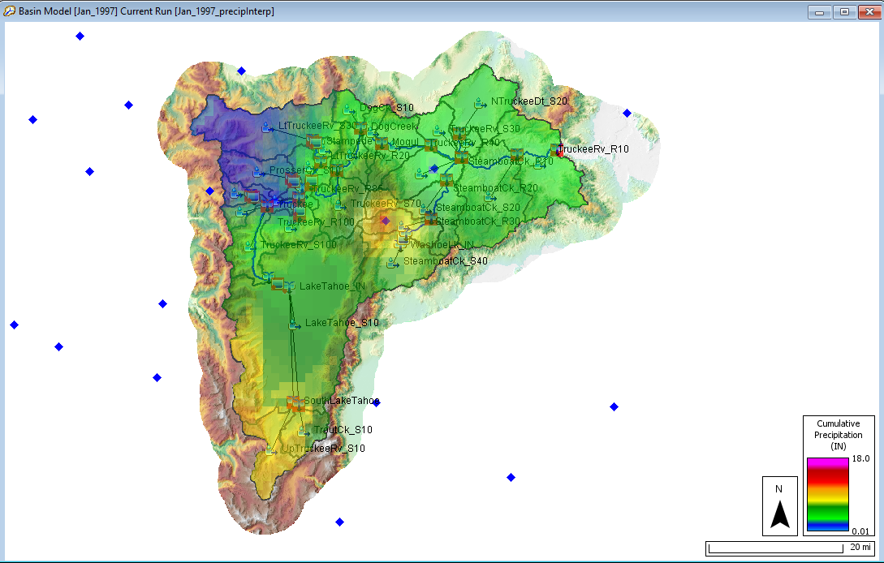
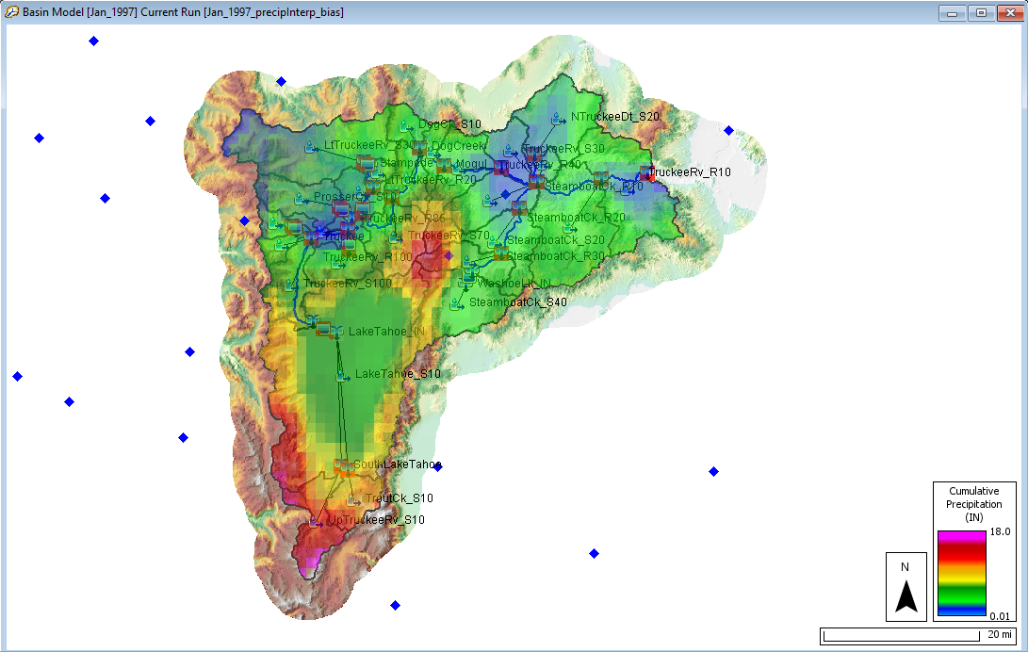
Interpolated Meteorology
Link to Example Tutorial

Slide 12
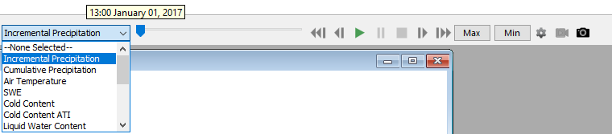
Spatial Results
  Incremental/Cumulative Precipitation, Loss and Excess
  Temperature
  Snow
  2D Transform Output
  Calibration Metrics
Animation Controls
Min/Max Results
Display Properties
Capture and Export Animation
Export Grid
Link to Example Tutorial

Slide 13
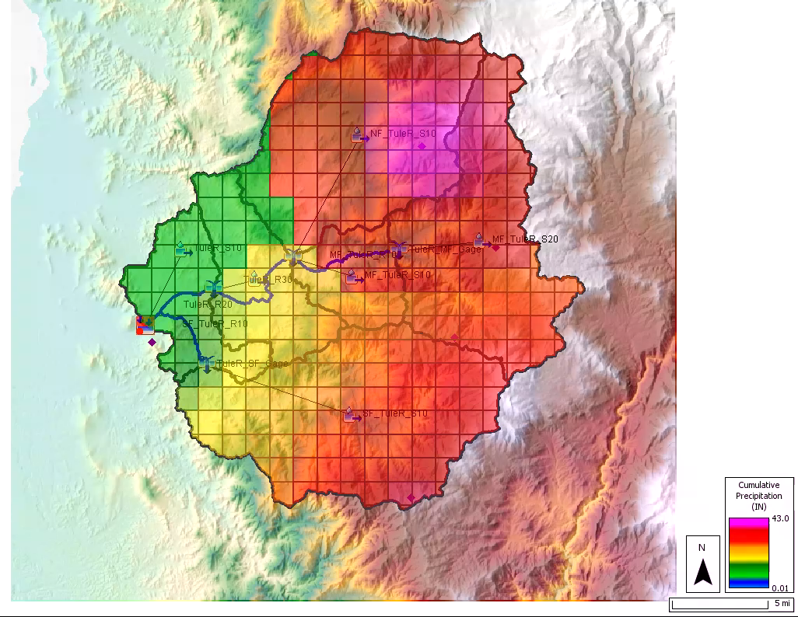
Spatial Results

Slide 14
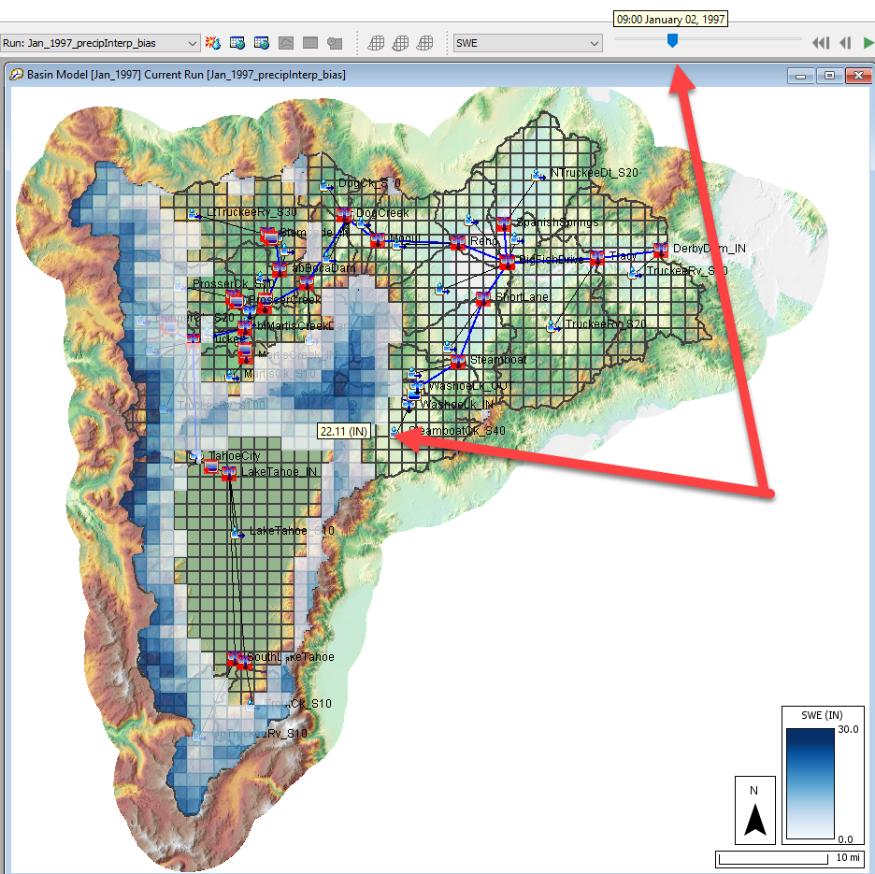
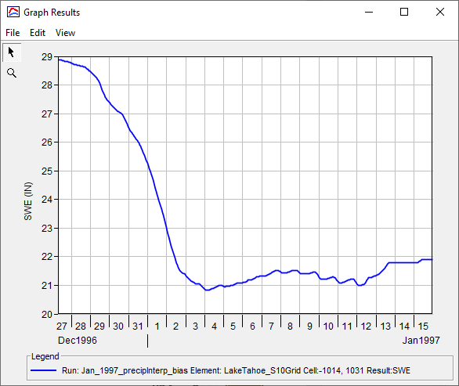
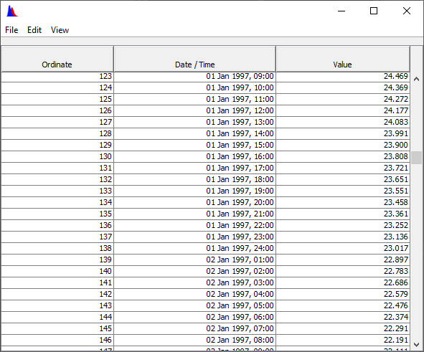
Spatial Results

Slide 15
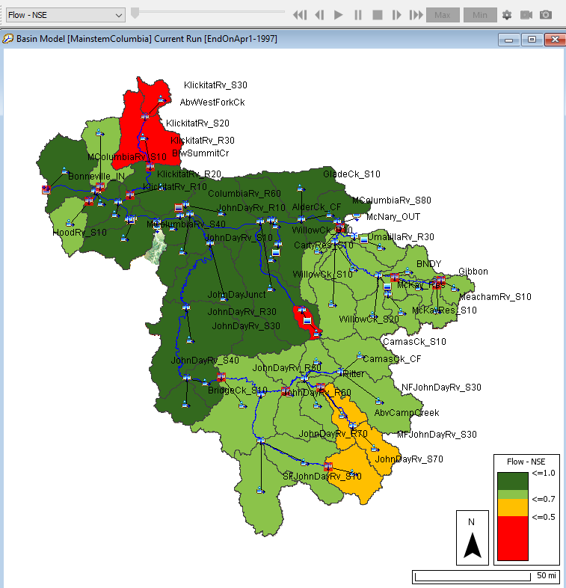
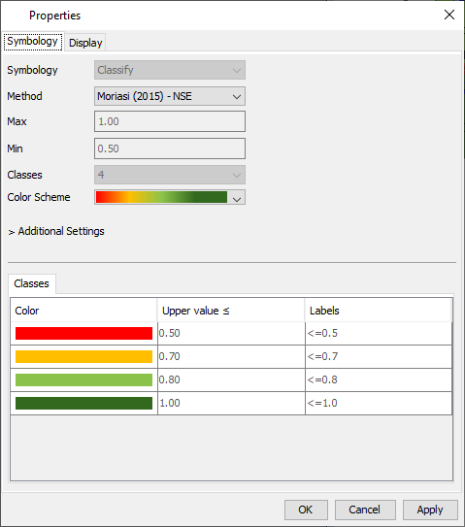
Spatial Results

Slide 16
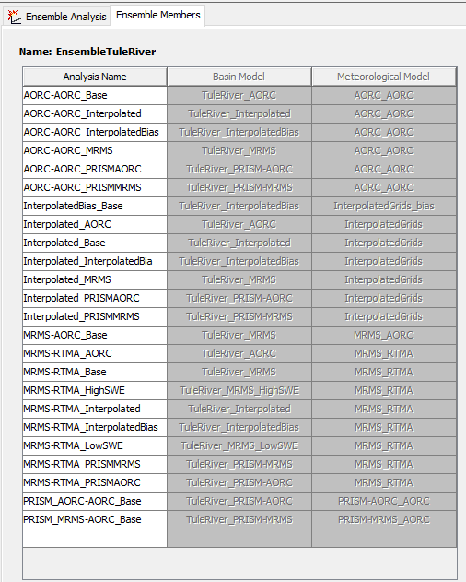
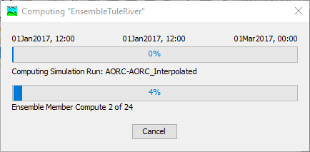
Ensemble Compute Option
Tool for evaluating uncertainty in meteorologic forcing data and in the hydrologic model (model configuration and parameters)
Built from existing simulation components
Summarizes results for post processing and for use as input in other models
Notes:
The ensemble compute option is a container for existing simulations in the project. It is a way to organize existing model simulations and extract model results.

Slide 17
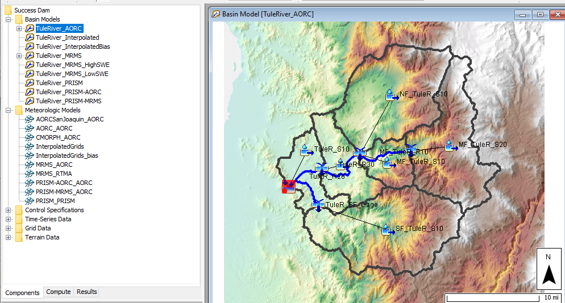
Ensemble Compute Option
Notes:
In this example, the model was configured with different precipitation (AORC, MRMS, Interpolated gages, Interpolated gages with a bias correction, and temporally downscaled PRISM) and temperature (AORC, RTMA, Interpolated with a lapse rate, and PRISM) datasets.
Basin models were calibrated for each individual meteorologic forcing.
An ensemble compute was configured to show results for two cases, one looks at results variability with only meteorologic data uncertainty and the other combines meteorologic and hydrologic model uncertainty. For example, the basin model calibrated to the AORC precipitation/temperature data was also combined with the other precipitation/temperature data sources.

Slide 18
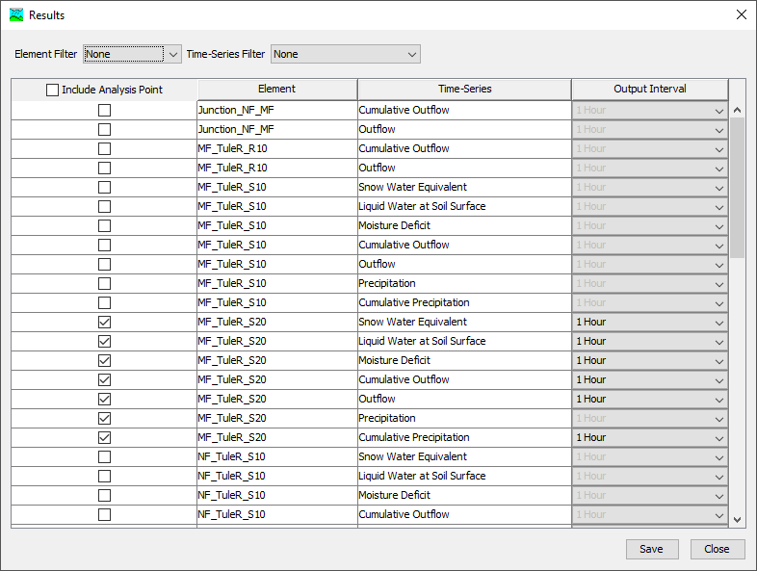
Ensemble Compute Option
You choose which results you want the program to extract and process from each of the ensemble members
Notes:
The program evaluates the Basin models in the ensemble compute and builds a list of model results the modeler can choose to save. By default, the ensemble compute does not generate results, instead, the simulations that make up the ensemble compute generate results and results are saved to their respective simulation DSS file. The ensemble compute extract’s model results from the selected simulations and organizes the results in an ensemble compute DSS file.

Slide 19
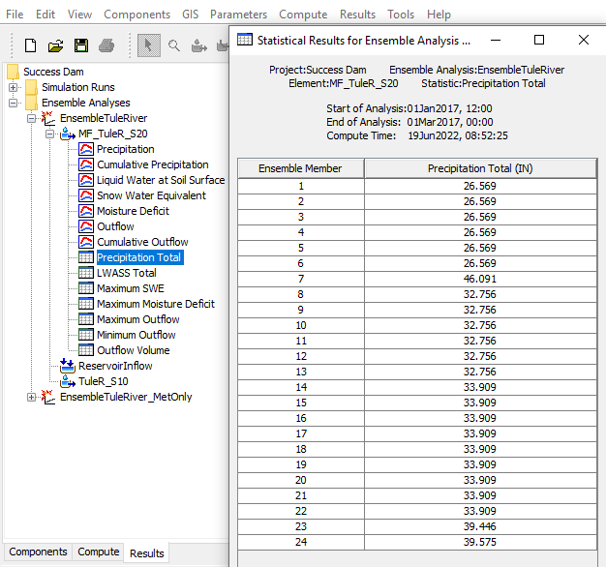
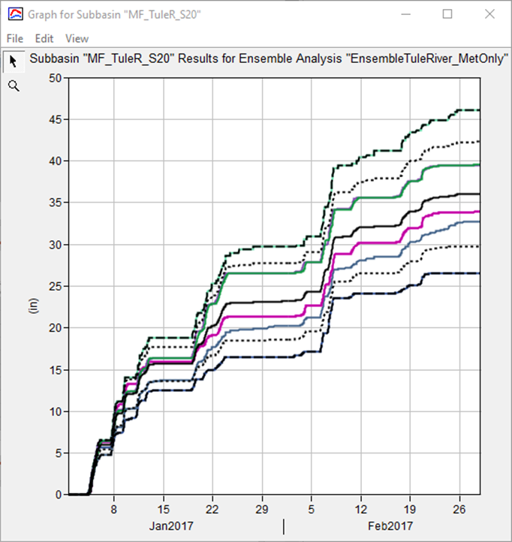
Ensemble Compute Option
Notes:
The team is still building out access to results. At this moment, you can click on results within the Results tab. Time series plots are available, these include results for each ensemble member, the mean, +/- 1 stdev, and mix/max time series. There are also tables with maximum Flow, SWE, Moisture Deficit and Total Precipitation.
The table and figure show the cumulative precipitation from the ensemble members for Jan/Feb 2017 – huge range!

Slide 20
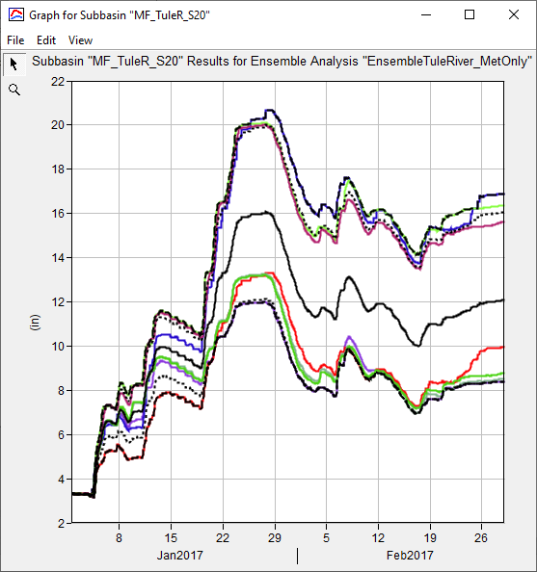
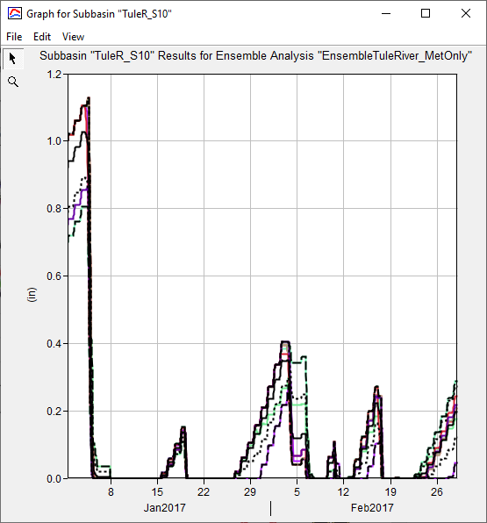
Ensemble Compute Option
Moisture Deficit
SWE
Notes:
The figure on the left shows the snow water equivalent from the ensemble members. Those ensemble members with more precipitation likely generated more SWE (temperature was practically the same across all datasets).
The figure on the right shows the moisture deficit from the ensemble members.

Slide 21
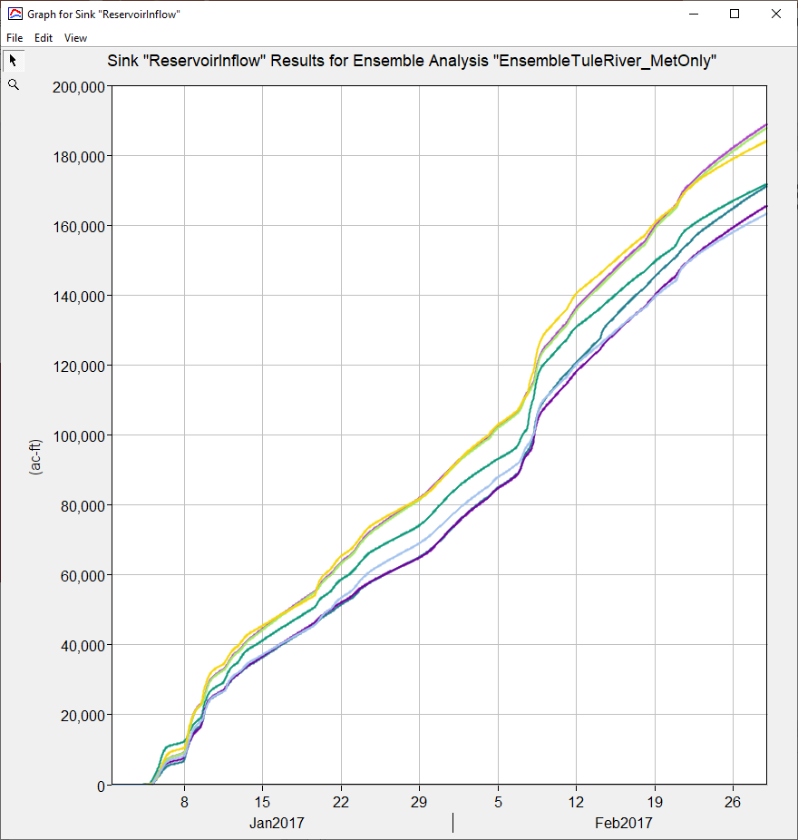
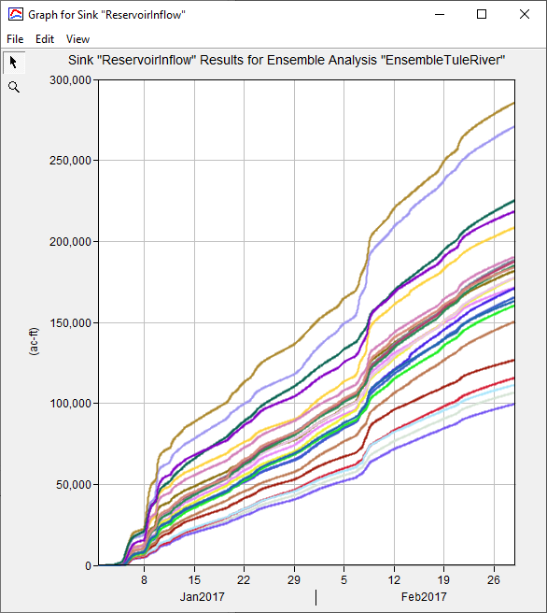
Ensemble Compute Option
Cumulative Inflow from Meteorologic Uncertainty
Cumulative Inflow from Meteorologic and Basin Model Uncertainty
Notes:
The figure on this slide shows the computed inflow into Success Dam from both Ensemble Simulations. The results on the left only shows computed inflow variability due to different meteorologic boundary conditions. There are separate basin models being used but they were calibrated for the precipitation/temperature data. The figure on the right include uncertainty in the basin model. For example, the basin model calibrated to the AORC precipitation dataset was used with the MRMS data set.
I understand this is a contrived approach, it would be somewhat similar to actual applications. There are multiple viable HMS basin model parameterizations that result in reasonable results. The ensemble compute option is a way do use those within a single compute.

Slide 22
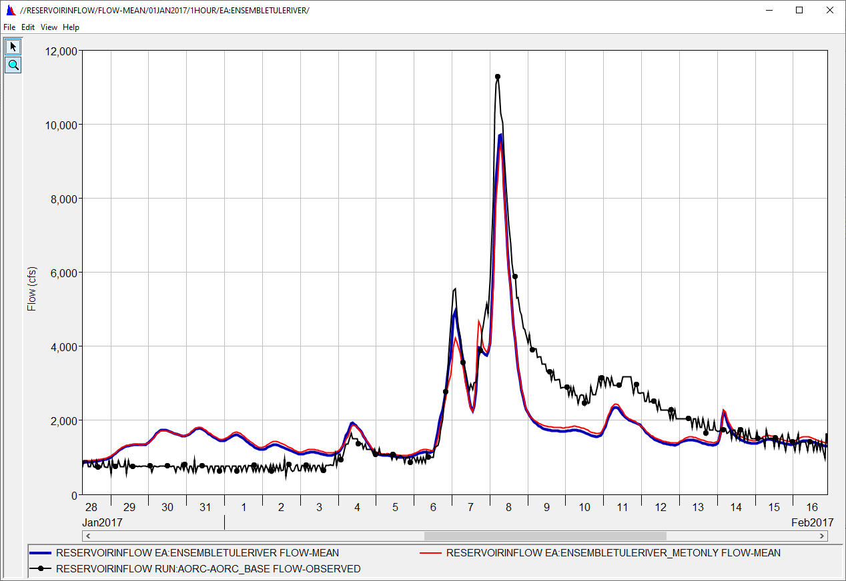
Ensemble Compute Option
Mean Ensemble from Meteorologic Uncertainty
Mean Ensemble from Meteorologic/Basin Model Uncertainty
Observed Flow
Notes:
The figure on this slide shows the MEAN ensemble results from both simulations and observed flow. Even though the second simulation (variable meteorology and basin models) generates a much wider spready in flow results, the mean still tracks the observed flow. This was mostly due to how the ensemble members were crafted and the number of combinations of meteorology and hydrology. The point is that the ensemble compute can be used to generate results that contain uncertainty due to meteorologic and hydrologic conditions, you can choose one results like, the mean from all ensemble members or +1/-1 stdev to make decisions.

Slide 23
Clark Unit Hydrograph Study Results
100 HEC-HMS models were built and calibrated
Regression equations were developed using calibrated parameters
Regression equations were validated using 18 locations
Uncertainty around predicted values can be included within HEC-HMS
Large team to collect and process data as well as perform modeling:
  HEC (9)
  San Francisco District (1)
  Sacramento District (6)
  Los Angeles District (5)
Training Material
Snow
Loss/Unit Hydrograph

Slide 24
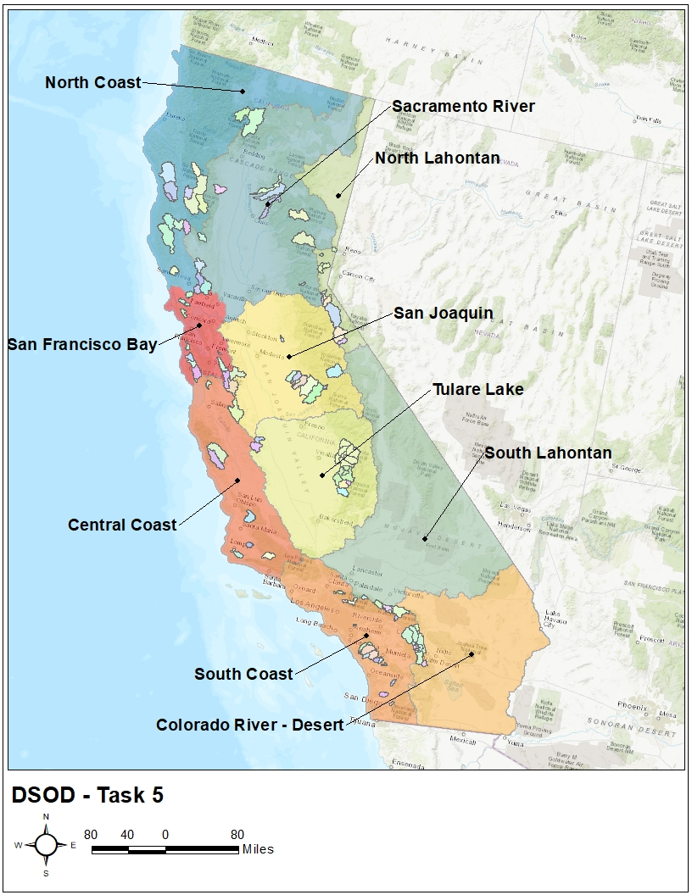
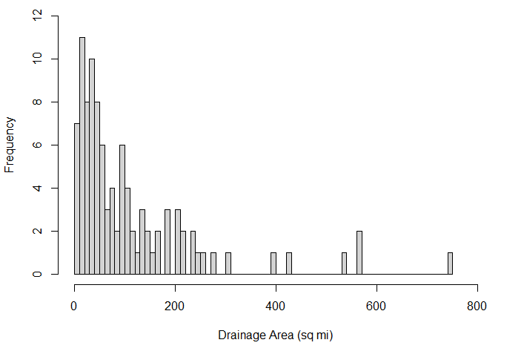
Clark Unit Hydrograph Study Results
Notes:
This is a map of the 100 locations that were chosen
A histogram counting the number of locations per drainage area bin is also shown
Drainage areas ranged between 3 sq mi (South Lahontan) and 745 sq mi (North Coast)
The average drainage area was 110 sq mi while the median was 61 sq mi

Slide 25
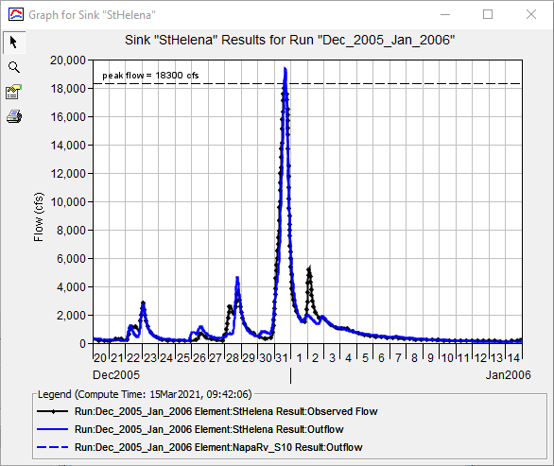
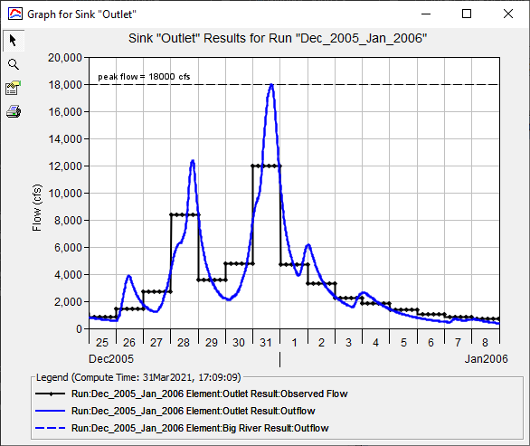
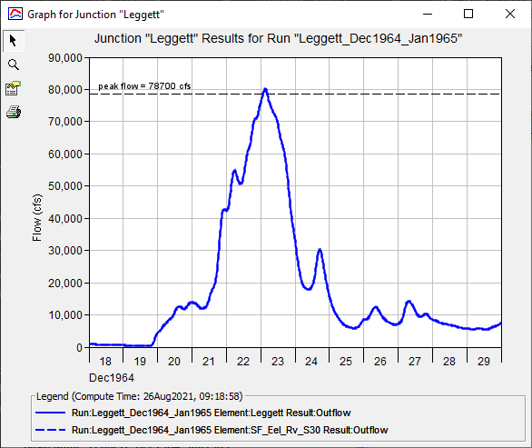
Clark Unit Hydrograph Study Results
For each location:
Select an extreme event
Calibrate infiltration, transform, baseflow , and temperature index* parameters using observed data
Use multiple statistical metrics to evaluate performance
Notes:
It is anticipated that DSOD will utilize the regression equations developed within this study to estimate Clark unit hydrograph parameters to simulate extreme events within dam safety studies.
As such, extreme storm events were selected for use during model calibration.
However, observed data availability, reliability, and ease of use were also considered.
Observed data that was available for use varied by location and flood event.
When available, 15-, 30-, or 60-minute observed streamflow was used.
When that data was not available, daily average and instantaneous peak streamflow was used (animate).
Finally, when all other data was not available, instantaneous peak streamflow was used (animate)
Model performance was evaluated by comparing computed results against observed results at each location.
Model parameters were altered to minimize the differences between computed and observed hydrograph shape, peak flow rate, and discharge volume.
When adequate observed data was available (at a minimum, daily average streamflow), summary statistics were used to quantify model performance
Statistical metrics included Nash-Sutcliffe Efficiency (NSE), Ratio of the Root Mean Square Error to the Standard Deviation (RSR), and Percent Bias (PBIAS).

Slide 26
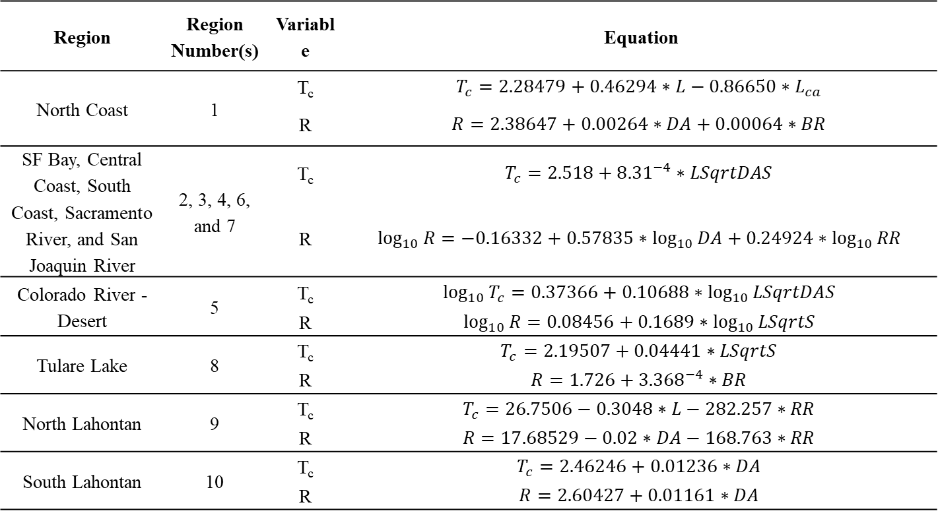
Clark Unit Hydrograph Study Results
Region | Region Number(s) | Variable | Equation
North Coast | 1 | T_{c} | $$T_{c}=2.28479+0.46294∗L−0.86650∗L_{ca}$$
 |  | R | $$R=2.38647+0.00264∗DA+0.00064∗BR$$
SF Bay, Central Coast, South Coast, Sacramento River, and San Joaquin River | 2, 3, 4, 6, and 7 | T_{c} | $$T_{c}=2.518+{8.31}^{−4}∗LSqrtDAS$$
 |  | R | $$\log_{10}{R}=−0.16332+0.57835∗\log_{10}{DA}+0.24924∗\log_{10}{RR}$$
Colorado River - Desert | 5 | T_{c} | $$\log_{10}{T_{c}}=0.37366+0.10688∗\log_{10}{LSqrtDAS}$$
 |  | R | $$\log_{10}{R}=0.08456+{0.1689∗log}_{10}{LSqrtS}$$
Tulare Lake | 8 | T_{c} | $$T_{c}=2.19507+0.04441∗LSqrtS$$
 |  | R | $$R=1.726+{3.368}^{−4}∗BR$$
North Lahontan | 9 | T_{c} | $$T_{c}=26.7506−0.3048∗L−282.257∗RR$$
 |  | R | $$R=17.68529−0.02∗DA−168.763∗RR$$
South Lahontan | 10 | T_{c} | $$T_{c}=2.46246+0.01236∗DA$$
 |  | R | $$R=2.60427+0.01161∗DA$$
Notes:
Here are all the regression equations that were developed

Slide 27
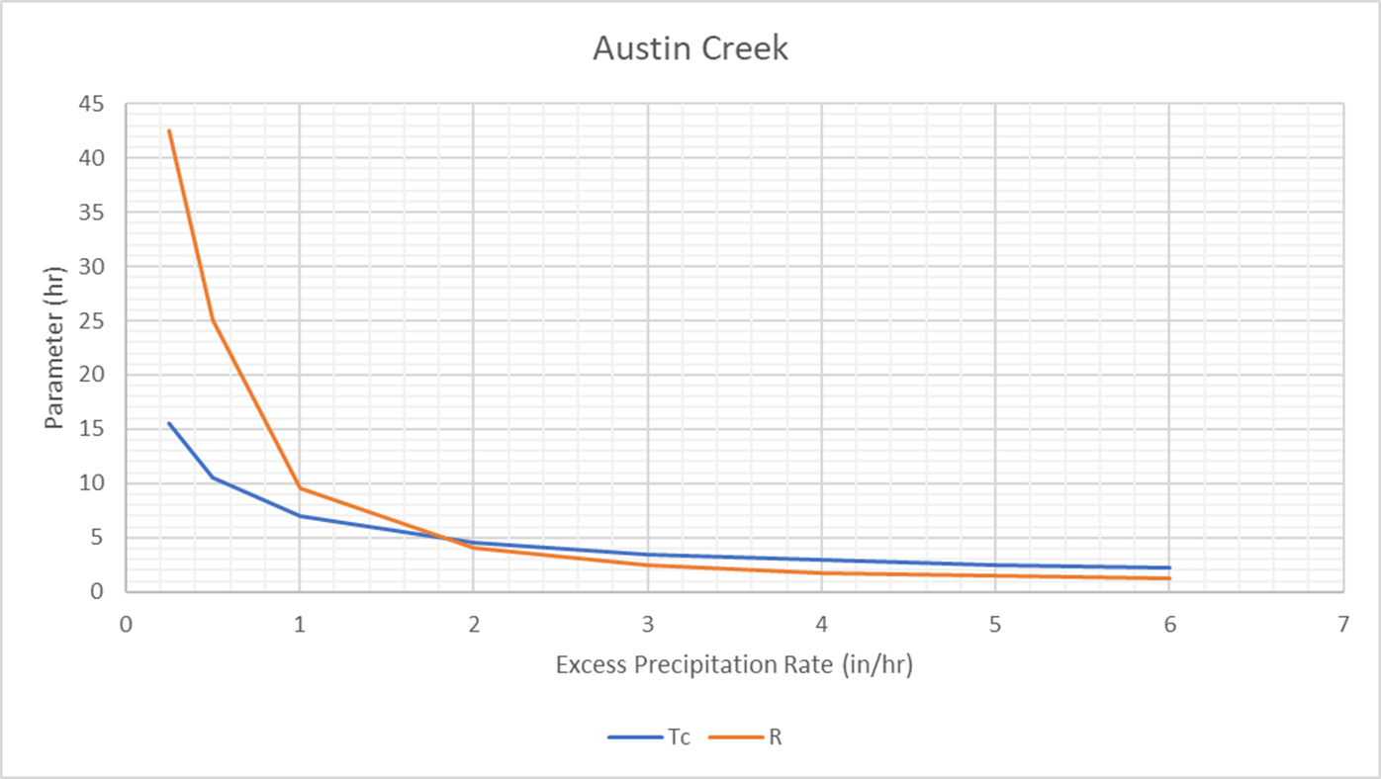
Clark Unit Hydrograph Study Results
  Develop regression equations that can predict how values of Tc and R vary with respect to excess precipitation for independent watersheds
Notes:
Sixteen locations were chosen throughout the state
Used existing Task 5 HEC-HMS models
2D Diffusion Wave transform results were used to calibrate Clark parameters for multiple excess precipitation rates
Regression equations were developed that can be used to predict Variable Clark unit hydrograph parameters
Regression equations were validated using 3 locations
This is a map of the 16 locations that were chosen
These 16 watersheds were also used within the Task 5 report to save time and $$$
A histogram counting the number of locations per drainage area bin is also shown
Drainage areas ranged between 8 sq mi and 113 sq mi
The average drainage area was 50 sq mi while the median was 53 sq mi

Slide 28
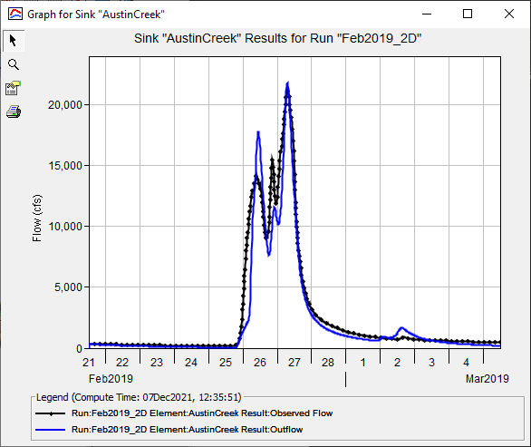
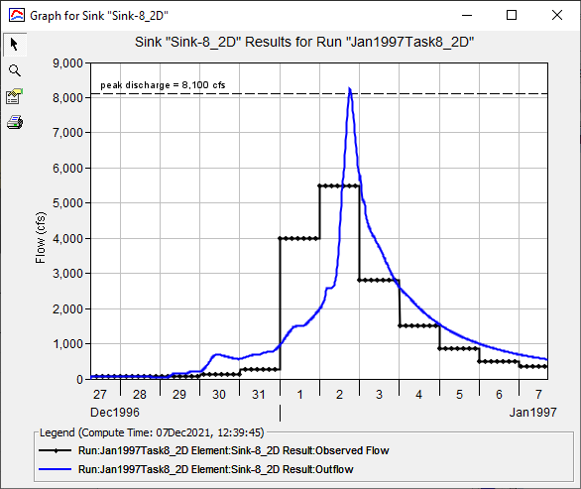
Clark Unit Hydrograph Study Results
For each location:
Use the same event as the Clark regression study
Calibrate infiltration, 2D Diffusion Wave, baseflow , and temperature index parameters using observed data
Use multiple statistical metrics to evaluate performance
Notes:
It is anticipated that DSOD will utilize the regression equations developed within this study to estimate Clark unit hydrograph parameters to simulate extreme events within dam safety studies.
As such, extreme storm events were selected for use during model calibration.
However, observed data availability, reliability, and ease of use were also considered.
Observed data that was available for use varied by location and flood event.
When available, 15-, 30-, or 60-minute observed streamflow was used.
When that data was not available, daily average and instantaneous peak streamflow was used (animate).
Model performance was evaluated by comparing computed results against observed results at each location.
Model parameters were altered to minimize the differences between computed and observed hydrograph shape, peak flow rate, and discharge volume.
When adequate observed data was available (at a minimum, daily average streamflow), summary statistics were used to quantify model performance
Statistical metrics included Nash-Sutcliffe Efficiency (NSE), Ratio of the Root Mean Square Error to the Standard Deviation (RSR), and Percent Bias (PBIAS).

Slide 29
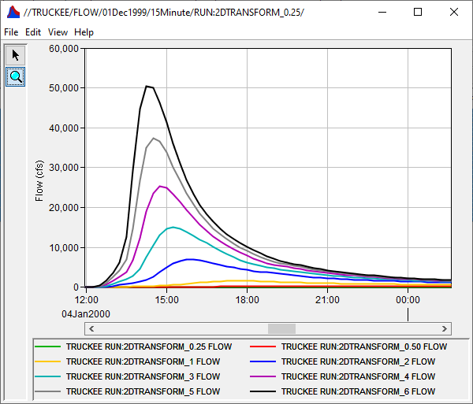
Clark Unit Hydrograph Study Results
For each location:
Simulate 0.25, 0.5, 1, 2, 3, 4, 5, and 6 in/hr precipitation events using the 2D Diffusion Wave Transform
Notes:
Following the calibration of each historical event HEC-HMS model, 0.25-, 0.5-, 1.0-, 2.0-, 3.0-, 4.0-, 5.0-, and 6.0-inches of excess precipitation over one hour was applied to each modeling domain and routed using the calibrated 2D diffusion wave transform parameters.
No losses or baseflow processes were included within these simulations.

Slide 30

Clark Unit Hydrograph Study Results
Excess Precipitation Rate (in/hr) | Variable | Equation
0.25 | T_{c,index} | $$\log_{10}T_{c}=0.04082−0.35461∗\log_{10}DA−0.53746∗S_{10−85}$$
 | R_{index} | $$R=−1.01528+1.7684∗L_{ca}−0.00316∗BR+120.4306∗RR$$
0.5 | T_{c,index} | $$\log_{10}T_{c}=−0.09866−0.42538∗\log_{10}DA−0.5683∗S_{10−85}$$
 | R_{index} | $$R=−1.40573+1.2471∗L_{ca}−0.00208∗BR+78.6917∗RR$$
1.0 | T_{c,index} | $$\log_{10}T_{c}=−0.2412−0.5586∗\log_{10}DA−0.6837∗S_{10−85}$$
 | R_{index} | $$R=−0.26226+0.6196∗L_{ca}−0.00118∗BR+38.7834∗RR$$
2.0 | T_{c,index} | $$\log_{10}T_{c}=−0.381−0.5353∗\log_{10}DA−0.6581∗S_{10−85}$$
 | R_{index} | $$R=0.507+0.2515∗L_{ca}−0.00063∗BR∗16.721∗RR$$
3.0 | T_{c,index} | $$\log_{10}T_{c}=−0.4809−0.5387∗\log_{10}DA−0.6703∗S_{10−85}$$
 | R_{index} | $$R=0.489+0.1709∗L_{ca}−0.00046∗BR+11.3057∗RR$$
4.0 | T_{c,index} | $$\log_{10}T_{c}=−0.5446−0.5107∗\log_{10}DA−0.6573∗S_{10−85}$$
 | R_{index} | $$R=0.4668+0.13062∗L_{ca}−0.00037∗BR+8.4999∗RR$$
5.0 | T_{c,index} | $$\log_{10}T_{c}=−0.5425−0.5204∗\log_{10}DA−0.6457∗S_{10−85}$$
 | R_{index} | $$R=0.4814+0.10512∗L_{ca}−0.00033∗BR+7.2064∗RR$$
6.0 | T_{c,index} | $$\log_{10}T_{c}=−0.5408−0.5403∗\log_{10}DA−0.6452∗S_{10−85}$$
 | R_{index} | $$R=0.5215+0.0824∗L_{ca}−0.00029∗BR+5.9854∗RR$$
Notes:
Here are all the regression equations that were developed

Slide 31

Clark Unit Hydrograph Study Results
Notes:
This is an example of the validation process for the Arroyo Seco location
The event simulated is the approximate 1/1000 AEP, while less rare than the PMF, is still an extreme amount of precipitation
As you can see, the predicted Variable Clark parameters produce very good results when compared against the 2D Diffusion Wave transform results
Again, the “base” Clark results underpredict the peak when compared against the 2D Diffusion Wave transform results. This is to be expected since the Clark parameters were calibrated for an event that is much less intense than the 1/1000 AEP event in this case
Excess precipitation rates = 0.7 in/hr (Jan2000) vs 4.35 in/hr (1/1000 AEP)

Slide 32

Questions?
Docs: https://www.hec.usace.army.mil/confluence/hmsdocs
To be added to the list, send an email to hec.hms@usace.army.mil with “subscribe” in the title or body.

