Slide 1
Variable Clark Unit Hydrograph Regression Analysis
9 May 2023
SEDHYD Conference
Mike Bartles, P.E.
Hydrologic Engineering Center
W. Daniel Meyersohn, PhD, P.E.
Division of Safety of Dams – Department of Water Resources

Slide 2
Overview
Clark vs. 2D vs. Variable Clark
HEC-HMS Modeling
Regression Equation Development, Validation, and Uncertainty
Example Application
Tech Transfer
2
Notes:
Overview

Slide 3
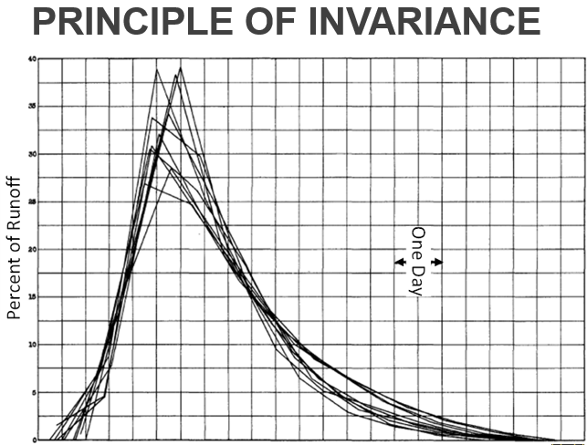
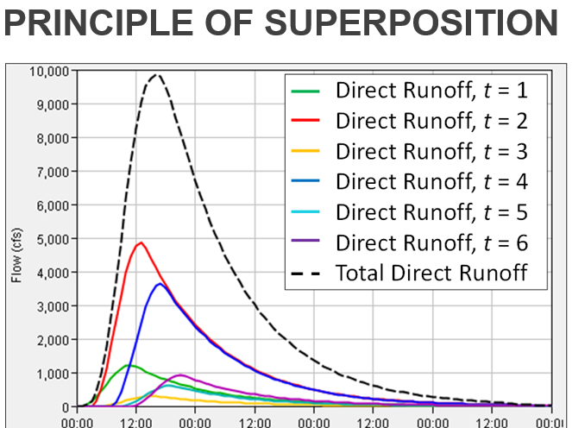
Unit Hydrograph Theory
Originally proposed by L. K. Sherman in 1932
Most commonly used method to transform excess precipitation to runoff at given locations
Recommended for use across the world
It’s not going away
3
Notes:
Unit hydrograph theory is the most commonly employed method within dam safety studies to transform excess precipitation to runoff at given locations in a dimensionless manner. In fact it’s recommended for use throughout the world in dam safety studies.
According to Sherman, 1932, who originally proposed the unit hydrograph concept, the unit hydrograph of a watershed is “…the basin outflow resulting from one unit of direct runoff generated uniformly over the drainage area at a uniform rainfall rate during a specified period of rainfall duration.” This implies that the response of 2 inches of runoff over a given time is 2 times the response of 1 inches of runoff over the same amount of time.
Unit hydrograph theory is still the state of the practice when it comes to hydrologic modeling. Take for instance analyses investigated parameter and modeling uncertainty: these often require many thousands of iterations that cannot be reasonably executed using more complicated runoff routing techniques. These analyses almost always are performed using unit hydrograph theory.

Slide 4
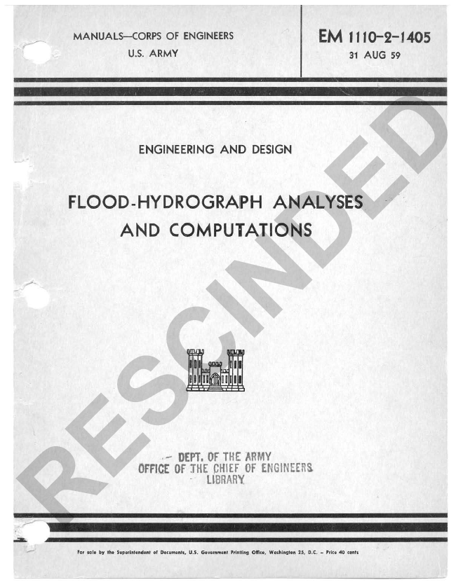
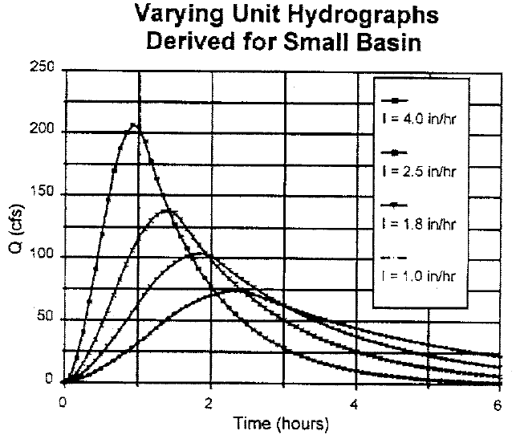
Unit Hydrograph Limitations
EM 1110-2-1405 compared “minor” and “major” floods at the same location throughout the U.S.
“In the majority of basins considered, the peak ordinates of unit hydrographs derived from major floods … were 25 to 50% higher than values computed from records of minor floods.”
4
Notes:
However, due to differences in hydraulic reactions between large and small precipitation events, the corresponding unit hydrographs from large and small events have not been found to be equal, as implied by unit hydrograph theory (i.e. the Principle of Invariance)
Minshall (1960) published an excellent paper that quantified the differences in unit hydrographs from differing intensities of precipitation arising from a small drainage area in Illinois
He showed that as precipitation intensity increases, runoff tends to peak sooner in time and has greater peak flow rates.
This is due to greater depths in the stream channels and overland planes; as water depth increases, effective roughness decreases leading to shorter travel times, etc.
EM 1110-2-1405 from 1959
First official USACE guidance document that presented the 25-50% peaking recommendation
The increases in major flood unit hydrographs were attributed to differences in areal distribution of rainfall (e.g., minor floods don’t affect the entire drainage area while major floods do) and hydraulic reactions (e.g., pool/riffles being drowned as large stages are realized)
This was published around the same time as the Minshall report
Lots of dams were being built and engineers wanted to account for inaccuracies in the methods they were using to design them

Slide 5
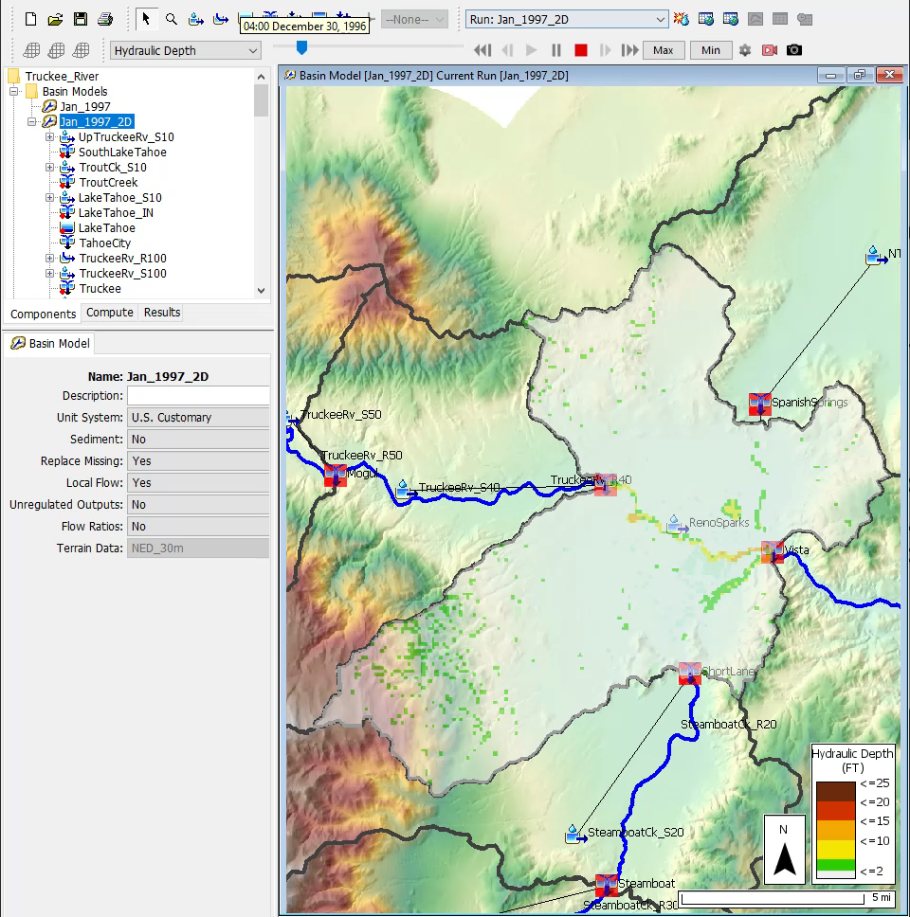
2D Diffusion Wave Transform
HEC’s 2D solver
Shared computational engine
between HEC-HMS and HEC-RAS
Users can simulate complex situations where necessary
Not every situation warrants the most complex solution
5
Notes:
The 2D solver that was pioneered by the HEC-RAS team was added to HEC-HMS within version 4.7
This exposed the 2D solver to a new array of hydrologic applications like precipitation-runoff
As improvements are made to the solver, both teams benefit and the solver becomes more robust

Slide 6
2D Diffusion Wave - Advantages/Disadvantages
Advantages
Predicted values are in accordance with hydraulic theory
Can be much more accurate than unit hydrograph theory, especially when extrapolating
Allows for:
  Unstructured and structured meshes
  Large cell sizes while still retaining detailed terrain information
Disadvantages
Computationally intense when compared to unit hydrograph theory
6

Slide 7
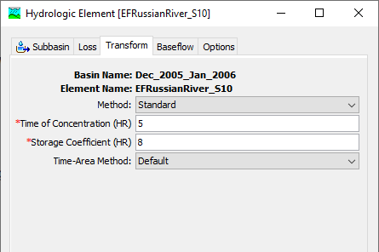
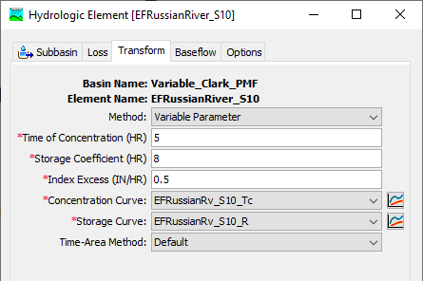
Variable Clark
Standard
Variable
7
Notes:
The Variable Clark method can be enabled by selecting the “Variable” option within the method drop down menu
The component editor will then change to allow for the selection of additional parameters like index excess, concentration curve, and storage curve

Slide 8
Variable Clark - Advantages/Disadvantages
Advantages
Similar to “regular” Clark advantages
Can simulate variable translation and attenuation
Much more accurate than “regular” Clark method, especially when extrapolating
Disadvantages
Requires development of variable Tc and R curves
8
Notes:
Clark advantages:
“Mature” method that has been used successfully in thousands of studies throughout the U.S.
Easy to set up and use.
Method is parsimonious; it includes only a few parameters necessary to explain the variation of runoff volume.
Variable Clark goes beyond that method and corrects for some of the deficiencies:
CAN simulate variable translation and attenuation
As such, it allows for much more accurate extrapolation when used in design storms that far exceed what has been observed in the watershed of interest
But, this comes at a cost in that you must define the variable Tc and R curves

Slide 9
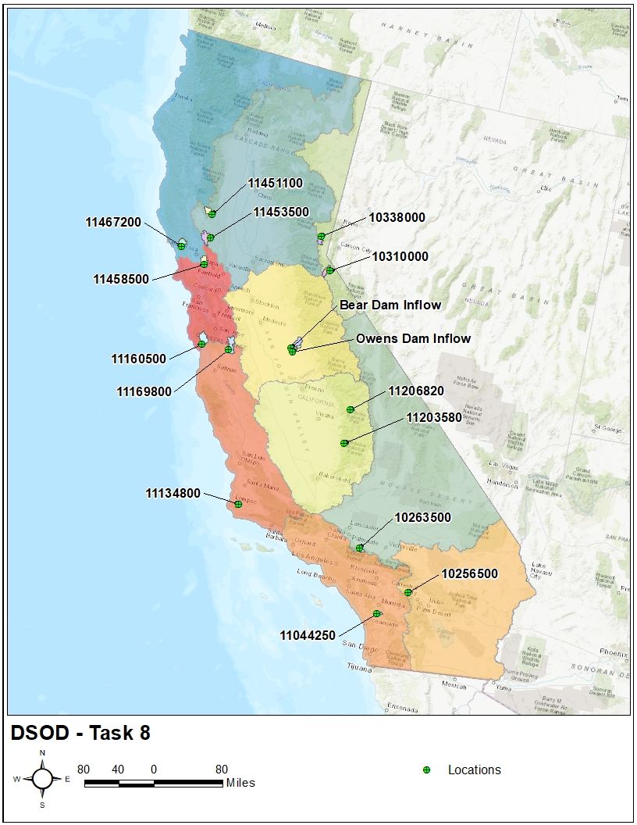
Locations
9
Notes:
Task 8 – Perform hydrologic analysis and develop guidance for peaking the Clark unit hydrograph using hydrologic characteristics.
This is a map of the 16 locations that were chosen
These 16 watersheds were also used within the Task 5 report to save time and $$$
A histogram counting the number of locations per drainage area bin is also shown
Drainage areas ranged between 8 sq mi and 113 sq mi
The average drainage area was 50 sq mi while the median was 53 sq mi

Slide 10
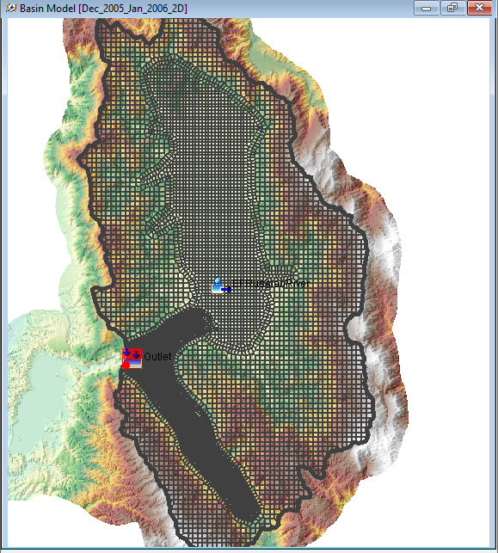
Model Development
Once locations were selected, assign to multiple team members
Utilize a large team to collect and process data as well as perform modeling
Start with a calibrated model from previous efforts
Create a new basin model using prescribed methods
Construct a 2D mesh within HEC-RAS
Calibrate model parameters using multiple statistical metrics
Complete this process within ~1 day
10
Notes:
A large team was assembled to collect data and perform the required modeling for this study
I would like to recognize all of their efforts because it wouldn’t have been possible to do this much work in as short a time frame as we did without their help
The same modeling techniques were used for each location:
Start with the Task 5 watershed
Create a new basin model which used the:
Unstructured discretizaton
Deficit and Constant losses
2D Diffusion Wave transform
Linear Reservoir baseflow
Gridded Temperature Index snowmelt*
The 2D Diffusion Wave transform requires a mesh, which was created within HEC-RAS

Slide 11
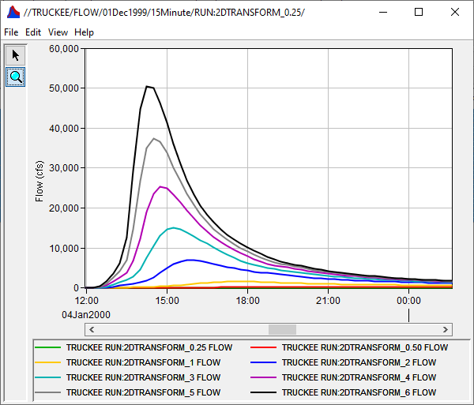
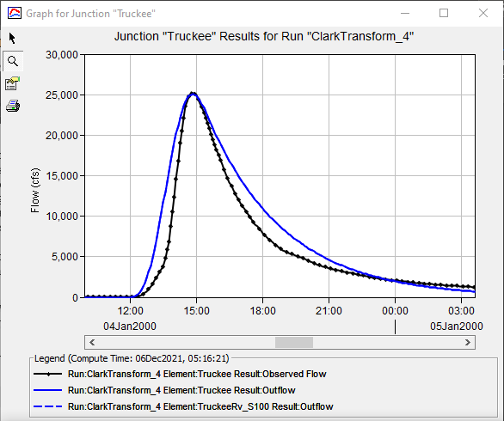
Hypothetical Event Calibration
For each location:
Simulate 0.25, 0.5, 1, 2, 3, 4, 5, and 6 in/hr precipitation events using the 2D Diffusion Wave Transform
Simulate the same events using Clark unit hydrograph
  Calibrate Tc and R
11
Notes:
Following the calibration of each historical event HEC-HMS model, 0.25-, 0.5-, 1.0-, 2.0-, 3.0-, 4.0-, 5.0-, and 6.0-inches of excess precipitation over one hour was applied to each modeling domain and routed using the calibrated 2D diffusion wave transform parameters.
No losses or baseflow processes were included within these simulations.

Slide 12
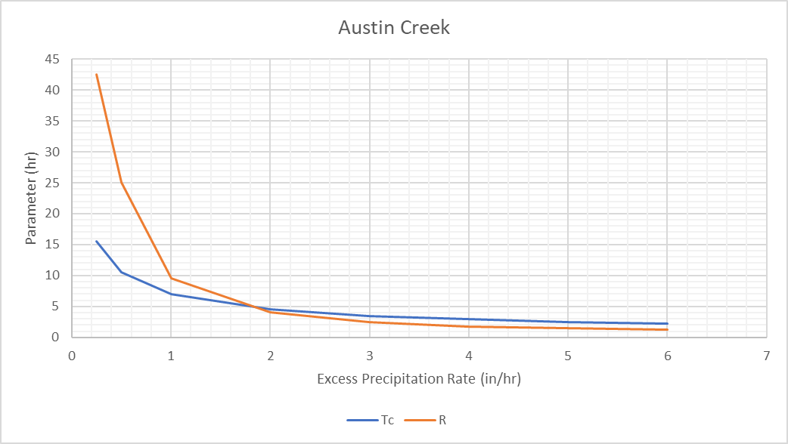
Hypothetical Event Calibration
12
Notes:
This ended up producing Tc and R values for all the aforementioned excess precipitation rates at each location

Slide 13
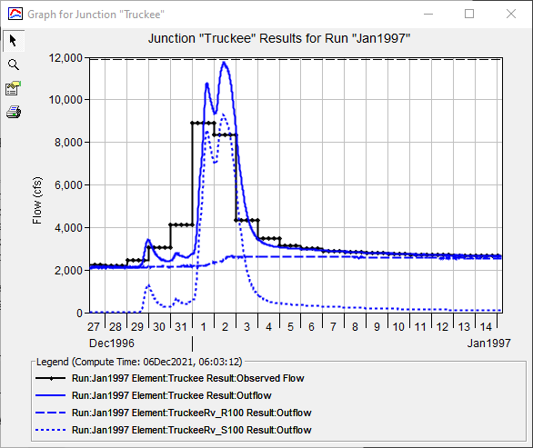
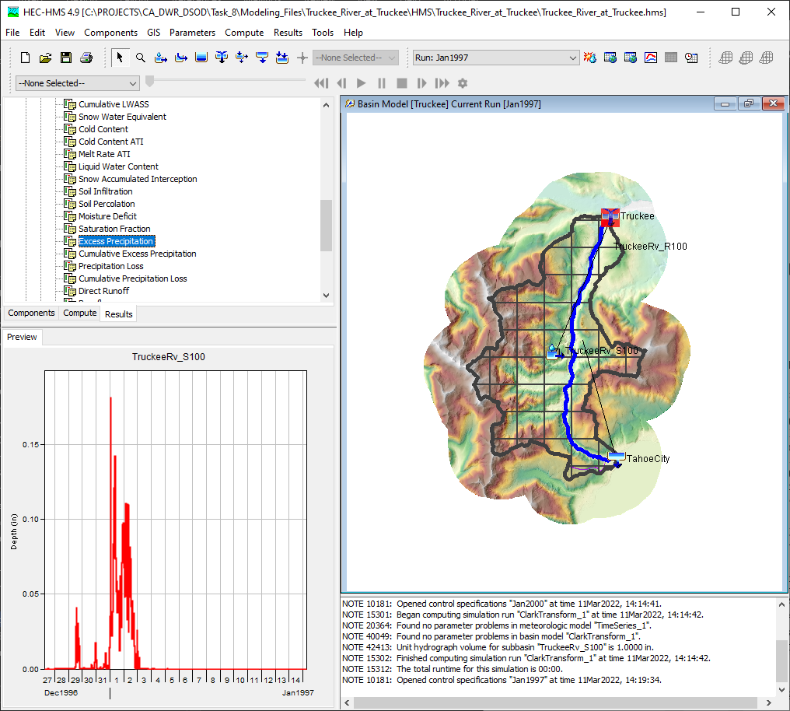
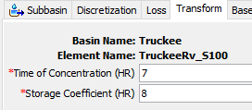
Selection of Index Parameters
Index Clark Parameters
Index Excess Precipitation
13
Notes:
Clark unit hydrograph parameters vary due to multiple factors including drainage area, watershed shape, and storm event, amongst others.
In order to develop regression equations that predict how Clark unit hydrograph parameters change with excess precipitation rate, dimensionless ratios of Tc and R with respect to index values were developed.
The calibrated Tc and R values derived within the Task 5 Report were selected as the index Clark unit hydrograph parameters for each of the 16 previously mentioned modeling domains.
It is anticipated that Clark unit hydrograph parameters such as these will be available within all dam safety studies undertaken by DSOD.
It is preferred that these parameters be obtained through model calibration, but they can also simply be predicted by the Task 5 regression equations.
The selection of index Clark unit hydrograph parameters for the Truckee River at Truckee modeling domain is shown above.
The maximum excess precipitation rate, in inches per hour, that was achieved during calibration within the Task 5 Report was selected as the index excess precipitation rate for each of the 16 previously mentioned modeling domains.
It is anticipated that excess precipitation rates such as these will be available within all dam safety studies undertaken by DSOD.
It is preferred that this excess precipitation rate be obtained through model calibration, but it can also be obtained from uncalibrated parameters.
Long story short, you simply need to simulate a large event, for which there is readily-available boundary condition data
The selection of an index excess precipitation rate for the Truckee River at Truckee modeling domain is shown above.
The key point is that this excess precipitation rate produced the previously shown Tc and R values. They should be realized from the same simulation.

Slide 14
Dimensionless Ratios
14
Notes:
Dimensionless ratios of Tc and R for each excess precipitation rate relative to the index parameters were then derived for each modeling domain by calculating the quotient of the index parameters and the calibrated Tc and R values shown for each modeling domain.
For example, for the Austin Creek location, the calibrated Tc parameters for each excess precipitation rate (16, 11, 7, 4.5, 3.5, 3, 2.5, and 2.3 hrs) were divided by the index Tc (3 hrs) to derive dimensionless ratios of Tc for each excess precipitation rate (5.17, 3.5, 2.33, 1.5, 1.17, 1.0, 0.83, and 0.75, respectively).
This calculation was then repeated for R to derive dimensionless ratios of R.
This process was repeated for each modeling domain
These were the values that were actually used to derive the regression equations.
The ratios of Tc and R relative to the index parameters for Austin Creek are shown above.

Slide 15
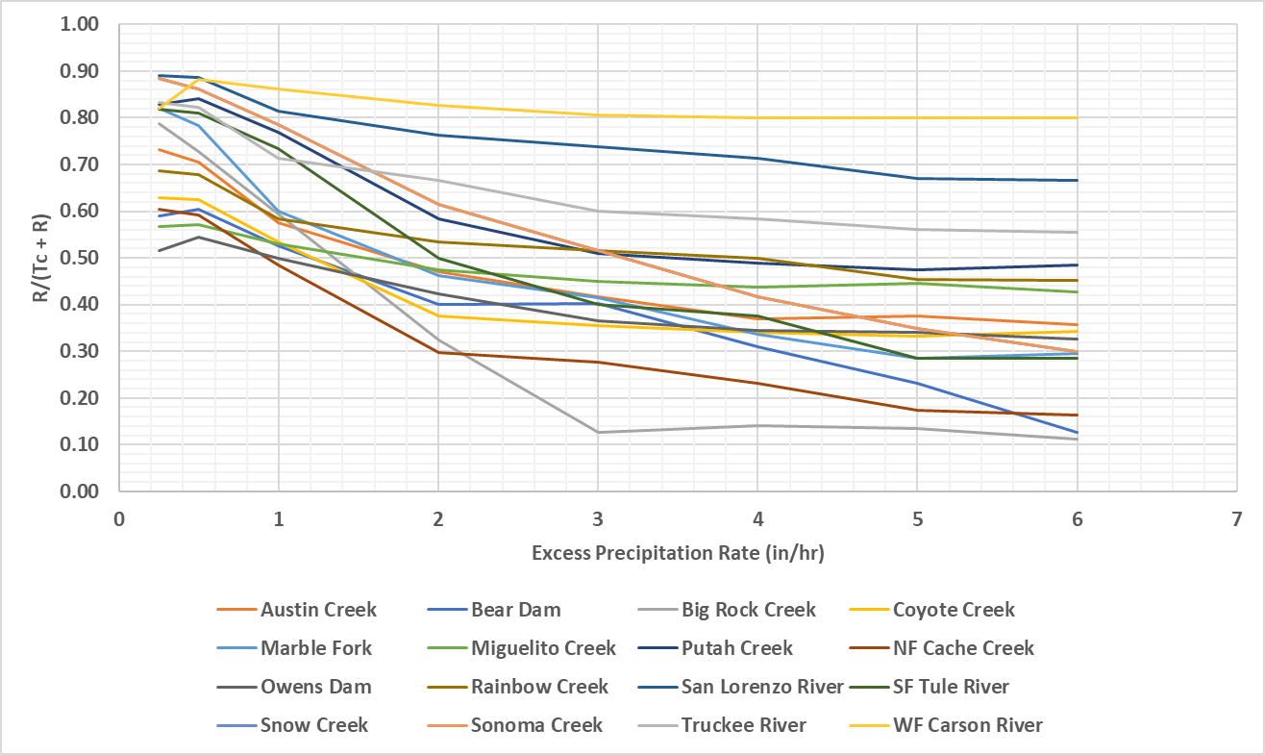
Dimensionless Ratios
15
Notes:
This plot demonstrates the behavior of the dimensionless ratio [R/(Tc+R)] as excess precipitation increases for each modeling domain
In most cases, this ratio flatlines near the 3 in/hr excess precipitation rate
However, that is not universally true. In some modeling domains, this dimensionless ratio does not asymptotically approach a value but instead keeps on decreasing as the excess precipitation rate increases

Slide 16
Regression Goal
  Develop regression equations that can predict how index values of T_{c} and R vary with respect to excess precipitation for independent watersheds
16

Slide 17
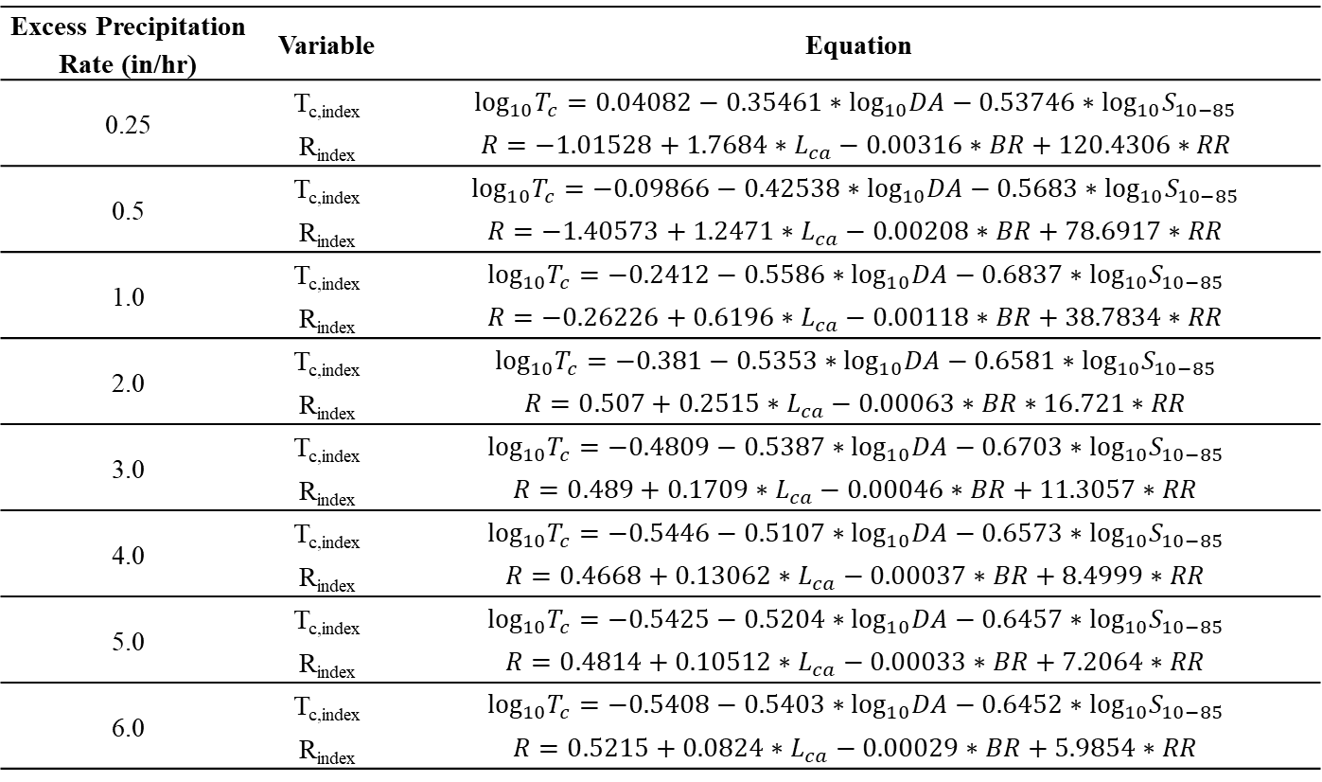
Regression Equations
Excess Precipitation Rate (in/hr) | Variable | Equation
0.25 | T_{c,index} | $$\log_{10}T_{c}=0.04082−0.35461∗\log_{10}DA−0.53746∗{\log_{10}S}_{10−85}$$
 | R_{index} | $$R=−1.01528+1.7684∗L_{ca}−0.00316∗BR+120.4306∗RR$$
0.5 | T_{c,index} | $$\log_{10}T_{c}=−0.09866−0.42538∗\log_{10}DA−0.5683∗{\log_{10}S}_{10−85}$$
 | R_{index} | $$R=−1.40573+1.2471∗L_{ca}−0.00208∗BR+78.6917∗RR$$
1.0 | T_{c,index} | $$\log_{10}T_{c}=−0.2412−0.5586∗\log_{10}DA−0.6837∗{\log_{10}S}_{10−85}$$
 | R_{index} | $$R=−0.26226+0.6196∗L_{ca}−0.00118∗BR+38.7834∗RR$$
2.0 | T_{c,index} | $$\log_{10}T_{c}=−0.381−0.5353∗\log_{10}DA−0.6581∗{\log_{10}S}_{10−85}$$
 | R_{index} | $$R=0.507+0.2515∗L_{ca}−0.00063∗BR∗16.721∗RR$$
3.0 | T_{c,index} | $$\log_{10}T_{c}=−0.4809−0.5387∗\log_{10}DA−0.6703∗{\log_{10}S}_{10−85}$$
 | R_{index} | $$R=0.489+0.1709∗L_{ca}−0.00046∗BR+11.3057∗RR$$
4.0 | T_{c,index} | $$\log_{10}T_{c}=−0.5446−0.5107∗\log_{10}DA−0.6573∗{\log_{10}S}_{10−85}$$
 | R_{index} | $$R=0.4668+0.13062∗L_{ca}−0.00037∗BR+8.4999∗RR$$
5.0 | T_{c,index} | $$\log_{10}T_{c}=−0.5425−0.5204∗\log_{10}DA−0.6457∗{\log_{10}S}_{10−85}$$
 | R_{index} | $$R=0.4814+0.10512∗L_{ca}−0.00033∗BR+7.2064∗RR$$
6.0 | T_{c,index} | $$\log_{10}T_{c}=−0.5408−0.5403∗\log_{10}DA−0.6452∗{\log_{10}S}_{10−85}$$
 | R_{index} | $$R=0.5215+0.0824∗L_{ca}−0.00029∗BR+5.9854∗RR$$
17
Notes:
Unlike the Task 5 Report, regression equations were developed using all available data.
Region-specific equations were not developed.
This was done to increase the sample size, reduce uncertainty in the results, and make the regression equations easier to apply.
Additionally, the same predictive variables were used for each excess precipitation rate to ease the use of the regression equations and mitigate the potential for sharp inflection points in the output or increasing ratios of Tc and R as excess precipitation rates increase for reasonable parameter values.
Here are all the regression equations that were developed

Slide 18
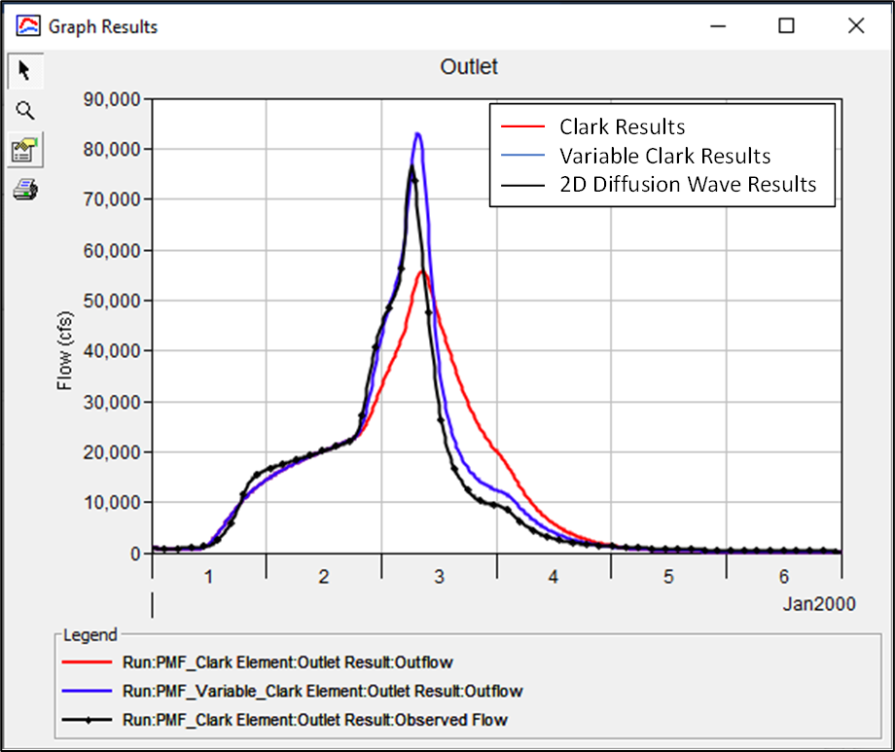
Validation Results – EF Russian River
18
Notes:
This is an example of the validation process for the EF Russian River location
The event simulated is the approximate PMF
As you can see, the predicted Variable Clark parameters agree pretty well when compared against the 2D Diffusion Wave transform results. The Variable Clark peak is actually slightly larger than the 2D Diffusion Wave results.
As expected, the “base” Clark results underpredict the peak when compared against the 2D Diffusion Wave transform results. This is to be expected since the Clark parameters were calibrated for an event that is much less intense than the PMF event
Excess precipitation rates = 0.44 in/hr (Dec2005-Jan2006) vs 2.1 in/hr (PMF)

Slide 19
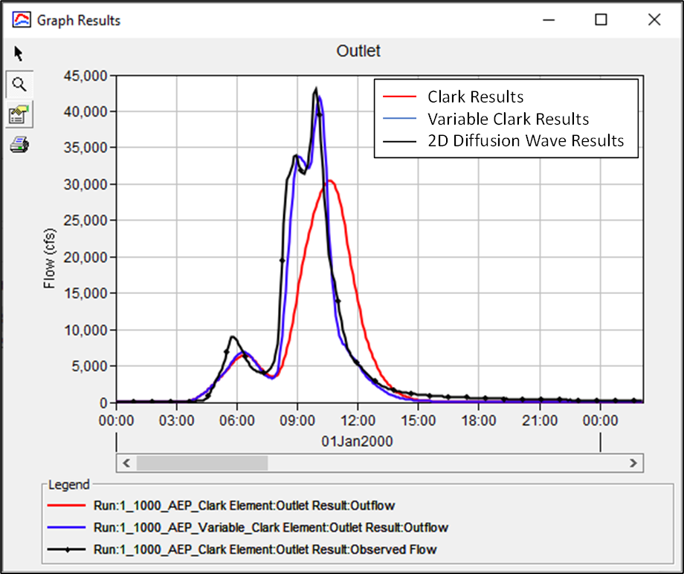
Validation Results – Arroyo Seco
19
Notes:
This is an example of the validation process for the Arroyo Seco location
The event simulated is the approximate 1/1000 AEP, while less rare than the PMF, is still an extreme amount of precipitation
As you can see, the predicted Variable Clark parameters produce very good results when compared against the 2D Diffusion Wave transform results
Again, the “base” Clark results underpredict the peak when compared against the 2D Diffusion Wave transform results. This is to be expected since the Clark parameters were calibrated for an event that is much less intense than the 1/1000 AEP event in this case
Excess precipitation rates = 0.7 in/hr (Jan2000) vs 4.35 in/hr (1/1000 AEP)

Slide 20
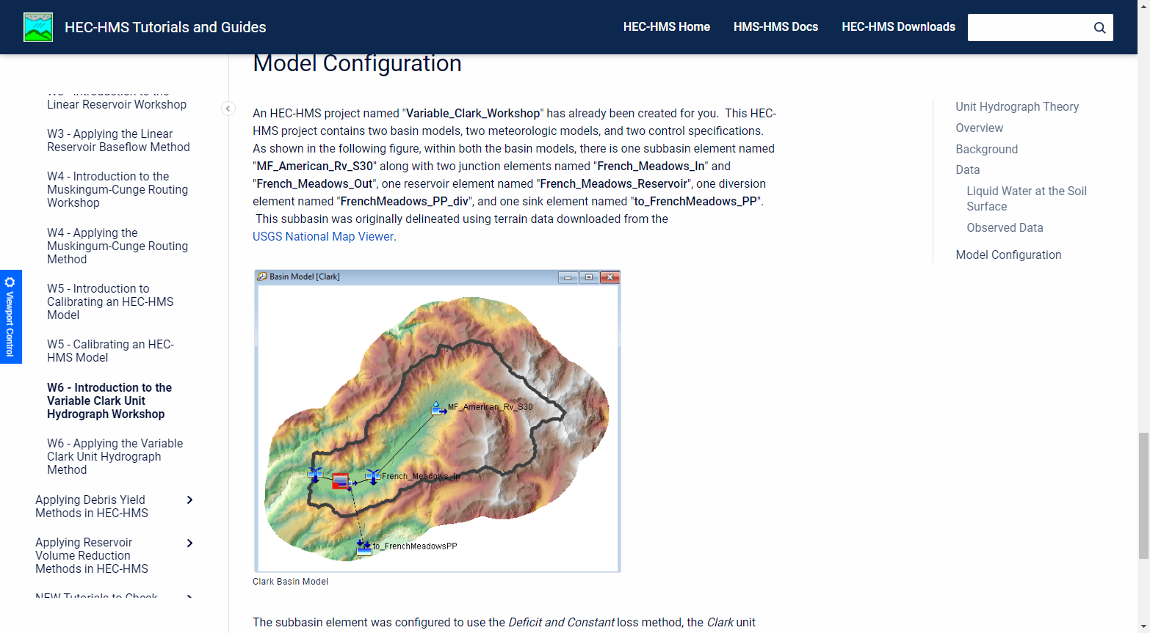
Tech Transfer
Link to Tutorials and Guides
20
Notes:
Several lectures and workshops have been posted to our website that presents example applications of these regression equations such as:
How to derive variable Clark parameters for an independent watershed?
How to apply variable Clark parameters within an HEC-HMS project?
How to understand the results that are produced when using variable Clark parameters?

Slide 21
Summary
100+ HEC-HMS models were built and calibrated throughout the state of CA
16 of these were used to evaluate Variable Clark parameters
Regression equations for both “regular” Clark and variable Clark methods were developed using calibrated parameters
Regression equations were validated at numerous locations
Example applications have been posted to HEC’s website
21

