Slide 1

Shared Data Components
Hydrologic Modeling with HEC-HMS
Slides by:
Tom Brauer (HEC), Greg Karlovits (HEC), Emily Moe (MVP)
Instructor:
Natasha Sokolovskaya (HEC)

Slide 2
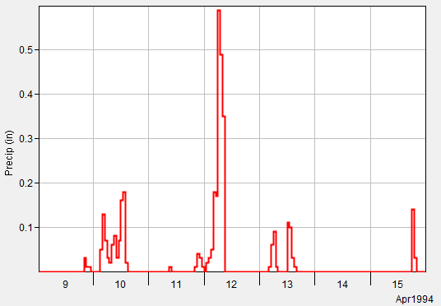
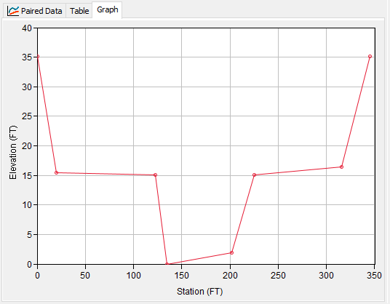
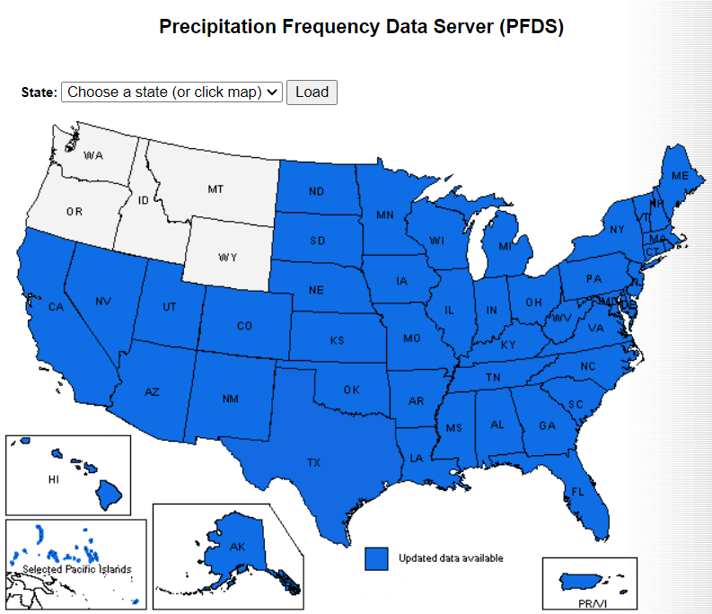
Types of Shared Data
Time-Series Data
Paired Data
Gridded Data
Terrain Data
https://hdsc.nws.noaa.gov/pfds/
Notes:
Shared data can be shared by different model components, such as multiple met models, or basin elements for terrain data.
There are four types of shared data in HMS. Will discuss the first three.
Terrain data was introduced in Lecture and workshops for HEC-HMS delineation tools https://www.hec.usace.army.mil/confluence/display/HMSGUIDES/Introduction+to+Creating+a+Georeferenced+Model+using+HEC-HMS+GIS+Tools

Slide 3

Time-Series Data
USGS Rain Gage
Image Credit: USGS
https://waterdata.usgs.gov/md/nwis/uv/?site_no=392703076162801

Slide 4
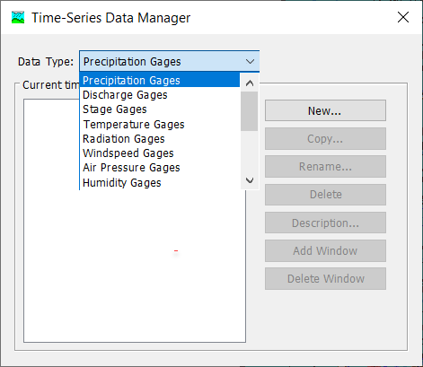
Time-Series Data
Observations of a Variable that are indexed by time.
Frequently used as hydrologic model boundary conditions.
Notes:
Time Series Data are observations of a hydrometeorological variable that are indexed by time.
Frequently, time-series data are used as boundary conditions for a hydrologic simulation.
Shown here is the Time-Series Data Manager, available by selecting Component > Time-Series Data Manager in the main window toolbar.
The Manager lists each type of Time-Series Data that are available in HMS. The Manager also allows the user to create a new Time-Series Component or create/rename/delete existing ones.

Slide 5
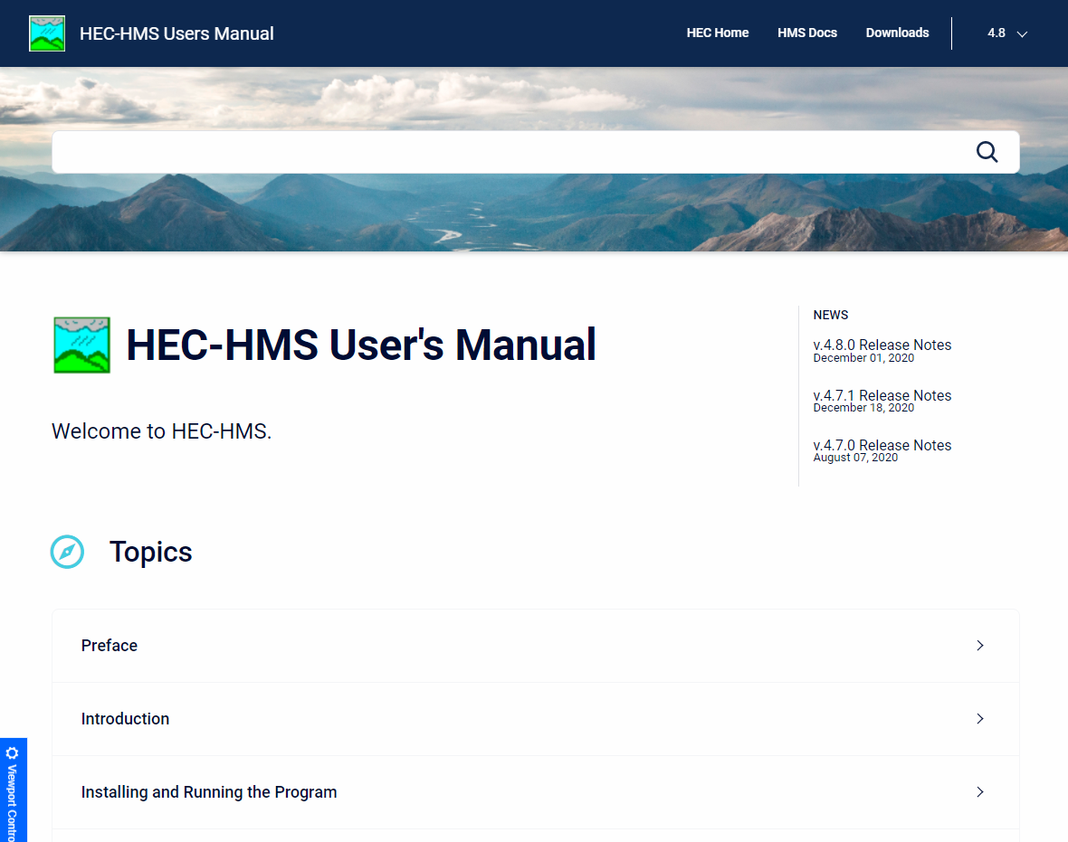
Time-Series Data
Common examples:
  Discharge
  Stage
  Precipitation
  Temperature
Full list available in the user’s manual: https://www.hec.usace.army.mil/confluence/hmsdocs/hmsum/latest/shared-component-data/time-series-data
Notes:
Common examples of time-series data include daily average streamflow, fifteen-minute precipitation gage observations, hourly surface temperature measurements and more.
A full list of time-series data that HMS can use is available in the user’s manual linked here: https://www.hec.usace.army.mil/confluence/hmsdocs/hmsum/latest/shared-component-data/time-series-data

Slide 6
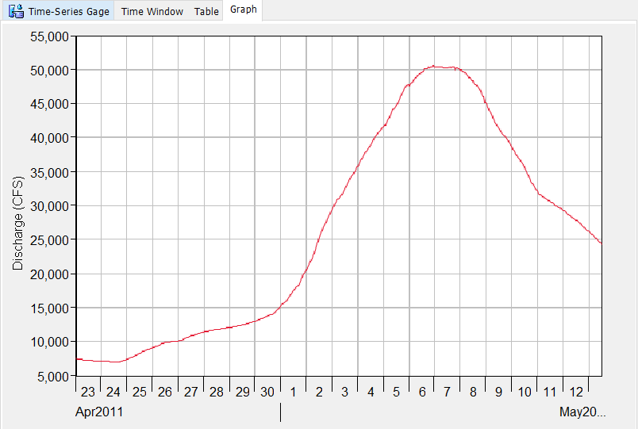
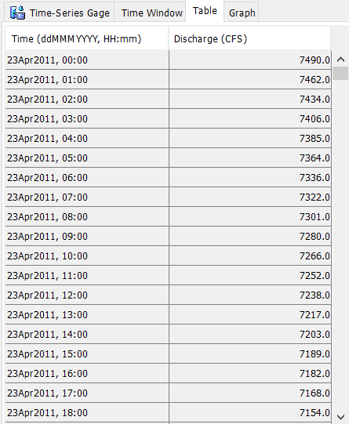
Discharge Gage
Notes:
Here is an example of Time-Series Data with a Discharge Gage.
The table on the left is one view that HMS offers of Time-Series Data. It includes the time and value of the parameter.
The graph on the right is the other HMS view of Time-Series components. It plots the timestamp (Date) on the x-axis and the value of the parameter on the y-axis.

Slide 7
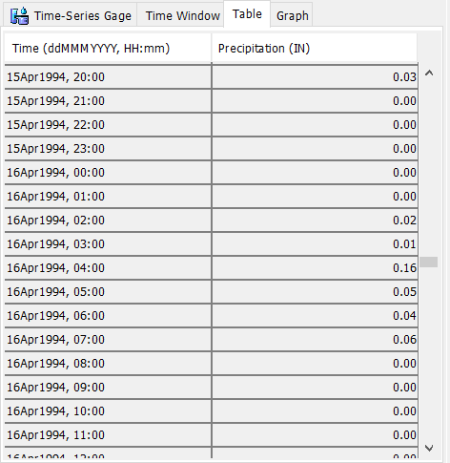
Precipitation Gage
Notes:
Here is another example of Time-Series Data with a Precipitation Gage
Again, the table on the left is one view that HMS offers of Time-Series Data. It includes the time and value of the parameter.
The graph on the right is the other HMS view of Time-Series components. It plots the timestamp (Date) on the x-axis and the value of the parameter on the y-axis.

Slide 8
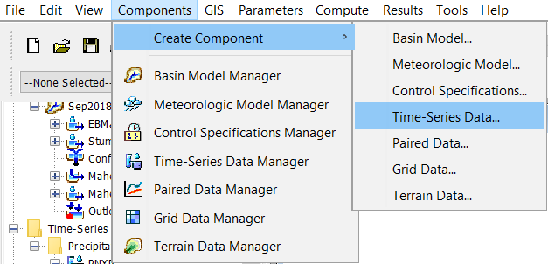
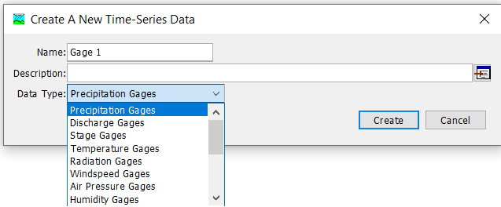
Notes:
There are two paths to creating new Time-Series Data Components.
The first is to use the Create Component > Time-Series Data… menu option. You will then be prompted with a window that asks for a name, a description and a data type. Select the data type first, then enter a name and description. As long as the name is unique for the data type, you can select Create and a new Time-Series Data Component will be created.

Slide 9
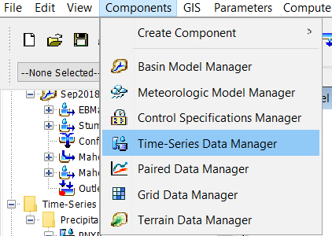
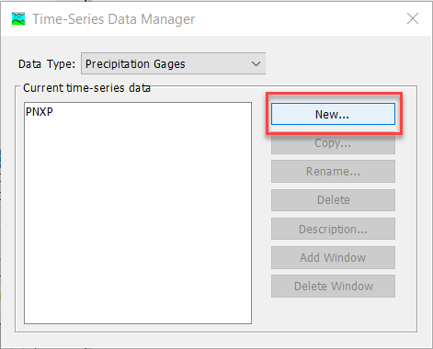
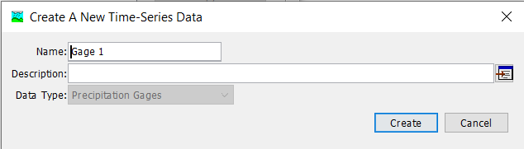
Notes:
The second path to creating a time series component is to use the Time-Series Manager menu option. A window will open that allows you to see all of the Time-Series Components that have been created for each type. Select the type of interest in the top menu, and the window will show all the Time-Series Components of that type that have been created, if any. To create a new one, select the New… button and then you will get a window like the lower left.

Slide 10
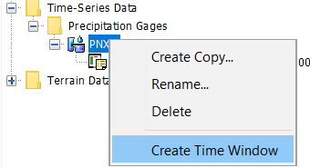
Time-Series Data Manager
View existing data by type
Create new
Copy
Rename
Delete
Notes:
Here is an overview of the options available within the Time-Series Data Manager.
Once the time-series data gage is created, it appears in the project tree on the left

Slide 11
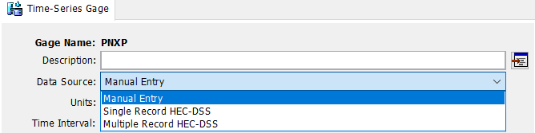
Time-Series Data Sources
Enter data manually
Link to an existing HEC-DSS file
Notes:
The time-series data must then be linked to the gage.
Time Series Data can be populated within HMS in one of two ways—manually (by copy/pasting data directly into the HMS time-series table) or by linking the time-series record from an existing DSS-file.

Slide 12
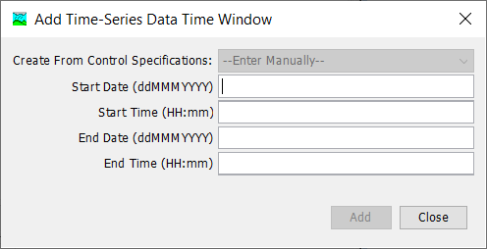
Time-Series Manual Entry
Create Time Window
Spreadsheet-like table
Copy-and-paste
Advanced functions
Notes:
To add a time-series data entry manually, you must first create a Time Window for the data.
Right-click on the gage > Create Time Window
Populate Add Time-Series Data Time Window Box
Make sure to follow the format (e.g. 01Jan2002, 05:00)

Slide 13
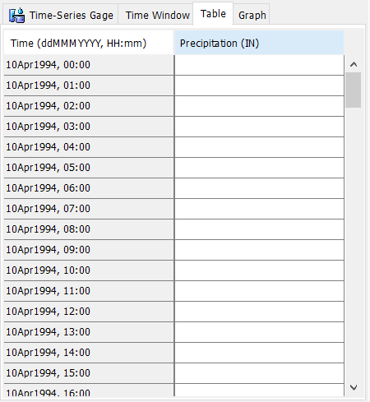

Time-Series Manual Entry
Create Time Window
Spreadsheet-like table
Copy-and-paste
Advanced functions
Notes:
Highlight the time window to enable the Manual Time Entry Table

Slide 14
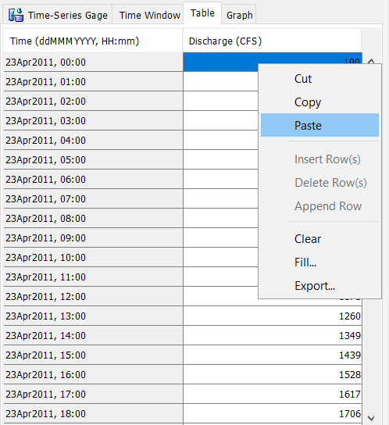
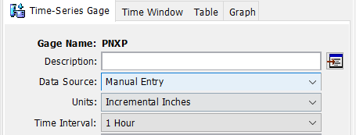
Time-Series Manual Entry
Create Time Window
Spreadsheet-like table
Copy-and-paste
Advanced functions
Notes:
The manual entry table behaves much like a spreadsheet. It is very easy to copy-and-paste from other applications like Excel to populate your time series data entry.
On the main tab, you must specify the units & time interval that you are entering for manual entry.

Slide 15
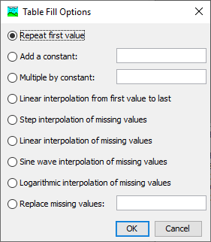
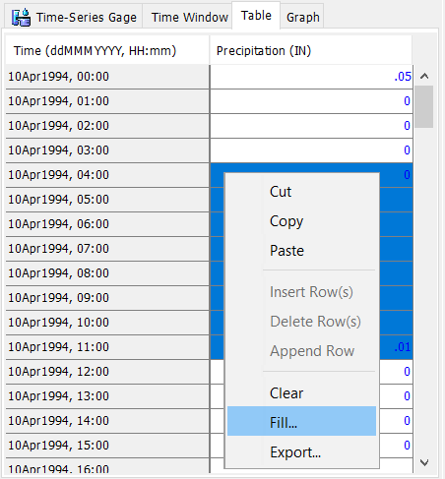
Time-Series Manual Entry
Create Time Window
Spreadsheet-like table
Copy-and-paste
Advanced functions
Notes:
The Fill… feature offers several advanced functions such as interpolating/filling in missing values.
The values in the table save to the projectName.dss file in the project directory and will be available next time you open the project.

Slide 16
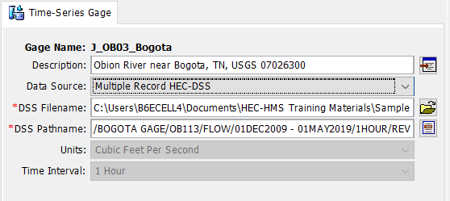
Time-Series from DSS-File
Link to existing time-series data in a DSS file
See User’s Manual for conventions:
https://www.hec.usace.army.mil/confluence/hmsdocs/hmsum/latest/shared-component-data/time-series-data
Notes:
Linking time series data directly to an HEC-DSS record is convenient when the time-series data already exists and you want to link it to the HMS model.
To do this, Simply point HMS to the correct DSS-File and Pathname to link the data to the time-series gage within HMS.

Slide 17
Paired Data

Slide 18
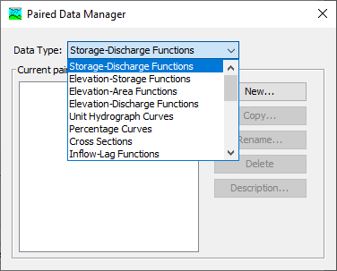
Paired Data
Data represented as X vs Y
Y = f(X)
Usually monotonically increasing
Notes:
Paired data in HMS are used to compute the value of one variable from another. Usually this is a functional relationship, where there is some Y that is a function of a given X. An example of this is a rating curve, which lets HMS compute stage for a given amount of flow.
One very important thing to note about paired data is that HMS will never attempt to extrapolate paired data. It will only interpolate.
Here is the Paired Data Manager, available by selecting Components > Paired Data Manager in the main window toolbar.
The Manager lists each type of Paired Data that are available in HMS. The Manager also allows the user to create a new Paired Data Component or create/rename/delete existing ones.

Slide 19
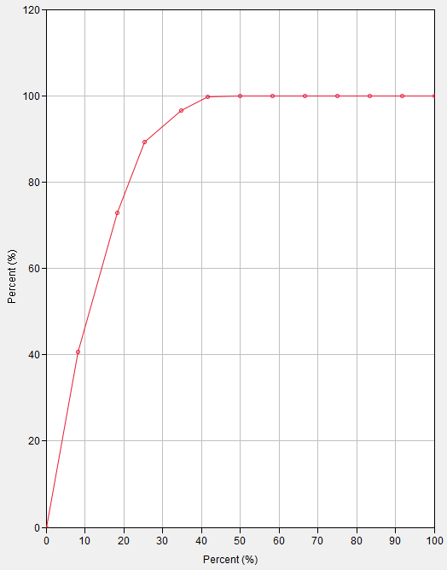
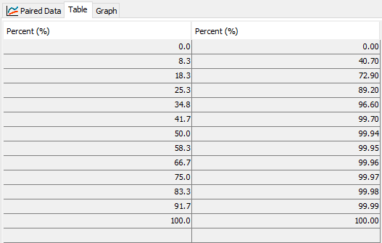
Percentage Curve
Notes:
Here is an example of a Paired Data of type Percentage Curve. It has X and Y values that are percentages (up to 100.) The values must be monotonically increasing. Most types of paired data behave in this way.
The table on the left is one view HMS offers of a Paired Data Component. It shows in two columns the X and Y values.
The graph on the right is the other HMS view of the Paired Data Component, and is an X vs. Y graph of the same table.

Slide 20
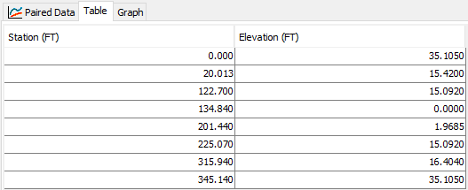
Cross-Section
Notes:
Here is an example of a Paired Data of type Cross-Section. It has X and Y values that are in feet, where X is the stationing along the channel cross section, and Y is the elevation for each point along the cross section. These paired data are used in the Muskingum-Cunge reach routing method and require that the cross-section is defined using eight points. Cross-sections are one of the special cases of paired data that are not functional or monotonically increasing.

Slide 21
Important Examples
(reservoirs)
Elevation-storage function
Elevation-discharge function
Dimensionless storm pattern
Channel cross-sections
Full list available in the user’s manual:
(rating curve)
(hypothetical storm)
(channel routing)
https://www.hec.usace.army.mil/confluence/hmsdocs/hmsum/latest/shared-component-data/paired-data
Notes:
There are many types of Paired Data that are used in HEC-HMS. HMS assigns specific types to each curve in order to prevent them from accidentally being confused with one another. Each type has its own units for the X and Y variables.
Some of the most commonly used Paired Data types are shown. The elevation-storage function is used to define the geometry of a reservoir, converting between reservoir stage and reservoir storage.
The elevation-discharge function, or rating curve, is used to compute stage from flow at an element. <<flow from stage>>
Dimensionless storm patterns are percent-percent curves that allow for creating storm patterns of any duration and intensity.
Channel cross-sections are mentioned because they break the monotonically-increasing rule. They are a special case.
Many other types are available for other types of modeling. Temperature Index snow modeling often requires one or more Paired Data curves as parameters. Hypothetical Storm precipitation often uses Paired Data for defining time patterns of storms, or point-to-area reduction functions.

Slide 22
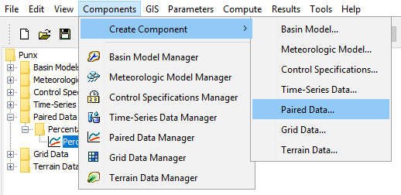
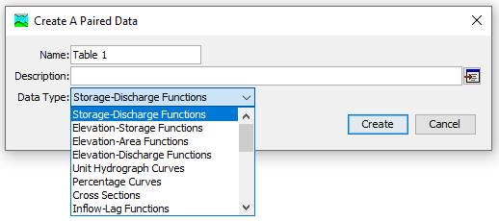
Notes:
There are two paths to creating new Paired Data Components.
The first is to use the Create Component > Paired Data… menu option. You will then be prompted with a window that asks for a name, a description and a data type. Select the data type first, then enter a name and description. So long as the name is unique for the data type, you can select Create and a new Paired Data Component will be created.

Slide 23
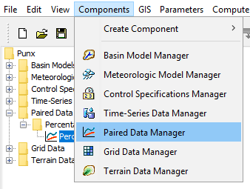
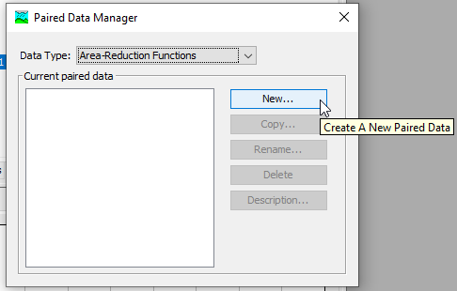
Notes:
There are two paths to creating new Paired Data Components.
The second path is to use the Paired Data Manager menu option. A window will open that allows you to see all the Paired Data Components that have been created for each type. Select the type of interest in the top menu, and the window will show all the Paired Data Components of that type that have been created, if any. To create a new one, select the New… button and then you will get a window like the “Create a Paired Data” window on the previous slide.

Slide 24
Paired Data Manager
View existing data by type
Create new
Copy
Rename
Delete

Slide 25
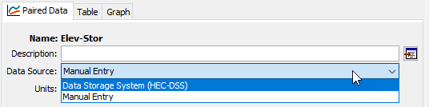
Data Sources
Link to an existing HEC-DSS file
Enter data manually
Notes:
There are two choices for paired data sources: HEC-DSS files, and manual entry. Choosing one or the other presents you with different options.

Slide 26
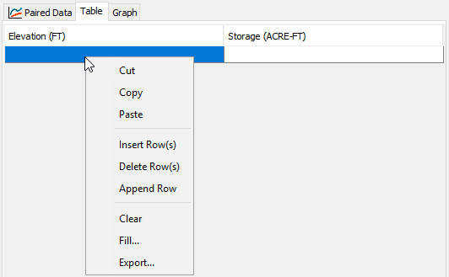
Manual Entry
Spreadsheet-like table
Copy-and-paste
Advanced functions
Notes:
The manual entry table behaves much like a spreadsheet. It is very easy to copy-and-paste from spreadsheets to fill out your paired data. This is the primary way of creating paired data, as most data that are used are stored in formats like CSV files and spreadsheet workbooks.
On the main tab you must specify the units that you are entering for manual entry.
There are other controls to change the shape of the table, such as inserting, deleting, and appending (adding to the end) rows.
The Fill… feature offers several advanced functions for filling the values in a column. This is especially handy for dealing with missing values.

Slide 27
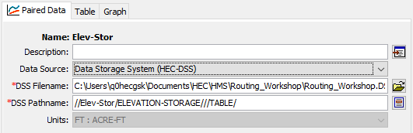
HEC-DSS File
Link to existing paired data in a DSS file
See User’s Manual for conventions
https://www.hec.usace.army.mil/confluence/hmsdocs/hmsum/latest/shared-component-data/paired-data
Notes:
HEC-DSS is convenient when a paired data object has been created already that you want to re-use. The easiest way to create one in the first place is to create it using manual entry in HMS. This makes sure that the pathname and unit conventions for the type of table you are trying to create are correct.
The C-part of the pathname controls the data type. Importing from DSS automatically handles data units.

Slide 28
Gridded Data

Slide 29
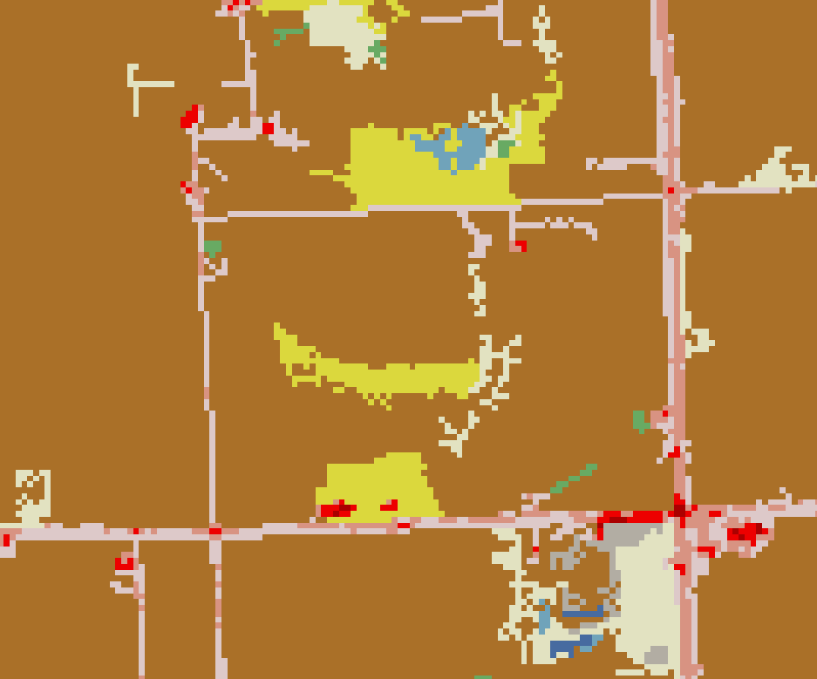
What’s a Grid?
Spatial data on a regular lattice
  Raster data
Each pixel represents an average value over the cell
Notes:
A regular lattice implies that the cell size is the same for the entire dataset, and that the cell location can be referenced from an index location (e.g. an origin, like the coordinates (0, 0)) and then an offset from it (row 10, column 26). If you work with GIS frequently you are already familiar with raster datasets – that is what we’re talking about with grid data.
The value for each cell is constant across the cell. For continuous data (numeric data that can take on any value over a range) the cell usually represents the average value of the true information. For example, a grid of elevation data is likely to represent the average of the true elevation over the grid cell.

Slide 30
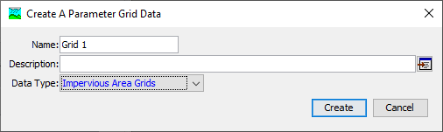

HMS: Two Grid Philosophies
A grid is a raster with no notion of time
A gridset is a set of rasters with each indexed by time
Notes:
In traditional HMS modeling, grid data are most frequently used to model precipitation boundary conditions, such as radar-based precipitation measurement. As HMS capabilities have grown, additional types of grid or raster data have been added to address modeling needs.
An important distinction exists between grids and gridsets in HMS.
Grids are static – they are an unchanging snapshot and are not associated with any sort of time. The example above shows an impervious area grid, which stays constant with respect to time. (Yes in real life impervious area amounts can change, but HMS cannot currently model time-varying impervious area.) These datasets contain a single grid.
Gridsets are not static, and are what you would use to represent boundary conditions like precipitation or temperature. The gridset contains many grids, and each grid is associated with a date and time. The example here shows a temperature gridset, which might contain a set of grids that are observations of surface temperature taken each hour.

Slide 31
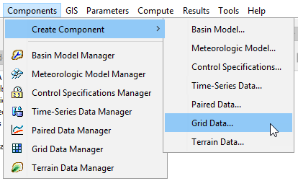
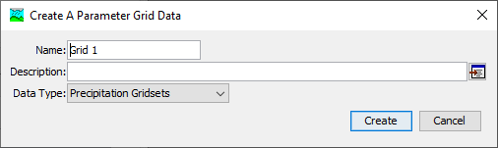
Notes:
There are two ways to create a grid data component. The first is to choose Components > Create Component > Grid Data…
You will see a dialog box like this. Choose the type of grid in the drop down menu, then give it a name. Pressing create adds a new grid data object to the watershed explorer.

Slide 32
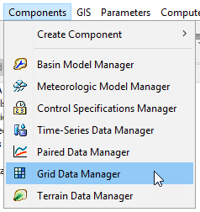
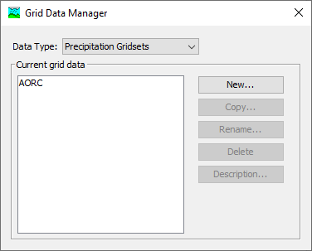
Notes:
The second way is to go through the Grid Data Manager, which can be accessed in the Components menu. The Grid Data Manager allows you to see all the grids that have already been created, organized by type. It also lets you create new ones, or copy/rename/delete existing ones. Pressing the New… button will launch the same creation dialog as the creation option from the previous slide.

Slide 33
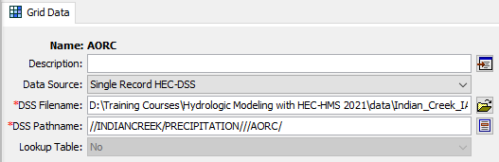
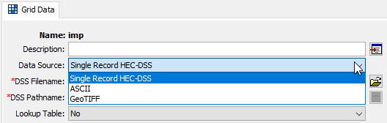
Data Sources
Varies by type of data
All can use HEC-DSS
Grids can use raster data formats
  ASCII
  GeoTIFF
Notes:
Depending on whether you’re working with a grid or a gridset, you can link an HMS grid component to different sources of data.
In any case, HEC-DSS can be used as a data source for a grid component. HMS underneath the hood is always dealing with HEC-DSS for data storage, so this format is always applicable. For gridsets, this is the only type of data that currently can be used. However, utilities for converting data from one format (e.g., NetCDF, HDF, etc.) to HEC-DSS are available and will be discussed in just a bit.
For grids, there are also two formats of raster data that can be linked up. GeoTIFF is the most common format used for these types of data. ASCII grids are mainly provided as an option for precipitation-frequency grids, but certainly can be used for other data types if that is how the source data are stored.

Slide 34
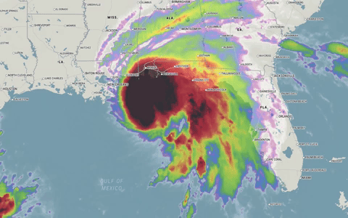
Gridset Workflow
Gridsets are more complicated because a time-series of grids is involved
Import source data to HEC-DSS
Create gridset in HEC-HMS
Link the datasource
https://cms.accuweather.com/wp-content/uploads/2020/09/HurricaneSallyTueMornLoop.gif
Notes:
Often the data we want to use for gridded boundary conditions are in a format that HMS cannot directly use. Commonly, NetCDF or HDF is used to store high-dimensional data, such as meteorologic or climatic data. Many times each time step of the data is in a separate source data file, meaning that a day’s worth of hourly timestep data might be in 24 files. In order to get HEC-HMS to use these, they need to be placed in a DSS file, with the correct convention. Then, you will need to create the correct type of grid data component and link the DSS file you created to that component.

Slide 35
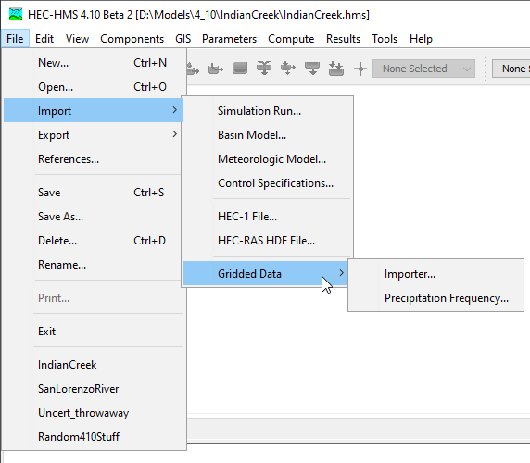
Grid Data Importer
A set of utilities for importing grid data to DSS are available
  Import from one or many files
  Choose which variables to import
  Clip
  Handle projections
  Resample
Notes:
HEC-HMS now features a tool for importing grid data from a variety of formats in the HEC-DSS format. It is able to handle one or many files as inputs, filter down to the variables of interest, clip the grid domains to a user-specified spatial extent, deal with projecting the grid data, and resampling the grid resolutions. It is available by going into the File menu, dropping down to Import, and selecting Import Gridded Data. The following slides will walk through a simple import using this tool.

Slide 36
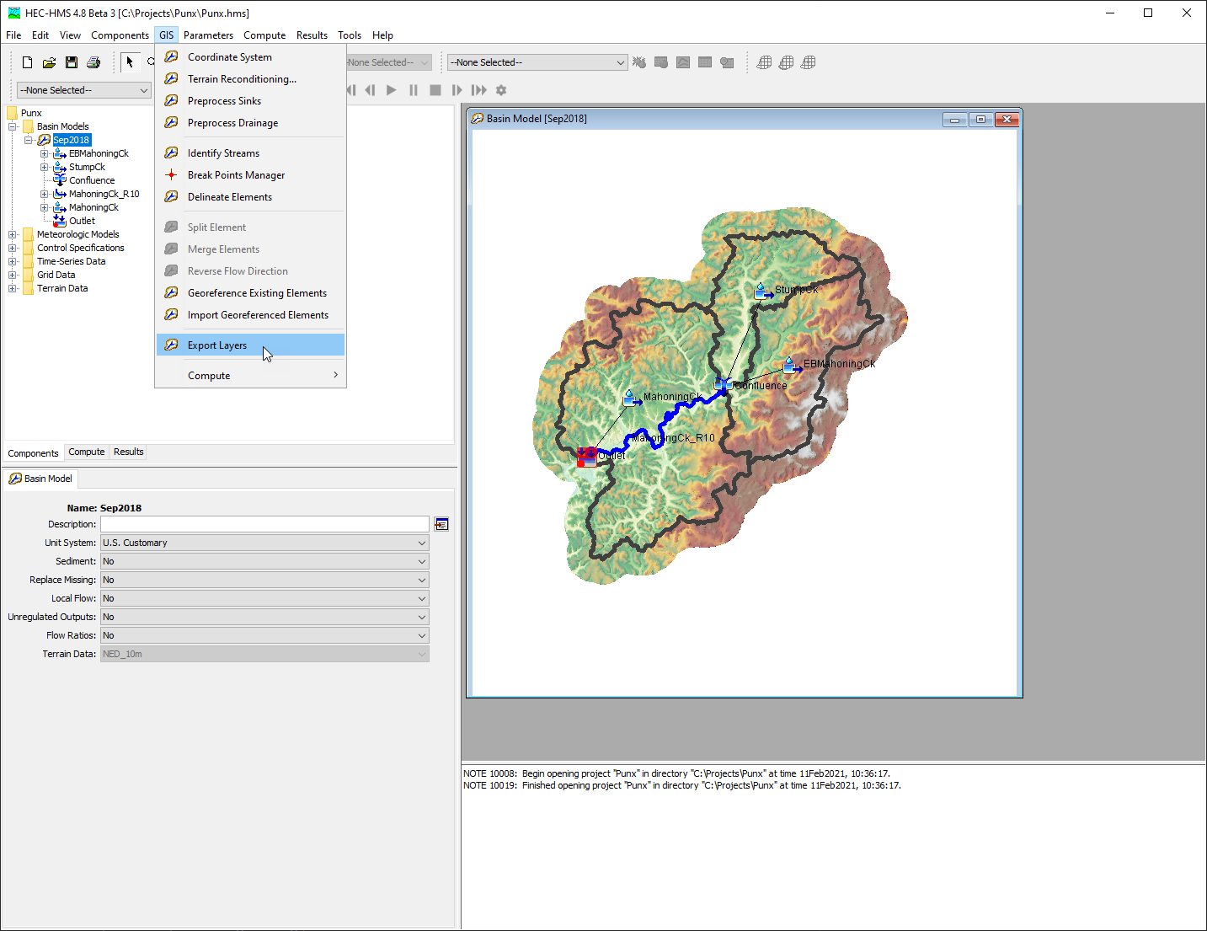
Export Subbasins Layer
Notes:
I like to start by exporting my subbasins layer. We will use the subbasins layer to clip grids on import.

Slide 37
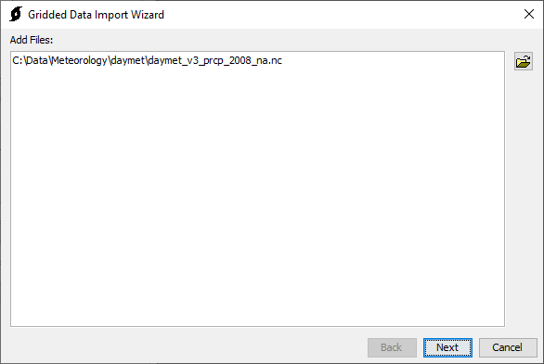
Step 1 - File Selection
Notes:
On the first screen, you can select as many files as you want to import into the DSS file at the end. Select the browse button on the right and add the files. Supported formats will be shown in the browsing dialog.
Some data are contained all within one file, as in the case shown here. In other cases, the data are spread across a number of files. In either instance you can add those source data files to the wizard.

Slide 38
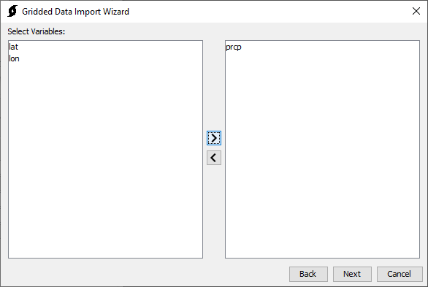
Step 2 - Variable Selection
Notes:
The variable selection step is important in case the source data store multiple kinds of data at a time. Some data have a convention that store latitude and longitude as grids as well, and we don’t want to import those. In this case we have selected the “prcp” data variable and moved it to the right side, meaning any data with the “prcp” variable type will be imported. The import utility will automatically interpret this as precipitation data. Many types of data are supported with this import utility, which recognizes most of the common abbreviations or variable names for gridded meteorologic data.

Slide 39
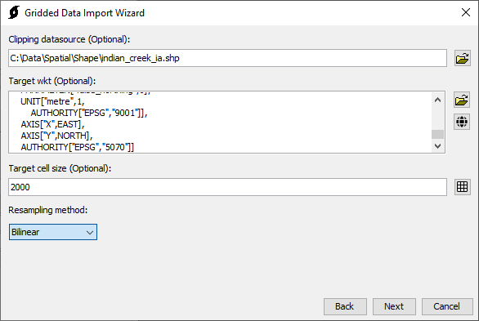
Step 3 - Clipping, Projection, and Resampling
Notes:
The third step handles all of the spatial processing.
Using a clipping datasource can drastically reduce the size of the output, especially when the source data covers a much larger spatial extent than the project area you are trying to model. One handy way to get a clipping datasource is to export the watershed polygon shapefile from your HEC-HMS watershed delineation.
The target WKT controls what projection the output data should be in. If you click the browse icon, you can browse to a source of spatial data and use the projection information for that dataset. Or, you can select the globe icon, which will give you some built in options, such as SHG, which is commonly used for HEC-HMS models in the United States.
The target cell size controls how the data will be resampled. This is the cell size that the output data will be in (measured in meters.) The output size is dependent on the resolution needed for the project. Use a cell size that is at smallest the size of the input data. Coarsening the resolution of the data will reduce file size. Typical options are selectable if you select the grid icon to the right of the box. A typical resolution for HMS models that takes into account the typical resolution of gridded data is 2,000 meters.
Finally the resampling method controls what method HEC-HMS will use to convert the source data to the target data. For meteorologic data, bilinear is typically adequate.

Slide 40
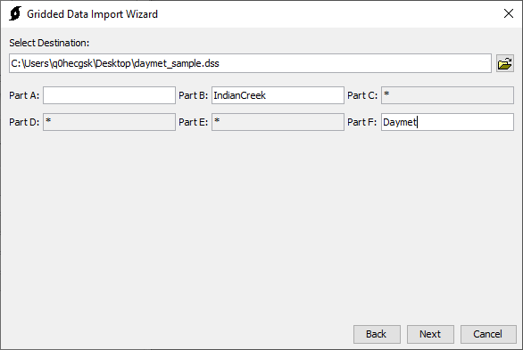
Step 4 - DSS Output Selection
Notes:
Finally, choose the destination for the data import. This can be an existing or a new HEC-DSS files. Then, specify the A, B, and F parts of the target DSS paths.
Refer to the users manual for DSS file naming conventions https://www.hec.usace.army.mil/confluence/hmsdocs/hmsum/latest/shared-component-data/
The importer will automatically handle the C, D, and E parts based on the import data.

Slide 41
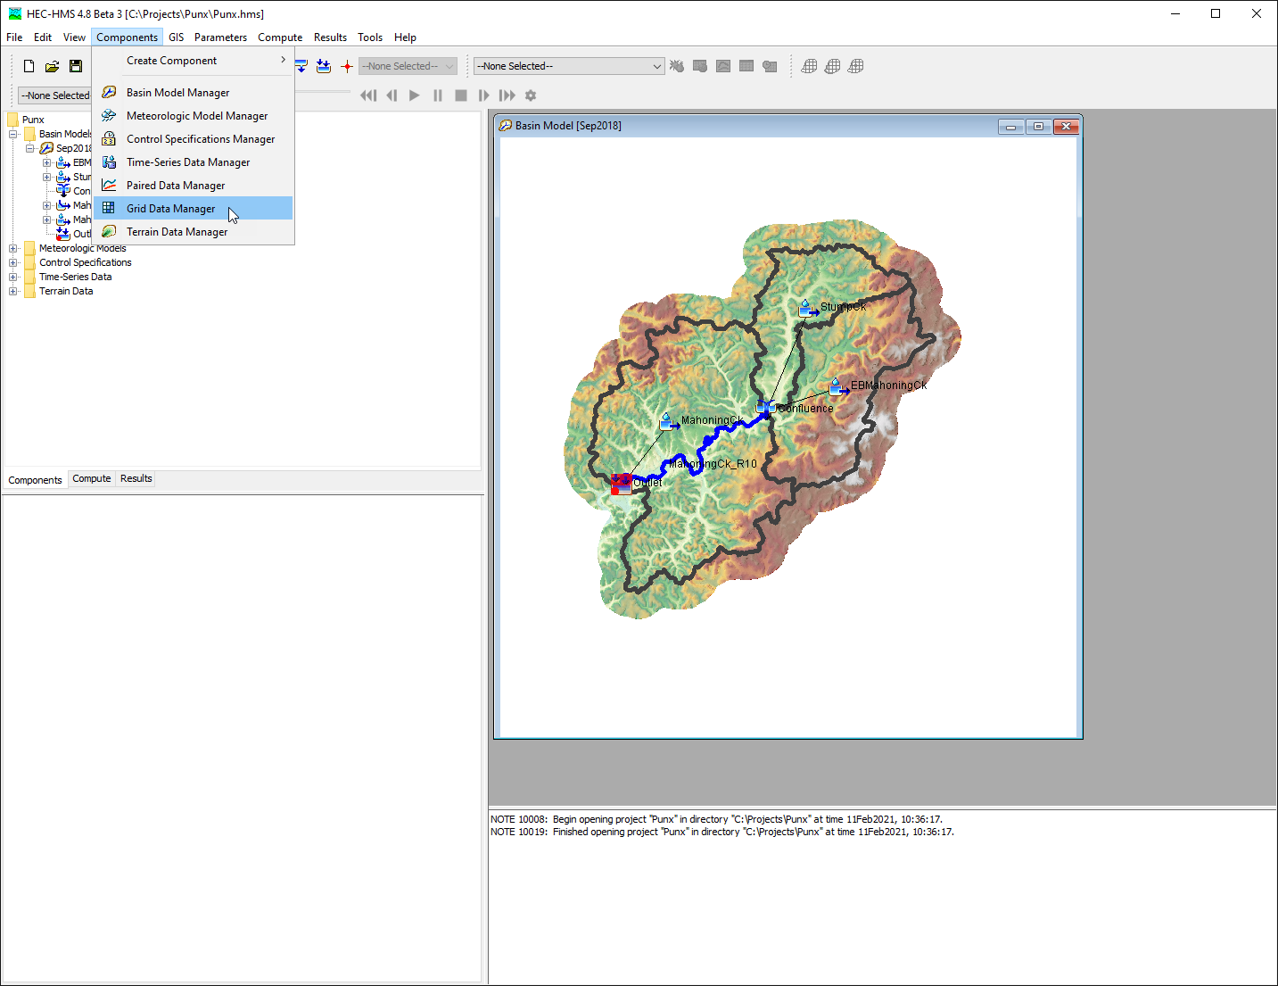
Add grid data in HEC-HMS
Notes:
Add a gridded data object in HEC-HMS to contain the gridded data.

Slide 42
Link Up Data
Notes:
Finally, create a new grid data component and link it to the DSS file you just created.

Slide 43
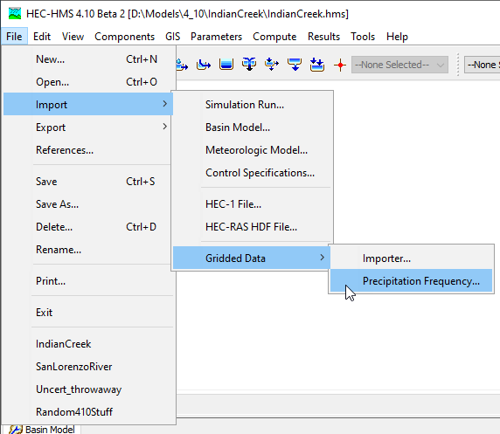
Precipitation-Frequency Importer

Slide 44


Precipitation-Frequency Importer

Slide 45
Additional Information
USGS national water dashboard:
https://dashboard.waterdata.usgs.gov/app/nwd/lang-en/?aoi=default
NCEI link to 15-min and hourly historical precip: https://www.ncei.noaa.gov/access/metadata/landing-page/bin/iso?id=gov.noaa.ncdc:C00313
HEC-HMS guide: working with gridded data: https://www.hec.usace.army.mil/confluence/hmsdocs/hmsguides/working-with-gridded-boundary-condition-data
Vortex tool: https://www.hec.usace.army.mil/confluence/hecnews/spring-2022/hec-vortex-a-collection-of-lightweight-data-processing-utilities-targeted-for-hec-applications
Notes:
These are some additional sources on obtaining and working with commonly used shared data.

Slide 46
Shared Data Components
Hydrologic Modeling with HEC-HMS

