Slide 1
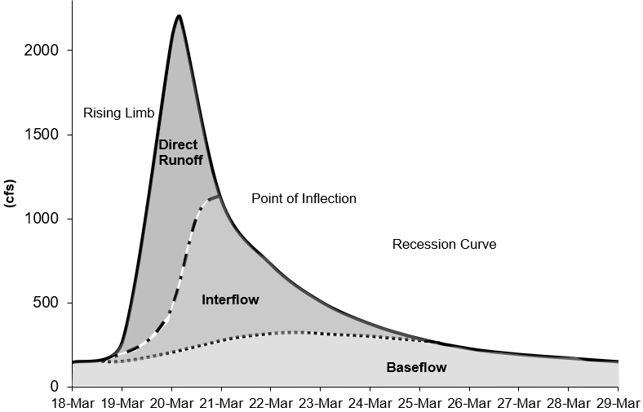
Modeling Baseflow in HEC-HMS
Notes:
x

Slide 2
baseflow in HEC-HMS
In many cases, direct runoff accounts for the flood magnitude. Baseflow is an important process to consider for modeling runoff volume.
Baseflow is comprised of runoff that infiltrates into the ground, flows down gradient, and then flows back onto the land surface in small channels, streams, and rivers.
Baseflow includes interflow and baseflow (or saturated groundwater flow). There are different paths water takes when moving through the ground.
Notes:
Runoff hydrograph – flow measured at a gage with time.
Baseflow important for total volume and duration
Interflow – unsaturated that hits surface and flows in surface channels
Baseflow – saturated underground flow, which is much slower

Slide 3
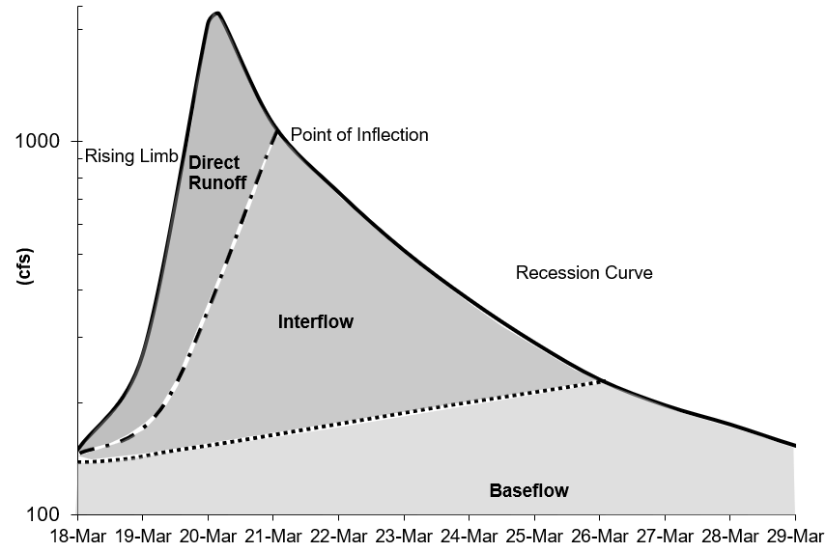
baseflow in HEC-HMS
There are different approaches to modeling baseflow, conceptual vs. process based. Currently, HEC-HMS includes conceptual methods for modeling baseflow.
There are techniques for identifying baseflow contributions from hydrographs:
  The point of inflection (when the recession curve transitions from concave down to concave up) is where direct runoff is replaced by groundwater flow components.
  Plotting the hydrograph in log space shows different baseflow contributions, based on changes in slope on the recession curve.

Slide 4
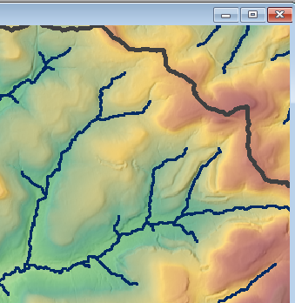

Interflow
  Interflow is where the infiltrated water travels to a stream above the groundwater level (unsaturated zone). The response time for interflow is longer than surface runoff.

Slide 5
Baseflow / Groundwater flow
Baseflow is where the infiltrated water percolates to a groundwater layer. The groundwater layer will contribute to stream flow when it is high enough. The response time for baseflow is longer than interflow.

Slide 6
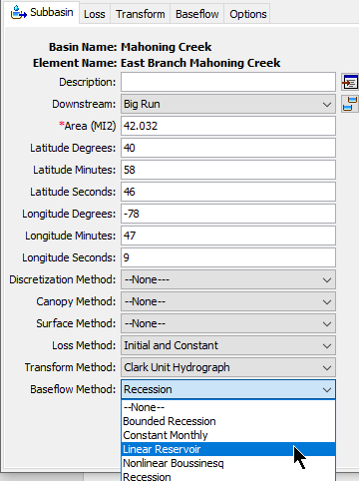
HEC-HMS Baseflow methods
The Baseflow Method can be selected for each subbasin element (using the Component Editor) or it can be selected using the global change methods tool from the Parameters menu.
Baseflow parameters can be entered from the subbasin element Component Editor or from Global editors.
The HEC-HMS baseflow methods are conceptual. The baseflow model should be calibrated using observations.
The Linear Reservoir method is the only method to conserve volume. The other baseflow methods could result in runoff volume exceeding precipitation volume.

Slide 7
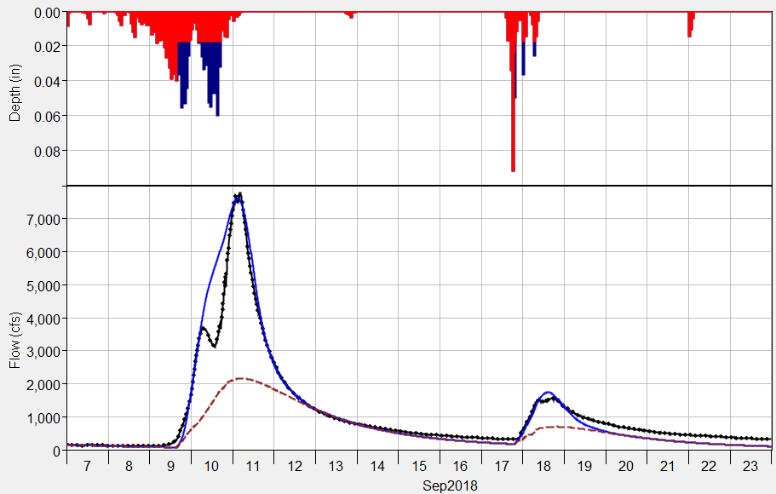
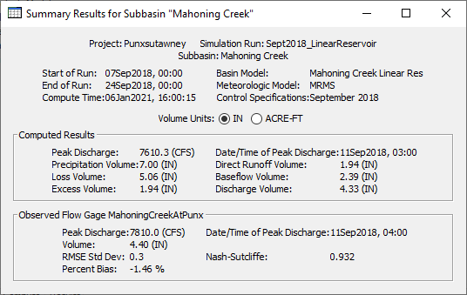
HEC-HMS Baseflow methods
Baseflow results are displayed in plots and tables for Subbasin elements only.
Subbasin plots show the computed runoff (total flow) and the baseflow hydrograph.
Summary tables show baseflow volume.
You can access individual time-series from the Watershed Explorer’s Results tab.
Computed Total Flow
Computed Baseflow
Observed Flow

Slide 8
Recession Baseflow Method

Slide 9
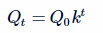
Recession Baseflow
The recession baseflow method models a hydrograph’s recession curve using the following equation:
(or Q_{t} / Q_{t-1} = k)
Q_{t} = flow at time t
Q₀ = flow at the beginning of the recession curve
k = exponential decay constant
t = time
Notes:
Recedes exponentially

Slide 10
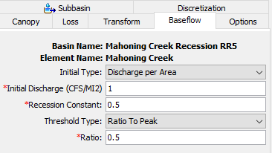
Recession Baseflow
Parameters for the Recession Baseflow Method:
  Initial Discharge (either specified as a rate or as a rate per area)
  Recession Constant (between 0 and 1)
  Threshold for starting the baseflow recession curve (specified as a flow threshold or as a ratio to peak)
Notes:
Note that it’s the total flow that’s fitted to the curve, and baseflow is calculated as total flow – direct inflow.

Slide 11
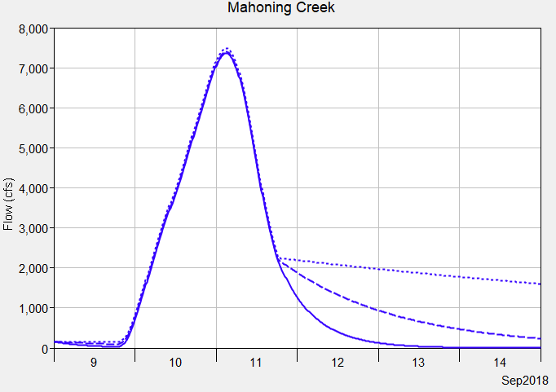
Recession Baseflow
The plot on this slide shows results from three different recession constants. A recession constant closer to 1 results in a flatter recession curve, a constant closer to 0 results in a steeper recession curve.
It is not possible to model both interflow and groundwater flow baseflow components using the recession baseflow method.
Notice the recession constant had little impact on the flood peak. The recession constant would impact a second flood event.
Recession Constant
0.9
0.5
0.1

Slide 12
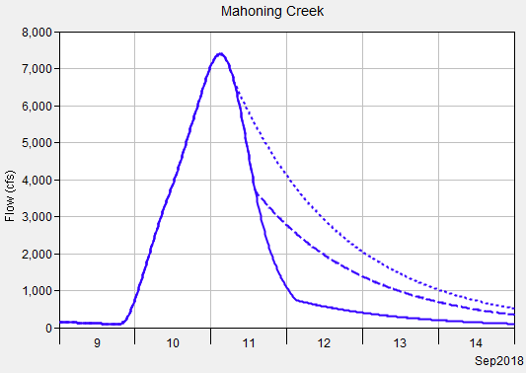
Recession Baseflow
The recession curve turns on when the receding limb of the hydrograph falls below a threshold/trigger flow.
You can choose a threshold type: ratio to peak or discharge (a ratio to peak of 0.5 means the threshold would be 50 cfs if the peak flow was 100 cfs).
Ratio to Peak is easier to apply across the basin model (generally consistent across subbasins), where a discharge threshold is dependent on subbasin size.
Ratio to Peak
0.9
0.5
0.1

Slide 13
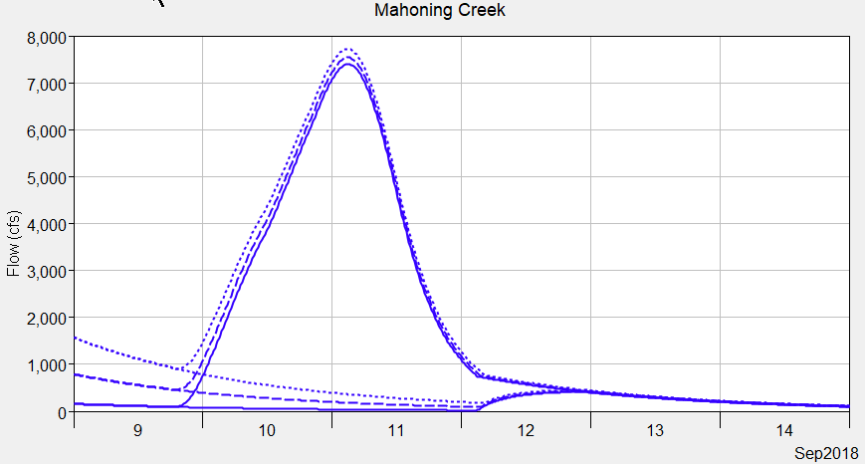
Recession Baseflow
You can choose an initial discharge type: Discharge per Area or Discharge (a discharge per area of 1 CFS/MI2 means the initial flow would be 100 cfs for a 100 square mile subbasin).
Discharge per Area is easier to apply across the basin model (generally consistent across subbasins), where a discharge initial type is dependent on the subbasin size.
The plot on this slide shows different initial discharge per area values.
Be strategic when setting the starting date of the simulation, reduce impacts from prior floods (only groundwater baseflow in the system).
Initial Discharge
10
5
1

Slide 14
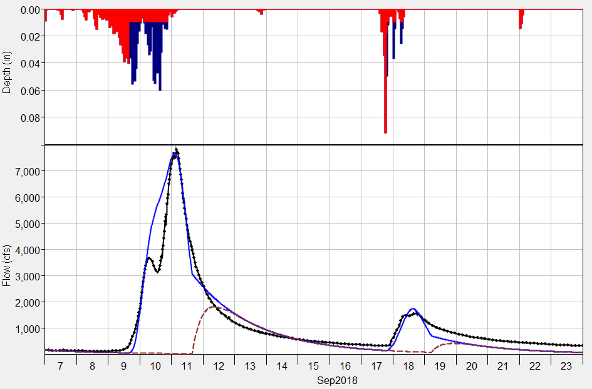
Recession Baseflow
Computed Total Flow
Computed Baseflow
Observed Flow
The recession baseflow method can be used for a continuous simulation. The method should be considered as an event model.
The recession curve resets between flood events, as shown in the plot.
The example on this slide also shows that the recession method cannot model both interflow and groundwater flow (there is only one recession constant).

Slide 15
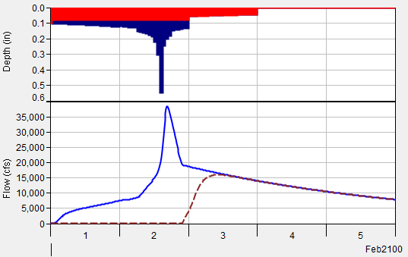
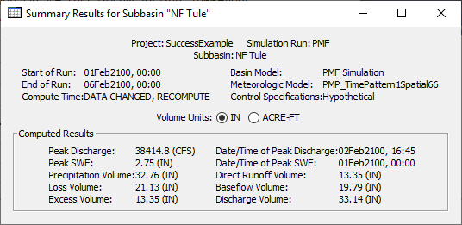
Recession Baseflow
Check the runoff volume when using the recession baseflow method to make sure the discharge volume does not exceed precipitation volume (there might be cases when this is ok) and computed volumes are similar to water balance studies in the region.
There might be tendencies to artificially increase baseflow to improve the model performance when precipitation data do not capture the storm event.
Applying the calibrated model to a hypothetical event with a much higher flood magnitude can cause unreasonable baseflow volumes. Reduce the ratio to peak for extreme hypothetical floods and check computed volume.

Slide 16
Linear Reservoir Baseflow Method

Slide 17
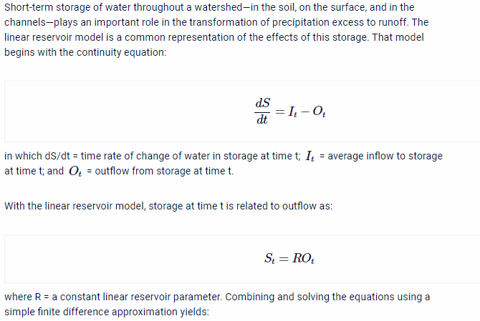
Linear Reservoir Baseflow
The linear reservoir baseflow method uses linear reservoirs to model the movement of infiltrated water through the soil, and back onto the land surface and through the stream network.
The continuity equation is used along with a linear relationship between storage and discharge:
dS/dt = change in storage at time t
I_{t} = average inflow to storage at time t
O_{t} = outflow from storage at time t
R = linear reservoir coefficient
Interflow - Linear Reservoir
Baseflow - Linear Reservoir

Slide 18
Linear Reservoir Baseflow
The linear reservoir baseflow method is designed to work with all loss methods.
Linear reservoir baseflow is explicitly identified in the Soil Moisture Accounting loss method.
All losses in the Initial and Constant, Curve Number, and Green and Ampt loss methods are available to the Linear Reservoir Baseflow (can overcome this assumption using the fraction option).
Only constant loss rate losses (represents saturated conditions) in the Deficit and Constant loss method is available to the Linear Reservoir Baseflow.
Canopy
Surface
Deficit/Constant
Moisture Deficit
Constant Loss Rate
Linear Reservoir Baseflow
Layer 1
Layer 2
Layer 3

Slide 19
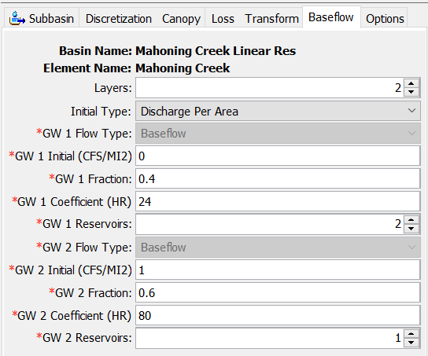
Linear Reservoir Baseflow
Canopy
Canopy
You can choose 1, 2, or 3 linear reservoir layers.
Each layer requires an initial discharge, fraction, linear reservoir coefficient, and number of reservoirs.
The fractions do not have to sum to 1. If they do not, the remainder represents water percolating to a deep aquifer.
Surface
Surface
Moisture Deficit
Deficit/Constant
Moisture Deficit
Deficit/Constant
Linear Reservoir Baseflow
Constant Loss Rate
Linear Reservoir Baseflow
Constant Loss Rate
Layer 1
Layer 1
Reservoir 1
Reservoir 1
Reservoir 2
Layer 2
Reservoir 1

Slide 20
Linear Reservoir Baseflow
The example on this slide shows two linear reservoir layers.
40 percent of the infiltrated water is routed within Layer 1.
60 percent of the infiltrated water is routed within Layer 2.
Notice the linear reservoir coefficients are different. Groundwater 1 can be used to model interflow, and groundwater 2 can be used to model groundwater flow.
Canopy
Surface
Deficit/Constant
Moisture Deficit
Constant Loss Rate
Linear Reservoir Baseflow
Layer 1
Layer 2
Layer 3

Slide 21
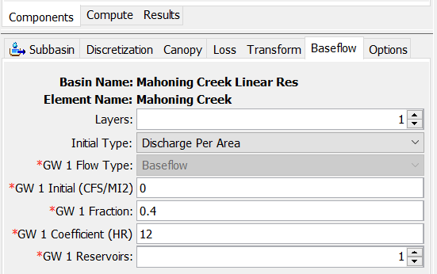
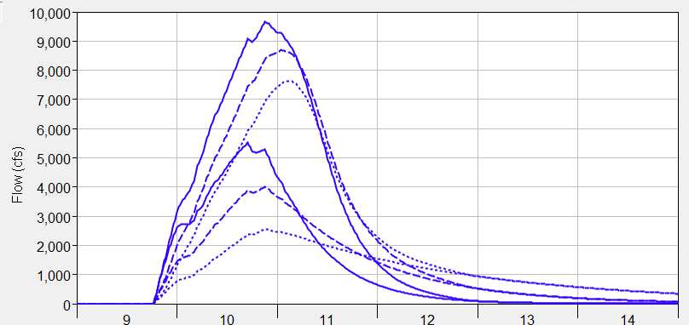
Linear Reservoir Baseflow
The plot on this slide shows three different simulations with different linear reservoir coefficients.
Notice how larger coefficient values attenuate the baseflow contribution, which reflects longer durations the infiltrated water spends in the ground.
Notice that the timing of the baseflow hydrograph is not influenced much by the storage coefficient.
Initially set the coefficients using multipliers of the Clark Storage Coefficient.
Total Flow
Coef. = 12 hours
Coef. = 24 hours
Coef. = 48 hours
Baseflow

Slide 22
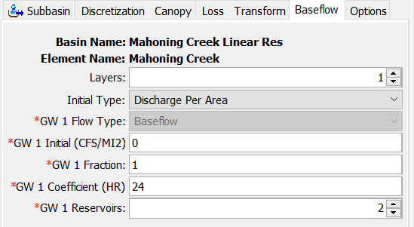
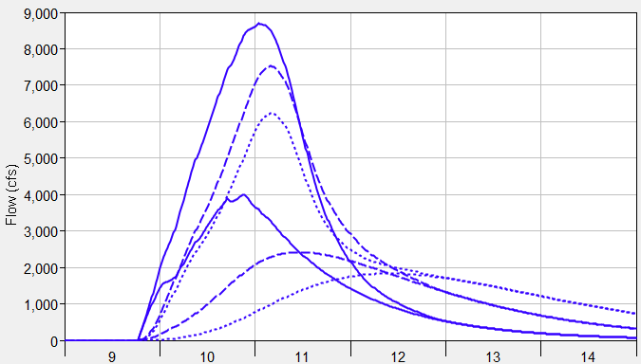
Linear Reservoir Baseflow
The plot on this slide shows three different simulations where the number of steps was varied.
2 steps means water flows into one linear reservoir with a coefficient of 24 hours, and then water from the first linear reservoir is routed through a second linear reservoir that also has a coefficient of 24 hours.
Notice how timing of the baseflow hydrograph is shifted and attenuation is increased as the number of linear reservoirs is increased.
Increase the number of linear reservoirs so the peak baseflow response occurs after the peak surface runoff response.
Total Flow
Steps = 1
Steps = 2
Steps = 3
Baseflow

Slide 23
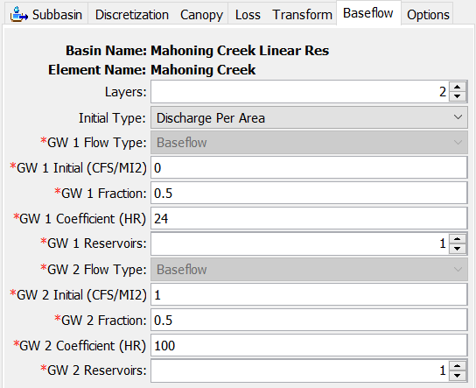
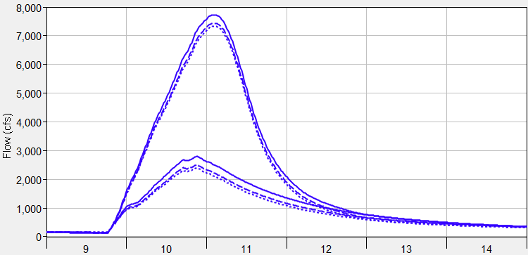
Linear Reservoir Baseflow
The plot on this slide shows three different simulations where the groundwater 2 linear reservoir coefficient was varied (50-50 split in infiltrated losses between layers).
Groundwater 2/3 layers can be used to model the longer responding groundwater flow, these components will not have as much of an impact on the flood magnitude.
Total Flow
GW2 Coef. = 100 hours
GW2 Coef. = 200 hours
GW2 Coef. = 300 hours
Baseflow

Slide 24
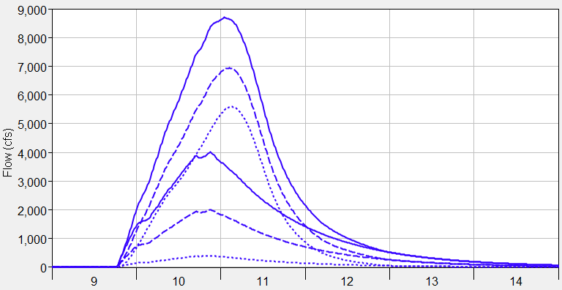
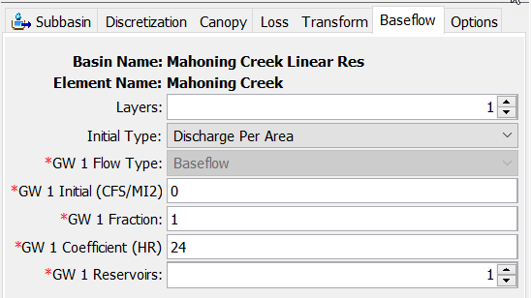
Linear Reservoir Baseflow
The plot on this slide shows three different simulations where the groundwater fraction was varied.
The fraction can be used to control the magnitude of the baseflow hydrograph (emphasize interflow), the fraction can be used to improve runoff volume.
Total Flow
GW 1 Fraction = 1 (volume 1.6 inches)
GW 1 Fraction = 0.5 (volume 0.8 inches)
GW 1 Fraction = 0.1 (volume 0.2 inches)
Baseflow

Slide 25
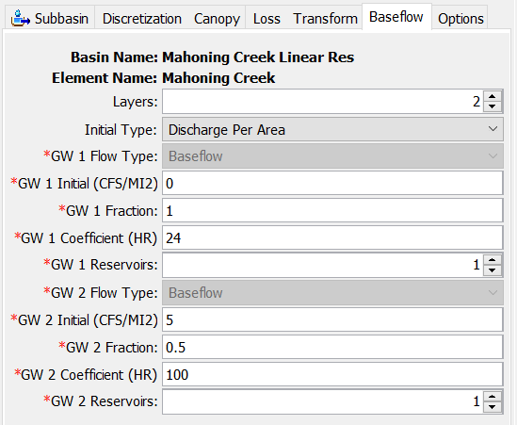
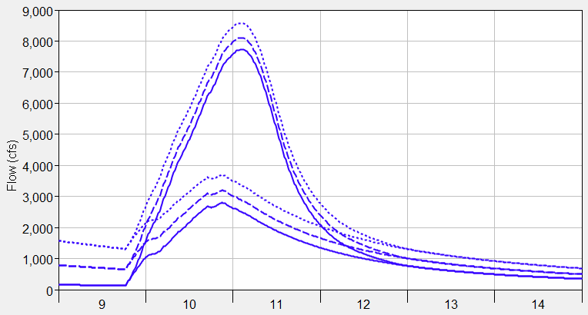
Linear Reservoir Baseflow
You can choose an initial discharge type: Discharge per Area or Discharge (a discharge per area of 1 CFS/MI2 means the initial flow would be 100 cfs for a 100 square mile subbasin)
Discharge per Area is easier to apply across the basin model (generally consistent across subbasins), where a discharge initial type is dependent on the subbasin size.
The plot on this slide shows different initial discharge per area values, manually adjust the initial discharge to match observations at the beginning of the simulation.
Be strategic when setting the starting date of the simulation, interflow could be set to zero and only initial GW2/3 specified.
Initial GW2 Disch. = 1 CFS/MI2
Initial GW2 Disch. = 5 CFS/MI2
Initial GW2 Disch. = 10 CFS/MI2

Slide 26
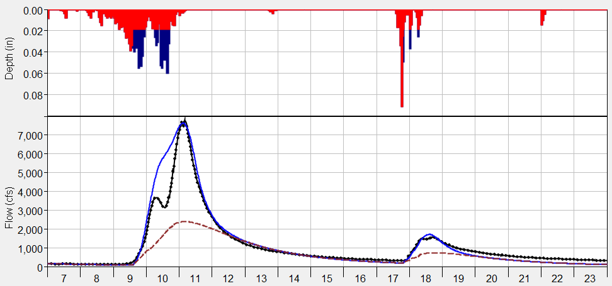
Linear Reservoir Baseflow
Computed Total Flow
Computed Baseflow
Observed Flow
The linear reservoir baseflow method can be used for a continuous simulation.
Linear reservoir method can simulate both interflow and groundwater flow (because it includes up to three layers, each layer has its own coefficient).

Slide 27
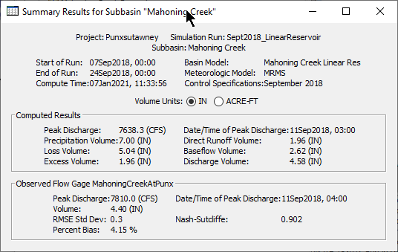
Linear Reservoir Baseflow
Always check the computed runoff volume. You will not have to worry about the total runoff volume exceeding precipitation volume, which could happen when using the other baseflow methods.
Verify modeled volumes are similar to regional water balance studies.

Slide 28
Linear Reservoir Baseflow
The linear reservoir coefficient could be estimated using flow observations, and the slope of the interflow and baseflow recession curve(s):
Q_{t} = flow at time t
Q₀ = flow at the beginning of the recession curve
K_{r} = exponential decay constant
T = time
R = linear reservoir coefficient
Q
=
1
Q
=
Q
×
K_{r}
T
S
=
−
t
R
−
t
o
t
ln(
)
ln(
)
K_{r}
K_{r}

Slide 29
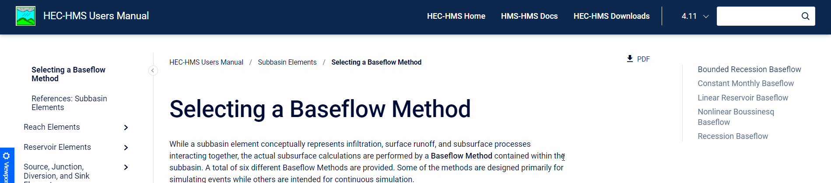
User’s manual
https://www.hec.usace.army.mil/confluence/hmsdocs/hmsum/4.11/subbasin-elements/selecting-a-baseflow-method

