Slide 1

Meteorologic Models
Historic Precipitation
Hydrologic Modeling with HEC-HMS
Slides by:
Greg Karlovits (HEC), Emily Moe (MVP), Daniel Black (HEC)

Slide 2
Snow Modeling

Slide 3
Objectives
Snowmelt
  Importance of Snow
  Temperature Index Method
  Calibration Approach
  Data Sources

Slide 4
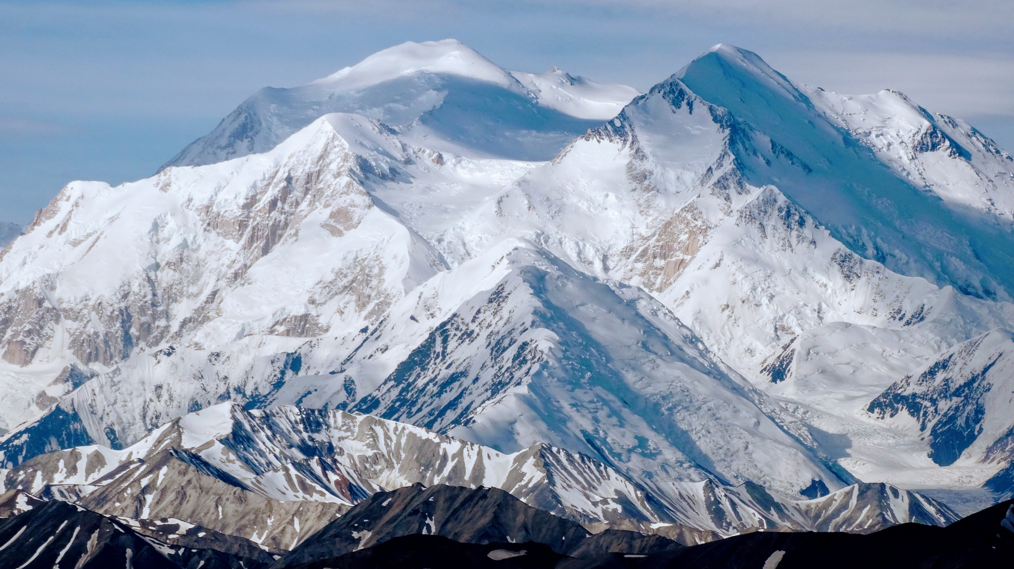
Importance of Snow for Water Resources
Snow represents a volume of water storage distributed over a watershed, that when melted into liquid water contributes a significant inflow into rivers, streams and reservoirs that must be dealt with in an efficient & effective manner.
Notes:
In some regions, snow represents a significant volume of water storage within the watershed that can produce powerful impacts as it melts, contributing significant additional inflow into rivers streams and reservoirs.

Slide 5
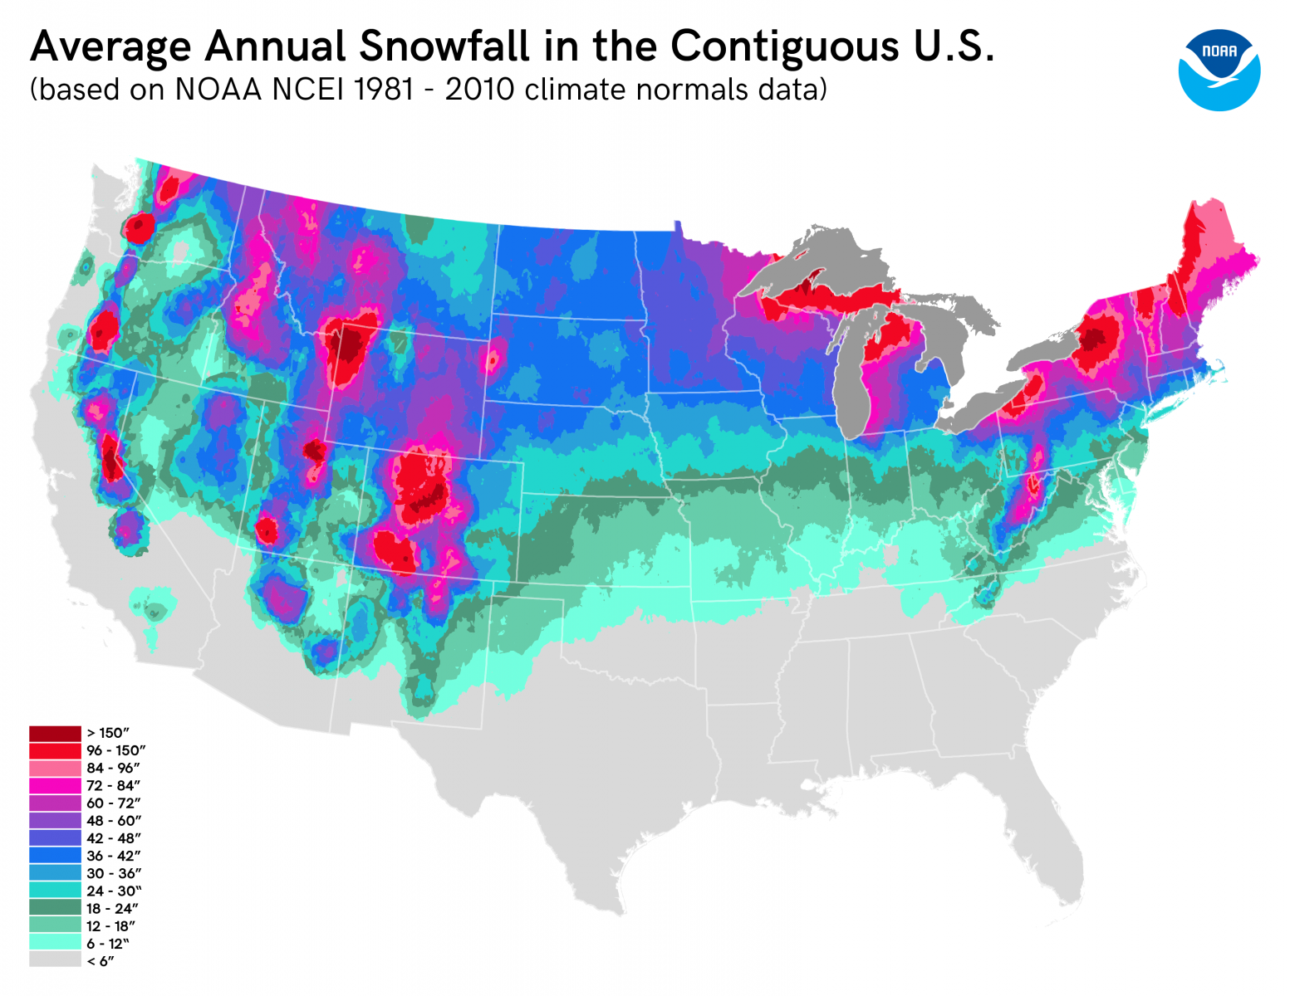
Importance of Snow within USACE
Reservoir Operation
  Timing, volume, optimization
  Release schedules, gate settings
Snowmelt Flooding
  Peak Runoff, Timing, Rain on snow
Planning & Design Studies
Source: https://atlas.niu.edu/klot/snowclimatology/USSnowContours.png
Notes:
A large portion of the United States is impacted by the effects of snowmelt. Within USACE, the effects of snowmelt can impact reservoir operations, produce flooding and impact planning & design studies.

Slide 6
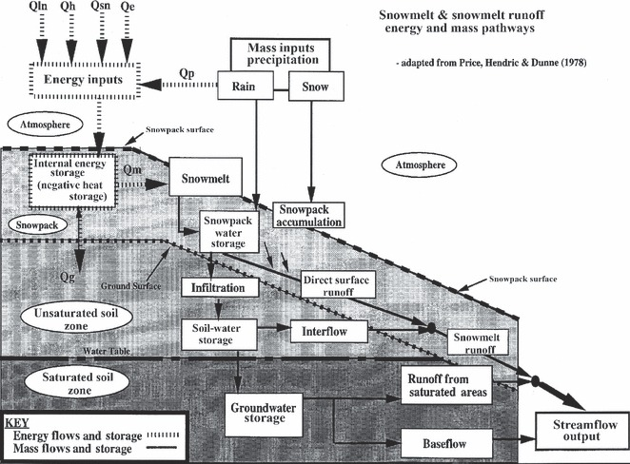
Snow Hydrology Goals
Snow Accumulation
  Estimation of the distribution of watershed snow water equivalent (SWE)
Snow Melt (Ablation)
  Timing and magnitude of snowmelt
Routing of Meltwater
  Where, When, How Much?
Notes:
The goal of snow hydrology is to track the volume of water within the watershed by estimating snow accumulation and ablation (melt) in terms of SWE—Snow Water Equivalent. Tracking the volume of SWE within a watershed, allows us to estimate the peak timing and magnitude of melt events that can then be routed through the watershed to assess possible impacts.

Slide 7
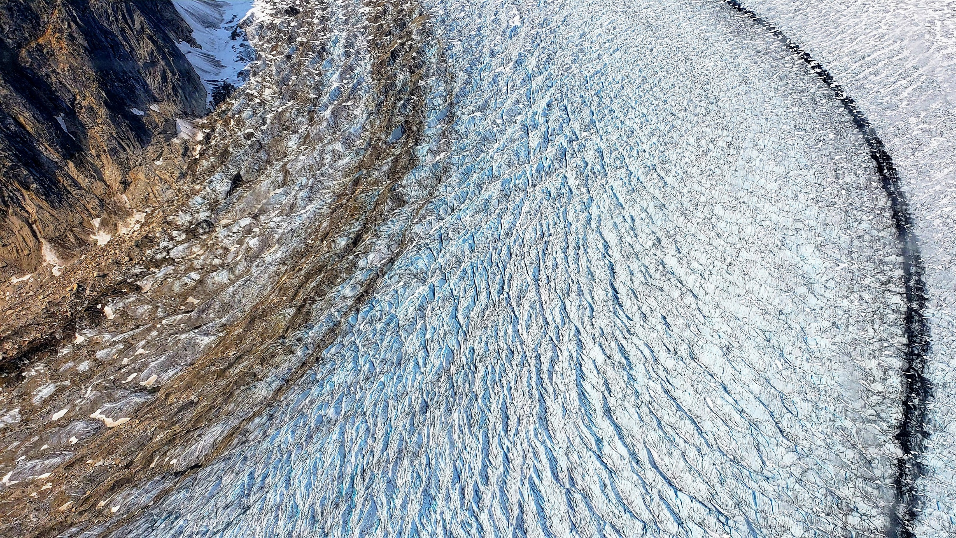
Precipitation
Air Temperature
Rain
Rain or Snow?
Snow
Add to Liquid Water
Add to Snowpack
Yes
Above Freezing?
Melt Snowpack
Add to Liquid Water
No
Snowmelt –
Temperature
Index Method
Yes
Snowpack
Below Freezing?
Refreeze Liquid Water
No
Liquid Water Limit
Groundmelt
Liquid Water to
Soil Surface
Notes:
HMS utilizes the Temperature Index Method to simulate snowmelt processes.
The Temperature Index Method essentially looks at falling precipitation with respect to air temperature to determine whether the precipitation is falling as rain or snow. If the temperature is over a specified limit, it’s considered rain and falls as liquid water; if the temperature is under the set threshold, the precipitation volume is added to the snowpack.
Next, the temperature index method determines if the air temperature is above freezing. If it is below freezing, no change in snowpack occurs; if it’s above freezing, the snowpack begins to melt and is added to the liquid water volume within the snowpack.
Then it considers—is the Snowpack temperature below freezing? If yes, the liquid water within the snowpack re-freezes; if the temperature of the snowpack is above freezing, the amount of liquid water within the snowpack is considered. If the liquid water volume within the snowpack exceeds a specified percentage of the overall snowpack (ex: 5%), the “Liquid Water Limit” is exceeded and water is released from the snowpack.
Additional melt may occur due to groundmelt and the melted snowpack is released as liquid water to the soil’s surface as runoff.
The flow chart for the temperature index snowmelt model shows how the information on the following slides comes together as a simulation algorithm.

Slide 8
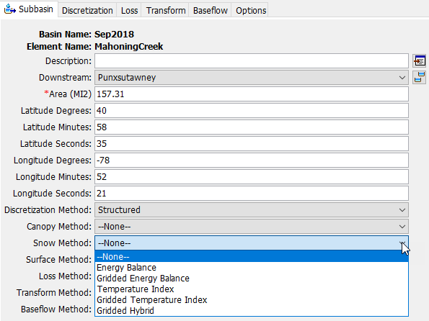
Snowmelt - Temperature Index Method Options
Data Required | Temperature Index (TI) | Gridded Temp. Index (GTI)
Temperature Data | X | —
Gridded Temperature Data | — | X
Initial Condition Grids (SWE, Cold Content, Liquid Water, Cold Content ATI, Meltrate ATI) | — | X
Lapse Rate (DEG F/1000 FT) | X | —
PX Temperature (F) | X | X
Base Temperature (F) | X | X
ATI Coefficient | X | —
Wet Meltrate | X | X
Rain Rate Limit (in/day) | X | X
ATI-Meltrate Coefficient | — | X
Dry Meltrate (in/DegF-Day) | X | —
ATI -Meltrate Function (in/DegF-Day) | — | X
Cold Limit (in/day) | X | X
ATI-Coldrate Function | X | X
Coldrate Coefficient | X | X
Water Capacity (%) | X | X
Groundmelt (in/day) | X | X
Temperature Index (TI)
  Lumped parameterization by subbasin
Gridded Temperature Index (GTI)
  Spatially distributed
  Additional grids/initial conditions required
Notes:
In HMS version 4.7, the snowmelt component is activated within the Meteorologic Model settings.
There are two approaches to snowmelt modeling with the temperature index method are available within HMS—
The first is the general temperature index method which involves a lumped parameter approach which assumes snow parameters and melt is homogenous within each subbasin. This method may be most appropriate when temperatures are consistent throughout each subbasin (or can be represented with a lapse rate) and/or if snowmelt events occur fairly consistently throughout the entire subbasin.
The second is the gridded temperature index method which involves gridded input parameters. The gridded approach allows for increased variability of key data within each subbasin, such as: temperature distribution, initial snowpack conditions and melt rates throughout each subbasin.
Both methods share many of the same data requirements with key differences being:
GTI requires gridded temperature data (vs. point-source temperature gage data)
GTI requires additional initial condition grids (for key parameters such as snow water equivalent, cold content, etc.)
The temperature index method can apply a lapse rate which is useful for subbasins with significant elevation variation

Slide 9
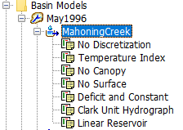
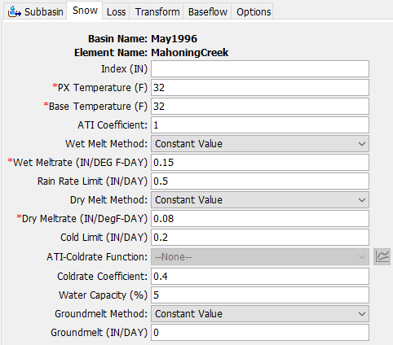
Snowmelt - Temperature Index Method Parameters
Temperature Index (TI)
Snowmelt Calibration Parameters
Lapse Rate: 0 for most; >0 for mountainous regions
*Px Temp: 32-34F
Base Temp: 32F
ATI-Meltrate Coefficient: 0.98-1.0 (typ.=1.0)
* Wet Meltrate: 0.05-0.15 in/F-day
* Rain Rate Limit: 0.25-0.50 in/day
* Dry-Meltrate: 0.015-0.15 in/F-day
Cold Limit = 0.2 in/day
ATI-Coldrate Fn: 0.01-0.045
ATI-Coldrate Coeff: 0.2-0.5
  0.2=Shallow Snowpack to 0.5=Deep Snowpack
Water Capacity: 3-5%
Groundmelt: Typically = 0 in/day
*Common Calibration Parameter
Notes:
Temperature index method parameters must be assigned by subbasin within the Meteorologic Model.
The figure in the center of this slide shows the (lumped parameter) Temperature Index dialog.
The far right of the page includes common parameter values as well as which parameters are typically adjusted during calibration.
The meltrate is the most sensitive parameter that will always have a direct impact on the snow calibration.

Slide 10
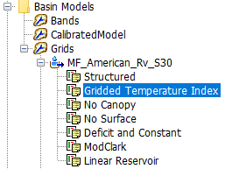
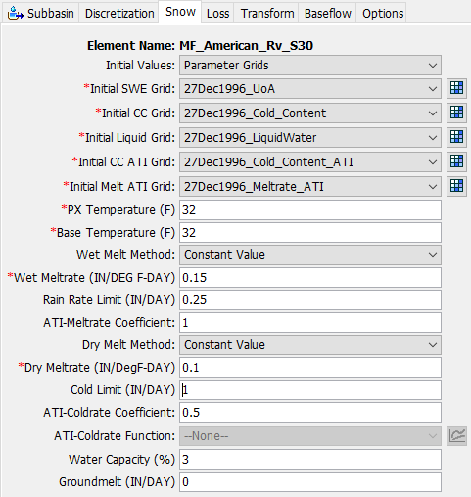
Snowmelt – Gridded Temperature Index Method Parameters
Gridded Temperature Index (GTI)
Snowmelt Calibration Parameters
Initial SWE, CC = Observed Data Grids
Initial Liquid, CC ATI, Melt ATI = Zero (acceptable assumption)
*Px Temp: 32-34F
Base Temp: 32F
* Wet Meltrate: 0.05-0.15 in/F-day
* Rain Rate Limit: 0.25-0.50 in/day
ATI-Meltrate Coefficient: 0.98-1.0 (typ.=1.0)
* ATI-Meltrate Fn: 0.015-0.15 in/F-day
Cold Limit = 0.2 in/day
ATI-Coldrate Coeff: 0.2-0.5
  0.2=Shallow Snowpack to 0.5=Deep Snowpack
ATI-Coldrate Fn: 0.01-0.045
Water Capacity: 3-5%
Groundmelt: Typically = 0 in/day
*Common Calibration Parameter
Notes:
Gridded temperature index method parameters must be assigned by subbasin within the Meteorologic Model.
The figure in the center of this slide shows the (distributed parameter) Gridded Temperature Index (GTI) dialog.
Initial Values for the GTI method can be set to spatially distributed parameter grids (as shown above) or can be set to default values (which reverts the initial conditions similar to the general TI method, but still determines future snowmelt on a gridded distribution).
The far right of the page includes common parameter values as well as which parameters are typically adjusted during calibration. Observed data is desirable for initial Snow Water Equivalent (SWE) and Cold Content (CC), but Zero-value grids can be used for the remaining gridded initial conditions (liquid water, cold contend ATI, Meltrate ATI) if no observed initial data is available.
Once again, the meltrate is the most sensitive parameter in the GTI approach (just like in the TI approach)--it will always have a direct impact on the snow calibration.

Slide 11
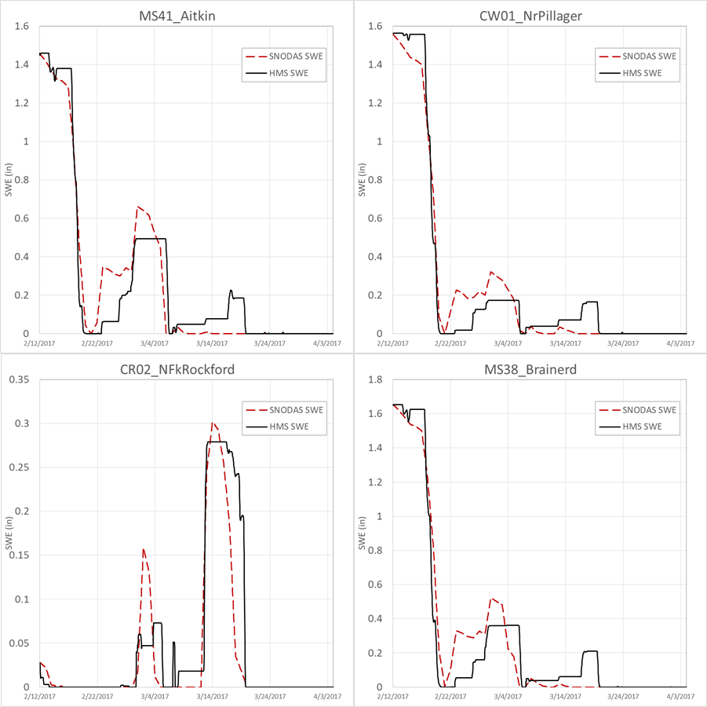
Snowmelt – Approach to Calibration
Calibrate snowmelt SWE first (before runoff calibrations).
Compare Modeled to Observed Snow Water Equivalent (SWE) Values.
Once melt of snowpack is calibrated, proceed with runoff calibration.
Notes:
When modeling snowmelt within HMS, you must first calibrate the melting of the snow component. To do this, we consider the Snow Water Equivalent (SWE) within the model and calibrate the modeled SWE to closely mirror the actual observed SWE. Once the snowpack is melting similarly to the observed data, you can proceed with the runoff calibration (infiltration, routing, etc.) to complete the event.

Slide 12
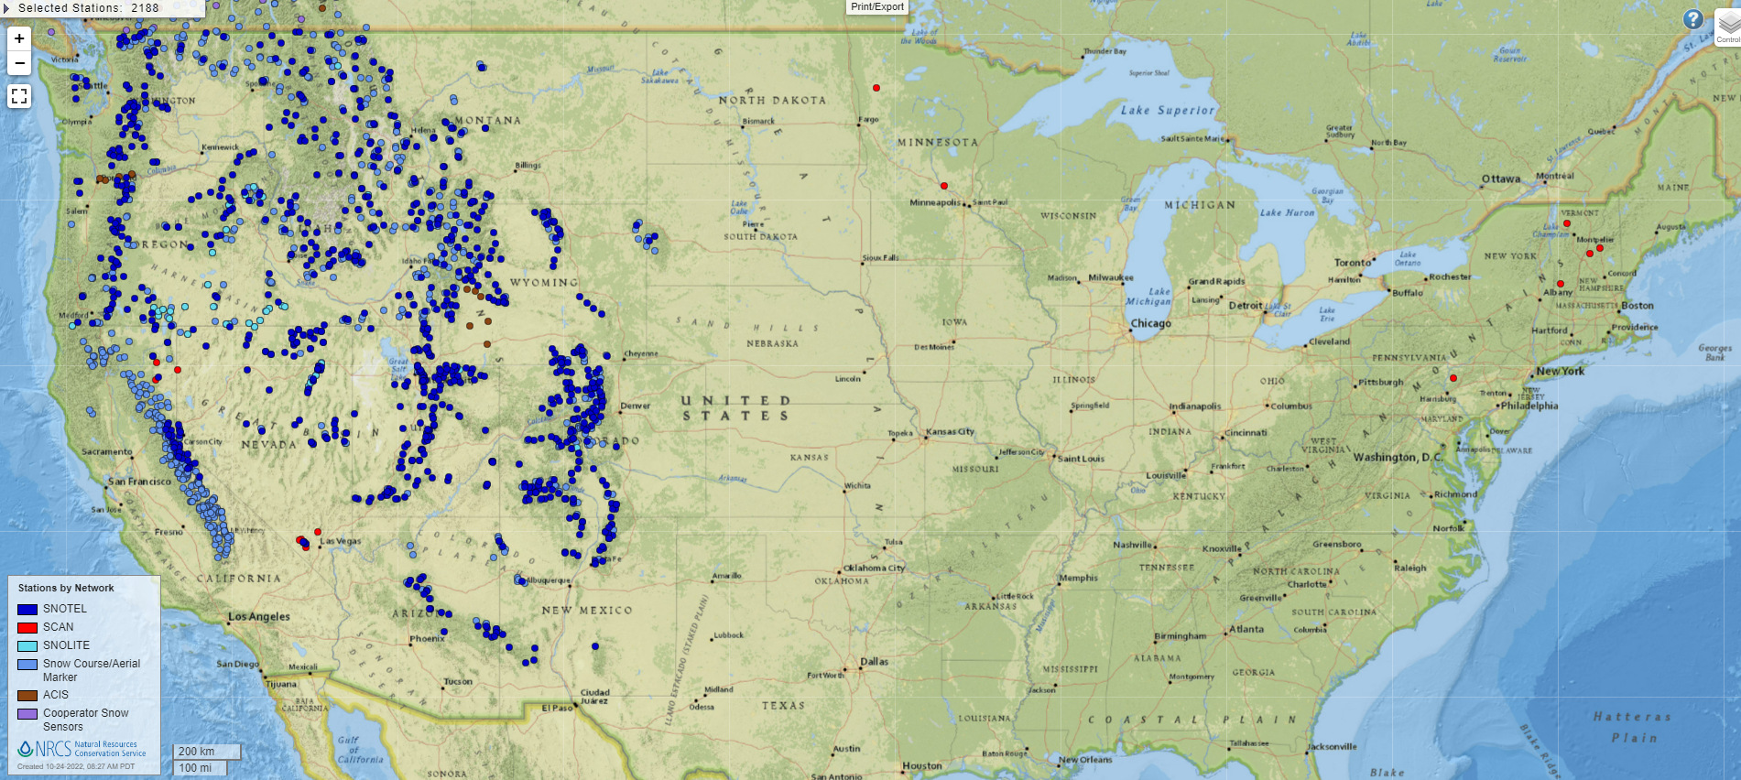
Snowmelt – Snow Observation Data
Source: https://www.nrcs.usda.gov/wps/portal/wcc/home/quicklinks/imap
Notes:
Where can you find observed snow data?
Luckily, several snow observation sites are available throughout the Western United States—shown here in Blue. Western US sources include both Snow Telemetry (SNOTEL) automated data collection sites as well as Snow Course sites where data is manually collected.
Unfortunately, observed snow data is more difficult to come by in the Midwest and Eastern United States—with just a handful of SCAN (Soil Climate Analysis Network) sites available—shown here in Red.

Slide 13
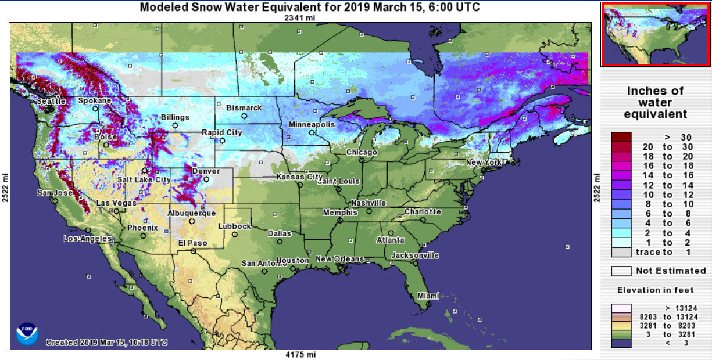
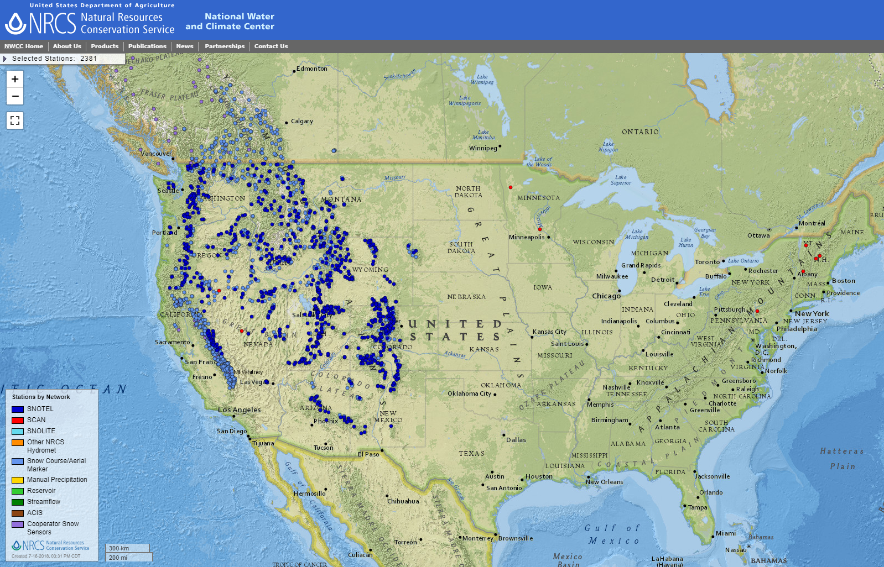
Snowmelt – Alternate “Observed” Snow Data
Snow Data Assimilation System (SNODAS)
PROS
Available nationwide (CONUS)
Includes HMS snowmelt distributed inputs
  SWE, Cold Content, etc.
Model is updated with observed data
  Gamma flights
  Point observations
  Corrections documented at: NOHRSC SNODAS Adjustments
CONS
SWE is a model output (not observed)
Observational updates not always timely
Still lack of “observed” data
Notes:
In regions where observed snow data is scarce, an alternate source may be adopted as “observed” snow data—the Snow Data Assimilation System (SNODAS).
SNODAS is actually a snow simulation model produced by the National Operational Hydrologic Remote Sensing Center (NOHRSC).
Benefits of the SNODAS data is that it’s available nationwide and includes information required for the HMS Temperature Index and Gridded Temperature Index snowmelt methods. While the SNODAS data is actually model output, the SNODAS model is corrected with observed data from gamma flights and point observations. Model corrections are then documented online.
Drawbacks of using the SNODAS data is that it is in itself model output and not actually observed. Updates made to the SNODAS model from field observations are not always timely and there’s still a large discrepancy of “observed” data availability in the non-Western United States.

Slide 14
Takeaways
Snowmelt
  Important driver in several watersheds
  Calibrated 1st (before runoff calibration)
  Several Parameters Required
  Observed (or est. observed) Data is Available

Slide 15
Meteorologic Models
Historic Precipitation
Hydrologic Modeling with HEC-HMS

