Slide 1
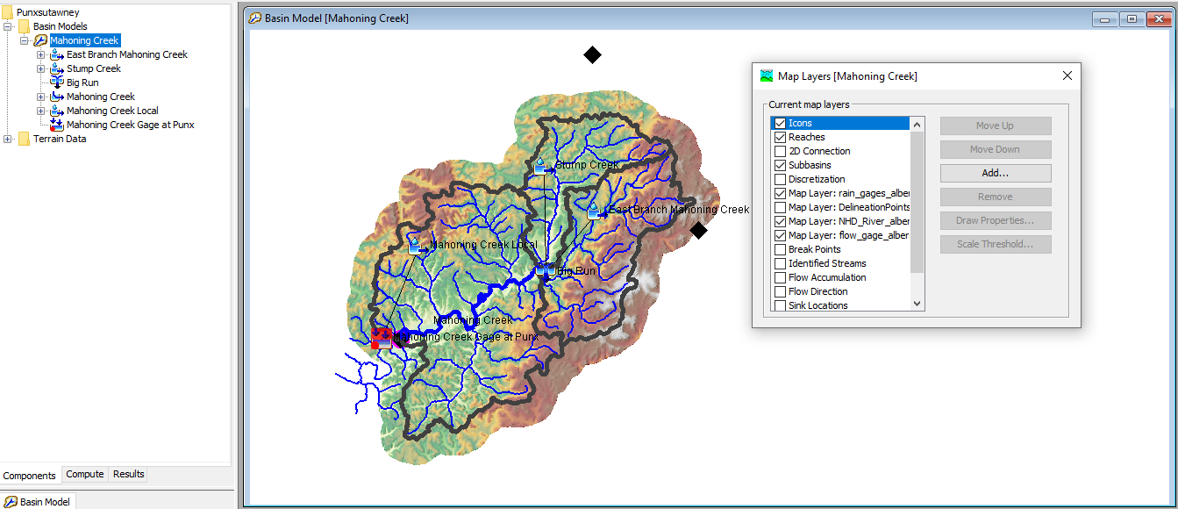
Subbasin Discretization

Slide 2
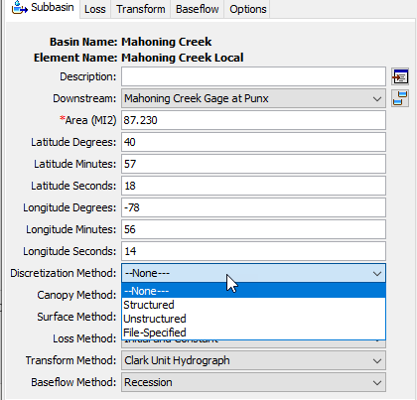
Subbasin Discretization
The Discretization method divides subbasin elements into smaller units
The “None” method implies basin average modeling
Gridded meteorologic and subbasin methods required either the Structured or Unstructured methods
The File-Specified method is required to link to the older *.Mod file format or to link to the new structured and unstructured files

Slide 3
Subbasin Discretization
The Structured discretization method is used to generate a SHG or UTM grid
The Unstructured discretization method is used when importing a 2D mesh from HEC-RAS

Slide 4
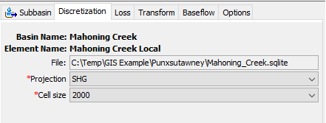
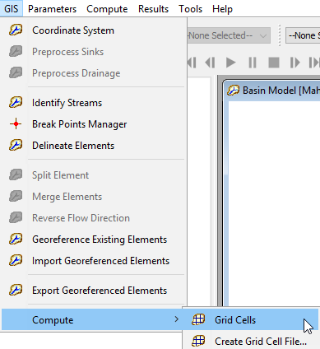
Subbasin Discretization
Structured Discretization
Choose the Projection, SHG or UTM
Choose the Cell size (50, 100, 200, 500, 1000, 2000, 5000, or 10000)
The program will Compute the structured grid, cell area, and travel length
Travel length is computed as the average value per grid cell using the flow direction grid and computed flow paths

Slide 5
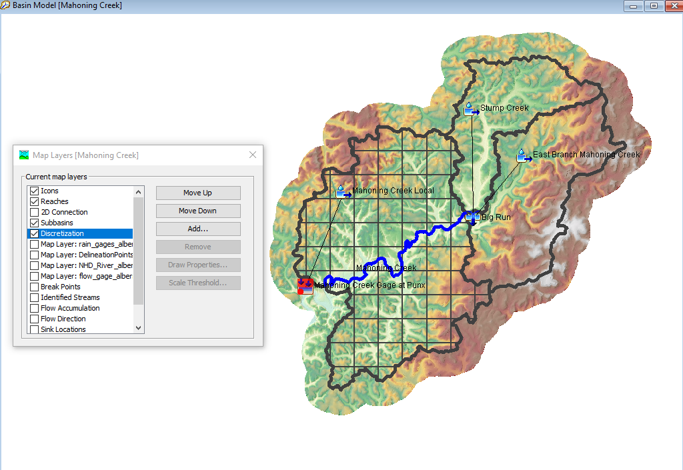
Subbasin Discretization
The discretization method can vary between subbasins in a basin model
HEC-HMS can display the discretization, turn on the Discretization layer from the Map Layers editor

Slide 6
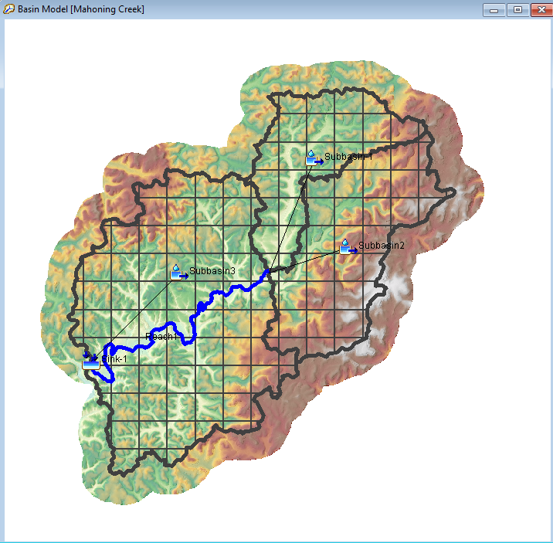
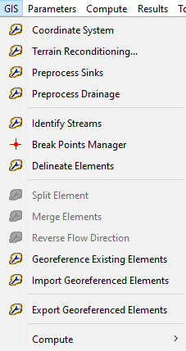
Subbasin Discretization
Projects where the delineation was already completed outside of HEC-HMS can take advantage of the Structured discretization method:
Georeference the subbasin elements
Load a terrain dataset
Run the Preprocess Sinks and Drainage steps (create the flow directions grid)
Choose the Structured Discretization specifications and run the compute grid cells tool

