Slide 1
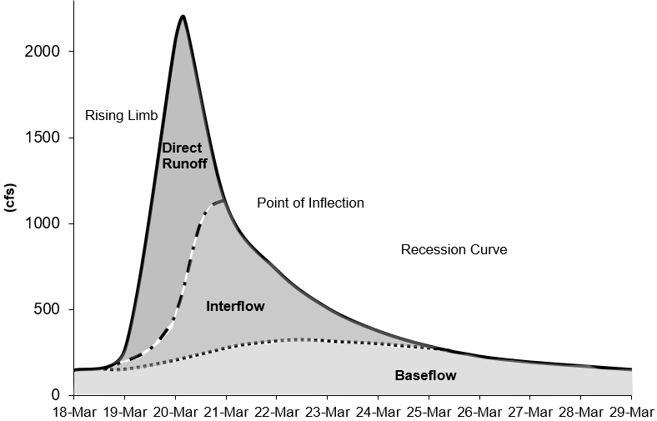
Linear Reservoir Baseflow Method

Slide 2
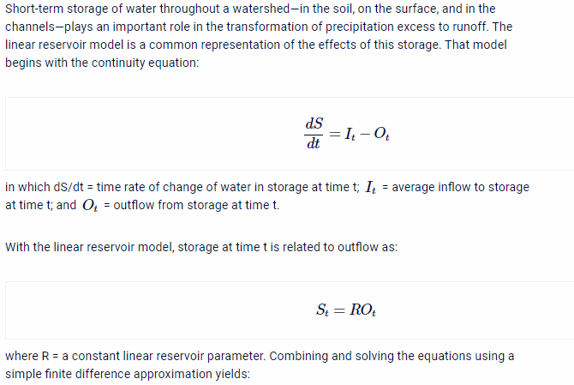
Linear Reservoir Baseflow
The linear reservoir baseflow method uses linear reservoirs to model the movement of infiltrated water through the soil, and back onto the land surface and through the stream network.
The continuity equation is used along with a linear relationship between storage and discharge:
dS/dt = change in storage at time t
I_{t} = average inflow to storage at time t
O_{t} = outflow from storage at time t
R = linear reservoir coefficient
Interflow - Linear Reservoir
Baseflow - Linear Reservoir

Slide 3
Linear Reservoir Baseflow
The linear reservoir baseflow method is designed to work with all loss methods.
Linear reservoir baseflow is explicitly identified in the Soil Moisture Accounting loss method.
All losses in the Initial and Constant, Curve Number, and Green and Ampt loss methods are available to the Linear Reservoir Baseflow (can overcome this assumption using the fraction option).
Only constant loss rate losses (represents saturated conditions) in the Deficit and Constant loss method is available to the Linear Reservoir Baseflow.
Canopy
Surface
Deficit/Constant
Moisture Deficit
Constant Loss Rate
Linear Reservoir Baseflow
Layer 1
Layer 2
Layer 3

Slide 4
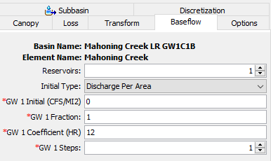
Linear Reservoir Baseflow
You can choose 1, 2, or 3 linear reservoir layers.
Each layer requires an initial discharge, fraction, linear reservoir coefficient, and number of steps.
The fractions do not have to sum to 1. If they do not, the remainder represents water percolating to a deep aquifer.
Canopy
Surface
Deficit/Constant
Moisture Deficit
Constant Loss Rate
Linear Reservoir Baseflow
Layer 1
Layer 2
Layer 3

Slide 5
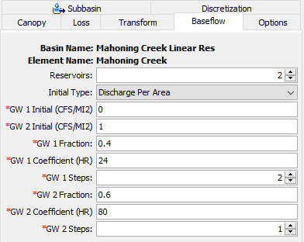
Linear Reservoir Baseflow
The example on this slide shows two linear reservoir layers.
40 percent of the infiltrated water is routed within Layer 1.
60 percent of the infiltrated water is routed within Layer 2.
Notice the linear reservoir coefficients are different. Groundwater 1 can be used to model interflow, and groundwater 2 can be used to model groundwater flow.
Canopy
Surface
Deficit/Constant
Moisture Deficit
Constant Loss Rate
Linear Reservoir Baseflow
Layer 1
Layer 2
Layer 3

Slide 6
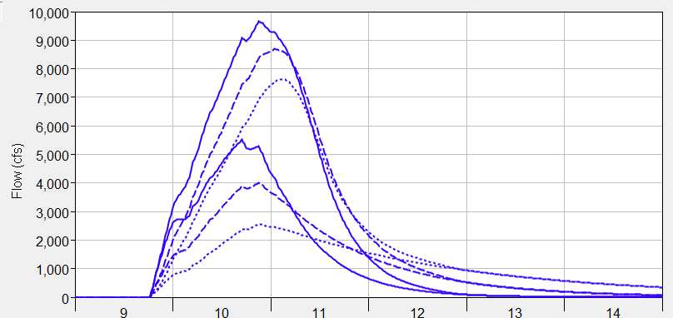
Linear Reservoir Baseflow
The plot on this slide shows three different simulations with different linear reservoir coefficients.
Notice how larger coefficient values attenuate the baseflow contribution, which reflects longer durations the infiltrated water spends in the ground.
Notice that the timing of the baseflow hydrograph is not influenced much by the storage coefficient.
Initially set the coefficients using multipliers of the Clark Storage Coefficient.
Total Flow
Coef. = 12 hours
Coef. = 24 hours
Coef. = 48 hours
Baseflow

Slide 7
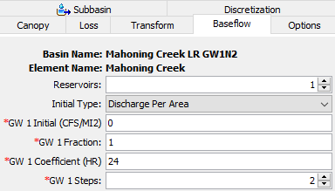
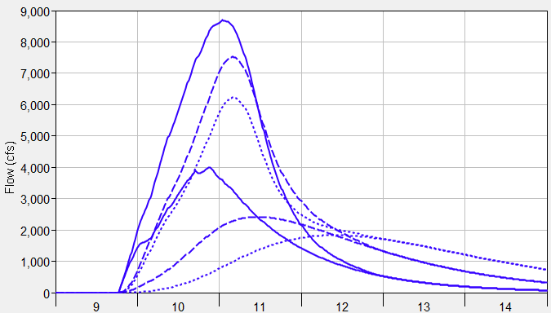
Linear Reservoir Baseflow
The plot on this slide shows three different simulations where the number of steps was varied.
2 steps means water flows into one linear reservoir with a coefficient of 24 hours, and then water from the first linear reservoir is routed through a second linear reservoir that also has a coefficient of 24 hours.
Notice how timing of the baseflow hydrograph is shifted and attenuation is increased as the number of linear reservoirs is increased.
Increase the number of steps so the peak baseflow response occurs after the peak surface runoff response.
Total Flow
Steps = 1
Steps = 2
Steps = 3
Baseflow

Slide 8

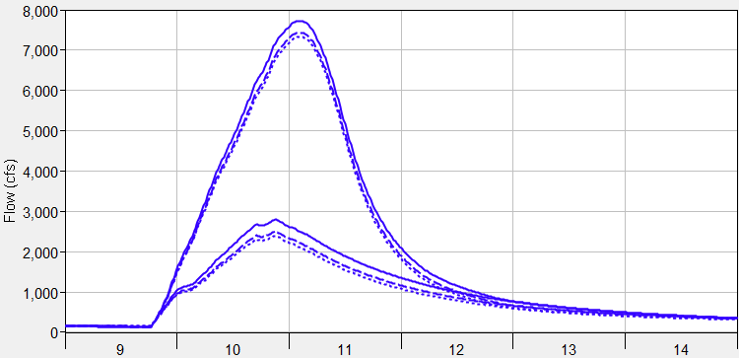
Linear Reservoir Baseflow
The plot on this slide shows three different simulations where the groundwater 2 linear reservoir coefficient was varied (50-50 split in infiltrated losses between layers).
Groundwater 2/3 layers can be used to model the longer responding groundwater flow, these components will not have as much of an impact on the flood magnitude.
Total Flow
GW2 Coef. = 100 hours
GW2 Coef. = 200 hours
GW2 Coef. = 300 hours
Baseflow

Slide 9
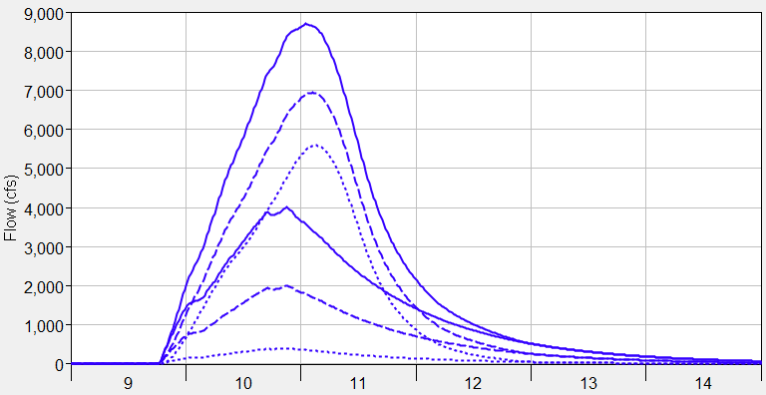
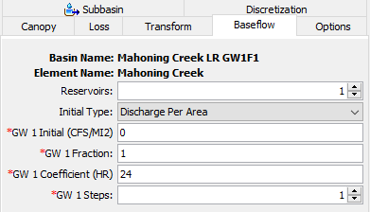
Linear Reservoir Baseflow
The plot on this slide shows three different simulations where the groundwater fraction was varied.
The fraction can be used to control the magnitude of the baseflow hydrograph (emphasize interflow), the fraction can be used to improve runoff volume.
Total Flow
GW 1 Fraction = 1 (volume 1.6 inches)
GW 1 Fraction = 0.5 (volume 0.8 inches)
GW 1 Fraction = 0.1 (volume 0.2 inches)
Baseflow

Slide 10
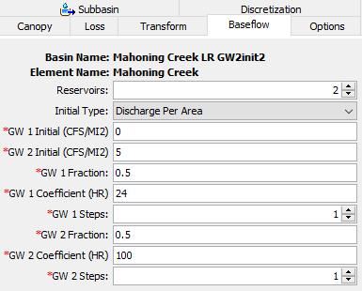
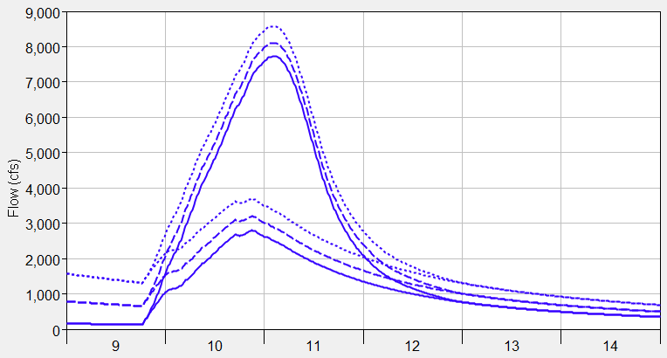
Linear Reservoir Baseflow
You can choose an initial discharge type: Discharge per Area or Discharge (a discharge per area of 1 CFS/MI2 means the initial flow would be 100 cfs for a 100 square mile subbasin)
Discharge per Area is easier to apply across the basin model (generally consistent across subbasins), where a discharge initial type is dependent on the subbasin size.
The plot on this slide shows different initial discharge per area values, manually adjust the initial discharge to match observations at the beginning of the simulation.
Be strategic when setting the starting date of the simulation, interflow could be set to zero and only initial GW2/3 specified.
Initial GW2 Disch. = 1 CFS/MI2
Initial GW2 Disch. = 5 CFS/MI2
Initial GW2 Disch. = 10 CFS/MI2

Slide 11
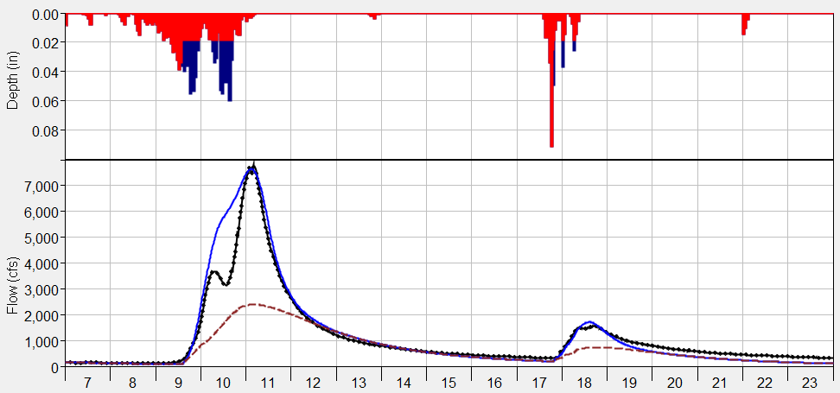
Linear Reservoir Baseflow
Computed Total Flow
Computed Baseflow
Observed Flow
The linear reservoir baseflow method can be used for a continuous simulation.
The plot on this slide also shows that the linear reservoir method can simulate both interflow and groundwater flow (because it includes up to three layers, each layer has its own coefficient).

Slide 12
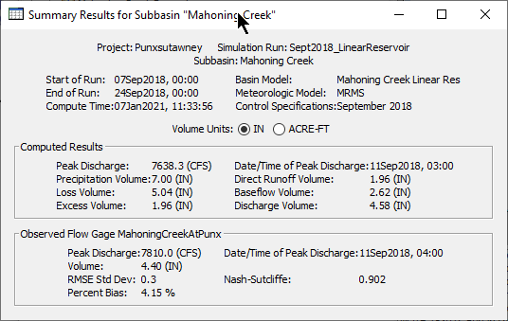
Linear Reservoir Baseflow
Always check the computed runoff volume. You will not have to worry about the total runoff volume exceeding precipitation volume, which could happen when using the other baseflow methods.
Verify modeled volumes are similar to regional water balance studies.

Slide 13
Linear Reservoir Baseflow
The linear reservoir coefficient could be estimated using flow observations, and the slope of the interflow and baseflow recession curve(s):
Q_{t} = flow at time t
Q₀ = flow at the beginning of the recession curve
K_{r} = exponential decay constant
T = time
R = linear reservoir coefficient
Q
=
1
Q
=
Q
×
K_{r}
T
S
=
−
t
R
−
t
o
t
ln(
)
ln(
)
K_{r}
K_{r}

