Slide 1
HEC-HMS
Surface Runoff
Unit Hydrograph Derivation

Slide 2
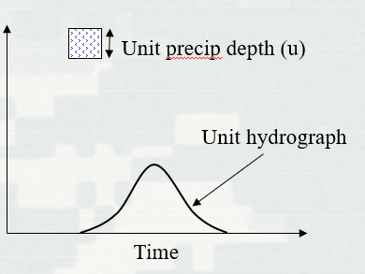
Unit Hydrograph
Defined as the “basin outflow resulting from 1.0 inch (1.0 mm) of direct runoff generated uniformly over the drainage area at a uniform rainfall rate during a specified period of rainfall duration.”
Often used for “lumped” parameter modeling
User Specified Unit Hydrograph, User-Specified S-Graph, Clark and ModClark, SCS, and Snyder’s
Notes:
Lets review the definition of a unit hydrograph again. The unit hydrograph is defined as the “basin outflow resulting from 1.0 inch (1.0 mm) of direct runoff generated uniformly over the drainage area at a uniform rainfall rate and during a specified period of rainfall.” The unit hydrograph is one of the available techniques to transform excess precipitation to discharge.
The unit hydrograph is often used for lumped parameter modeling and there are different methods available in HEC_HMS to characterize the unit hydrograph.

Slide 3
Unit Hydrograph Assumptions
Rainfall excesses of equal duration are assumed to produce hydrographs with equivalent time bases regardless of the intensity of the rain
Direct runoff ordinates for a storm of given duration are assumed directly proportional to rainfall excess volumes. Twice the rainfall produces a doubling of hydrograph ordinates (superposition)
The time distribution of direct runoff is assumed independent of antecedent precipitation (time invariance)
Excess precipitation is spatially distributed uniformly and has a constant intensity throughout the time interval
Notes:
The unit hydrograph comes with a set of assumptions and principles that are important to understand.
Excess rainfall of equal duration are assumed to produce hydrographs with equivalent time bases regardless of the intensity of the rain. Time base is referring to the duration of direct runoff (after accounting for losses and removing baseflow). Regardless of how many inches your rainfall within a specified duration, you will get the same time base.
The direct runoff ordinates for a storm of given duration are assumed directly proportional to rainfall excess volumes. That means if you have 2 times the rainfall, you will get a doubling of the hydrograph ordinates. This highlights the principle of superposition - if you compare the runoff from 1 inch of rainfall to the runoff from 2 inches of rainfall, you essentially get a hydrograph that’s twice the size.
The time distribution of direct runoff is assumed independent of antecedent precipitation. This is the principle of time-invariance. Regardless of the state of the watershed, if you have one inch of rainfall over your basin, you will always get the same hydrograph regardless of when that rainfall occurs.
Excess precipitation is spatially distributed uniformly and has a constant intensity throughout the time interval. This is described in the definition of the unit hydrograph and restated again.

Slide 4
UH - Limitations
Normally do not see proportional behavior in river flow.
Time-invariance can be affected by the seasons
Areal distribution of rainfall rarely uniform over time and space
Notes:
Now that you have an understanding of the assumptions, you could probably tell there are limitations to this concept when applied to natural catchments. We’ll describe three limitations to applying the UH. The assumption of proportionality and superposition mostly conflicts with the observed behavior of river flow, which are typically non-proportional (or non-linear). The antecedent conditions of the ground, whether the ground starts off as saturated or unsaturated, can have a significant affect on the behavior of runoff. Rainfall intensities have also been shown to affect the runoff behavior as non-linear with increasing rainfall intensities.
The assumption of time-invariance can be affected by the season. The response hydrograph can be expected to vary based on the time of year. For example, vegetation might be at its highest development during the spring or summer and therefore hydraulic behavior of the catchment might be rougher and affect the runoff response.
The assumption of excess rainfall uniformly distributed in space and time is also not normally seen. More often, storms tend to vary in intensity in both space and time and the contributing runoff areas will expand and contract as the catchment dries and wets. However, this last limitation can be accounted for in your modeling by selecting a smaller rainfall duration to capture the changes in intensities. The changes in space can be accounted for by delineating your watershed to smaller subbasin if the data is available.
Despite these limitations, the unit hydrograph method is still used widely because of its simplicity to apply to many different types of watersheds and is still the basis for many analysis and estimation techniques.

Slide 5
Unit Hydrograph – Derivation Example
Notes:
Let go over how someone would derivate a unit hydrograph from an observed hydrograph and rainfall.

Slide 6
Unit Hydrograph - Derived
Separate interflow and base flow
Excess precip depth (d)
Excess precip depth (d)
Direct runoff
Direct runoff
Flow
Flow
Interflow
Base flow
Time
Time
Notes:
The first step to deriving a unit hydrograph for your watershed is to separate the interflow and baseflow. The main goal of separating these out is so we can analyze just the direct runoff. There are many different techniques for separating interflow and baseflow from the hydrograph, all of which require some user judgement. In this example, direct runoff begins at the onset (click) of excess precipitation. The inflection point (click) on the recession limb of the hydrograph is used to indicate the change in physical processes controlling discharge which we infer is the interflow or baseflow. So a straight line (click) is drawn from the start of excess rainfall to the inflection point on the hydrograph. What you (click) are left with is the direct runoff.

Slide 7
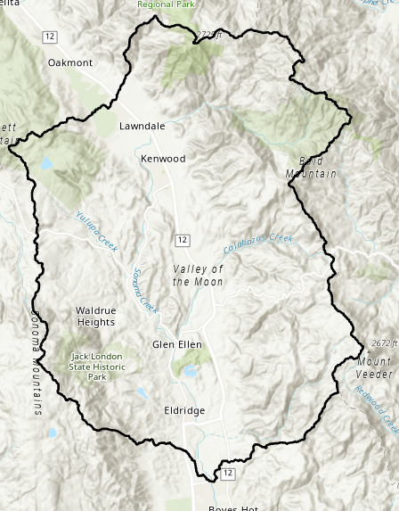
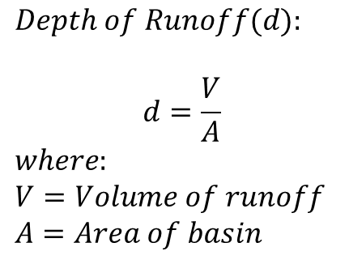
Unit Hydrograph - Derived
Measure the total volume of direct runoff under the hydrograph and convert this to depth over the watershed
$$Depth of Runoff(d):$$
$$d=\frac{V}{A}$$
$$where:$$
$$V=Volume of runoff$$
$$A=Area of basin$$
Area (A)
Excess precip depth (d)
Flow
Direct runoff (V)
Time
Notes:
Once we have the direct runoff hydrograph, we measure the total volume of direct runoff which is the area under the hydrograph (click) and convert to a depth over the watershed. The depth could be computed simply done by dividing the volume (click) under the direct runoff curve by the area (click) of the watershed.

Slide 8

Unit Hydrograph - Derived
Divide the ordinates of the direct runoff by the depth of runoff (d)
Excess precip depth (d)
Unit precip depth (u)
Direct runoff
Direct runoff
Flow
$$×\frac{1}{d}$$
Flow/u
Time
Time
Notes:
So we have the direct runoff hydrograph and the depth of runoff under our hydrograph. We scale our direct runoff hydrograph by dividing (click) the ordinates of direct runoff by the depth of runoff that we computed in step 2. We divide by the depth because we are interested in getting the unit depth of 1 inch or 1 mm. Once you divide each ordinate by the depth, you will obtained (click) your unit hydrograph
In practice this procedure would be conducted for a number of storms and the ordinates averaged to determine the final unit hydrograph for the basin.

Slide 9
Unit Hydrograph - Derived
Estimate the duration of the unit hydrograph
Excess Rainfall Duration
Precip
Φ index
Time
Notes:
We have our unit hydrograph. Our last step is to estimate the duration of the unit hydrograph using the observed rainfall. The unit hydrograph derived from an observed hydrograph is tied to a rainfall duration. For example, it could be that 3 hours of excess rainfall generated our unit hydrograph. So we would call the unit hydrograph, a 3-hr unit hydrograph, where the 3-hrs came from the duration of excess precipitation. The rainfall storm itself could be longer than 3-hours but we are just interested in the excess rainfall after we remove losses. So, to estimate the duration, we take the depth of direct runoff that we estimated in step 2, determine the total volume of your rainfall, and subtract your rainfall losses until you match the depth of direct runoff to estimate the effective duration.
One simple technique to accomplishing this is to use the Φ index (click) such that the depth of excess precipitation is equal to the depth of direct runoff. The Φ index is based on the assumption of a uniform infiltration rate so it would be up to the hydrologist or engineer to decide if that is reasonable assumption. As you can probably tell, you would want to be selective in the types of storms and hydrographs you choose to analyze. You would want to select storms with simple structures where you can get a defined, single peaked hydrograph. Select storms where you can get a uniform distribution of rainfall throughout the period of excess, and uniform spatial distribution over the entire watershed.

Slide 10
Unit Hydrograph – Derivation Example
Notes:
Here is unit hydrograph derivation example starting with an observed streamflow over 24 hours. We use a simple baseflow separation technique of 35 cfs which gets subtracted from the hydrograph to get our direct runoff as well as calculating the volume of our direct runoff. In this case, the volume was calculated using the trapezoid method. Once we got our total volume, we divide by the watershed area to get the runoff depth. We scale our direct runoff by dividing the runoff depth to obtain our unit hydrograph. To confirm that we have a unit hydrograph, we can calculate the area under the unit hydrograph, get the total volume, and divide by the watershed area. We should receive a depth of 1 inch.

Slide 11
Unit Hydrograph – Derivation Example
Excess Rainfall Duration
= 0.84 inches (Step 2)
Precip
Rainfall total depth (5 hours) = 3.34 inches
Φ index = 0.5 in/hr
Time
Rainfall duration = 3-hr
Notes:
To compute the rainfall duration, we estimate the total rainfall depth of 3.34 inches (click). We are looking to get 0.84 inches of excess rainfall which we had computed from the depth of direct runoff. The direct runoff depth could be obtained by using a constant loss estimate of 0.5 in/hr (click). This leaves us with 3-hrs as the excess rainfall (click) and therefore can call the unit hydrograph as a 3-hr unit hydrograph. Try not to get confused between the excess rainfall duration and the time interval of the unit hydrograph. In the previous slide, we see that the time interval for the unit hydrograph was 2-hours, but that does not make it a 2-hr unit hydrograph. The rainfall duration defines the type of unit hydrograph.

Slide 12
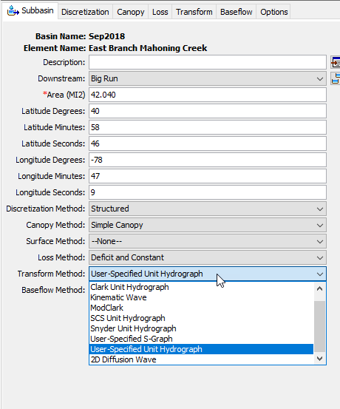
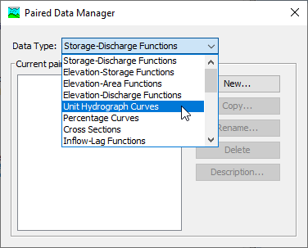
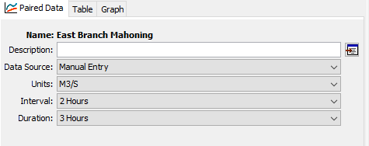
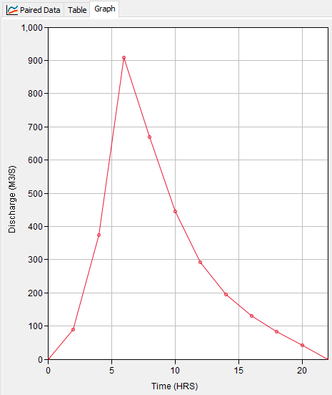
Unit Hydrograph in HEC-HMS
Notes:
So now that you’ve come up with your unit hydrograph, you’ll want to add it to HMS. The first step (click) is to select the transform method User Specified Unit Hydrograph. Next, (click) you will need to create a Unit Hydrograph Curve in the Paired Data Manager. Once you have a paired data created, (click) you need to set the Interval which is the interval of your hydrograph and the duration which is the duration of excess rainfall. In our example, we have a hydrograph interval of 2 hours and a duration of 3 hours, which we calculated in step 4. Lastly, (click) add your newly created unit hydrograph by either manually entering in the values or by importing through DSS if you created your unit hydrograph there.

Slide 13
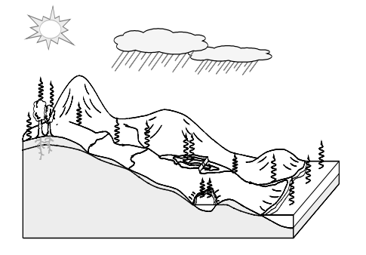
Thank you for listening!
Visit our website!
https://www.hec.usace.army.mil/confluence/hmsdocs/hmsum/4.7
https://www.hec.usace.army.mil/software/hec-hms/

