Slide 1
Rainfall-Runoff Modeling
Surface Runoff in HEC-HMS
Synthetic Unit Hydrographs –
Snyder's Unit Hydrograph

Slide 2
Snyder UH - Theory
Snyder’s UH originally looked at using hydrograph peak, watershed lag, and the time base as the critical characteristics for the unit hydrograph
Developed from study of watersheds in the Appalachian Highlands ranging from 10 to 10,000 mi²
Notes:
The Synder’s Unit Hydrograph originally looked at using the hydrograph peak, watershed lag, and the timebase to develop the unit hydrograph. This method was developed for a study of watersheds in the Appalachian Highlands with areas ranging from 10 sq miles to 10,000 sq miles.

Slide 3
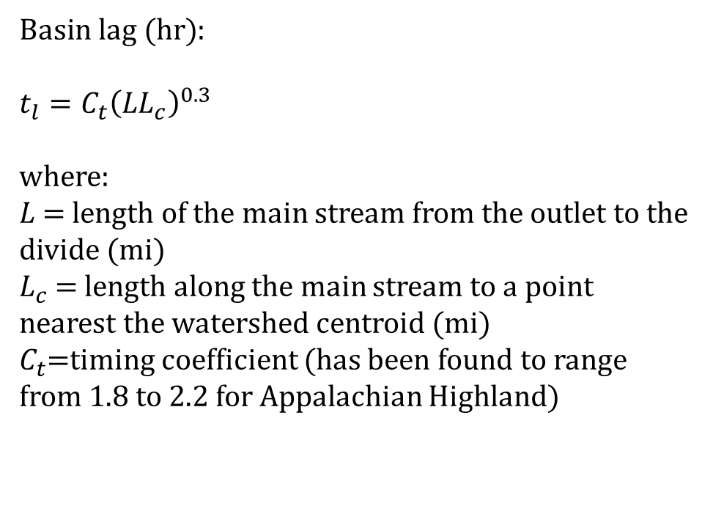
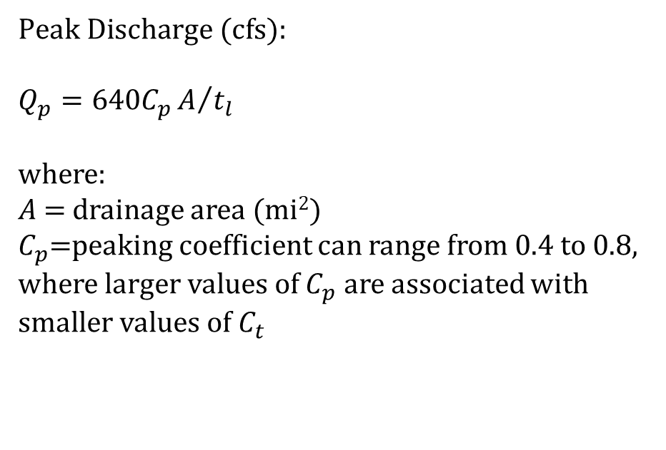
Snyder UH - Equations
$\text{Basin} \text{lag}\text{ (}\text{hr}\text{)}$:
$$t_{l}=C_{t}{\left(LL_{c}\right)}^{0.3}$$
where:
$L$= length of the main stream from the outlet to the divide (mi)
$L_{c}$ = length along the main stream to a point nearest the watershed centroid (mi)
$C_{t}$=timing coefficient (has been found to range from 1.8 to 2.2 for Appalachian Highland)
$\text{Peak} \text{Discharge}\text{ (}\text{cfs}\text{)}$:
$$Q_{p}=640C_{p}A/{t_{l}}$$
where:
$A$= drainage area (mi²)
$C_{p}$=peaking coefficient can range from 0.4 to 0.8, where larger values of $C_{p}$ are associated with smaller values of $C_{t}$
Notes:
Snyder’s requires two parameters: the watershed lag and the peak discharge. The watershed lag is defined the same as the SCS UH method, which is from the center of mass of rainfall to the hydrograph peak value. Synder’s method provide an equation to estimate watershed lag, by multiplying Ct, which is the timing coefficient, by the length of the longest flow path and the length . Lc is the length of the centroidal flow path. Ct is a variable coefficient best estimated through calibration.
The peak discharge is calculated by multiplying 640 by Cp, which is the peaking coefficient, by the watershed area, and the basin lag. Cp, has values that range from 0.4 to 0.8 (could be lower or higher) and generally represent retention or storage capacity of the watershed. There are tables that provide typical ranges for timing coefficient and storage coefficient but the best way is to calibrate for these parameters.

Slide 4
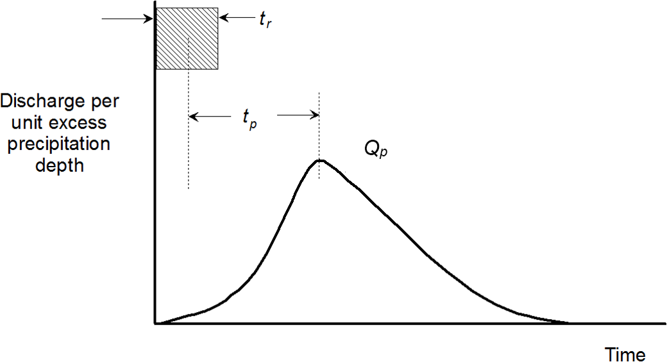
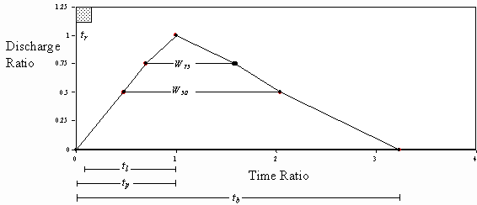
Snyder UH – Illustrated
Source: HEC (2000)
Notes:
The Snyder method is unique compared to the last two method in that it generates several points to define the hydrograph. There isn’t a dimensionless unit hydrograph or time-area curve to smooth out the rising limb and falling limb. It’s somewhat of a connect the dot exercise to define your shape and making sure the area under the hydrograph is equal to 1 unit. Here is not a lot of definition to the rising limb or falling limb of your unit hydrograph.
In HMS, the Snyder’s method only computes a 0,0 initial base value and the peak value delayed by the lag value. The method actually calls the Clark UH method and iterates through its parameters, Tc and R, to create a unit hydrograph that matches the Snyders hydrograph peak value and peak timing. So you essentially using the Clark Unit Hydrograph method when selecting Snyder’s but you will still get the peak value and peak timing based on the Snyder’s method. If you want to better understand how the Clark Unit Hydrograph works, we have a video under the Basic HMS class that discusses the Clark method

Slide 5
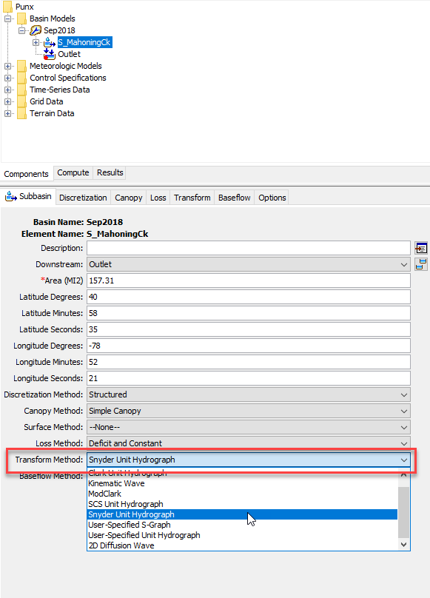
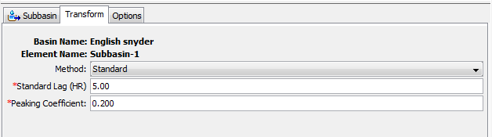
Snyder UH - Implementation in HEC-HMS
Notes:
Similar to the other methods, you select Snyder’s UH in the Transform Method. Navigate to the transform tab to put in your transform parameters.
The first is selecting the method. In HMS, there is currently three different methods available. The standard method requires the user to estimate parameters using standard techniques for estimating lag. There are two other methods, the Fort Worth District and Tulsa District method, which we won’t touch on, but they are methods to account for urbanization. These approaches may be effective at estimating parameters in ungaged watersheds if they are similar to the watersheds used to develop the approach.
Since we selected the standard method, the standard lag is defined as the length of time between the centroid of precipitation mass and the peak flow of the resulting hydrograph. Many relationships for estimating lag from subbasin characteristics have been developed for different regions.
The peaking coefficient measures the steepness of the hydrograph that results from a unit of precipitation.

Slide 6
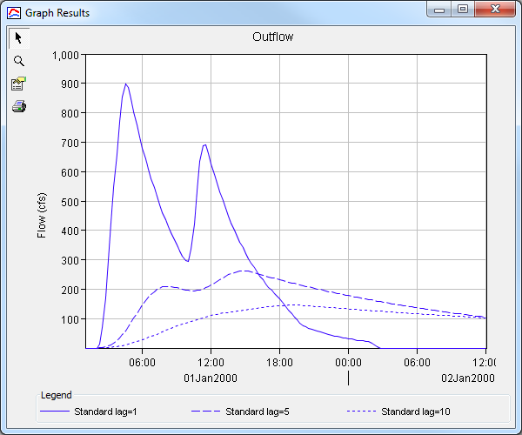
Snyder UH – Adjusting Standard Lag
Notes:
Example adjusting standard lag. As you increase lag, you can see the hydrograph peak reduce and the shape spread out.

Slide 7
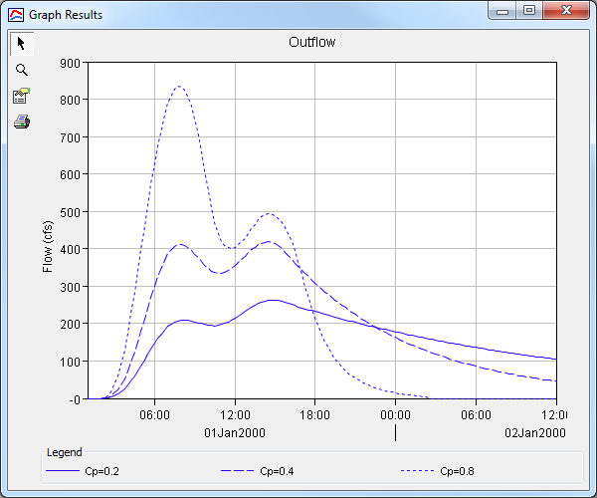
Snyder UH – Adjusting Peaking Coefficient
Notes:
Example adjusting peaking coefficient. As you increase Cp, you can see the hydrograph peak increase. So again, HMS is not creating a true Snyder’s hydrograph and that is because there isn’t enough ordinates created. The hydrograph you see is the result of the Clark UH that iterates its parameters to match the Snyder hydrograph result. That way, you can get more ordinates on the rising limb and recession limb.

Slide 8
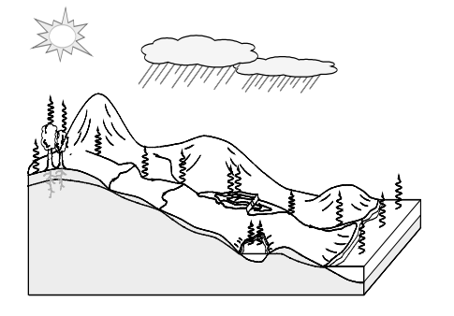
Thank you for listening!
Visit our website!
https://www.hec.usace.army.mil/confluence/hmsdocs/hmsum/4.7
https://www.hec.usace.army.mil/software/hec-hms/

