Slide 1
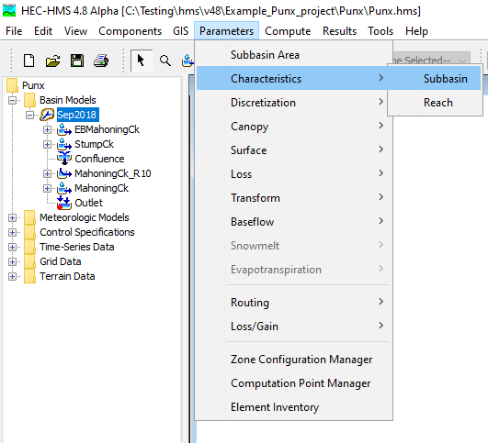
Subbasin Characteristics
Geospatial subbasin characteristics can be computed within HEC-HMS.
Notes:
Hey there HMS modelers. My name is Josh Willis and I’m with the Corps of Engineers. This lecture will cover subbasin characteristics computations within HMS. Subbasin characteristics can be accessed by clicking Parameters | Characteristics | Subbasin.

Slide 2
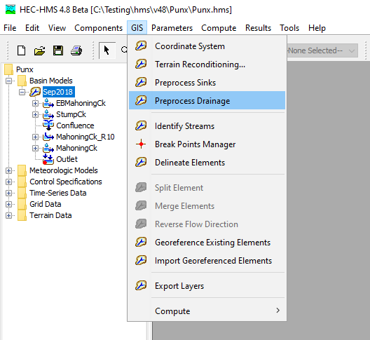
Subbasin Characteristics
Before subbasin characteristics are available, the basin model must have georeferenced subbasins and the GIS | Preprocess Drainage steps must be computed.
Notes:
Now I do want to mention that there are a few pre-requisites that need to be met before subbasin characteristics can be computed. First off, your HMS model needs to have georeferenced subbasins and secondly, within the GIS menu, the Preprocess Drainage step needs to be completed. I would recommend to take this a step further and to also compute the Preprocess Sinks step. If your terrain model has sinks, this will affect the longest flowpath calculations which, in turn, can lead to squirrely subbasin characteristics computations.

Slide 3
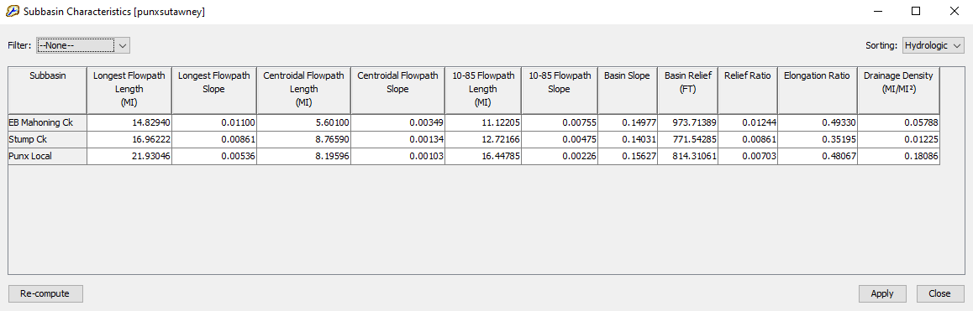
Subbasin Characteristics
Longest Flowpath Length
Longest Flowpath Slope
Centroidal Flowpath Length
Centroidal Flowpath Slope
10-85 Flowpath Length
10-85 Slope
Basin Slope
Basin Relief
Relief Ratio
Elongation Ratio
Drainage Density
Notes:
This slide lists all the subbasin characteristics that are currently computed in HMS. The first time that you access this table, the characteristics for each subbasin will be computed on the fly. The table is editable, so you could manually change some of the computed values if you so choose. Now let’s say you come to this table for the first time, and you realize that you forgot to fill sinks. Or maybe you decide to change the Identify Streams threshold both of which these calculations are dependent on. No worries. You could go back, perform those tasks, return to this table, and then click Re-compute in the lower left. That will update the calculations based on the latest data.

Slide 4
Subbasin Characteristics
Longest Flowpath Length and Slope
The longest flowpath extends from the subbasin outlet to the most hydraulically-remote point upstream. Longest flowpath length is significant in that it is typically used to determine the time of concentration for a watershed.
The longest flowpath slope is the elevation difference of the most hydraulically-remote point and the subbasin outlet point divided by the longest flowpath length.
LongestFlowpathSlope = (UpstreamElevation – OutletElevation) / LongestFlowpathLength
Notes:
Longest Flowpath Length. This is a measure of the length that water travels from the most hydraulically remote point upstream in a subbasin all the way down to the subbasin outlet. This length is very significant in that it is typically used to determine the time of concentration for a watershed.
The longest flowpath slope can be defined as the elevation difference of the most hydraulically-remote point and the subbasin outlet point divided by the longest flowpath length.

Slide 5
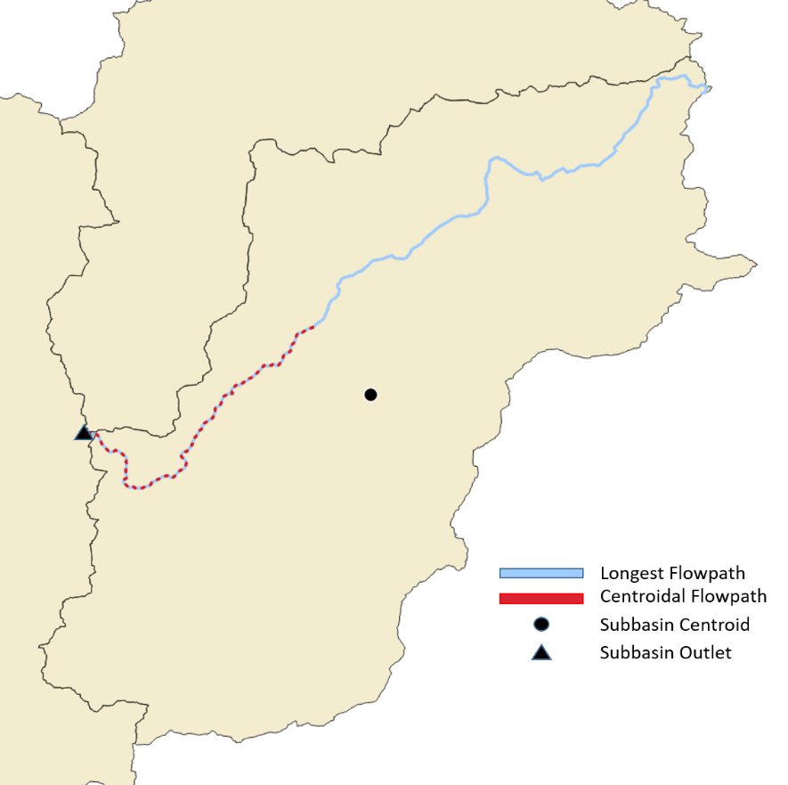
Subbasin Characteristics
Centroidal Flowpath Length and Slope
The centroidal flowpath is a subset of longest flowpath. It begins at the subbasin outlet and extends upstream along the longest flowpath until it reaches the point along the longest flowpath that is nearest to the subbasin centroid.
CentroidalFlowpathSlope = (UpstreamElevation – OutletElevation) / CentroidalFlowpathLength
Notes:
Let’s talk about centroidal flowpath. As you can see in the image, centroidal flowpath (shown in red) is a subset of longest flowpath (shown in blue). The upstream end starts at the point nearest to the subbasin centroid and then ends at the subbasin outlet, just like the longest flowpath. Centroidal slope is calculated by dividing the upstream and downstream elevation difference by the centroidal flowpath length.

Slide 6
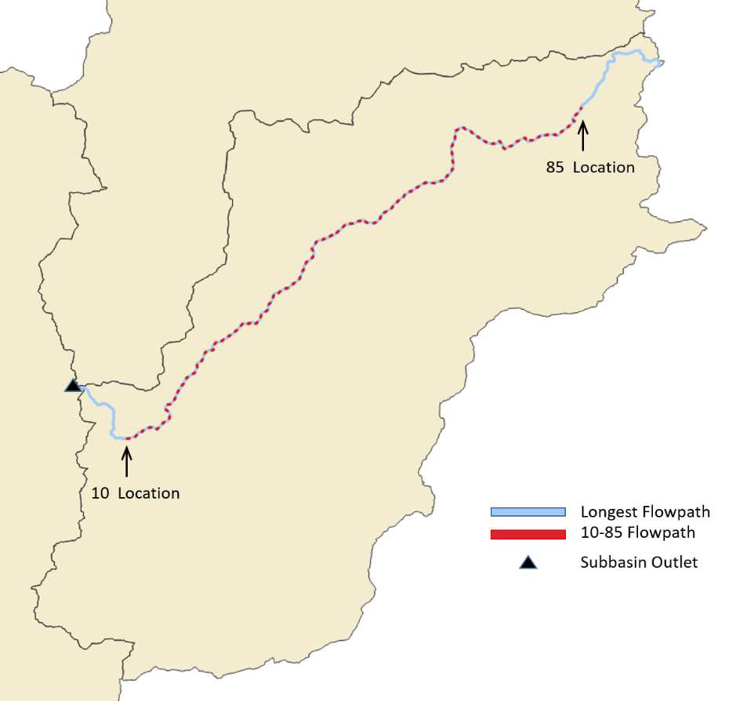
Subbasin Characteristics
10-85 Flowpath Length and Slope
The 10-85 flowpath is also a subset of longest flowpath. Measuring from the outlet in the upstream direction, the 10-85 flowpath begins at a point representing ten percent of the total length of the longest flowpath and ends at a point representing eighty-five percent of the total length.
10_85FlowpathSlope = (85Elevation – 10Elevation) / 10_85FlowpathLength
Notes:
10-85 flowpath is also a subset of the longest flowpath. In the graphic here, if you think of the subbasin outlet as point zero and the most hydraulically remote point of the longest flowpath as 100, then the 10-85 flowpath extends from the 10 percent location up to the 85 percent location.
The 10-85 slope then, is simply the elevation difference between the 85 and 10 locations, divided by the 10-85 length.

Slide 7

Subbasin Characteristics
Why do we have different length and slope calculations?
500ft
450ft
L_{LFP}
400ft
Plan View: Longest Flowpath
Profile View: Longest Flowpath
Notes:
If you are like me, you might be thinking why do we have all these different types of flowpaths and slopes. Well, they each tell us something a little different about a subbasin. For many subbasins, the longest flowpath slope represents a very steep slope that may not be indicative of the typical flowpath slopes within a subbasin. Over here on the right, we have a profile view of a longest flowpath and up near the basin divide it gets quite steep. So your longest flowpath slope may be steeper than the slope along the majority of the path.
Whereas with Centroidal and 10-85 slopes, they are usually more representative of the typical slopes found along flowpaths. Empirical equations have been developed that use a variety of lengths and slopes to estimate subbasin parameters such as lag time or time of concentration. In another video, we’ll talk about how you can use some of these flowpath lengths and slopes to quickly initialize parameter estimates in your HMS model.

Slide 8
Subbasin Characteristics
Basin Slope
The basin slope represents the average slope of the entire subbasin (rise/run). For each elevation raster value within the subbasin, the algorithm scans the surrounding eight neighbors and computes the slope using the maximum scanned elevation difference.
The algorithm does not weigh north, east, south, and west neighbors more than diagonal neighbors; each neighbor is considered equally. The basin slope output is the average of all the computed slope values in the subbasin.
Notes:
The basin slope algorithm looks at each elevation cell within a subbasin and then scans the surrounding eight neighbor cells. It then computes a slope using the maximum scanned elevation difference. The basin slope algorithm repeats this process for each cell, and then takes an average at the end.

Slide 9
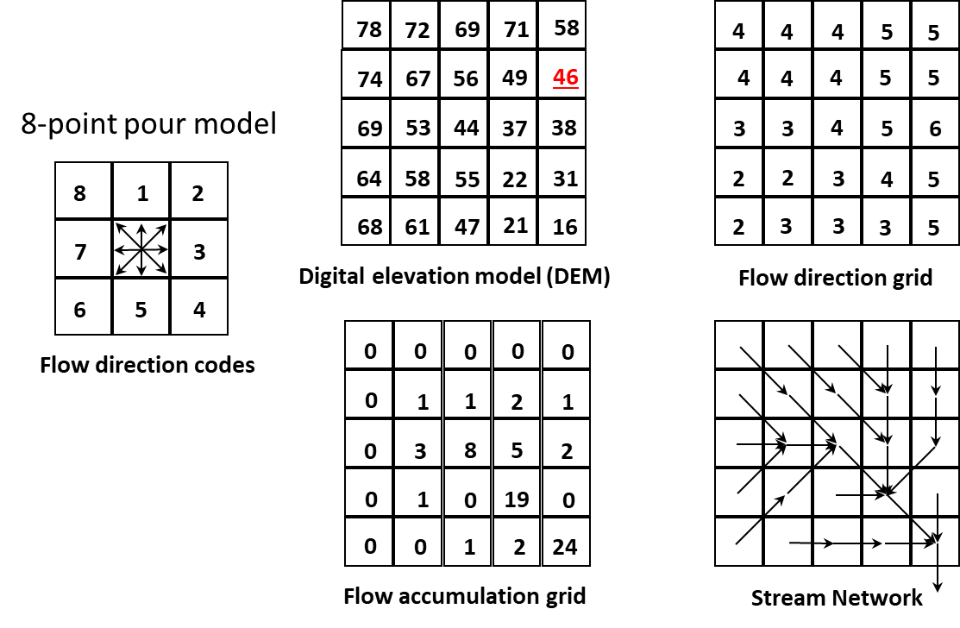
Subbasin Characteristics
Basin Slope
Basin Slope can be thought of as the average slope of all the Stream Network arrows.
Notes:
This slide provides a more visual way of thinking of basin slope. The 8-point pour model, which is discussed in a different video, is used to compute a stream network from a DEM and resulting flow direction and accumulation datasets. The Basin Slope can be thought of as taking the average slope of all of the arrows seen in the stream network part of the figure.

Slide 10
Subbasin Characteristics
Basin Relief
Basin relief represents the elevation difference between the highest point on the drainage divide and the outlet point of the subbasin.
500ft
450ft
400ft
Profile View: Longest Flowpath
Notes:
Basin relief is a simple one. It is simply the highest point on the drainage divide minus the outlet elevation. In this example, the basin relief would be about 100 feet.

Slide 11
Subbasin Characteristics
Relief Ratio
The relief ratio is simply the basin relief divided by the length of the longest flowpath.
500ft
450ft
L_{LFP}
400ft
Profile View: Longest Flowpath
Notes:
The relief ratio is based on two prior characteristics that we have already discussed. It is the basin relief divided by the longest flowpath length.

Slide 12
Subbasin Characteristics
Elongation Ratio
The elongation ratio is a dimensionless ratio used to categorize the general shape of a subbasin. It is a ratio between the diameter of a circle with the same area as the subbasin and the basin length. Elongation ratio values typically range from 0.2 to 1.0, with lower values representing elongated basins and values close to 1 representing circular basins.
ElongationRatio = (Area^{0.5}/Length) ∗ (2/π^{0.5})
D_{C}
L_{LFP}
Elongation Ratio = D_{C} / L_{LFP}
Notes:
The elongation ratio of a subbasin is used to describe the subbasin’s general shape. So if you were to imagine a circle that has the same area as your subbasin of interest, the elongation ratio would be the diameter of the circle divided by the length of your subbasin. And HMS uses the longest flowpath length as an estimate of subbasin length. An elongation ratio close to 1.0 would indicate a circular subbasin whereas an elongation ratio of, let’s say 0.2, would indicate an elongated subbasin shape.

Slide 13
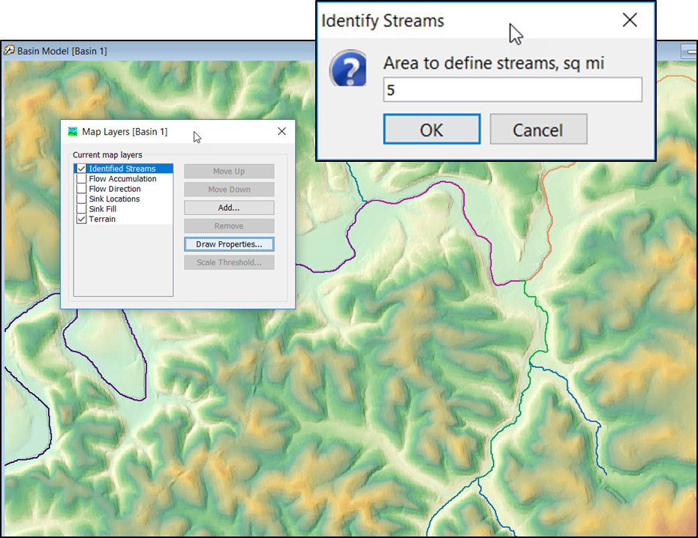
Subbasin Characteristics
Drainage Density
Drainage density is a metric used to describe the efficiency in which a subbasin is drained by stream channels. It is computed by summing the total length of stream channels within the subbasin and then dividing by the area of the subbasin.
Notes:
Lastly, we have drainage density. This is a metric that describes how well a subbasin is drained by stream channels. Drainage density is the total length of all the stream channels divided by the subbasin area. The basic idea is the higher the drainage density, the more efficient your subbasin is at draining a rain event.
As discussed in a previous lecture, the identify streams threshold is defined by the user. Since the Identify Streams threshold directly impacts the total length of defined stream channels, it also has a significant impact on the computed drainage density values. And if you haven’t computed identify streams yet as part of the HMS GIS workflow, then when you compute subbasin characteristics the drainage density values will return zeros. Well that’s all she wrote for subbasin characteristics. Thanks folks.

