Slide 1


HEC-HMS
Shared Data Components:
Paired Data
Gregory Karlovits, P.E., PH, CFM
Hydrologic Engineering Center
U.S. Army Corps of Engineers

Slide 2
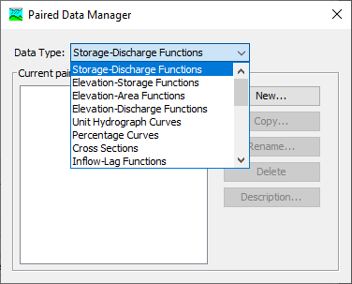
Paired Data
Data represented as X vs Y
Y = f(X)
Usually monotonically increasing
Notes:
Paired data in HMS are used to compute the value of one variable from another. Usually this is a functional relationship, where there is some Y that is a function of a given X. An example of this is a rating curve, which lets HMS compute stage for a given amount of flow.
One very important thing to note about paired data is that HMS will never attempt to extrapolate paired data. It will only interpolate.
Here is the Paired Data Manager, available by selecting Components > Paired Data Manager in the main window toolbar.
The Manager lists each type of Paired Data that are available in HMS. The Manager also allows the user to create a new Paired Data Component or create/rename/delete existing ones.

Slide 3
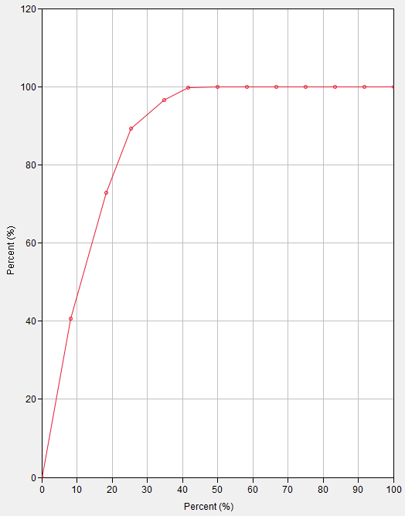
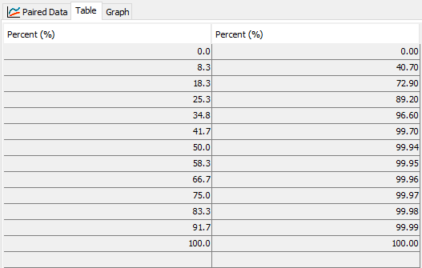
Percentage Curve
Notes:
Here is an example of a Paired Data of type Percentage Curve. It has X and Y values that are percentages (up to 100.) The values must be monotonically increasing. Most types of paired data behave in this way.
The table on the left is one view HMS offers of a Paired Data Component. It shows in two columns the X and Y values.
The graph on the right is the other HMS view of the Paired Data Component, and is an X vs. Y graph of the same table.

Slide 4
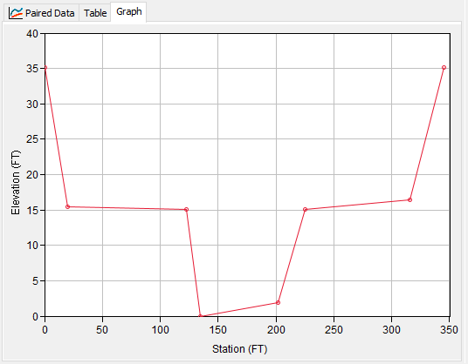
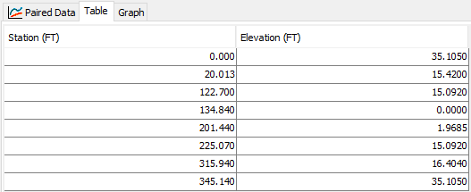
Cross-Section
Notes:
Here is an example of a Paired Data of type Cross-Section. It has X and Y values that are in feet, where X is the stationing along the channel cross section, and Y is the elevation for each point along the cross section. These paired data are used in the Muskingum-Cunge reach routing method and require that the cross-section is defined using eight points. Cross-sections are one of the special cases of paired data that are not functional or monotonically increasing.

Slide 5
Important Examples
(reservoirs)
Elevation-storage function
Elevation-discharge function
Dimensionless storm pattern
Channel cross-sections
Full list available in the user’s manual:
(rating curve)
(hypothetical storm)
(channel routing)
https://www.hec.usace.army.mil/confluence/hmsdocs/hmsum/latest/shared-component-data/paired-data
Notes:
There are many types of Paired Data that are used in HEC-HMS. HMS assigns specific types to each curve in order to prevent them from accidentally being confused with one another. Each type has its own units for the X and Y variables.
Some of the most commonly used Paired Data types are shown. The elevation-storage function is used to define the geometry of a reservoir, converting between reservoir stage and reservoir storage.
The elevation-discharge function, or rating curve, is used to compute stage from flow at an element.
Dimensionless storm patterns are percent-percent curves that allow for creating storm patterns of any duration and intensity.
Channel cross-sections are mentioned because they break the monotonically-increasing rule. They are a special case.
Many other types are available for other types of modeling. Temperature Index snow modeling often requires one or more Paired Data curves as parameters. Hypothetical Storm precipitation often uses Paired Data for defining time patterns of storms, or point-to-area reduction functions.

Slide 6
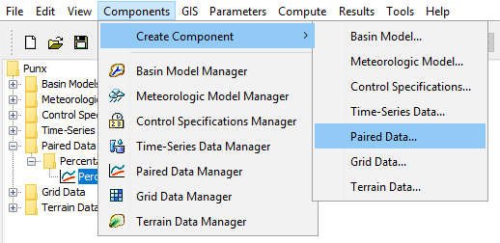
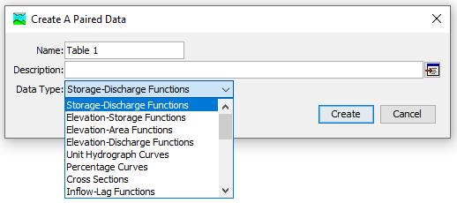
Notes:
There are two paths to creating new Paired Data Components.
The first is to use the Create Component > Paired Data… menu option. You will then be prompted with a window that asks for a name, a description and a data type. Select the data type first, then enter a name and description. So long as the name is unique for the data type, you can select Create and a new Paired Data Component will be created.

Slide 7
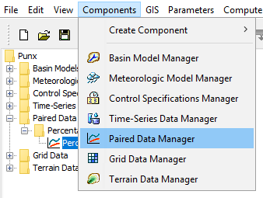
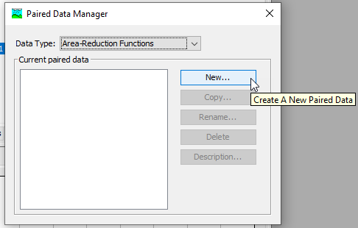
Notes:
There are two paths to creating new Paired Data Components.
The second path is to use the Paired Data Manager menu option. A window will open that allows you to see all the Paired Data Components that have been created for each type. Select the type of interest in the top menu, and the window will show all the Paired Data Components of that type that have been created, if any. To create a new one, select the New… button and then you will get a window like the “Create a Paired Data” window on the previous slide.

Slide 8
Paired Data Manager
View existing data by type
Create new
Copy
Rename
Delete

Slide 9
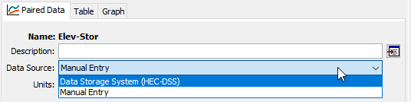
Data Sources
Link to an existing HEC-DSS file
Enter data manually
Notes:
There are two choices for paired data sources: HEC-DSS files, and manual entry. Choosing one or the other presents you with different options.

Slide 10
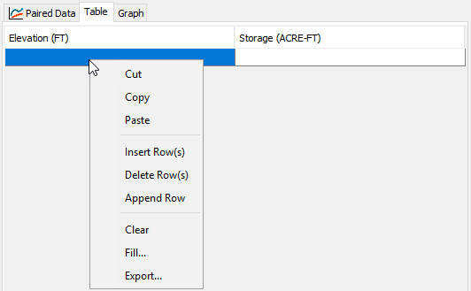
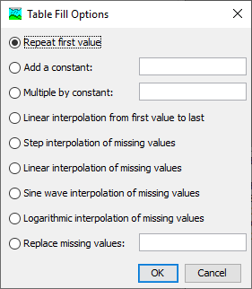
Manual Entry
Spreadsheet-like table
Copy-and-paste
Advanced functions
Notes:
The manual entry table behaves much like a spreadsheet. It is very easy to copy-and-paste from spreadsheets to fill out your paired data. This is the primary way of creating paired data, as most data that are used are stored in formats like CSV files and spreadsheet workbooks.
On the main tab you must specify the units that you are entering for manual entry.
There are other controls to change the shape of the table, such as inserting, deleting, and appending (adding to the end) rows.
The Fill… feature offers several advanced functions for filling the values in a column. This is especially handy for dealing with missing values.

Slide 11
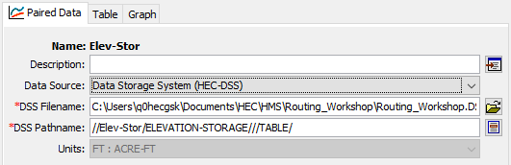
HEC-DSS File
Link to existing paired data in a DSS file
See User’s Manual for conventions
https://www.hec.usace.army.mil/confluence/hmsdocs/hmsum/latest/shared-component-data/paired-data
Notes:
HEC-DSS is convenient when a paired data object has been created already that you want to re-use. The easiest way to create one in the first place is to create it using manual entry in HMS. This makes sure that the pathname and unit conventions for the type of table you are trying to create are correct.
The C-part of the pathname controls the data type. Importing from DSS automatically handles data units.

Slide 12
HEC-HMS
Shared Data Components
Paired Data
Gregory Karlovits, P.E., PH, CFM
USACE Hydrologic Engineering Center

