Slide 1
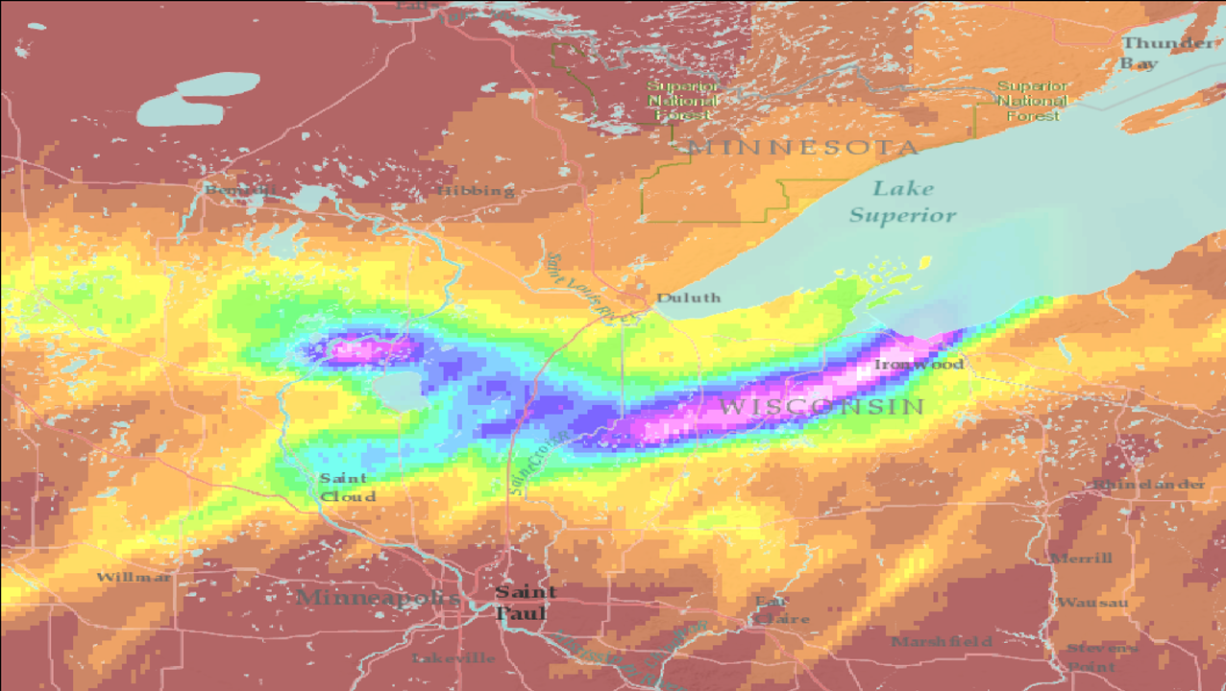

HEC-HMS
Shared Data Components:
Grid Data
Gregory Karlovits, P.E., PH, CFM
Hydrologic Engineering Center
U.S. Army Corps of Engineers

Slide 2
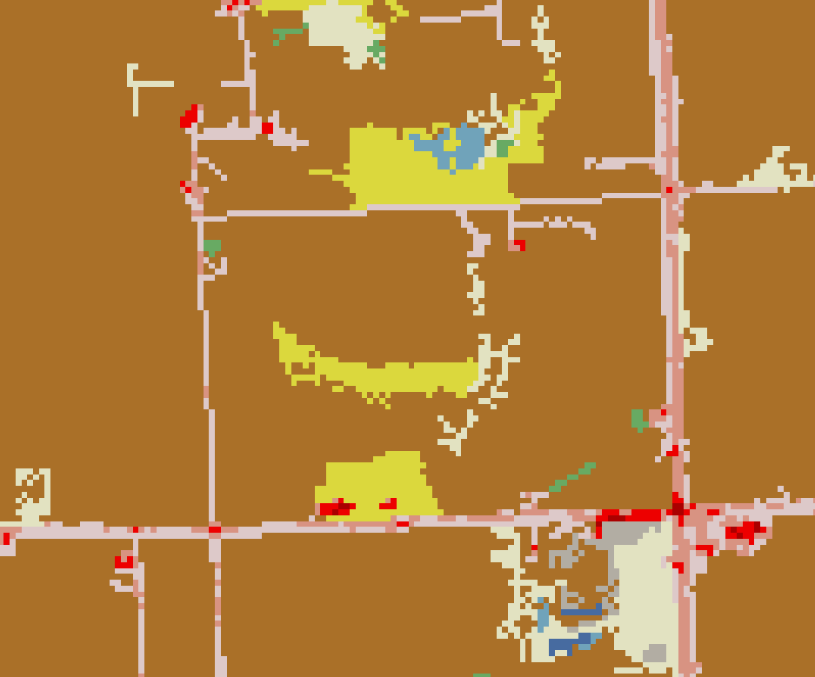
What’s a Grid?
Spatial data on a regular lattice
  Raster data
Each pixel represents an average value over the cell
Notes:
A regular lattice implies that the cell size is the same for the entire dataset, and that the cell location can be referenced from an index location (e.g. an origin, like the coordinates (0, 0)) and then an offset from it (row 10, column 26). If you work with GIS frequently you are already familiar with raster datasets – that is what we’re talking about with grid data.
The value for each cell is constant across the cell. For continuous data (numeric data that can take on any value over a range) the cell usually represents the average value of the true information. For example, a grid of elevation data is likely to represent the average of the true elevation over the grid cell.

Slide 3
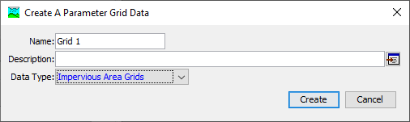

HMS: Two Grid Philosophies
A grid is a raster with no notion of time
A gridset is a set of rasters with each indexed by time
Notes:
In traditional HMS modeling, grid data are most frequently used to model precipitation boundary conditions, such as radar-based precipitation measurement. As HMS capabilities have grown, additional types of grid or raster data have been added to address modeling needs.
An important distinction exists between grids and gridsets in HMS.
Grids are static – they are an unchanging snapshot and are not associated with any sort of time. The example above shows an impervious area grid, which stays constant with respect to time. (Yes in real life impervious area amounts can change, but HMS cannot currently model time-varying impervious area.) These datasets contain a single grid.
Gridsets are not static, and are what you would use to represent boundary conditions like precipitation or temperature. The gridset contains many grids, and each grid is associated with a date and time. The example here shows a temperature gridset, which might contain a set of grids that are observations of surface temperature taken each hour.

Slide 4
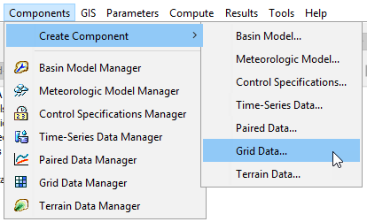
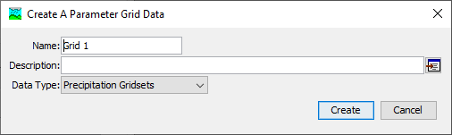
Notes:
There are two ways to create a grid data component. The first is to choose Components > Create Component > Grid Data…
You will see a dialog box like this. Choose the type of grid in the drop down menu, then give it a name. Pressing create adds a new grid data object to the watershed explorer.

Slide 5
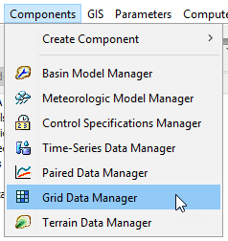
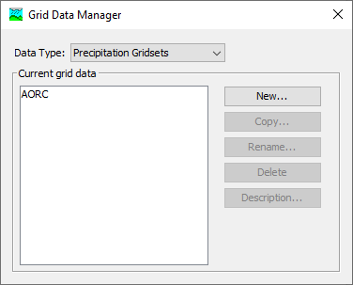
Notes:
The second way is to go through the Grid Data Manager, which can be accessed in the Components menu. The Grid Data Manager allows you to see all the grids that have already been created, organized by type. It also lets you create new ones, or copy/rename/delete existing ones. Pressing the New… button will launch the same creation dialog as the creation option from the previous slide.

Slide 6
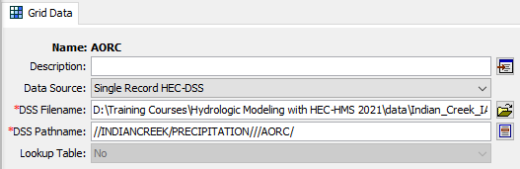
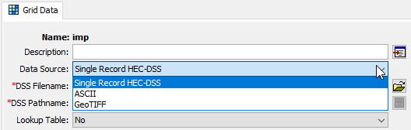
Data Sources
Varies by type of data
All can use HEC-DSS
Grids can use raster data formats
  ASCII
  GeoTIFF
Notes:
Depending on whether you’re working with a grid or a gridset, you can link an HMS grid component to different sources of data.
In any case, HEC-DSS can be used as a data source for a grid component. HMS underneath the hood is always dealing with HEC-DSS for data storage, so this format is always applicable. For gridsets, this is the only type of data that currently can be used. However, utilities for converting data from one format (e.g., NetCDF, HDF, etc.) to HEC-DSS are available and will be discussed in just a bit.
For grids, there are also two formats of raster data that can be linked up. GeoTIFF is the most common format used for these types of data. ASCII grids are mainly provided as an option for precipitation-frequency grids, but certainly can be used for other data types if that is how the source data are stored.

Slide 7
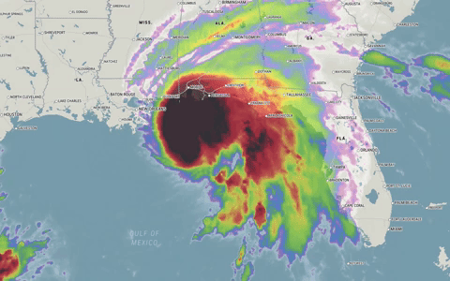
Gridset Workflow
Gridsets are more complicated because a time-series of grids is involved
Import source data to HEC-DSS
Create gridset in HEC-HMS
Link the datasource
https://cms.accuweather.com/wp-content/uploads/2020/09/HurricaneSallyTueMornLoop.gif
Notes:
Often the data we want to use for gridded boundary conditions are in a format that HMS cannot directly use. Commonly, NetCDF or HDF is used to store high-dimensional data, such as meteorologic or climatic data. Many times each time step of the data is in a separate source data file, meaning that a day’s worth of hourly timestep data might be in 24 files. In order to get HEC-HMS to use these, they need to be placed in a DSS file, with the correct convention. Then, you will need to create the correct type of grid data component and link the DSS file you created to that component.

Slide 8
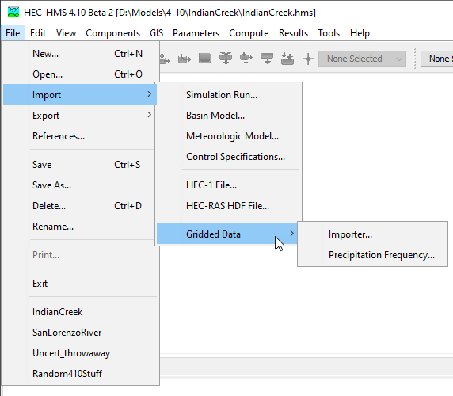
Grid Data Importer
A set of utilities for importing grid data to DSS are available
  Import from one or many files
  Choose which variables to import
  Clip
  Handle projections
  Resample
Notes:
HEC-HMS now features a tool for importing grid data from a variety of formats in the HEC-DSS format. It is able to handle one or many files as inputs, filter down to the variables of interest, clip the grid domains to a user-specified spatial extent, deal with projecting the grid data, and resampling the grid resolutions. It is available by going into the File menu, dropping down to Import, and selecting Import Gridded Data. The following slides will walk through a simple import using this tool.

Slide 9
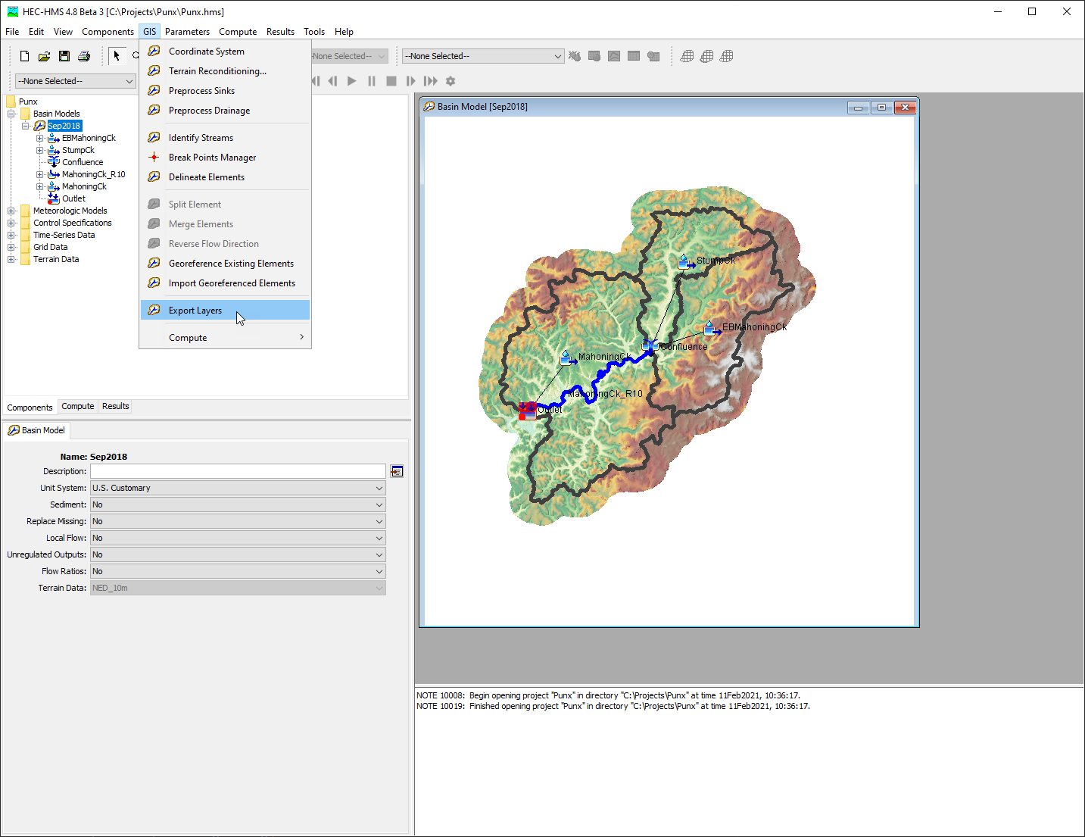
Export Subbasins Layer
Notes:
I like to start by exporting my subbasins layer. We will use the subbasins layer to clip grids on import.

Slide 10
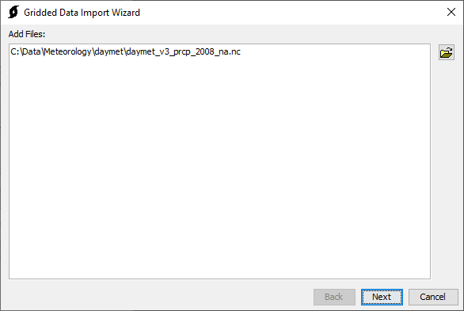
Step 1 - File Selection
Notes:
On the first screen, you can select as many files as you want to import into the DSS file at the end. Select the browse button on the right and add the files. Supported formats will be shown in the browsing dialog.
Some data are contained all within one file, as in the case shown here. In other cases, the data are spread across a number of files. In either instance you can add those source data files to the wizard.

Slide 11
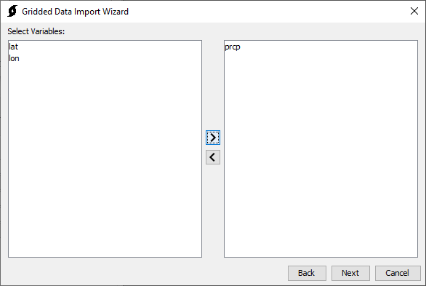
Step 2 - Variable Selection
Notes:
The variable selection step is important in case the source data store multiple kinds of data at a time. Some data have a convention that store latitude and longitude as grids as well, and we don’t want to import those. In this case we have selected the “prcp” data variable and moved it to the right side, meaning any data with the “prcp” variable type will be imported. The import utility will automatically interpret this as precipitation data. Many types of data are supported with this import utility, which recognizes most of the common abbreviations or variable names for gridded meteorologic data.

Slide 12
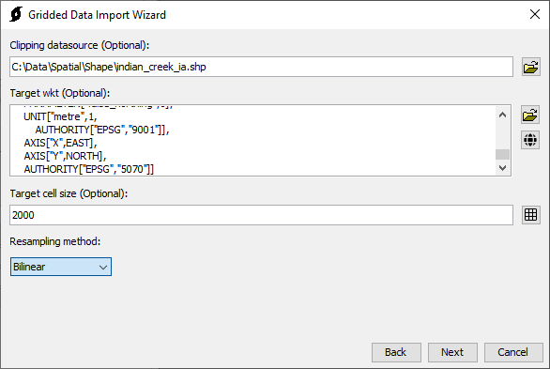
Step 3 - Clipping, Projection, and Resampling
Notes:
The third step handles all of the spatial processing.
Using a clipping datasource can drastically reduce the size of the output, especially when the source data covers a much larger spatial extent than the project area you are trying to model. One handy way to get a clipping datasource is to export the watershed polygon shapefile from your HEC-HMS watershed delineation.
The target WKT controls what projection the output data should be in. If you click the browse icon, you can browse to a source of spatial data and use the projection information for that dataset. Or, you can select the globe icon, which will give you some built in options, such as SHG, which is commonly used for HEC-HMS models in the United States.
The target cell size controls how the data will be resampled. This is the cell size that the output data will be in (measured in meters.) The output size is dependent on the resolution needed for the project. Use a cell size that is at smallest the size of the input data. Coarsening the resolution of the data will reduce file size. Typical options are selectable if you select the grid icon to the right of the box. A typical resolution for HMS models that takes into account the typical resolution of gridded data is 2,000 meters.
Finally the resampling method controls what method HEC-HMS will use to convert the source data to the target data. For meteorologic data, bilinear is typically adequate.

Slide 13
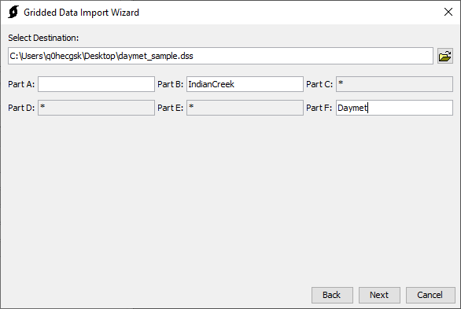
Step 4 - DSS Output Selection
Notes:
Finally, choose the destination for the data import. This can be an existing or a new HEC-DSS files. Then, specify the A, B, and F parts of the target DSS paths. The importer will automatically handle the C, D, and E parts based on the import data.

Slide 14
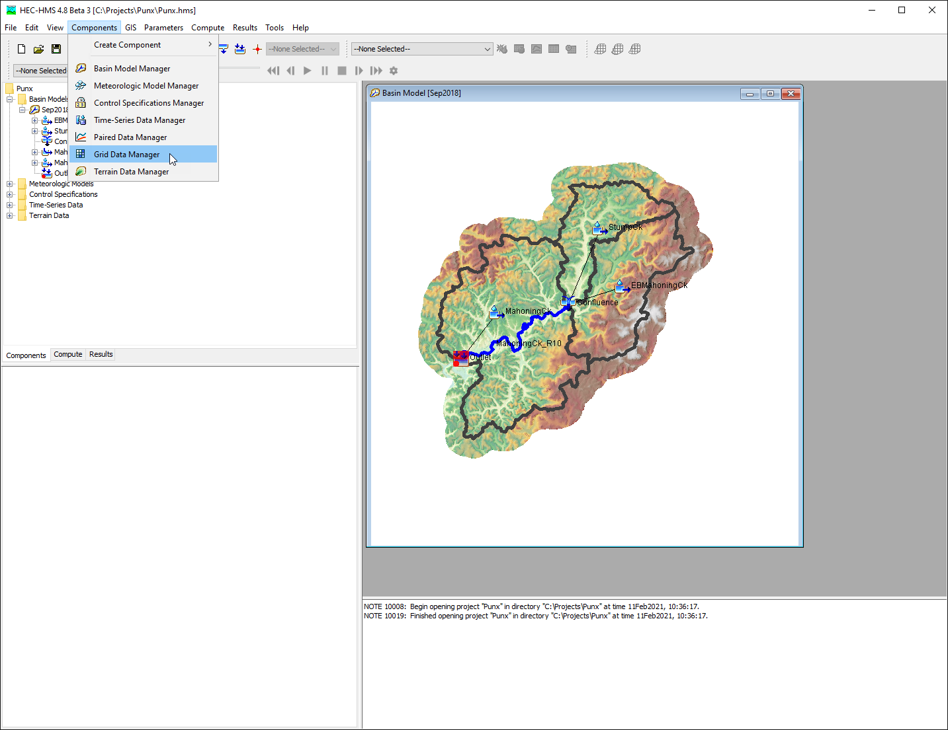
Add grid data in HEC-HMS
Notes:
Add a gridded data object in HEC-HMS to contain the gridded data.

Slide 15
Link Up Data
Notes:
Finally, create a new grid data component and link it to the DSS file you just created.

Slide 16
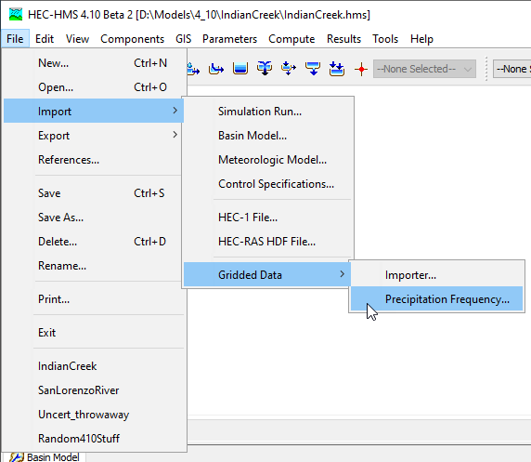
Precipitation-Frequency Importer

Slide 17
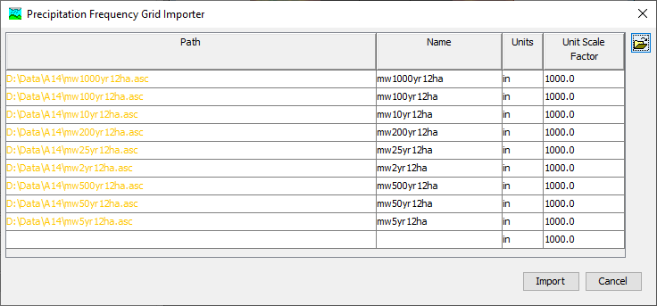
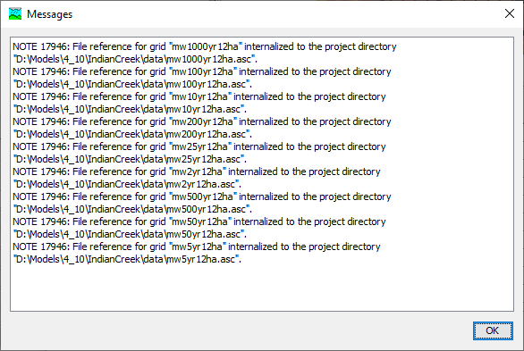
Precipitation-Frequency Importer

Slide 18
HEC-HMS
Shared Data Components
Grid Data
Gregory Karlovits, P.E., PH, CFM
USACE Hydrologic Engineering Center

