Slide 1


HEC-HMS
Calibration:
Parameter Impacts
Gregory Karlovits, P.E., PH, CFM
Hydrologic Engineering Center
U.S. Army Corps of Engineers
Notes:
Hello HMS modelers. I’m Greg Karlovits, senior hydraulic engineer at the US Army Corps of Engineers Hydrologic Engineering Center. In this video, we will go over the impacts of various hydrologic parameters using a controlled experiment, so you can get an idea of how they might influence your calibration.

Slide 2
Parameter Impacts
Deficit + constant loss rate
Clark unit hydrograph
Linear reservoir baseflow
Direct Runoff
Interflow
Baseflow
Notes:
We will investigate how changing the parameters for three of the model processes in a simple watershed model change the response of the output hydrograph.
The model we are testing is capturing three processes – direct runoff, interflow, and baseflow. The loss process partitions the incoming precipitation into direct runoff or sends it to interflow and baseflow. We can control that behavior by changing the loss parameters.
The shape of the direct runoff hydrograph at the outlet of the watershed is controlled by the unit hydrograph transform parameters.
For the water sent to baseflow, some of it responds slower than direct runoff, but faster than baseflow. This is interflow, which is water flowing in the unsaturated portion of the ground. Its response can be controlled with a layer of a linear reservoir.
The remainder of the water is sent to baseflow, which is the slowest responding portion of this model. It is also modeled with a layer of a linear reservoir.

Slide 3
Experimental Control
SCS type II storm
5 inches point depth
1 mi² subbasin
Initial deficit 1 in, constant rate 0.1 in hr⁻¹
T_{c} 1 hr, R 1 hr
Baseflow K₁ 30 hr, K₂ 100 hr
Notes:
This experiment gives us a well-behaved single peak hydrograph that is dominated by direct runoff. The values for these parameters are made up but are not unrealistic.
The experiment will vary parameters by taking half or double their baseline value, one a time.
We start with an SCS storm, which is a design storm time pattern that will give us a single-peaked hydrograph. The five inch point depth ensures that this event will generate direct runoff.
The area only affects the magnitude of the results, so we can give it an arbitrary area of one square mile.
The remainder of the parameters have been selected so that they are easy to alter.

Slide 4
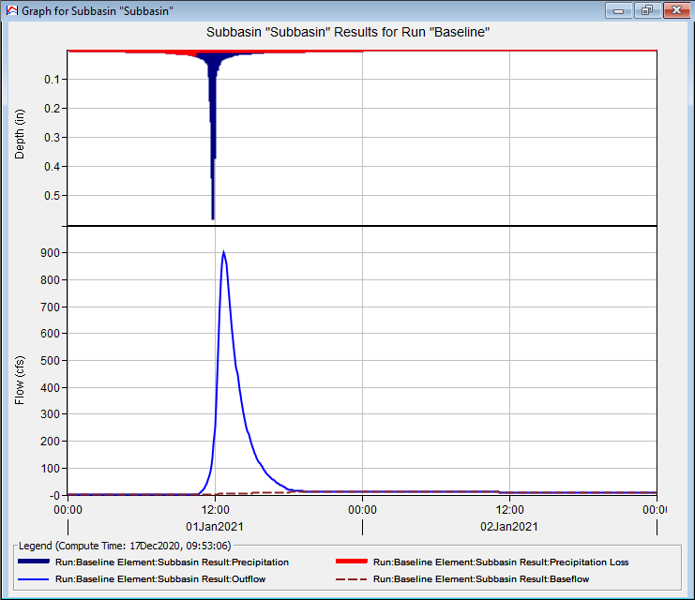
Baseline
Notes:
Here is the result of running the experimental control. The output hydrograph will be used as an observed data time series for the subbasin element we are simulating. This view of the subbasin result allows us to look at the behavior of the loss parameters on the input hyetograph on the top, as well as the output hydrograph, which shows both the total outflow hydrograph, as well as the baseflow contribution.

Slide 5
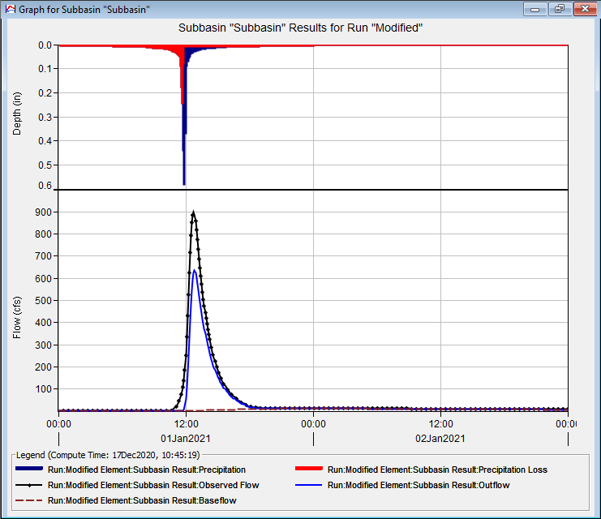
Initial Deficit Doubled
Notes:
The first result shows the change that occurs when the initial deficit is doubled. Note on top how much of the hyetograph is now lost in the red portion of the top graph. The impact of this can be seen below – the baseline is shown in black, with the new hydrograph in blue. Overall, volume and peak intensity have decreased. The volume comes off of the early part of the hydrograph.

Slide 6
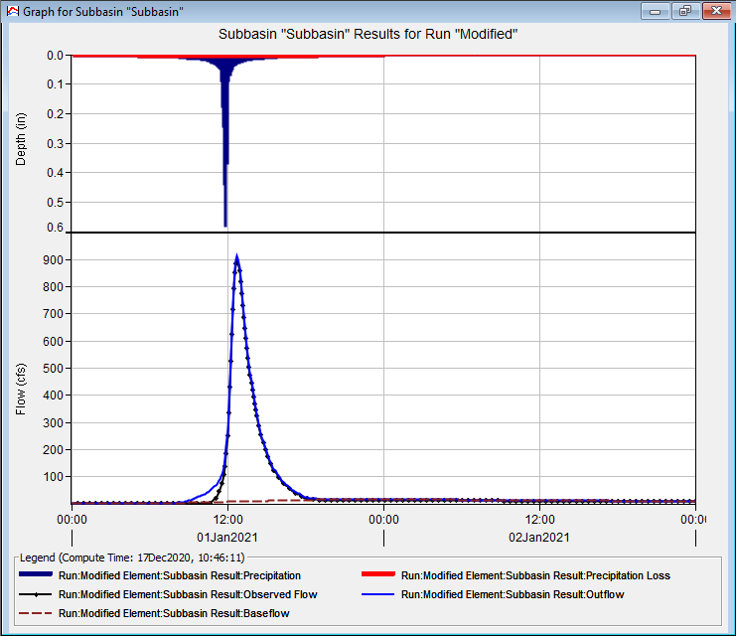
Initial Deficit Halved
Notes:
Reducing the initial deficit mainly changes what happens in the early portion of the hydrograph. Notice that the hydrograph begins ascending earlier when the initial deficit is lower. This has the impact of increasing the volume of the hydrograph and slightly increasing the peak discharge.

Slide 7
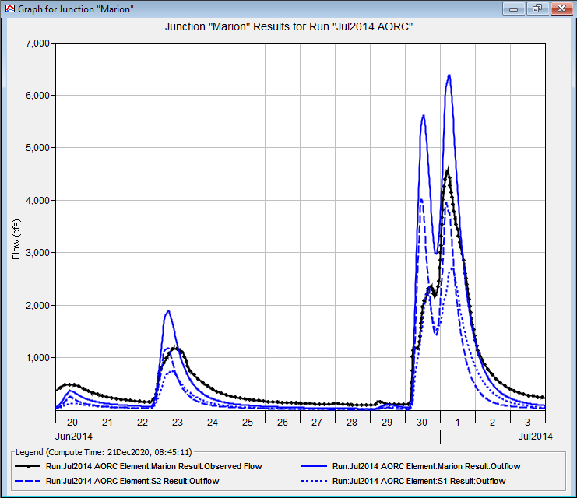
When to Change Initial Deficit?
Volume is off-target
Adjust early part of hydrograph
Include/exclude antecedent events
Notes:
The initial deficit is also important when the input rainfall is not as simple as this experimental case. Often there will be small rainfall inputs prior to the main event of interest and controlling whether those produce runoff or not, and the magnitude of their runoff, will often be determined by the initial deficit value. Initial deficit is only going to be important for the initial events in a simulation, and will not have impacts on later hydrographs in a longer simulation.

Slide 8
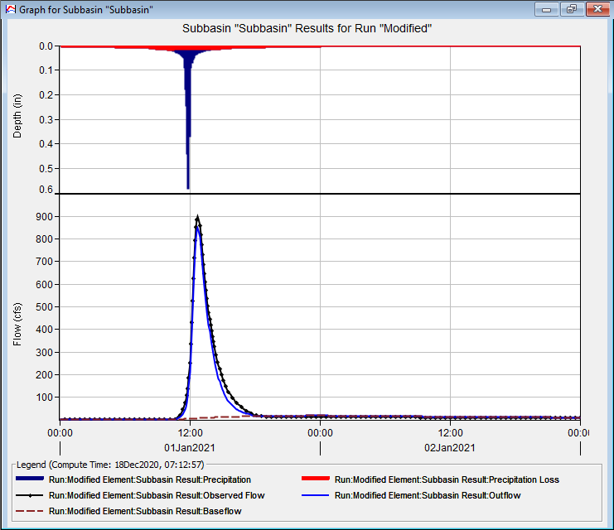
Constant Rate Doubled
Notes:
The constant rate is fundamental for calibration. It mainly controls the partition between direct runoff and baseflow. It has the effects of reducing the overall direct runoff volume, as well as the peak of the hydrograph. In this experiment the difference seems small because the output hydrograph is so dominated by direct runoff. When calibrating a case like this, the unit hydrograph parameters become very important.

Slide 9
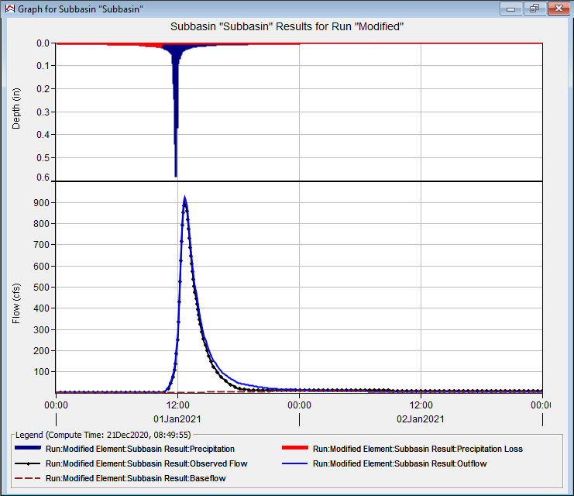
Constant Rate Halved
Notes:
Decreasing the constant rate has the opposite effect – generally increasing the direct runoff volume, and increasing the peak of the hydrograph. Again, in this case, direct runoff is dominating so the effect is small.

Slide 10
When to Change Constant Rate?
Volume is off-target
Adjust peak runoff
Adjust contribution of direct runoff vs. baseflow
Notes:
Constant rate is going to be the most important factor in adjusting where the volume of water goes. If you are finding that your model response is generally much too fast, and you are missing the receding limb of the hydrograph as it returns to baseflow by a lot, then changing the constant rate to send more water to baseflow is probably the solution. The converse is true as well. To get much more rapid, “flashy” response, then decreasing the constant rate allows the unit hydrograph parameters to control that faster response.

Slide 11
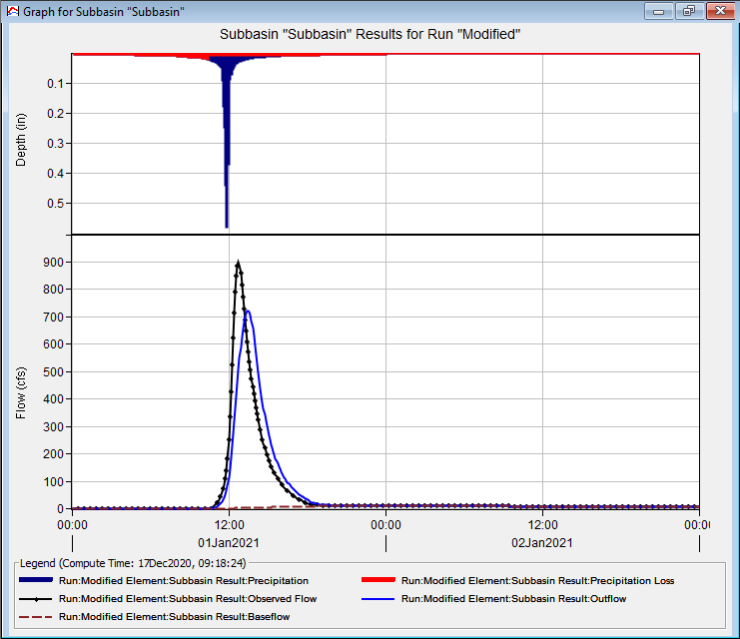
T_{c} doubled
Notes:
The Clark unit hydrograph has two parameters, the time of concentration, abbreviated T_{c} and storage coefficient R. T_{c} can be thought of as how long it takes for water to reach the outlet of the watershed from the most hydrologically distant point. This means it is mainly a timing parameter. Here you can see that if you increase T_{c}, the peak of the hydrograph is delayed. It is also reduced in magnitude. Increasing T_{c} translates the hydrograph slightly, but also induces some attenuation.

Slide 12
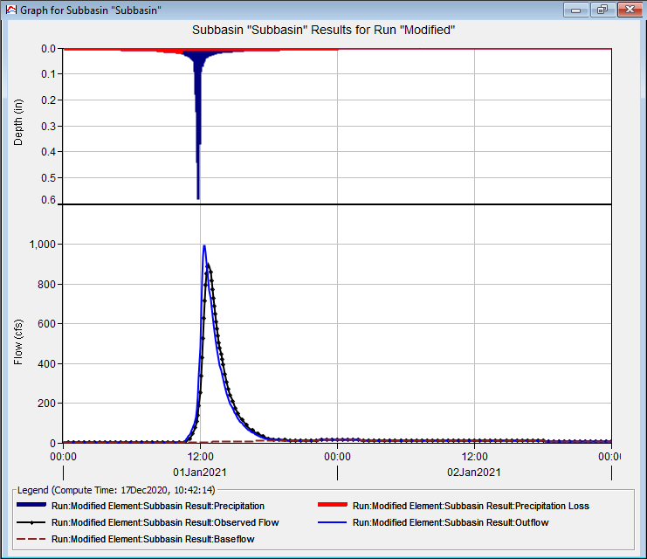
T_{c} halved
Notes:
On the other hand, shortening T_{c} shifts the hydrograph peak to the left and increases the peak magnitude. Watersheds that respond very rapidly to rainfall inputs tend to have small times of concentration and may have very “spiked” looking hydrographs such as the blue one in this figure.

Slide 13
When to Change T_{c}?
Direct runoff is most of the hydrograph
Adjust timing of peak
Adjust magnitude of peak
Notes:
Changes to time of concentration have the most impact when the hydrograph is dominated by direct runoff. Use T_{c} mainly to change the timing of the hydrograph peak. Small adjustments to the magnitude of the peak can be made with T_{c} as well.

Slide 14
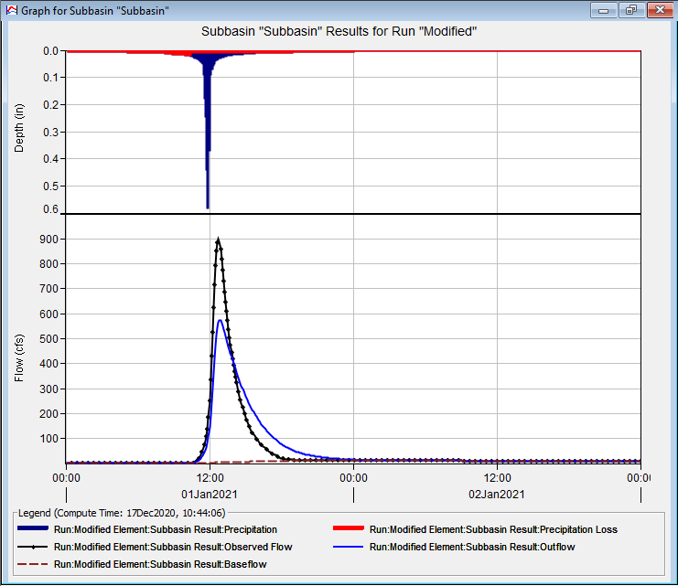
R doubled
Notes:
R has a tremendous amount of power in changing the shape of the response of direct runoff hydrographs. It does not change the timing of the response but does shape the attenuation. Note here with a doubling of R the peak magnitude drops, with the volume that occurred in the peak being pushed to the receding limb of the hydrograph.

Slide 15
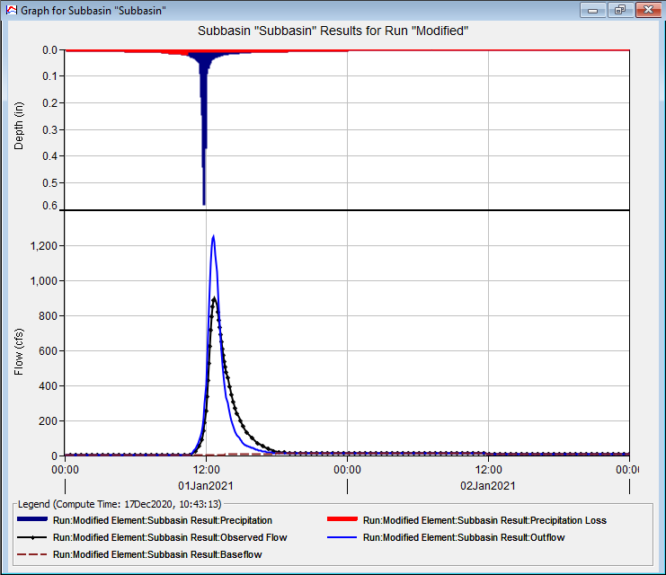
R halved
Notes:
On the other side of changes to R, a decrease causes an increase in the peak magnitude of the hydrograph by reducing attenuation. Much of the volume in the receding limb has been pushed into the peak. Shortening R allows you to model flashier watersheds.

Slide 16
When to Change R?
Direct runoff most of the hydrograph
Adjust overall peakedness of hydrograph
Adjust receding limb of direct runoff hydrograph
Notes:
R is a shape parameter, to contrast T_{c}, a timing parameter. Bear in mind that R and T_{c} are related. If your values for R and T_{c} head far in opposite directions from the initial estimates, then you might want to consider other kinds of adjustments. R is only going to have an impact if most of your hydrograph is generated by direct runoff, otherwise you will need to adjust baseflow instead.

Slide 17
Baseflow
Baseflow adjustments more important when direct runoff is small
Change the controls:
  Point depth reduced to 1 in
  Initial deficit reduced to 0 in
  Constant rate increased to 0.75 in hr⁻¹
  Longer simulation window
Notes:
To see the impacts of baseflow, we need to alter our experiment a little bit so that direct runoff doesn’t dominate the response. Here we will reduce the intensity of the storm event and allow most of the event to be infiltrated by increasing the loss parameter. To see the impacts of these changes, we will also need to run a longer simulation window.

Slide 18
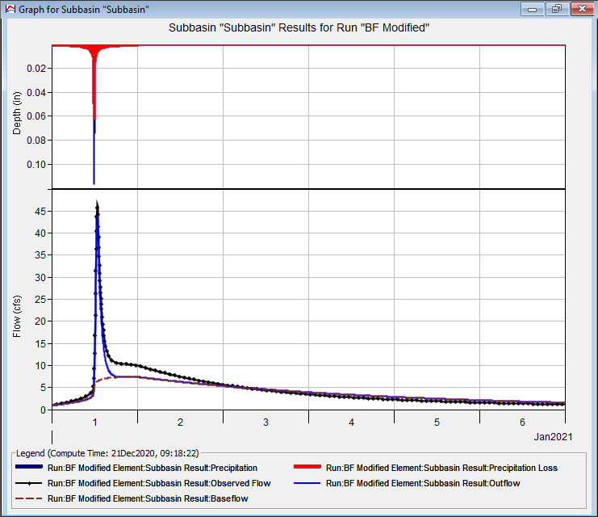
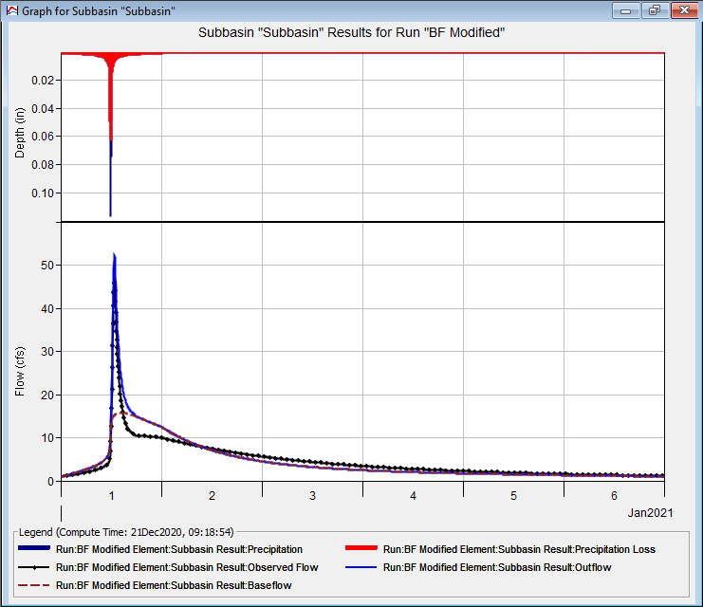
K₁ doubled
K₁ halved
Notes:
In our two-layer baseflow model, the first layer is being used to model the more rapid response of interflow. The response is still an order of magnitude slower than the direct runoff response, so it takes more time to see the impact of changing the coefficient.
Doubling the coefficient pushes a significant amount of the baseflow volume out into the long receding limb of the hydrograph. It also reduces the peak magnitude of the event hydrograph because of the slower response of the baseflow. Bear in mind that the losses occurring during the start of the rainfall event are going to baseflow, so the peak of the event can be affected when stacked on top of this changed baseflow response.
Halving the coefficient has the opposite effect – there is a much more rapid baseflow response, and because those initial losses are reaching the outlet faster, the hydrograph peak increases. Notice also that much of the baseflow volume occurs immediately after the peak of the direct runoff portion of the hydrograph, and the volume is lost from the long receding tail of the hydrograph.
For linear reservoir baseflow models with multiple layers, the lower layers generally are even slower and control the response shape on an even longer scale. They can be adjusted similarly, bearing in mind that the larger the coefficient relative to the length of the event, the less it will control the peak magnitude. It will however control how the event recedes.

Slide 19
When to Change Baseflow?
Need to match the recession speed
Watershed is interflow dominated
Notes:
Baseflow is mainly changed so that the receding limb of the hydrograph is matched. Usually this is taken as a sign that the overall baseflow response is captured adequately. However, in some watersheds, most of the response is controlled by interflow or baseflow. This occurs when overall rainfall intensities are low, although volumes may be large. This may also happen in conjunction with snowmelt. In these cases, the unit hydrograph parameters may exhibit little control and tuning the baseflow parameters will be more important.

Slide 20
HEC-HMS
Calibration
Parameter Impacts
Gregory Karlovits, P.E., PH, CFM
USACE Hydrologic Engineering Center
Notes:
This has been a discussion of the impacts of loss, transform, and baseflow parameters on calibrating an HEC-HMS model. For more information, please see the HMS user’s manual or tutorials and guides online, or other videos in this series. Thanks and have a great day!

