Slide 1
Running a simulation
Thomas Brauer, P.E.
Hydrologic Engineering Center
Notes:
Hi, this is Tom Brauer from the Hydrologic Engineering Center. This is the third and final video in a series of videos where I’m going to build a basic HEC-HMS model. In the first video I created a new project, and a basin model. In the second video I added precipitation gages and created a meteorologic model. In this video I’m going to create a control specification and compute a simulation run.

Slide 2
steps:
Create new Control Specification
Create Simulation Run
Compute the Simulation Run
View Results
Notes:
Here are the list of steps that we will take.

Slide 3
steps:
Create new Control Specification
Create Simulation Run
Compute the Simulation Run
View Results
Notes:
First we’ll create a new control specification.

Slide 4
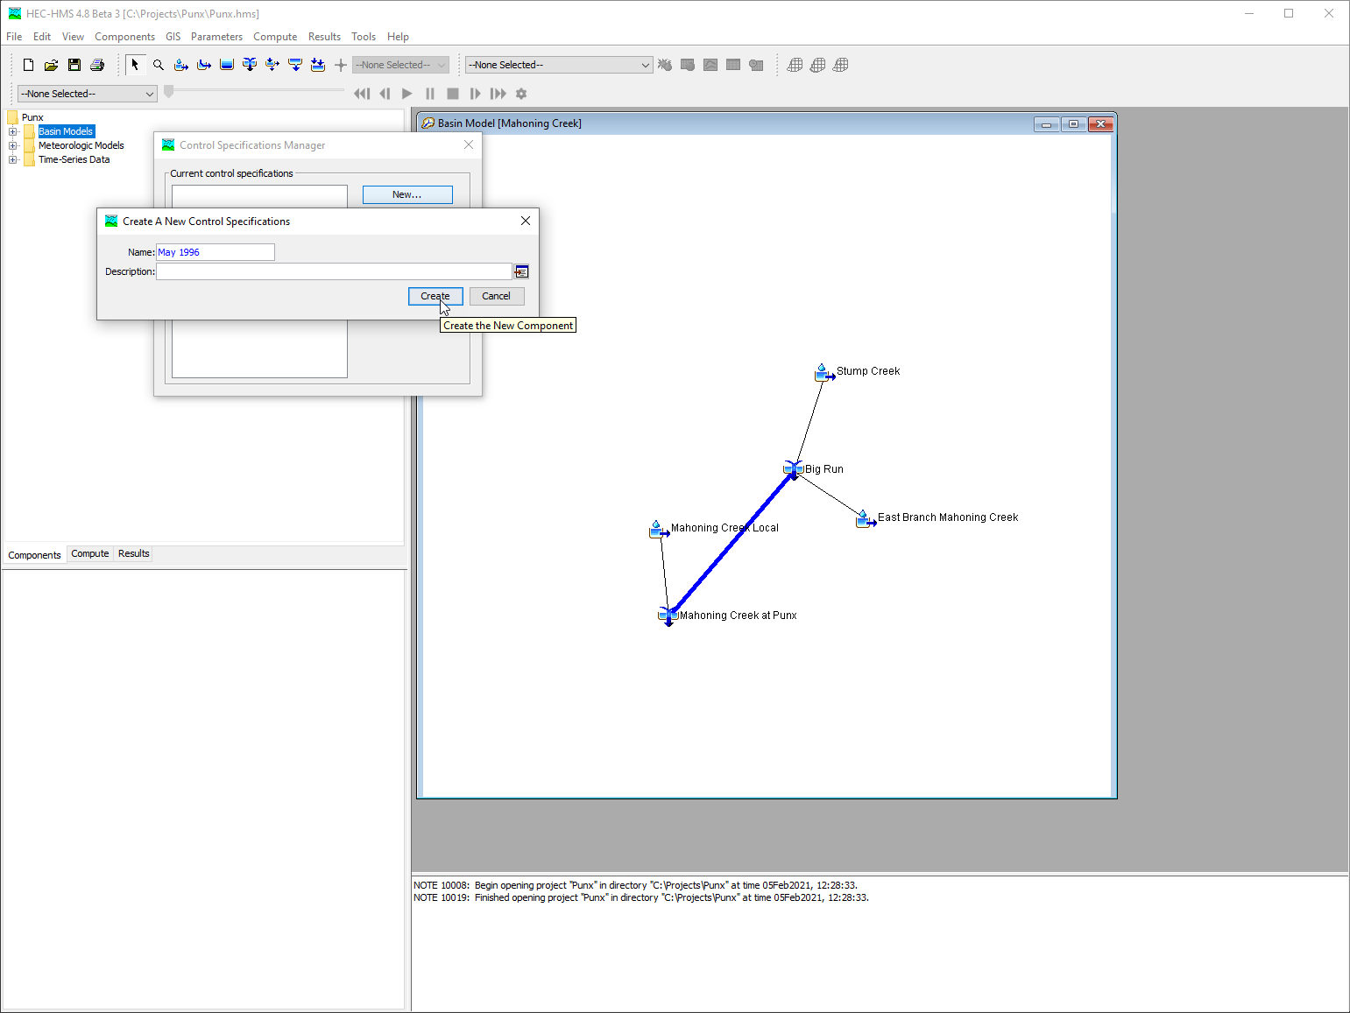
Create control specification
Notes:
Control Specifications define the temporal resolution and extent of a simuation. To create a new control specification, select Components | Control Specifications Manager. In the Control Specifications Manger select New. Name the control specification after the event being modeled. Navigate to the Control Specification in the watershed explorer. Parameterize the control specification in the component editor.

Slide 5
steps:
Create new Control Specification
Create Simulation Run
Compute the Simulation Run
View Results
Notes:
Next I’m going to create a simulation run.

Slide 6
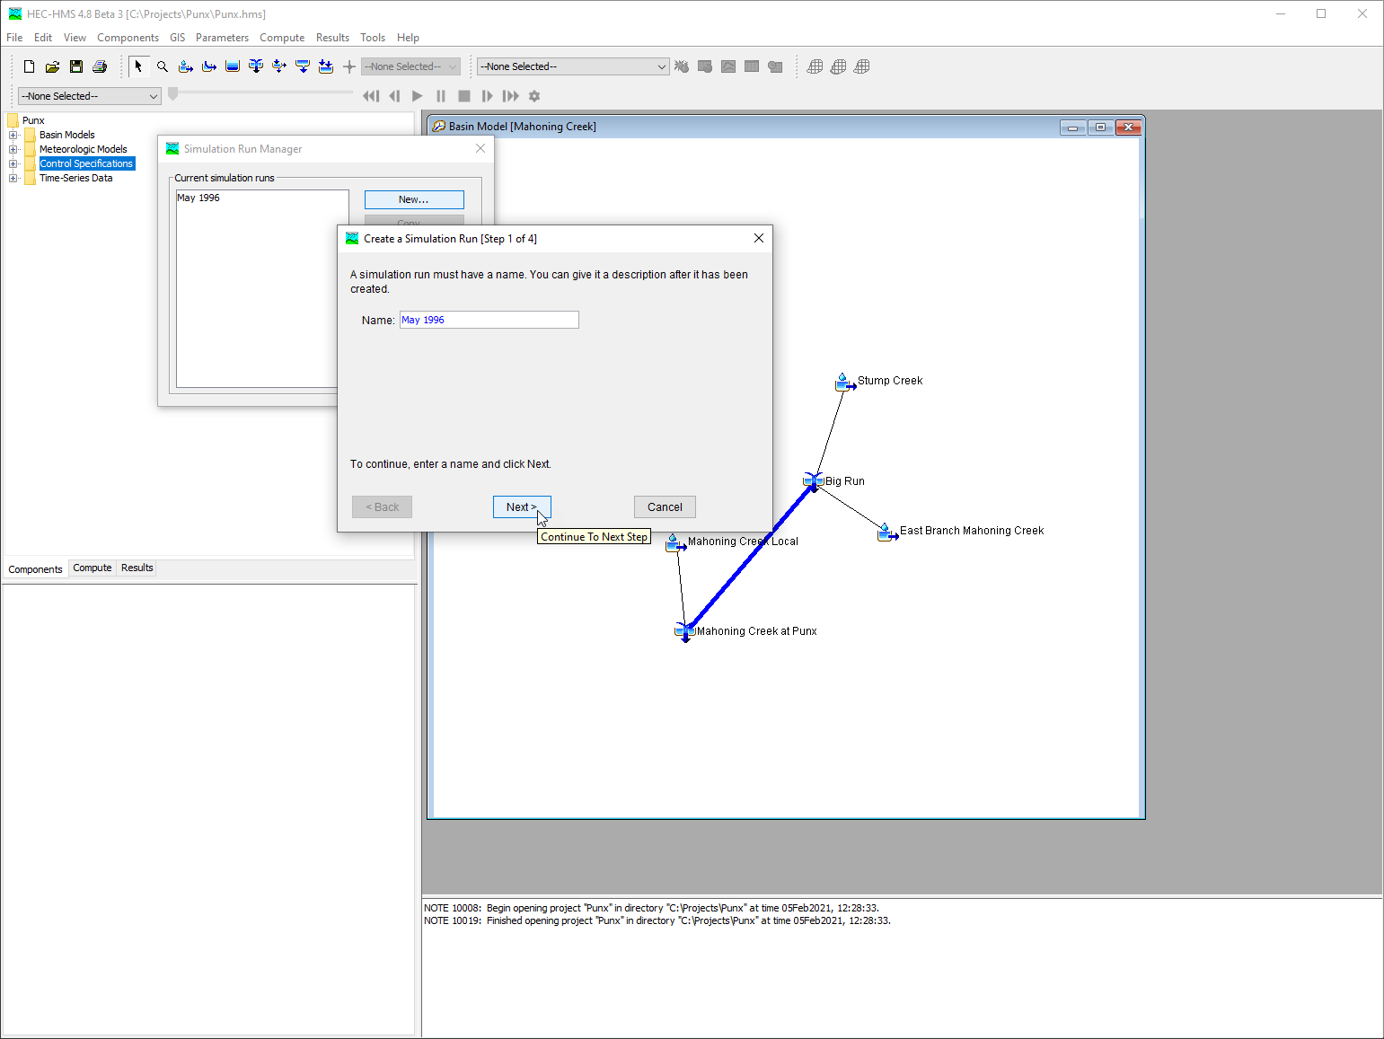
Create a simulation run
Notes:
A simulation run is the combination of a basin model, a meteorologic model, and a control specification. To create a simulation run select Compute | Simulation Run Manager. In the Simulation Run Manager select New. Name the simuation run after the event being modeled. Select a basin model, a meteorologic model, and a control specification.

Slide 7
steps:
Create new Control Specification
Create Simulation Run
Compute the Simulation Run
View Results
Notes:
Now I’m going to compute the simulation run.

Slide 8
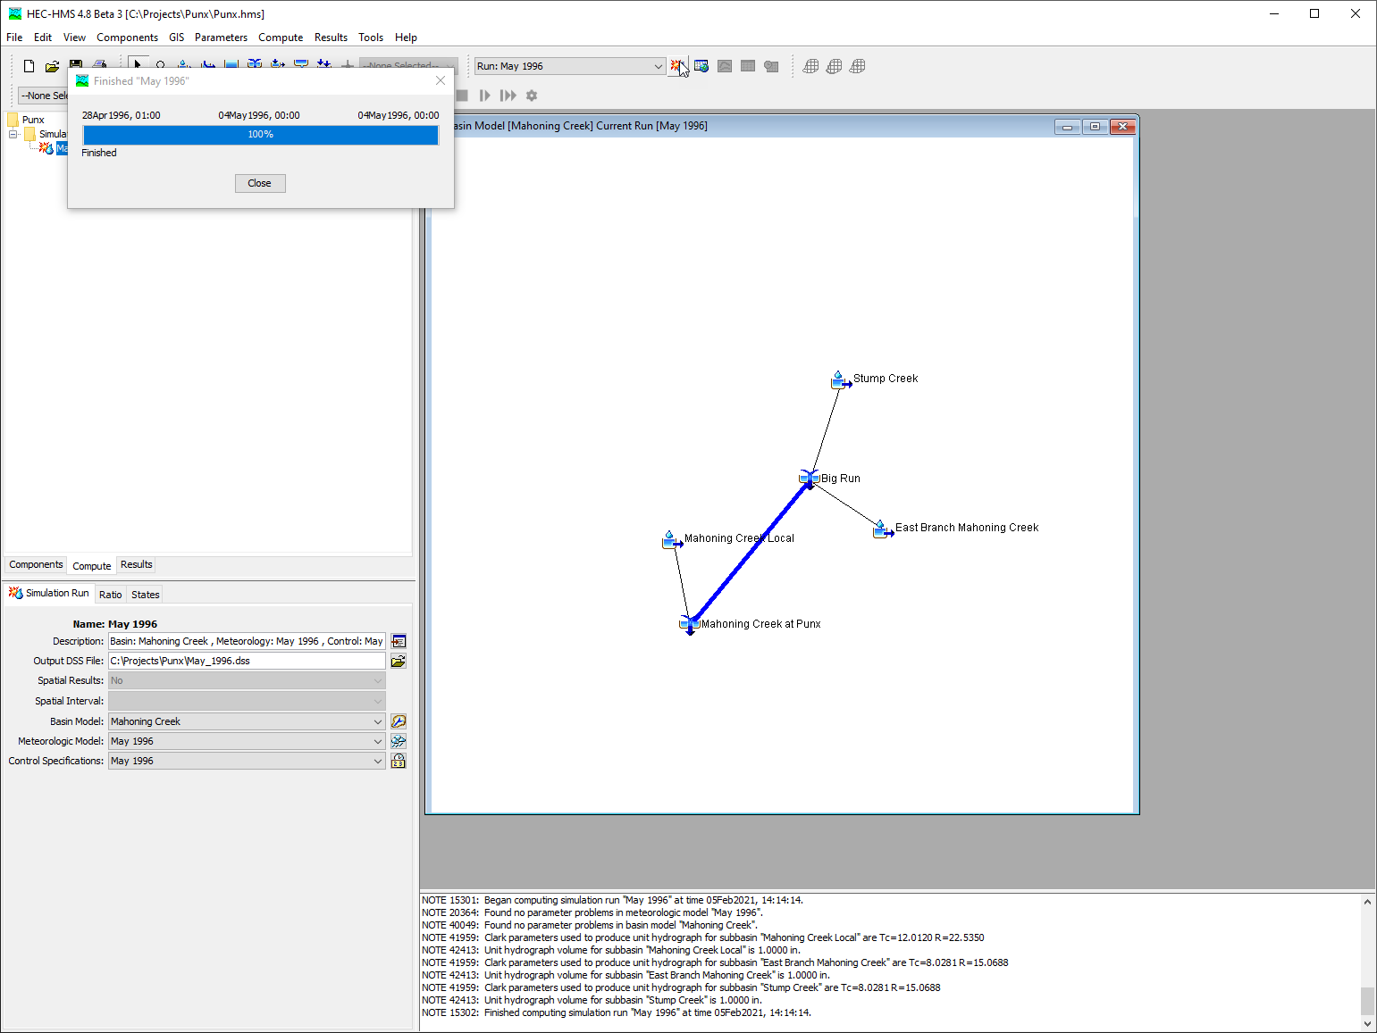
Compute the simulation
Notes:
There are several ways to compute the simulation run in HEC-HMS. The easiest is to select the simulation run in the compute toolbar, and click the compute button. If I have the simulation run selected I can also compute from the compute menu. Another option is to compute from the compute tab in the watershed explorer.

Slide 9
steps:
Create new Control Specification
Create Simulation Run
Compute the Simulation Run
View Results
Notes:
Now I’m going to view results.

Slide 10
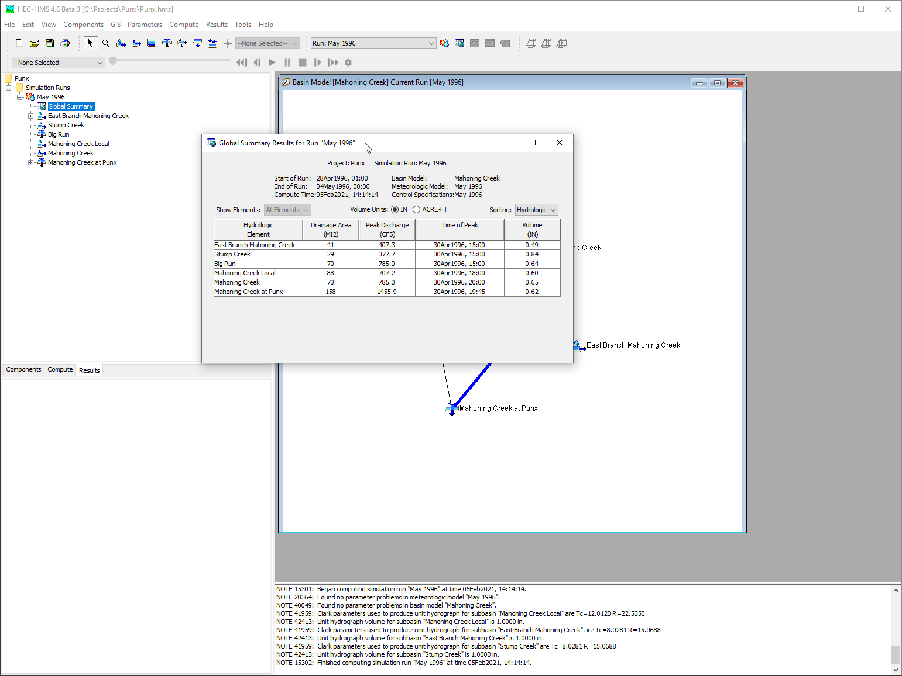
View Results
Notes:
There is an entire video dedicated to viewing results so refer to that video for more in depth coverage. In this video I’m going to navigate to the results tab of the watershed explorer. From the results tab I can access a global summary table, and element results.

Slide 11
steps:
Create new Control Specification
Create Simulation Run
Compute the Simulation Run
View Results
Notes:
This concludes the three video series on creating a basic HEC-HMS model. In the first video we created a new project, and a basin model, in the second video, we added precipitation gages and a meteorologic model, and in this video we created a control specification and computed a simulation run. Finally, we viewed the results from our simulation run.

Slide 12
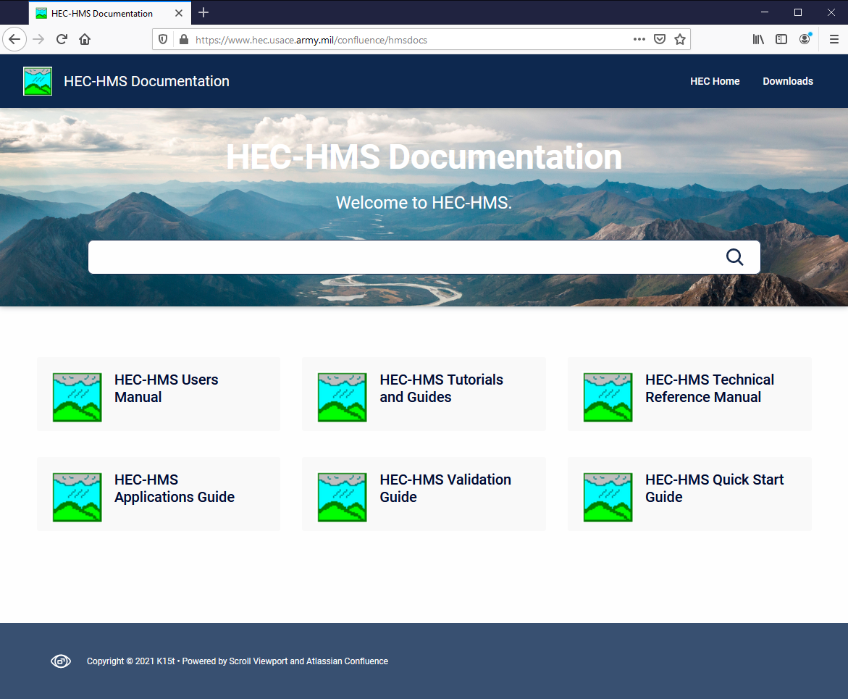
FOR MORE…
Notes:
For more resources on HEC-HMS check out the HEC-HMS documentation website.

