Slide 1
Viewing Results in HEC-HMS
Thomas Brauer, P.E.
Hydrologic Engineering Center
Notes:
Hi, this is Tom Brauer from the Hydrologic Engineering Center. In this video I’m going to go over some of the different result displays in HEC-HMS. I’ll also demonstrate different ways to access the results in the program. Finally, I’ll show how to access results from the backing HEC-DSS database.

Slide 2
Five Result Displays in HMS:
Global summary table
Element graph
Element summary table
Element time series
Spatial Results
Notes:
Here are the five result displays we’ll go over. The first is a global summary table. The next three are results displays for a single hydrologic element. Finally we’ll look at spatial results.

Slide 3
Five Result Displays in HMS:
Global summary table
Element graph
Element summary table
Element time series
Spatial Results
Notes:
First, the global summary table.

Slide 4
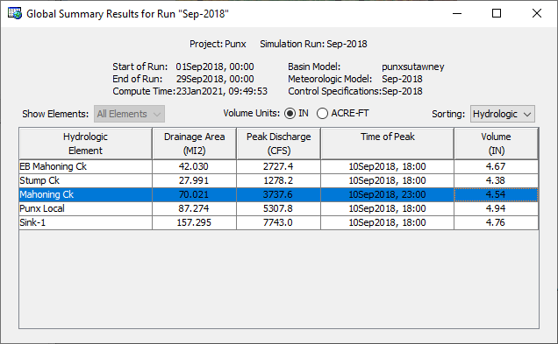
Notes:
The table includes one row for each element in the basin model and columns for element name, drainage area, peak flow, time of peak flow, and total outflow volume.
Results can be shown as a depth or a volume. Also, elements can be sorted in alphabetic or hydrologic order.

Slide 5
Five Result Displays in HMS:
Global summary table
Element graph
Element summary table
Element time series
Spatial Results
Notes:
Next, we will look at the element graph.

Slide 6
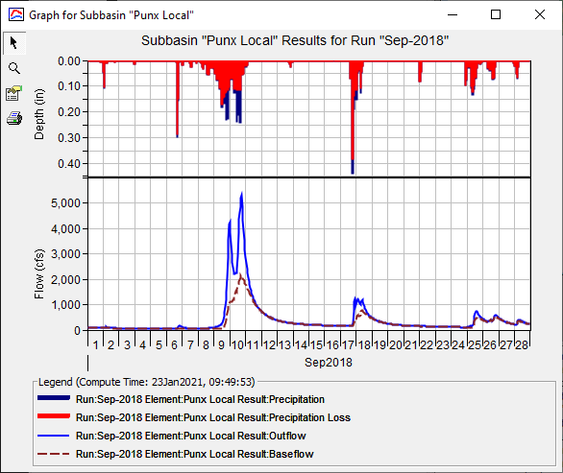
Notes:
The information included in the graph varies by element type, but always includes outflow. Optional items such as observed flow, computed stage, and observed stage are also included when present.

Slide 7
Five Result Displays in HMS:
Global summary table
Element graph
Element summary table
Element time series
Spatial Results
Notes:
Next, we’ll look at the element summary table.

Slide 8
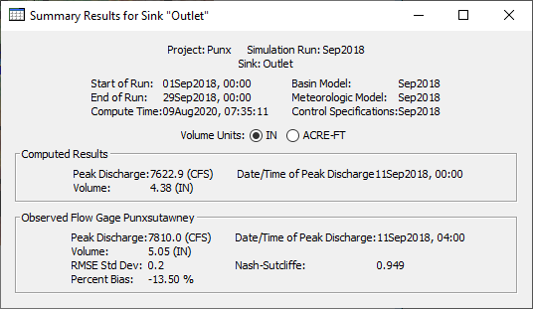
Notes:
The information included in the summary table varies by element type but always includes the peak flow, time of peak flow, and outflow volume. If observed data are available, then information about the observed data are presented, as well as goodness-of-fit statistics which describe the degree of agreement between the simulated time-series and the observed data.
Results can be shown as a depth or a volume.

Slide 9
Five Result Displays in HMS:
Global summary table
Element graph
Element summary table
Element time series
Spatial Results
Notes:
Next, we will look at the element time-series.

Slide 10
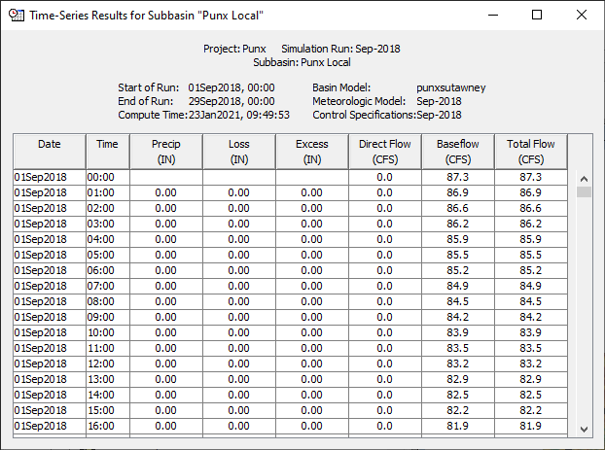
Notes:
The time-series table includes the same information as the graph but in numerical format. Data from the table can be copied to the clipboard and pasted wherever.

Slide 11
Five Result Displays in HMS:
Global summary table
Element graph
Element summary table
Element time series
Spatial Results
Notes:
Finally, let’s look at the spatial result display.

Slide 12
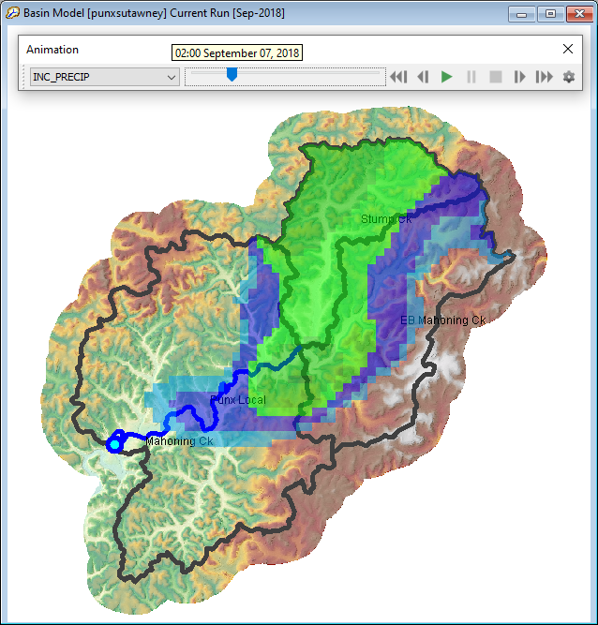
Notes:
Spatial results give a spatial representation of select variables from a compute. Currently a single spatial variable can be viewed at a time. You can pause and step through the simulation frame-by-frame or playback the simulation in a continuous loop.
For spatial variables to appear in the animation toolbar, spatial results must be turned on for the compute. More on that in the second part of this video.

Slide 13
Five WAYS to Access results in HMS:
Watershed explorer Results tab
Right-click option in basin map
Compute toolbar
Results menu
Animation Toolbar
Notes:
In this part of the video, I’m going to demonstrate five different ways to access results in HEC-HMS.

Slide 14
Five WAYS to Access results in HMS:
Watershed explorer Results tab
Right-click option in basin map
Compute toolbar
Results menu
Animation Toolbar
Notes:
The first way that I’ll demonstrate accessing results, is the Watershed explorer Results tab.

Slide 15
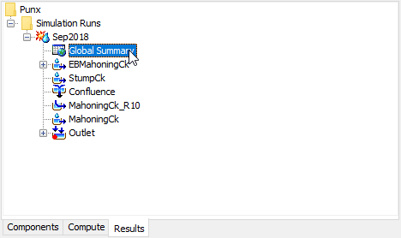

Slide 16
Five WAYS to Access results in HMS:
Watershed explorer Results tab
Right-click option in basin map
Compute toolbar
Results menu
Animation Toolbar
Notes:
The next way I’ll demonstrate accessing results, is from a right-click option in the Basin Map.

Slide 17
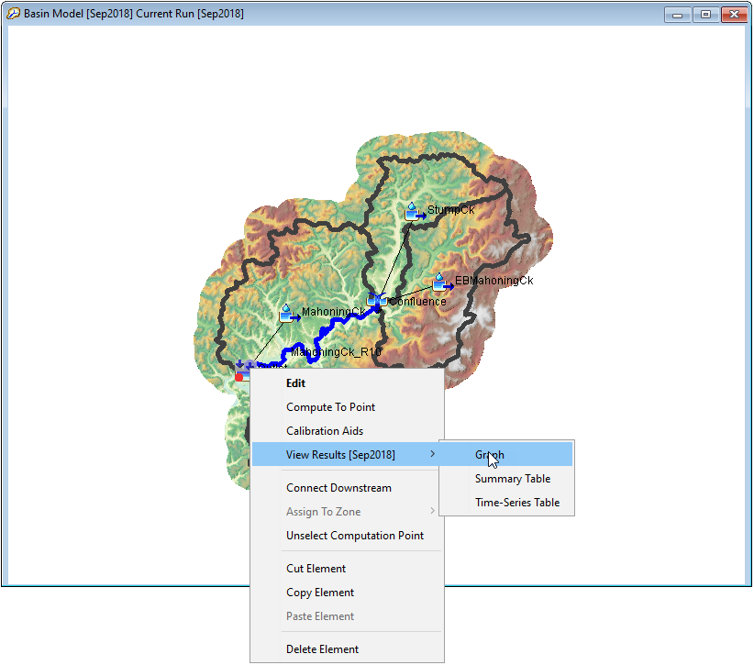

Slide 18
Five WAYS to Access results in HMS:
Watershed explorer Results tab
Right-click option in basin map
Compute toolbar
Results menu
Animation Toolbar
Notes:
The next way I’ll demonstrate accessing results, is from the compute toolbar.

Slide 19
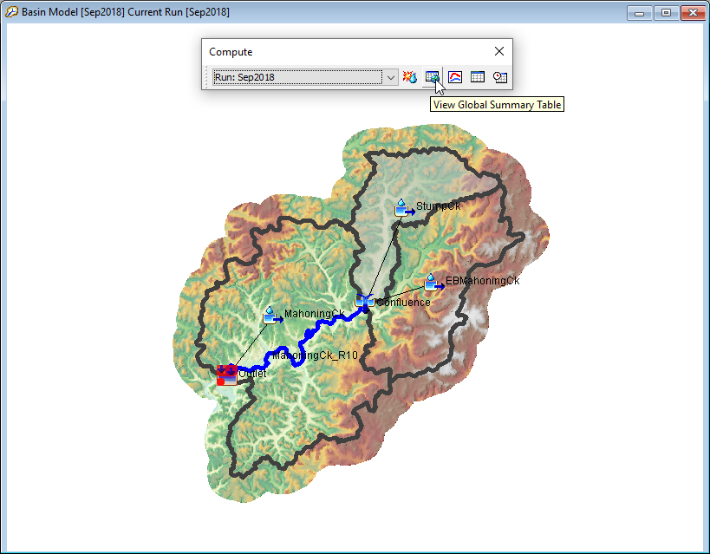

Slide 20
Five WAYS to Access results in HMS:
Watershed explorer Results tab
Right-click option in basin map
Compute toolbar
Results menu
Animation Toolbar
Notes:
The next way that I’ll demonstrate accessing results, is from the results menu.

Slide 21
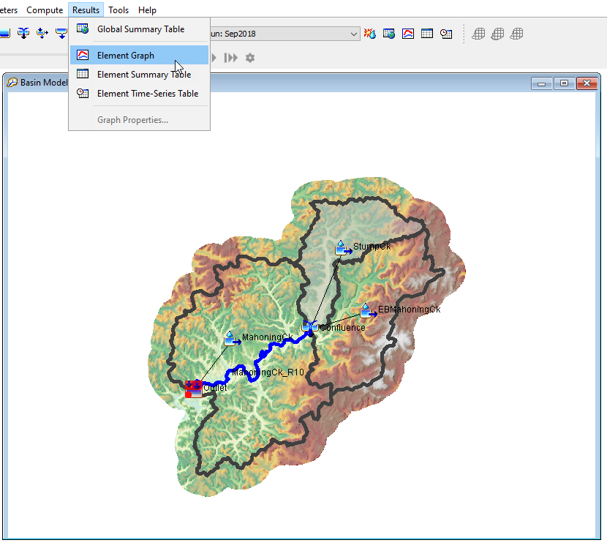

Slide 22
Five WAYS to Access results in HMS:
Watershed explorer Results tab
Right-click option in basin map
Compute toolbar
Results menu
Animation Toolbar
Notes:
Finally, now I’m going to show how to access spatial results from the animation toolbar.

Slide 23
Notes:
To view spatial results you must turn spatial results on in the compute component editor. You can optionally select a spatial results interval that is different from your computation time step.
You can use the animation toolbar to select the different spatial results available and step through each time step.

Slide 24
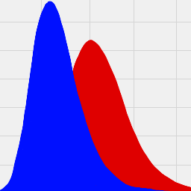
Accessing the results HEC-DSS file
Notes:
Finally, I’m going to demonstrate how to access results from the backing HEC-DSS database file.

Slide 25
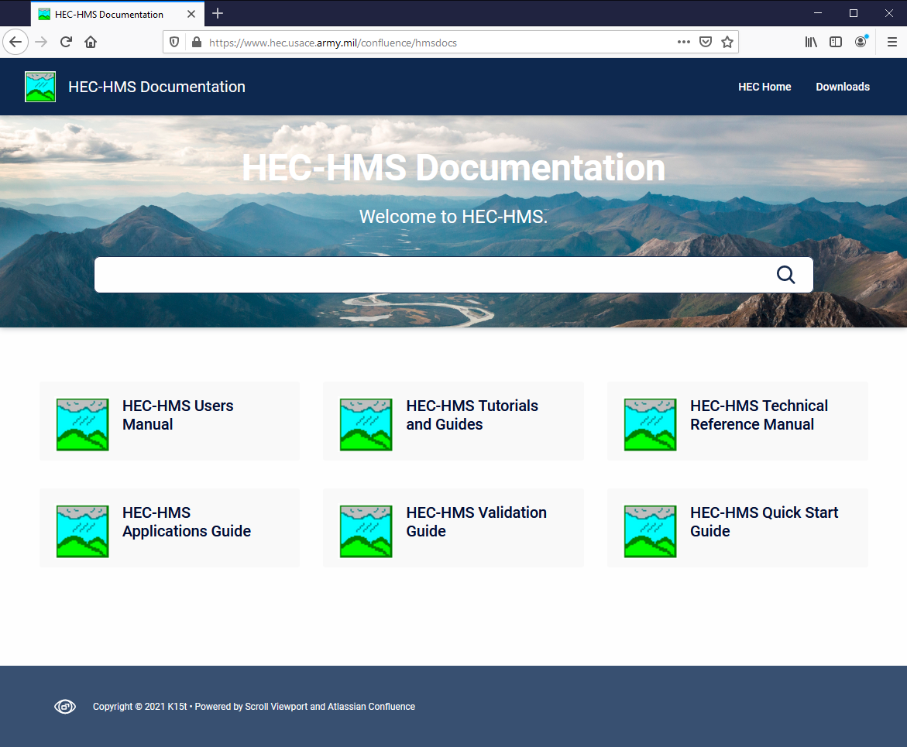
FOR MORE…
Notes:
This concludes the presentation on viewing results. For more resources on HEC-HMS check out the HEC-HMS documentation website.

