Slide 1
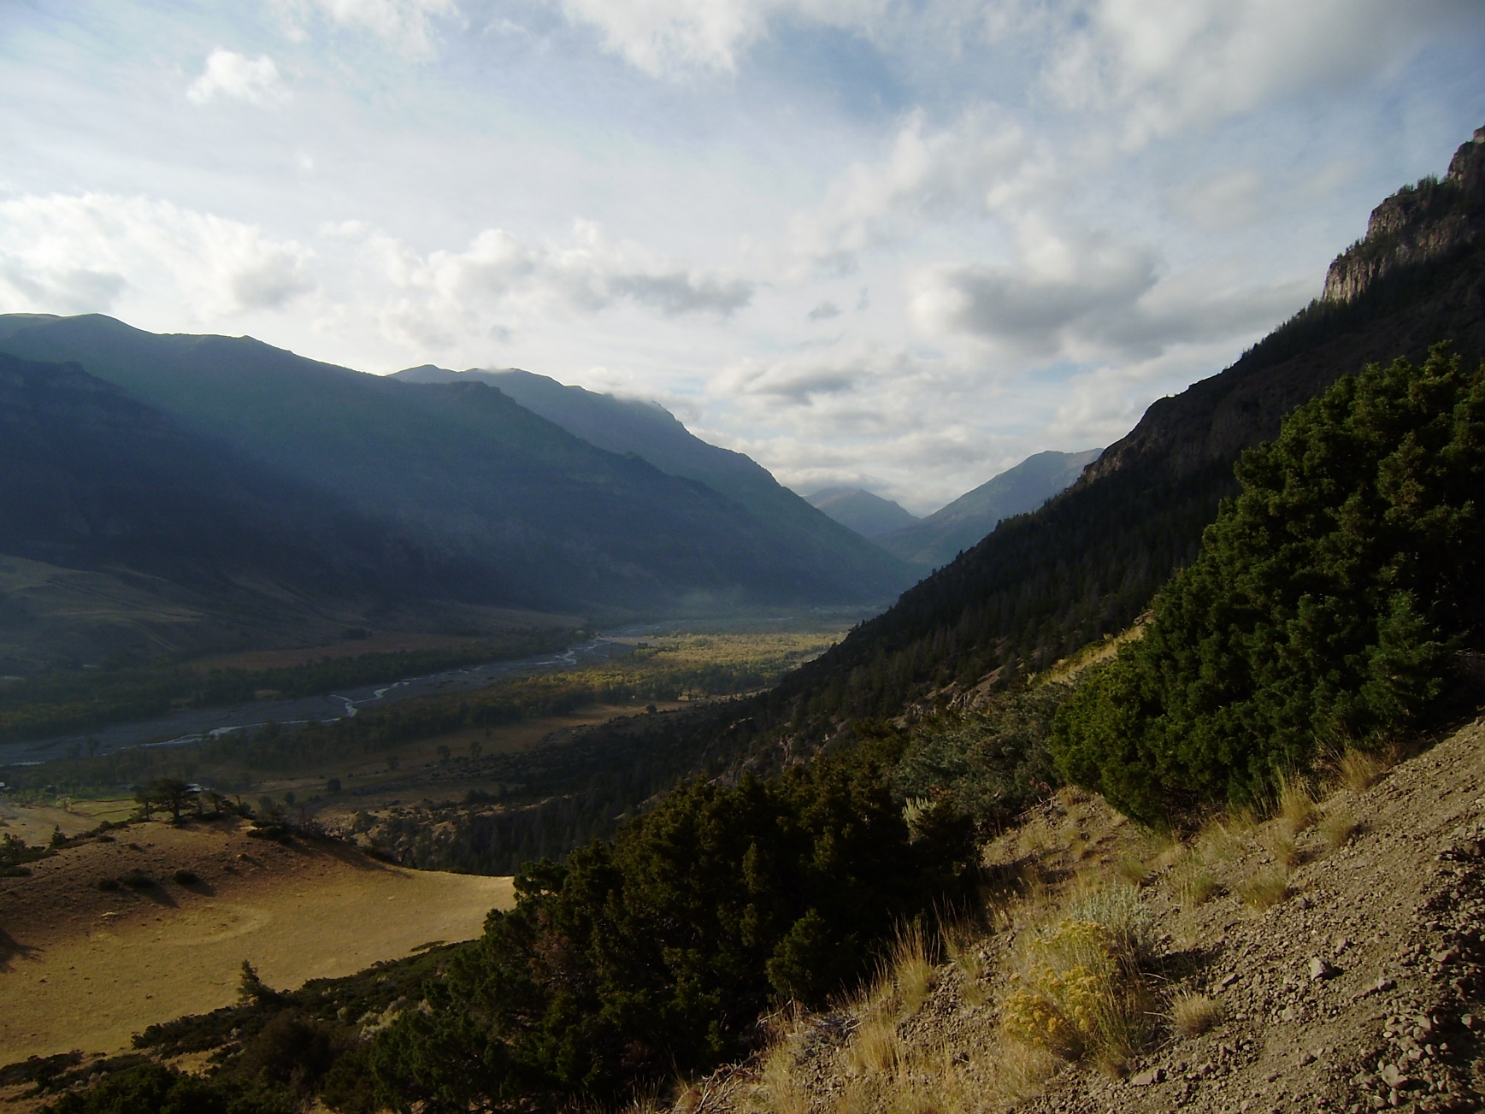
Deficit and Constant Method within HEC-HMS
Notes:
Hey HMS modelers, this is Mike Bartles from the Hydrologic Engineering Center.
In this video, we’re look at the deficit and constant loss method, which is pretty similar to initial and constant method that was discussed in the last video.

Slide 2
Objectives
Introduce the Deficit and Constant method
Discuss commonly used data sources and parameter estimation techniques
Summarize parameter calibration techniques
Present advantages and disadvantages
Notes:
By the end of this lecture, you should be familiar with the Deficit and Constant loss method.
We’ll look at an example computation, discuss common data sources, parameter estimation techniques, and calibration techniques.
At the end, we’ll finish by comparing advantages and disadvantages of this method.

Slide 3
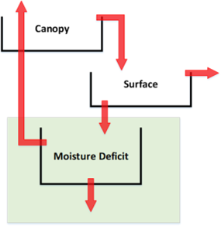
Deficit and Constant Loss Method
Keeps track of the moisture state using a simple 1-layer storage volume
Precipitation first satisfies the moisture deficit and then a constant loss rate is applied to remaining precipitation.
When ET is included, the moisture deficit will increase until a maximum value is reached.
Notes:
This method is similar to the initial and constant method in that an initial volume must be satisfied and, afterwards, any additional precipitation is lost at a constant rate. Anything that’s not infiltrated will become excess precipitation.
However, this method is capable of continuous simulation by accounting for the subbasin moisture deficit.
To do this, a maximum moisture deficit and evapotranspiration data are also required.
Evapotranspiration increases the subbasin moisture deficit during periods of no precipitation. In other words, evapotranspiration acts to dry out the soil.

Slide 4
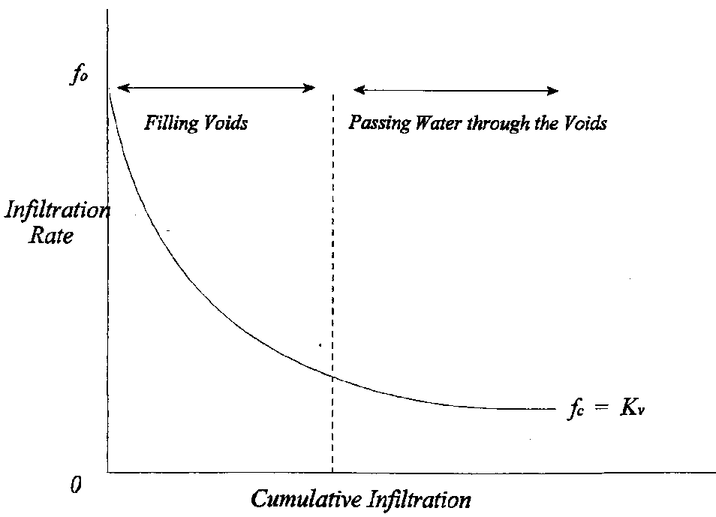
Deficit and Constant Loss Method
Initial Deficit
Constant Loss
Notes:
Recall again that infiltration has been shown to start an initially high rate and decrease exponentially towards an asymptotic limit called the saturated hydraulic conductivity.
When using the deficit and constant loss method, there’s only an initial loss volume, which is the green rectangle in this image, and a constant rate, which is the top of the red rectangle in this image, to recreate this exponential curve.
As such, just with like the initial constant method, you’ll typically over estimate infiltration rates at some times and underestimate it at other times in order to provide a good fit throughout the entire simulation time window.

Slide 5
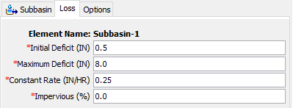
Example
Time | Precip (in) | Loss (in) | Excess (in)
0200 | 0.5 | 0.5 | 0.0
0300 | 0.5 | 0.25 | 0.25
0400 | 1.0 | 0.25 | 0.75
0500 | 0.5 | 0.25 | 0.25
0600 | 0.0 | 0.0 | 0.0
0700 | 0.0 | 0.0 | 0.0
0800 | 0.0 | 0.0 | 0.0
0900 | 0.0 | 0.0 | 0.0
1000 | 0.5 | 0.45 | 0.05
1100 | 0.5 | 0.25 | 0.25
1200 | 0.5 | 0.25 | 0.25
1300 | 0.5 | 0.25 | 0.25
1400 | 0.5 | 0.25 | 0.25
ET = 0.05 in/hr
Notes:
This method requires three parameters, an initial deficit, a maximum deficit, and a constant rate. A directly connected impervious area can also be specified. When a non-zero value for directly connected impervious area is specified, infiltration computations won’t be carried out on that portion of the subbasin or grid cells and all precipitation will become excess.
I should also mention that evapotranspiration is an optional meteorologic parameter as well. It doesn’t have to be used. Without it, this method functions exactly the same as the initial and constant method.
Now let’s step through an example computation.
In the first time step, half an inch of precipitation is lost to satisfy the initial deficit (animate).
In the next time step, another half inch of total precipitation fell and 0.25 inches of constant loss is applied resulting in 0.25 inches of excess (animate).
In the next time step, 1 inch of total precipitation fell, 0.25 inches of constant loss is applied, and 0.75 inches of excess results (animate).
In the next time step, a half inch of total precipitation fell, 0.25 inches of constant loss is applied, and 0.25 inches of excess results (animate).
Then, there’s a lull in precipitation. During this time, ET is applied which increases the moisture deficit by 0.05 inches per hour. Since it doesn’t rain for 4 hours, the moisture deficit reaches 0.2 inches by hour 10 (animate). A half inch of precipitation falls during this time step of which 0.2 inches goes to the moisture deficit and an additional 0.25 inches is lost to the constant rate. This results in 0.05 inches of excess.
For the remaining time steps, only the constant rate of 0.25 inches is in play.

Slide 6
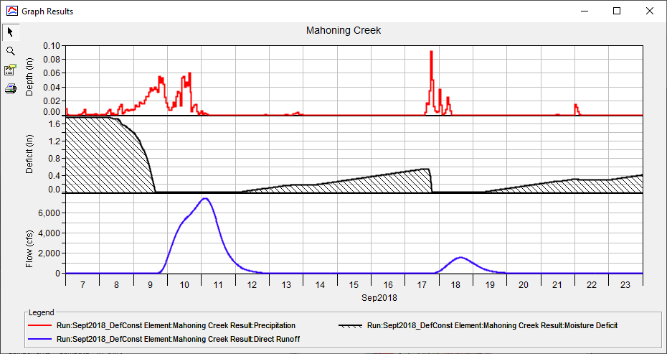
Example
Precipitation
Moisture Deficit
Direct Runoff
Notes:
This figure shows a different 2 week simulation using the deficit and constant loss method and highlights the continuous simulation capabilities that this method affords.
The top viewport shows precipitation in red, the middle viewport shows moisture deficit in black, and the bottom viewport shows direct runoff in blue.
Notice how the moisture deficit increases during periods of no precipitation and decreases when it rains.
Specifically, a half inch of moisture deficit is recovered by September 17th which must be satisfied before runoff initiates.

Slide 7
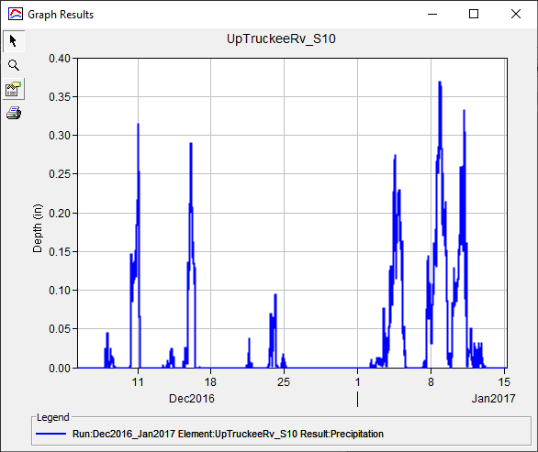
Parameter Estimation – Initial Deficit
Based upon antecedent conditions, evapotranspiration, and soil
Did it rain a day/week/month before the simulation start?
Start your simulation far enough back in time so initial conditions don’t affect results at the time of interest
Precipitation
Notes:
Now, let’s talk about parameter estimation for this method.
When estimating an appropriate initial deficit, you should scrutinize the prevailing antecedent conditions prior to the start of your simulation.
For instance, did it rain a week prior to the start, or has it not rained in several months?
But, when using this method, I like to start my simulations at times that are far away from my time period of interest such that initial conditions don’t matter.
Given reasonable evapotranspiration and a sensible maximum deficit, which I’ll talk about next, I can avoid spending too much time worrying about initial conditions with this method, which is nice.

Slide 8
Parameter Estimation – Maximum Deficit
The driest a soil can become under the influence of gravity, evaporation, and transpiration.
  Saturation storage minus wilting point storage
Get surficial texture from soils database
Relate texture to required parameters in literature values
Notes:
Now, for the maximum deficit.
Maximum deficit refers to the driest a soil can become after being drained by gravity, evaporation, and transpiration.
This parameter must be specified as an effective depth in either inches or millimeters.
Typically, maximum deficit is estimated as the difference between the saturation storage and the wilting point storage of a soil over an assumed active layer depth. I typically assume an active layer depth of 24 to 36 inches.
Saturation storage refers to the amount of moisture that can be held within a soil column when all air bubbles have been forced out. A soil’s effective porosity is a pretty good estimate of saturation storage.
Wilting point storage refers to the amount of water that is so tightly bound to soil particles that it cannot be evaporated or transpired. Technically, this parameter is defined as the water remaining within an initially saturated soil column when subjected to a sustained pressure of -15 bar (i.e. 217.5 pounds per square inch).
Like I’ve previously said, this parameter is best estimated using surficial texture from a soils database and related to literature values.

Slide 9
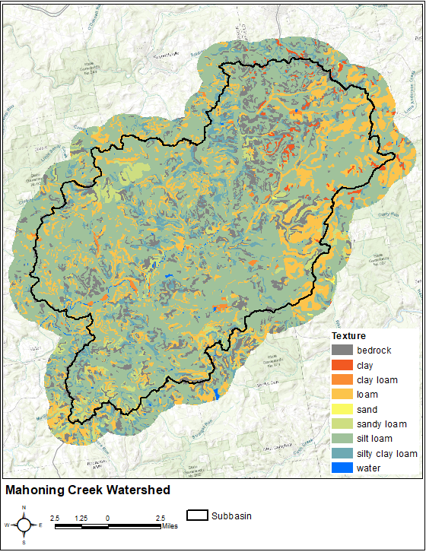
Parameter Estimation – Constant Rate
Get surficial texture from soils database
Relate texture to saturated hydraulic conductivity in literature values
Notes:
Similarly, the constant rate can be estimated by first extracting surficial textures from a soils database and relating them to published saturated hydraulic conductivity values for the predominant soils.
In this image, over half of the subbasin of interest is covered by silt loam. So, a decent place to start would be to use an estimate of saturated hydraulic conductivity for silt loam and begin calibrating from there.

Slide 10
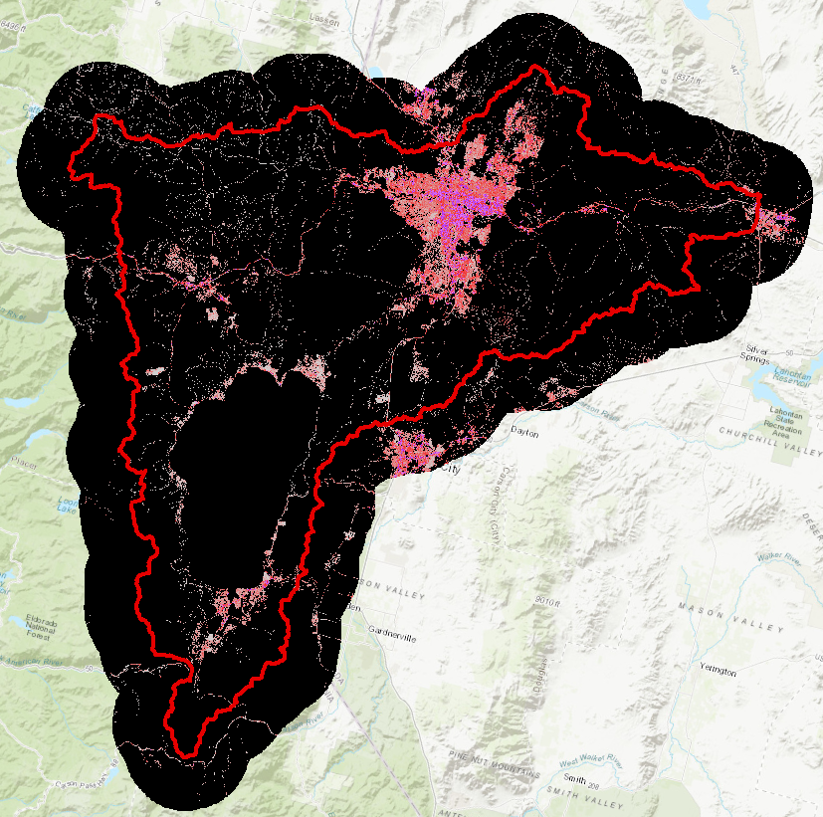
Parameter Estimation – Impervious Area
Estimate using GIS
National Land Cover Database (NLCD)
  NLCD 2016
Include large, standing water bodies
Notes:
Also, go ahead and estimate percent impervious area using a GIS source like the National Land Cover Database.
But, be sure to include large, standing water bodies in these estimates as rain falling directly onto a large lake or reservoir should not be subject to infiltration.

Slide 11
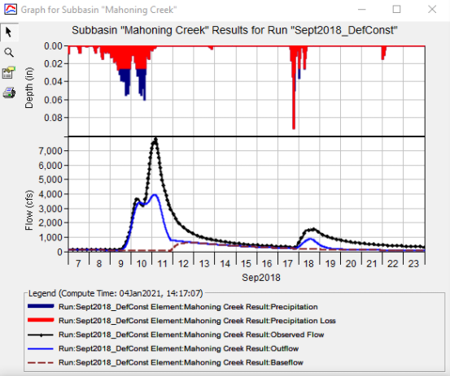
Calibration Techniques
Match initiation of runoff
Match observed runoff volume
Use multiple statistical metrics
  Nash-Sutcliffe Efficiency
  Root Mean Square Error
  Percent Bias
Notes:
Like I talked about in the Initial and Constant video, when calibrating the Deficit and Constant method, I like to start by modifying my initial parameter estimates until I get the initiation of runoff correct.
Specifically, I’m trying to match the time at which runoff starts to rise.
Then, I try to match the observed runoff volume.
In this example, observed flow is shown in black and computed flow is shown in blue.
I’ve matched the time of runoff initiation pretty well, but my the peak on Sep 10th isn’t matching the observed data. So, I need to decrease my constant loss rate.
As always, when calibrating, use multiple statistical metrics, like Nash-Sutcliffe Efficiency and percent bias to measure model performance as they compare your results from different perspectives and are better than the eyeball test.

Slide 12
Advantages
Similar to advantages of Initial and Constant method
  Mature method
  Easy to set up and use
  Parameters can be related to predominant soil textures
  Parsimonious
Method is scalable in that it allows for continuous simulation (but is not required for use).
Disadvantages
Similar to disadvantages of Initial and Constant method
  Difficult to apply to ungaged areas
  Method may be too simple
Notes:
The advantages of the Deficit and Constant method are similar to the Initial and Constant method in that it’s simple, it’s been used successfully many, many times, the required parameters can be easily estimated from observed data, and the method is parsimonious.
However, the Deficit and Constant method has an additional advantage in that it allows for infiltrated water to be extracted through evapotranspiration.

Slide 13
Review
Deficit and Constant method builds upon the of the Initial and Constant method
  Similar advantages and disadvantages
Can be used within long term simulations!
Parameters can be easily estimated
Next lecture will focus on Green and Ampt loss method within HEC-HMS
Notes:
In this video, I introduced the deficit and constant infiltration method, which is a great option to become familiar with.
This really is a good one to use for simulating infiltration. In fact I use it all the time on studies.
It’s quick to parameterize and calibrate. And it allows for continuous simulation.
In the next video, we’ll focus on the Green and Ampt loss method which is a more physically-based option and includes more dials to use when calibrating.
I’ll see you next time. Thanks for watching!

