Slide 1
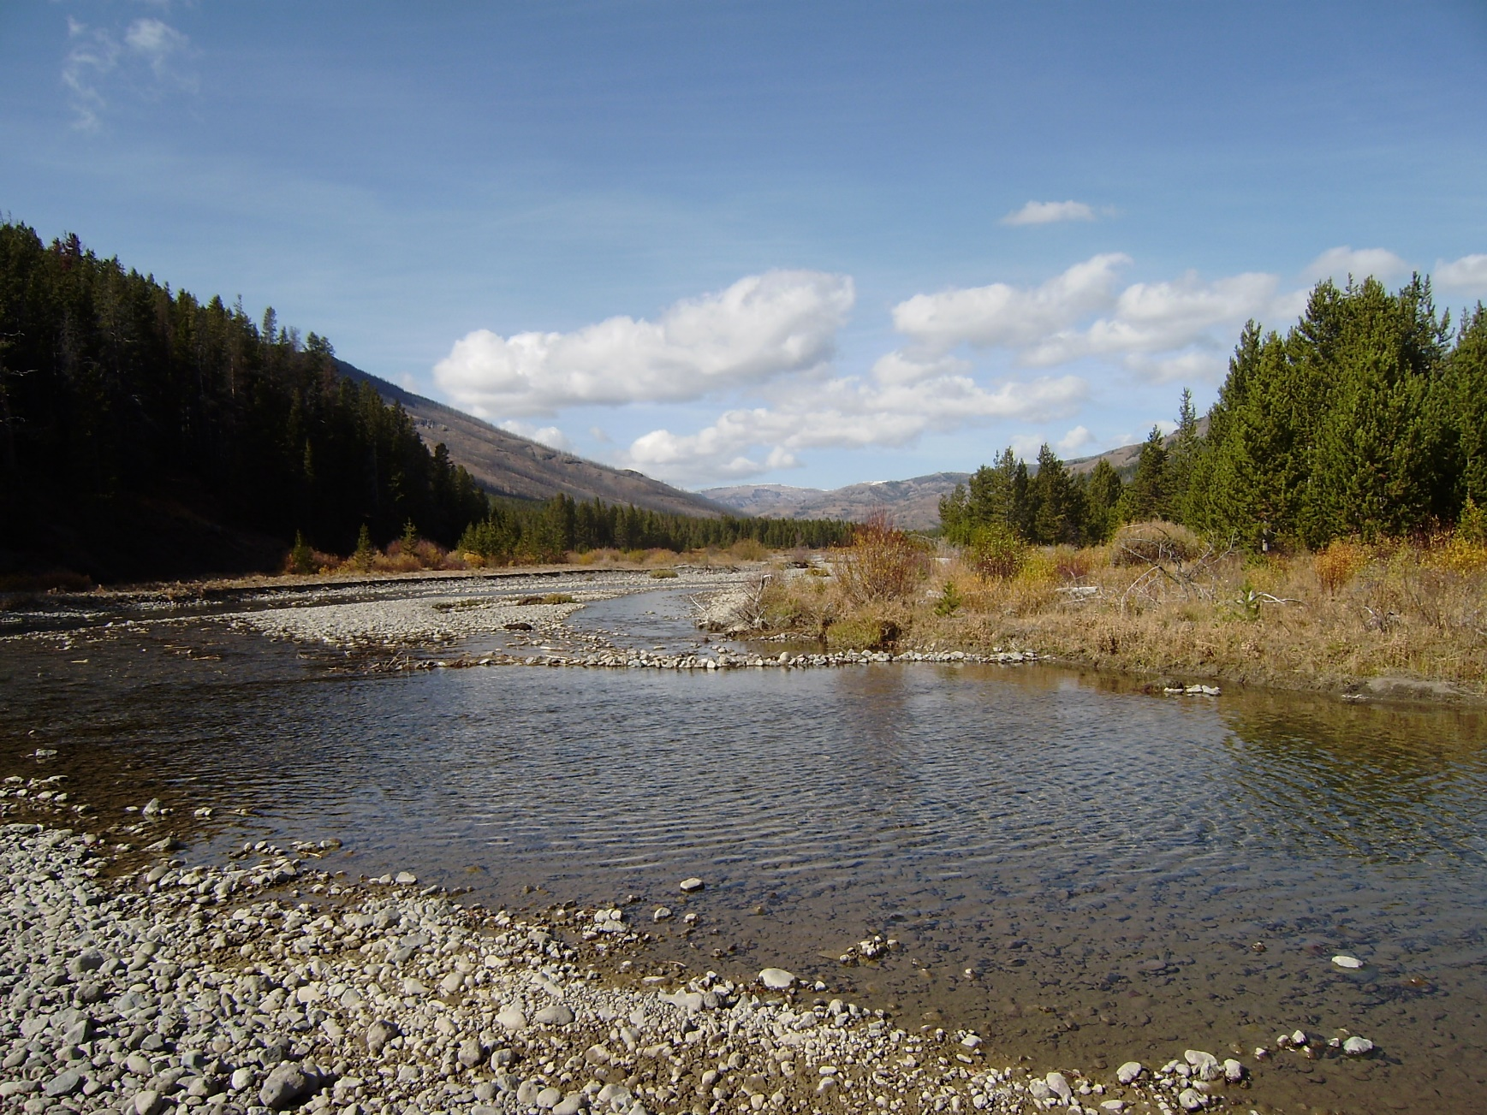
Lag Routing Method within HEC-HMS
Notes:
Hey HMS modelers, this is Mike Bartles from the Hydrologic Engineering Center.
In this video, I’m going to introduce the Lag method, which is the simplest routing method available within HEC-HMS.

Slide 2
Objectives
Introduce the Lag routing method
Present an example
Discuss common parameter estimation and calibration techniques
Present advantages and disadvantages
Notes:
By the end of this lecture, you should be familiar with the Lag routing method.
I’ll present an example computation, we’ll discuss common parameter estimation techniques, and calibration techniques.
Finally, we’ll finish up by comparing advantages and disadvantages when using this method.

Slide 3
Lag Method
Only represents translation
No attenuation effects
Notes:
As I stated previously, the Lag method is as simple as it gets with reach routing.
This method only represents translation.
You cannot attenuate an inflow hydrograph when using this method.

Slide 4

Equations of Motion
  Continuity:
  Momentum:
$$Inflow=Outflow$$
Notes:
Recall that all routing methods start with the equations of motion which includes conservation of mass and momentum.
The Lag method simplifies the continuity equation by setting inflow equal to outflow (animate). There’s no change in storage over time.
The momentum equation is also completely thrown out (animate).
These simplifications make the method ultra simple to parameterize and solve but they drastically limit it’s applicability.
In particular, the required parameter can’t be estimated from physical characteristics of the reach and attenuation isn’t possible when using this method.

Slide 5
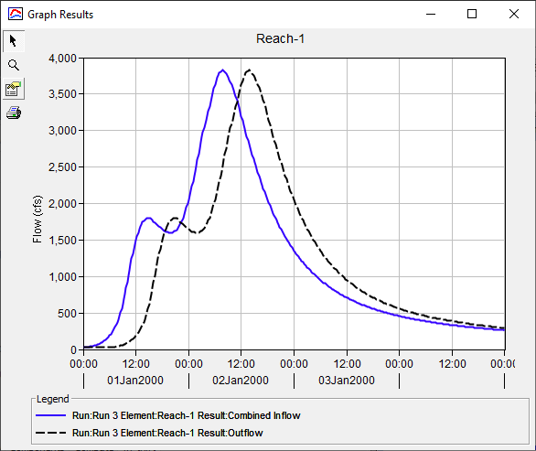
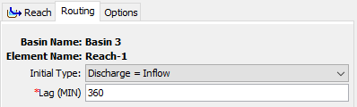
Example
 | Peak (cfs) | Time of Peak
Inflow | 3825 | 1/2/2000 7:45
Outflow | 3825 | 1/2/2000 13:45
Diff | 0 | 6.0 hrs
Notes:
This method requires an initial condition and one parameter: lag time. Lag time cannot vary throughout a simulation so this method cannot simulate variable translation.
This example shows how an inflow hydrograph, shown in blue, is translated and attenuated to produce the outflow hydrograph shown in black.
The inflow hydrograph is uniformly translated in time by 6 hours, which is controlled by, and equivalent to, the lag time parameter.
That’s it. There’s no attenuation or anything else. Just a simple translation.

Slide 6
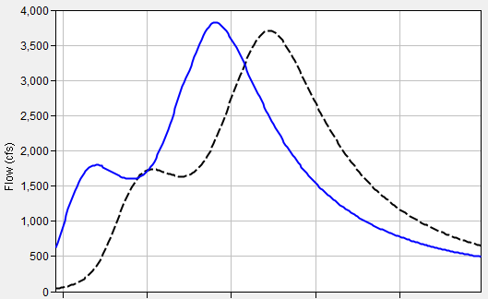
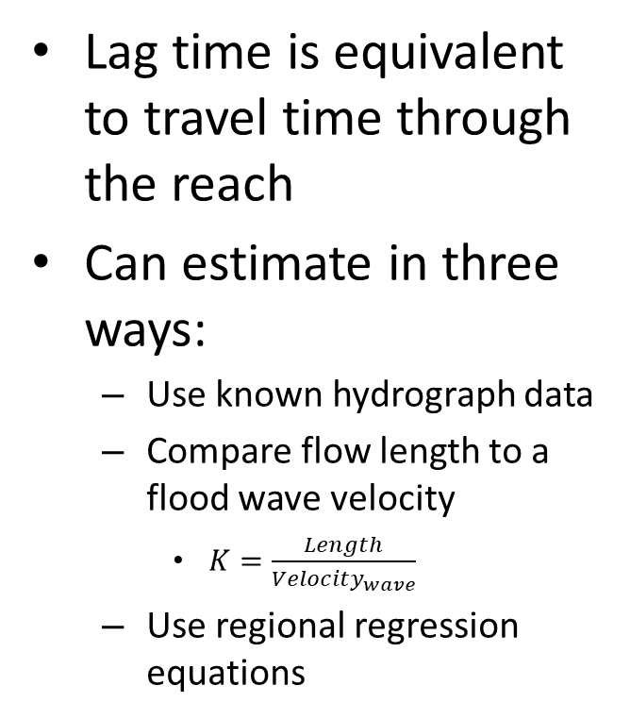
Parameter Estimation – Lag Time
Lag time is equivalent to travel time through the reach
Can estimate in three ways:
  Use known hydrograph data
  Compare flow length to a flood wave velocity
    $K=\frac{Length}{{Velocity}_{wave}}$
  Use regional regression equations
Notes:
When estimating an appropriate lag time, three approaches can be used.
The first approach uses observed data at the start and end of the reach to directly compute the travel time. This approach is depicted in the right-hand image. You can use the elapsed time between centroid of areas of the two hydrographs, between the hydrograph peaks, or between midpoints of the rising limbs. However, it’s usually a rare occurrence that observed data is available at both the upstream and downstream end of the reach, so this approach isn’t too common.
The second approach to estimate lag time uses a computed flood wave velocity and flow length to infer a travel time. Remember that a length divided by a velocity results in a time. This approach is more commonly used.
Finally, regression equations relating parameters like slope and length are available in some regions that can be used to estimate this parameter.

Slide 7
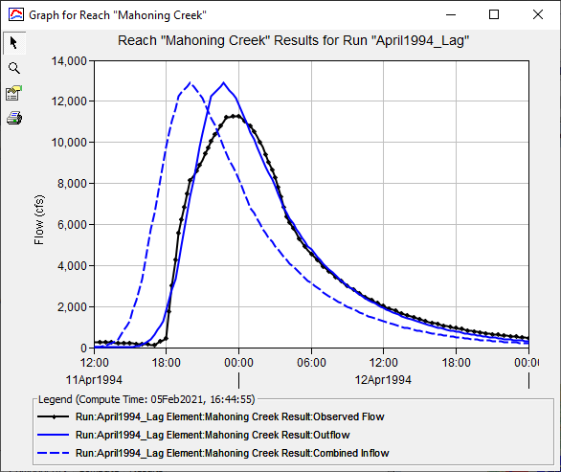
Calibration Techniques
Match rising limb of hydrograph
It the computed peak doesn’t match the observed peak, there’s not much you can do…
Use multiple statistical metrics
  Nash-Sutcliffe Efficiency
  Root Mean Square Error
  Percent Bias
Notes:
When calibrating the Lag method, you can only modify one parameter. Whether you want to align the peak flow rates or better match the rising limb, you’re kind of stuck.
In this example, observed flow is shown in black and computed flow is shown in solid blue.
I’ve matched the rising limb decently well, but my computed peak discharge is too high. But, I can’t do anything to reduce the peak, so that’s about as good as it gets with this method.
Remember to use multiple statistical metrics to gauge whether your model is accurate.

Slide 8
Advantages
Simple, parsimonious method.
Disadvantages
Method may be too simple; no attenuation effects are simulated by this method.
Parameters cannot be estimated using measurable channel characteristics.
Only appropriate for use in streams that experience no attenuation.
Cannot simulate backwater effects or impacts of hydraulic structures.
Notes:
The only advantage of this method is that it’s simple; there’s only one parameter to estimate. This also makes the method parsimonious.
However, it’s so simple that it’s only accurate in steep streams with little to no available storage.

Slide 9
Review
Lag method is the simplest routing method within HEC-HMS
Primary advantage (simplicity) is also its primary disadvantage
Next lecture will focus on Muskingum routing method within HEC-HMS
Notes:
In review, I introduced the Lag routing method.
This is the simplest routing method available within HEC-HMS.
However, it’s simplicity is also a disadvantage for complicated scenarios.
In the next video, we’ll delve into the Muskingum routing method, which has more complexities and is applicable to a wider range of scenarios, than the Lag method.
I’ll see you then. Thanks for watching!

