Slide 1
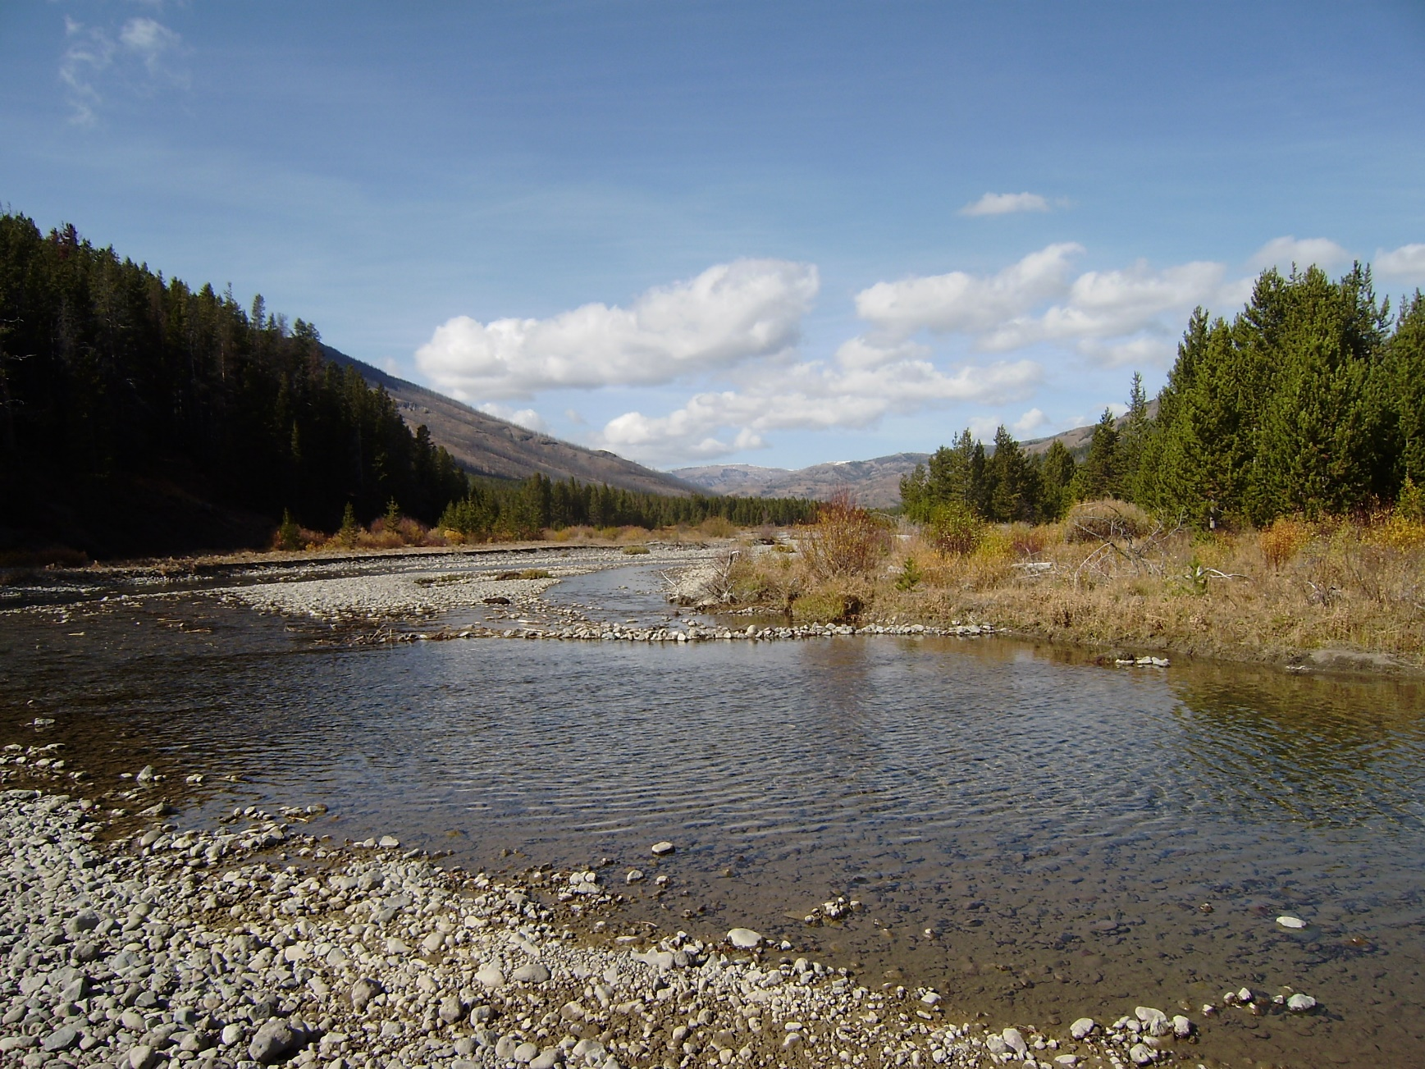
Muskingum Routing Method within HEC-HMS
Notes:
Hey HMS modelers, this is Mike Bartles from the Hydrologic Engineering Center.
In this video, we’re going to continue discussing routing methods within HEC-HMS by talking about the Muskingum method.
A good bit of the material within this lecture was originally developed by Gary Brunner who’s also from HEC.

Slide 2
Objectives
Introduce the Muskingum routing method
Present an example
Discuss common parameter estimation and calibration techniques
Present advantages and disadvantages
Notes:
By the end of this lecture, you should be familiar with the Muskingum routing method.
I’ll present an example computation, we’ll discuss common parameter estimation techniques, and calibration techniques.
Finally, we’ll finish up by comparing advantages and disadvantages when using this method.

Slide 3
Muskingum Method
Developed to accommodate the looped relationship between storage and outflow that exists in rivers
Relationship between storage and discharge at the outlet is not a unique relationship, it is looped
Notes:
Routing in natural rivers is complicated by the fact that storage in a river reach is not a function of outflow alone.
That’s because the water surface in a channel, during the passage of a flood wave, is not uniform.
The storage and water surface slope within a river reach, for a given outflow, is greater during the rising stages of a flood wave than during the falling stages.
Therefore, the relationship between storage and discharge at the outlet of a channel is not a unique relationship.
Rather it is a looped relationship, as shown in the figure on right.
The Muskingum method was developed in an attempt to accommodate this looped relationship.

Slide 4
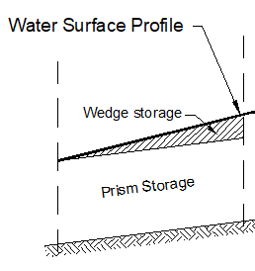
Muskingum Method
Visualize storage as Prism and Wedge parts
Notes:
Within the Muskingum method, storage within a reach is visualized in two parts: Prism and Wedge Storage.
In the example image, prism storage is shown in red (animate) and wedge storage is shown in green (animate).

Slide 5
Muskingum Method
Rising Limb
Falling Limb
Notes:
During the rising stages of the flood wave the wedge storage is positive and added to the prism storage. This situation is depicted in the left-hand image. Here’s prism storage (animate) and here’s wedge storage (animate) during the rising limb.
Conversely, during the falling stages of a flood wave, the wedge storage is negative and subtracted from the prism storage. This situation is depicted in the right-hand image. Here’s prism storage (animate) and here’s wedge storage (animate) during the falling limb.

Slide 6
Equations of Motion
  Continuity:
  Momentum:
Relationship between storage in a reach and discharge at the outlet
Notes:
Let’s go back to the continuity and momentum equations.
The Muskingum method starts by simplifying the continuity equation (animate) to inflow minus outflow = change in storage over time (animate)
The momentum equation is replaced (animate) with a relationship relating storage in the reach and discharge at the outlet (animate).
These simplifications make the method simple to parameterize and solve, but they also limit it’s applicability.
In particular, attenuation is handled numerically and isn’t related to any physically measurable characteristics of the reach.
Because the momentum equation is replaced, this method cannot simulate backwater effects. Also, this method is best applied to steep streams with slopes greater than 2 ft/mi and slowly rising hydrographs.

Slide 7
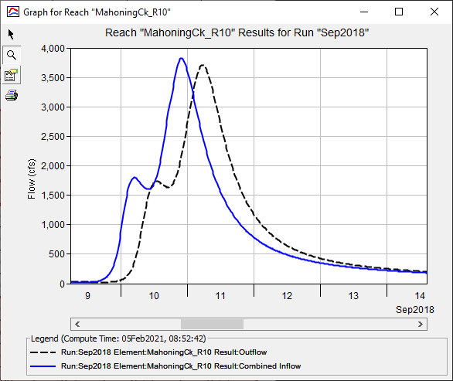
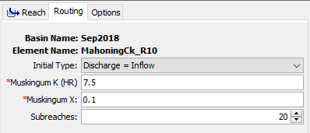
Example
 | Peak (cfs) | Time of Peak
Inflow | 3825 | 9/10/2018 21:45
Outflow | 3705 | 9/11/2018 5:15
Diff | 120 | 7.5 hrs
Notes:
This method requires an initial condition and three parameters: K, X and number of subreaches.
K, X, and number of subreaches are constant throughout time. So, this method cannot simulate variable translation and attenuation.
This example shows how an inflow hydrograph, shown in blue, is translated and attenuated to produce the outflow hydrograph shown in black.
The inflow hydrograph is uniformly translated in time by 7.5 hours, which is controlled by, and equivalent to, the K parameter. I gotta stress the “uniformly translated” portion of that statement. All points along the curve are translated by that much: the peak, the centroid of mass, everything.
The peak of the inflow hydrograph is reduced by 120 cfs, which is controlled by the X parameter and number of subreaches.

Slide 8
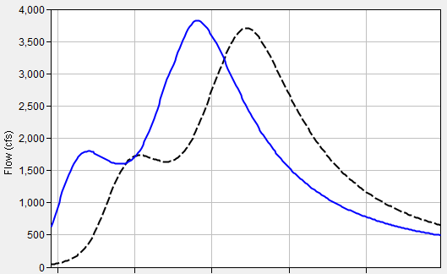
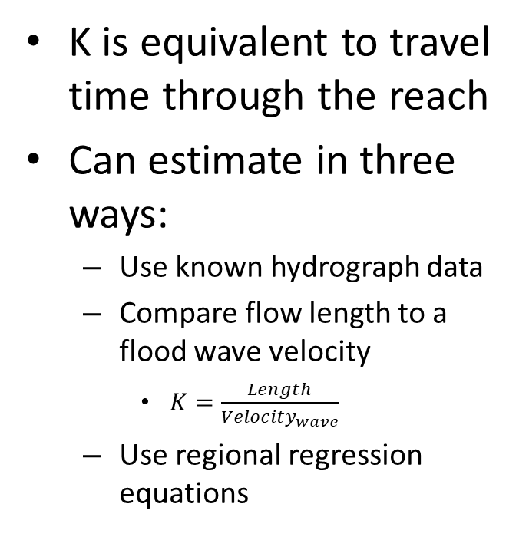
Parameter Estimation – K
K is equivalent to travel time through the reach
Can estimate in three ways:
  Use known hydrograph data
  Compare flow length to a flood wave velocity
    $K=\frac{Length}{{Velocity}_{wave}}$
  Use regional regression equations
Notes:
When estimating an appropriate K, three approaches can be used.
The first approach uses observed data at the start and end of the reach to directly compute the travel time. This approach is depicted in the right-hand image. You can use the elapsed time between centroid of areas of the two hydrographs, between the hydrograph peaks, or between midpoints of the rising limbs. However, it’s usually a rare occurrence that observed data is available at both the upstream and downstream end of the reach, so this approach isn’t too common.
The second approach to estimate K uses a computed flood wave velocity and flow length to infer a travel time. This approach is more commonly used and we’ll explore more on the next slide.
Finally, regression equations relating parameters like slope, roughness, and length are available in some regions that can be used to infer this parameter.

Slide 9
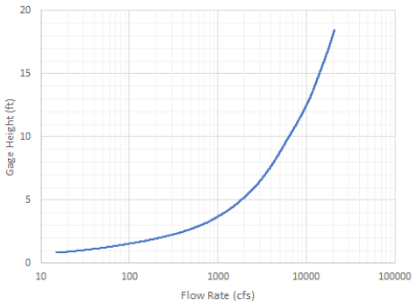
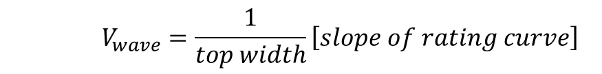
Parameter Estimation – K
Compare flow length to a flood wave velocity
  Manning’s Equation
  Kleitz – Seddon Law
    Flood wave velocity can be approximated from the channel and rating curve
α
    $$V_{wave}=\frac{1}{top width}\left[slope of rating curve\right]$$
Notes:
A value for K can be estimated as the travel time of the flood wave through the routing reach.
The flood wave velocity can be estimated using Manning’s equation or the Kleitz-Seddon Law.
The Kleitz-Seddon law allows you to approximate flood wave velocity from a stage-flow rating curve at representative location for the routing reach.
This method requires you to estimate the slope of the rating curve and the top width, both at a flow rate of interest.
In the image to the right, the flow rate of interest is 10,000 cfs (animate).
The slope at this point can then be estimated (animate).
The top width must also be estimated for the flow rate of interest using aerial photos, field surveys, or backwater calculations.

Slide 10
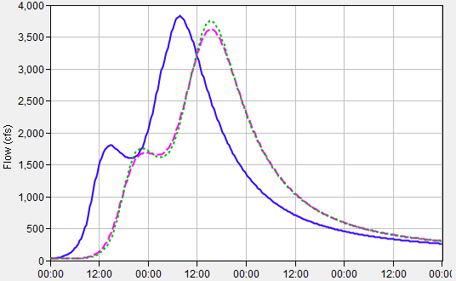
Parameter Estimation – X
Affects attenuation
Dimensionless coefficient
Lacks a strong physical meaning
Limited to bound 0.0 to 0.5
  When X = 0:
    Storage is only a function of outflow
    Maximum attenuation
  When X = 0.5:
    Equal weight to inflow and outflow
    No attenuation; only translation
Start with 0.25 and calibrate
Inflow
Outflow; X = 0.4
Outflow; X = 0.1
Notes:
X is a dimensionless coefficient that controls attenuation.
As I mentioned before, since attenuation is numerical when using this method, this parameter lacks a strong physical meaning and can’t be easily estimated from physical characteristics of the reach.
X must be between 0 and 0.5.
When X=0.0, storage becomes solely a function of outflow and this results in the maximum amount of attenuation.
When X=0.5, storage is equally weighted between inflow and outflow and no attenuation will be simulated.
Typically, I set X equal to 0.25 and then calibrate using observed data.

Slide 11
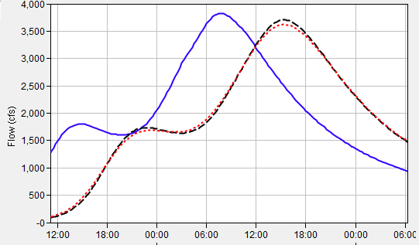
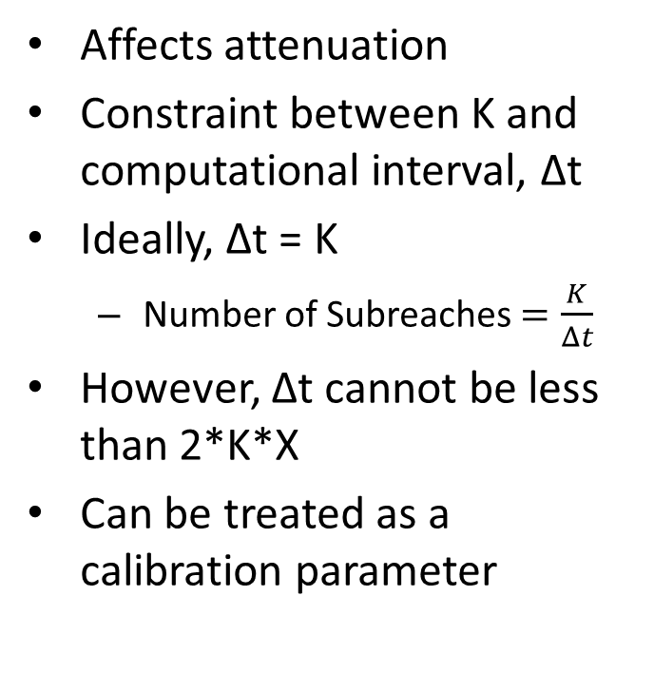
Parameter Estimation - Number of Subreaches
Affects attenuation
Constraint between K and computational interval, Δt
Ideally, Δt = K
  Number of Subreaches $=\frac{K}{Δt}$
However, Δt cannot be less than 2*K*X
Can be treated as a calibration parameter
Inflow
Outflow; # of subreaches = 20
Outflow; # of subreaches = 10
Notes:
The Muskingum routing method has a constraint related to the relationship between the parameter K and the computation interval.
Ideally, the two should be equal, but the computation interval should not be less than 2 * K * X to avoid instabilities.
A long routing reach should be subdivided into sub reaches so that the travel time through each sub reach is approximately equal to the routing computation interval.
This assumes that factors such as channel geometry and roughness have been taken into consideration when estimating K.
To initially estimate this parameter, divide your estimate of K by the computational time interval.
However, this parameter also acts to produce attenuation, so it can be modified during calibration.

Slide 12
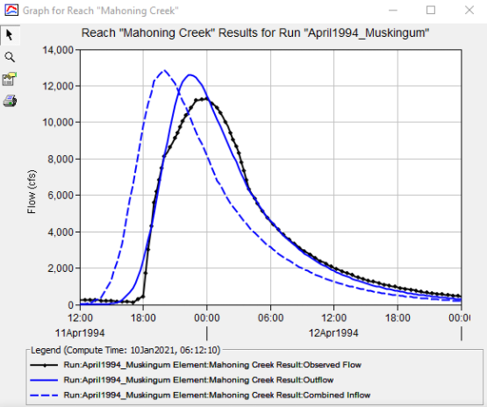
Calibration Techniques
Match rising limb of hydrograph
Match peak discharge
Use multiple statistical metrics
  Nash-Sutcliffe Efficiency
  Root Mean Square Error
  Percent Bias
Notes:
When calibrating the Muskingum method, I like to start by modifying my initial estimate of K to best match the rising limb of the observed hydrograph.
Then, I modify X and number of subreaches in an attempt to match the observed peak flow rate.
In this example, observed flow is shown in black and computed flow is shown in solid blue.
I’ve matched the rising limb decently well, but my computed peak discharge is too high. So, I need to decrease my X parameter and/or number of subreaches.
Remember to use multiple statistical metrics to gauge whether your model is accurate.

Slide 13
Advantages
"Mature" method that has been used successfully in thousands of studies throughout the U.S.
Easy to set up and use.
Method is parsimonious; it includes only a few parameters necessary to explain the variation of runoff volume.
Disadvantages
Method may be too simple to accurately predict flood wave translation and attenuation.
Only appropriate for use in moderately steep streams (bed slopes > 2 ft/mi).
Cannot simulate variable translation and attenuation.
Cannot simulate backwater effects or impacts of hydraulic structures.
Notes:
The main advantage of this method is that it’s simple! Because it’s simple, it’s been successfully used all over the world for numerous types of applications.
Also, this method is parsimonious in that a small number of variables (or parameters) are used to explain something which allows for easy investigation of model uncertainty.
However, the primary disadvantage of this method is also that it’s simple.
This method also cannot simulate variable translation and attenuation affects; you only get one go by defining a constant K, X, and number of subreaches for a simulation.

Slide 14
Review
Muskingum method is simple to use and calibrate
Primary advantage (simplicity) is also its primary disadvantage
Next lecture will focus on Muskingum-Cunge routing method within HEC-HMS
Notes:
In review, I introduced the Muskingum routing method.
This is a simple to parameterize and use method within HEC-HMS.
However, it’s simplicity is also a disadvantage for complicated scenarios.
In the next video, we’ll delve into the Muskingum-Cunge routing method which builds upon the Muskingum method.
Thanks for watching!

