Slide 1
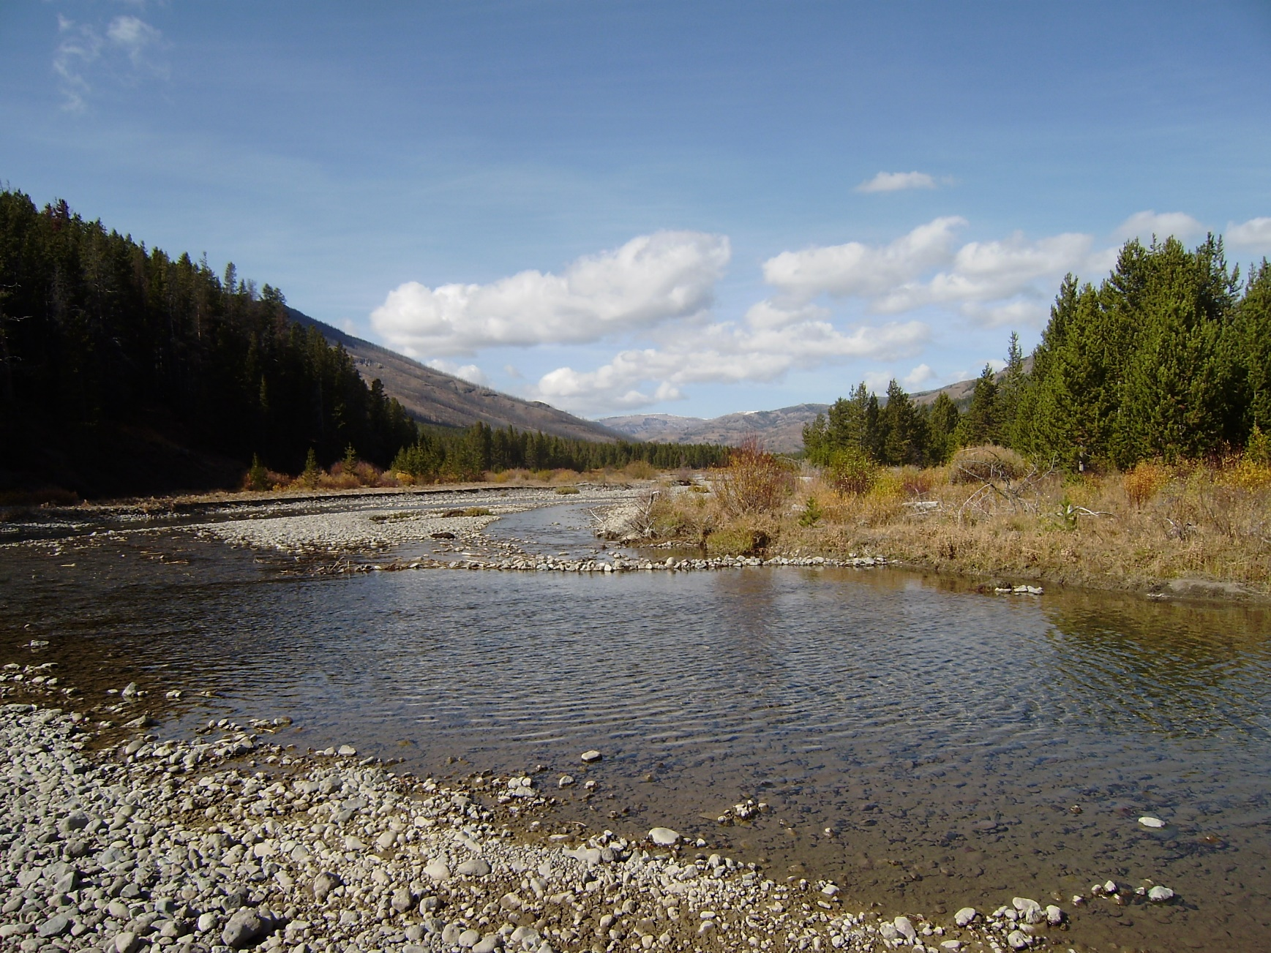
Muskingum-Cunge Routing Method within HEC-HMS
Notes:
Hey HMS modelers, this is Mike Bartles from the Hydrologic Engineering Center.
In this video, we’re going to continue discussing routing methods within HEC-HMS by delving into the Muskingum-Cunge method.
A good bit of the material within this lecture was originally developed by Gary Brunner who’s also from HEC.

Slide 2
Objectives
Introduce the Muskingum-Cunge routing method
Present an example
Discuss common parameter estimation and calibration techniques
Present advantages and disadvantages
Notes:
By the end of this lecture, you should be familiar with the Muskingum-Cunge routing method.
I’ll present an example computation, we’ll discuss common parameter estimation techniques, and calibration techniques.
Finally, we’ll finish up by comparing advantages and disadvantages when using this method.

Slide 3
Muskingum-Cunge Method
Builds upon the Muskingum method
  Within the Muskingum method, the X parameter (i.e. attenuation) is not physically based
Cunge set numerical diffusion equal to physical diffusion
  This allowed for parameters to be physically-based as well as improving accuracy and applicability
Notes:
When using the Muskingum method, attenuation is achieved through numerical diffusion rather than physical.
Cunge improved upon the original Muskingum method by setting this numerical diffusion to a physical estimate of diffusion.
The resultant “Muskingum-Cunge” method, as it’s now referred to, has parameters that can be estimated from physical characteristics of the channel, allows for variable translation and diffusion, compares well with full unsteady flow equations over a wide range of flow situations, and is independent of the simulation time step.
This was a big leap forward and major improvement over the Muskingum method! I cannot stress that enough.

Slide 4
Equations of Motion
  Continuity:
  Momentum:
Notes:
Recall that all routing methods start with the equations of motion which includes conservation of mass and momentum.
The Muskingum-Cunge method simplifies the continuity equation (animate) and neglects the acceleration terms within the momentum equation (animate).
These two equations can then be combined to form what’s called the convective diffusion equation.
The use of these simplifications make the method applicable to a wider range of scenarios than the Muskingum method but it still cannot simulate backwater effects. Also, it’s still best applied to steep streams with slopes greater than 2 ft/mi and slowly rising hydrographs.

Slide 5
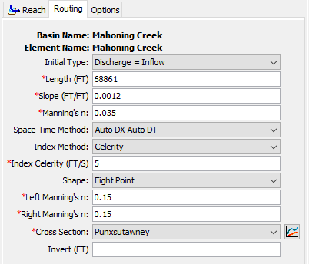
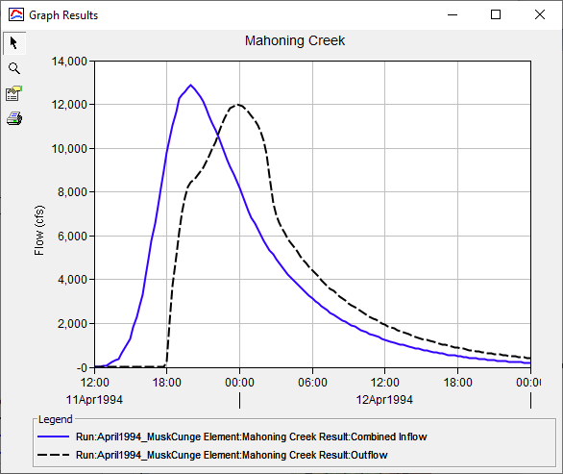
Example
Notes:
This method requires an initial condition and multiple parameters: length, friction slope, manning’s roughness, a space-time interval method and value, an index method and value, and a cross section shape and parameters.
This example shows how an inflow hydrograph, shown in blue, is translated and attenuated to produce the outflow hydrograph shown in black.
The inflow hydrograph is translated in time by a varying amount. Translation isn’t uniform and depends upon the inflow hydrograph and the physical characteristics of the reach in question.
The inflow hydrograph is also attenuated. Similarly, the amount of attenuation depends upon the inflow hydrograph and the physical characteristics of the reach.

Slide 6
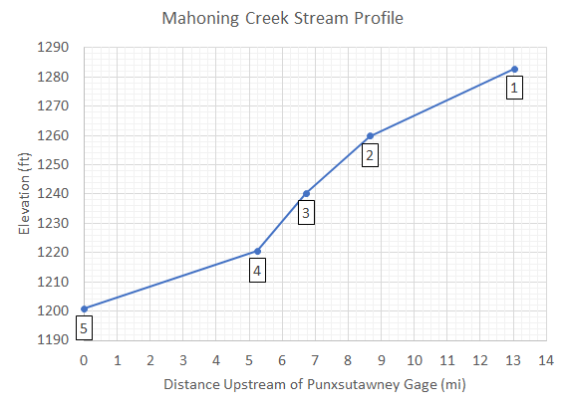
Parameter Estimation – Reach Length and Friction Slope
Compute reach characteristics
  Parameters | Characteristics | Reach
Friction slope can be initially estimated using bed slope
  If slope varies significantly, it may be necessary to use multiple reaches with different slopes
Notes:
Both reach length and friction slope can be estimated directly within HEC-HMS if you have associated a terrain data set with your basin model and your reaches are georeferenced.
When estimating an initial friction slope, I usually equate to the bed slope.
However, if the slope is expected to vary significantly, it may be necessary to use multiple reaches with different slopes instead of just one. This is the case for the image to the right. Three different reaches, each with different slopes, are likely most appropriate for this use case.

Slide 7
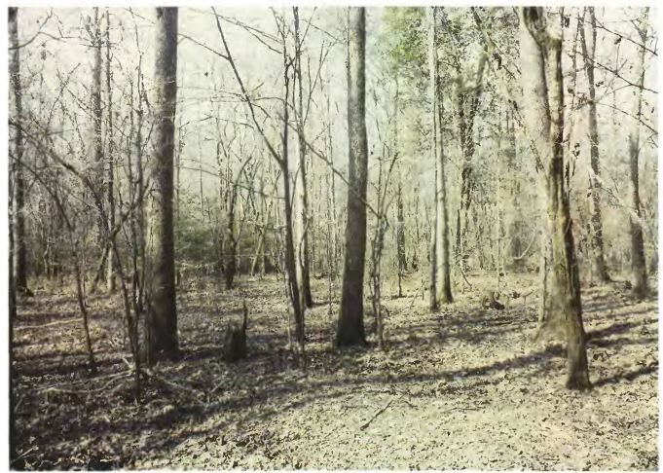
Parameter Estimation – Manning’s Roughness
Average value for the whole reach
Estimate using “reference” streams or through calibration
Bayou de Loutre near Farmerville, LA
Computed roughness: n = 0.11
Depth of flow: 3.6 ft
Notes:
The Manning's n roughness coefficient should be set as the average value for the whole reach.
This value can be estimated using “reference” streams with established roughness coefficients or through calibration.
As an example, the image to the right is of a floodplain in Louisiana with a computed Manning’s n of 0.11.

Slide 8
Parameter Estimation – Space-Time Interval and Index Method
Critical to ensure accuracy and stability
Three Space-Time Interval options:
  Auto DX Auto DT
  Specified DX Auto DT
  Specified DX Specified DT
Two Index options:
  Flow
  Celerity
    5 ft/s
Notes:
A space-time interval and index method are required for each routing reach.
These parameters are critical to ensure accuracy and stability of the method.
For most applications, the Auto DX Auto DT method is adequate.
For most applications, using the Celerity index method and a celerity of 5 ft/s is adequate, but can vary based upon the use case.

Slide 9
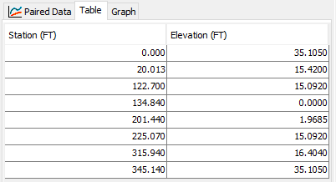
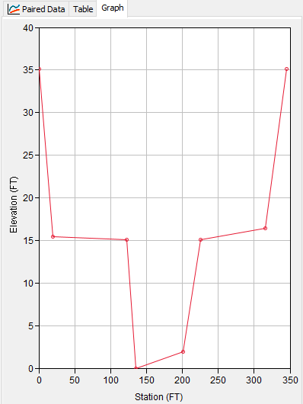
Parameter Estimation – Cross Section
Six shapes:
  Circle
  Eight point
  Rectangular
  Tabular
  Trapezoid
  Triangle
Estimate parameters using GIS information
Notes:
HEC-HMS allows you to specify the required cross section information in the six ways that are shown here.
I personally prefer to use the 8 point cross section shape.
Depending upon the chosen shape, additional information will have to be entered to describe the cross-section shape.
All the required parameters can be estimated using GIS information.
In the example shown here, I took a field-surveyed cross section and simplified it to just eight points, which can be done fairly rapidly.

Slide 10
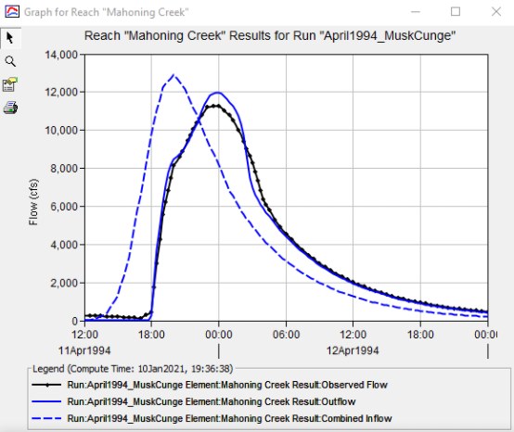
Calibration Techniques
Match rising limb of hydrograph
Match peak discharge
Use multiple statistical metrics
  Nash-Sutcliffe Efficiency
  Root Mean Square Error
  Percent Bias
Notes:
Like all other methods, I like to start calibrating Muskingum-Cunge parameters by first trying to best match the rising limb of the observed hydrograph.
Then, I modify parameters in an attempt to match the observed peak flow rate.
In this example, observed flow is shown in black and computed flow is shown in solid blue.
I’ve matched the rising limb decently well, but my computed peak discharge is too high. In this particular case, it would be best if I split the reach into separate pieces with individual parameters to better match the observed data.
Remember to use multiple statistical metrics to gauge whether your model is accurate.

Slide 11
Advantages
Similar to advantages of the Muskingum method.
Predicted values are in accordance with open channel flow theory.
Parameters can be estimated using measurable channel characteristics.
Can use cross-section shapes that include overbank areas.
Good for ungaged reaches.
Disadvantages
Only appropriate for use in moderately steep streams (bed slopes > 2 ft/mi).
Cannot simulate backwater effects or impacts of hydraulic structures.
Method is less parsimonious than Muskingum; it requires many more parameters.
Notes:
A major advantage of this method is that the predicted values are in accordance with open channel flow theory.
Also, you can simulate variable translation and attenuation.
Finally, the required parameters can be estimated using physically measurable characteristics.
However, this method is less parsimonious than simpler methods in that more parameters are required.
It also cannot simulate backwater effects and is only appropriate for use in streams with slopes greater than 2 ft/mi and situations with slow rising hydrographs.

Slide 12
Review
Muskingum-Cunge method recreates classical open channel flow phenomena
Parameters can be estimated using physically measurable characteristics
Great for locations with little to no observed discharge data
Requires a greater number of parameters than simpler methods
Notes:
In review, I introduced the Muskingum-Cunge routing method.
This method can recreate classical open channel flow phenomena and the required parameters can be estimated using physically measurable characteristics.
This makes it a great choice for locations with little to no observed discharge data.
However, it also requires more parameters than simpler methods.
Thanks for watching! I’ll see you next time.

