Slide 1
Advanced Model Calibration
Thomas Brauer, P.E.
Hydrologic Engineering Center
Notes:
Hi, this is Tom Brauer from the Hydrologic Engineering Center and in this video I’m going to present some advanced calibration techniques that were used in a 60 year continuous simulation of the Russian River in California.

Slide 2
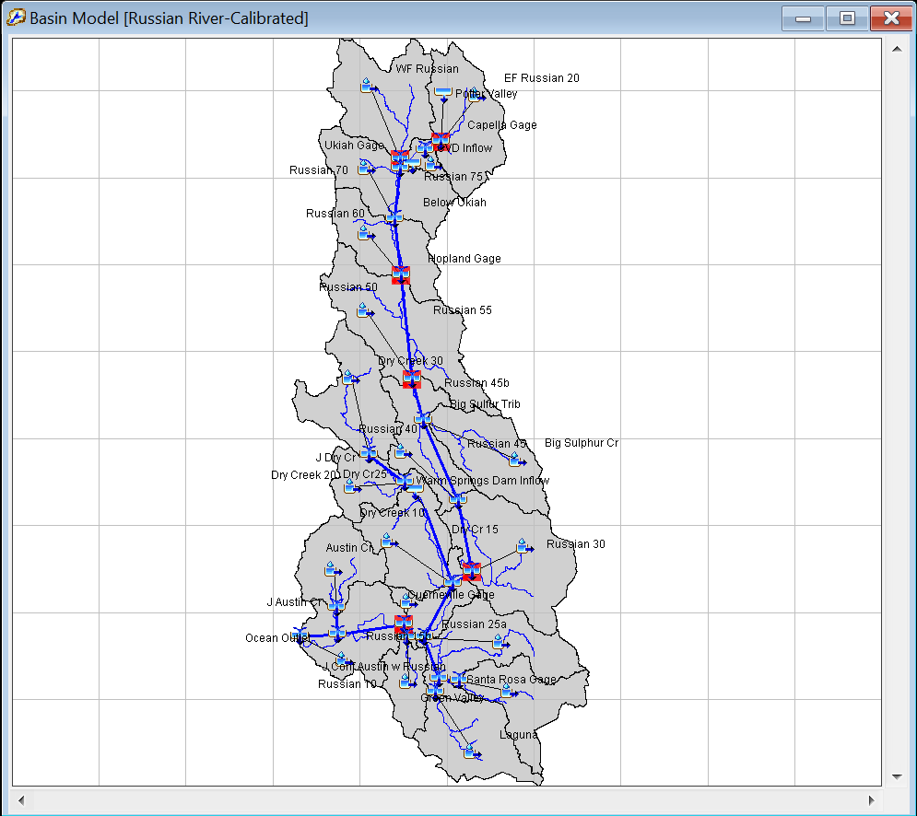
Russian River 60 Yr period of record
Notes:
This is the basin map as configured in HEC-HMS. As you can see there are six calibration locations.
This study weighed the competing interests of water supply in the Coyote Valley Dam reservoir (t) vs flood risk downstream (t, t). It was important that both volumes and peak flows were well represented by the model.

Slide 3
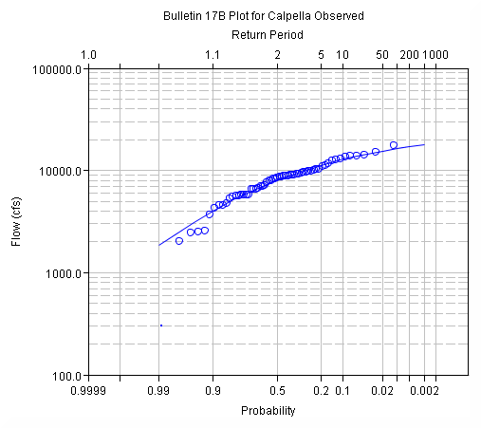
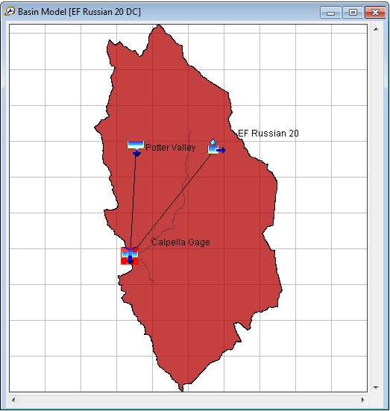
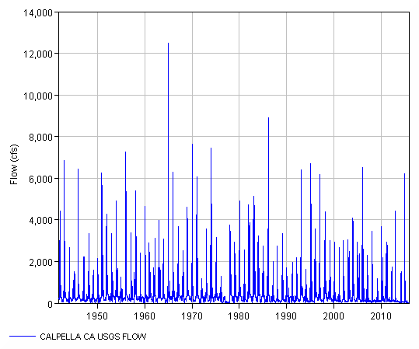
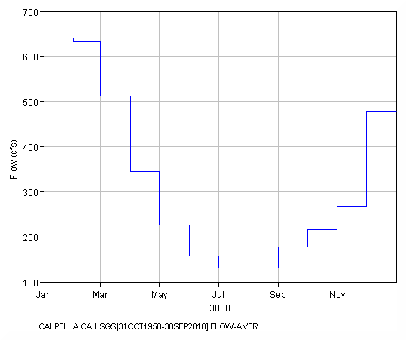
Runoff Signatures
Notes:
Calibration should always proceed from upstream to downstream. In this case we are starting with our most upstream subbasin, EF Russian 20. If we run our 60 year simulation, the result is a 60 year runoff hydrograph. (t) How do we calibrate a 60 year hydrograph? In this case we used runoff signatures to make graphical inspections easier (t).
Runoff signatures are response patterns. Examples include:
Annual runoff
Seasonal runoff
A Flow duration curve
Low flow flow frequency
High flow flow frequency
Runoff hydrograph
Of these, the runoff hydrograph is the most familiar, but from the runoff hydrograph we can derive an annual maximum flow series and a monthly volume distribution.

Slide 4
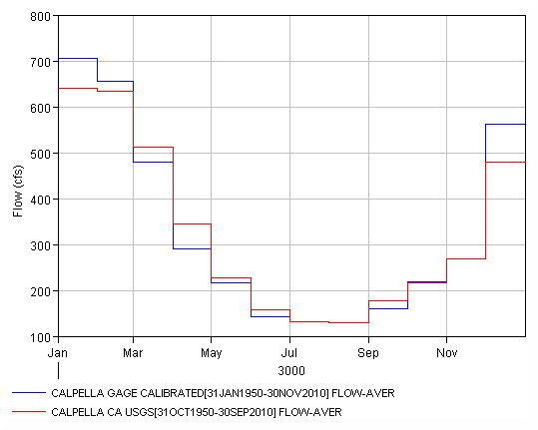
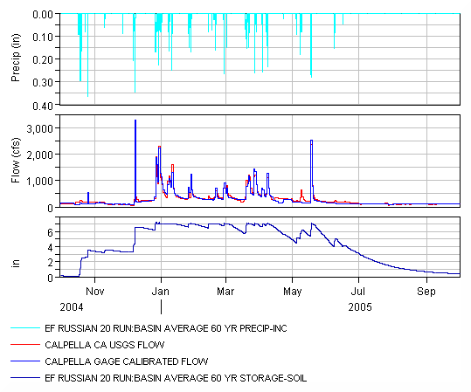
Monthly Volume
Notes:
Monthly volumes were important in this study for analyzing water supply.
The calibration started with monthly volumes.
If we were modeling a single water year, the calibration would focus on the timing of the first major runoff event of the year (t), then the soil moisture state in between events during the wet season (t).
This is subject to the Crop Coefficient and soil storage parameters.
For period of record the we adjusted these parameters while graphically inspecting (t) the monthly flow volumes.
You can see monthly averages for computed vs observed time-series.

Slide 5
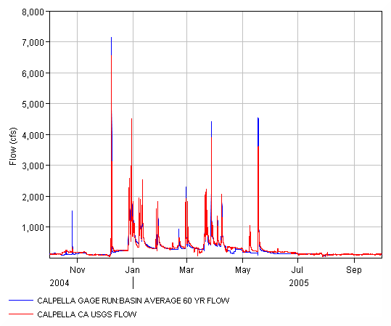
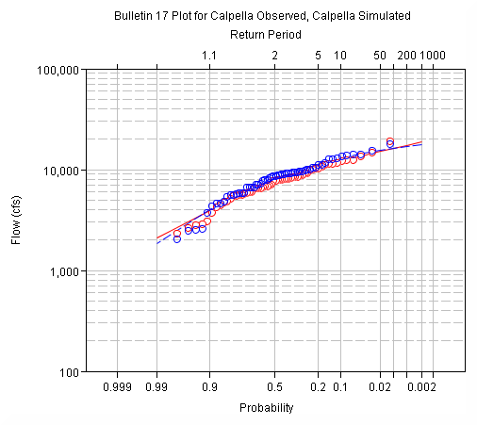
Annual Maximum Flows
Notes:
The annual maximum flow-frequency curve was evaluated to characterize flood risk.
If we were doing a single water year calibration, we would focus on individual hydrograph peaks (t).
Peak flows are sensitive to the infiltration rate in the soil loss model.
For the period of record, we adjusted these parameters while graphically inspecting (t) the flow-frequency curve.
The focus of calibration was overall correlation between computed and observed flow frow-frequency curves with emphasis on low probability events (t) since the study was focused on floods.

Slide 6
Runoff Hydrograph
Notes:
Finally we zoomed in on the runoff hydrograph to calibrate the recession limb of hydrographs (t) and baseflow recession curves. All of the baseflow methods in HEC-HMS require a graphical fit to calibrate coefficients.

Slide 7
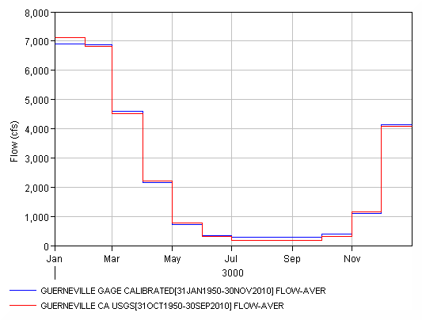
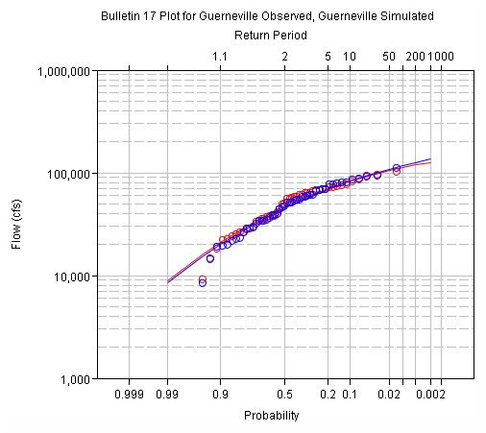
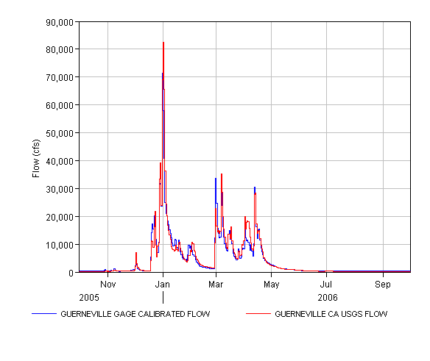
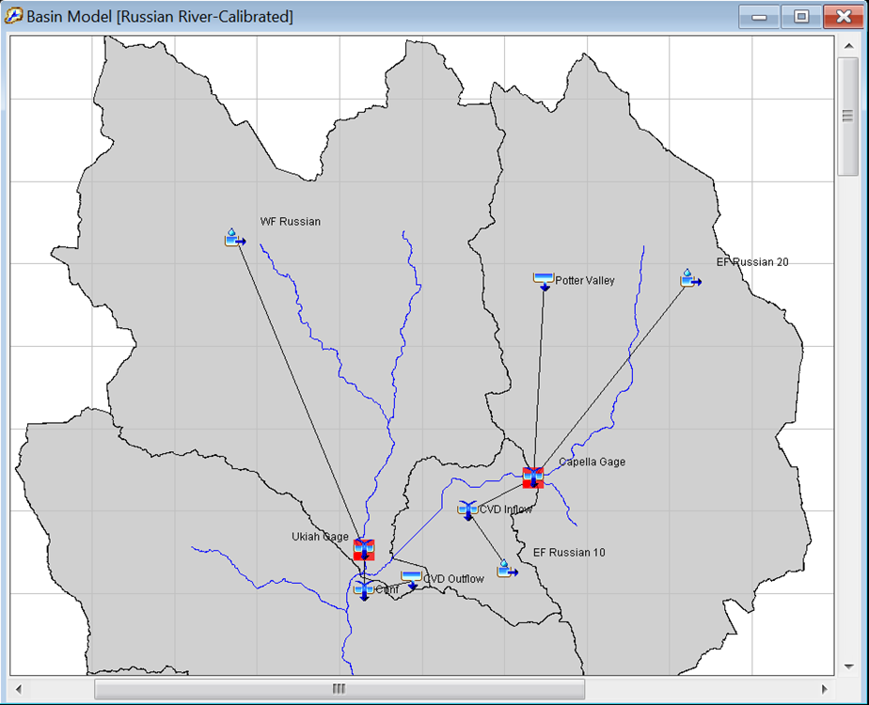
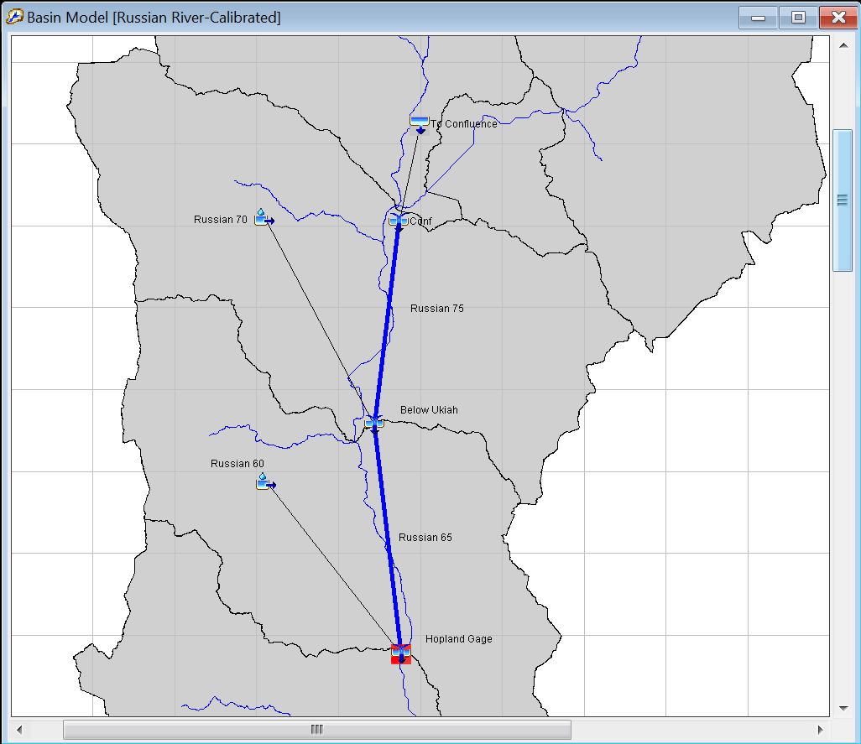
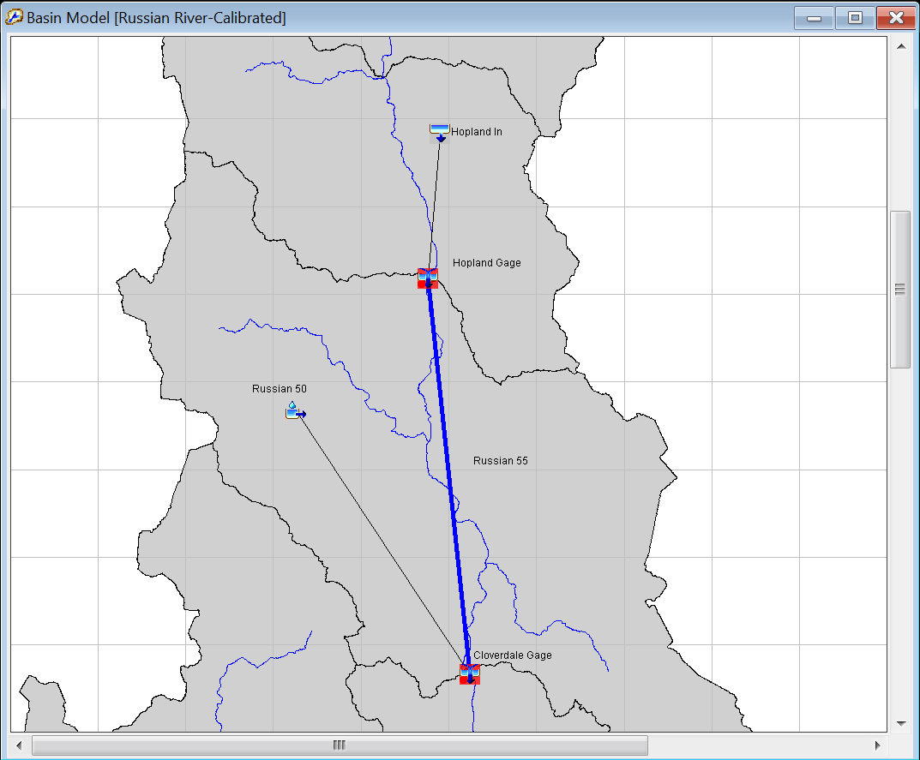
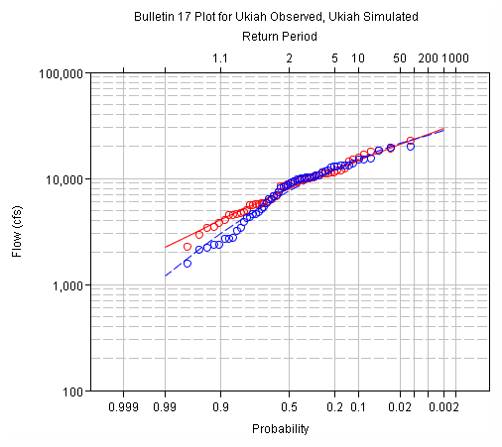
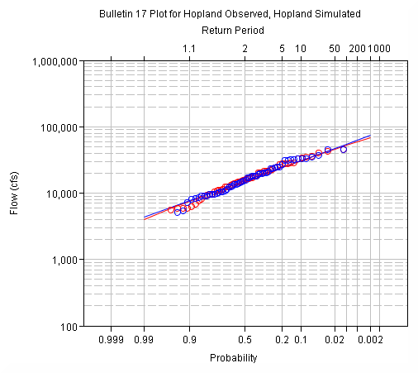
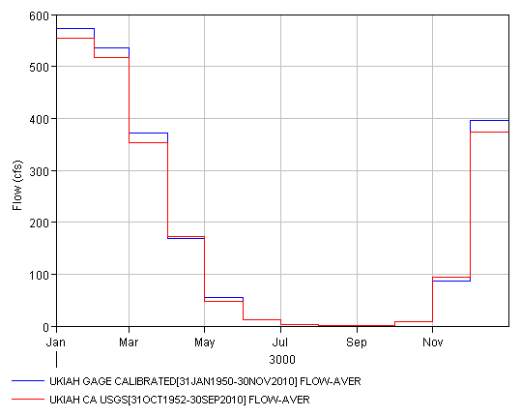
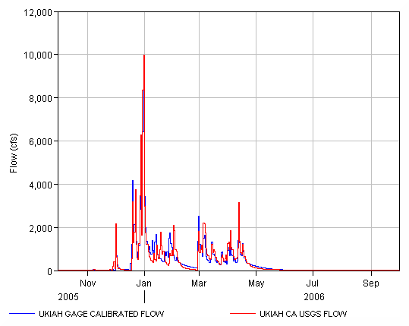
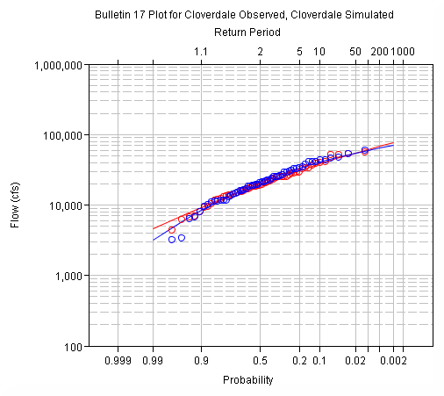
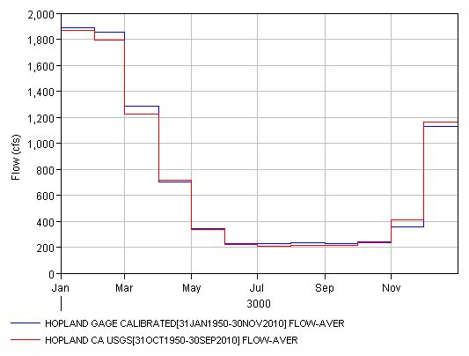
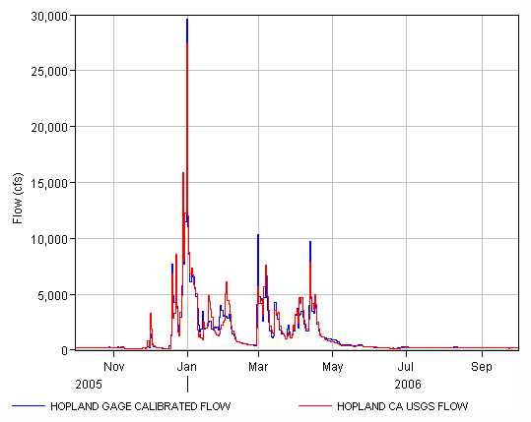
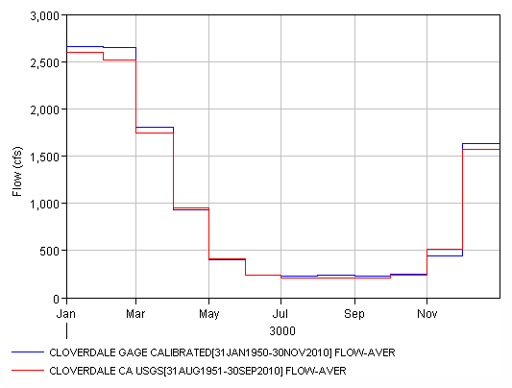
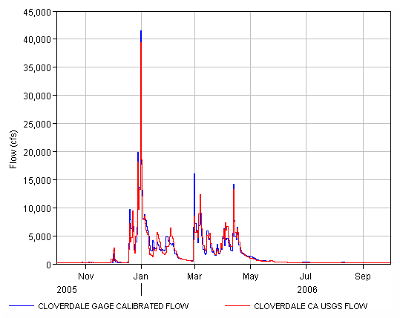
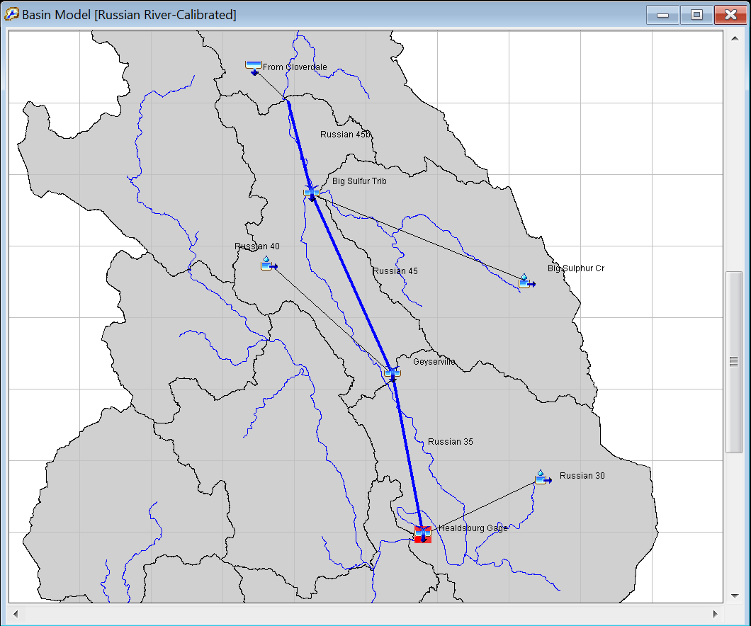
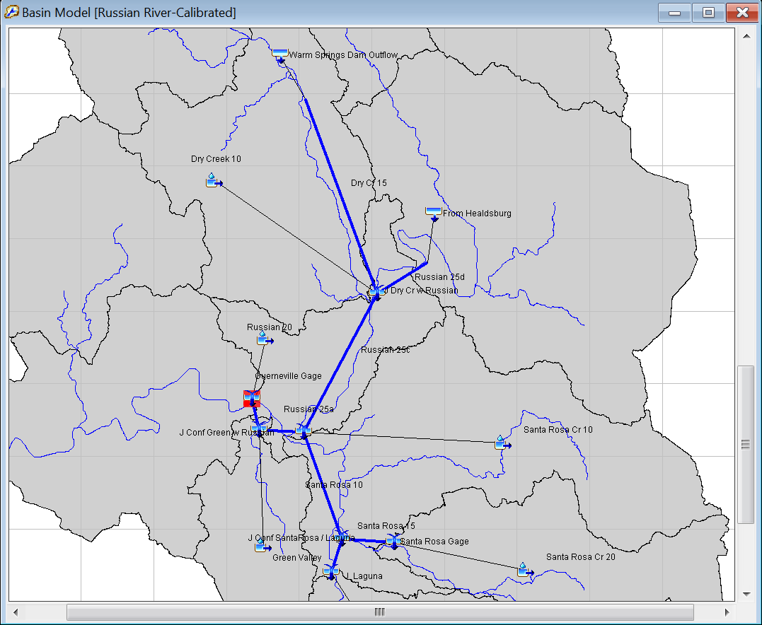
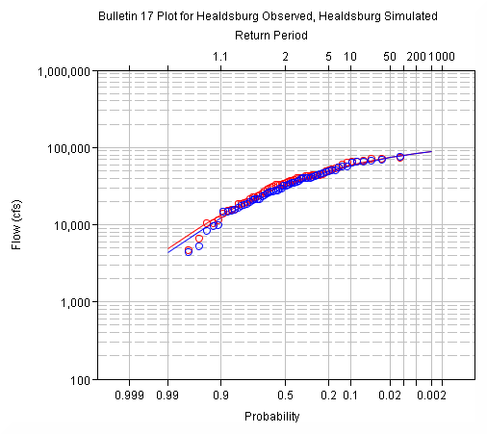
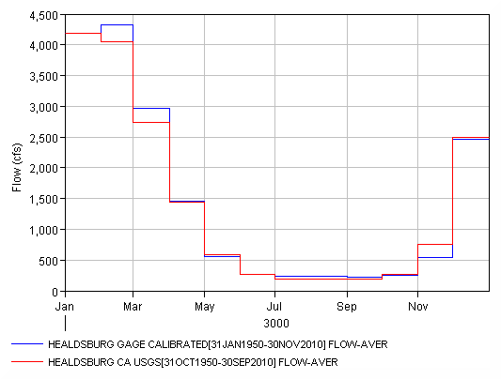
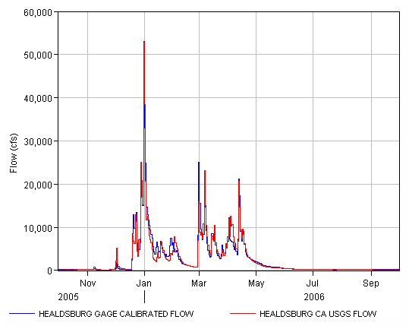
Calibration Sequence
Notes:
The calibration proceeded from upstream to downstream. For each calibration location the monthly volume, annual maximum flow, and runoff hydrograph calibrations were performed. The model was considered calibrated once the calibration at the final modeling location was complete.

Slide 8
Model Performance
Performance Rating | NSE | RSR | R² | PBIAS
Very Good | 0.65<𝑁𝑆𝐸≤1.00 | 0.00<𝑅𝑆𝑅≤0.60 | 0.65<𝑅2≤1.00 | 𝑃𝐵𝐼𝐴𝑆< ±15
Good | 0.55<𝑁𝑆𝐸≤0.65 | 0.60<𝑅𝑆𝑅≤0.70 | 0.55<𝑅2≤0.65 | ±15≤𝑃𝐵𝐼𝐴𝑆<±20
Satisfactory | 0.40<𝑁𝑆𝐸≤0.55 | 0.70<𝑅𝑆𝑅≤0.80 | 0.40<𝑅2≤0.55 | ±20≤𝑃𝐵𝐼𝐴𝑆<±30
Unsatisfactory | 𝑁𝑆𝐸≤0.40 | 𝑅𝑆𝑅>0.80 | 𝑅2≤0.40 | 𝑃𝐵𝐼𝐴𝑆≥±30
Location | NSE | RSR | R² | PBIAS
Capella | 0.854 | 0.382 | 0.892 | -1.242
Ukiah | 0.880 | 0.347 | 0.880 | -2.350
Hopland | 0.913 | 0.295 | 0.919 | -1.435
Cloverdale | 0.927 | 0.270 | 0.931 | -2.710
Healdsburg | 0.915 | 0.292 | 0.916 | -2.210
Guerneville | 0.938 | 0.250 | 0.939 | -3.233
Notes:
We used summary statistics to throughout the calibration process to quantify model performance. The calibrated model performed “Very Good” for all statistics, at all locations, based on the ranges defined.

Slide 9
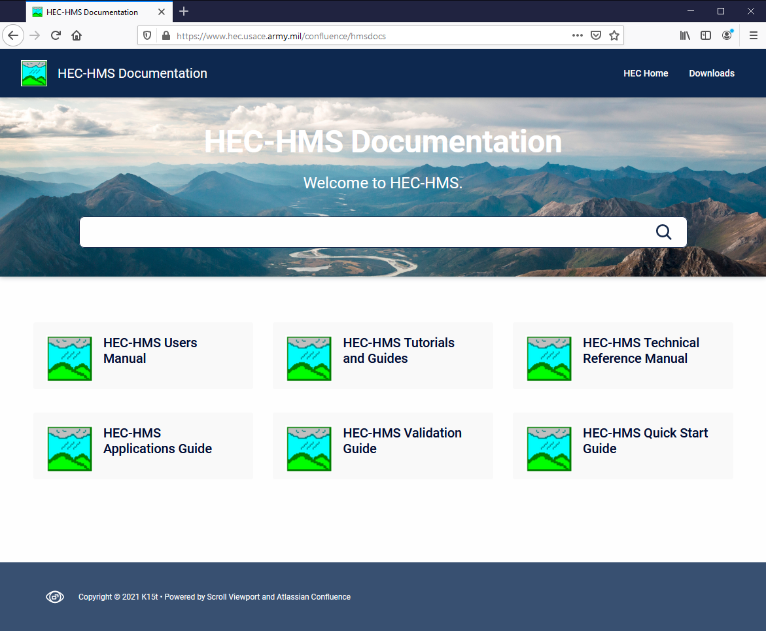
FOR MORE…
Notes:
This concludes the presentation on advanced calibration techniques. For more resources on HEC-HMS check out the HEC-HMS documentation website.

